Slide 1
Informatics 121 Software Design I
Lecture 8
Duplication of course material for any commercial purpose without the explicit written permission of the professor is prohibited.

Slide 2
Discussion
There will be discussion this Friday
Please join your designated discussion

Slide 3
Today’s lecture
Design methods (application design)

Slide 4
Software design methods
 | Application design | Interaction design | Architecture design | Implementation design
Analysis | competitive testing contextual inquiry feature comparison stakeholder analysis task analysis | critical incident technique interaction logging personas scenarios | framework assessment model-driven engineering quality-function-deployment reverse engineering world modeling | release planning summarization test-driven design visualization
Synthesis | affinity diagramming concept mapping mind mapping morphological chart | design/making participatory design prototyping storyboarding | architectural styles generative programming component reuse decomposition | pair programming refactoring search software patterns
Evaluation | requirements review role playing wizard of oz | cognitive walkthrough evaluative research heuristic evaluation think-aloud protocol | formal verification simulation weighted objectives | correctness proofs inspections/reviews parallel deployment testing

Slide 5
Software design methods
 | Application design | Interaction design | Architecture design | Implementation design
Analysis | competitive testing contextual inquiry feature comparison stakeholder analysis task analysis | critical incident technique interaction logging personas scenarios | framework assessment model-driven engineering quality-function-deployment reverse engineering world modeling | release planning summarization test-driven design visualization
Synthesis | affinity diagramming concept mapping mind mapping morphological chart | design/making participatory design (parallel) prototyping storyboarding | architectural styles generative programming component reuse decomposition | pair programming refactoring search software patterns
Evaluation | requirements review role playing wizard of oz | cognitive walkthrough evaluative research heuristic evaluation think-aloud protocol | formal verification simulation weighted objectives | correctness proofs inspections/reviews parallel deployment testing

Slide 6
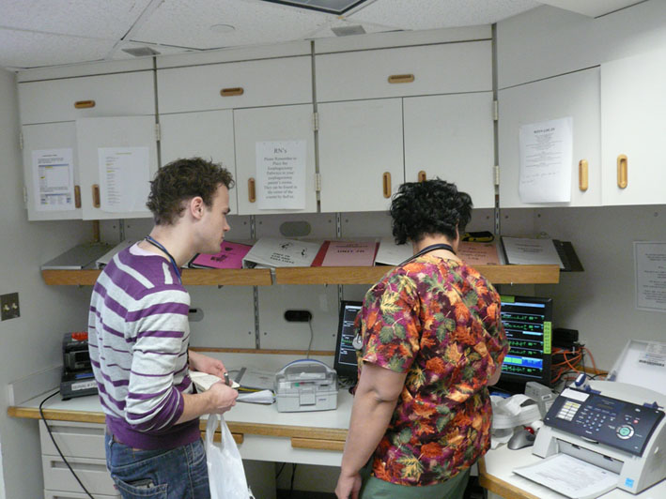
Contextual inquiry
Contextual inquiry is the process of observing and interviewing a user in context – while they are engaged in the actual setting of life

Slide 7
Procedure
Plan
Identify users
Visit and inquire

Slide 8
Example: plan
Decide, beforehand, the purpose of the contextual inquiry
what type of information
which type of setting
which type of users

Slide 9
Example: identify users
Draw an advertisement in the newspaper
Social media recruiting
Ask client for access to representative users
Use an external recruitment service to target particular (typically representative) demographics

Slide 10
Example: visit and inquire
Two-to-three hour visit
Master-apprentice model
observer takes note of what the user does
user shares their thoughts on the work they perform
observer inquires why the user does what they do
observer takes notes
Ideally, a contextual inquiry becomes a rich conversation
shared stories and insights
clarified interpretations

Slide 11
Example (insufficient inquiry, bias)
http://youtu.be/o1sswVMmSO4

Slide 12
Example (too much inquiry)
http://youtu.be/Gd5fA9UQDjE

Slide 13
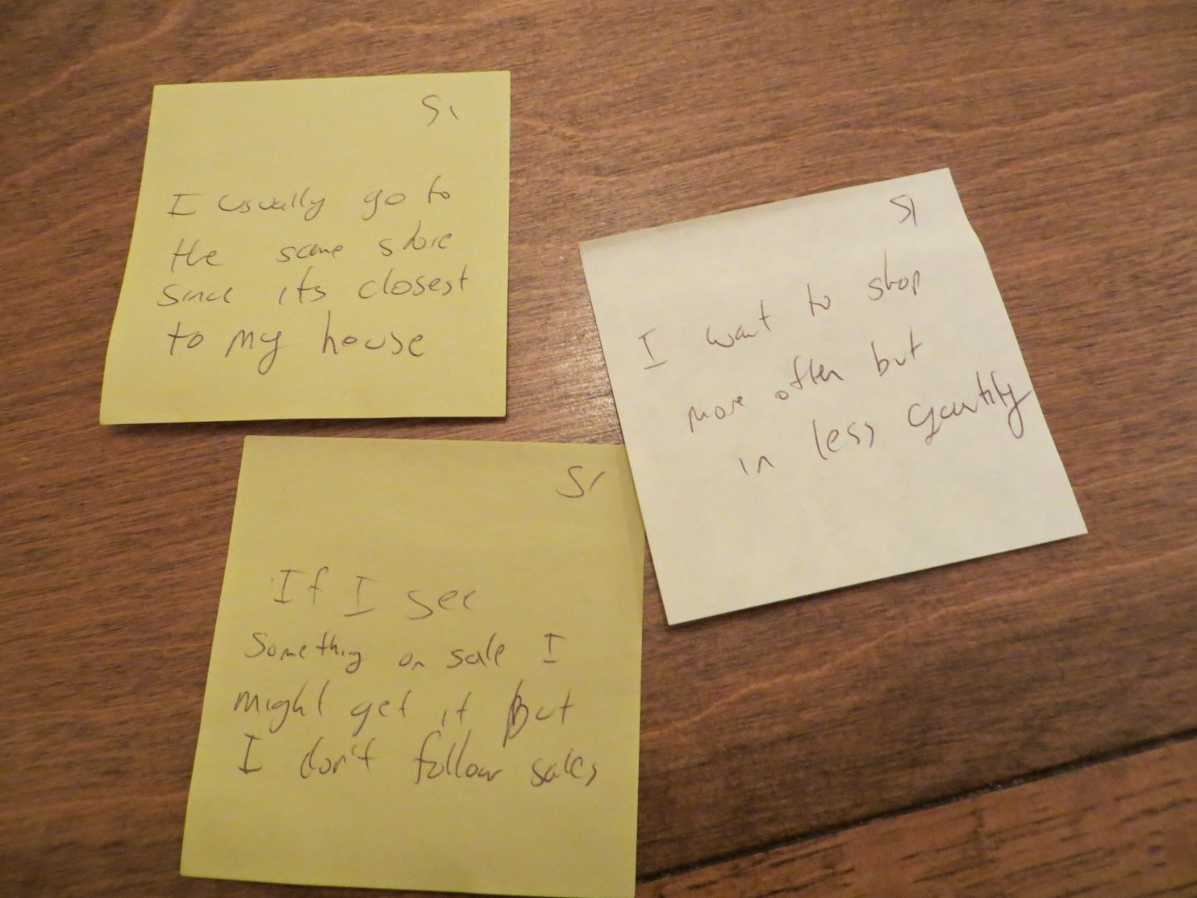
Typical notation: notes

Slide 14
Criteria for successful use
Access to the ‘right’ users involved in the ‘right’ activities
Extensive sharing
Ability to expand inquiry
A strong focus on why (why not)

Slide 15
Strengths and weaknesses
Strengths
Weaknesses
Reveals underlying and often invisible work structure
flows, tasks, artifacts, physical environment, culture, …
Involves actual users
Exposes rationale
Can challenge assumptions held by the designer
Not as involved as a full ethnography, but can still yield very usable insights and results
Users may not know the answers to the important questions
Steeped in current practices, perhaps stifling creativity
Observer bias
Lessons that can be learned depend strongly on the activities being performed by the user
Stops short of analysis

Slide 16
Variants
Questionnaire
Ethnography
Interview

Slide 17
Software design methods
 | Application design | Interaction design | Architecture design | Implementation design
Analysis | competitive testing contextual inquiry feature comparison stakeholder analysis task analysis | critical incident technique interaction logging personas scenarios | framework assessment model-driven engineering quality-function-deployment reverse engineering world modeling | release planning summarization test-driven design visualization
Synthesis | affinity diagramming concept mapping mind mapping morphological chart | design/making participatory design (parallel) prototyping storyboarding | architectural styles generative programming component reuse decomposition | pair programming refactoring search software patterns
Evaluation | requirements review role playing wizard of oz | cognitive walkthrough evaluative research heuristic evaluation think-aloud protocol | formal verification simulation weighted objectives | correctness proofs inspections/reviews parallel deployment testing

Slide 18
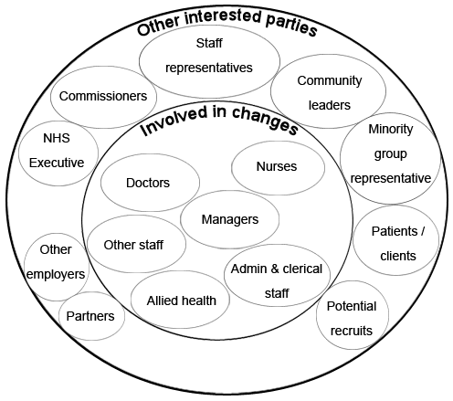
Stakeholder analysis
Stakeholder analysis is the process of visually documenting the key constituents and their relations to the design project

Slide 19
Procedure
Brainstorm all possible stakeholders
Organize stakeholders
Verify stakeholders
Iterate as necessary

Slide 20
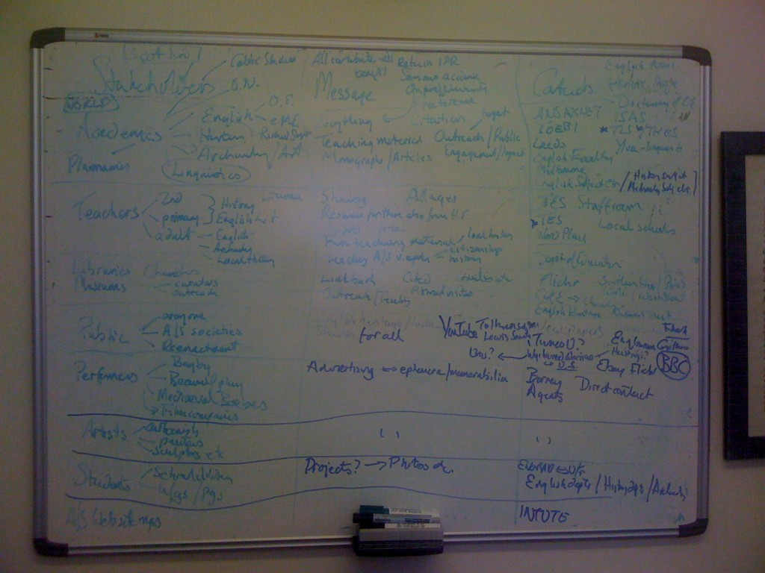
Example: brainstorm all possible stakeholders
Speculative, as inclusive as possible of all possible stakeholders
Audience, client, beneficiaries, supporters, adversaries, people in a position of power, legislature, …

Slide 21
Example: organize stakeholders
Relate the stakeholders according to important differences that might play out in the design project
Examine multiple ways of organizing the stakeholders

Slide 22
Example: verify stakeholders
Verify with as many sources as possible – client, users, legislature, other stakeholders themselves – as to whether the stakeholders are indeed the stakeholders
any additions
any removals
any changes

Slide 23
Example: iterate as necessary
Repeat the process as long as improvements can be made to the stakeholder map
examine whether meaningful subclasses of stakeholders can be devised
examine whether meaningful superclasses of stakeholders can be devised

Slide 24
Typical notation: Venn diagram

Slide 25
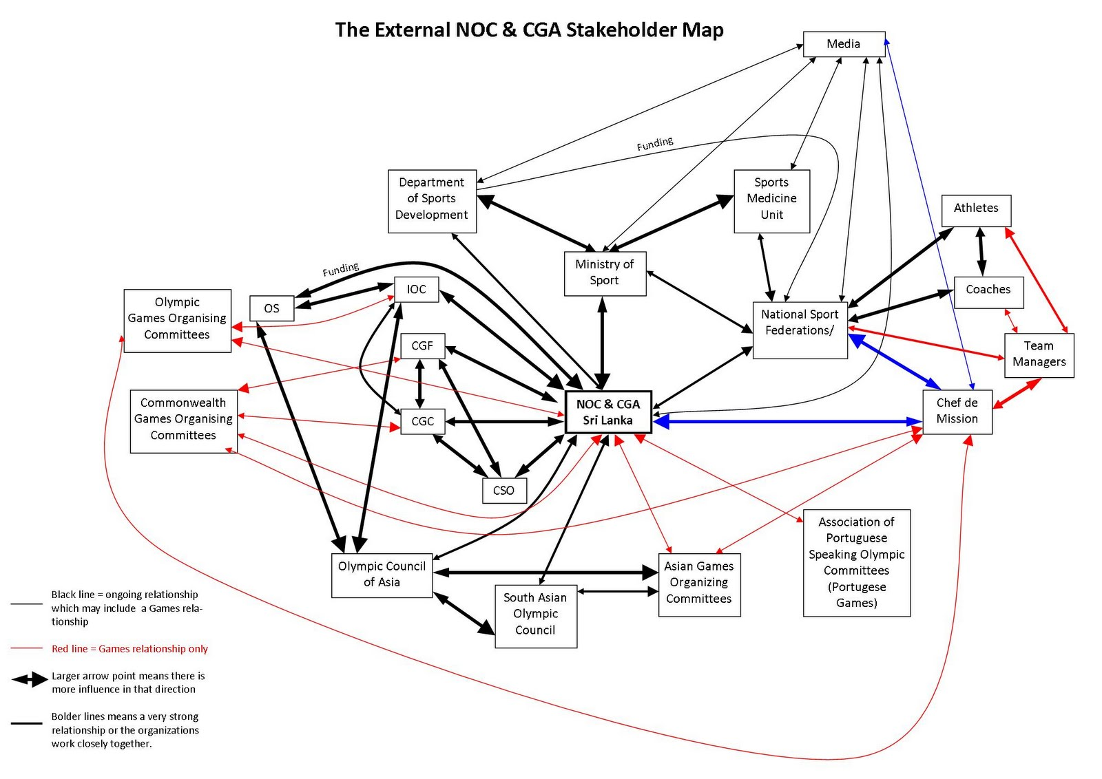
Typical notation: box and arrow diagram

Slide 26
Criteria for successful use
The designer must possess, or have access to people with, strong domain knowledge
Relies on early insight into the design problem, and what dimensions might matter

Slide 27
Strengths and weaknesses
Strengths
Weaknesses
Builds expansive set of different stakeholders and how they may influence the design project
Can challenge assumptions held by the designer
Stops at documenting the stakeholders, not necessarily documenting whether and how they will influence the project
goals
constraints
Requires refinement from abstract stakeholders to actual individuals

Slide 28
Software design methods
 | Application design | Interaction design | Architecture design | Implementation design
Analysis | competitive testing contextual inquiry feature comparison stakeholder analysis task analysis | critical incident technique interaction logging personas scenarios | framework assessment model-driven engineering quality-function-deployment reverse engineering world modeling | release planning summarization test-driven design visualization
Synthesis | affinity diagramming concept mapping mind mapping morphological chart | design/making participatory design prototyping storyboarding | architectural styles generative programming component reuse decomposition | pair programming refactoring search software patterns
Evaluation | requirements review role playing wizard of oz | cognitive walkthrough evaluative research heuristic evaluation think-aloud protocol | formal verification simulation weighted objectives | correctness proofs inspections/reviews parallel deployment testing

Slide 29
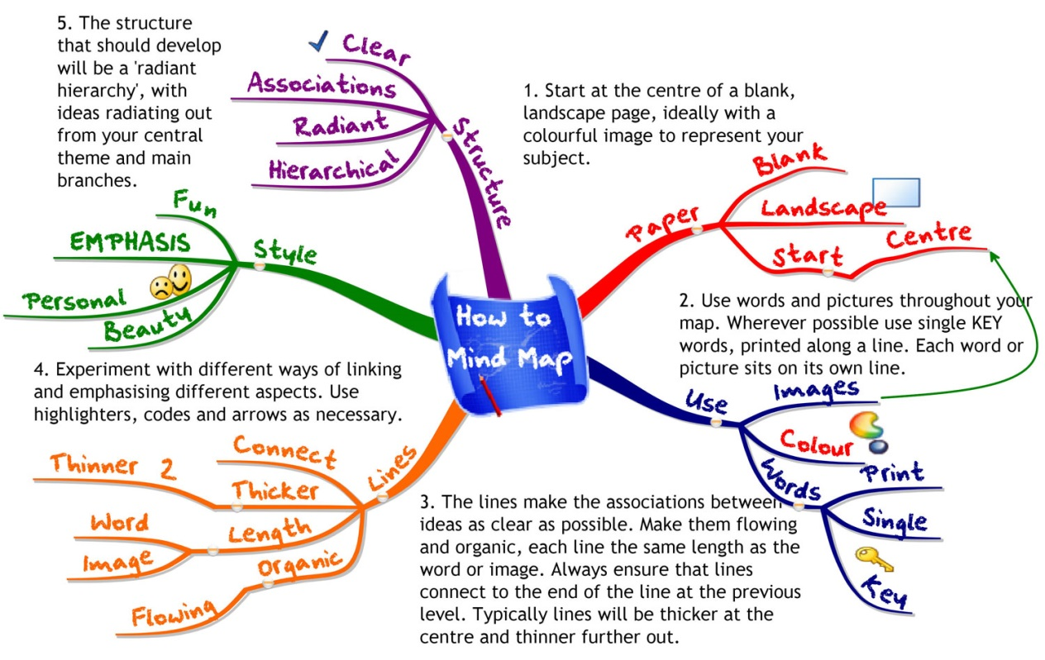
Mind mapping
Mind mapping is the process of generating ideas and developing concepts when the underlying relationships are unclear

Slide 30
Procedure
Identify the focus word or question
Free associate outward from the focus
Reorganize as needed
Annotate

Slide 31
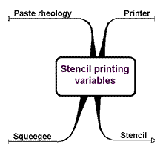
Example: identify the focus word or question

Slide 32
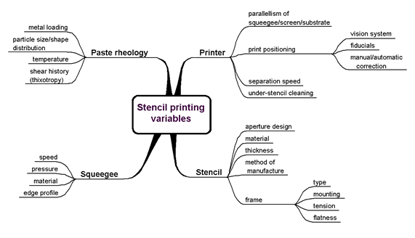
Example: free associate outward from the focus

Slide 33
Example: reorganize as needed

Slide 34
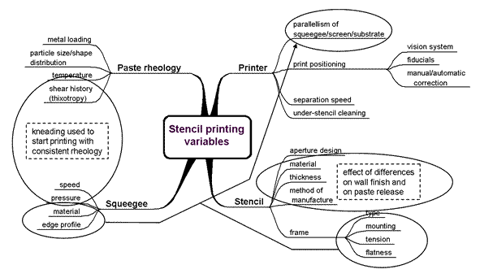
Example: annotate

Slide 35
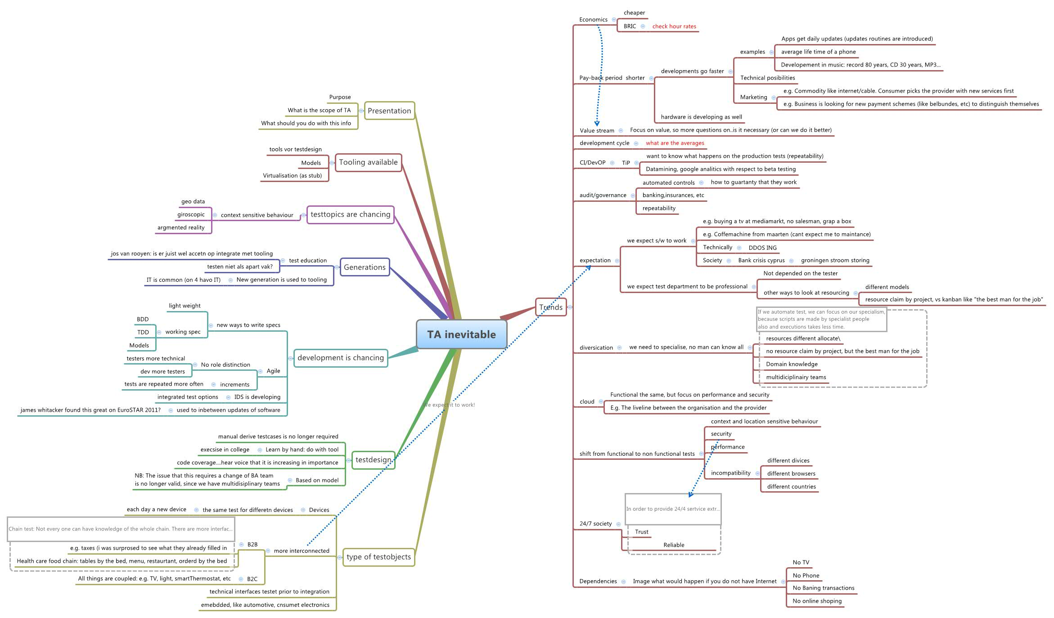
Typical notation: mind map

Slide 36
Criteria for successful use
The designer must possess, or have access to people with, strong domain knowledge
Relies on early insight into the design problem, and what dimensions might matter
One should not dismiss ideas (generate first, consolidate later)
Collaborate

Slide 37
Strengths and weaknesses
Strengths
Weaknesses
Can be used for many different purposes
Fluid representation suitable for tool use
Builds common understanding and language
Encourages idea generation
Can uncover ‘hidden’ relationships
Lightweight
May become too disconnected from reality
May become too unwieldy in size and complexity
Generation of ideas is restricted by the hierarchical form of representation
Requires a well-trained moderator

Slide 38
Variants
Concept mapping

Slide 39
Choosing design methods to apply
Focus on essence
Focus on the unknown
Focus on making progress

Slide 40
Focus on essence
Every design problem has an essence, the key – and often most difficult – part that must be understood and addressed ‘right’ for the design solution (plan for change in the world) to satisfy the stakeholders
Postponing understanding and addressing the essence of a design problem incurs a significant risk of rework at a later time

Slide 41
Focus on the unknown
Every design problem involves knowledge deficiencies – gaps in the understanding of the design problem and its possible solutions – that must be addressed for the design solution (plan for change in the world) to satisfy the stakeholders
Postponing understanding and addressing knowledge deficiencies incurs a significant risk of rework at a later time

Slide 42
Focus on making progress
Every design problem involves times during which the design project gets stuck; focusing effort elsewhere and continuing to make progress is often the right approach in response
Continuing to focus on a stuck issue for extended periods of time tends to be effort that is wasted

Slide 43
Design studio 2
You are to design the educational traffic simulator that is described in the design prompt that we handed out in class today
This will be a multi-week, multi-step effort

Slide 44
Design studio 2
As a team…
…identify the audience and other stakeholders
…identify possible goals, constraints, and assumptions
…apply the feature comparison and mind mapping design methods

Slide 45
Design studio 2
Grading criteria
your understanding of the design problem
innovativeness, understandability, elegance, and completeness of the design solution
does it do what it is supposed to do
“can we understand what you did, why, and do we believe you made good choices”

Slide 46
Design studio 2
Due Tuesday November 4, at the beginning of class

