Slide 1
Informatics 121 Software Design I
Lecture 10
Duplication of course material for any commercial purpose without the explicit written permission of the professor is prohibited.

Slide 2
Today’s lecture
Class survey
Design practice
Design studio 2

Slide 3
Class survey – the good
Practicality of the course
Interaction, not just lecture
Creativity and thinking

Slide 4
Class survey – the bad
Grading and grades
Length of the midterm
Team work

Slide 5
French fries and mayonnaise
Multiple frietwagens
Multiple employees
Varied menus
Varied pricing
with ‘grouping’
I owe you’s
Inventory
Different reports

Slide 6
Things we need to model
Frietwagens
Owners
Employees
Orders
Customers
Type of trucks
Food
fries
condiments
Transaction
Payment type
Menu
Menu item
Statistics

Slide 7
Where is the essence?
Reports?
Condiments?
Owners?
...?

Slide 8
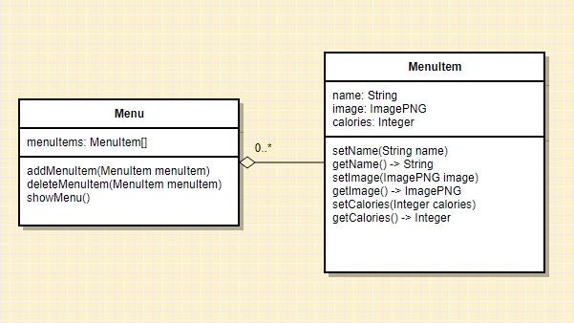
Example 1: representing menus

Slide 9
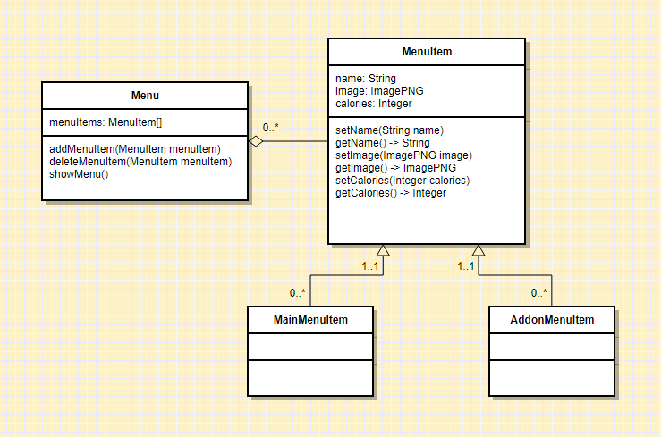
Example 1: representing menus

Slide 10
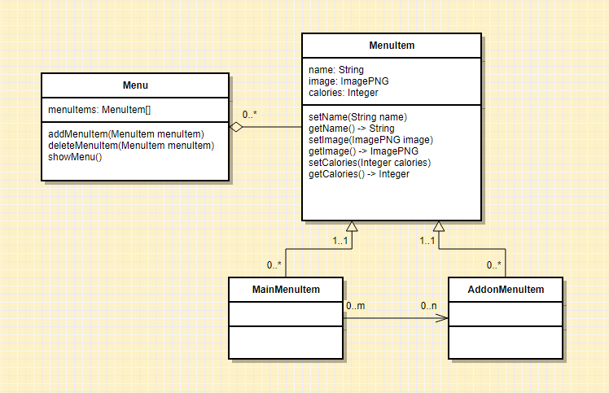
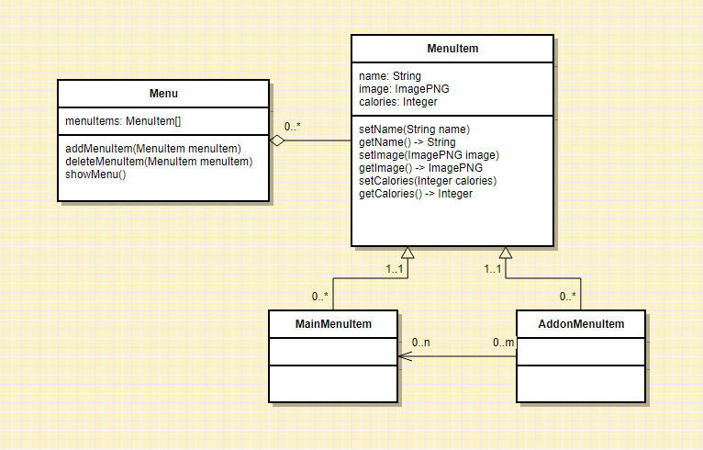
Example 1: representing menus

Slide 11
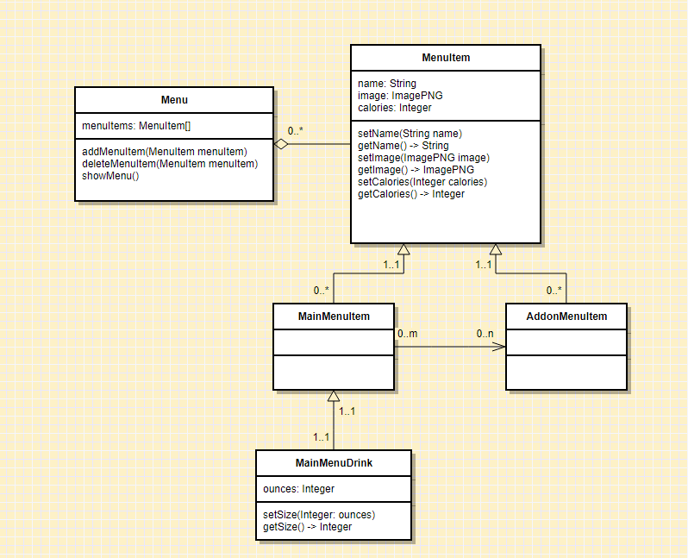
Example 1: representing menus

Slide 12
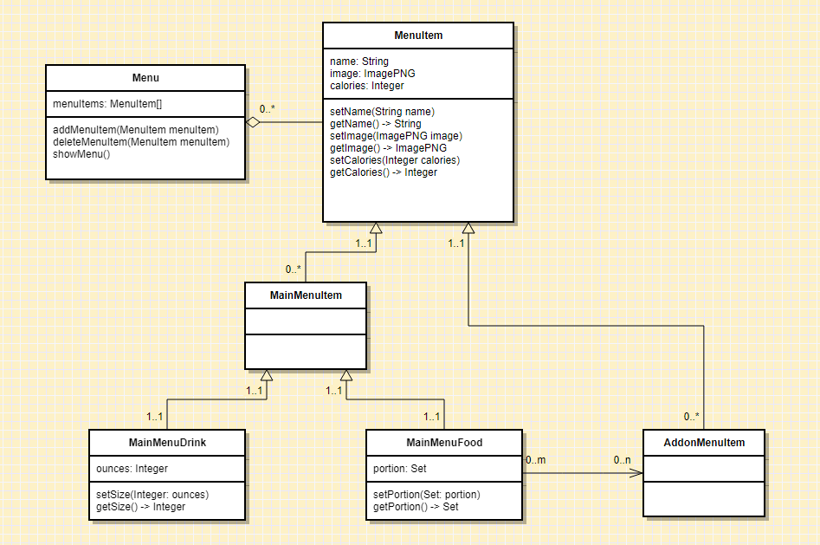
Example 1: representing menus

Slide 13
Example 1: what do we really need?

Slide 14
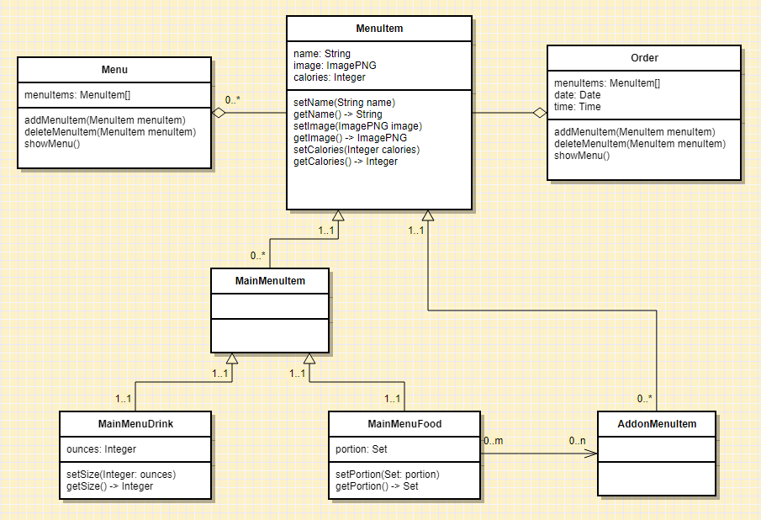
Example 2: accurate record of sales

Slide 15
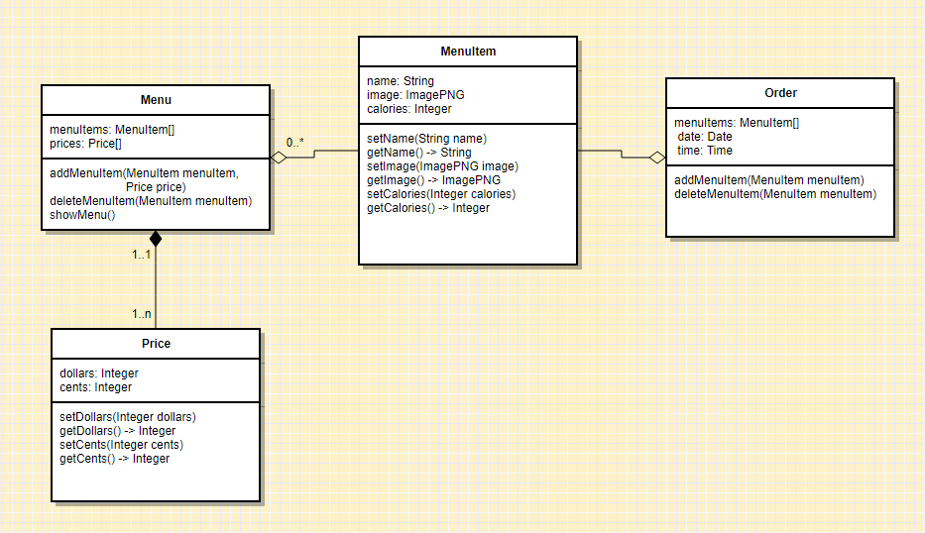
Example 2: accurate record of sales

Slide 16
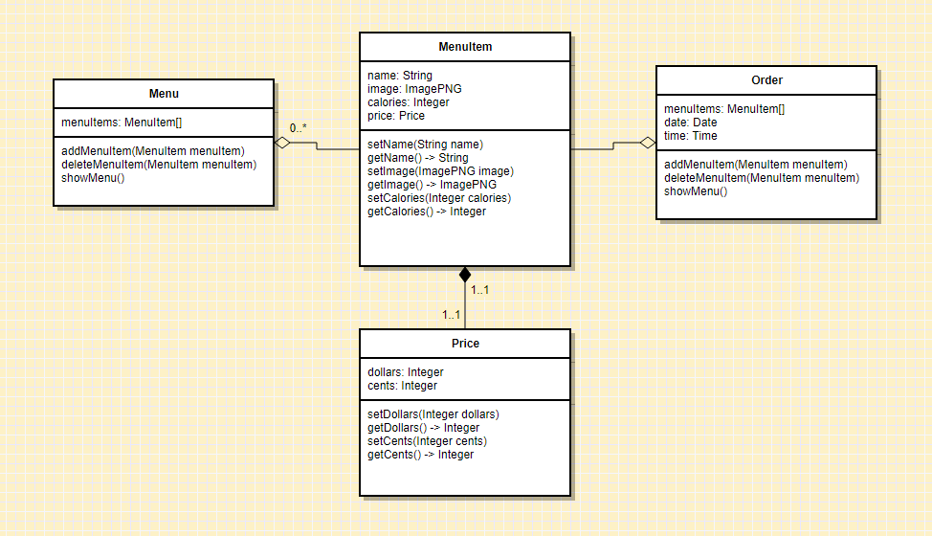
Example 2: accurate record of sales

Slide 17
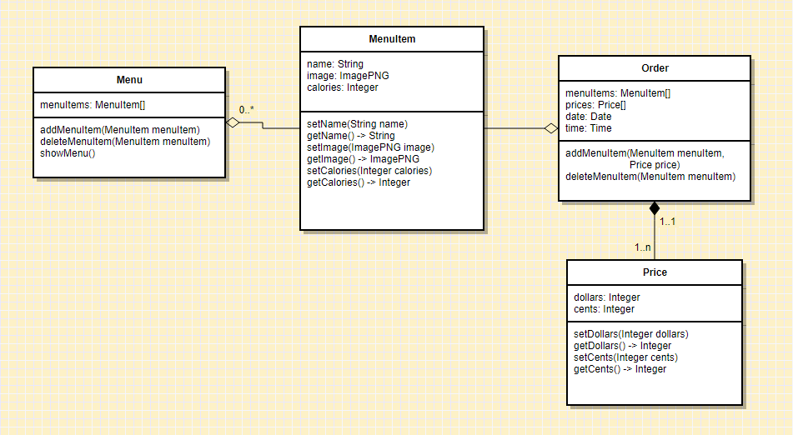
Example 2: accurate record of sales

Slide 18
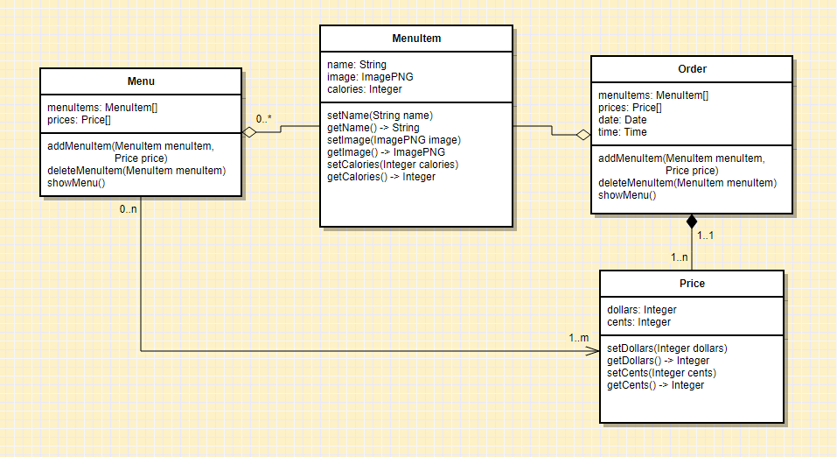
Example 2: accurate record of sales

Slide 19
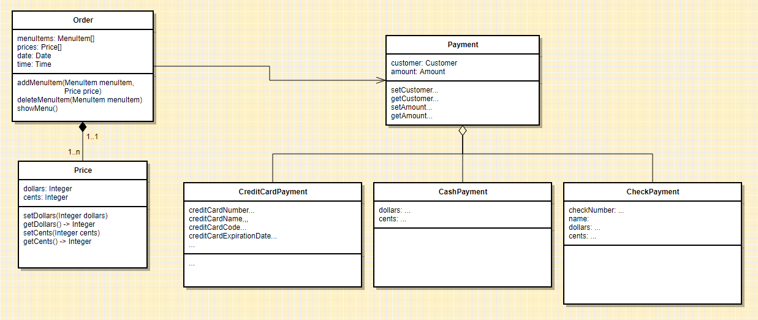
Example 2: accurate record of sales

Slide 20
Example 2: accurate record of sales
Split payments?
Cashbacks?
I owe you’s?
Partial I owe you’s?

Slide 21
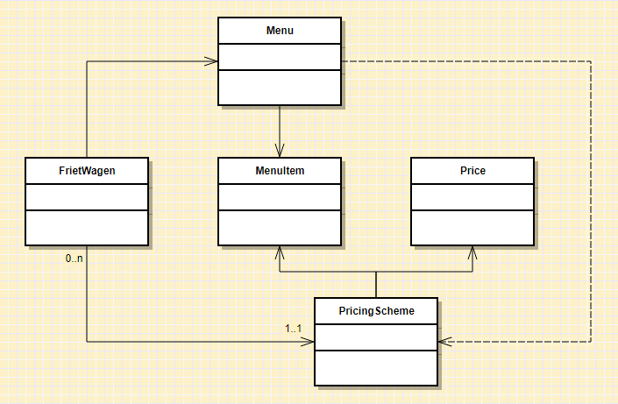
Example 3: groups of frietwagens

Slide 22
Expert practices we (should have) used
Solve simpler problems first
Go as deep as needed
Simulate continually
Focus on essence
Generate alternatives
Are alert to evidence that challenges their theory
Think about what they are not designing
Invest now to save time later

Slide 23
Experts prefer solutions that they know work

Slide 24
Design studio 2 (part 1)
As a team, design an educational traffic simulator based on the design prompt we handed out in class
Make sure to consider at least three different approaches, highlight tradeoffs among the approaches, and discuss why you chose the approach you took
briefly document the approaches you considered but did not adopt
Your group will be announced at the start of your discussion

Slide 25
Design studio 2 (part 1)
Focus
predicting the future
making tradeoffs
managing bias
accommodating change
balancing cost, quality, and effort
solving a problem, now and later

Slide 26
Design studio 2 (part 1)
Practice what you have learned about experts:
solve simpler problems first
draw the problem as much as they draw the solution
move among levels of abstraction
go as deep as needed
simulate continually
are alert to evidence that challenges their theory
think about what they are not designing
invest now to save time later

Slide 27
Design studio 2 (part 1)
Practice what you have learned about experts:
focus on the essence
prefer solutions that they know work
address knowledge deficiencies
generate alternatives
are skeptical

Slide 28
Design studio 2 (part 1)
Bring two printed copies to class, Thursday November 9
make sure to identify all group members
make sure to identify your discussion time
No extensions, not even for reduced points

Slide 29
Design studio 2 (part 1)
What should the document look like?

Slide 30
Design studio 2 (part 1)
What should the point distribution be?

Slide 31
Design studio 2 (part 1)
Questions?

