Slide 1
Informatics 121 Software Design I
Lecture 10
Duplication of course material for any commercial purpose without the explicit written permission of the professor is prohibited.

Slide 2
Today’s lecture
Midterm
Design studio 2
Design practice

Slide 3
Midterm
November 7
All material up to and including the lecture on November 5
Closed book; bring pen/pencil/eraser
Theory and practice

Slide 4
Sample question
The definition of design used in Informatics 121 is:

Slide 5
Sample question
Name the four types of design that must be addressed in software design:

Slide 6
Sample question
Why do experts prefer to work with others?

Slide 7
Sample question
Name the four types of design that must be addressed in software design:

Slide 8
Sample question
Suppose you are to design a new web app that allows anyone to track any flight, its departure and destination airport, where it currently is in route, and its anticipated arrival time. List a possible goal, constraint, assumption, decision, and idea for the web app as related to application design:

Slide 9
Sample question
Suppose you are asked to design a new web app through which it is possible to register your bicycle(s), so that if a bike is stolen and later found, the police can return it to the rightful owner. What features would you foresee this software system to have (it is not necessary to be exhaustive):

Slide 10
Sample question
Continuing the previous question, draw a few mock-ups of how you envision the system to work:

Slide 11
Questions?

Slide 12
Design studio 2 (part 1)
As a team, design an educational traffic simulator based on the design prompt we hand out in discussion
Make sure to consider at least three different approaches, highlight tradeoffs among the approaches, and discuss why you chose the approach you took
briefly document the approaches you considered but did not adopt
Your group will be announced at the start of your discussion

Slide 13
Design studio 2 (part 1)
Focus
predicting the future
making tradeoffs
marrying technical and social perspectives
facing unique problems
knowing when to stop
accommodating change

Slide 14
Design studio 2 (part 1)
Practice what you have learned about experts:
solve simpler problems first
draw the problem as much as they draw the solution
move among levels of abstraction
go as deep as needed
simulate continually
are alert to evidence that challenges their theory
think about what they are not designing
invest now to save time later

Slide 15
Design studio 2 (part 1)
Practice what you have learned about experts:
focus on the essence
prefer solutions that they know work
address knowledge deficiencies
generate alternatives
are skeptical

Slide 16
Design studio 2 (part 1)
Due through GradeScope, Tuesday November 12, at noon
make sure to identify all group members
make sure to identify your discussion time
All intermediate artifacts should be submitted through Linecept
No extensions, not even for reduced points

Slide 17
Design studio 2 (part 1)
Team members will assess other team members
in terms of the contributions they make
in terms of enabling others to make contributions

Slide 18
Design studio 2 (part 1)
Questions?

Slide 19
Design studio 2 (part 1)
What should the document look like?

Slide 20
Design studio 2 (part 1)
What should the grading criteria be?

Slide 21
French fries and mayonnaise
Multiple frietwagens
Multiple employees
Varied menus
Varied pricing
with ‘grouping’
I owe you’s
Inventory
Different reports

Slide 22
Things we need to model
Frietwagens
Owners
Employees
Orders
Customers
Type of trucks
Product
fries
condiments
Combo
Transaction
Inventory
Supplier
Menu
Menu item
Food
Payment method
Report

Slide 23
Where is the essence?
Reports?
Condiments?
Inventory?
Owners?
…

Slide 24
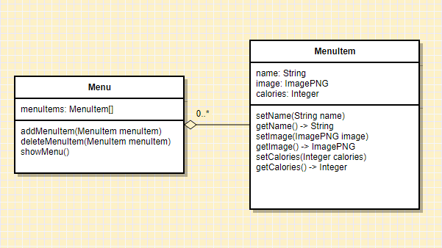
Example 1: representing menus

Slide 25
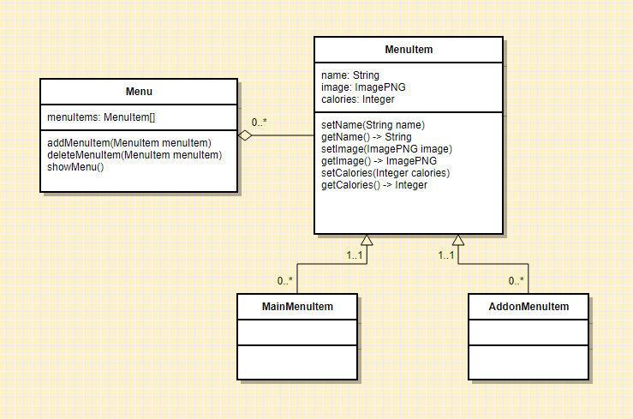
Example 1: representing menus

Slide 26
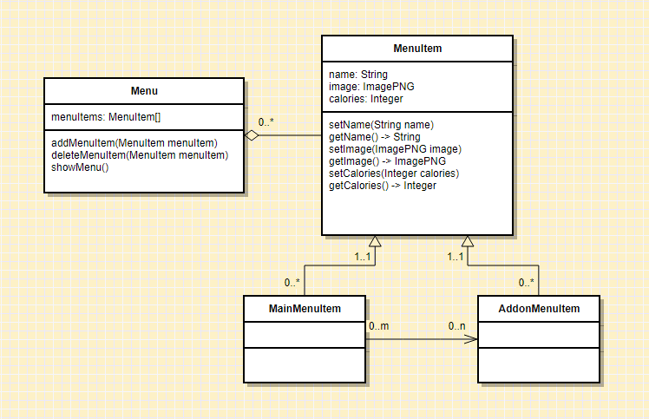
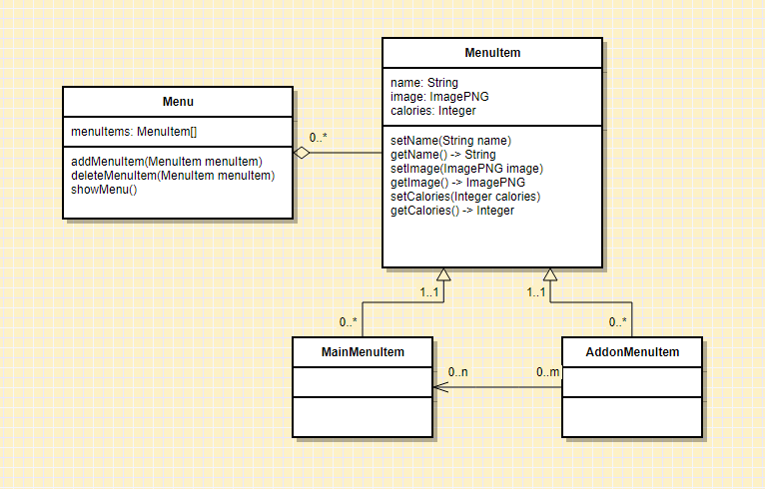
Example 1: representing menus

Slide 27
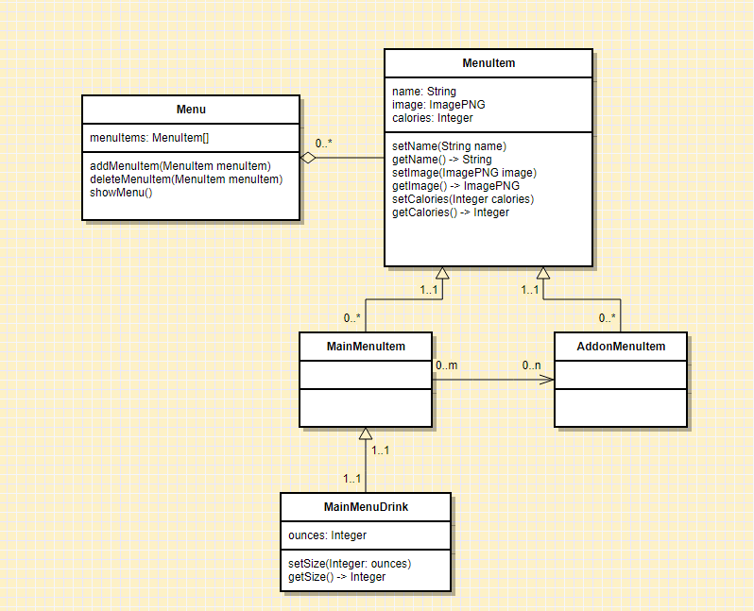
Example 1: representing menus

Slide 28
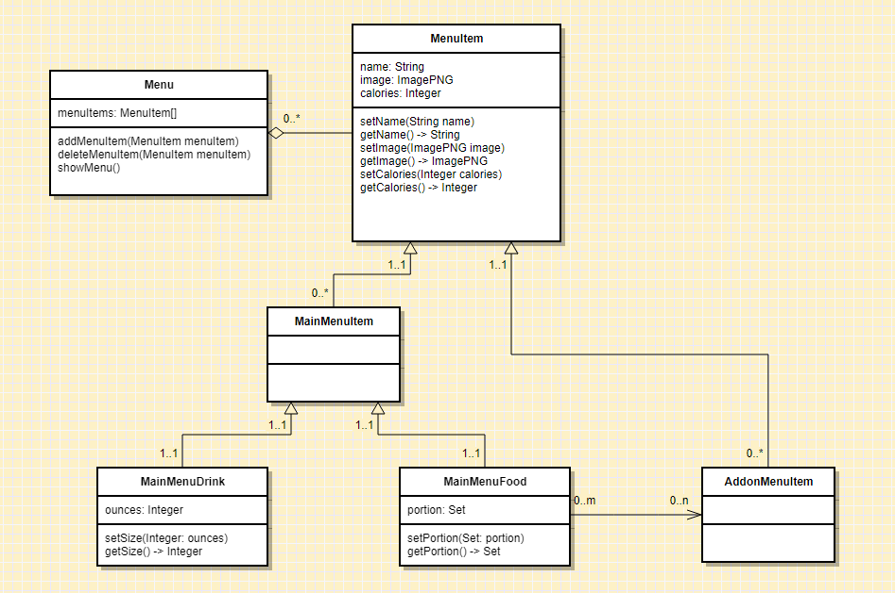
Example 1: representing menus

Slide 29
Example 1: what do we really need?

Slide 30
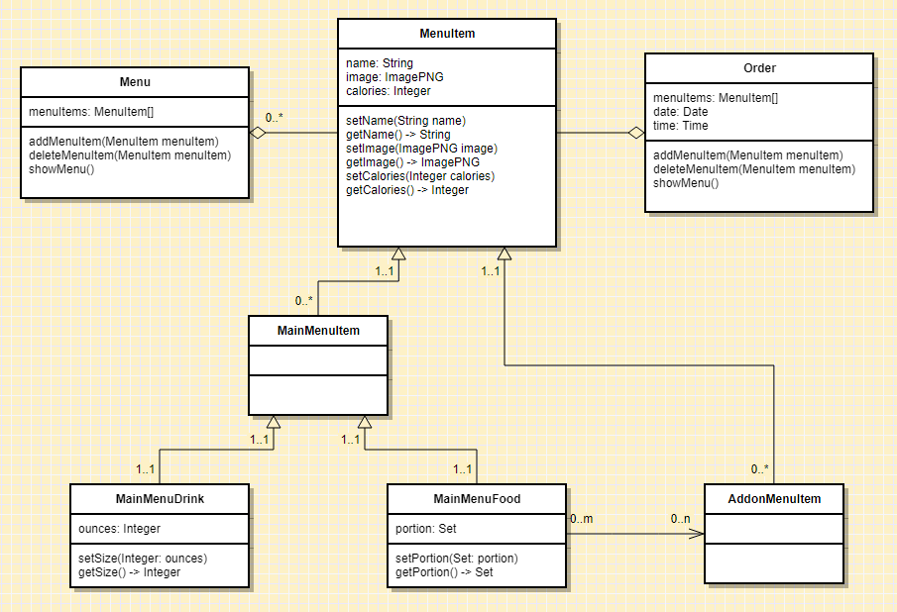
Example 2: accurate record of sales

Slide 31
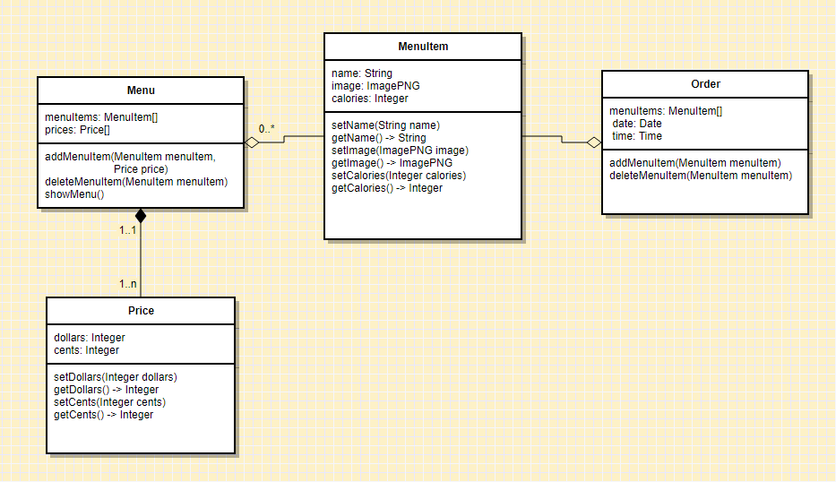
Example 2: accurate record of sales

Slide 32
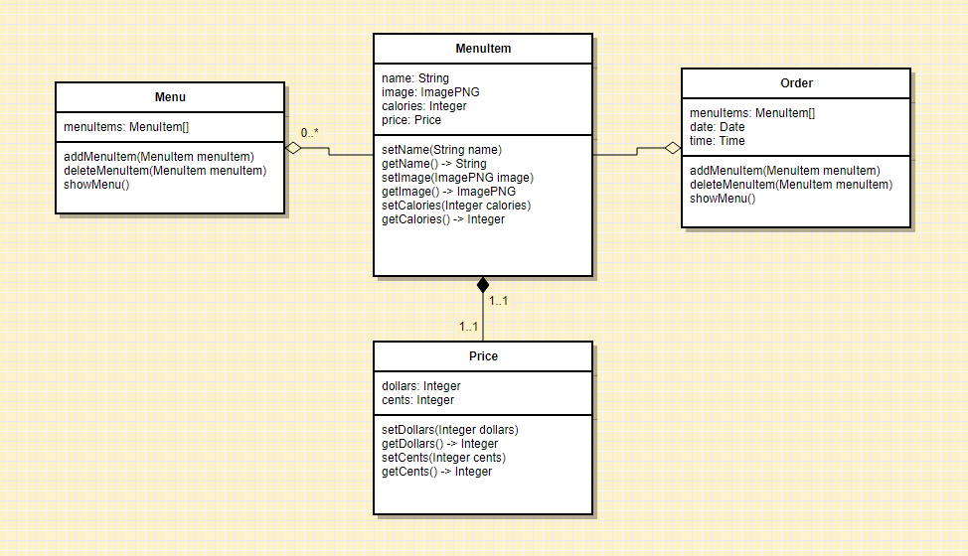
Example 2: accurate record of sales

Slide 33
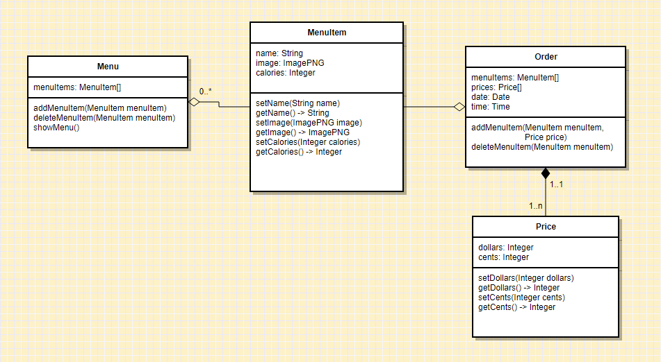
Example 2: accurate record of sales

Slide 34
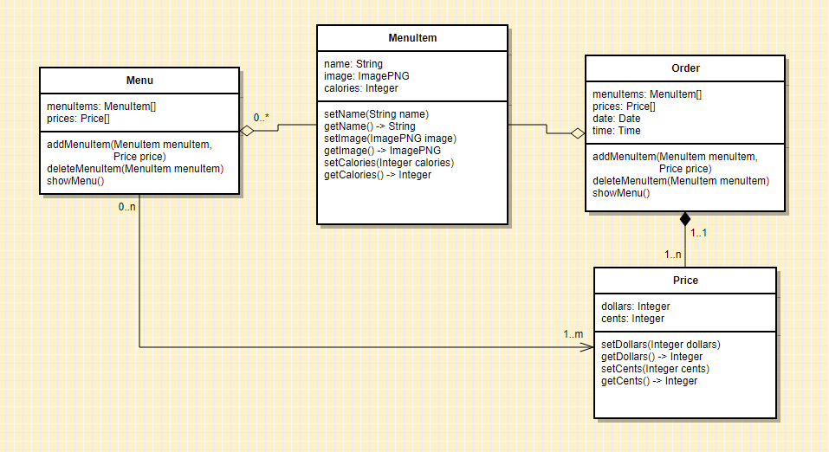
Example 2: accurate record of sales

Slide 35
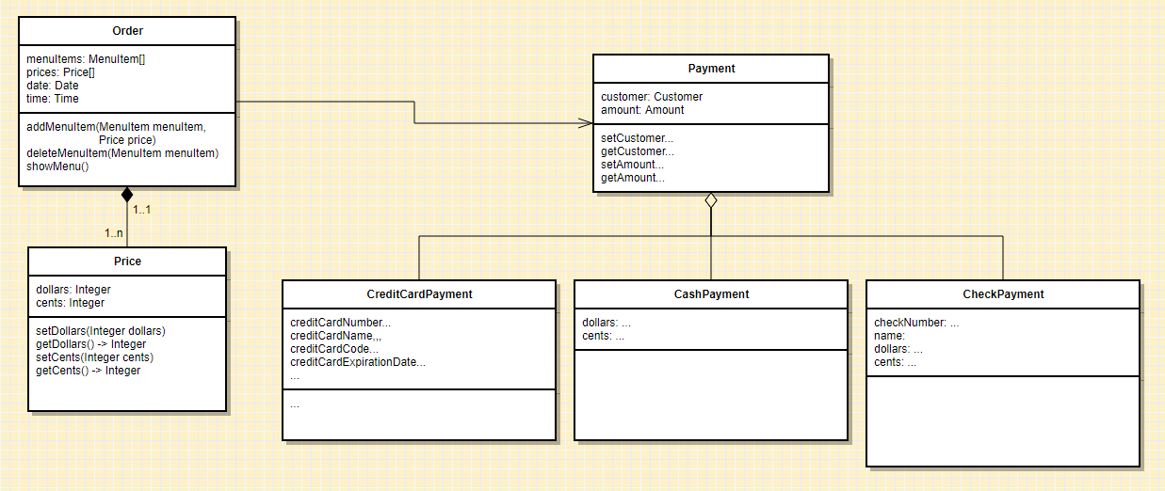
Example 2: accurate record of sales

Slide 36
Example 2: accurate record of sales
Split payments?
Cashbacks?
I owe you’s?
Partial I owe you’s?

Slide 37
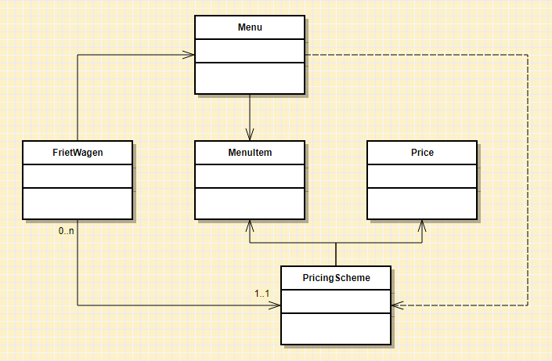
Example 3: groups of frietwagens

Slide 38
Expert practices we (should have) used
Solve simpler problems first
Go as deep as needed
Simulate continually
Focus on essence
Generate alternatives
Are alert to evidence that challenges their theory
Think about what they are not designing
Invest now to save time later

Slide 39
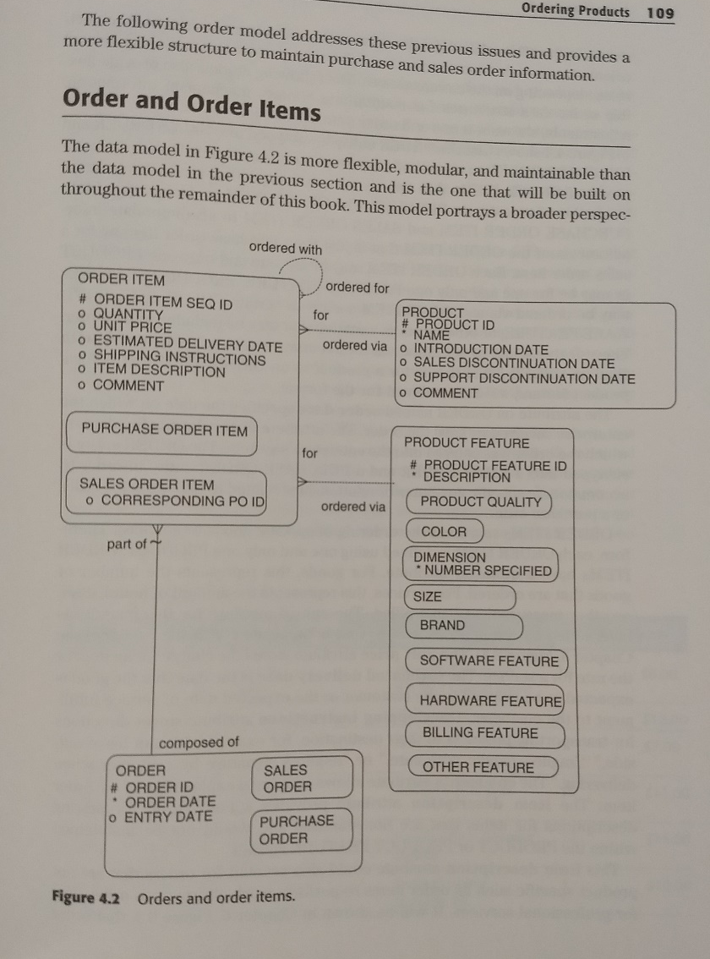
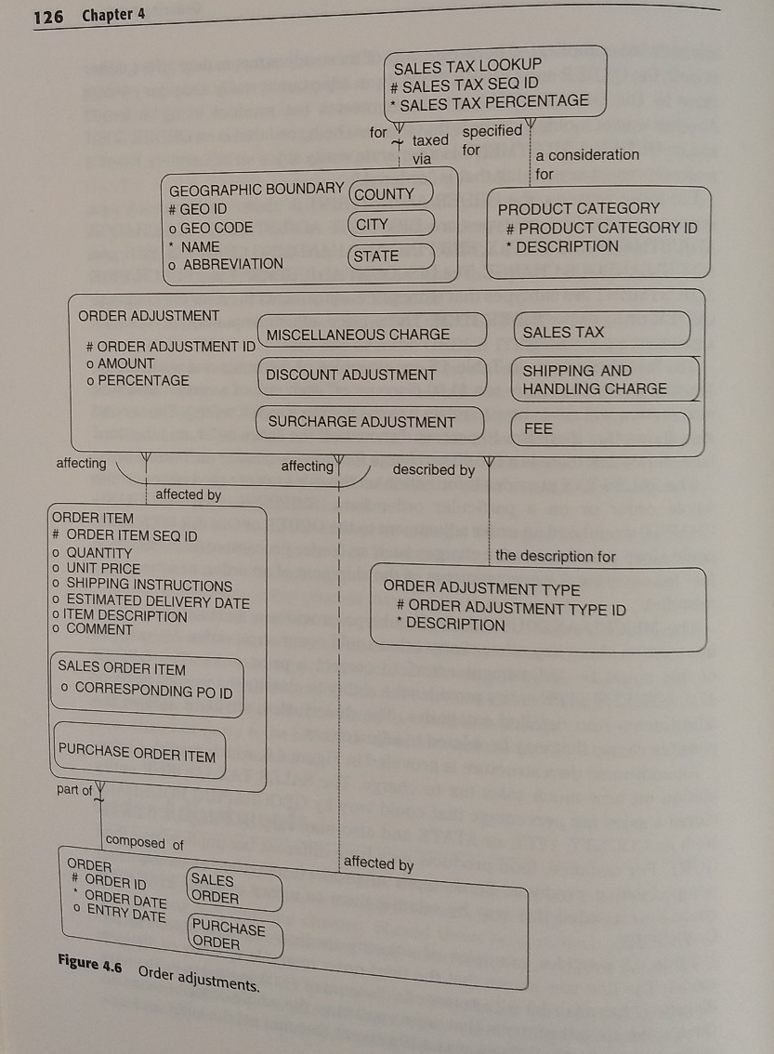
Experts prefer solutions that they know work

