Slide 1
Informatics 121 Software Design I
Lecture 5
Duplication of course material for any commercial purpose without the explicit written permission of the professor is prohibited.

Slide 2
Discussion
There will be discussion tomorrow
mandatory to attend, since group work continues
Please join your designated discussion

Slide 3
Today
Hand in one copy of your design studio 1, part 1, to one of the TAs
must do so before end of class today
Brief lecture
Start designing RobotKid with your team
Design studio 1, part 2
Linecept

Slide 4
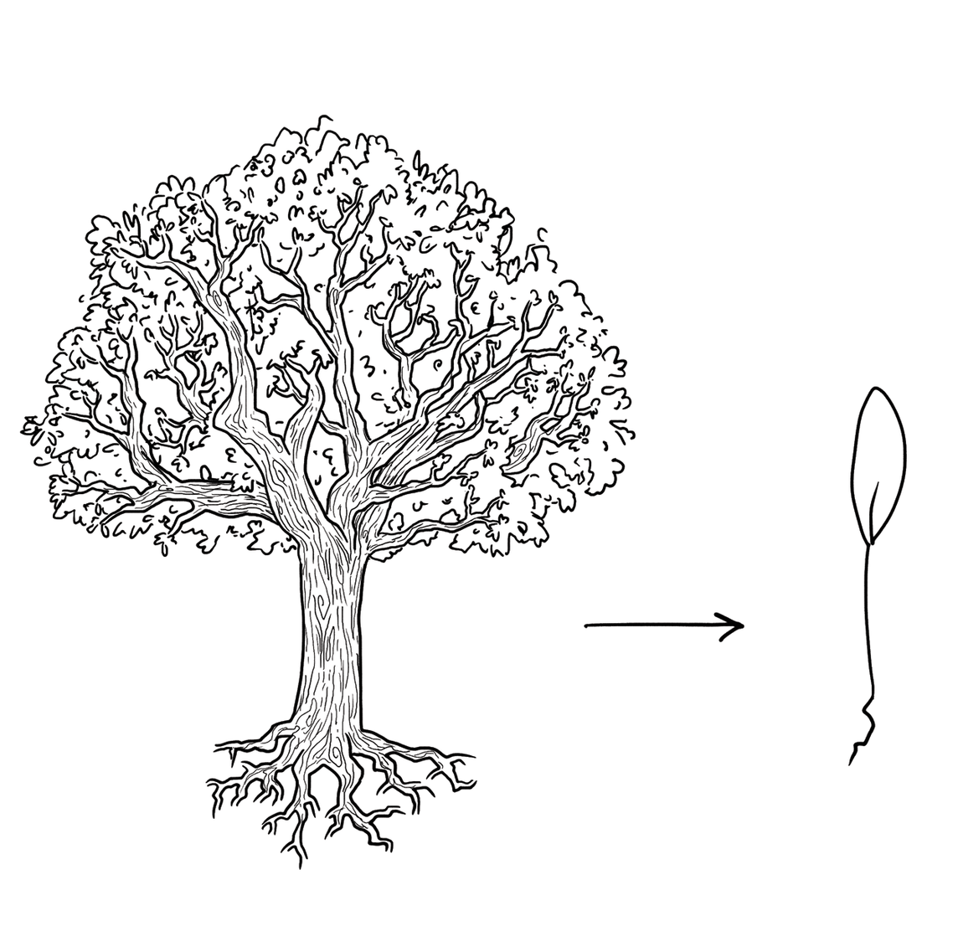
Experts focus on the essence

Slide 5
Experts prefer solutions that they know work

Slide 6
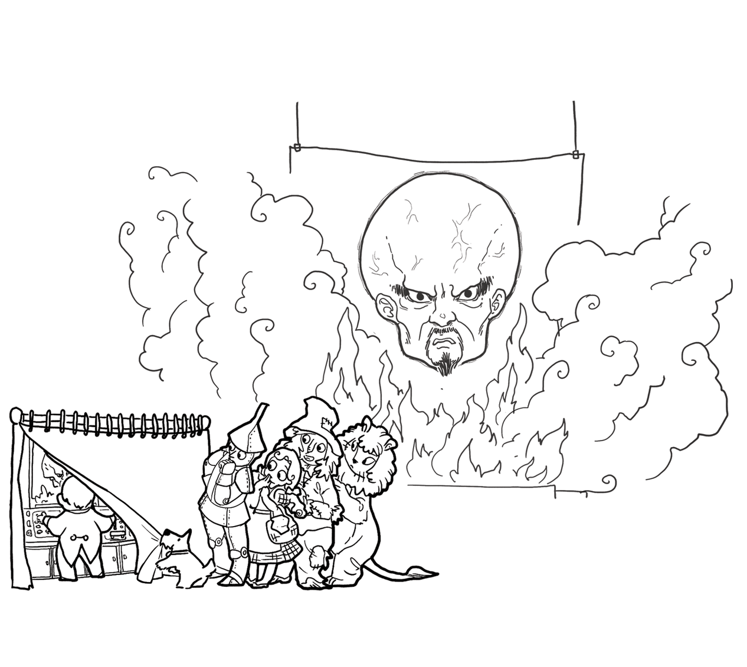
Experts address knowledge deficiencies

Slide 7
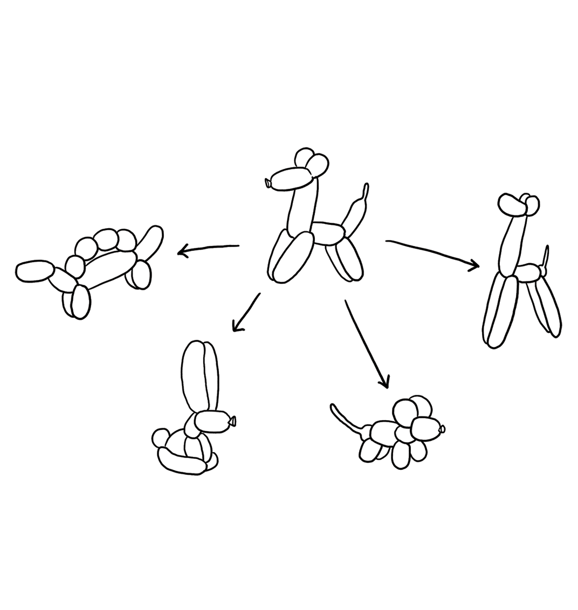
Experts generate alternatives

Slide 8
Experts are skeptical

Slide 9
Design cycle
synthesize
goals
constraints
assumptions
decisions
ideas
analyze
evaluate

Slide 10
Work time!
Your client is RobotKid, a new company that aims to help kids who cannot attend school be part of school as much as possible. RobotKid is a software company, and in particular wants to leverage existing telerobots to provide an outstanding experience that goes beyond ‘just being there’.
The company has sought you and your team out, because you are excellent designers. All of the software design is in your hands, as RobotKid has the idea protected (meaning no competition), but has no idea how to actually design the software.

Slide 11
Done with work time

Slide 12
Design studio 1 (part 2)
As a team, design RobotKid in terms of the functionality it will offer and how the audience will interact with it
Make sure that you explicitly identify goals, constraints, and assumptions
Make sure to consider at least three different approaches, highlight tradeoffs among the approaches, and discuss why you chose the approach you took
briefly document the approaches you considered but did not adopt

Slide 13
Design studio 1 (part 2)
Practice what you have learned about experts:
focus on the essence
prefer solutions that they know work
address knowledge deficiencies
generate alternatives
are skeptical
Due Tuesday October 24, at noon (through GradeScope and Linecept)
make sure to identify all group members

Slide 14
Design studio 1 (part 2)
All intermediate artifacts must be uploaded to Linecept
all results from every in-person meeting
all results from every virtual meeting
all results from any work you do on your own
Results should be uploaded as a scan, photograph, or PDF
attributable as to who participated
Handout with basic Linecept info

Slide 15
Design studio 1 (part 2)
Team members will assess other team members
in terms of the contributions they make
in terms of enabling others to make contributions

