Slide 1
Informatics 121 Software Design I
Lecture 8
Duplication of course material for any commercial purpose without the explicit written permission of the professor is prohibited.

Slide 2
Announcements
No class Thursday
Design studio 1 due Thursday @ noon, including team evaluations
Design studio 2 will be out Friday, in discussion
There will be discussion on Friday

Slide 3
Today’s lecture
Design artifacts
Design notations
Expert behaviors
Design studio 2, part 1

Slide 4
Design
designer
plan
maker
change in the world
other stakeholders
audience
experiences

Slide 5
A design artifact
An externalized representation used to further a design project
goals, constraints, assumptions, ideas, decisions
design problem, design solution, or both
partial or complete
fluid or frozen

Slide 6
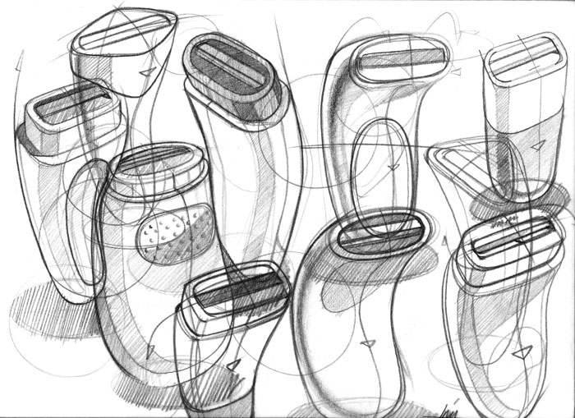
Example

Slide 7
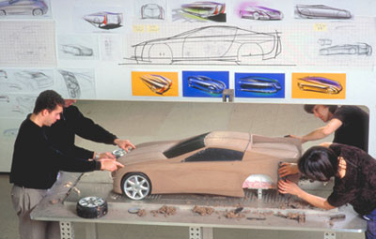
Example

Slide 8
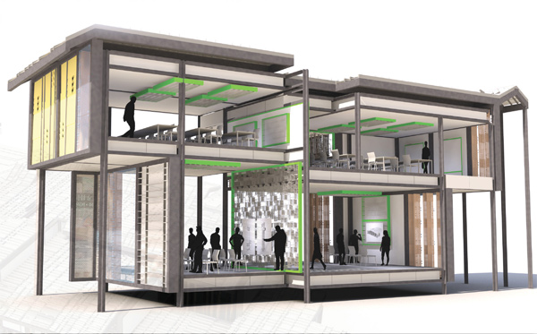
Example

Slide 9
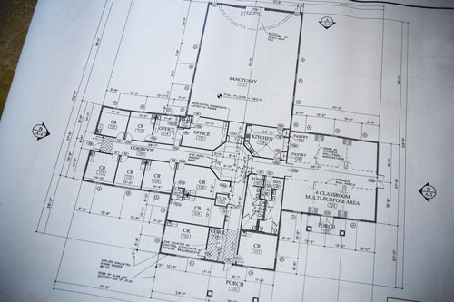
Example

Slide 10
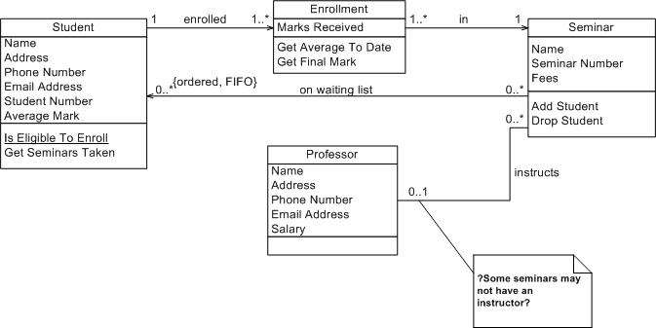
Example

Slide 11
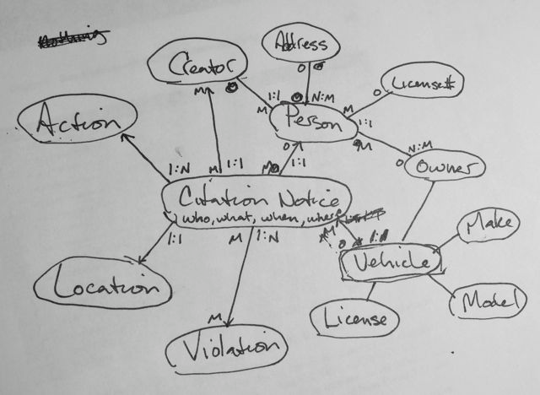
Example

Slide 12
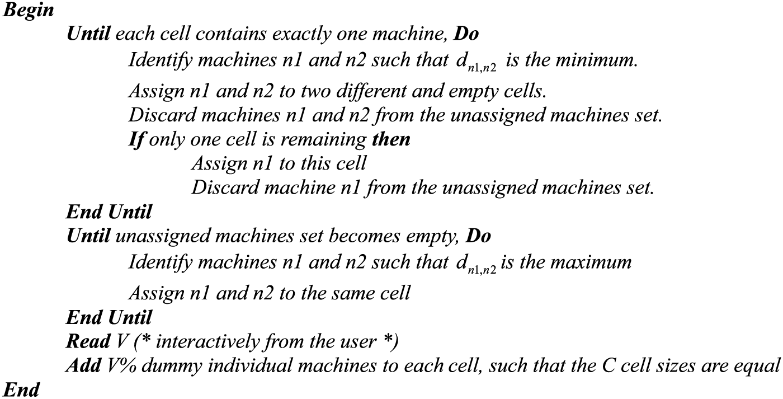
Example

Slide 13
Purpose of design artifacts
Design artifacts to think
Design artifacts to talk
Design artifacts to prescribe

Slide 14
Thinking design artifact

Slide 15
Thinking design artifact

Slide 16
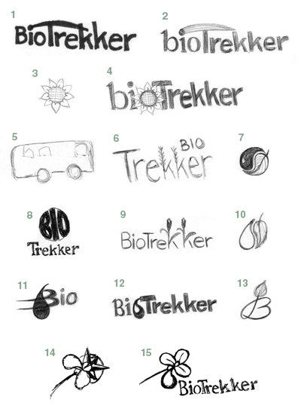
Thinking design artifact

Slide 17
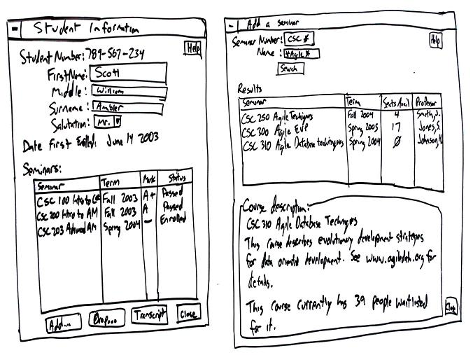
Thinking design artifact

Slide 18
Talking design artifact

Slide 19
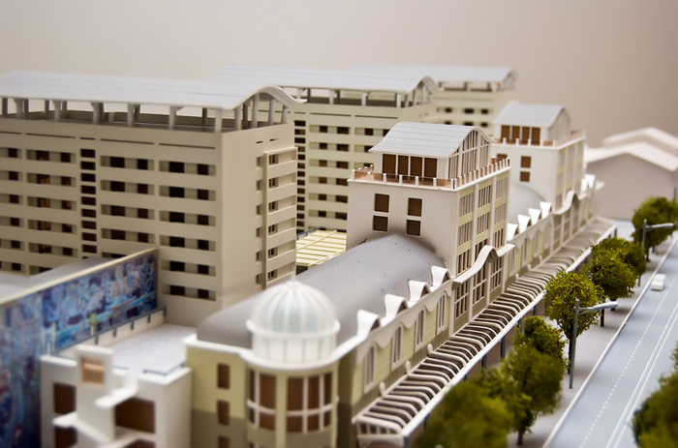
Talking design artifact

Slide 20
Talking design artifact

Slide 21
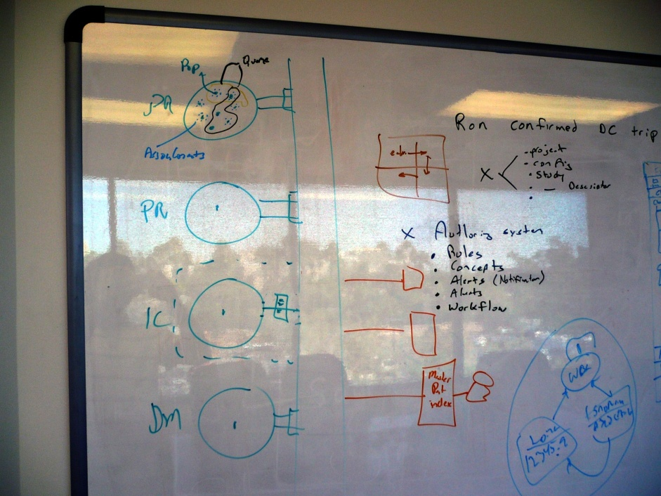
Talking design artifact

Slide 22
Prescribing design artifact

Slide 23
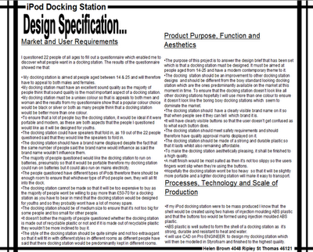
Prescribing design artifact

Slide 24
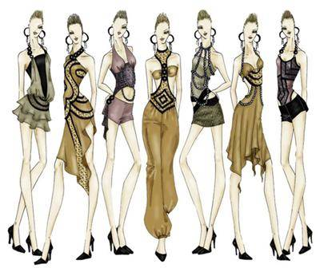
Prescribing design artifact

Slide 25
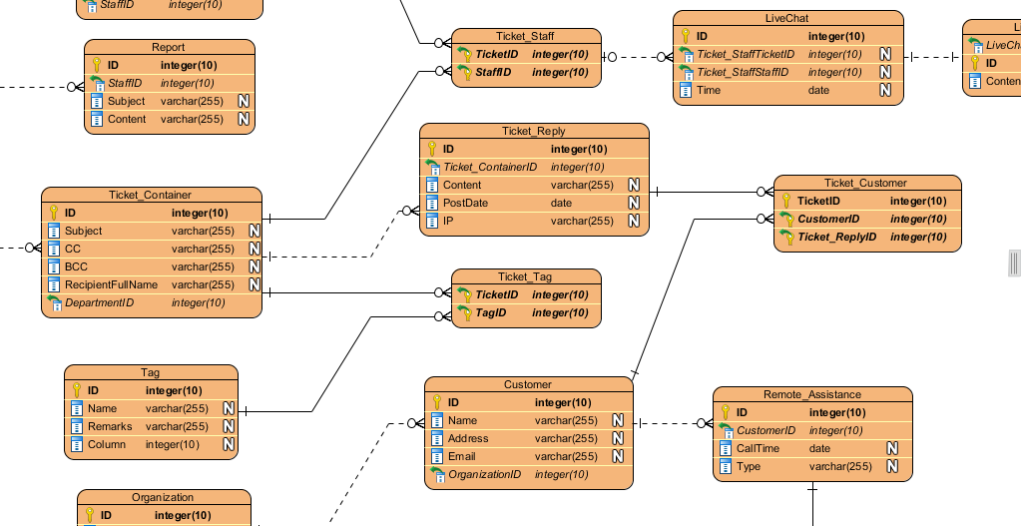
Prescribing design artifact

Slide 26
Abstraction
An abstraction is formed by reducing the information content of a concept or an observable phenomenon, typically to retain only information which is relevant for a particular purpose
choice of what to include
choice of what not to include
Each abstraction makes some information readily available at the expense of obscuring or removing other information

Slide 27
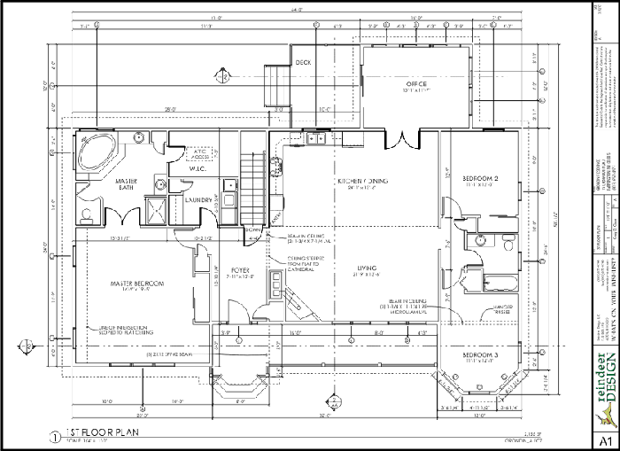
Floor plan

Slide 28
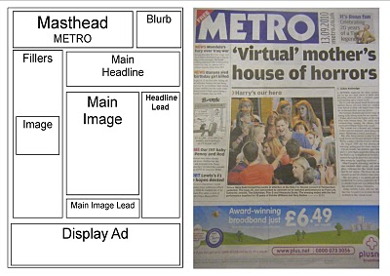
Page layout

Slide 29
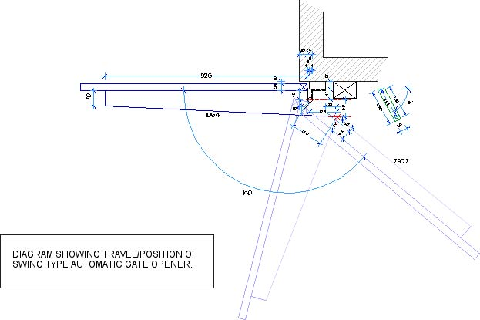
Mechanical engineering diagram

Slide 30
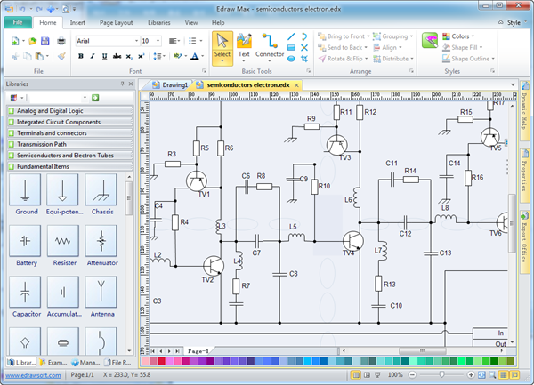
Schematic

Slide 31
Product sketch

Slide 32
Model

Slide 33
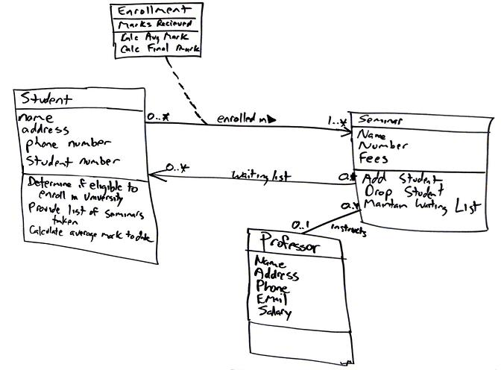
Class diagram

Slide 34
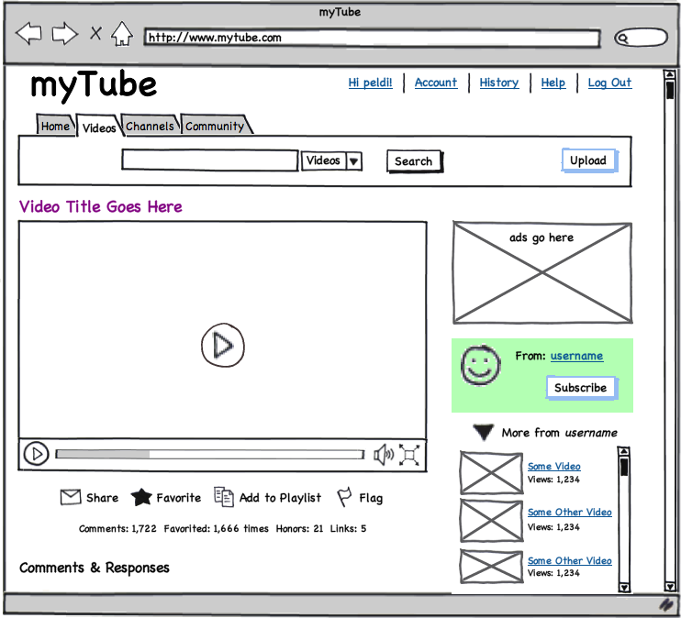
User interface mock-up
[balsamiq]

Slide 35
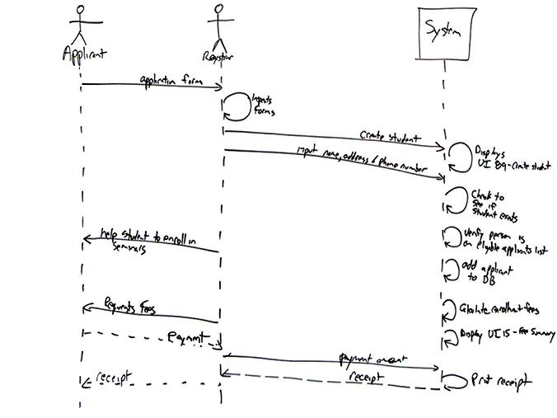
Sequence diagram

Slide 36
Design notation
A design notation offers a language for specifying certain aspects of a design artifact
textual and/or graphical vocabulary for specifying individual and composite elements
rules governing how individual elements can be combined into composite elements
implicit and/or explicit semantics for giving meaning
Each design notation is typically suited for a particular domain and a particular purpose
Every design notation invariably introduces abstraction

Slide 37
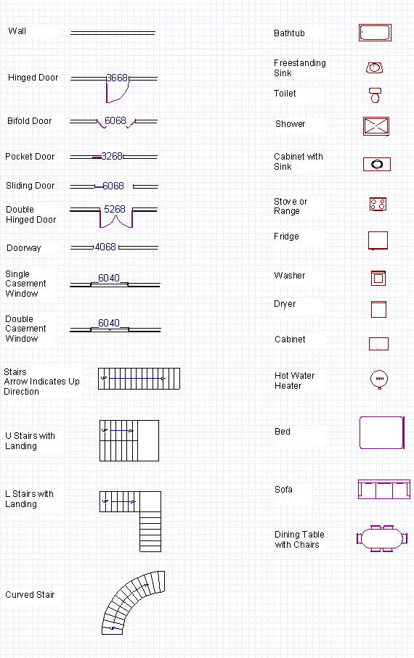
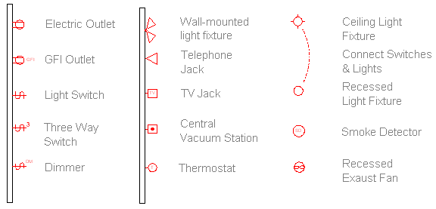
Example notation

Slide 38
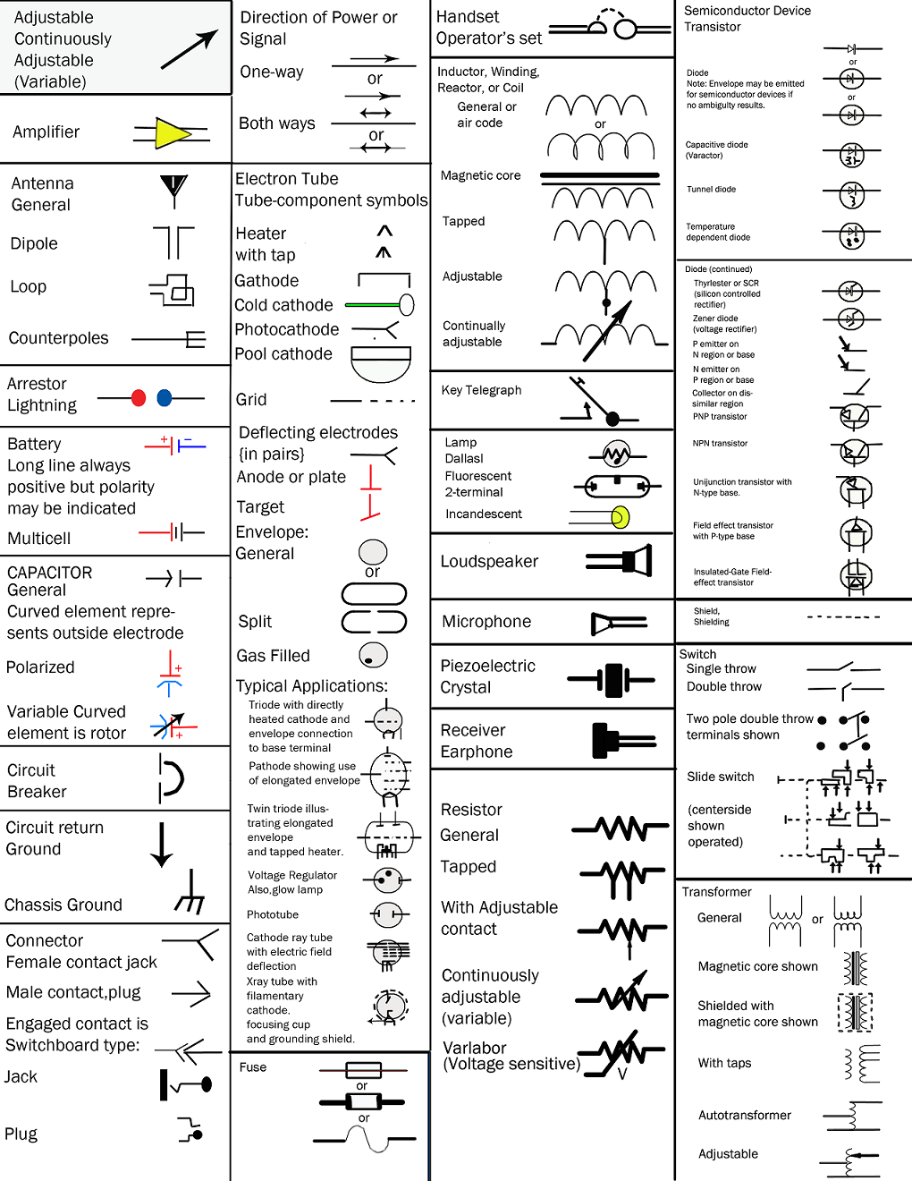
Example notation

Slide 39
Example notation

Slide 40
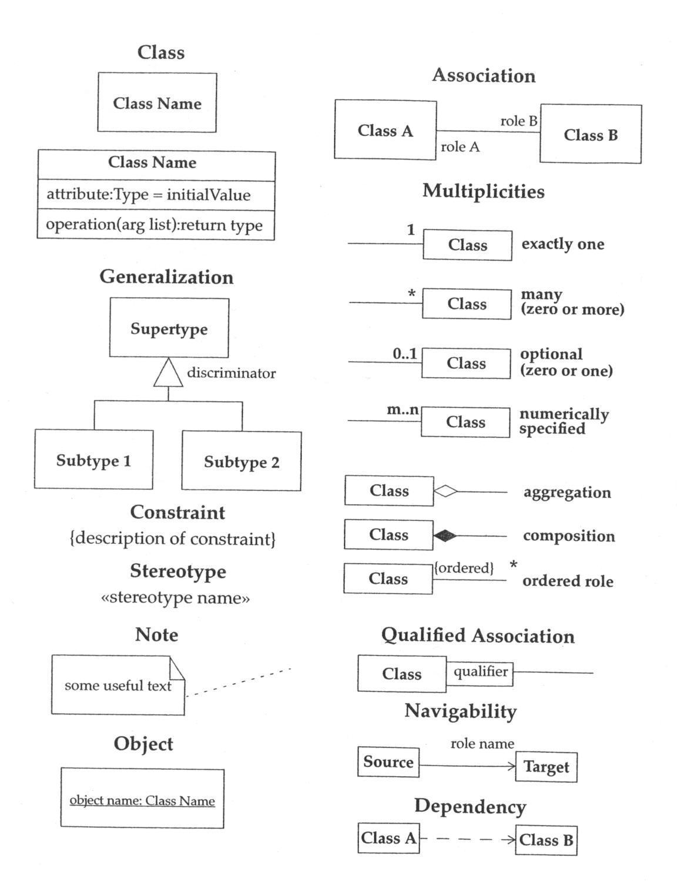
Example notation

Slide 41
Example notation

Slide 42
Considerations in choosing a design notation
Who is the audience?
What is the objective?
What is the timeframe?

Slide 43
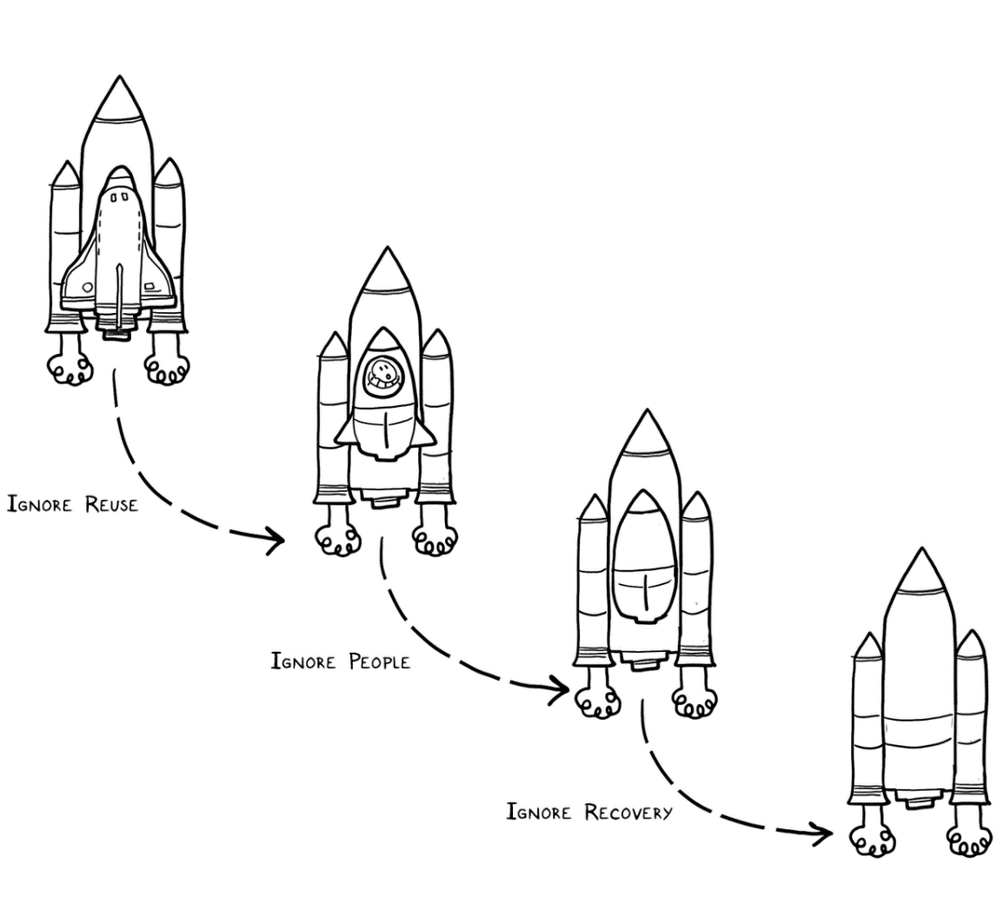
Experts solve simpler problems first

Slide 44
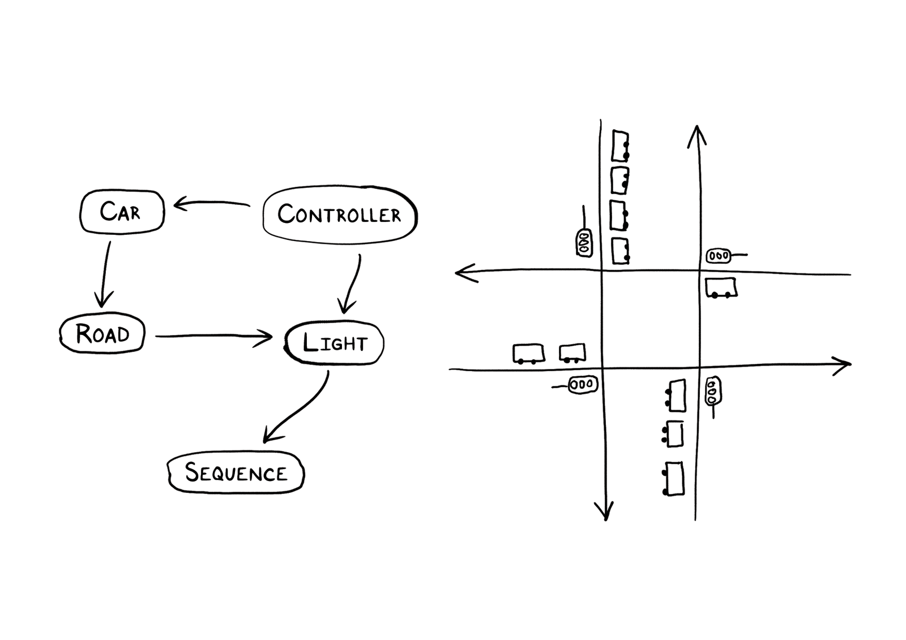
Experts draw the problem as much as they draw the solution

Slide 45
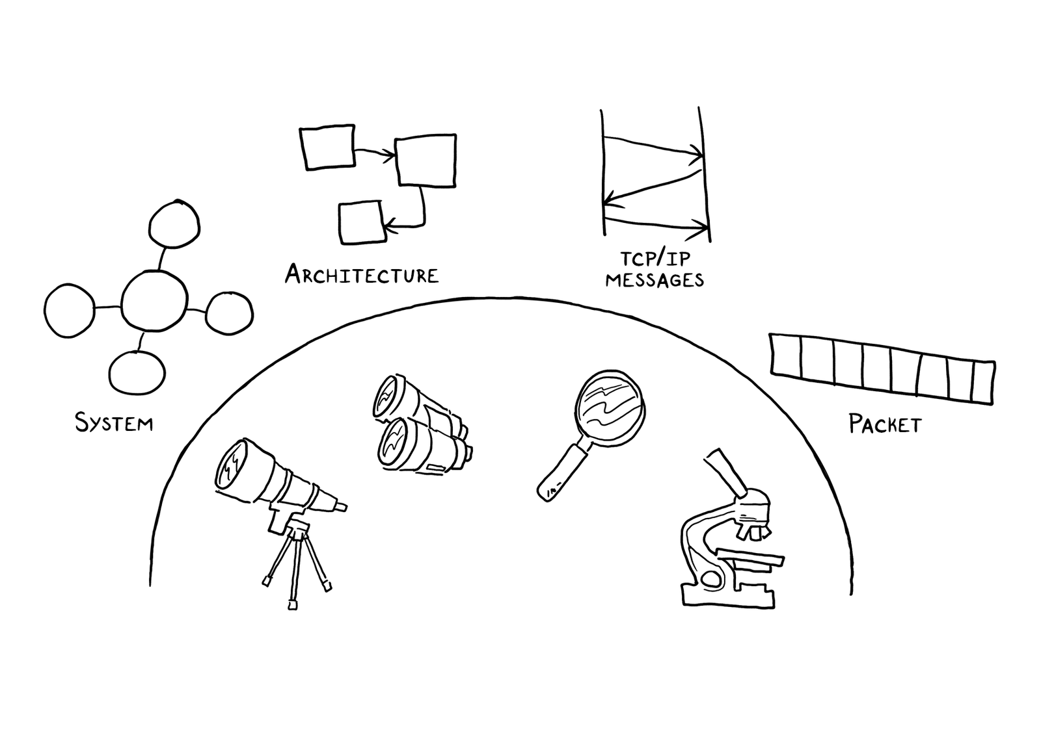
Experts move among levels of abstraction

Slide 46
Experts go as deep as needed

Slide 47
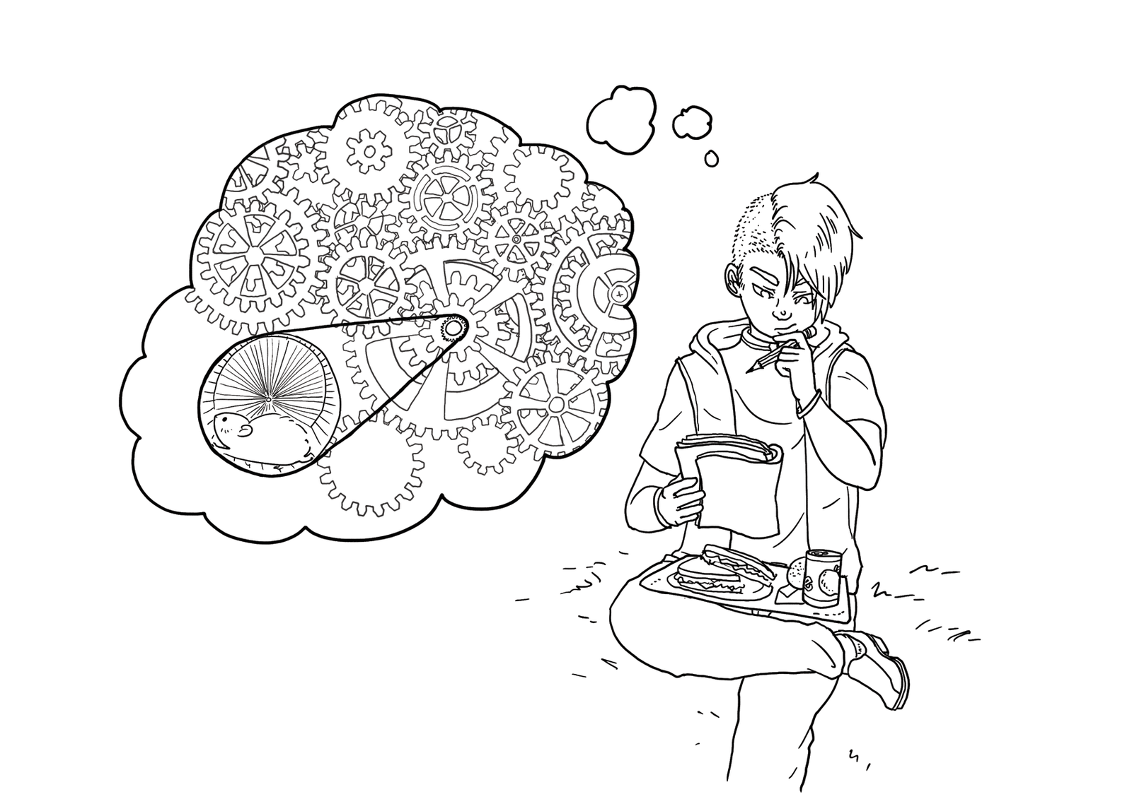
Experts simulate continually

Slide 48
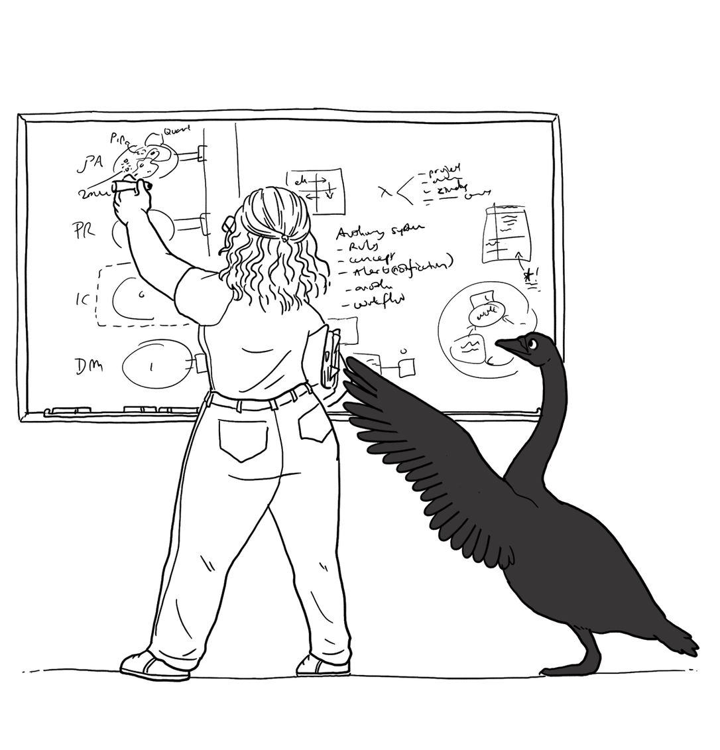
Experts are alert to evidence that challenges their theory

Slide 49
Experts think about what they are not designing

Slide 50
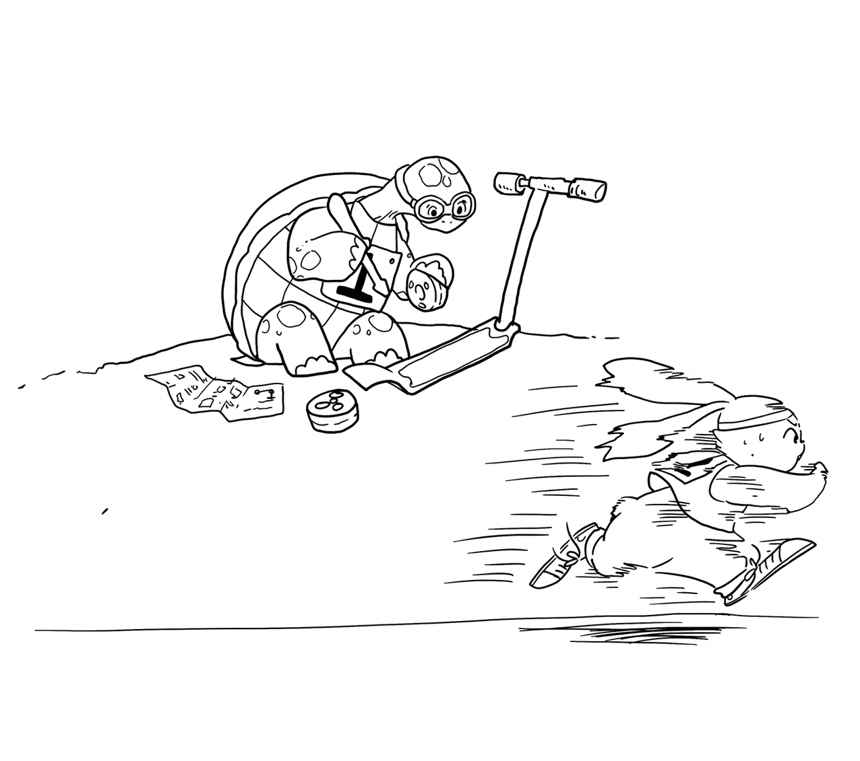
Experts invest now to save time later

Slide 51
Design studio 2 (part 1)
As a team, design an educational traffic simulator based on the design prompt we hand out in discussion
Make sure to consider at least three different approaches, highlight tradeoffs among the approaches, and discuss why you chose the approach you took
briefly document the approaches you considered but did not adopt
Your group will be announced at the start of your discussion

Slide 52
Design studio 2 (part 1)
Focus
predicting the future
making tradeoffs
marrying technical and social perspectives
facing unique problems
knowing when to stop
accommodating change

Slide 53
Design studio 2 (part 1)
Practice what you have learned about experts:
solve simpler problems first
draw the problem as much as they draw the solution
move among levels of abstraction
go as deep as needed
simulate continually
are alert to evidence that challenges their theory
think about what they are not designing
invest now to save time later

Slide 54
Design studio 2 (part 1)
Practice what you have learned about experts:
focus on the essence
prefer solutions that they know work
address knowledge deficiencies
generate alternatives
are skeptical

Slide 55
Design studio 2 (part 1)
Due through GradeScope, Thursday November 12, at noon
make sure to identify all group members
make sure to identify your discussion time
All intermediate artifacts should be submitted through Linecept
No extensions, not even for reduced points

Slide 56
Design studio 2 (part 1)
Team members will assess other team members
in terms of the contributions they make
in terms of enabling others to make contributions

