Slide 1
Informatics 121 Software Design I
Lecture 1
Duplication of course material for any commercial purpose without the explicit written permission of the professor is prohibited.

Slide 2
Announcements
No class Friday
Future of Software Design workshop
No class Monday
Martin Luther King, Jr. Day
No discussion Friday

Slide 3
Today
Logistics
Course goals
A design story
Defining design

Slide 4
Logistics
http://www.ics.uci.edu/~andre/informatics121w2018.html
Professor: André van der Hoek (andre@uci.edu)
TAs
Kaj Dreef (kdreef@uci.edu)
Vishal Sharma (vishals1@uci.edu)

Slide 5
Logistics
Office hours
every Friday, 10:30-11:30
by appointment
Open door policy
DBH 5038
Piazza
https://piazza.com/uci/winter2018/in4matx121/home
TAs have office hours and you can also reach them via e-mail

Slide 6
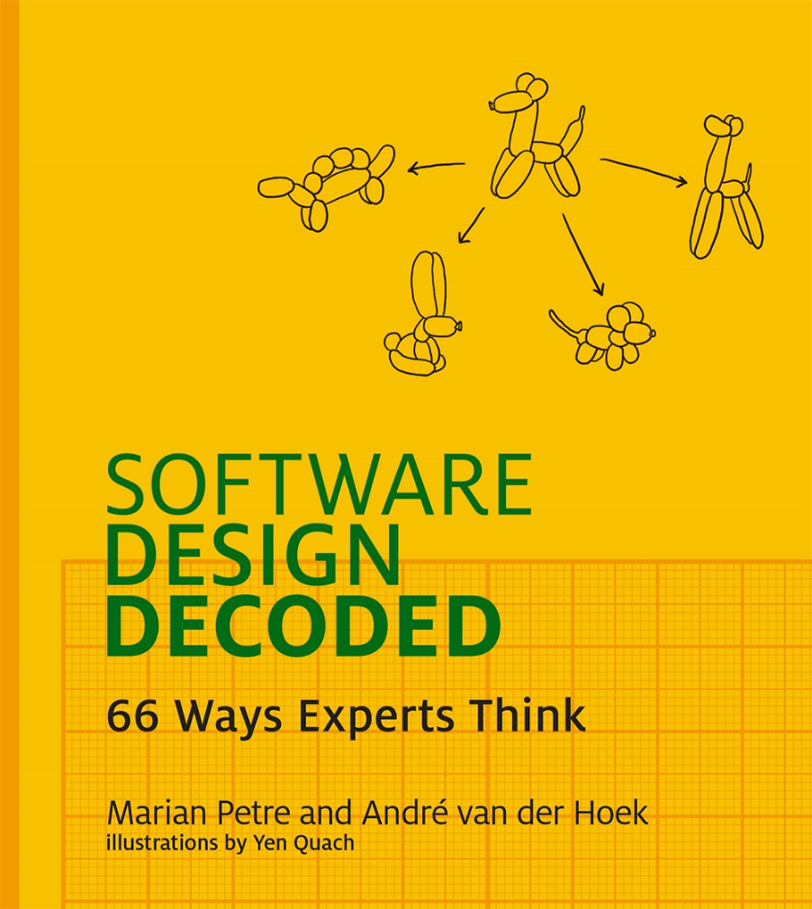
Required book

Slide 7
Goals
For you to know the theory of (software) design
For you to have at your disposal a set of software design techniques
For you to extensively practice software design
For you to learn to think deep(er)

Slide 8
This course answers three primary questions
What is (software) design?
How to engage in good software design?
What are the habits of professional software designers?

Slide 9
Place in the curriculum
Informatics 121
conceptual: being a designer, design methods, application design, …
Informatics 122
technical: patterns, UML, reverse engineering, component reuse, …
Informatics 124
technical: internet architectures, distributed systems, programming, …
Informatics 131
conceptual: user interface design, principles, evaluation, …
Informatics 133
technical: user interaction design, mobile devices, design methods, …

Slide 10
Structure of the course
Lecture
Discussion
Midterm & final
15% & 25%
Three design studios
20% each

Slide 11
Basic tenor of the class
Creativity
Team work
Disagreements
Constructive criticism
Pressure

Slide 12
Basic tenor of the class
Examples
Discussion

Slide 13
Questions?

Slide 14
My question: what is software design?
Notes:
Let’s run a small experiment. Talk with in groups of 3-5, with at least 2 people you do not know yet. Introduce yourself first (thank you) and come up with a good ‘definition’ (or sentence or two) describing what your group thinks is software design.
Andre is going to capture some of them.

Slide 15
Designers in action [SPSD 2010]

Slide 16
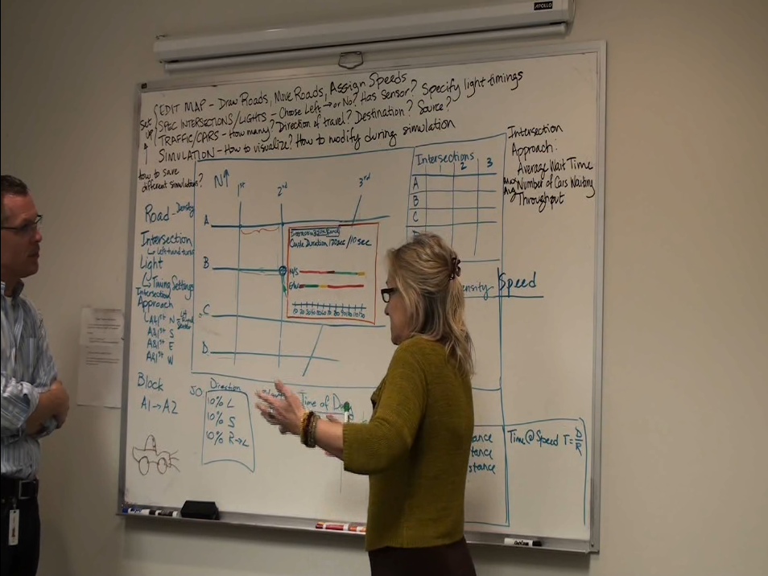
Designers in action [SPSD 2010]

Slide 17
Designers in action [Hortonworks]
Notes:
HADOOP!

Slide 18
March 25, 2011 [Mirth]
Notes:
This is the diagram that resulted from the brainstorming session that started it all. On the left is the “wish list” of requirements, in the center in the architecture (a system of queues and messages being passed between them), and on the right is a crude class diagram In quotes is the principle: “No DB as temp store.”

Slide 19
April 4, 2011
Notes:
This is the UML class diagram that resulted from the previous whiteboard session, including notes and modifications.

Slide 20
April 2011
Notes:
This is a UI mocking that was created to represent a part of the UML diagram (the data store).

Slide 21
February 3, 2012
Notes:
This is the first session where we pick up the architecture almost a year later. This has the same idea of processes writing to queues, along with some class elements (“Message Object”) and some UI mockups (tabbed interface). A key part of this architecture is having many smaller queues (highlighted) rather than one large database.

Slide 22
February 9, 2012
Notes:
This is an update to the first UML diagram made to look nicer and incorporate the comments.

Slide 23
February 2012
Notes:
This is the first attempt at understanding the data flow through the system.

Slide 24
February 15, 2012
Notes:
This diagram is the result of the added requirement that any given data channel can have multiple destinations, so this now represented destinations 1-3.

Slide 25
March 2012
Notes:
This diagram explains the various persistence modes that were being explored to replace the database. This diagram was used in conjunction with the performance test results.

Slide 26
March 6, 2012

Slide 27
March 12, 2012
Notes:
We need to use a database! The technologies we were looking at do not fit our architecture and requirements, we need to revisit using a schema to store our data. Math formulas are used for the first time to make decisions about data storage.

Slide 28
March 13, 2012
Notes:
Now we reintroduce SQL terms (INSERT, UPDATE, SELECT) to show that we need to go deeper into our data store abstraction and better understand what is happening “under the hood”.

Slide 29
March 14, 2012
Notes:
The database is a central part of the new architecture now.

Slide 30
March 14, 2012
Notes:
First use of a UML communication diagram. Email from developer: “I followed some of the examples given here to create a UML communication diagram based on the current Donkey3 code. Hopefully it will help to show how the objects are interacting with each other.”

Slide 31
March 20, 2012
Notes:
Now it is part of the previous data flow diagram.

Slide 32
Defining design
Decision making, in the face of uncertainty, with high penalties for error
To choose the things we use shall look as they do
A creative activity—it involves bringing into being something new and useful that has not existed previously
Relating product with situation to give satisfaction
The imaginative jump from present facts to future possibilities
To form a plan or scheme of, to arrange or conceive in the mind, … for later execution

Slide 33
Defining design
To initiate change in man-made things
To plan or intend for a purpose
To work out a solution in one’s mind
The transition from possible solutions to a specific one
…

Slide 34
Three themes
Design focuses on identifying a novel envisioned future
Design involves deliberate decision making and planning; it is not simply acting out of impulse
Design decisions are consequential: there are stakeholders who must be satisfied with the result

Slide 35
Our definition of design
To decide upon a plan for a novel change in the world that, when realized, satisfies stakeholders
Notes:
But as we did so opportunistically, we quickly figured out we needed something to frame the discussion, what are they doing when they are doing this? So we arrived at design behaviors – things they do, things that recur, and things that have a definite purpose in the design meeting with respect to advancing the design at hand.

