Slide 1
Informatics 121 Software Design I
Lecture 10
Duplication of course material for any commercial purpose without the explicit written permission of the professor is prohibited.

Slide 2
Today’s lecture
Abstraction
Design notations
UML

Slide 3
Abstraction
An abstraction is formed by reducing the information content of a concept or an observable phenomenon, typically to retain only information which is relevant for a particular purpose
choice of what to include
choice of what not to include
Each abstraction makes some information readily available at the expense of obscuring or removing other information

Slide 4
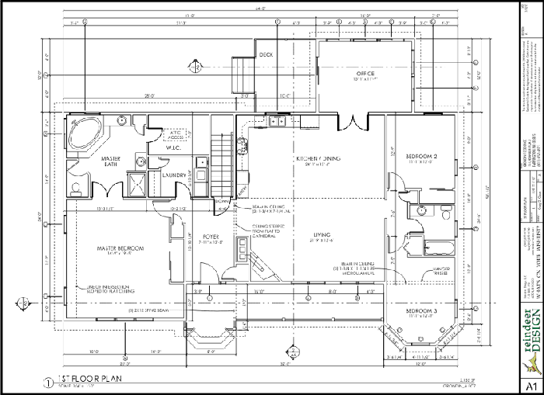
Floor plan

Slide 5
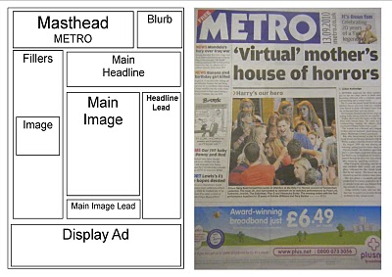
Page layout

Slide 6
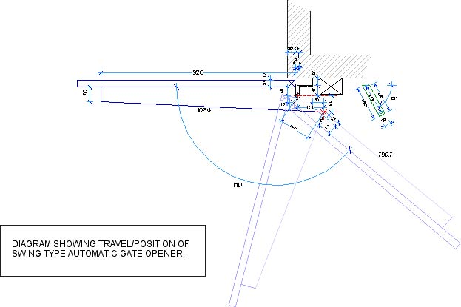
Mechanical engineering diagram

Slide 7
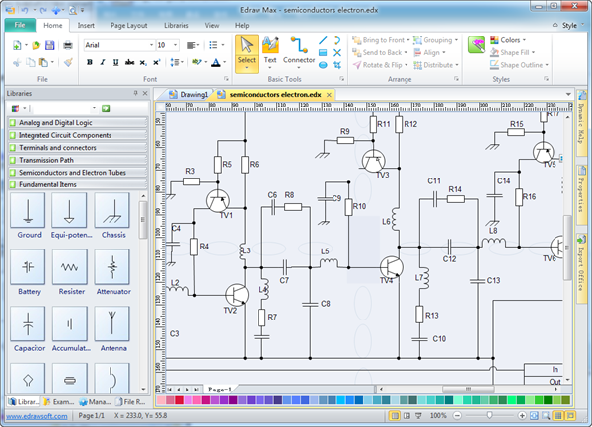
Schematic

Slide 8
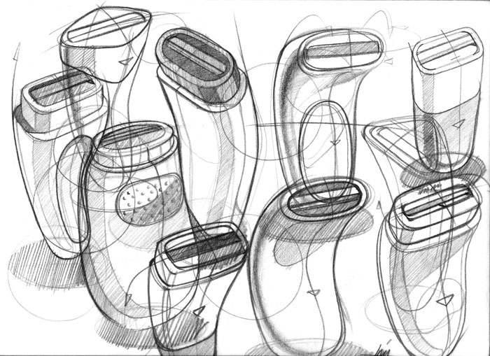
Product sketch

Slide 9
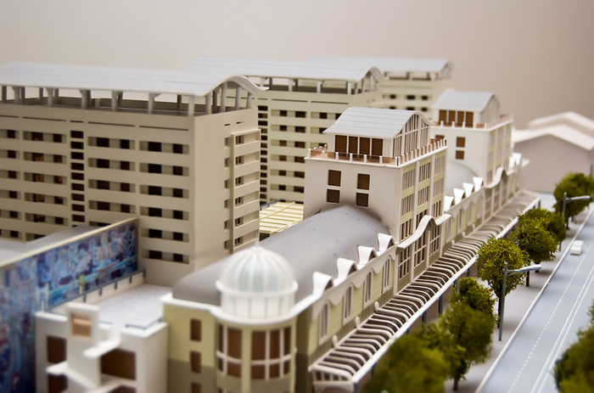
Model

Slide 10
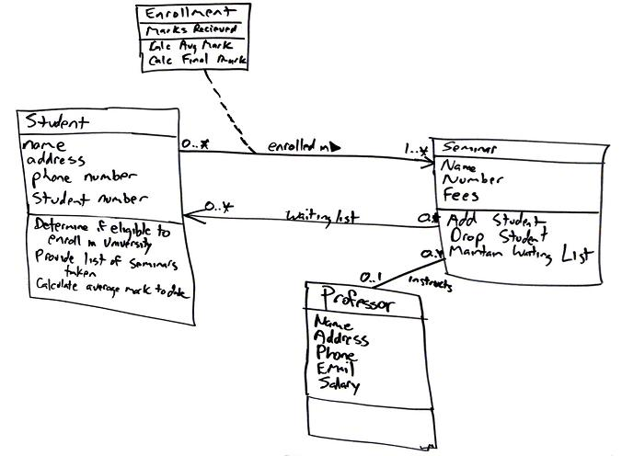
Class diagram

Slide 11
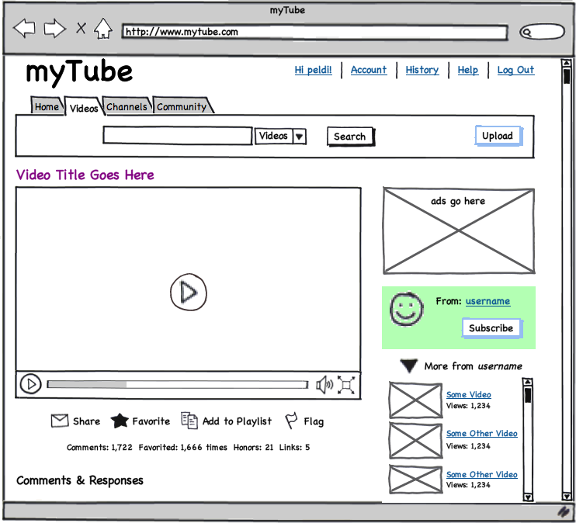
User interface mock-up
[balsamiq]

Slide 12
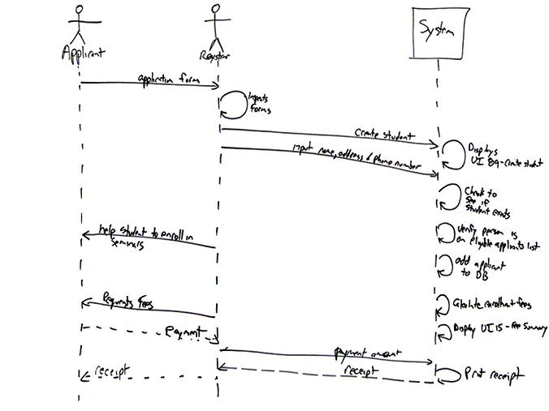
Sequence diagram

Slide 13
Design notation
A design notation offers a language for specifying certain aspects of a design artifact
textual and/or graphical vocabulary for specifying individual and composite elements
rules governing how individual elements can be combined into composite elements
implicit and/or explicit semantics for giving meaning
Each design notation is typically suited for a particular domain and a particular purpose
Every design notation invariably introduces abstraction

Slide 14
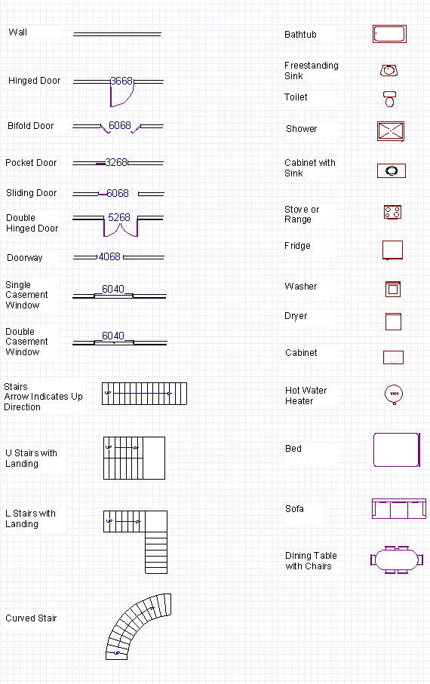
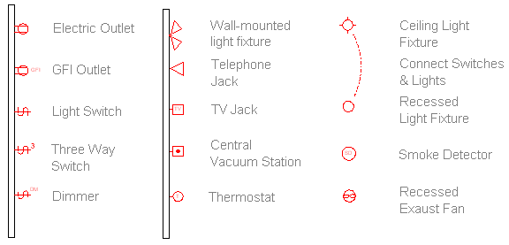
Example notation

Slide 15
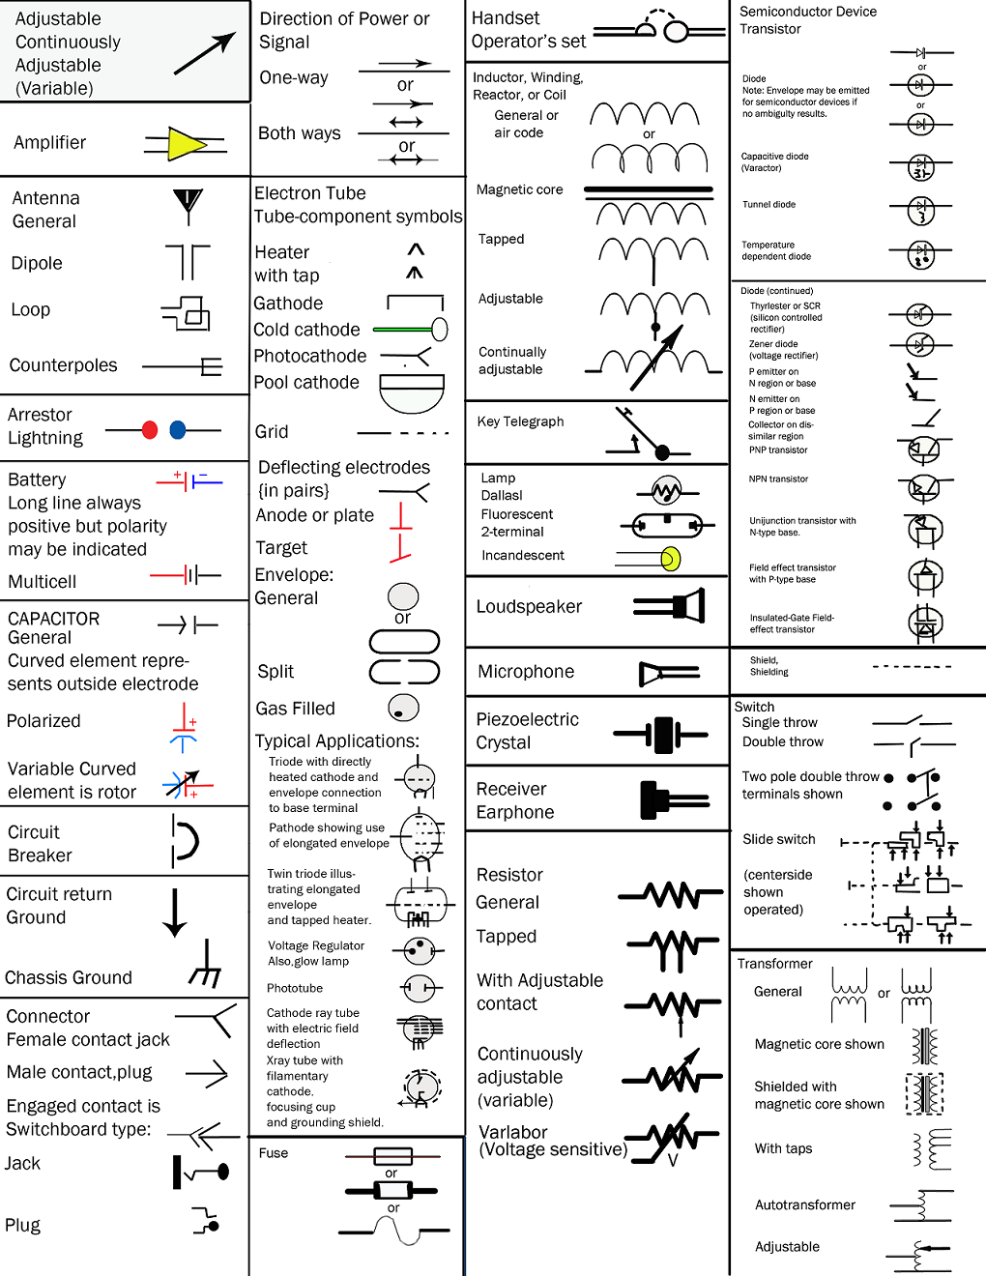
Example notation

Slide 16
Example notation

Slide 17
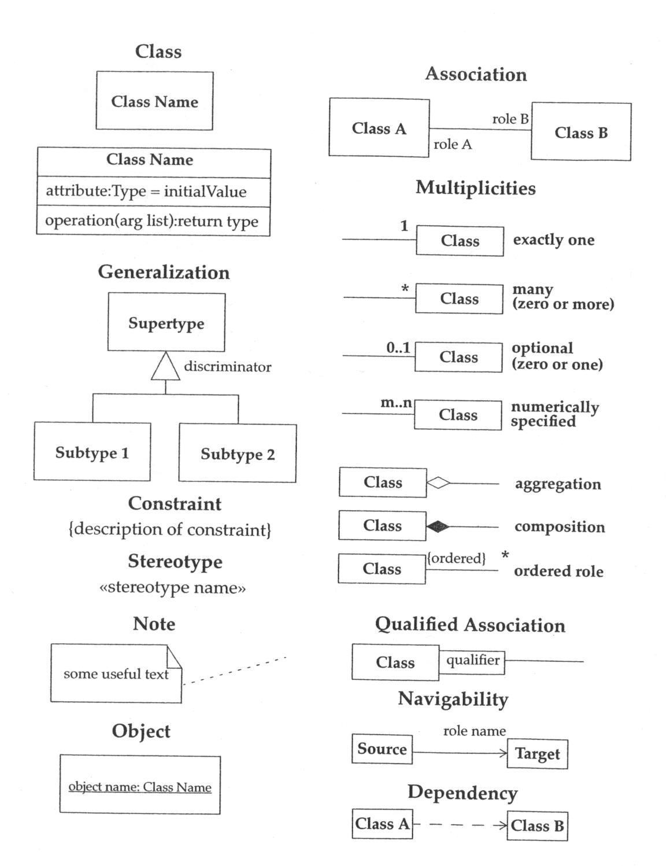
Example notation

Slide 18
Example notation

Slide 19
Considerations in choosing a design notation
Who is the audience?
What is the objective?
What is the timeframe?

Slide 20
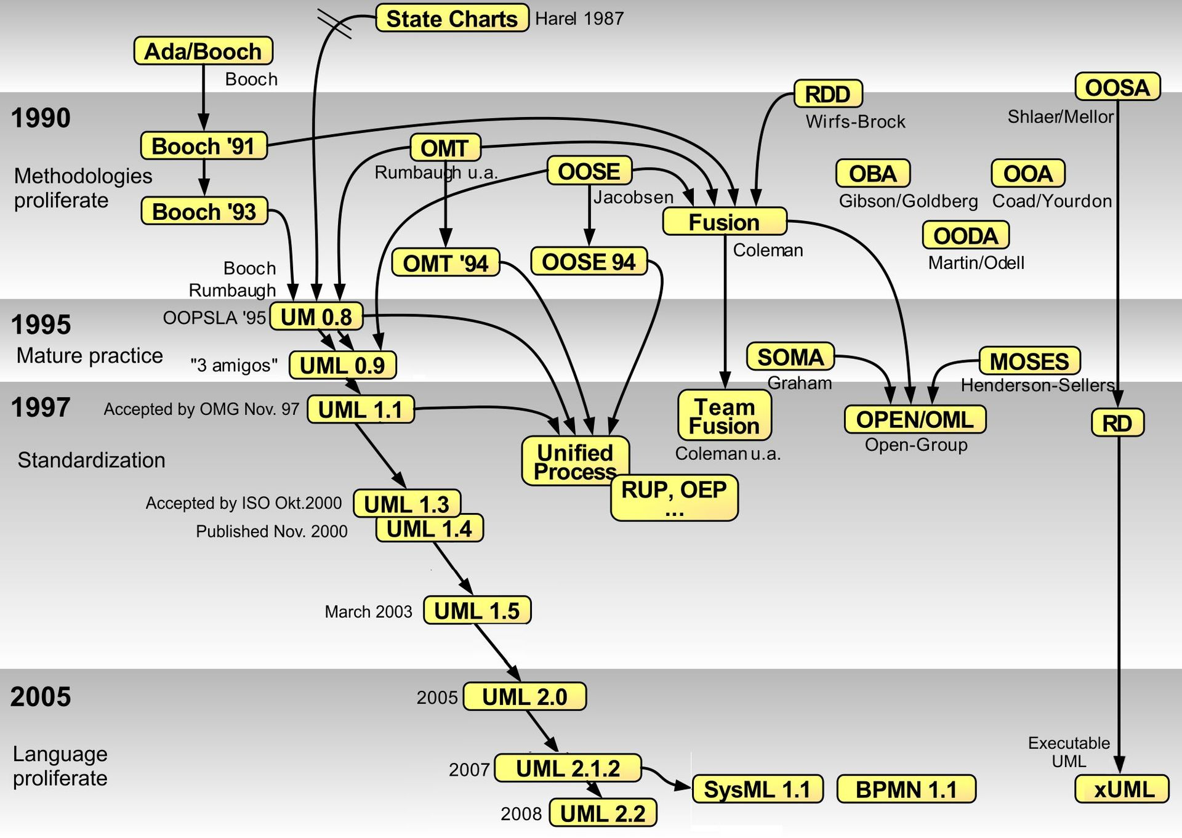
History of (some) software design notations
Notes:
By Guido Zockoll, Axel Scheithauer & Marcel Douwe Dekker (Mdd) - Translation and update of File:OO-historie-2.svg by AxelScheithauer, Okt 6, 2009, CC BY-SA 3.0, https://commons.wikimedia.org/w/index.php?curid=23052855

Slide 21
UML class diagrams

Slide 22
Association, aggregation, composition
Association
most general kind of relationship
instructor <teaches a> class, kid <plays with a> friend
Aggregation
more specific kind of relationship
has-a relationship, is-a-part-of relationship
child can exist independent of the parent
bird <is-part-of-a> flock, airplane type <has-a> engine model
Composition
more specific yet
consists-of relationship, contains relationship
child cannot exist independent of the parent
house <consists-of a> room, university <contains a> department

Slide 23
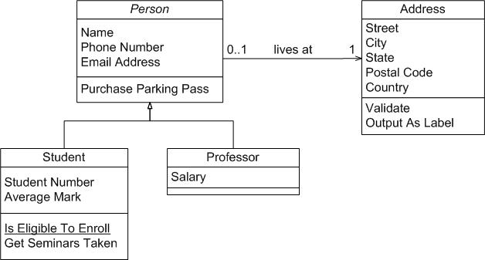
UML example

Slide 24
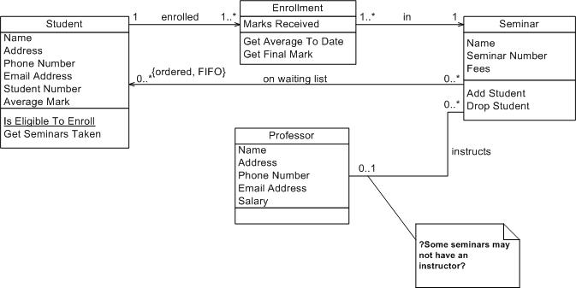
UML example

Slide 25
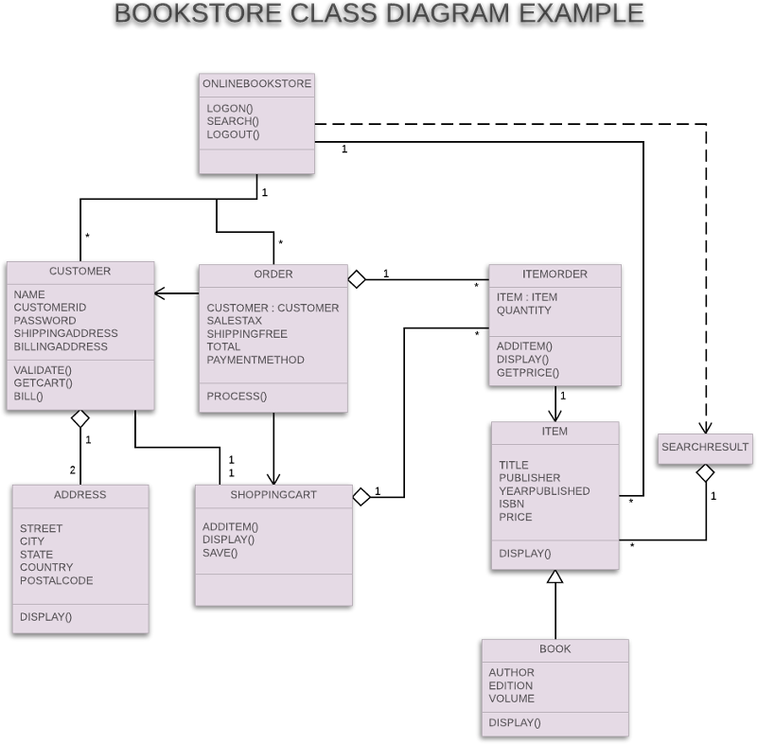
UML example

Slide 26
UML example

Slide 27
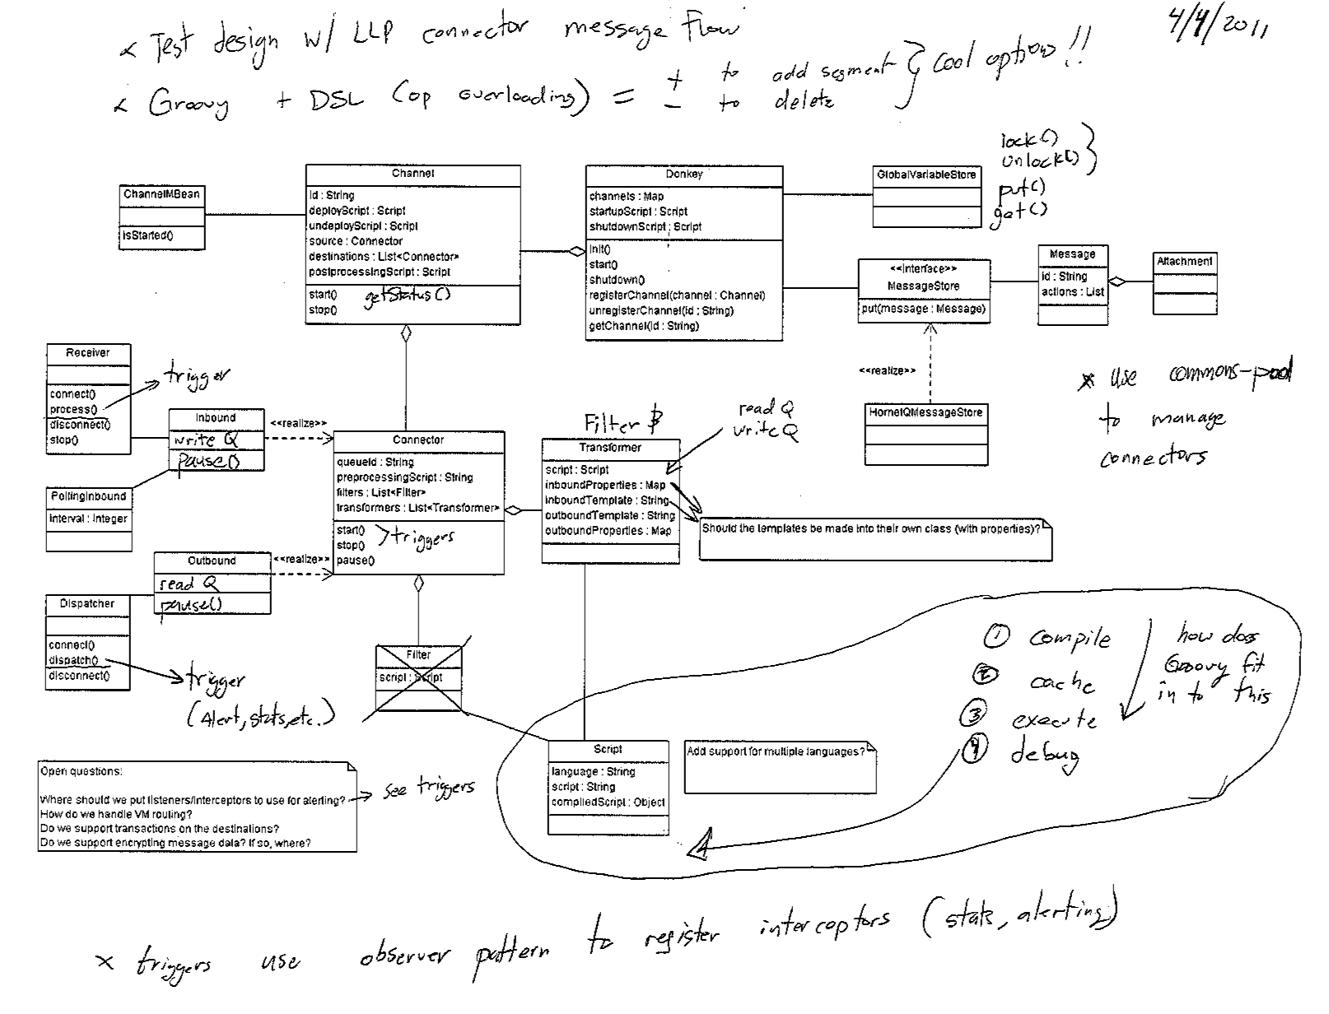
UML example

Slide 28
UML example
Notes:
This is an update to the first UML diagram made to look nicer and incorporate the comments.

