Slide 1
Informatics 121 Software Design I
Lecture 13
Duplication of course material for any commercial purpose without the explicit written permission of the professor is prohibited.

Slide 2
Today’s lecture
Design methods
Feature comparison
Contextual inquiry (light)

Slide 3
Software design
what is it to accomplish?
application design
satisfactory experience
how does one interact with it?
interaction design
change in the world
what is its conceptual core?
architecture design
plan for realization
what are its implementation details?
implementation design

Slide 4
Realistic design process
what is it to accomplish?
satisfactory experience
how does one interact with it?
change in the world
what is its conceptual core?
plan for realization
what are its implementation details?

Slide 5
Backtracking
what is it to accomplish?
satisfactory experience
how does one interact with it?
change in the world
what is its conceptual core?
plan for realization
what are its implementation details?

Slide 6
Realistic design process
what is it to accomplish?
satisfactory experience
how does one interact with it?
change in the world
what is its conceptual core?
plan for realization
what are its implementation details?
What happens here?

Slide 7
Realistic design process
what is it to accomplish?
satisfactory experience
how does one interact with it?
change in the world
what is its conceptual core?
plan for realization
what are its implementation details?
Or here?

Slide 8
Design method
A self-contained, structured technique that guides a designer in advancing some aspect of the design project at hand
Serves as a bridge from the overall process of design to actual individual and collaborative design work

Slide 9
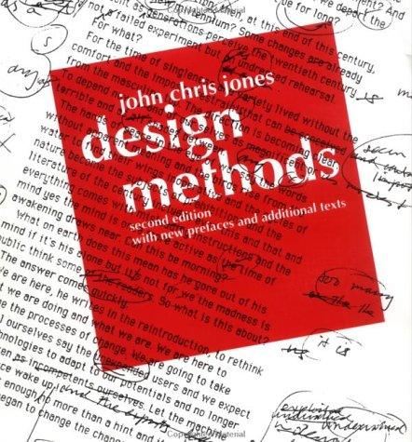
Origin

Slide 10
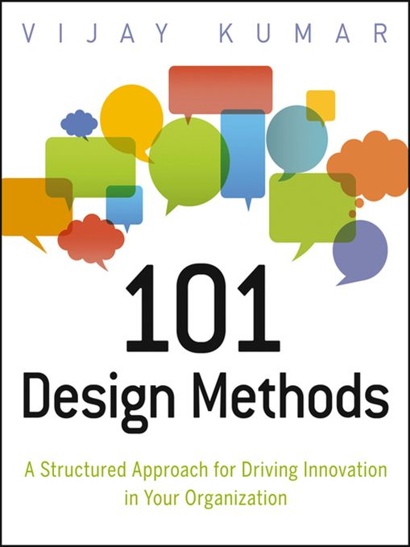
Today

Slide 11
Example

Slide 12
Example

Slide 13
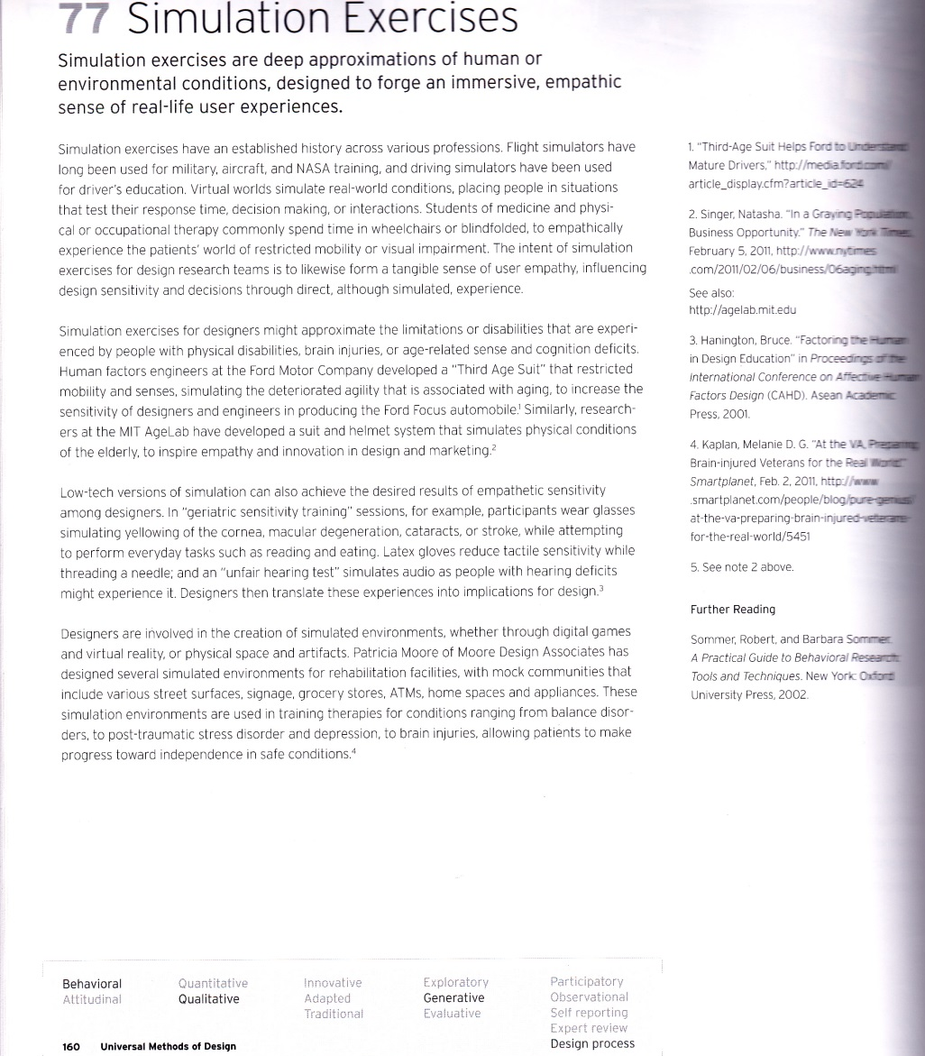
Example

Slide 14
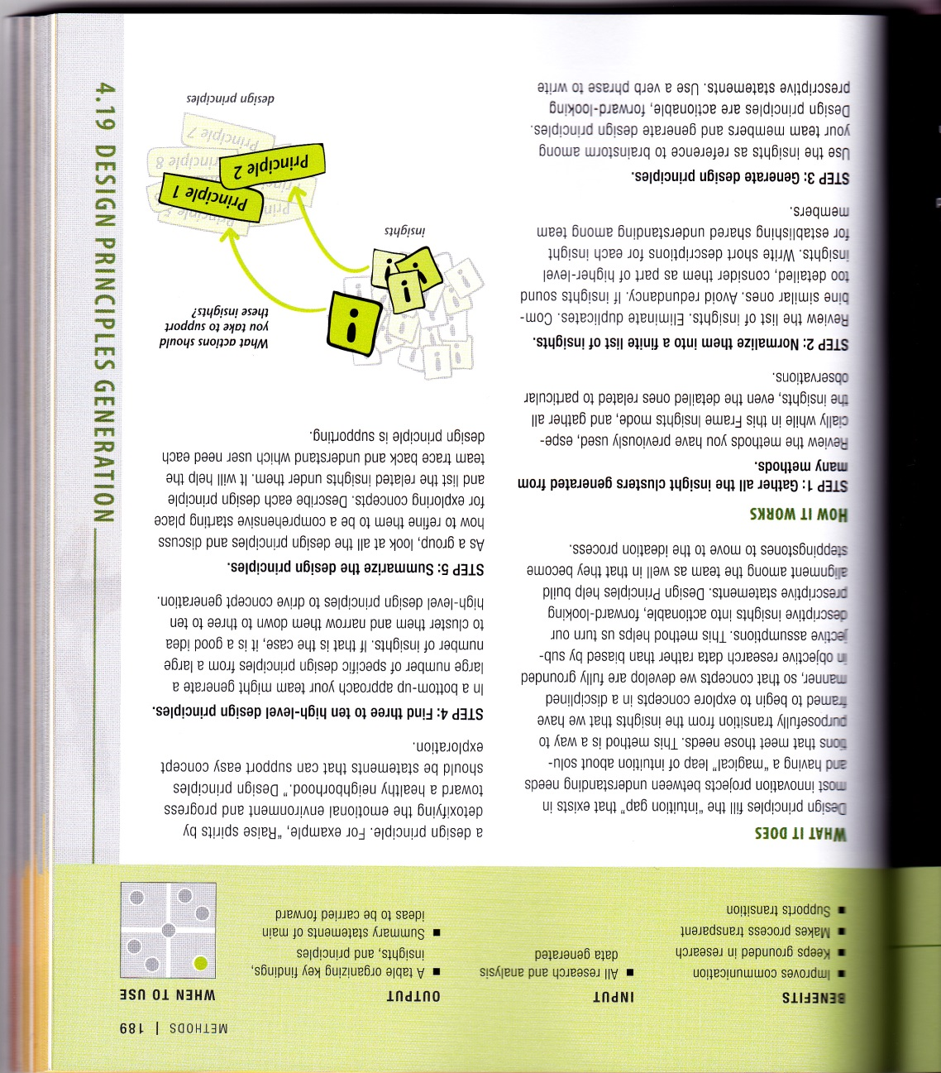
Example

Slide 15
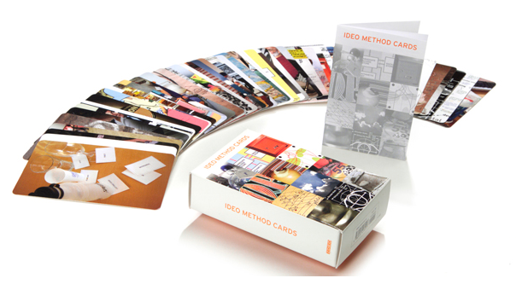
Example

Slide 16
Characteristics of design methods
Each design method suits a specific purpose with respect to the design cycle and overall design project
Each design method expects a certain context for it to lead to optimal results
Applying just one design method rarely suffices (but still may help)

Slide 17
Example – decision making

Slide 18
Example – unearthing assumptions

Slide 19
Example – generating ideas

Slide 20
Example – identifying goals

Slide 21
Design methods – magic?
what is it to accomplish?
satisfactory experience
how does one interact with it?
change in the world
what is its conceptual core?
plan for realization
what are its implementation details?

Slide 22
Software design methods
 | Application design | Interaction design | Architecture design | Implementation design
Analysis | competitive testing contextual inquiry feature comparison stakeholder analysis task analysis | critical incident technique interaction logging personas scenarios | framework assessment model-driven engineering quality-function-deployment reverse engineering world modeling | release planning summarization test-driven design visualization
Synthesis | affinity diagramming concept mapping mind mapping morphological chart | design/making participatory design prototyping storyboarding | architectural styles generative programming component reuse decomposition | pair programming refactoring search software patterns
Evaluation | requirements review role playing wizard of oz | cognitive walkthrough evaluative research heuristic evaluation think-aloud protocol | formal verification simulation weighted objectives | correctness proofs inspections/reviews parallel deployment testing

Slide 23
Software design methods
 | Application design | Interaction design | Architecture design | Implementation design
Analysis | competitive testing contextual inquiry feature comparison stakeholder analysis task analysis | critical incident technique interaction logging personas scenarios | framework assessment model-driven engineering quality-function-deployment reverse engineering world modeling | release planning summarization test-driven design visualization
Synthesis | affinity diagramming concept mapping mind mapping morphological chart | design/making participatory design prototyping storyboarding | architectural styles generative programming component reuse decomposition | pair programming refactoring search software patterns
Evaluation | requirements review role playing wizard of oz | cognitive walkthrough evaluative research heuristic evaluation think-aloud protocol | formal verification simulation weighted objectives | correctness proofs inspections/reviews parallel deployment testing

Slide 24
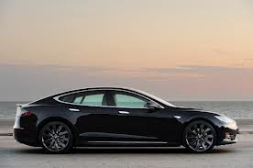
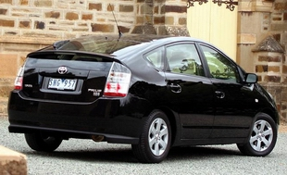
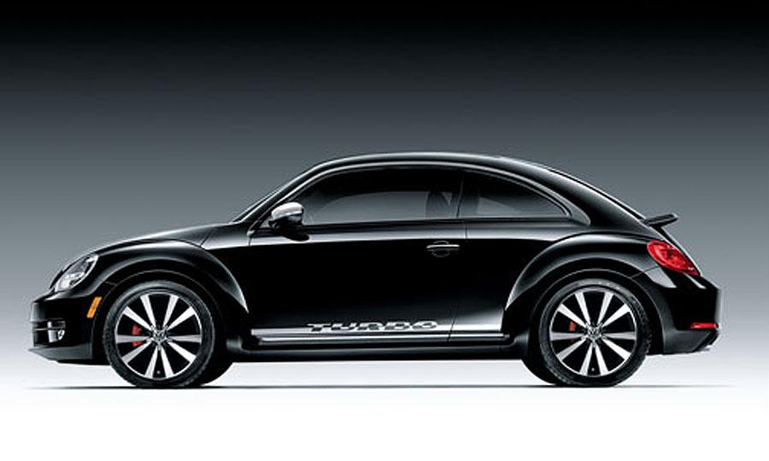
Feature comparison
Feature comparison is the process of conducting research to learn about the features of competing products
Tesla Model S
Toyota Prius
Volkswagen Beetle

Slide 25
Procedure
Identify competitors and their products
Establish dimensions for comparison
Conduct research
Analyze results

Slide 26
Example: identify competitors and their products
Tesla Model S
Toyota Prius
Volkswagen Beetle

Slide 27
Example: establish dimensions for comparison
Type of engine
Miles per gallon
Range on a single refuel/recharge
Number of passengers
Number of doors
…

Slide 28
Example: conduct research
Request brochures
Visit manufacturer web site
Visit independent review web site (e.g., J.D. Powers)
Visit car dealers
Ask friends
…

Slide 29
Example: analyze results
 | Tesla Model S | Toyota Prius | Volkswagen Beetle
Type of engine | Fully electric | Hybrid | Gasoline
Miles per gallon | 89 | 50 | 32
Range on a single refuel/recharge | 300 | 540 | 594
Number of passengers | 7 | 5 | 4
Number of doors | 4 | 4 | 4
… | … | … | …

Slide 30
Example: analyze results
A fully electric vehicle reduces the driving range significantly
A hybrid car may represent an appropriate tradeoff between driving range and fuel efficiency
Four doors is standard
Tesla Model S, except for its driving range, is (tied for) best in all categories, and therefore perhaps our main competitor
…

Slide 31
Typical notation: comparison matrix
 | Tesla Model S | Toyota Prius | Volkswagen Beetle
Type of engine | Fully electric | Hybrid | Gasoline
Miles per gallon | 89 | 50 | 32
Range on a single refuel/recharge | 300 | 540 | 594
Number of passengers | 7 | 5 | 4
Number of doors | 4 | 4 | 4
… | … | ...

Slide 32
Alternative notation: radar chart

Slide 33
Criteria for successful use
Direct or indirect access to the specifications of the competing products
Creation of a meaningful set of dimensions for comparison
Appropriate depth of analysis

Slide 34
Strengths and weaknesses
Strengths
Weaknesses
Helps identify key competitors
Creates a detailed account of competing products
Builds an understanding of the full landscape as it exists today
range of feature sets
differentiation
best practices
Lightweight design method
Focuses on the present, not what competing products might look like in the (near) future
Reinforces existing boundaries, perhaps stifling creativity
Lightweight design method

Slide 35
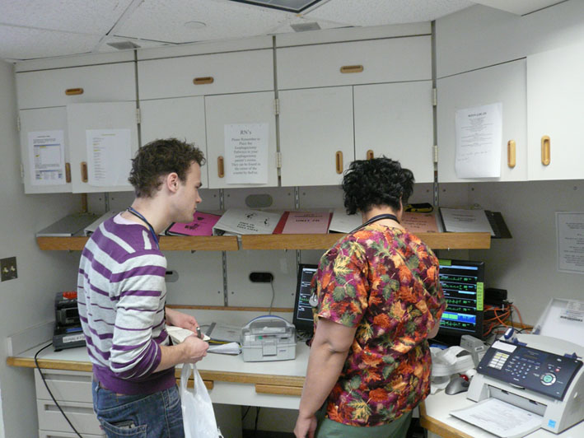
Contextual inquiry (light)
Contextual inquiry is the process of observing and interviewing a user in context – while they are engaged in the actual setting of life

Slide 36
Procedure
Plan
Identify users
Schedule and conduct visits
Analyze the data

Slide 37
Example: plan
Decide, beforehand, the purpose of the contextual inquiry
what type of information
which type of setting
which type of users

Slide 38
Example: identify users
Draw an advertisement in the newspaper
Social media recruiting
Ask client for access to representative users
Use an external recruitment service to target particular (typically representative) demographics

Slide 39
Example: schedule and conduct visits
Two-to-three hour visit
Master-apprentice model
observer takes note of what the user does
user shares their thoughts on the work they perform
observer inquires why the user does what they do
observer takes notes
Ideally, a contextual inquiry becomes a rich conversation
shared stories and insights
clarified interpretations

Slide 40
Example
https://www.youtube.com/watch?v=JV6br-npgfw

Slide 41
Example
https://www.youtube.com/watch?v=Gd5fA9UQDjE

Slide 42
Example: analyze results
90% of the time, the existing software is used one way, but 10% of the time, an exceptional use occurs
A small number of users circumvent the existing software system by passing paper notes back and forth
Users of the future software system have goals that do not align with management’s goals
...

Slide 43
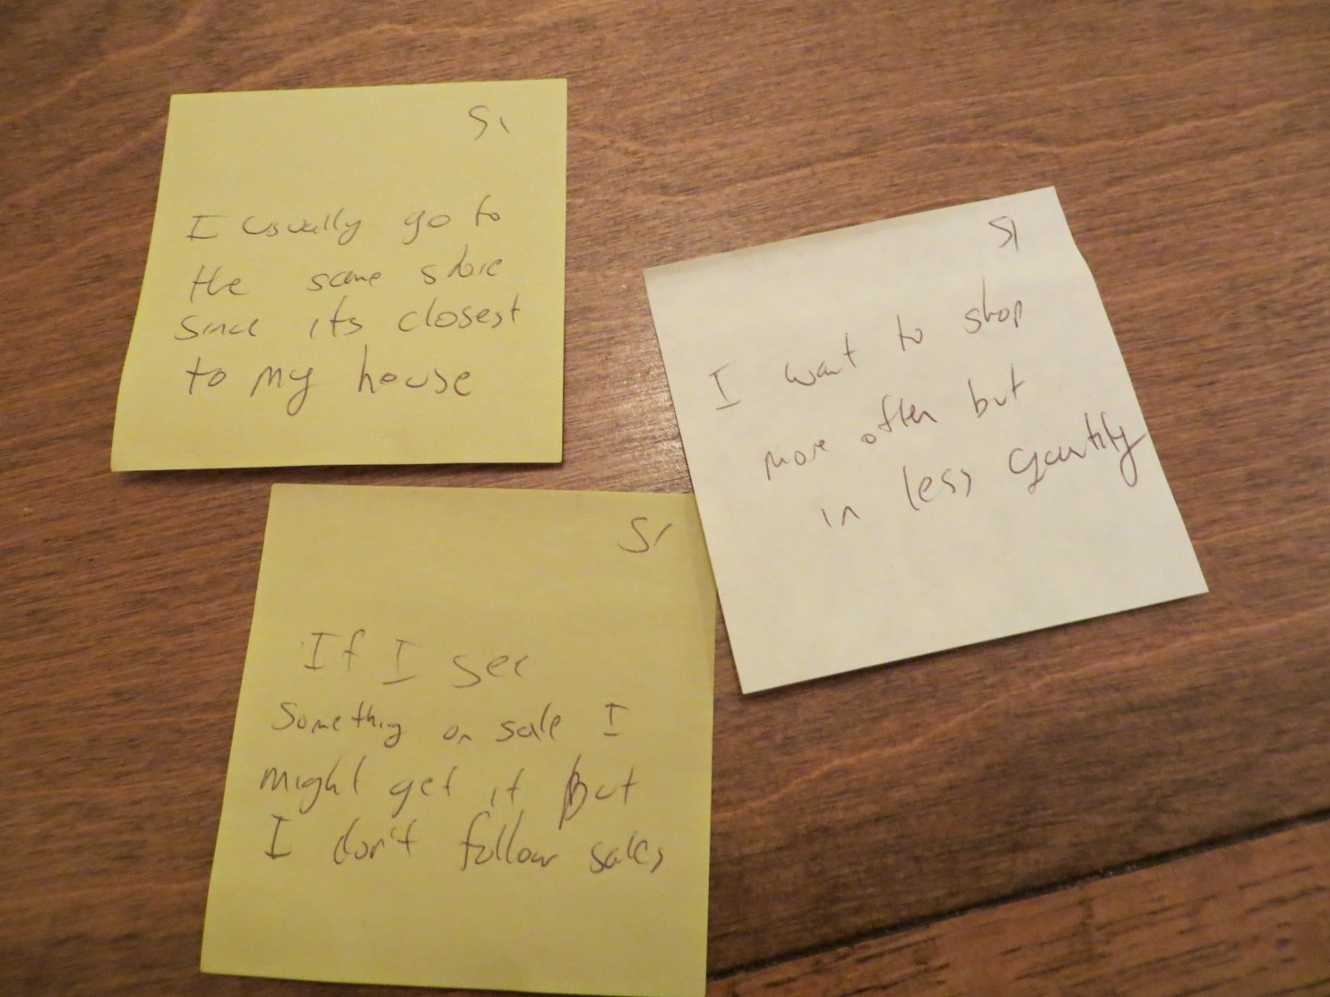
Typical notation: notes

Slide 44
Criteria for successful use
Access to the ‘right’ users involved in the ‘right’ activities
Extensive sharing
Ability to expand inquiry
A strong focus on why (why not)

Slide 45
Strengths and weaknesses
Strengths
Weaknesses
Reveals underlying and often invisible work structure
flows, tasks, artifacts, physical environment, culture, …
Involves actual users
Exposes rationale
Can challenge assumptions held by the designer
Not as involved as a full ethnography, but can still yield very usable insights and results
Users may not know the answers to the important questions
Steeped in current practices, perhaps stifling creativity
Observer bias
Lessons that can be learned depend strongly on the activities being performed by the user
Stops short of analysis

Slide 46
Variants
Contextual design
Questionnaire
Ethnography
Interview

