Slide 1
Informatics 121 Software Design I
Lecture 14
Duplication of course material for any commercial purpose without the explicit written permission of the professor is prohibited.

Slide 2
Today’s lecture
Contextual inquiry (light)
Mind mapping

Slide 3
Software design methods
 | Application design | Interaction design | Architecture design | Implementation design
Analysis | competitive testing contextual inquiry feature comparison stakeholder analysis task analysis | critical incident technique interaction logging personas scenarios | framework assessment model-driven engineering quality-function-deployment reverse engineering world modeling | release planning summarization test-driven design visualization
Synthesis | affinity diagramming concept mapping mind mapping morphological chart | design/making participatory design prototyping storyboarding | architectural styles generative programming component reuse decomposition | pair programming refactoring search software patterns
Evaluation | requirements review role playing wizard of oz | cognitive walkthrough evaluative research heuristic evaluation think-aloud protocol | formal verification simulation weighted objectives | correctness proofs inspections/reviews parallel deployment testing

Slide 4
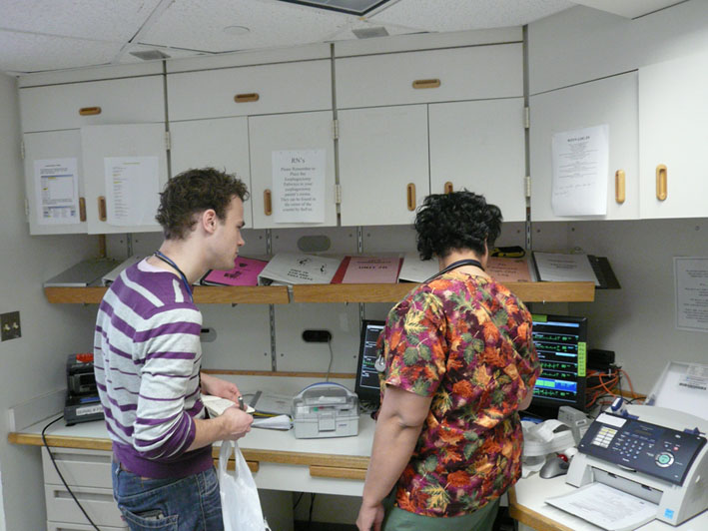
Contextual inquiry (light)
Contextual inquiry is the process of observing and interviewing a user in context – while they are engaged in the actual setting of life

Slide 5
Procedure
Plan
Identify users
Schedule and conduct visits
Analyze the data

Slide 6
Example: plan
Decide, beforehand, the purpose of the contextual inquiry
what type of information
which type of setting
which type of users

Slide 7
Example: identify users
Draw an advertisement in the newspaper
Social media recruiting
Ask client for access to representative users
Use an external recruitment service to target particular (typically representative) demographics

Slide 8
Example: schedule and conduct visits
Two-to-three hour visit
Master-apprentice model
observer takes note of what the user does
user shares their thoughts on the work they perform
observer inquires why the user does what they do
observer takes notes
Ideally, a contextual inquiry becomes a rich conversation
shared stories and insights
clarified interpretations

Slide 9
Example
https://www.youtube.com/watch?v=JV6br-npgfw

Slide 10
Example
https://www.youtube.com/watch?v=Gd5fA9UQDjE

Slide 11
Example: analyze results
90% of the time, the existing software is used one way, but 10% of the time, an exceptional use occurs
A small number of users circumvent the existing software system by passing paper notes back and forth
Users of the future software system have goals that do not align with management’s goals
...

Slide 12
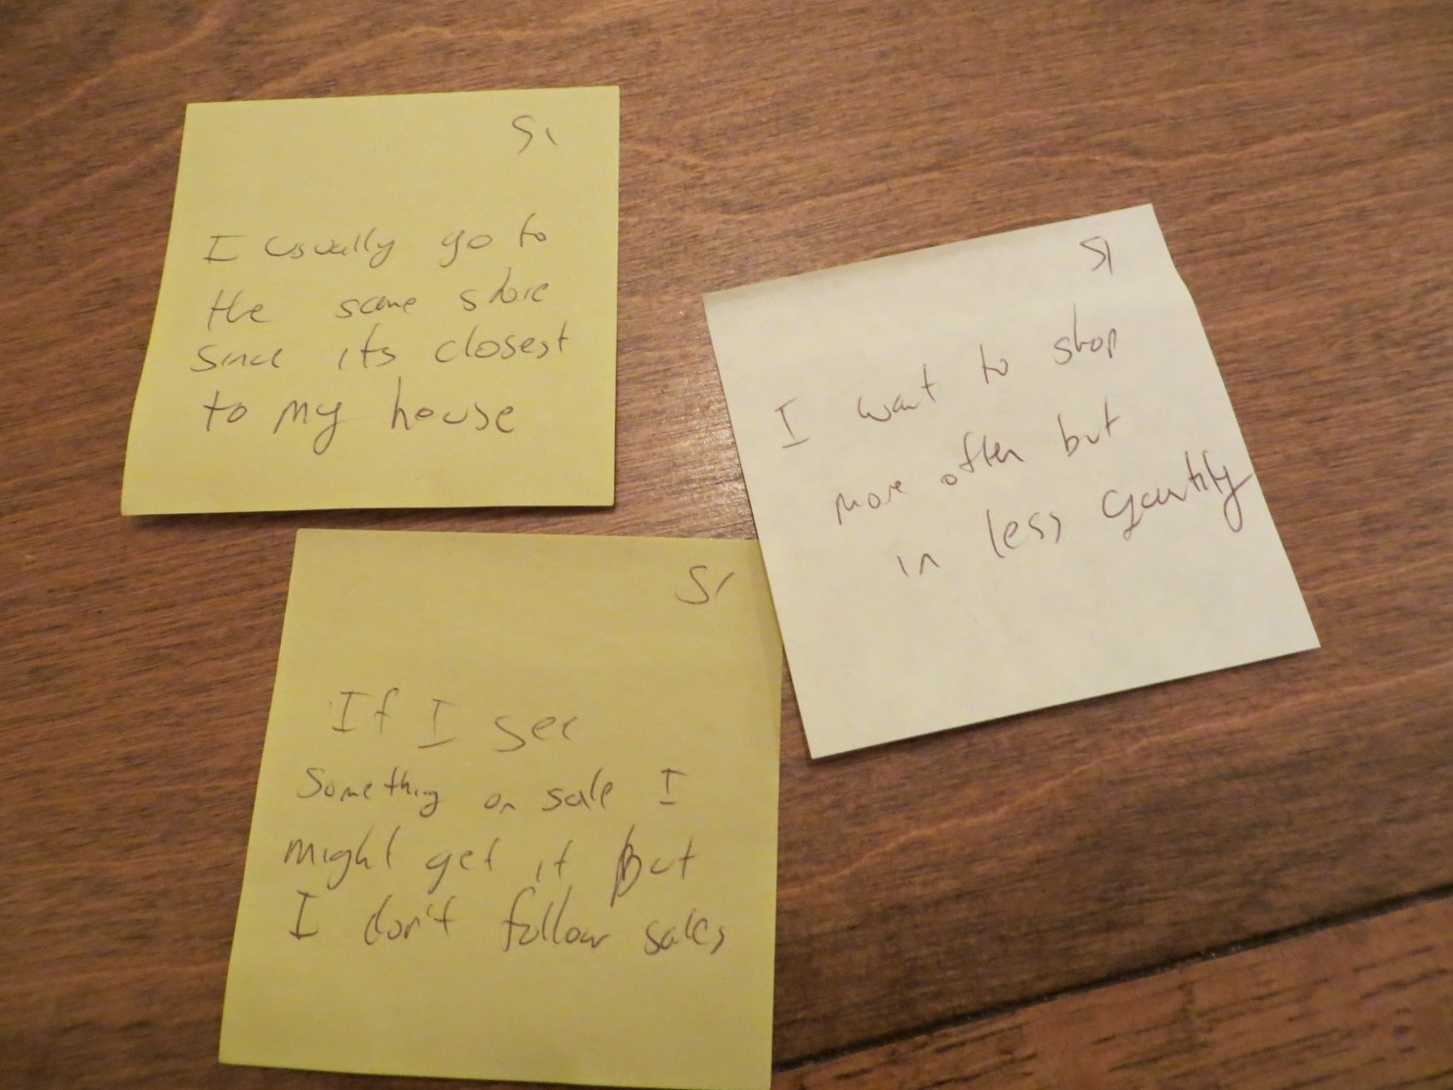
Typical notation: notes

Slide 13
Criteria for successful use
Access to the ‘right’ users involved in the ‘right’ activities
Extensive sharing
Ability to expand inquiry
A strong focus on why (why not)

Slide 14
Strengths and weaknesses
Strengths
Weaknesses
Reveals underlying and often invisible work structure
flows, tasks, artifacts, physical environment, culture, …
Involves actual users
Exposes rationale
Can challenge assumptions held by the designer
Not as involved as a full ethnography, but can still yield very usable insights and results
Users may not know the answers to the important questions
Steeped in current practices, perhaps stifling creativity
Observer bias
Lessons that can be learned depend strongly on the activities being performed by the user
Stops short of analysis

Slide 15
Variants
Contextual design
Questionnaire
Ethnography
Interview

Slide 16
Software design methods
 | Application design | Interaction design | Architecture design | Implementation design
Analysis | competitive testing contextual inquiry feature comparison stakeholder analysis task analysis | critical incident technique interaction logging personas scenarios | framework assessment model-driven engineering quality-function-deployment reverse engineering world modeling | release planning summarization test-driven design visualization
Synthesis | affinity diagramming concept mapping mind mapping morphological chart | design/making participatory design prototyping storyboarding | architectural styles generative programming component reuse decomposition | pair programming refactoring search software patterns
Evaluation | requirements review role playing wizard of oz | cognitive walkthrough evaluative research heuristic evaluation think-aloud protocol | formal verification simulation weighted objectives | correctness proofs inspections/reviews parallel deployment testing

Slide 17
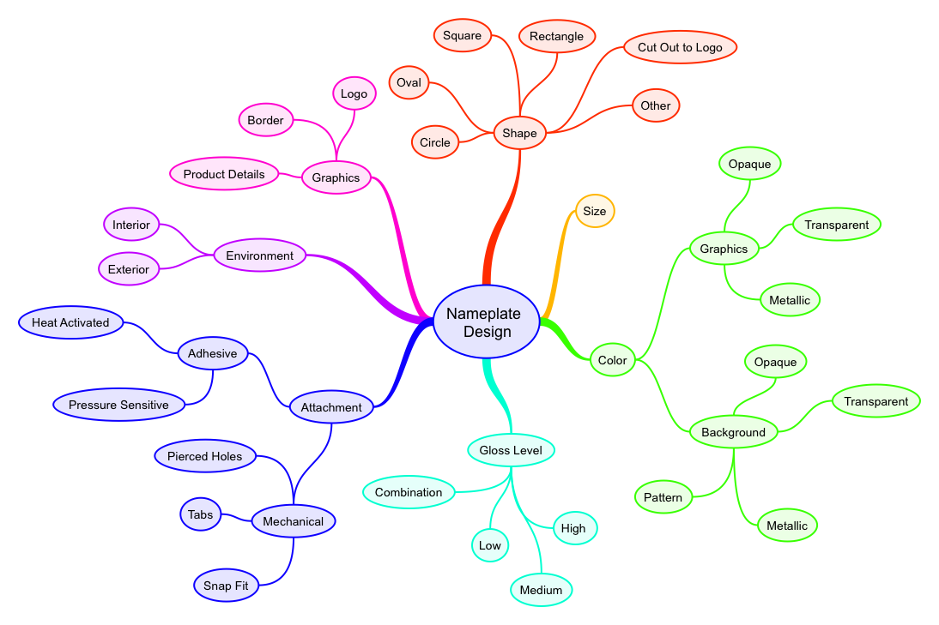
Mind mapping
Mind mapping is the process of generating ideas and developing concepts when the underlying relationships are unclear

Slide 18
Procedure
Identify the focus word or question
Free associate outward from the focus
Reorganize as needed
Annotate

Slide 19
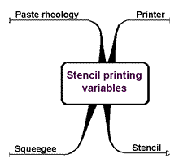
Example: identify the focus word or question

Slide 20
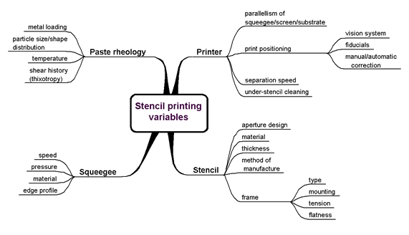
Example: free associate outward from the focus

Slide 21
Example: reorganize as needed

Slide 22
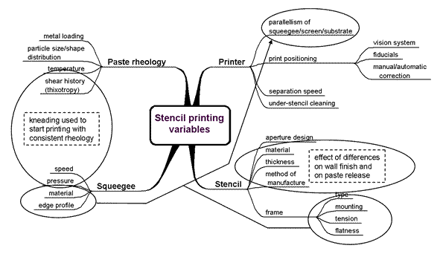
Example: annotate

Slide 23
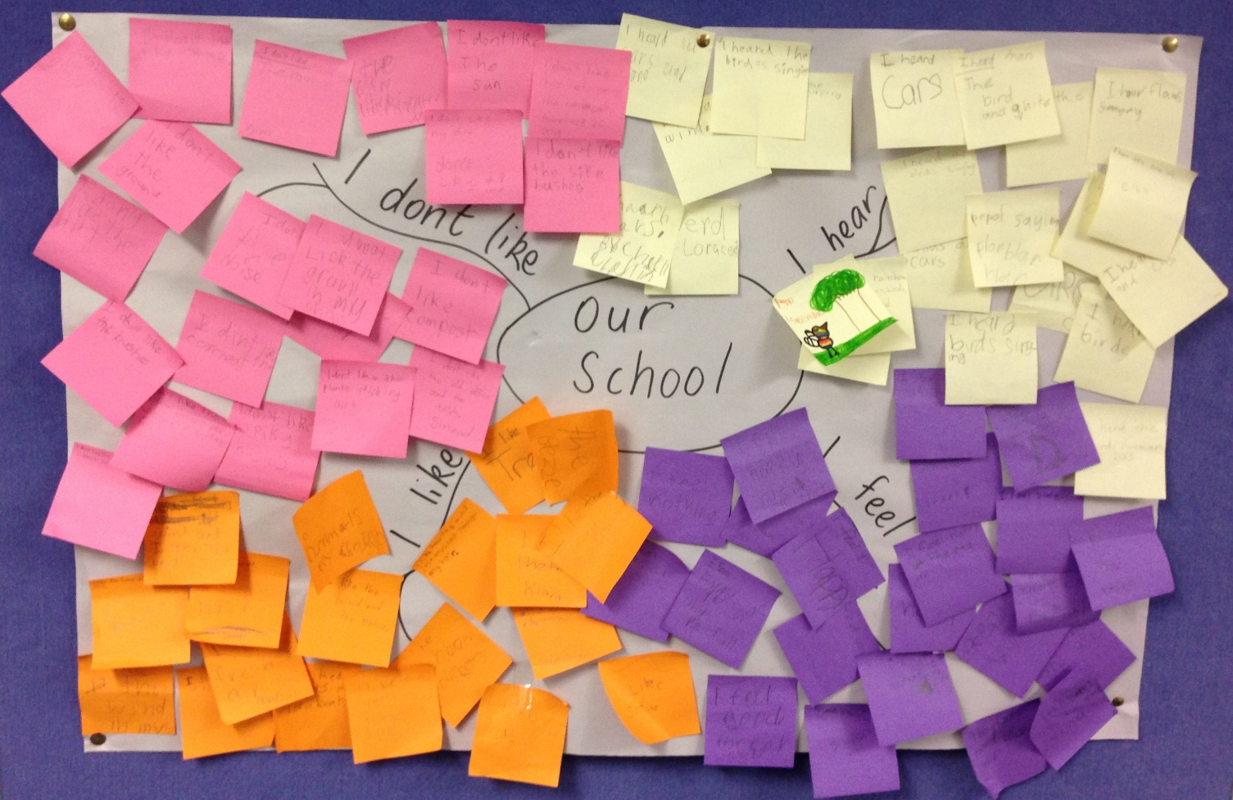
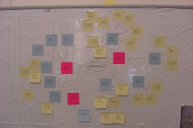
Typical notation: mind map

Slide 24
Criteria for successful use
The designer must possess, or have access to people with, strong domain knowledge
Relies on early insight into the design problem, and what dimensions might matter
One should not dismiss ideas (generate first, consolidate later)
Collaborate

Slide 25
Strengths and weaknesses
Strengths
Weaknesses
Can be used for many different purposes
Fluid representation suitable for tool use
Builds common understanding and language
Encourages idea generation
Can uncover ‘hidden’ relationships
Lightweight
May become too disconnected from reality
May become too unwieldy in size and complexity
Generation of ideas is restricted by the hierarchical form of representation
Requires a well-trained moderator

Slide 26
Variants
Concept mapping

Slide 27
Practice
Disney electronic queue management system

