Slide 1
Informatics 121 Software Design I
Lecture 16
Duplication of course material for any commercial purpose without the explicit written permission of the professor is prohibited.

Slide 2
Announcements
No office hours today

Slide 3
Today’s lecture
Design studio 3
Design methods

Slide 4
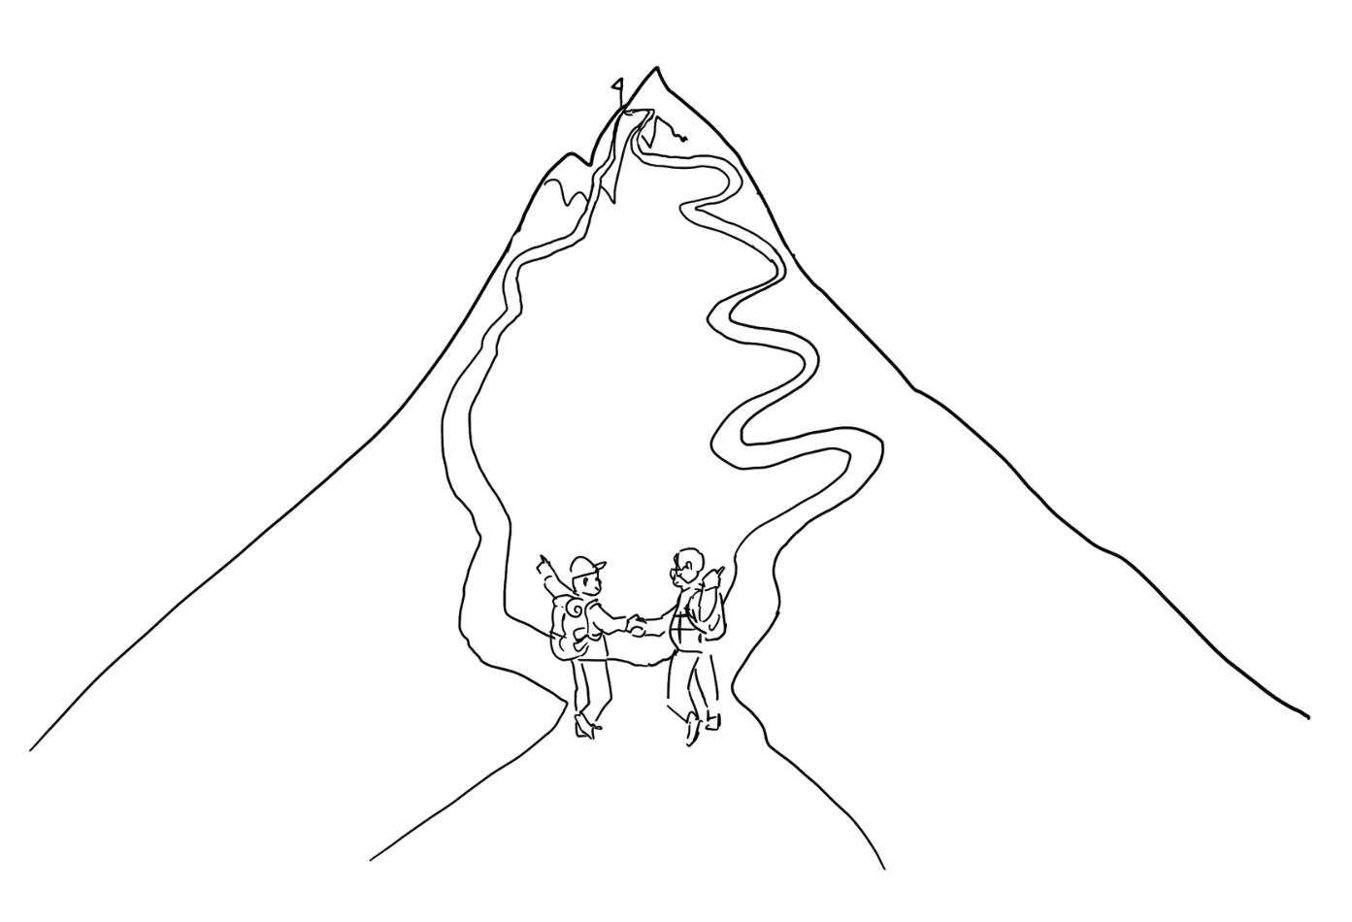
Experts agree to disagree

Slide 5
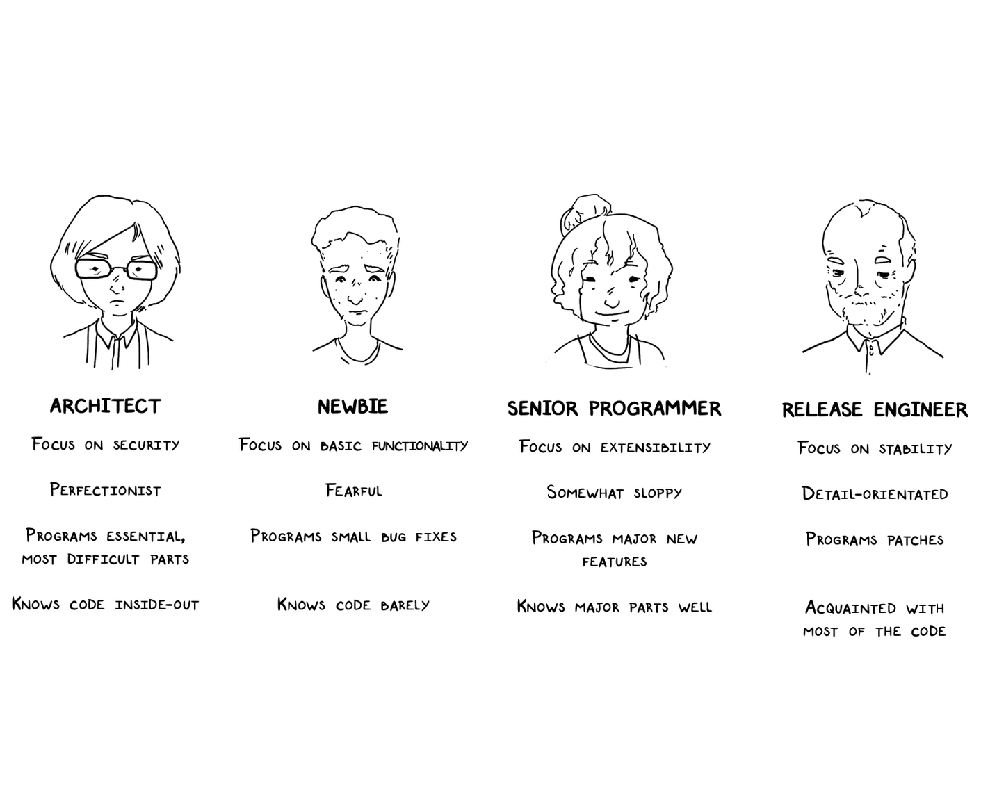
Experts use design methods (selectively)

Slide 6
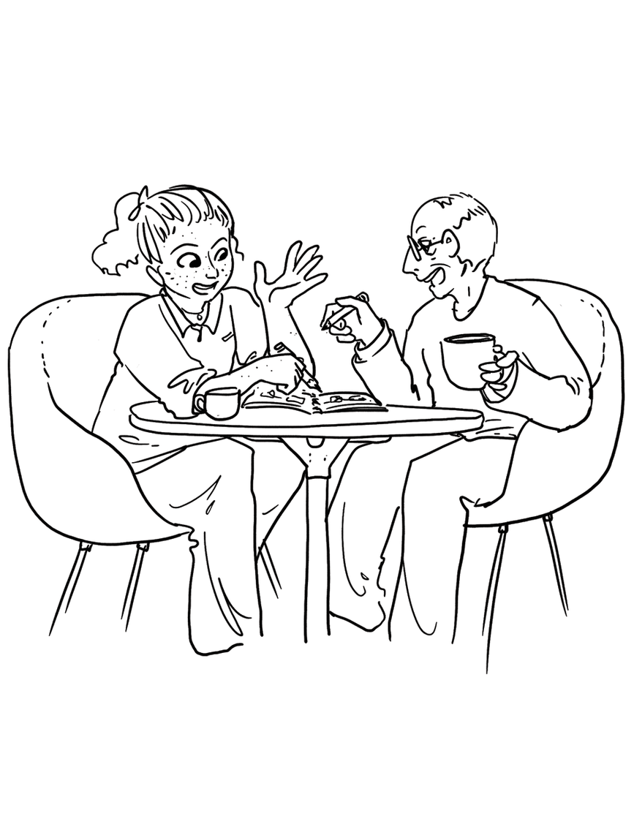
Experts externalize their thoughts

Slide 7
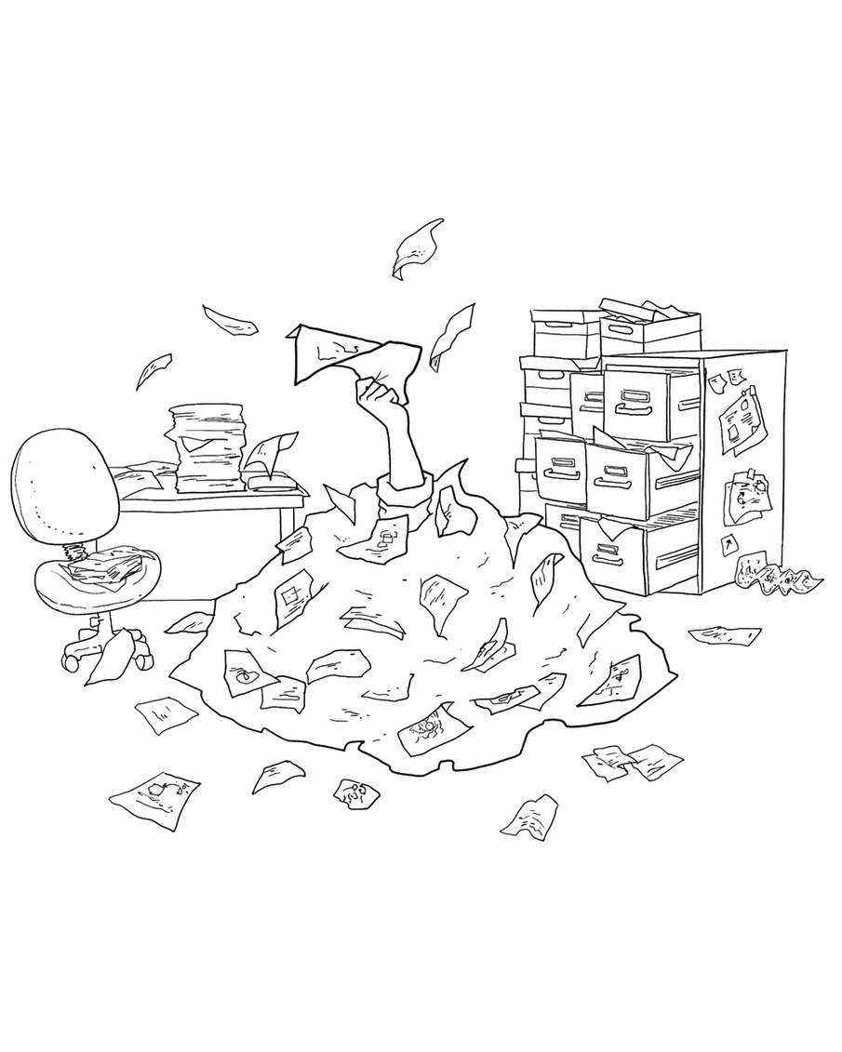
Experts keep sketches

Slide 8
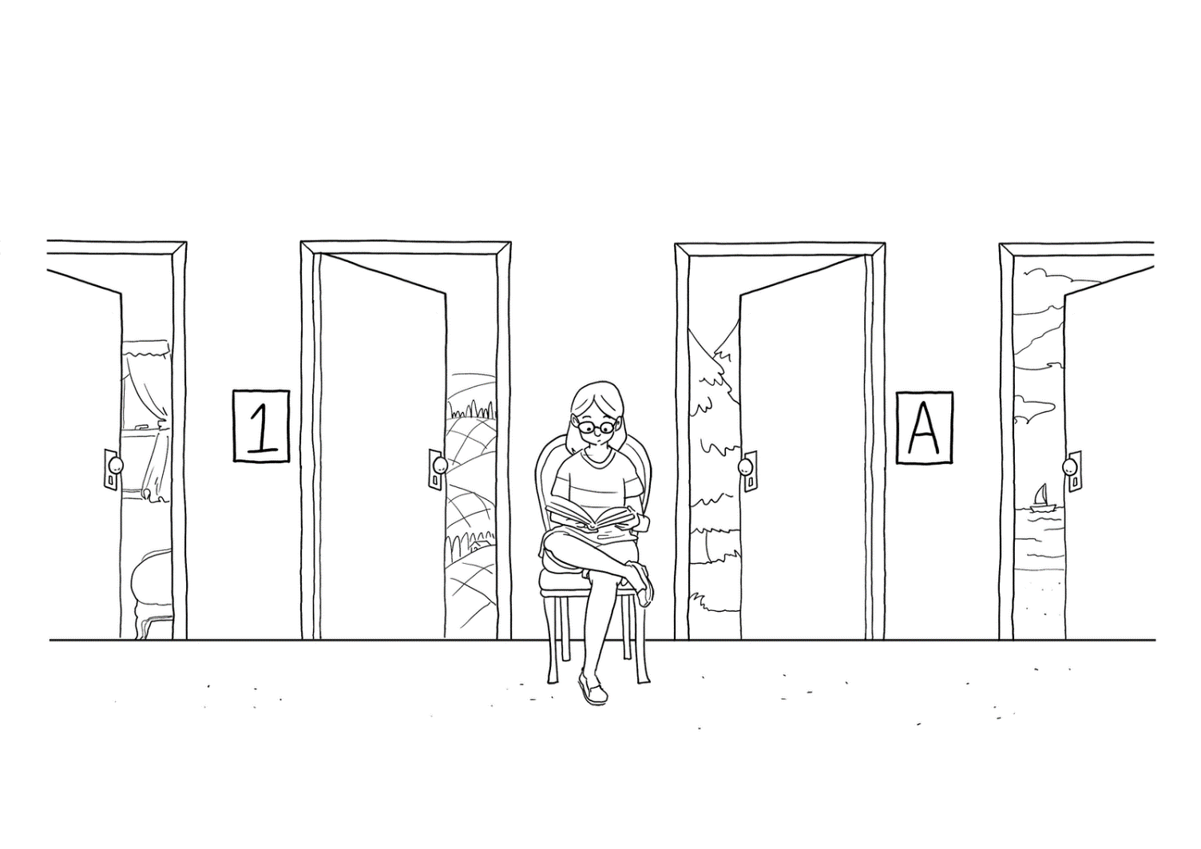
Experts keep options open

Slide 9
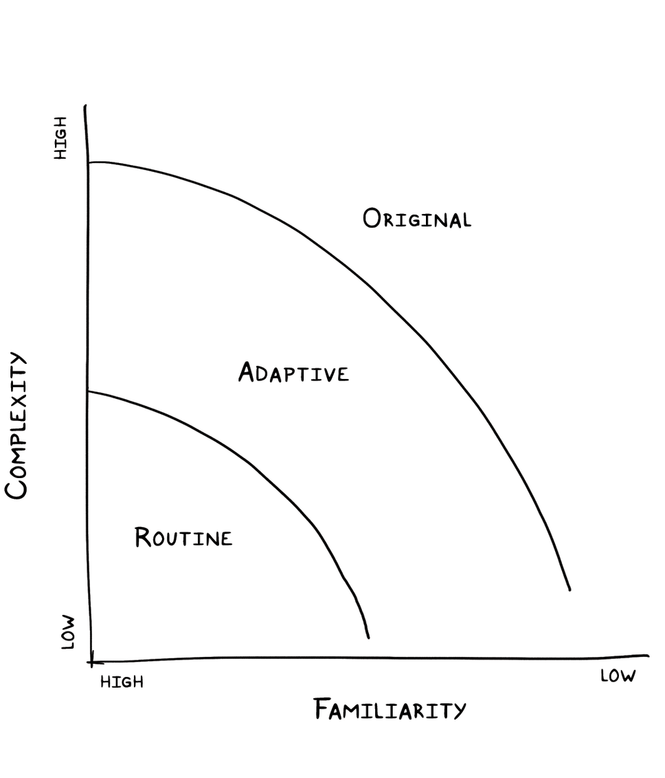
Experts adjust to the degree of uncertainty present

Slide 10
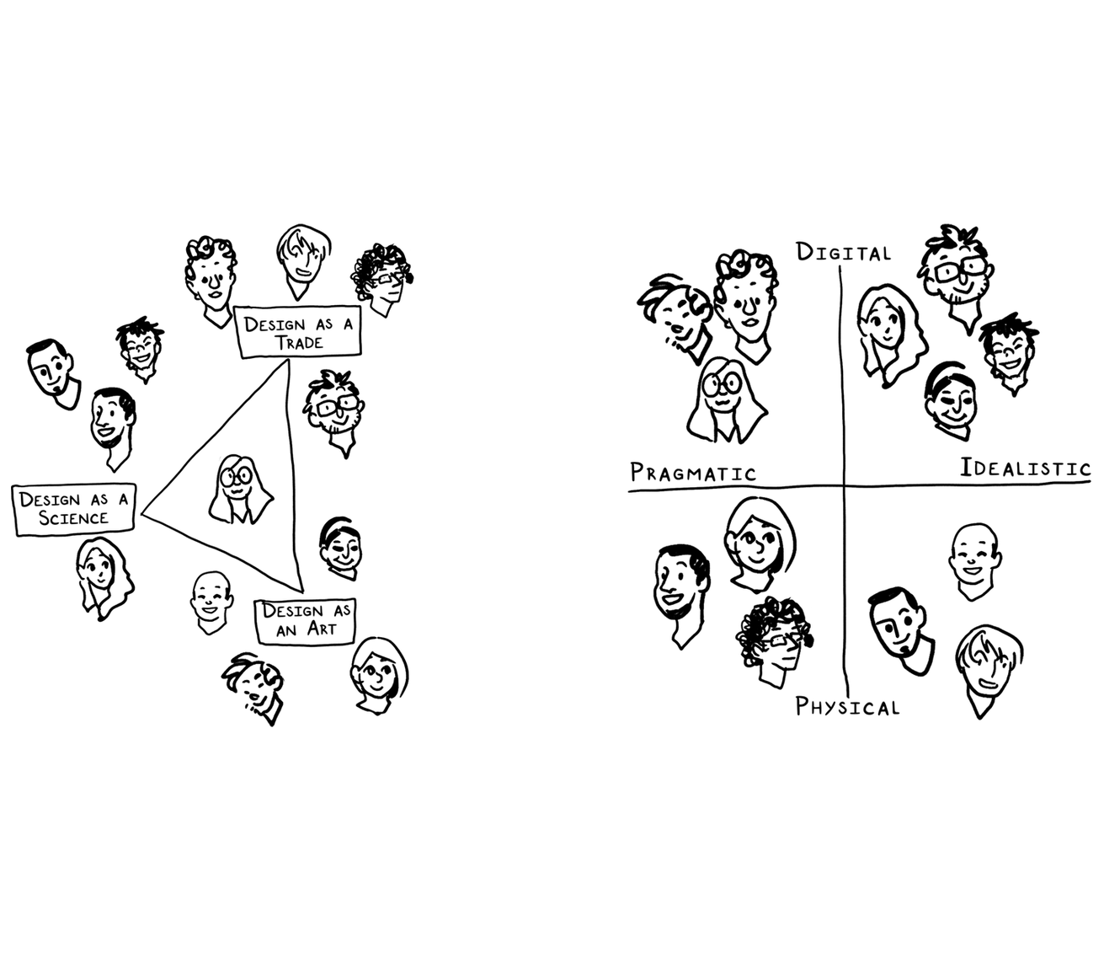
Experts explore different perspectives

Slide 11
Experts play the fool

Slide 12
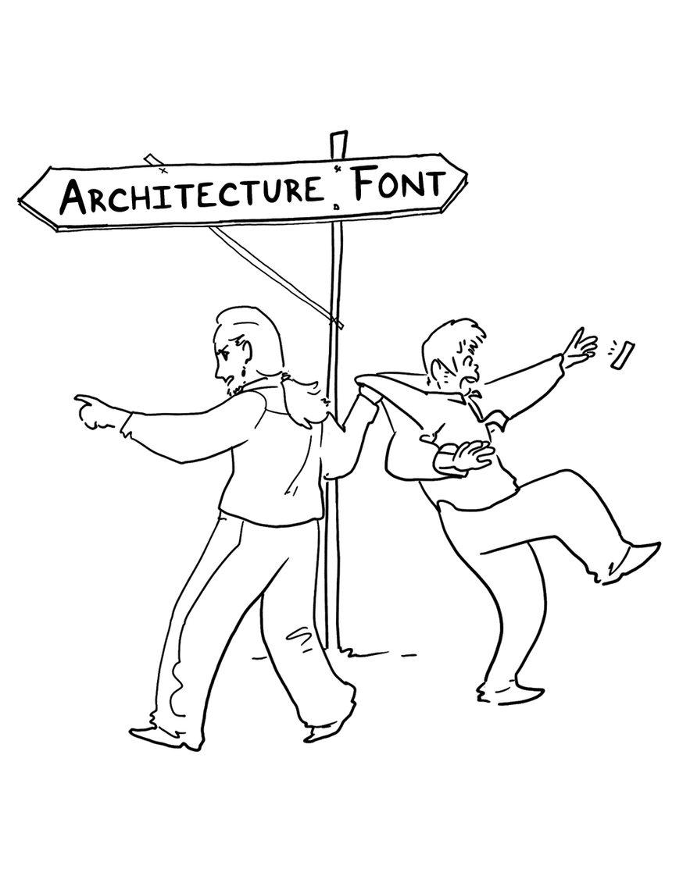
Experts curtail digressions

Slide 13
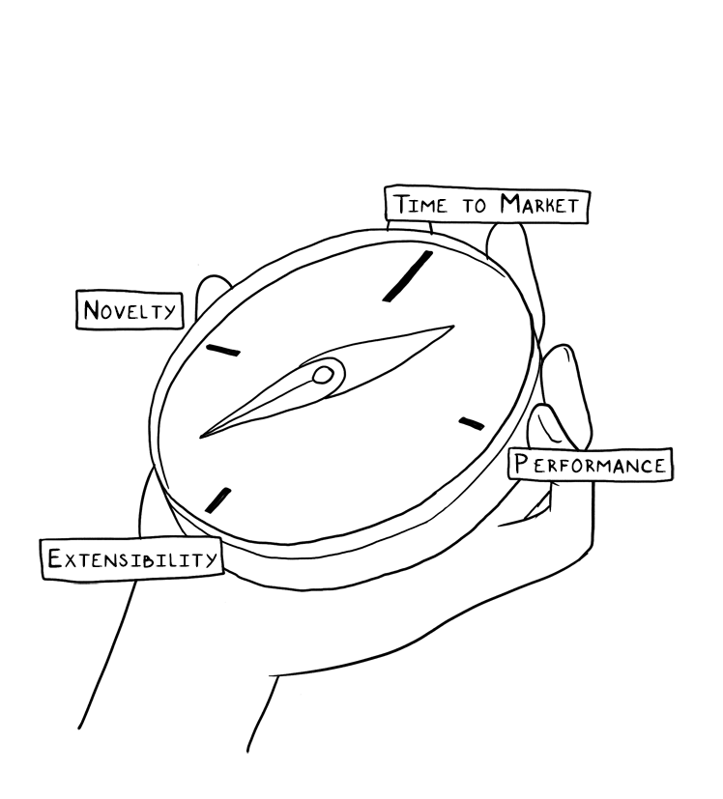
Experts retain their orientation

Slide 14
Design studio 3
Questions?

Slide 15
Software design methods
 | Application design | Interaction design | Architecture design | Implementation design
Analysis | competitive testing contextual inquiry feature comparison stakeholder analysis task analysis | critical incident technique interaction logging personas scenarios | framework assessment model-driven engineering quality-function-deployment reverse engineering world modeling | release planning summarization test-driven design visualization
Synthesis | affinity diagramming concept mapping mind mapping morphological chart | design/making participatory design prototyping storyboarding | architectural styles generative programming component reuse decomposition | pair programming refactoring search software patterns
Evaluation | requirements review role playing wizard of oz | cognitive walkthrough evaluative research heuristic evaluation think-aloud protocol | formal verification simulation weighted objectives | correctness proofs inspections/reviews parallel deployment testing

Slide 16
Software design methods
 | Application design | Interaction design | Architecture design | Implementation design
Analysis | competitive testing contextual inquiry feature comparison stakeholder analysis task analysis | critical incident technique interaction logging personas scenarios | framework assessment model-driven engineering quality-function-deployment reverse engineering world modeling | release planning summarization test-driven design visualization
Synthesis | affinity diagramming concept mapping mind mapping morphological chart | design/making participatory design prototyping storyboarding | architectural styles generative programming component reuse decomposition | pair programming refactoring search software patterns
Evaluation | requirements review role playing wizard of oz | cognitive walkthrough evaluative research heuristic evaluation think-aloud protocol | formal verification simulation weighted objectives | correctness proofs inspections/reviews parallel deployment testing

Slide 17
Personas
Personas is the process of developing meaningful and relatable user profiles that capture common behaviors

Slide 18
Procedure
Collect data through field research
Segment the users into archetypes
Create the personas

Slide 19
Example: collect data through field research
Observations
Interviews
Ethnography

Slide 20
Example: segment the users into archetypes
Organize the individual users into groups
affinity diagramming
two-dimensional axes
informal clustering
Typically repeated multiple times to explore different user characteristics
Recombine characteristics into hypothetical users who are both representative of a larger group and different amongst each other

Slide 21
Example: create the personas
Name the archetype and associate an image
Briefly introduce their life situation
Briefly describe their goals
Briefly describe their characteristic behaviors
Usually, between three and five personas are created, at most one page each

Slide 22
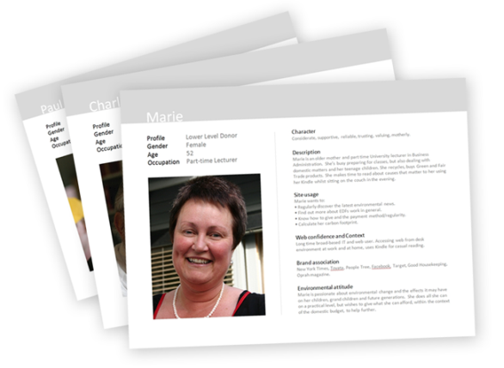
Typical notation: cards

Slide 23
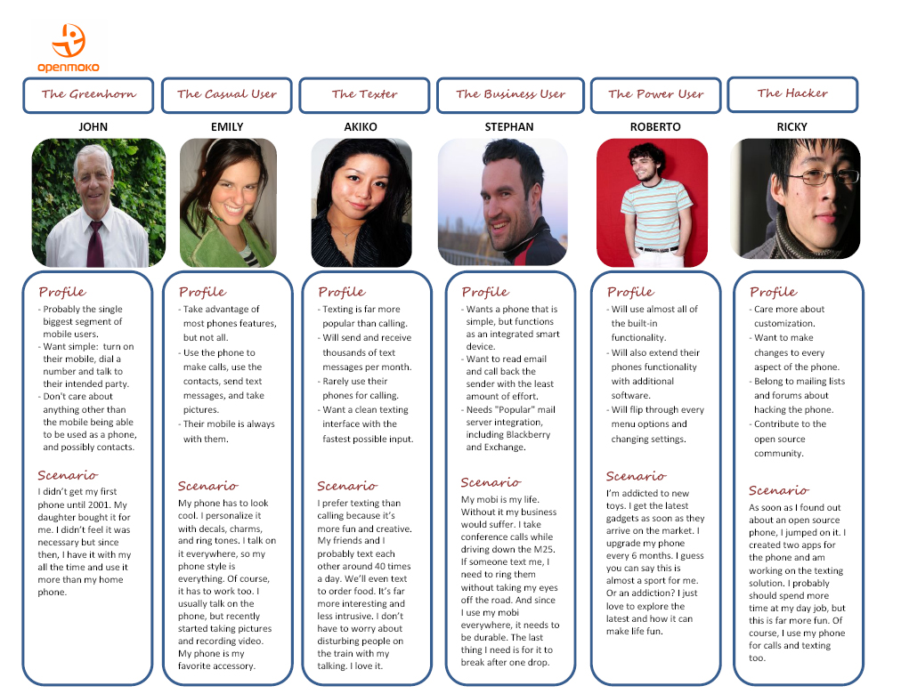
Typical notation: table

Slide 24
Criteria for successful use
Must be based on actual, in-depth field research
Must focus on key differentiating characteristics that might influence the design project

Slide 25
Strengths and weaknesses
Strengths
Weaknesses
Explicitly brings users into the design process
Builds a shared understanding of the audience among the design team members
Provides an implicit test for future design ideas
Helps focus on essence
Might distance the designer from actual users and overly focus on the personas
Might distance the designer from a-typical users
Tends to work less well for design projects involving complex work practices

Slide 26
Software design methods
 | Application design | Interaction design | Architecture design | Implementation design
Analysis | competitive testing contextual inquiry feature comparison stakeholder analysis task analysis | critical incident technique interaction logging personas scenarios | framework assessment model-driven engineering quality-function-deployment reverse engineering world modeling | release planning summarization test-driven design visualization
Synthesis | affinity diagramming concept mapping mind mapping morphological chart | design/making participatory design prototyping storyboarding | architectural styles generative programming component reuse decomposition | pair programming refactoring search software patterns
Evaluation | requirements review role playing wizard of oz | cognitive walkthrough evaluative research heuristic evaluation think-aloud protocol | formal verification simulation weighted objectives | correctness proofs inspections/reviews parallel deployment testing

Slide 27
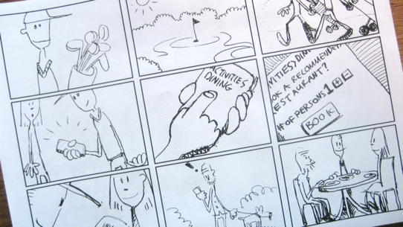
Storyboarding
Storyboarding is the process of visually communicating expected interactions in context

Slide 28
Procedure
Decide upon interaction
Decide upon story to be told
Decide upon level of artistic detail
Draw and annotate story
Iterate

Slide 29
Decide upon interaction
Mary is exploring the online book collection
Mary is reading an excerpt from one book
Tom buys the book in his car

Slide 30
Decide upon story to be told
While Mary is exploring the online book collection, she is pleasantly surprised to find that an author that she liked before has written a new book and she orders it
While Mary is exploring the online book collection, she very much likes the automated recommendation that the system makes based on books she purchased in the past
While Tom is driving in the car, he uses his mobile phone to order the book, but has to stop to actually type in requisite credit card information on the ordering screen

Slide 31
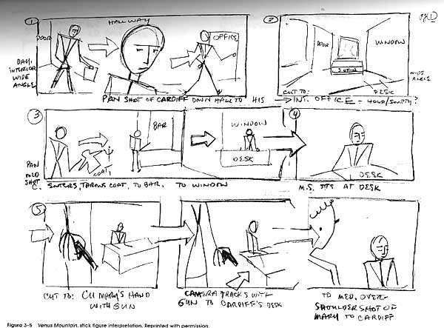
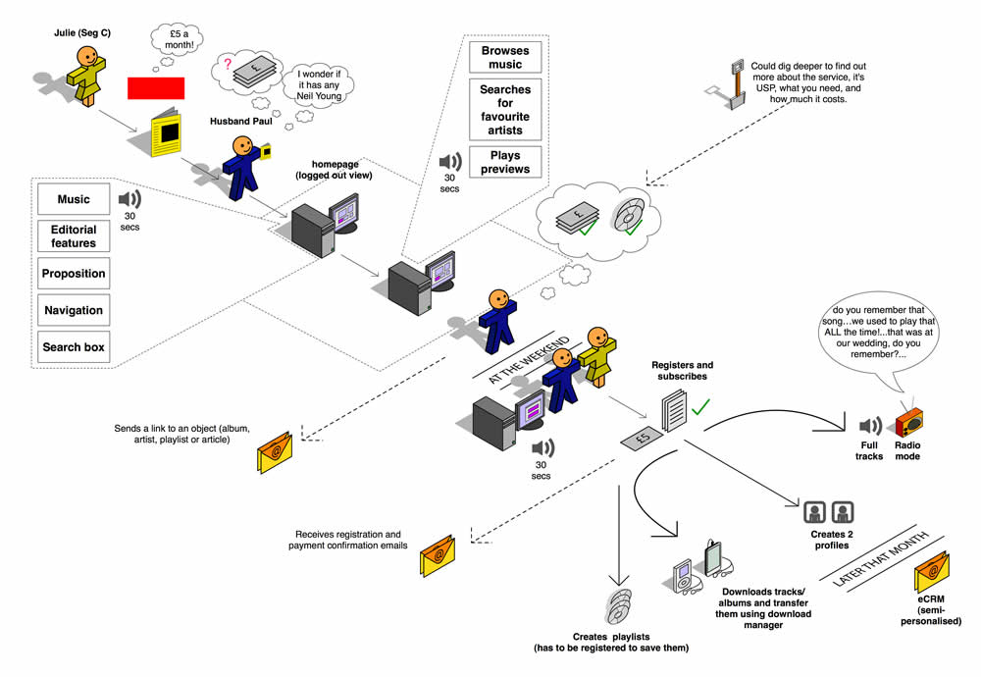
Example: decide upon level of artistic detail

Slide 32
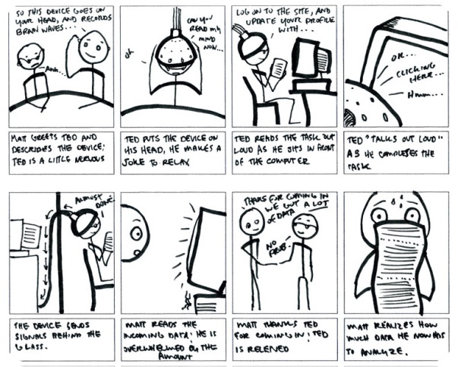
Example: draw and annotate story

Slide 33
Example: iterate

Slide 34
Typical notation: storyboard

Slide 35
Criteria for successful use
Develop short effective stories
Apply a strong sense of aesthetics
Must be open to storyboarding multiple ideas
Should have a definite sense of possible solutions
Collaborate

