Slide 1
Informatics 121 Software Design I
Lecture 18
Duplication of course material for any commercial purpose without the explicit written permission of the professor is prohibited.

Slide 2
Announcements
No (official) discussion today
Office hours today from 11:00 to 11:30

Slide 3
Today’s lecture
Architecture design

Slide 4
Four types of software design
what is it to accomplish?
application design
satisfactory experience
how does one interact with it?
interaction design
change in the world
what is its conceptual core?
architecture design
plan for realization
what are its implementation details?
implementation design

Slide 5
Architecture
“The conceptual core”
“That what really makes it work”
“Principal set of design decisions”
“Essence of the solution”

Slide 6
Architecture

Slide 7
Architecture

Slide 8
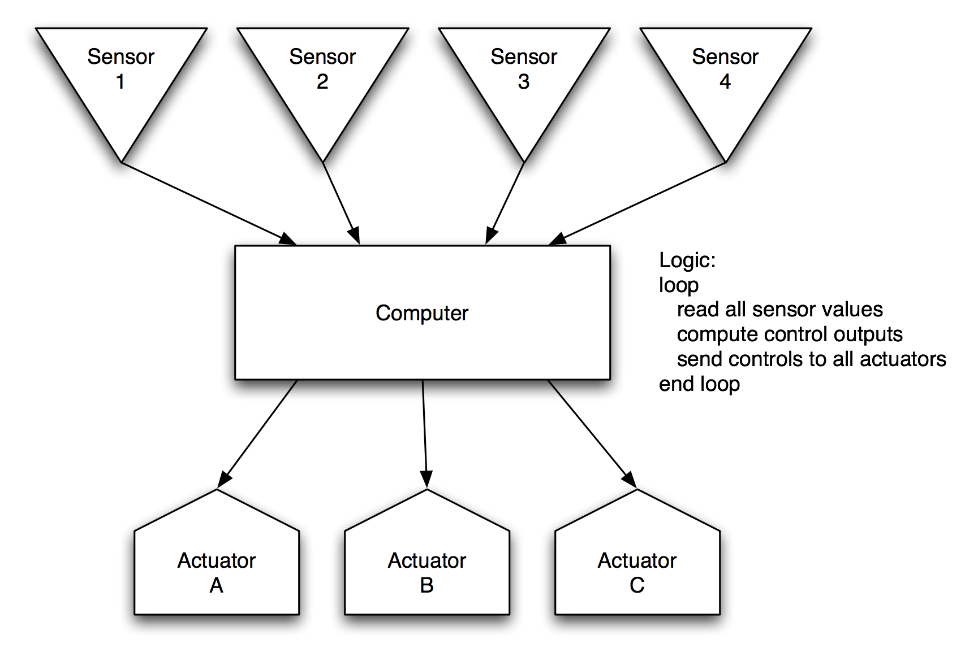
Architecture

Slide 9
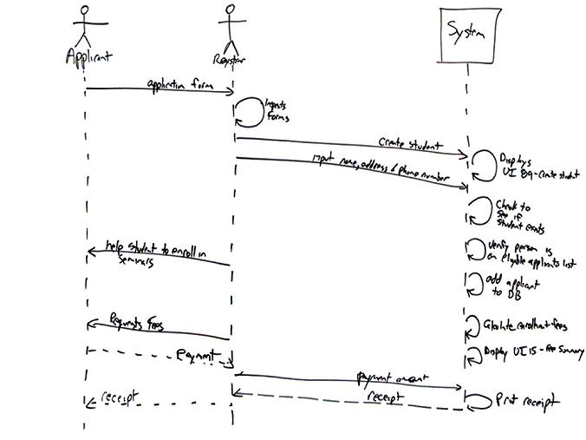
Architecture

Slide 10
Architecture
Components and connectors
Data model
Protocol
Interface
Naming
Algorithm
…

Slide 11
Example: self-driving cars

