Slide 1
Informatics 121 Software Design I
Lecture 3
Duplication of course material for any commercial purpose without the explicit written permission of the professor is prohibited.

Slide 2
Discussion
There will not be discussion this upcoming Friday
There will be no lecture this Monday

Slide 3
Today
Two fundamental challenges
Design failure
Design cycle
Design studio 1

Slide 4
Software design
software designer
source code
compiler*
runnable program
other stakeholders
users
experiences
[* or, at times, the person who installs and configures the software instead of the compiler]

Slide 5
Two fundamental challenges
The nature of software
The nature of people

Slide 6
Nature of software (Brooks)
Complexity
software is among the most complex people-made artifacts
Conformity
software has no laws of nature that simplify its existence; rather, it lives in a world of designed artifacts to which it must conform
Changeability
software is subject to continuous pressure to change
Invisibility
because the reality of software is not embedded into space, it is inherently unvisualizable

Slide 7
Nature of people
Diversity
people differ in how they experience the world
Indiscernibility
experiences are distinctly mental in nature, with tangible reactions and signs not always matching the actual experience
Familiarity
people tend to be risk averse, sticking to role, organizational, and societal norms and values
Volatility
with every new exposure, people reinterpret and modify their opinions and expectations

Slide 8
Software design
Predicting the future
Making tradeoffs
Managing bias
Accommodating change
Balancing cost, quality, and effort
Solving a problem, now and later

Slide 9
Software design: predicting the future
Software design is a predictive activity that must anticipate the experiences of people
account for differing experiences
account for shifting experiences
Furthermore, when people share their vision for a future change in the world, they tend to be conservative
The difficulty lies in how to balance what people perceive they need and what they actually need

Slide 10
Software design: making tradeoffs
Tradeoffs must be made continuously over the course of a design project
a design solution is judged relative to other possible solutions that could have been made
it is frequently impossible to quantify the relative virtues of each alternative
Furthermore, any given design solution inevitably satisfies certain audiences and certain stakeholders more than others
The difficulty lies in how to balance decisions across the needs and anticipated experiences of the various constituent audiences and stakeholders

Slide 11
Software design: managing bias
Bias exists within all stakeholders, and can be a positive or negative influence
audience
designer
client
others
Furthermore, bias is typically difficult to detect and address
The challenge lies in how to balance benefiting from positive bias while avoiding the effects of negative bias

Slide 12
Software design: accommodating change
Change happens and must be anticipated
changing client demands
changing context of people, hardware, and software
changing understanding of the design problem
changing attitudes of the audience
Furthermore, the more complete a design solution already is, the more difficult it is to change it
The difficulty lies in how to balance accommodating change with making sufficient progress on the design solution

Slide 13
Software design: balancing cost, quality, effort
Quality, cost, and effort are three constraining factors in design, not all of which can be optimized at the same time
cost constraints are typically set by other stakeholders
cost constraints are typically set before the design project is truly understood
Furthermore, there is no stopping rule, since no optimal design solution exists
The difficulty lies in how to balance a design solution that is of ‘good enough’ quality with expectations on cost and effort

Slide 14
Software design: solving a problem, now and later
Software ultimately solves someone’s problem (or at least fulfills someone’s need)
software does not wear out
software provides critical societal infrastructure
Because software does not wear out, it very likely will have to accommodate new needs as well as deviations from present needs
The difficulty lies in how to balance addressing today’s design problem with accommodating future, unknown needs

Slide 15
Why design
To develop the right software
for now
for later
To develop the software right
on time
within budget

Slide 16
Software design failure: air traffic control
Air-Traffic Control System in LA Airport
Incident Date: 9/14/2004 Ironic Factor: ***** (IEEE Spectrum) -- It was an air traffic controller's worst nightmare. Without warning, on Tuesday, 14 September, at about 5 p.m. Pacific daylight time, air traffic controllers lost voice contact with 400 airplanes they were tracking over the southwestern United States. Planes started to head toward one another, something that occurs routinely under careful control of the air traffic controllers, who keep airplanes safely apart. But now the controllers had no way to redirect the planes' courses.
...
The controllers lost contact with the planes when the main voice communications system shut down unexpectedly. To make matters worse, a backup system that was supposed to take over in such an event crashed within a minute after it was turned on. The outage disrupted about 800 flights across the country.
...
Inside the control system unit is a countdown timer that ticks off time in milliseconds. The VCSU uses the timer as a pulse to send out periodic queries to the VSCS. It starts out at the highest possible number that the system's server and its software can handle—2³². It's a number just over 4 billion milliseconds. When the counter reaches zero, the system runs out of ticks and can no longer time itself. So it shuts down.
Counting down from 2³² to zero in milliseconds takes just under 50 days. The FAA procedure of having a technician reboot the VSCS every 30 days resets the timer to 2³² almost three weeks before it runs out of digits.

Slide 17
Software design failure: air traffic control
Air-Traffic Control System in LA Airport
Incident Date: 9/14/2004 Ironic Factor: ***** (IEEE Spectrum) -- It was an air traffic controller's worst nightmare. Without warning, on Tuesday, 14 September, at about 5 p.m. Pacific daylight time, air traffic controllers lost voice contact with 400 airplanes they were tracking over the southwestern United States. Planes started to head toward one another, something that occurs routinely under careful control of the air traffic controllers, who keep airplanes safely apart. But now the controllers had no way to redirect the planes' courses.
...
The controllers lost contact with the planes when the main voice communications system shut down unexpectedly. To make matters worse, a backup system that was supposed to take over in such an event crashed within a minute after it was turned on. The outage disrupted about 800 flights across the country.
...
Inside the control system unit is a countdown timer that ticks off time in milliseconds. The VCSU uses the timer as a pulse to send out periodic queries to the VSCS. It starts out at the highest possible number that the system's server and its software can handle—2³². It's a number just over 4 billion milliseconds. When the counter reaches zero, the system runs out of ticks and can no longer time itself. So it shuts down.
Counting down from 2³² to zero in milliseconds takes just under 50 days. The FAA procedure of having a technician reboot the VSCS every 30 days resets the timer to 2³² almost three weeks before it runs out of digits.

Slide 18
Software design failure: Mars climate orbiter
NASA Mars Climate Orbiter
Incident Date: 9/23/1999 Price Tag: $125 million Ironic Factor: **** WASHINGTON (AP) -- For nine months, the Mars Climate Orbiter was speeding through space and speaking to NASA in metric. But the engineers on the ground were replying in non-metric English. It was a mathematical mismatch that was not caught until after the $125-million spacecraft, a key part of NASA's Mars exploration program, was sent crashing too low and too fast into the Martian atmosphere. The craft has not been heard from since.
...
Noel Henners of Lockheed Martin Astronautics, the prime contractor for the Mars craft, said at a news conference it was up to his company's engineers to assure the metric systems used in one computer program were compatible with the English system used in another program. The simple conversion check was not done, he said.

Slide 19
Software design failure: Mars climate orbiter
NASA Mars Climate Orbiter
Incident Date: 9/23/1999 Price Tag: $125 million Ironic Factor: **** WASHINGTON (AP) -- For nine months, the Mars Climate Orbiter was speeding through space and speaking to NASA in metric. But the engineers on the ground were replying in non-metric English. It was a mathematical mismatch that was not caught until after the $125-million spacecraft, a key part of NASA's Mars exploration program, was sent crashing too low and too fast into the Martian atmosphere. The craft has not been heard from since.
...
Noel Henners of Lockheed Martin Astronautics, the prime contractor for the Mars craft, said at a news conference it was up to his company's engineers to assure the metric systems used in one computer program were compatible with the English system used in another program. The simple conversion check was not done, he said.

Slide 20
Software design failure: child support agency
EDS Child Support System Is Anything But
Since 2004, Electronic Data Systems (EDS) has been maligned throughout much of the U.K. for a massively unpopular software program it built for the Child Support Agency. Complaints are registered frequently. A recap given by Sun Dog Interactive in 2009 revealed that over a five-year span, there were 1.9 million people who had overpaid into the system, 700,000 who had underpaid, and around $7 billion in uncollected child support payments along with a backlog of 239,000 cases and 36,000 new cases “stuck” in the system. As you can see from the image, it’s a problem so rampant there is even a website devoted to the agency’s screw-ups, fittingly titled CSAHell.com.

Slide 21
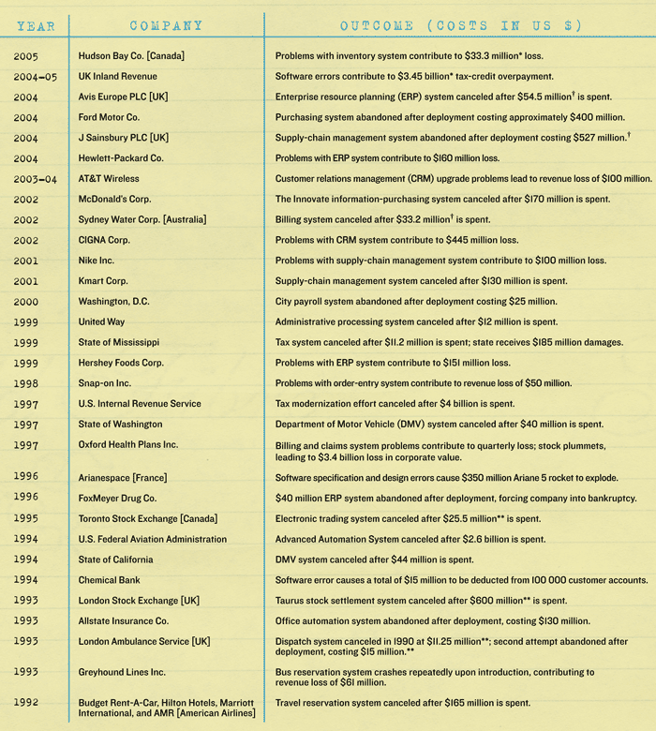
Software design failures
Notes:
http://spectrum.ieee.org/computing/software/why-software-fails

Slide 22
Top 10 software failures of 2011
Financial services giant fined $25 million for hiding software glitch that cost investors $217 million
Computer system bugs cause Asian banking facilities’ downtime
Cash machine bug benefits customers by giving them extra money
Leading smartphones suffer an international blackout
Bugs in social networking app for tablet just hours after delayed release
22 people wrongly arrested in Australia due to failures in new NZ $54.5 million courts computer system
50,500 cars recalled after airbag-related software glitch
Recall of one million cars addresses fire and rollaway concerns
Telecoms glitch affects 47,000 customers’ meter readings and costs company NZ $2.7 million
Army computer glitches hinder coordinated efforts in insurgent tracking
Notes:
http://www.businesscomputingworld.co.uk/top-10-software-failures-of-2011/

Slide 23
Top 15 worst computer software blunders
St. Mary’s Mercy Medical Center Kills Its Patients, On Paper
Knight Capital Group Loses Nine Figures in 30 Minutes
World War III Narrowly Averted
AT&T Demonstrates How Not to Upgrade Software
World Of Warcraft Creates Literal Computer Virus
Apple Maps Goes Nowhere Fast
Michigan Dept. of Corrections Grants Prisoners Early Release
California ‘Paroles’ 450 Violent Offenders (Without Supervision)
IRS Costs America Close To $300 Million
Patriot Missile System Timing Issue Leads To 28 Dead
…
Notes:
http://www.intertech.com/Blog/15-worst-computer-software-blunders/

Slide 24
Design cycle
synthesize
analyze
evaluate

Slide 25
Design cycle
synthesize
goals
constraints
assumptions
decisions
ideas
analyze
evaluate

Slide 26
Goals
A goal represents an explicit acknowledgment of a desired result that the eventual design solution must achieve
Goals may be suggested by any of the stakeholders
client
other stakeholders
audience
designer
Goals change over time, and may or may not be (partially) addressed by the current state of the design solution

Slide 27
Example goals
The luxury airplane must be 10% more fuel-efficient than its predecessor
The library must be able to hold 250,000 books
The award must be representative of the professional society that is commissioning it

Slide 28
Constraints
A constraint represents an explicit acknowledgment of a condition that restricts the design project
Constraints may be suggested by any of the stakeholders
client
other stakeholders
audience
designer
Constraints change over time, and may or may not be (partially) met by the current state of the design project

Slide 29
Example constraints
The luxury airplane must weigh less than 50,000 pounds
The library must not violate federal disability laws
The award must cost less than $1000 to produce

Slide 30
Assumptions
An assumption represents a fact that is taken for granted, may or may not be true, and influences the design project
Assumptions may be made by any of the stakeholders
client
other stakeholders
audience
designer
Assumptions change over time, and may or may not be (partially) fulfilled by the current state of the design project

Slide 31
Example assumptions
The average person weighs 85 kilograms
The library needs to serve the community with an area stocked with personal computers
The professional society’s logo is red and white, which therefore must be its preferred colors for the award

Slide 32
Decisions
A decision represents a specific choice of how to further the design solution, typically after some amount of consideration
Decisions are the sole responsibility of the designer, though they can be (heavily) influenced by other stakeholders
Decisions change over time, and new decisions may or may not (partially) align with the current state of the design project

Slide 33
Example decisions
The fuselage and wings of the luxury airplane shall be made out of carbon composites
The library shall have bookshelves that are not movable
The award shall be made out of colored glass

Slide 34
Idea
An idea represents a thought or opinion, ranging from highly unformed to fully formed, that potentially shapes the design solution
Ideas typically are the sole responsibility of the designer, though they may be inspired by many different sources
Ideas change over time, and new ideas may or may not (partially) align with the current state of the design project

Slide 35
Example ideas
What if the luxury airplane had a shower on board?
Perhaps the library membership cards should have RFID tags, so a visitor can simply grab the books they want, walk by an automated scanner, and have their books be on loan
I am thinking that the award should be a variant of last year’s award

Slide 36
Design the software that flies a drone
synthesize
goals
constraints
assumptions
decisions
ideas
analyze
evaluate

Slide 37
Design a new version of EEE/Canvas
synthesize
goals
constraints
assumptions
decisions
ideas
analyze
evaluate

Slide 38
Design studio 1
Your client is TransportationAssist, a new company that recognizes the potential of smart phones to help elderly in ‘getting around’ in their day-to-day lives.
The company particularly is invested in two new directions: (1) assisting elderly in taking public transportation, helping them getting from one destination to another, and (2) tracking their whereabouts so others can check in on them.
The company has sought you out, because you are an excellent designer. All of the software design is in your hands, as TransportationAssist has the idea protected (meaning no competition), but has no idea how to actually design the software.

Slide 39
Design studio 1 (part 1)
Identify the audience and other stakeholders
Identify possible goals, constraints, and assumptions
Bring two printed copies to discussion, next Friday
one for the TAs
one for your group
Your group will be announced at the start of your discussion

