Slide 1
Informatics 121 Software Design I
Lecture 4
Duplication of course material for any commercial purpose without the explicit written permission of the professor is prohibited.

Slide 2
Announcements
There will be discussion this Friday
must attend your designated discussion, as this is the first time your group meets and starts its design process for design studio 1, part 2

Slide 3
Today
French fries and mayonnaise

Slide 4
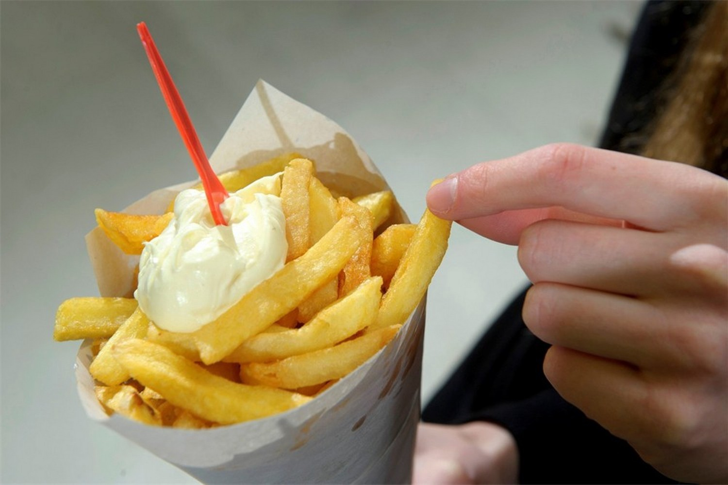
French fries and mayonnaise

Slide 5
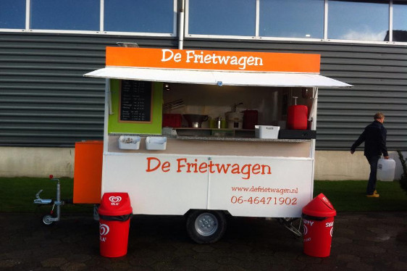
French fries and mayonnaise

Slide 6
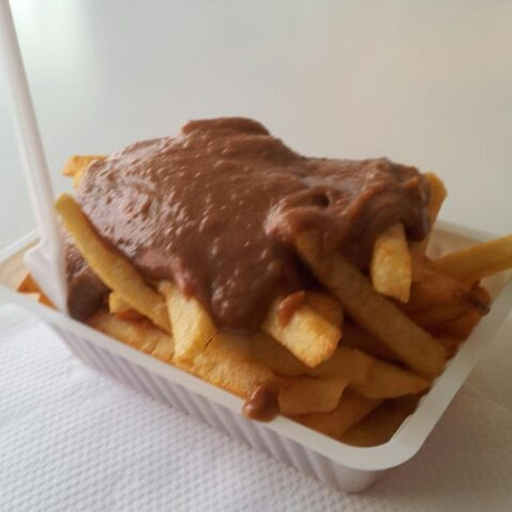
French fries and mayonnaise

Slide 7
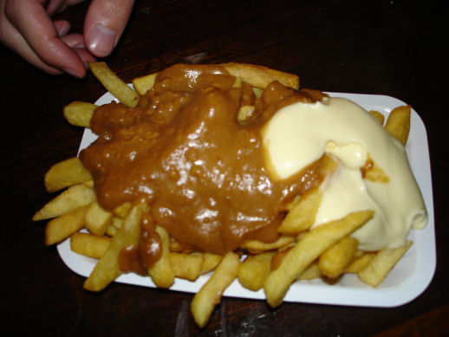
French fries and mayonnaise

Slide 8
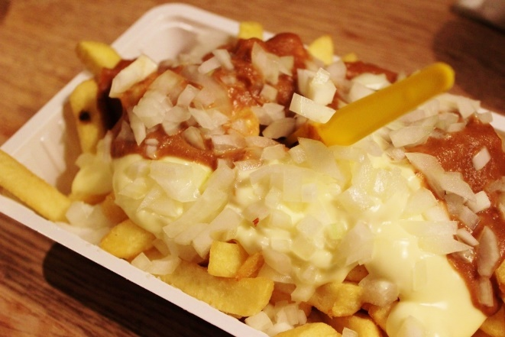
French fries and mayonnaise

Slide 9
Reflection
What went well?
What did not go well?
What are you most worried about in terms of progress at this time?
What would you like to do different?
What might we be mixing up?

Slide 10
French fries and mayonnaise

Slide 11
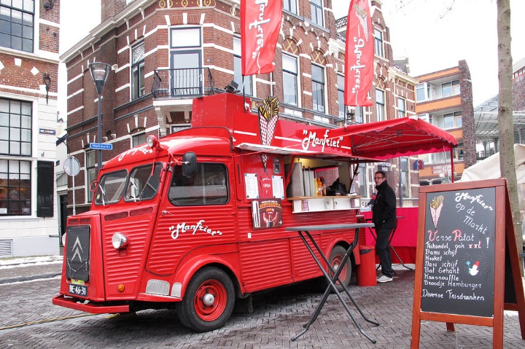
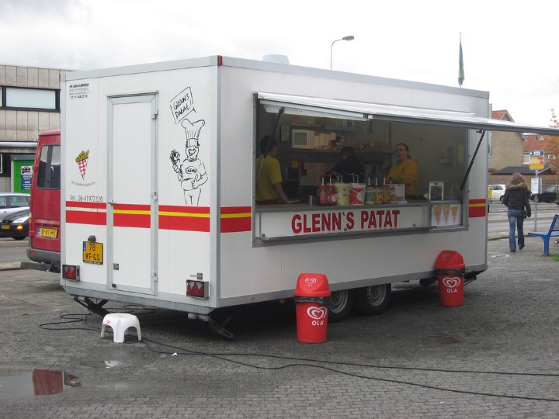
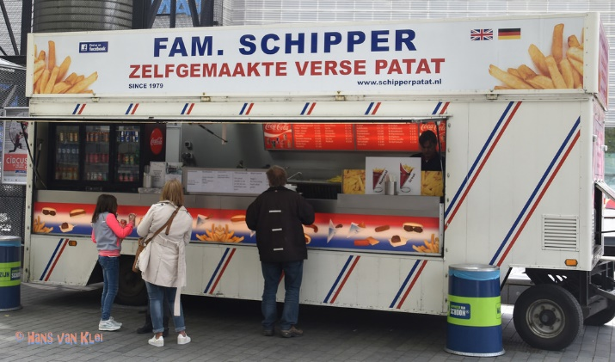
French fries and mayonnaise

Slide 12
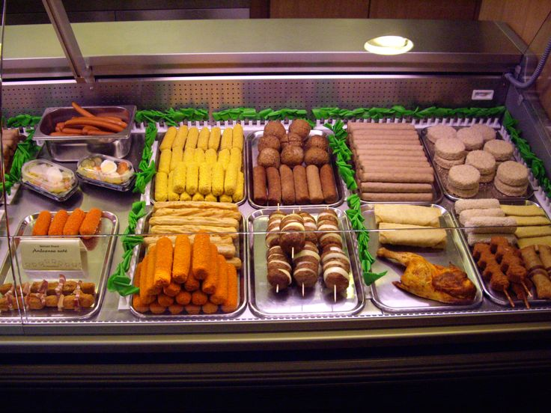
French fries and mayonnaise

Slide 13
Reflection
What went well?
What did not go well?
What did you learn about the problem?
What did you not learn about the problem?
What did you learn about the solution?
What did you not learn about the solution?

