Slide 1
Informatics 121 Software Design I
Lecture 6
Duplication of course material for any commercial purpose without the explicit written permission of the professor is prohibited.

Slide 2
Today
Expert behaviors
Design practice

Slide 3
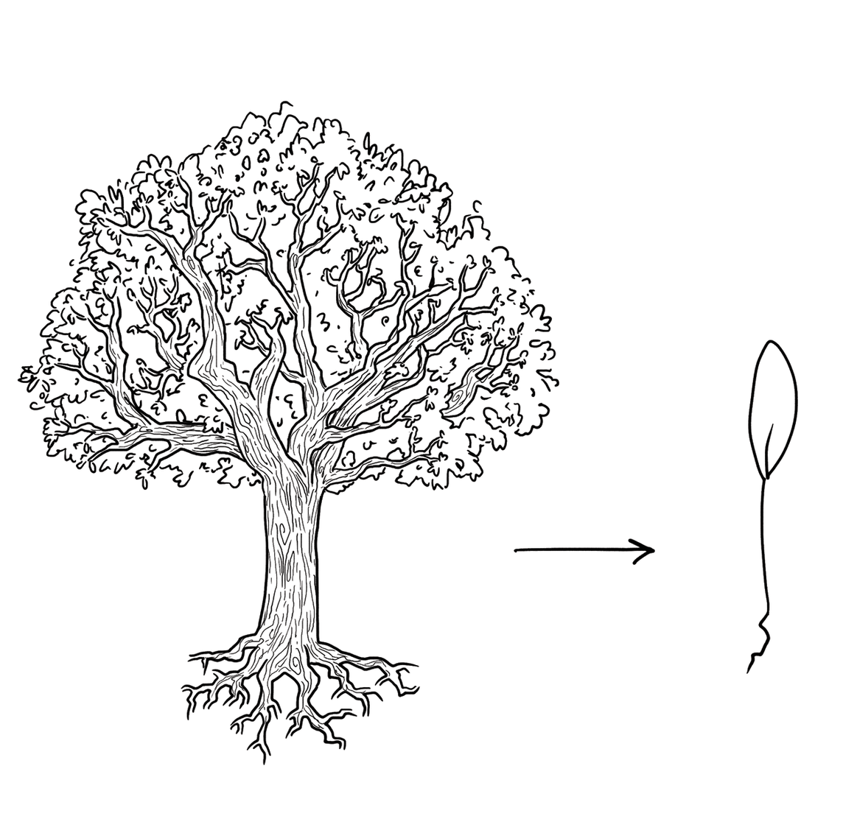
Experts focus on the essence

Slide 4
Experts prefer solutions that they know work

Slide 5
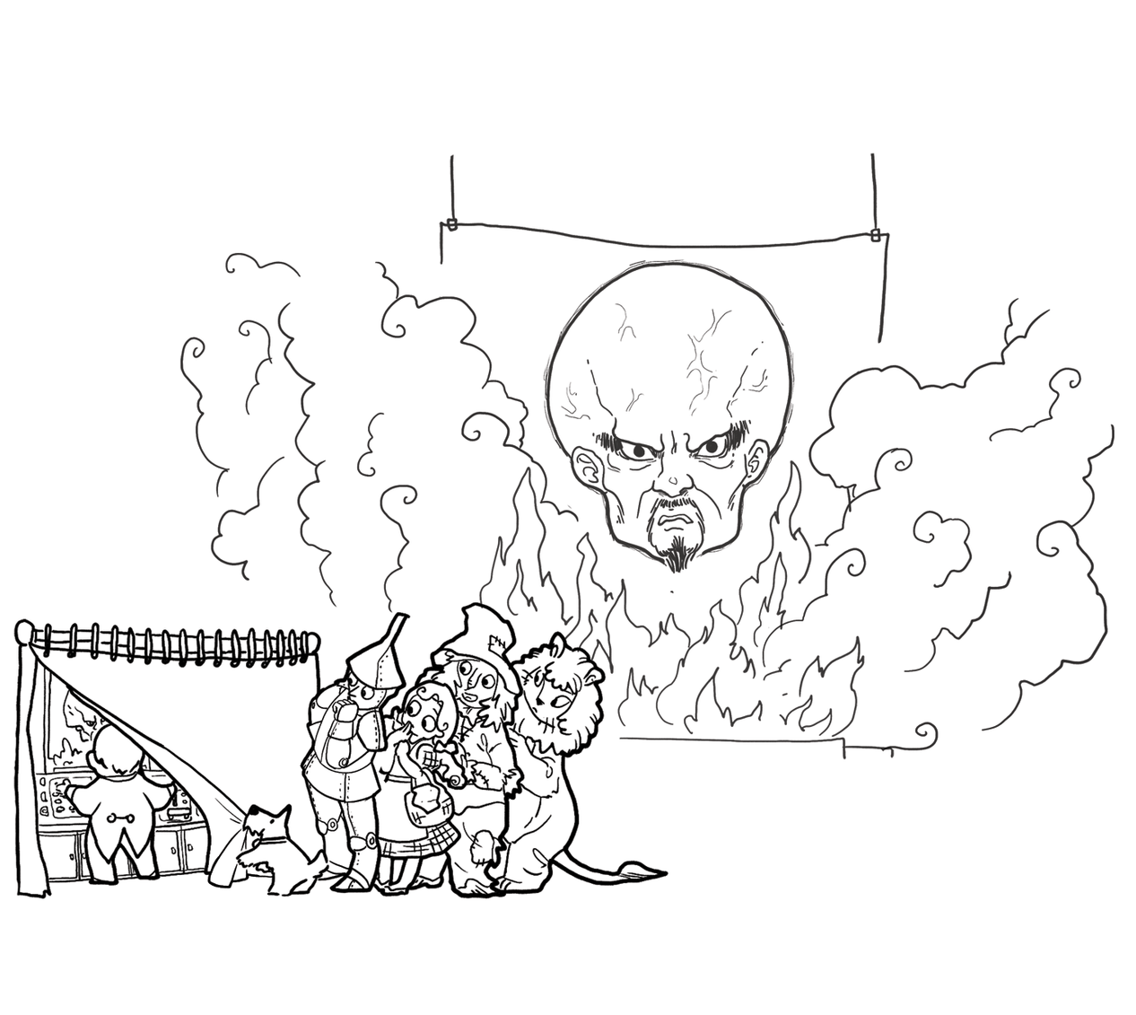
Experts address knowledge deficiencies

Slide 6
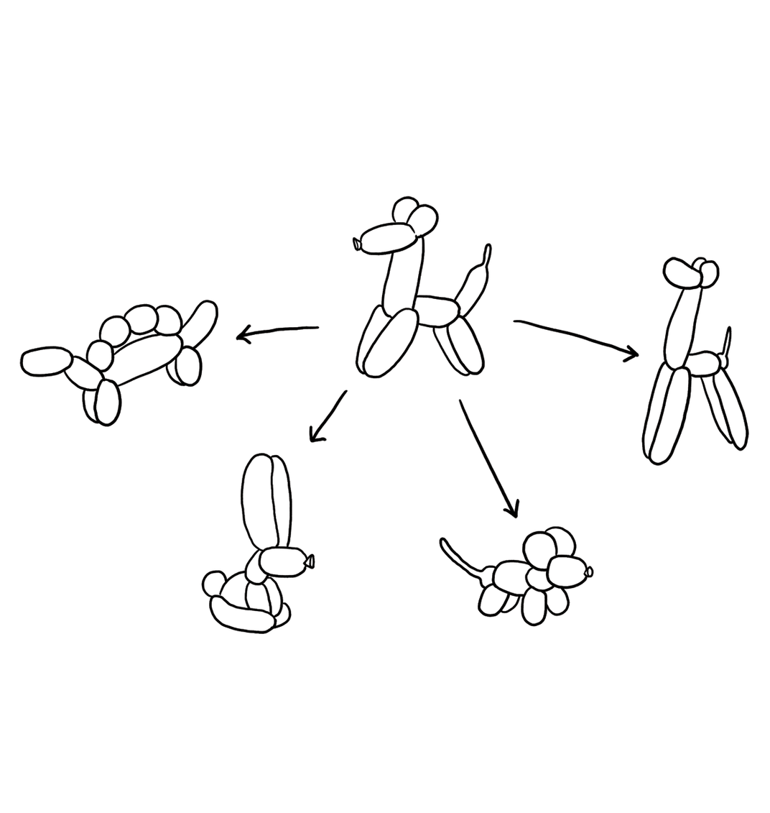
Experts generate alternatives

Slide 7
Experts are skeptical

Slide 8
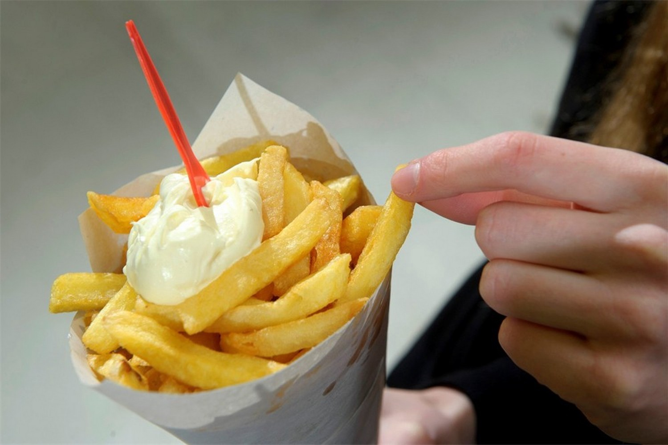
French fries and mayonnaise

Slide 9
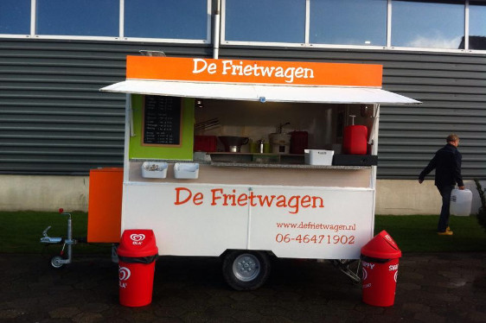
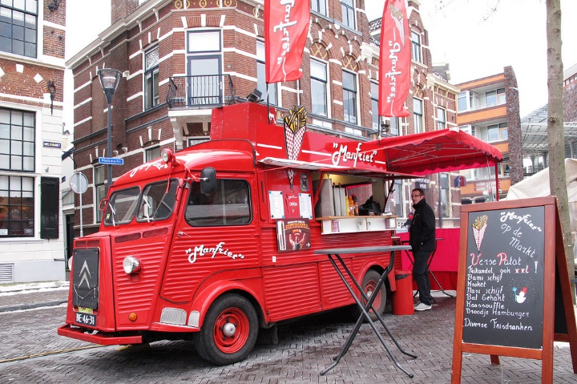
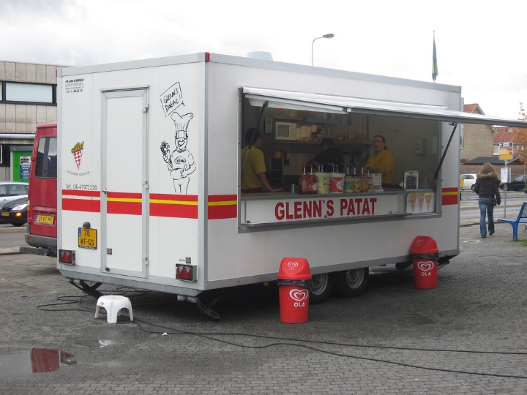
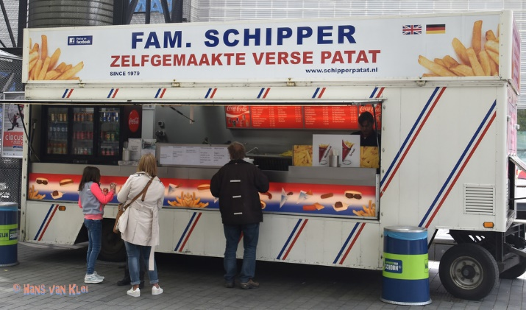
French fries and mayonnaise

Slide 10
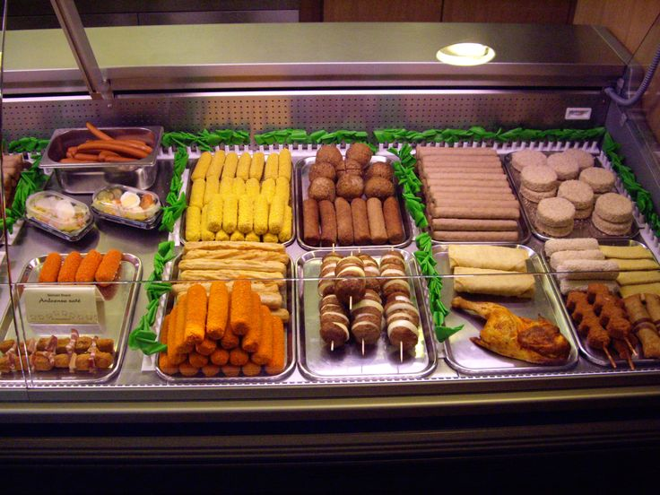
French fries and mayonnaise

