Slide 1
Informatics 121 Software Design I
Lecture 7
Duplication of course material for any commercial purpose without the explicit written permission of the professor is prohibited.

Slide 2
Discussion
There is discussion today
Please join your designated discussion

Slide 3
Today
Design failure
Midterm

Slide 4
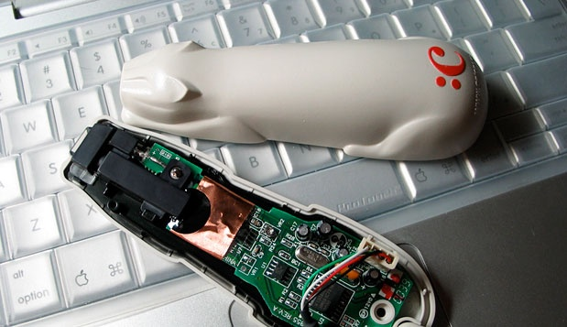
Design failure
Notes:
http://www.joelonsoftware.com/articles/fog0000000037.html

Slide 5
Design failure

Slide 6
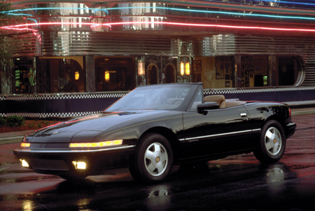
Design failures
(1988)

Slide 7
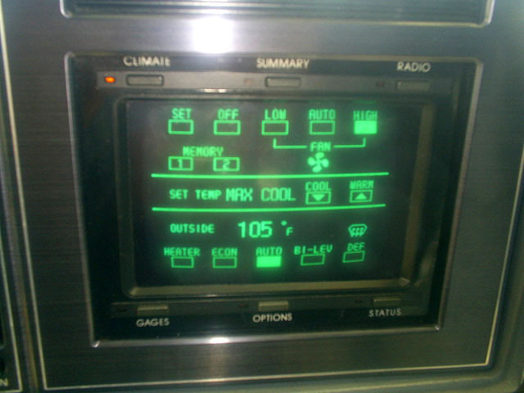
Design failure
(1988)

Slide 8
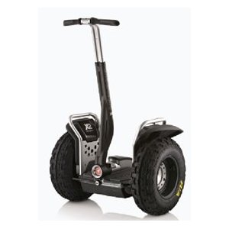
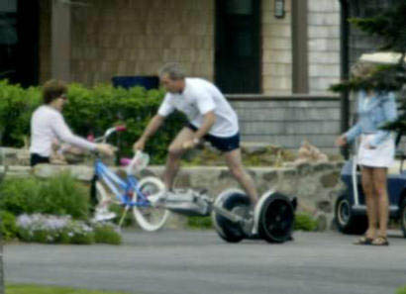
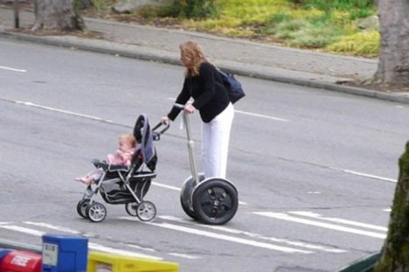
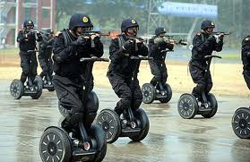
Design failure
(1988)

Slide 9
Software design failure: air traffic control
Air-Traffic Control System in LA Airport
Incident Date: 9/14/2004 Ironic Factor: ***** (IEEE Spectrum) -- It was an air traffic controller's worst nightmare. Without warning, on Tuesday, 14 September, at about 5 p.m. Pacific daylight time, air traffic controllers lost voice contact with 400 airplanes they were tracking over the southwestern United States. Planes started to head toward one another, something that occurs routinely under careful control of the air traffic controllers, who keep airplanes safely apart. But now the controllers had no way to redirect the planes' courses.
...
The controllers lost contact with the planes when the main voice communications system shut down unexpectedly. To make matters worse, a backup system that was supposed to take over in such an event crashed within a minute after it was turned on. The outage disrupted about 800 flights across the country.
...
Inside the control system unit is a countdown timer that ticks off time in milliseconds. The VCSU uses the timer as a pulse to send out periodic queries to the VSCS. It starts out at the highest possible number that the system's server and its software can handle—2³². It's a number just over 4 billion milliseconds. When the counter reaches zero, the system runs out of ticks and can no longer time itself. So it shuts down.
Counting down from 2³² to zero in milliseconds takes just under 50 days. The FAA procedure of having a technician reboot the VSCS every 30 days resets the timer to 2³² almost three weeks before it runs out of digits.

Slide 10
Software design failure: air traffic control
Air-Traffic Control System in LA Airport
Incident Date: 9/14/2004 Ironic Factor: ***** (IEEE Spectrum) -- It was an air traffic controller's worst nightmare. Without warning, on Tuesday, 14 September, at about 5 p.m. Pacific daylight time, air traffic controllers lost voice contact with 400 airplanes they were tracking over the southwestern United States. Planes started to head toward one another, something that occurs routinely under careful control of the air traffic controllers, who keep airplanes safely apart. But now the controllers had no way to redirect the planes' courses.
...
The controllers lost contact with the planes when the main voice communications system shut down unexpectedly. To make matters worse, a backup system that was supposed to take over in such an event crashed within a minute after it was turned on. The outage disrupted about 800 flights across the country.
...
Inside the control system unit is a countdown timer that ticks off time in milliseconds. The VCSU uses the timer as a pulse to send out periodic queries to the VSCS. It starts out at the highest possible number that the system's server and its software can handle—2³². It's a number just over 4 billion milliseconds. When the counter reaches zero, the system runs out of ticks and can no longer time itself. So it shuts down.
Counting down from 2³² to zero in milliseconds takes just under 50 days. The FAA procedure of having a technician reboot the VSCS every 30 days resets the timer to 2³² almost three weeks before it runs out of digits.

Slide 11
Software design failure: Mars climate orbiter
NASA Mars Climate Orbiter
Incident Date: 9/23/1999 Price Tag: $125 million Ironic Factor: **** WASHINGTON (AP) -- For nine months, the Mars Climate Orbiter was speeding through space and speaking to NASA in metric. But the engineers on the ground were replying in non-metric English. It was a mathematical mismatch that was not caught until after the $125-million spacecraft, a key part of NASA's Mars exploration program, was sent crashing too low and too fast into the Martian atmosphere. The craft has not been heard from since.
...
Noel Henners of Lockheed Martin Astronautics, the prime contractor for the Mars craft, said at a news conference it was up to his company's engineers to assure the metric systems used in one computer program were compatible with the English system used in another program. The simple conversion check was not done, he said.

Slide 12
Software design failure: Mars climate orbiter
NASA Mars Climate Orbiter
Incident Date: 9/23/1999 Price Tag: $125 million Ironic Factor: **** WASHINGTON (AP) -- For nine months, the Mars Climate Orbiter was speeding through space and speaking to NASA in metric. But the engineers on the ground were replying in non-metric English. It was a mathematical mismatch that was not caught until after the $125-million spacecraft, a key part of NASA's Mars exploration program, was sent crashing too low and too fast into the Martian atmosphere. The craft has not been heard from since.
...
Noel Henners of Lockheed Martin Astronautics, the prime contractor for the Mars craft, said at a news conference it was up to his company's engineers to assure the metric systems used in one computer program were compatible with the English system used in another program. The simple conversion check was not done, he said.

Slide 13
Software design failure: child support agency
EDS Child Support System Is Anything But
Since 2004, Electronic Data Systems (EDS) has been maligned throughout much of the U.K. for a massively unpopular software program it built for the Child Support Agency. Complaints are registered frequently. A recap given by Sun Dog Interactive in 2009 revealed that over a five-year span, there were 1.9 million people who had overpaid into the system, 700,000 who had underpaid, and around $7 billion in uncollected child support payments along with a backlog of 239,000 cases and 36,000 new cases “stuck” in the system. As you can see from the image, it’s a problem so rampant there is even a website devoted to the agency’s screw-ups, fittingly titled CSAHell.com.

Slide 14
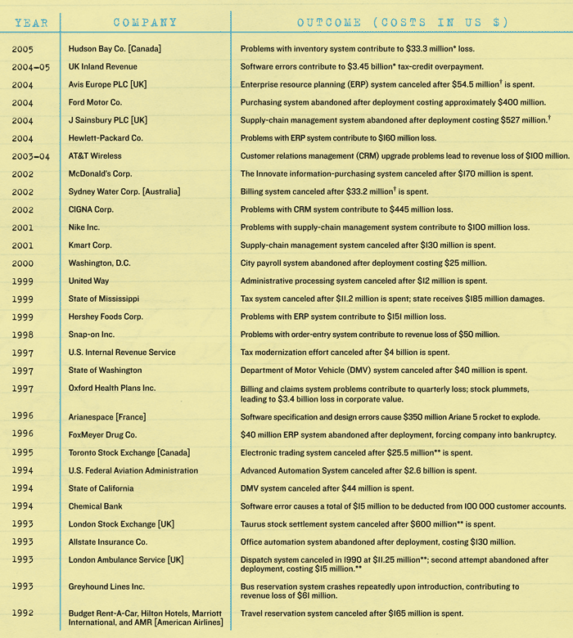
Software design failures
Notes:
http://spectrum.ieee.org/computing/software/why-software-fails

Slide 15
Top 10 software failures of 2011
Financial services giant fined $25 million for hiding software glitch that cost investors $217 million
Computer system bugs cause Asian banking facilities’ downtime
Cash machine bug benefits customers by giving them extra money
Leading smartphones suffer an international blackout
Bugs in social networking app for tablet just hours after delayed release
22 people wrongly arrested in Australia due to failures in new NZ $54.5 million courts computer system
50,500 cars recalled after airbag-related software glitch
Recall of one million cars addresses fire and rollaway concerns
Telecoms glitch affects 47,000 customers’ meter readings and costs company NZ $2.7 million
Army computer glitches hinder coordinated efforts in insurgent tracking
Notes:
http://www.businesscomputingworld.co.uk/top-10-software-failures-of-2011/

Slide 16
Top 15 worst computer software blunders
St. Mary’s Mercy Medical Center Kills Its Patients, On Paper
Knight Capital Group Loses Nine Figures in 30 Minutes
World War III Narrowly Averted
AT&T Demonstrates How Not to Upgrade Software
World Of Warcraft Creates Literal Computer Virus
Apple Maps Goes Nowhere Fast
Michigan Dept. of Corrections Grants Prisoners Early Release
California ‘Paroles’ 450 Violent Offenders (Without Supervision)
IRS Costs America Close To $300 Million
Patriot Missile System Timing Issue Leads To 28 Dead
…
Notes:
http://www.intertech.com/Blog/15-worst-computer-software-blunders/

Slide 17
Four types of software design
what is it to accomplish?
application design
satisfactory experience
how does one interact with it?
interaction design
change in the world
what is its conceptual core?
architecture design
plan for realization
what are its implementation details?
implementation design

Slide 18
Feasibility and desirability
feasibility
designer
plan
maker
change in the world
other stakeholders
audience
experiences
desirability

Slide 19
Why design
To develop the right software
for now
for later
To develop the software right
on time
within budget
on target

Slide 20
Midterm

