Slide 1
Informatics 121 Software Design I
Lecture 11
Duplication of course material for any commercial purpose without the explicit written permission of the professor is prohibited.

Slide 2
Announcements
There will be discussion this Friday
Midterm is this Thursday
Bring your student ID, we will be checking it

Slide 3
Today’s lecture
Design practice

Slide 4
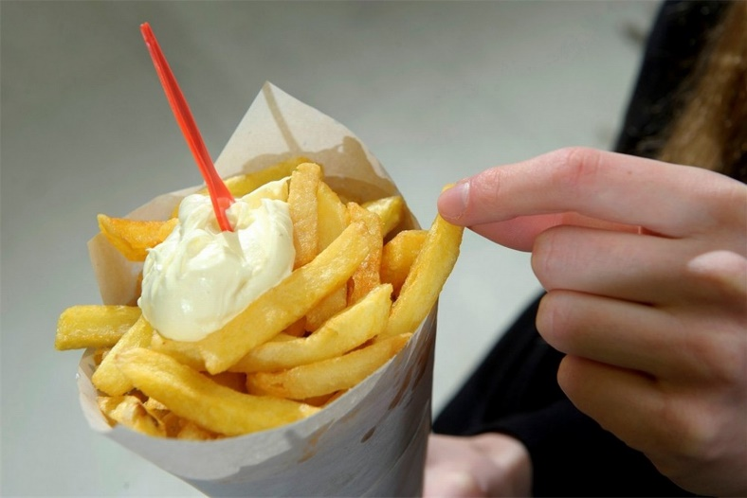
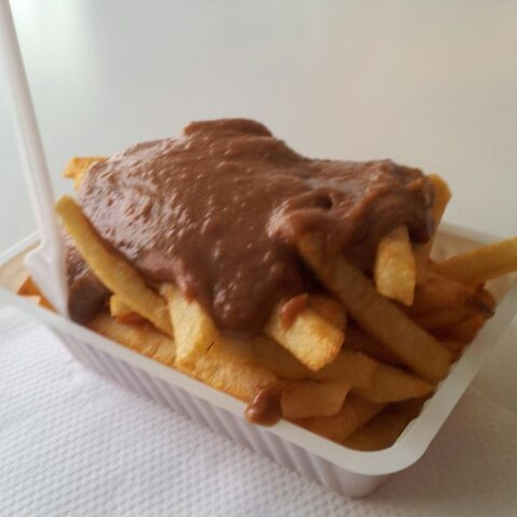
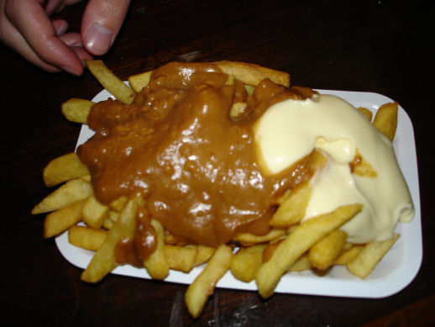
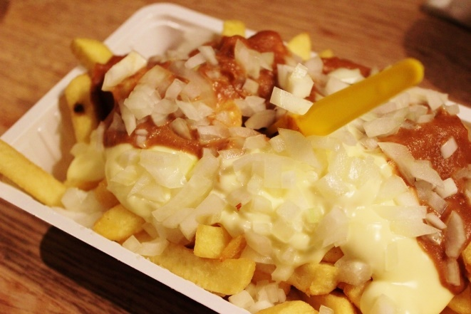
French fries and mayonnaise

Slide 5
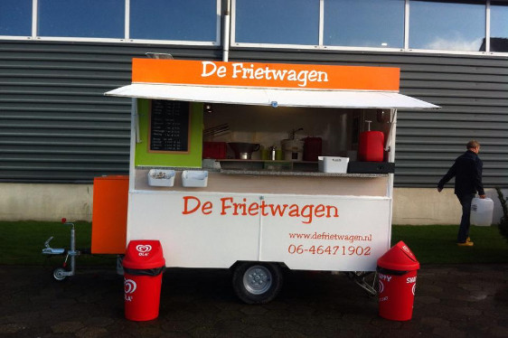
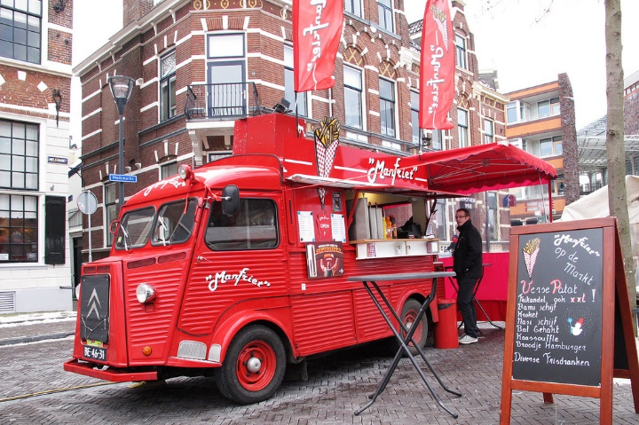
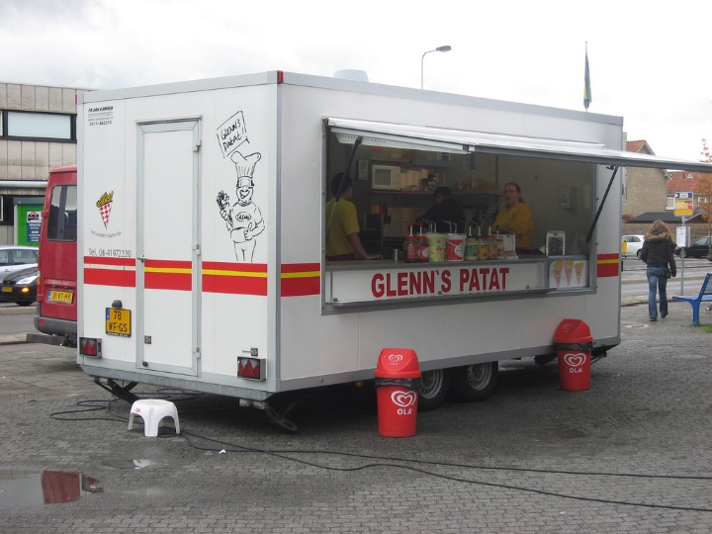
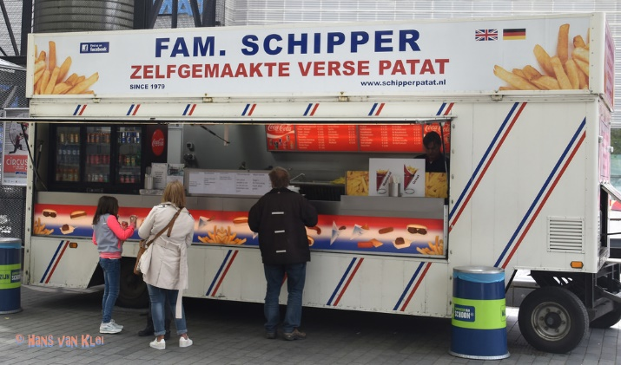
French fries and mayonnaise

Slide 6
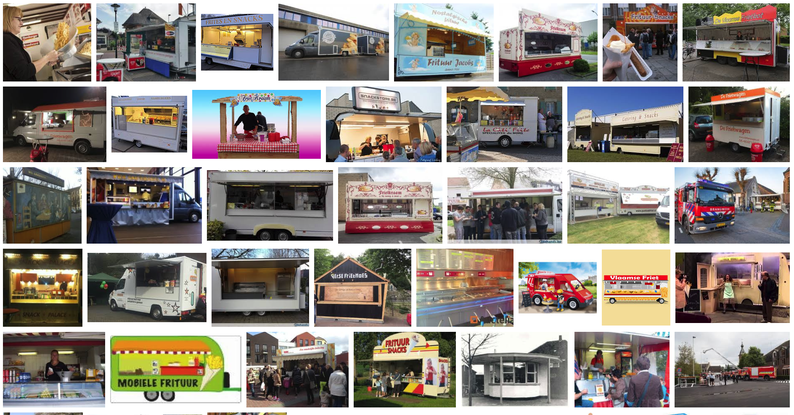
French fries and mayonnaise

Slide 7
French fries and mayonnaise
Multiple frietwagens
Multiple employees
Varied menus
Varied pricing
with ‘grouping’
I owe you’s
Inventory
Different reports

Slide 8
Things we need to model
Frietwagens
Owners
Employees
Orders
Customers
Type of trucks
Product
fries
condiments
Combo
Transaction
Inventory
Supplier
Menu
Menu item
Food
Payment method
Report

Slide 9
Where is the essence?
Reports?
Condiments?
Inventory?
Owners?
…

Slide 10
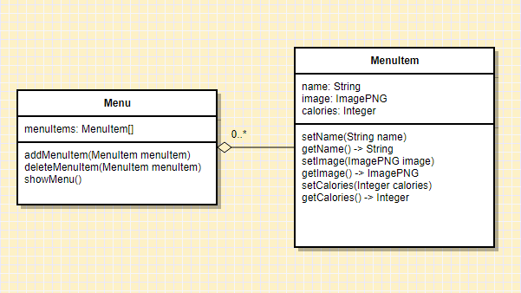
Example 1: representing menus

Slide 11
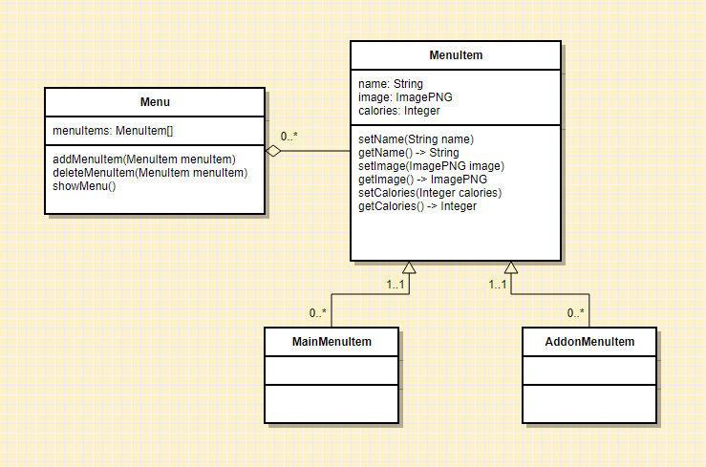
Example 1: representing menus

Slide 12
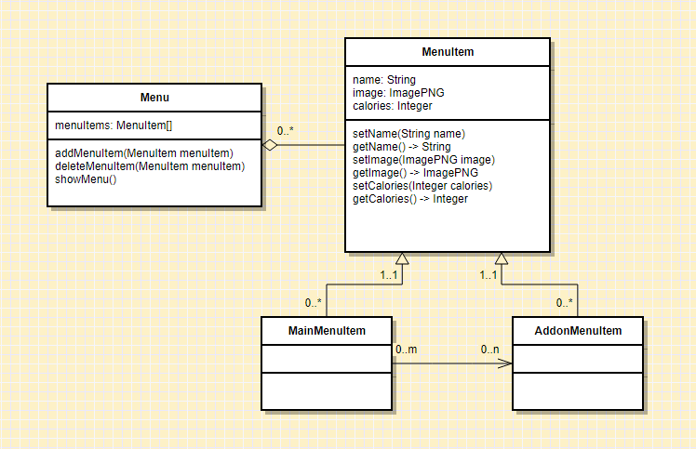
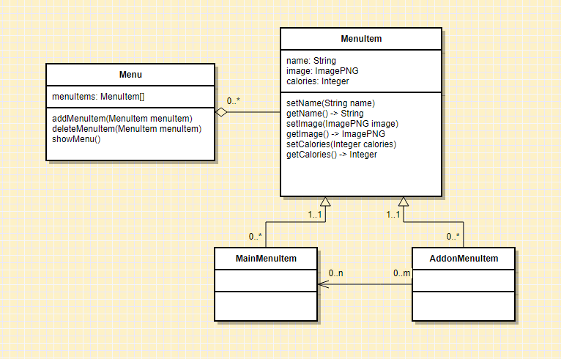
Example 1: representing menus

Slide 13
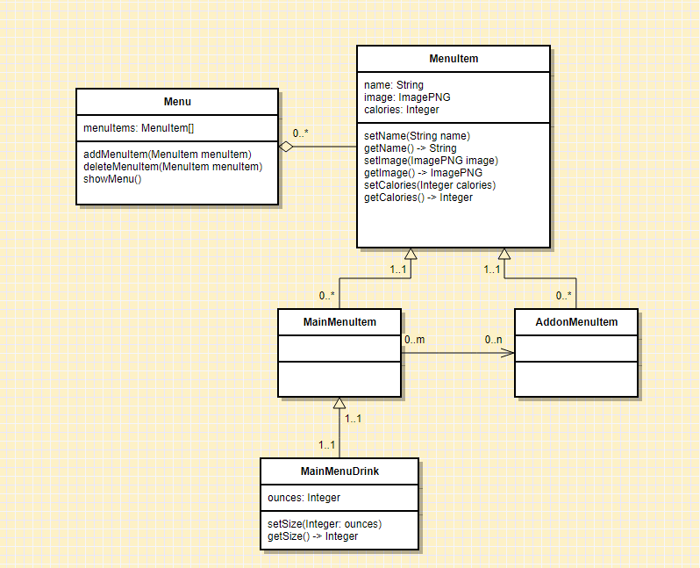
Example 1: representing menus

Slide 14
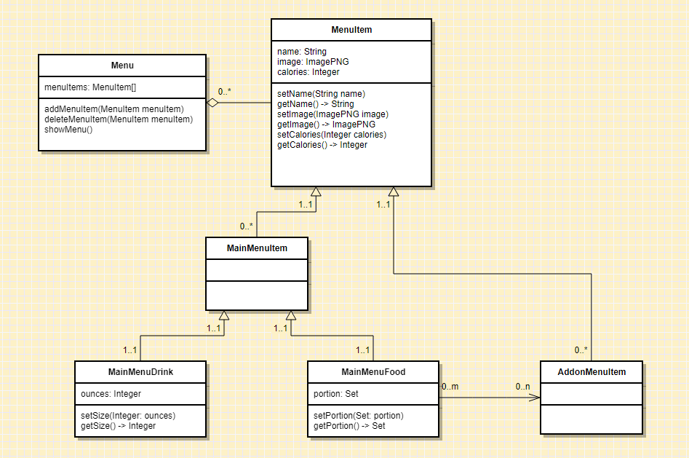
Example 1: representing menus

Slide 15
Example 1: what do we really need?

Slide 16
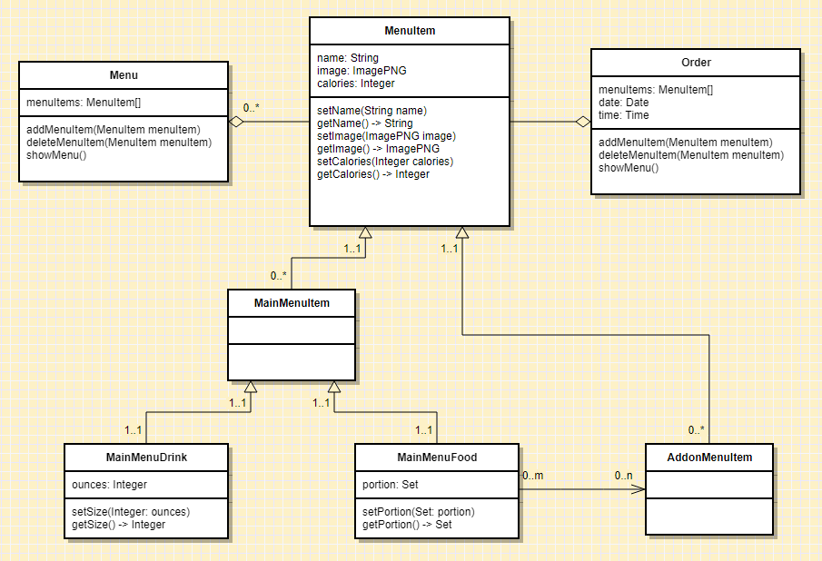
Example 2: accurate record of sales

Slide 17
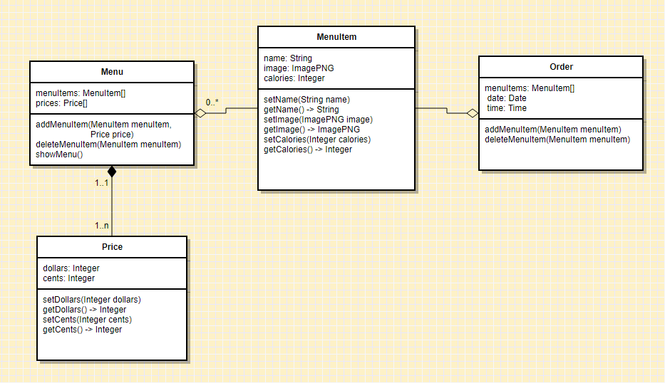
Example 2: accurate record of sales

Slide 18
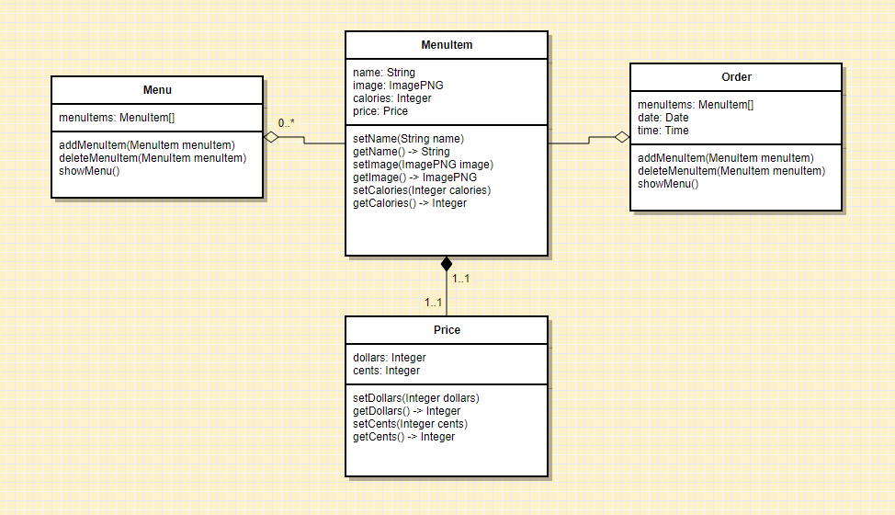
Example 2: accurate record of sales

Slide 19
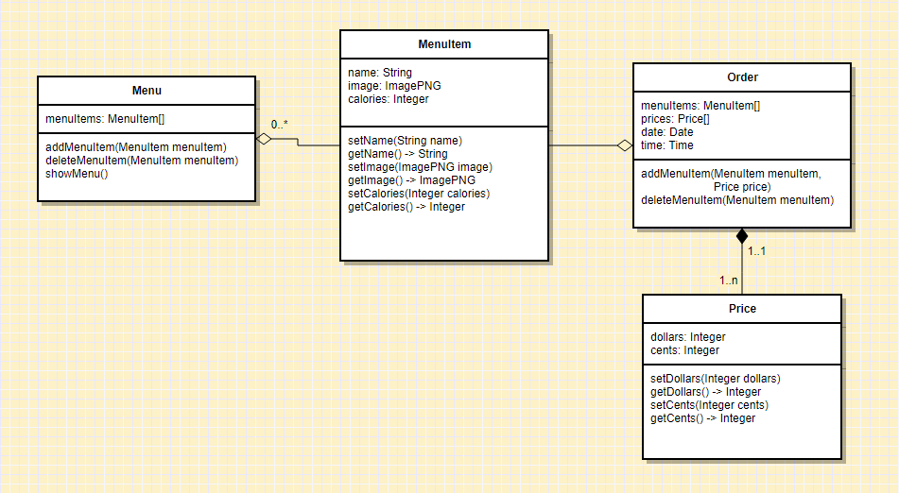
Example 2: accurate record of sales

Slide 20
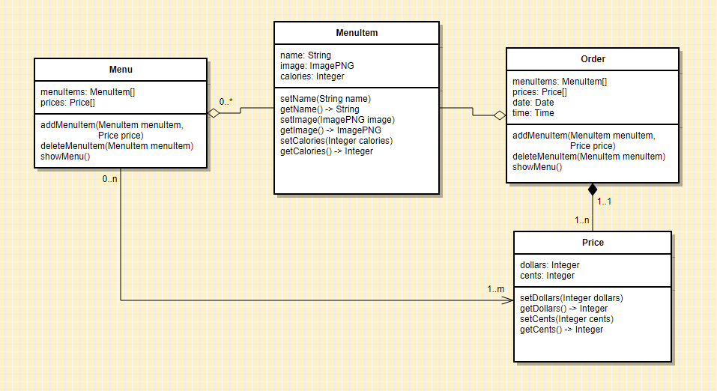
Example 2: accurate record of sales

Slide 21
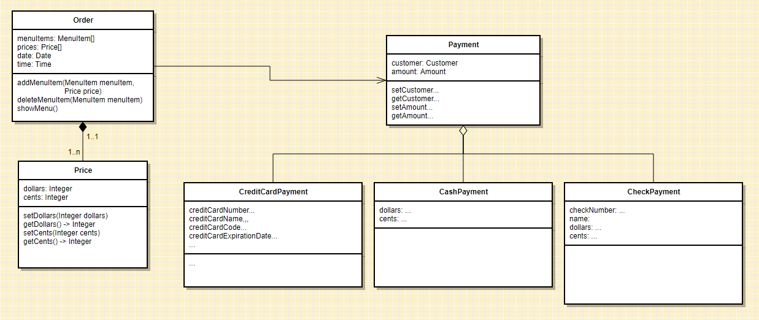
Example 2: accurate record of sales

Slide 22
Example 2: accurate record of sales
Split payments?
Cashbacks?
I owe you’s?
Partial I owe you’s?

Slide 23
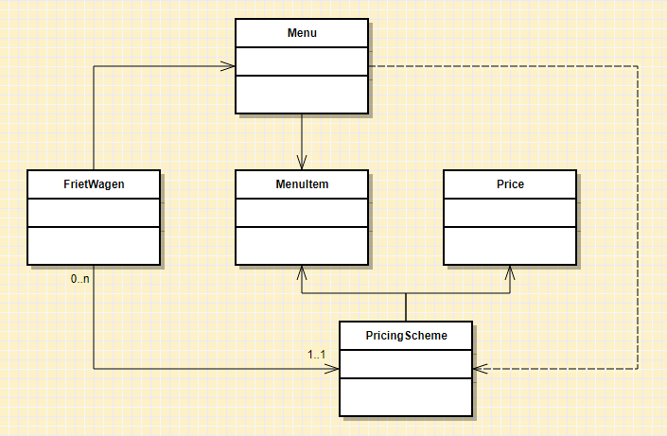
Example 3: groups of frietwagens

Slide 24
Expert practices we (should have) used
Solve simpler problems first
Go as deep as needed
Simulate continually
Focus on essence
Generate alternatives
Are alert to evidence that challenges their theory
Think about what they are not designing
Invest now to save time later

Slide 25
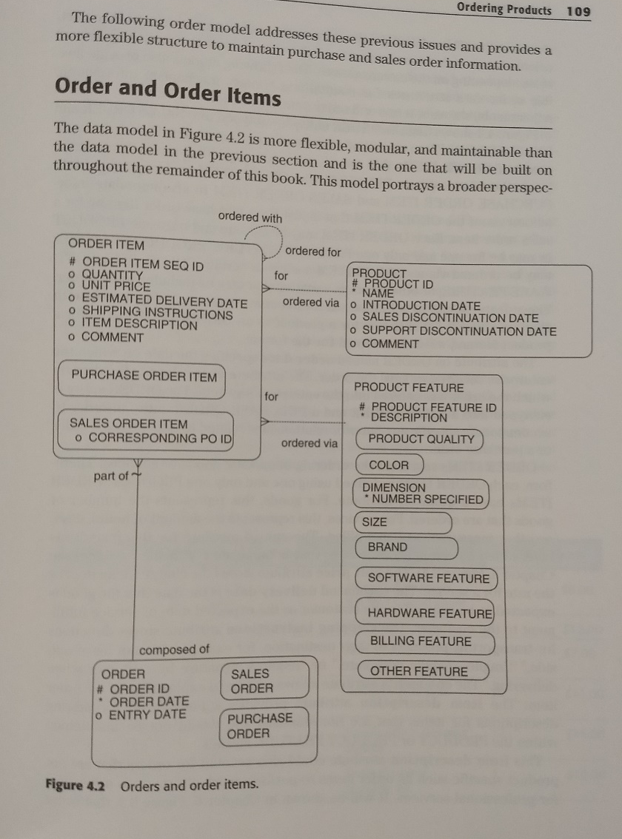
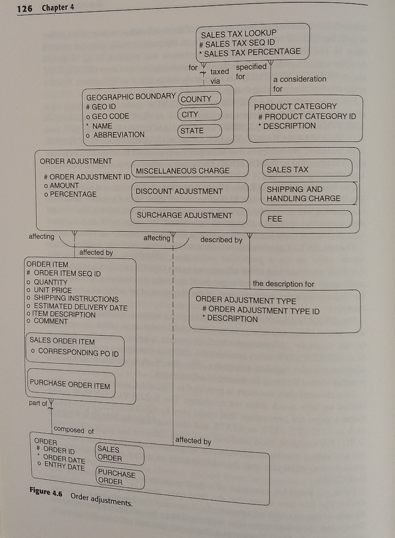
Experts prefer solutions that they know work

