Slide 1
Informatics 121 Software Design I
Lecture 5
Duplication of course material for any commercial purpose without the explicit written permission of the professor is prohibited.

Slide 2
Discussion
There will be discussion this upcoming Friday
Please join your designated discussion

Slide 3
Today
Expert behaviors
Four types of design
Design studio 1

Slide 4
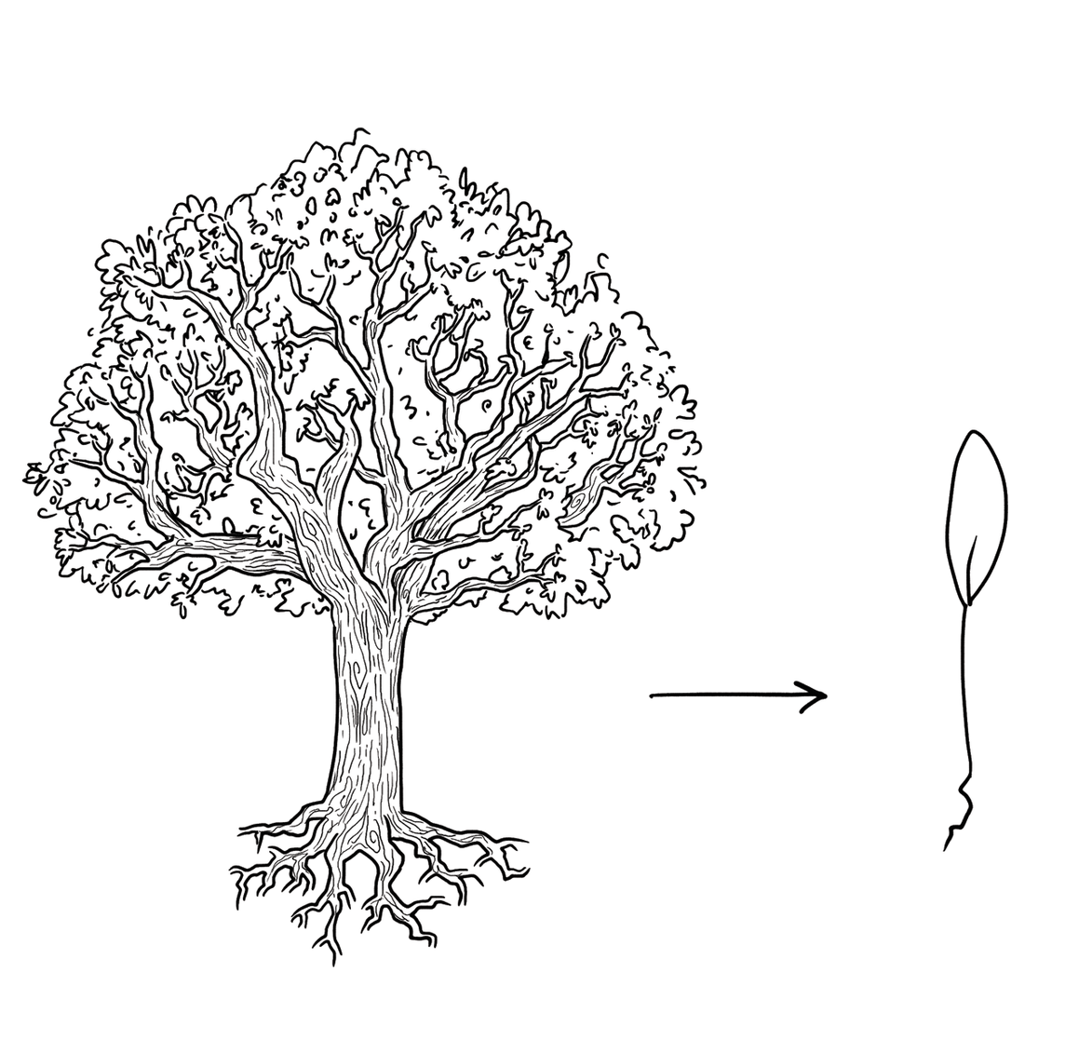
Experts focus on the essence

Slide 5
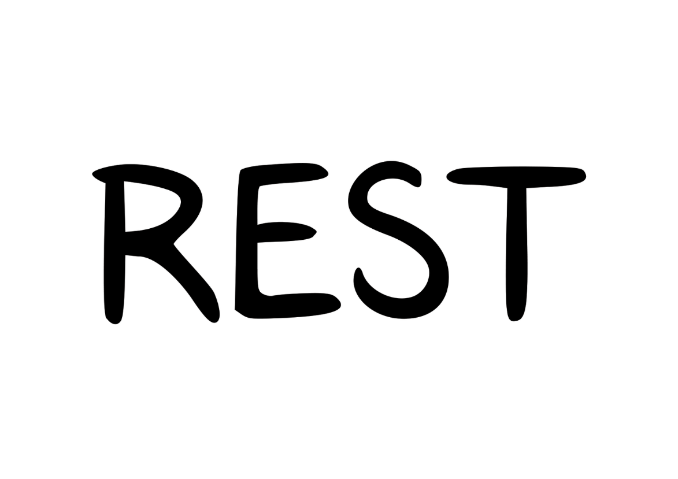
Experts prefer solutions that they know work

Slide 6
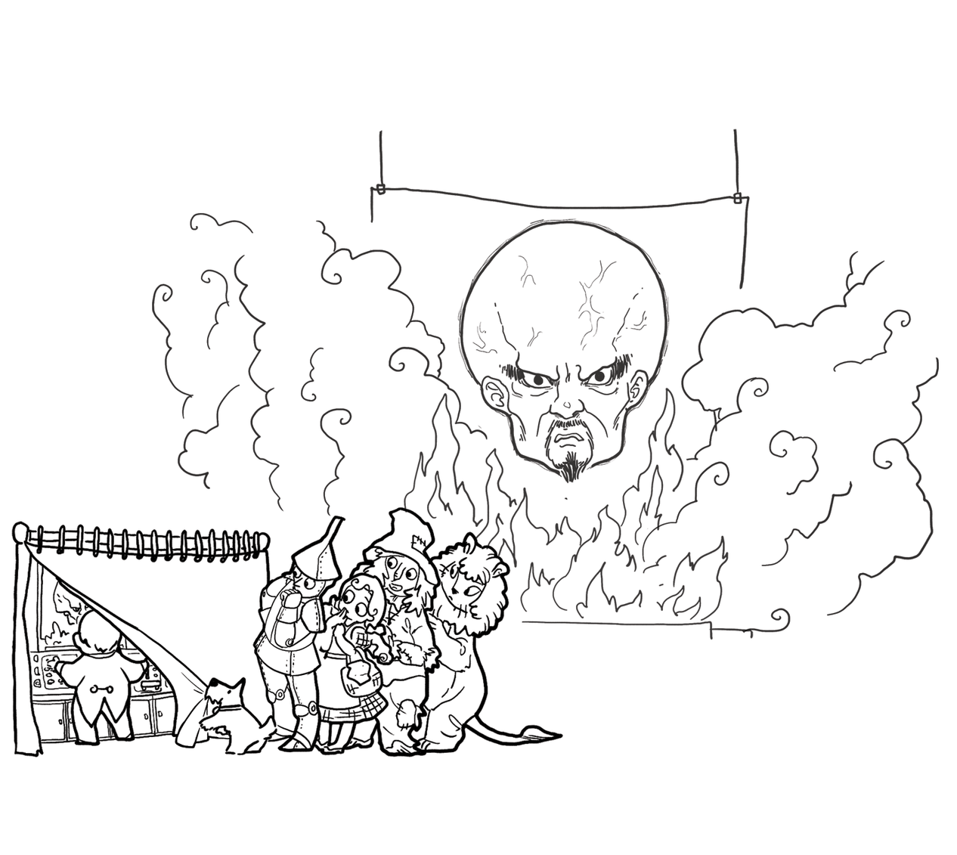
Experts address knowledge deficiencies

Slide 7
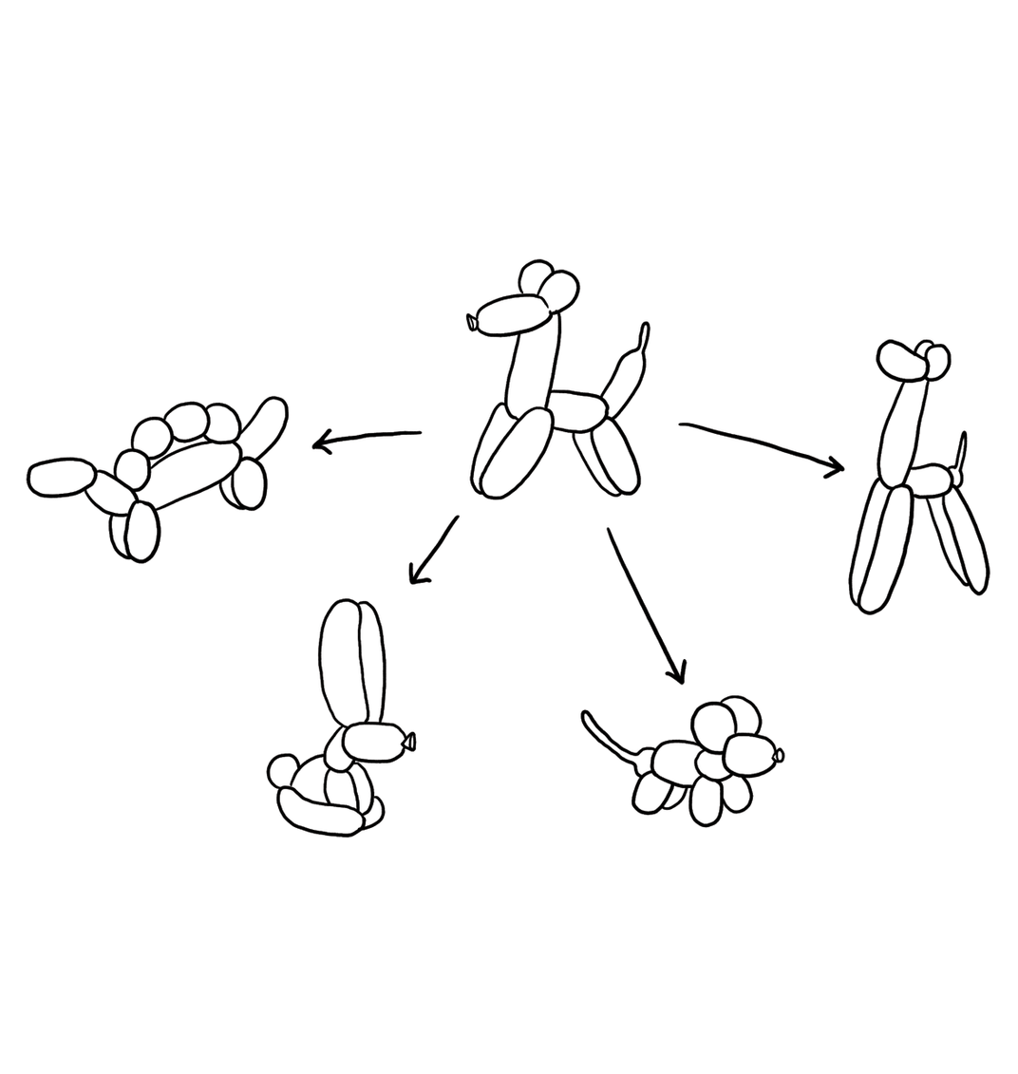
Experts generate alternatives

Slide 8
Experts are skeptical

Slide 9
Design
designer
plan
maker
change in the world
other stakeholders
audience
experiences

Slide 10
Feasibility and desirability
feasibility
designer
plan
maker
change in the world
other stakeholders
audience
experiences

Slide 11
Feasibility and desirability
feasibility
designer
plan
maker
change in the world
other stakeholders
audience
experiences
desirability

Slide 12
Four types of design
desirability
what is it to accomplish?
how does one interact with it?
feasibility
what is its conceptual core?
what are its implementation details?

Slide 13
Four types of design
what is it to accomplish?
satisfactory experience
how does one interact with it?
change in the world
what is its conceptual core?
plan for realization
what are its implementation details?

Slide 14
Four types of software design
what is it to accomplish?
application design
satisfactory experience
how does one interact with it?
interaction design
change in the world
what is its conceptual core?
architecture design
plan for realization
what are its implementation details?
implementation design

Slide 15
Design a mobile phone messaging system
what is it to accomplish?
application design
satisfactory experience
how does one interact with it?
interaction design
change in the world
what is its conceptual core?
architecture design
plan for realization
what are its implementation details?
implementation design

Slide 16
Design a word processor
what is it to accomplish?
application design
satisfactory experience
how does one interact with it?
interaction design
change in the world
what is its conceptual core?
architecture design
plan for realization
what are its implementation details?
implementation design

Slide 17
Design cycle
synthesize
goals
constraints
assumptions
decisions
ideas
analyze
evaluate

Slide 18
Design studio 1
Your client is RealPlay, a new company that recognizes the importance of children not only playing on some form of laptop, phone, or tablet, but also playing with friends in the real world.
RealPlay is particularly looking to break the increasing screen-oriented world of children by finding them opportunities to play with other children. It’s looking to borrow ideas from Facebook, Doodle, and so on, but really wants to ‘blow this out of the water’ and be the next unicorn ($1B startup). Additional functionality, then, is something it wants thought about.
The company has sought you out, because you are an excellent designer. All of the software design is in your hands. PlayTime has the idea protected (meaning no competition), but has no idea how to actually design the software.

Slide 19
Design studio 1 (part 1)
Identify possible audiences and other stakeholders
Identify possible goals, constraints, and assumptions
Bring two printed copies to discussion, this Friday
one for the TAs
one for your group
Your group will be announced at the start of your discussion

Slide 20
Design studio 1 (part 2)
As a team, design the consumer facing side of RealPlay in terms of the functionality it will offer and how users will interact with it
Make sure that you explicitly identify goals, constraints, and assumptions
Make sure to consider at least three different approaches, highlight tradeoffs among the approaches, and discuss why you chose the approach you took
briefly document the approaches you considered but did not adopt

Slide 21
Design studio 1 (part 2)
Practice what you have learned about experts:
focus on the essence
prefer solutions that they know work
address knowledge deficiencies
generate alternatives
are skeptical
Due Tuesday February 5, at noon (through GradeScope)
make sure to identify all group members

Slide 22
Design studio 1 (part 2)
Team members will assess other team members
in terms of the contributions they make
in terms of enabling others to make contributions
Worth 15 points (team grade)

