Slide 1
Informatics 43 Introduction to Software Engineering
Lecture 1
Duplication of course material for any commercial purpose without the explicit written permission of the professor is prohibited.

Slide 2
Today’s lecture
Administrative details
Software is everywhere
Definitions
Business perspective on software engineering
Engineering perspective on software engineering
Design perspective on software engineering
Remainder of this class

Slide 3
Today’s lecture
Administrative details
Software is everywhere
Definitions
Business perspective on software engineering
Engineering perspective on software engineering
Design perspective on software engineering
Remainder of this class

Slide 4
Instructional team
Professors
André van der Hoek (andre@uci.edu)
Hadar Ziv (hadarziv97@gmail.com)
TA
Lee Martie (lmartie@uci.edu)
Reader
Ankita Raturi (sudokita@gmail.com)

Slide 5
Reaching us – André van der Hoek
Office hours by appointment only
Open door policy
DBH 5228
DBH 5038
E-mail
IM

Slide 6
Reaching us – Hadar Ziv
Office hours by appointment only
Open door policy
DBH 5062
E-mail

Slide 7
Reaching us – Lee Martie and Ankita Raturi
Office hours
to be announced
E-mail

Slide 8
Course web site
http://www.ics.uci.edu/~andre/informatics43f2012.html

Slide 9
Textbook
No required textbook

Slide 10
Be involved…
Attend class
Visit course web site on a regular basis
Read e-mail frequently
Ask questions

Slide 11
…but do not be too involved
If you do not follow the UC Irvine Academic Honesty policy, you fail the course with an F
All course work is on an individual basis
do not borrow work
do not lend work
Your TA is your friend, but your friend is not your TA

Slide 12
Assignments
Start early
Hand in at the beginning of class
No late assignments will be accepted
grade is “F” for a late assignment
Package properly
include your name, student ID, and e-mail address
include cover page

Slide 13
Grading
Performed by TA, reader, and professor
Resolve disagreements with the TA and reader first

Slide 14
Grade distribution
Assignments | 30%
Midterm | 30%
Final | 40%

Slide 15
Exceptions
Only granted by the professors
Contact professors as soon as possible
Contact professors with valid reasons

Slide 16
Questions
When in doubt
ask the TA or reader
ask the professors
E-mail questions
address properly
sign with your name
answers are (generally) copied to everybody

Slide 17
Today’s lecture
Administrative details
Software is everywhere
Definitions
Business perspective on software engineering
Engineering perspective on software engineering
Design perspective on software engineering
Remainder of this class

Slide 18
Software is everywhere: cars
http://spectrum.ieee.org/green-tech/advanced-cars/this-car-runs-on-code/
“New cars now frequently carry 200 pounds of electronics and more than a mile of wiring”
“…if you bought a premium-class automobile recently, it probably contains close to 100 million lines of software code…”

Slide 19
Software is everywhere: cars
“The radio on many cars talks to the automatic transmission over an in-car network”
“The airbag accelerometer, parking lights, GPS navigation, cell phone, and door locks also network so that in a serious accident, the car calls for emergency aid, sends the GPS coordinates of the accident, unlocks the doors, and flashes the car’s lights”

Slide 20
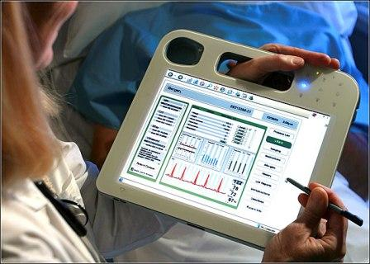
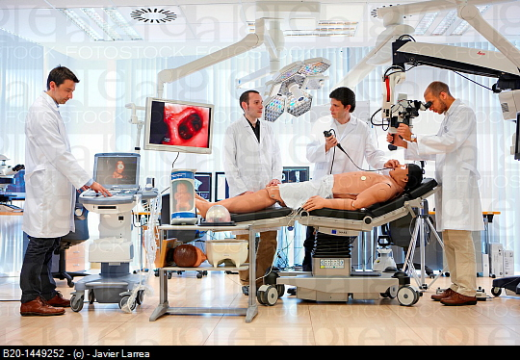
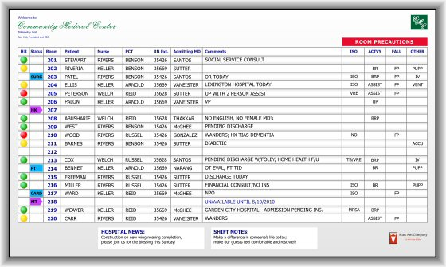
Software is everywhere: medical systems

Slide 21
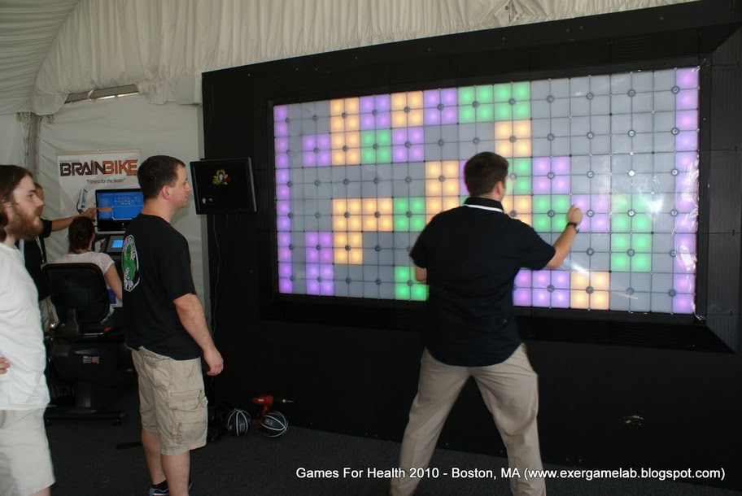
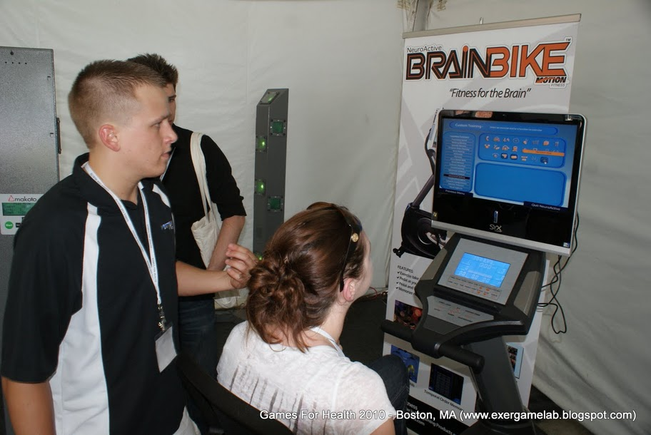
Software is everywhere: games

Slide 22
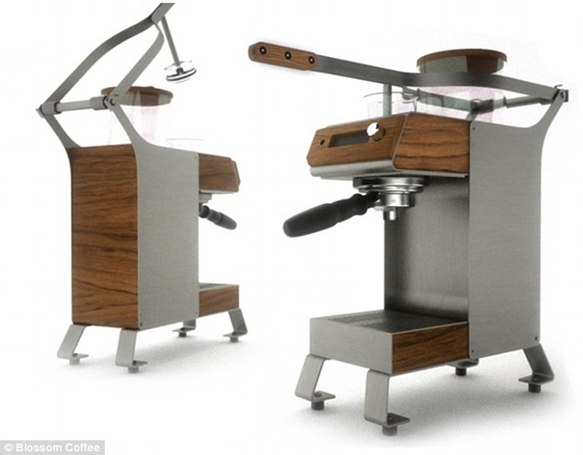
Software is everywhere: bonus

Slide 23
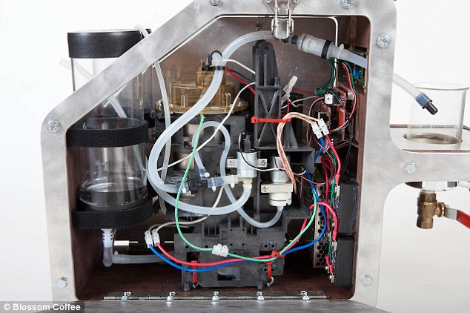
Software is everywhere: bonus
The machine also connects to WiFi and has a camera for a QR scanner. They hope that some day, coffee bags will have a QR code that the machine will recognize and brew appropriately.

Slide 24
Today’s lecture
Administrative details
Software is everywhere
Definitions
Business perspective on software engineering
Engineering perspective on software engineering
Design perspective on software engineering
Remainder of this class

Slide 25
Software engineering
“A discipline that deals with the building of software systems which are so large that they are built by a team or teams of engineers.” [Ghezzi, Jazayeri, Mandrioli]

Slide 26
Software engineering
“A discipline that deals with the building of software systems which are so large that they are built by a team or teams of engineers.” [Ghezzi, Jazayeri, Mandrioli]
“Multi-person construction of multi-version software.” [Parnas]

Slide 27
Software engineering
“A discipline whose aim is the production of fault-free software, delivered on-time and within budget, that satisfies the user’s needs. Furthermore, the software must be easy to modify when the user’s needs change.” [Schach]
“It’s where you get to design big stuff and be creative.” [Taylor]

Slide 28
Software engineering
“Difficult.” [van der Hoek]
“A form of creative human design.” [Ziv]

Slide 29
Today’s lecture
Administrative details
Software is everywhere
Definitions
Business perspective on software engineering
Engineering perspective on software engineering
Design perspective on software engineering
Remainder of this class

Slide 30
Business perspective: cars
“…of all the staff hours in the entire program to build the Two-Mode Hybrid transmission…some 70 percent…were devoted to developing the control software”

Slide 31
Business perspective: medical systems
“…they won’t cover anywhere near the staggering cost of an Epic EHR. Duke University Health System will shell out $700 million, so will Boston-based Partners HealthCare; University of California, San Francisco will pay $150 million…”
“Partners HealthCare — the giant parent organization of Massachusetts General and Brigham and Womens, among other hospitals — recently signed off on a new system that will cost at least $600 million and take years to fully implement. The real final tab is anyone’s guess.”

Slide 32
Business perspective: game development
“The average price of game production slowly rose from $1M–4M in 2000 to over 5M in 2006 to over 20M in 2010.”
“Grand Theft Auto IV is touted as the most expensive game ever made. The evidence: Rockstar Games spent a cool $100M on this fourth installment. At times, as many as 1000 people were purported to be working on the game and the stupendous soundtrack alone shows it…”
“In 2009 games market annual value is estimated between $7–30 billion, depending on which sales figures are included. This is on par with films box office market.”

Slide 33
Business perspective: bonus
http://spectrum.ieee.org/computing/software/who-killed-the-virtual-case-file
“Instead, the FBI claims, the VCF's contractor, Science Applications International Corp. (SAIC), in San Diego, delivered 700 000 lines of code so bug-ridden and functionally off target that this past April, the bureau had to scrap the US $170 million project, including $105 million worth of unusable code.”

Slide 34
Business perspective
Ultimately, from a business perspective, two issues matter:
cost of developing (purchasing) software
time to market of product
The cost and time to market should both be minimized as much as possible
Software engineering can help both in keeping cost low and accelerating time to market

Slide 35
Today’s lecture
Administrative details
Software is everywhere
Definitions
Business perspective on software engineering
Engineering perspective on software engineering
Design perspective on software engineering
Remainder of this class

Slide 36
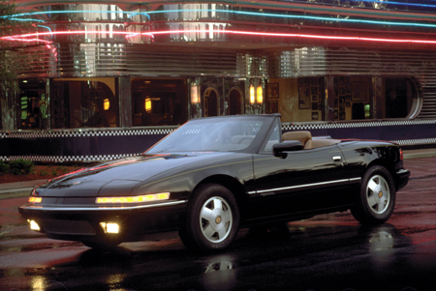
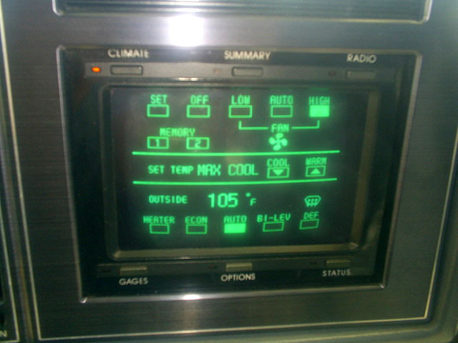
Engineering perspective: cars
(1988)

Slide 37
Engineering perspective: medical systems
https://threatpost.com/en_us/blogs/fda-software-failures-responsible-24-all-medical-device-recalls-062012
Software failures were behind 24 percent of all the medical device recalls in 2011, according to data from the U.S. Food and Drug Administration, which said it is gearing up its labs to spend more time analyzing the quality and security of software-based medical instruments and equipment.

Slide 38
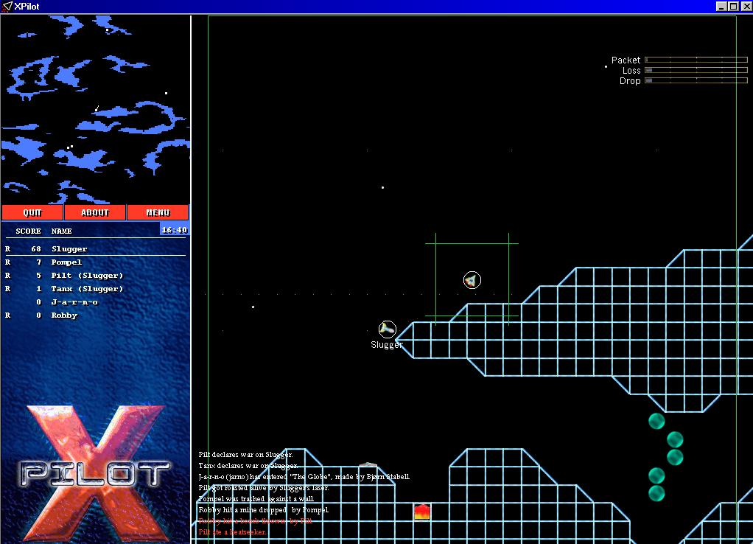
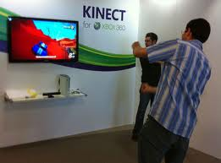
Engineering perspective: game development

Slide 39
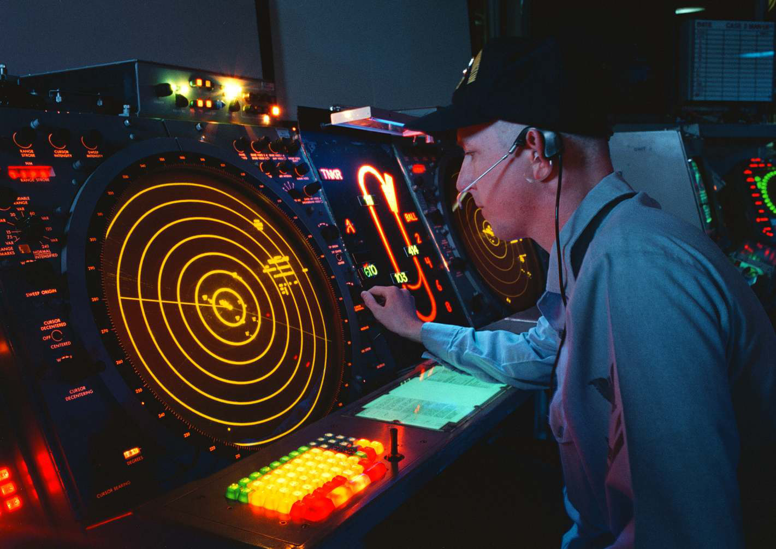
Engineering perspective: bonus

Slide 40
Engineering perspective
Ultimately, from an engineering perspective, what matters is the internal quality of the software, and making it work within the constraints of the environment
This internal quality should be maximized as much as possible
Software engineering can help in engineering systems with better internal quality

Slide 41
Today’s lecture
Administrative details
Software is everywhere
Definitions
Business perspective on software engineering
Engineering perspective on software engineering
Design perspective on software engineering
Remainder of this class

Slide 42
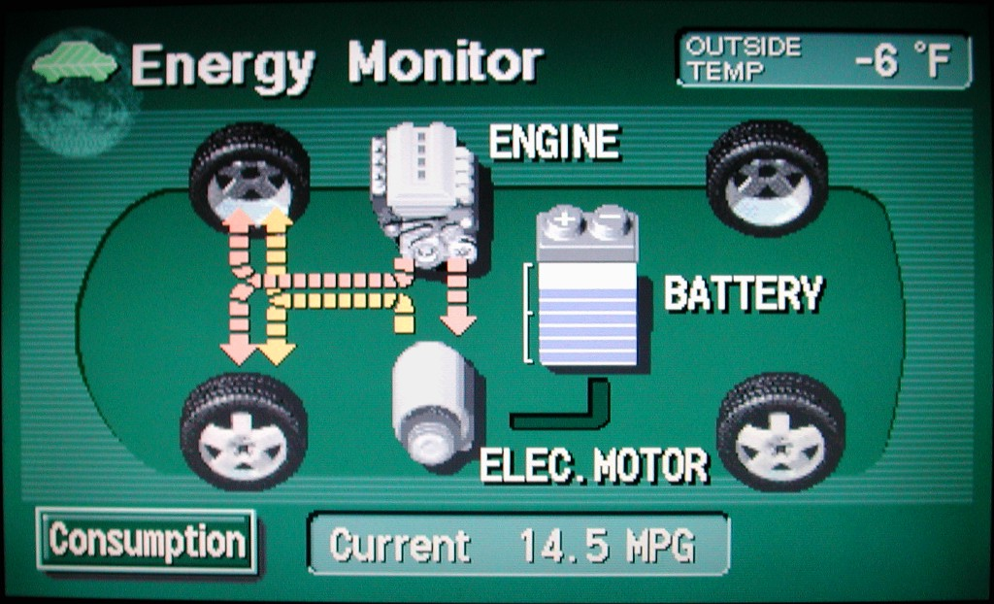
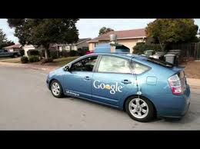
Design perspective: cars

Slide 43
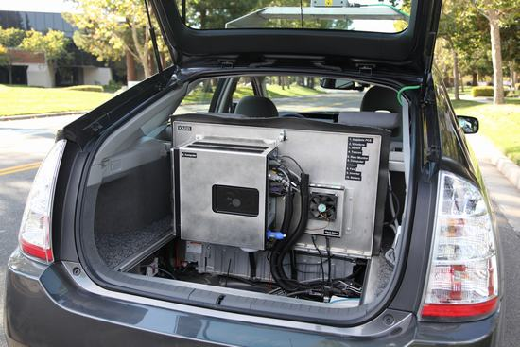
Design perspective: cars

Slide 44
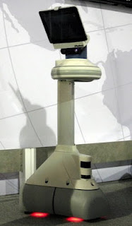
Design perspective: medical systems
“Unfortunately, Ava is extremely not awesome looking.... They should take a hint from Apple and make her look awesome.

Slide 45
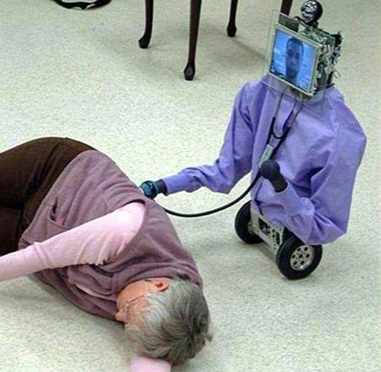
Design perspective: medical systems
“Unfortunately, Ava is extremely not awesome looking.... They should take a hint from Apple and make her look awesome.

Slide 46
Design perspective: game development
http://www.designersnotebook.com/Design_Resources/No_Twinkie_Database/no_twinkie_database.htm
“…the things that make a boss battle boring are, "stupid amounts of repetition, ridiculously high/replenishing energy [i.e. boss health] combined with unimaginative gameplay (yawn), and powered up versions of previous bosses.“
“More lazy puzzle design. At the end of Infidel, which was another Infocom adventure, you had to do four things in a certain sequence. The number of possible combinations is 4! (four factorial, or 24). There was no clue whatsoever as to the correct sequence; you just had to try them all. Yuck. Yet another time-waster with no enjoyment value. “

Slide 47
Design perspective: bonus

Slide 48
Design perspective: bonus
“The new Maps may improve over time, but at least out of the gate, this is one of Apple's biggest flops.”

Slide 49
Design perspective
Ultimately, from an design perspective, what matters is the external quality of the software
This external quality should be maximized as much as possible
Software engineering can help in designing systems with better external quality

Slide 50
Today’s lecture
Administrative details
Software is everywhere
Definitions
Business perspective on software engineering
Engineering perspective on software engineering
Design perspective on software engineering
Remainder of this class

