Slide 1
Informatics 43 Introduction to Software Engineering
Lecture 7
Duplication of course material for any commercial purpose without the explicit written permission of the professor is prohibited.

Slide 2
Today’s lecture
Designs
Abstraction
Design notations
Class diagrams
Use case diagrams
Storyboards

Slide 3
Designs

Slide 4
Designs

Slide 5
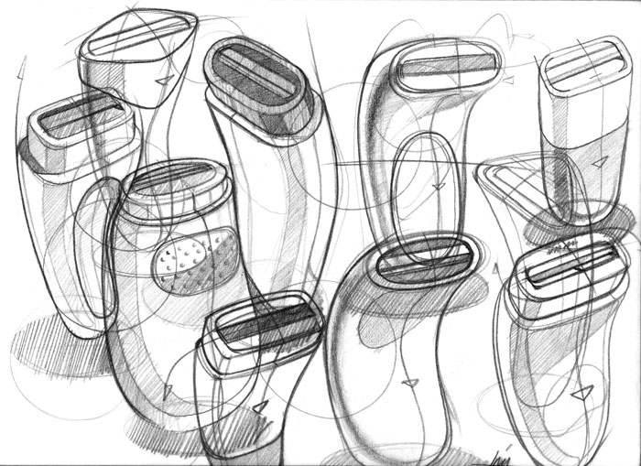
Designs

Slide 6
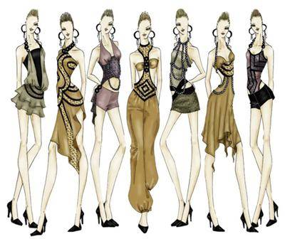
Designs

Slide 7
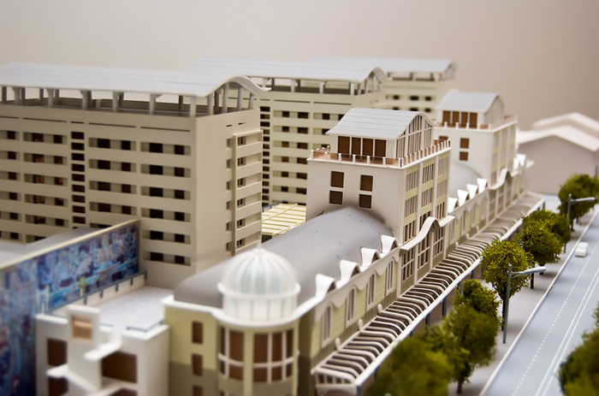
Designs

Slide 8
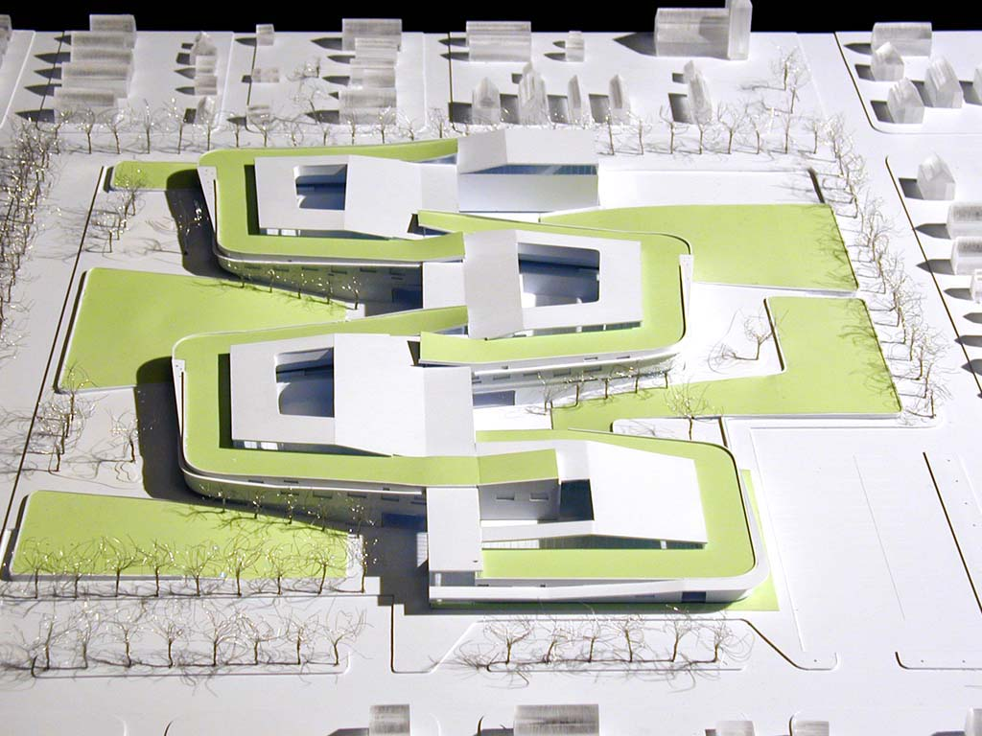
Designs

Slide 9
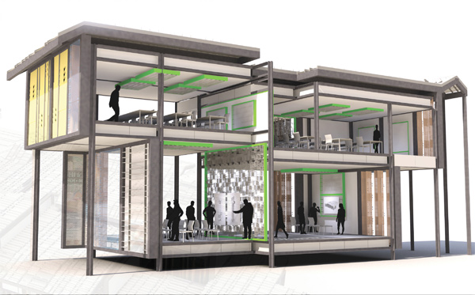
Designs

Slide 10
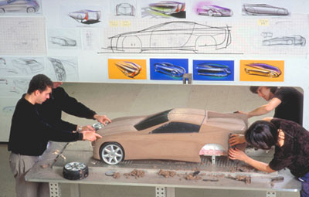
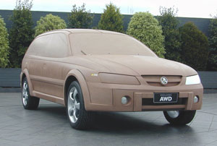
Designs

Slide 11
Purpose of designs
Designs to think
Designs to talk
Designs to prescribe

Slide 12
Today’s lecture
Designs
Abstraction
Design notations
Class diagrams
Use case diagrams
Storyboards

Slide 13
Abstraction
Abstractions are formed by reducing the information content of a concept or an observable phenomenon, typically to retain only information which is relevant for a particular purpose
what do I need to know
what do I not need to know
Every design notation supports a certain kind of abstraction

Slide 14
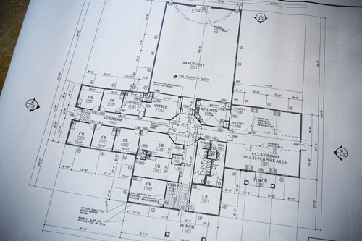
Designs

Slide 15
Designs

Slide 16
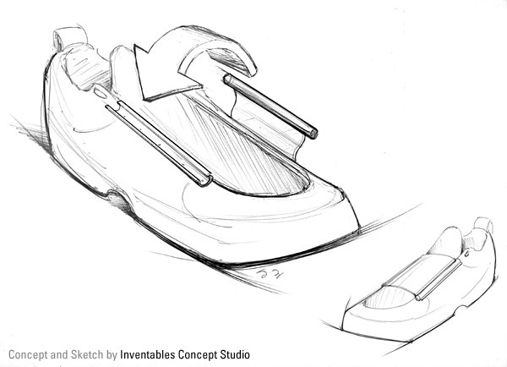
Designs

Slide 17
Today’s lecture
Designs
Abstraction
Design notations
Class diagrams
Use case diagrams
Storyboards

Slide 18
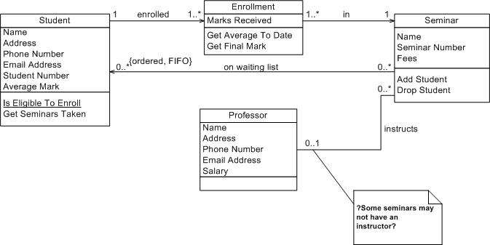
Examples – class diagrams

Slide 19
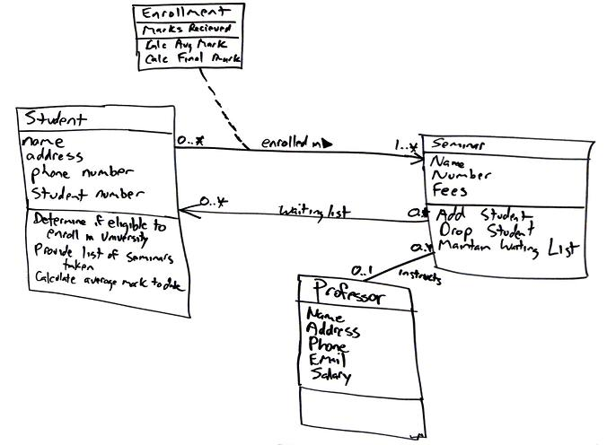
Examples – class diagrams

Slide 20
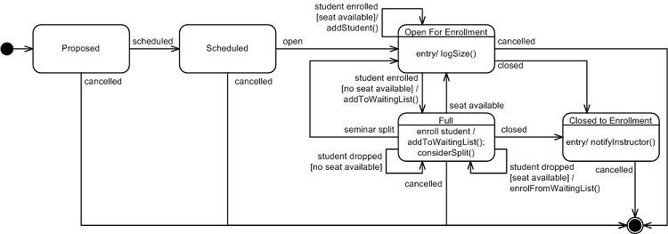
Examples – state transition diagrams

Slide 21
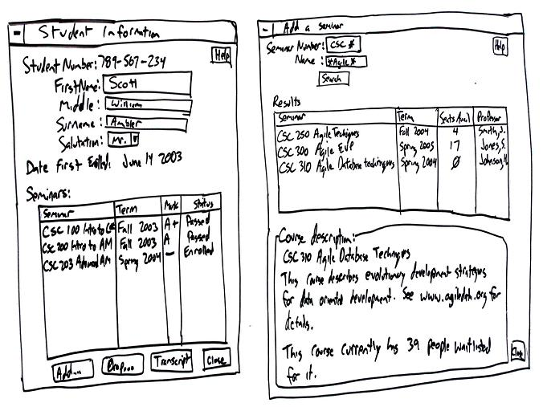
Examples – user interfaces

Slide 22
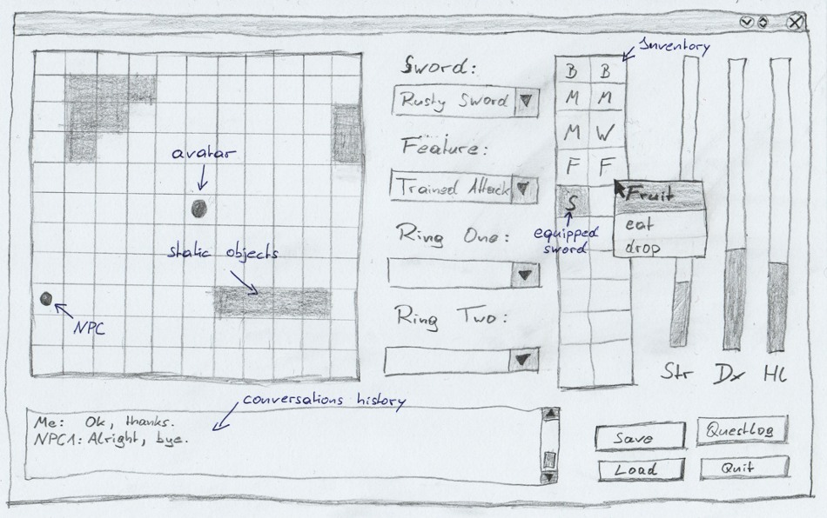
Examples – user interfaces

Slide 23
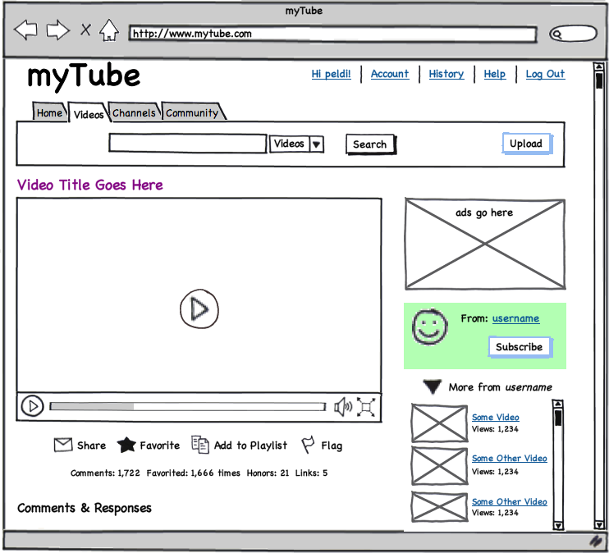
Examples – user interfaces
[balsamiq]

Slide 24
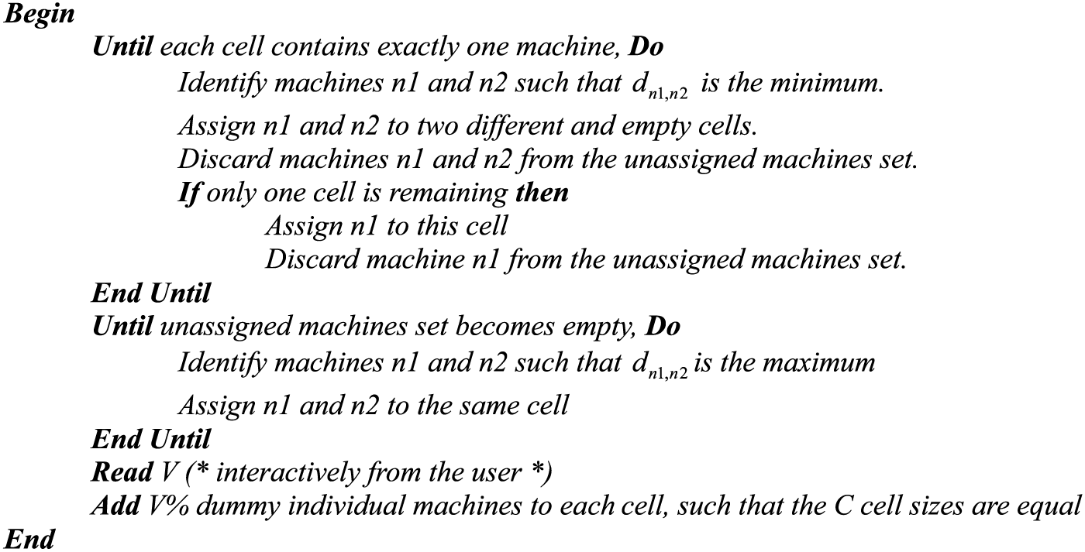
Examples – pseudo code

Slide 25
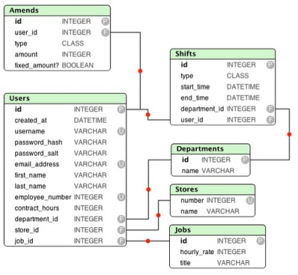
Examples – entity relationship diagrams

Slide 26
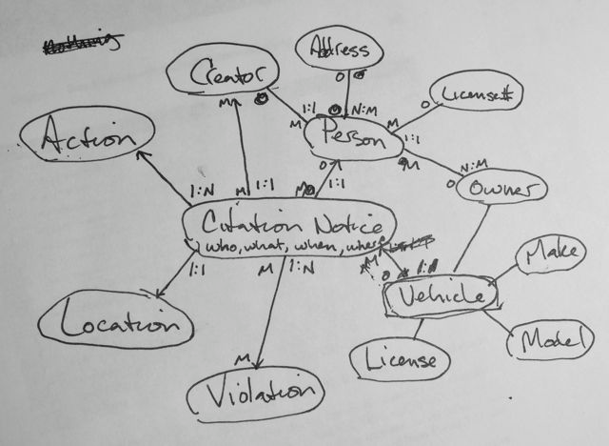
Examples – entity relationship diagrams

Slide 27
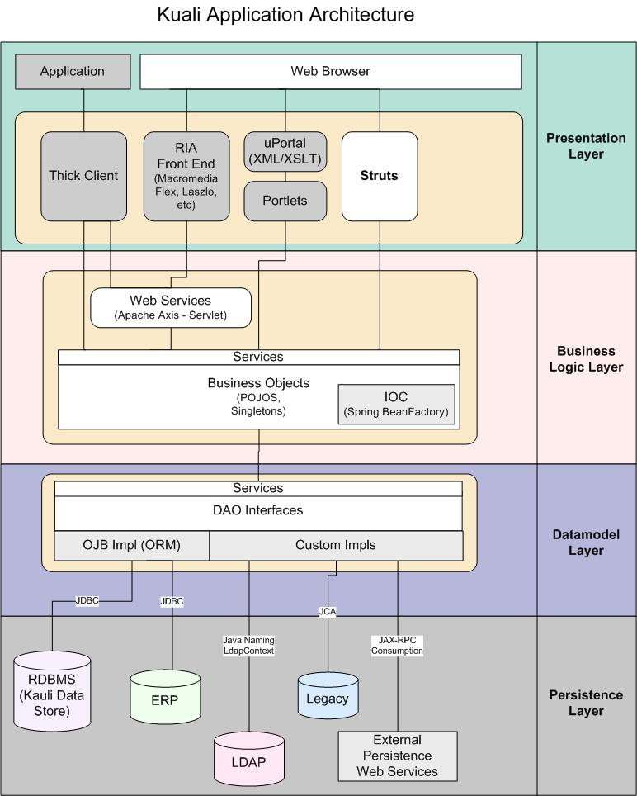
Examples – architecture diagrams

Slide 28
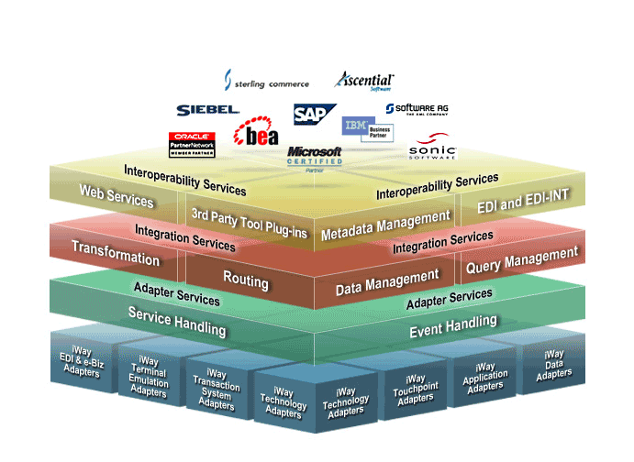
Examples – architecture diagrams

Slide 29
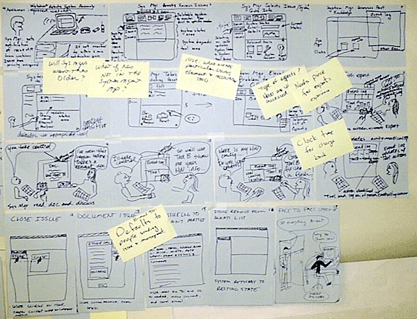
Examples – storyboard

Slide 30
Examples – storyboard

Slide 31
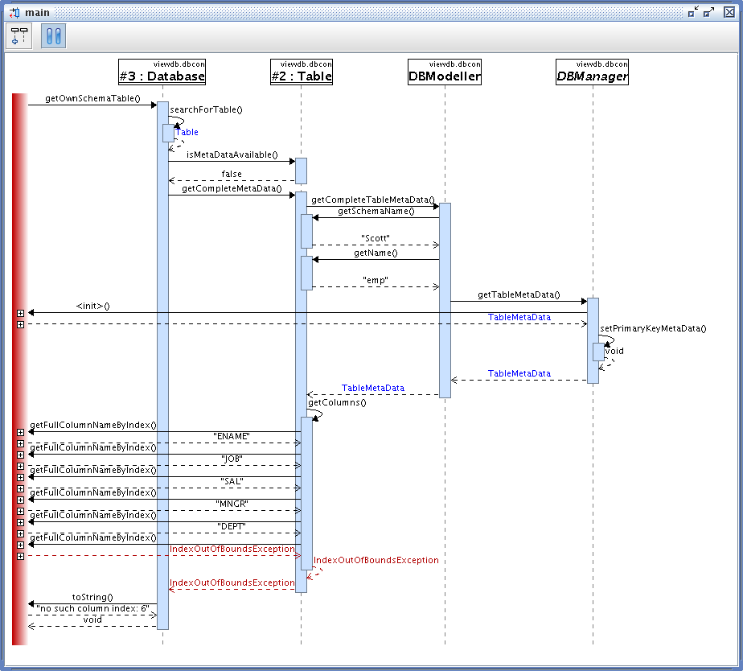
Examples – sequence diagrams

Slide 32
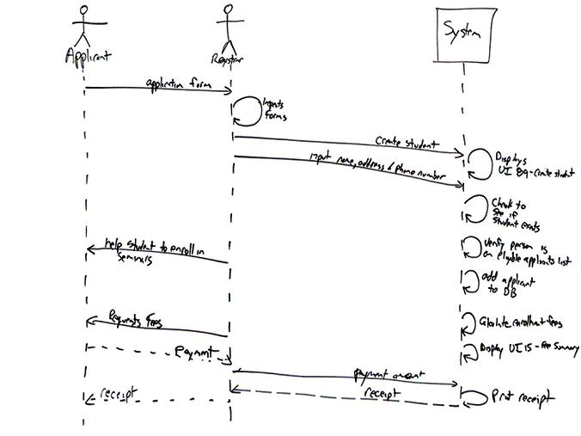
Examples – sequence diagrams

Slide 33
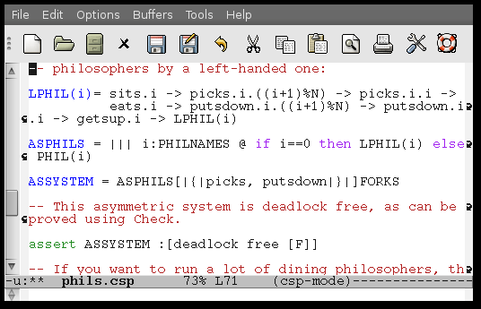
Examples – communicating sequential processes

Slide 34
Today’s lecture
Designs
Abstraction
Design notations
Class diagrams
Use case diagrams
Storyboards

Slide 35
Class diagrams
UML class diagrams show the classes of the system, their inter-relationships, and the operations and attributes of the classes
Typically used:
model domain concepts
create a detailed, object oriented design of the code

Slide 36
Example class diagram

Slide 37
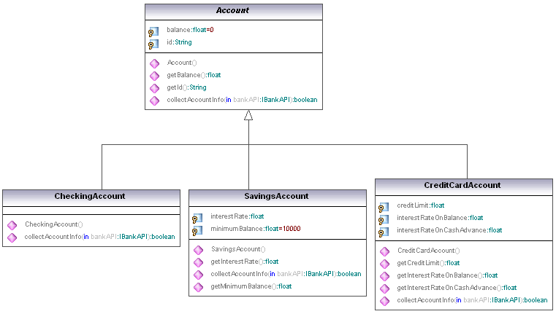
Example class diagram

Slide 38
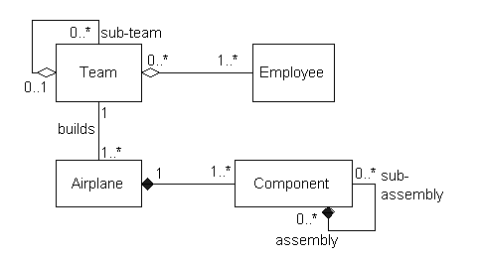
Example class diagram

Slide 39
Today’s lecture
Designs
Abstraction
Design notations
Class diagrams
Use case diagrams
Storyboards

Slide 40
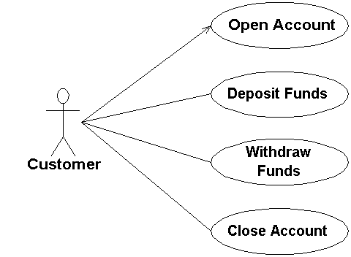
Use case example

Slide 41
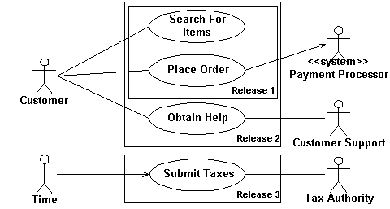
Use case example

Slide 42
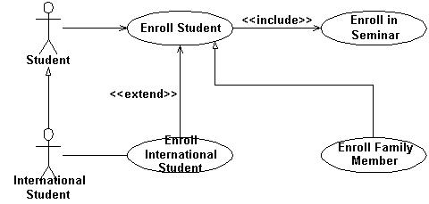
Use case example

Slide 43
Today’s lecture
Designs
Abstraction
Design notations
Class diagrams
Use case diagrams
Storyboards

Slide 44
Storyboard example

Slide 45
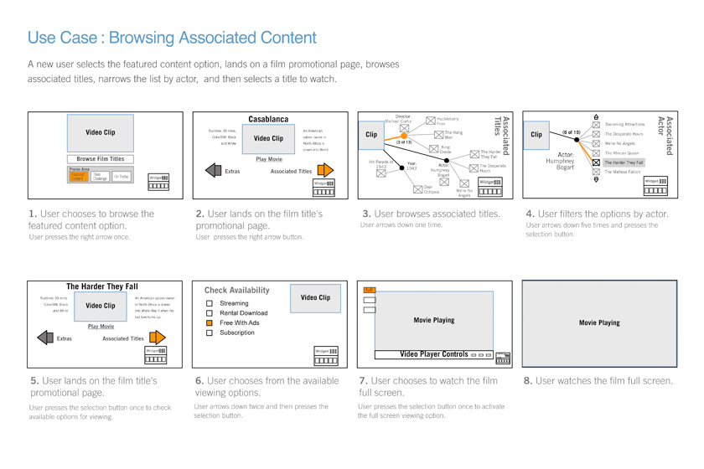
Storyboard example

Slide 46
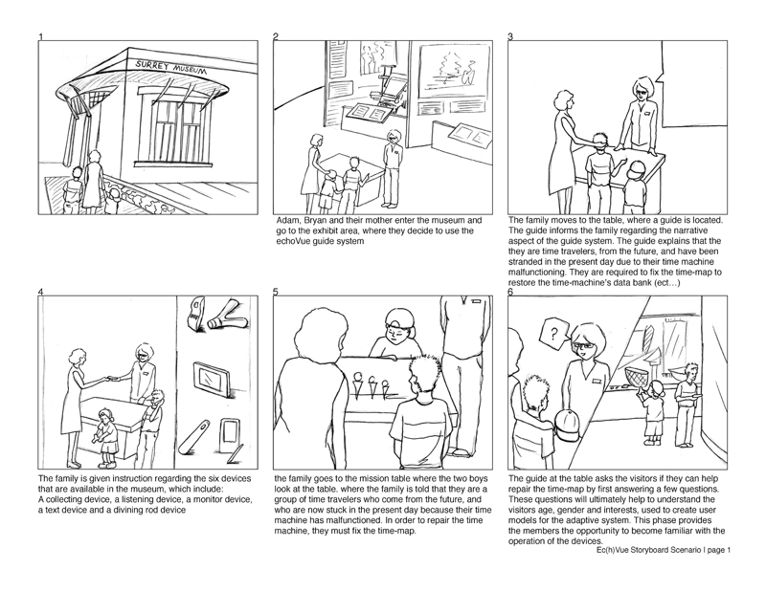
Storyboard example

