Slide 1
Number Systems
binary, octal, and hexadecimal numbers
  why used
conversions, including to/from decimal
negative binary numbers
floating point numbers
character codes

Slide 2
Radix Number Systems
basic idea of a radix number system --
how do we count:
decimal: 10 distinct symbols, 0-9
  when we reach 9, we repeat 0-9 with 1 in front:
  0,1,2,3,4,5,6,7,8,9, 10,11,12,13, …, 19
  then with a 2 in front, etc: 20, 21, 22, 23, …, 29
  until we reach 99
  then we repeat everything with a 1 in the next position:
  100, 101, …, 109, 110, …, 119, …, 199, 200, …
other number systems follow the same principle with a different base (radix)

Slide 3
Radix Number Systems
octal: we have only 8 distinct symbols: 0-7
  when we reach 7, we repeat 0-7 with 1 in front
  0,1,2,3,4,5,6,7, 10,11,12,13, …, 17
  then with a 2 in front, etc: 20, 21, 22, 23, …, 27
  until we reach 77
  then we repeat everything with a 1 in the next position:
  100, 101, …, 107, 110, …, 117, …, 177, 200, …
decimal to octal correspondence:
D | 0 | 1 | … | 7 | 8 | 9 | 10 | 11 | … | 15 | 16 | 17 | … | 23 | 24 | … | 63 | 64 | …
O | 0 | 1 | … | 7 | 10 | 11 | 12 | 13 | … | 17 | 20 | 21 | … | 27 | 30 | … | 77 | 100 | …

Slide 4
Radix Number Systems
binary: we have only 2 distinct symbols: 0, 1
why?: digital computer can only represent 0 and 1
  when we reach 1, we repeat 0-1 with 1 in front
  0,1, 10,11
  then we repeat everything with a 1 in the next position:
  100, 101, 110, 111, 1000, 1001, 1010, 1011, 1100, …
decimal to binary correspondence:
D | 0 | 1 | 2 | 3 | 4 | 5 | 6 | 7 | 8 | 9 | 10 | 11 | 12 | …
B | 0 | 1 | 10 | 11 | 100 | 101 | 110 | 111 | 1000 | 1001 | 1010 | 1011 | 1100 | …

Slide 5
Radix Number Systems
hexadecimal: we have 16 distinct symbols: 0-9,A-F
  when we reach 9, we continue until F
  then repeat with 1 in front
  0,1, …, 9,A,B,C,D,F, 10,11, …, 19,1A,1B,1C,1D,1E,1F
  then with a 2 in front, etc: 20, 21, …, 29, 2A, …, 2F
  until we reach FF
  then we repeat everything with a 1 in the next position:
  100, 101, …, 109, 10A, …, 10F, 110, …, 11F, …, 1FF, 200, …
decimal to hexadecimal correspondence:
D | 0 | 1 | … | 7 | 8 | 9 | 10 | 11 | … | 15 | 16 | 17 | … | 25 | 26 | … | 31 | 32 | …
H | 0 | 1 | … | 7 | 8 | 9 | A | B | … | F | 10 | 11 | … | 19 | 1A | … | 1F | 20 | …

Slide 6
Radix Number Systems
purpose of different systems
binary:
  digital computer can only represent 0 and 1
octal:
  better for human use
  very easy to convert to/from binary
hexadecimal
  also very easy to convert to/from binary
  slightly more difficult for humans, but
  1 hex digit = 4 binary digits (power of 2: 1 byte = 2 hex)

Slide 7
Number System Conversions
convert binary ↔ octal
3 bits = 1 octal digit
use conversion table:
O | 0 | 1 | 2 | 3 | 4 | 5 | 6 | 7
B | 000 | 001 | 010 | 011 | 100 | 101 | 110 | 111
Example:
10111010000110₂ = 10 111 010 000 110₂ = 27206₈
It also works with a decimal point, e.g.:
50.3₈ = 101 000.011₂

Slide 8
Number System Conversions
convert binary ↔ hex
4 bits = 1 hex digit
use conversion table:
H | 0 | 1 | 2 | 3 | 4 | 5 | 6 | 7
B | 0000 | 0001 | 0010 | 0011 | 0100 | 0101 | 0110 | 0111
H | 8 | 9 | A | B | C | D | E | F
B | 1000 | 1001 | 1010 | 1011 | 1100 | 1101 | 1110 | 1111
Example:
10111010000110₂ = 10 1110 1000 0110₂ = 2E86₁₆
It also works with a decimal point, e.g.:
50.3₁₆ = 101 0000.0011₂

Slide 9
Number System Conversions
to/from decimal
use basic principle of radix numbers:
each digit corresponds to a power of the radix
in decimal:
3205.3 = 3*1000 + 2*100 + 0*10 + 5*1 + 3*0.1
= 3*10³ + 2*10² + 0*10¹+ 5*10⁰ + 3*10⁻¹
In general, a decimal number can be decomposed into:
…d₃*10³ + d₂*10² + d₁*10¹ + d₀*10⁰ + d₋₁*10⁻¹ + d₋₂*10⁻²…

Slide 10
Number System Conversions
a binary number can be decomposed into:
… +d₃*2³ + d₂*2² + d₁*2¹ + d₀*2⁰ + d₋₁*2⁻¹ + d₋₂*2⁻² + …
… +d₃*8 + d₂*4 + d₁*2 + d₀*1 + d₋₁*0.5 + d₋₂*0.25 +…
convert binary → decimal
learn powers of 2:
  1, 2, 4, 8, 16, 32, 64, 128, 256, 512, 1024, …
  for each binary digit that is 1 add corresponding power
Example:
  110101₂ = 2⁵ + 2⁴ + 2² + 2⁰ = 32 + 16 + 4 + 1 = 53₁₀
  1.01₂ = 2⁰ + 2⁻² = 1 + ¼ = 1.25₁₀

Slide 11
Number System Conversions
decimal → binary:
decompose number into powers of 2
  How: repeatedly subtract the largest possible power
for each component write a 1 in corresponding digit
Example: convert 53₁₀
  53 – 2⁵ = 53 – 32 = 21
  21 – 2⁴ = 21 – 16 = 5
  5 – 2² = 5 – 4 = 1
  1 – 2⁰ = 1 – 1 = 0
the powers are: 5, 4, 2, 0
the binary number is: 110101₂

Slide 12
Number System Conversions
summary
  binary ↔ octal/hex:
  grouping of 3 or 4 bits
  octal ↔ hex:
  via binary
  binary → decimal:
  sum up powers of 2
  decimal → binary:
  decompose into powers of 2
  octal/hex ↔ decimal:
  use powers of 8 or 16
  easier: via binary

Slide 13
Negative Binary Numbers
signed magnitude:
  left-most bit is a sign bit
  Example with 8 bits:
  5 = 0000 0101, –5 = 1000 0101
one’s complement:
  flip all bits (0 becomes 1, 1 becomes 0)
  Example: 5 = 0000 0101, –5 = 1111 1010
  Advantage: subtract by adding negative number
  Example: 12 – 5 = 12+(–5)
    add left-most carry to sum
  Problem: 2 forms of zero:
    0000 0000 = 1111 1111
12 | 0000 1100
–5 | + 1111 1010
carry | 1 1111 000
 | 0000 0110
7 | 0000 0111

Slide 14
Negative Binary Numbers
two’s complement:
  one’s complement + 1
  Example: 5 = 0000 0101, –5 = 1111 1010+1 = 1111 1011
  add/subtract as before, but left-most carry is discarded
12 | 0000 1100
–5 | + 1111 1011
carry | 1 1111 000
7 | 0000 0111
drawback of two’s complement: extra negative number
  with 8 bits we have 2⁸ = 256 possible combinations:
  2⁷ = 128 combinations have left-most bit = 0:
  represent zero and 127 positive integers
  2⁷ = 128 combinations have left-most bit = 1:
  represent 128 negative integers

Slide 15
Negative Binary Numbers
decimal | binary | decimal | 1’s complement | 2’s complement
0 | 0000 0000 | –0 | 1111 1111 | 0000 0000
1 | 0000 0001 | –1 | 1111 1110 | 1111 1111
2 | 0000 0010 | –2 | 1111 1101 | 1111 1110
3 | 0000 0011 | –3 | 1111 1100 | 1111 1101
… | … |  | … | …
126 | 0111 1110 | –126 | 1000 0001 | 1000 0010
127 | 0111 1111 | –127 | 1000 0000 | 1000 0001
128 | nonexistent | –128 | nonexistent | 1000 0000
eliminate –0 by shifting range down
  +0 = –0 = 0000 0000
–128 exists only in negative range

Slide 16
Finite-Precision Numbers
number of bits determines the max/min number
Problem:
  assume 4 bits
  4 + 5 = 9
  1001 = -7 → wrong result!
  9 is too large for 4 bits (largest positive integer: 0111=7)
  overflow – must compare sign bits to detect:
  A and B have the same sign and A+B has a different sign
4 | 0100
5 | 0101
carry | 100
? | 1001

Slide 17
Negative Binary Numbers
excess N representation
basic idea: add N to every number (N=2^{m-1} or 2^{m-1}-1)
Example: 8 bits
  can represent 2⁸ = 256 different combinations (0-255)
  add 2⁷ = 128 (or 127) to every number to be represented
used in floating point formats
number | -128 | -127 | … | -1 | 0 | 1 | … | 127 | 128
excess 128 representation | 0 | 1 | … | 127 | 128 | 129 | … | 255
excess 127 representation |  | 0 | … | 126 | 127 | 128 | … | 254 | 255

Slide 18
Floating-Point Numbers
needed for very large or very small numbers
express numbers as n = f * 10e
  Example: +213.1 = +2.131 * 10² = +0.2131 * 10³
  two forms of normalized notation
represent number as:
  base is implicit, normally 2
  fraction (mantissa) is normalized; common choices:
    0.1 …
    1. …
  sign bit applies to fraction (signed magnitude)
  exponent: signed integer (2’s complement, excess 2^{m-1})
sign bit | exponent e | fraction f

Slide 19
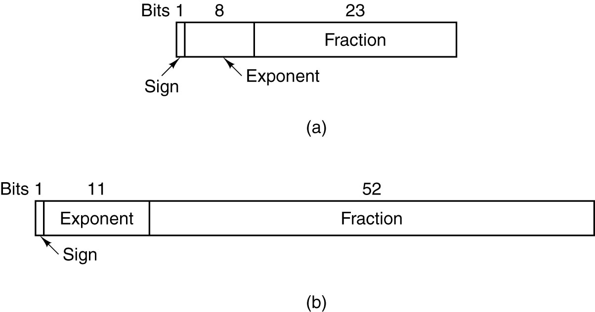
Floating-Point Numbers
exponent size vs. fraction size:
max/min size of expressible numbers vs. accuracy
Example: IEEE Standard
  single precision
  double precision

Slide 20
Floating-Point Numbers
single precision standard: 32 bit word
  1 sign bit (0 is positive, 1 is negative)
  8 bits in exponent
    excess 127 system used: exponent ranges from -126 to +127
  23 bits in fraction
    normalized to 1. …
    leading 1 is always present and thus implied (not represented)
    I.e.: precision is 24 bits
  max. positive number:
    fraction: 1.111 1111 … 1111 = 2⁰ + 2⁻¹ + 2⁻² + 2⁻³ + … + 2⁻²³
      = 1 + 1/2 + 1/4 + 1/8 + …
      = ~2
    max = +2 * 2¹²⁷ = +2¹²⁸
  min. negative number: –2¹²⁸

Slide 21
Floating-Point Numbers
  min. positive number:
    smallest fraction: 1.000 … 0000 = 2⁰ = 1
    smallest exponent: -126
    min pos number = 1 * 2⁻¹²⁶ = 2⁻¹²⁶
  max. negative number: –2⁻¹²⁶
negative overflow | expressible negative numbers | negative underflow | positive underflow | expressible positive numbers | positive overflow
–2¹²⁸ –2⁻¹²⁶ 0 +2⁻¹²⁶ +2¹²⁸

Slide 22
Floating-Point Numbers
Examples: show 0.5 as floating point (hex bit pattern)
  change to binary and normalize: 0.5₁₀ = 0.1₂ = 1.0 * 2⁻¹
  leading 1 is implied, fraction: 000 0000 … 0000₂
  exponent: -1 in decimal is -1+127 in excess 127, i.e. 126
  126 = 64 + 32 + 16 + 8 + 4 + 2 = 0111 1110₂
  0011 1111 0000 0000 … 0000₂ = 3F000000₁₆
show 42E48000 in decimal
  42E48000₁₆ = 0100 0010 1110 0100 1000 0000 0000 0000₂
  exponent = 1000 0101₂ = 128 + 4 + 1 = 133₁₀
  133 is in excess 127 notation; in decimal: 133 – 127 = 6
  mantissa: 1.11001001₂
  result = 1.11001001₂ * 2⁶ = 1110 010.01₂ = 114.25₁₀
1 | 8 bits | 23 bits
0 | 0111 1110 | 000 0000 0000 0000 0000 0000

Slide 23
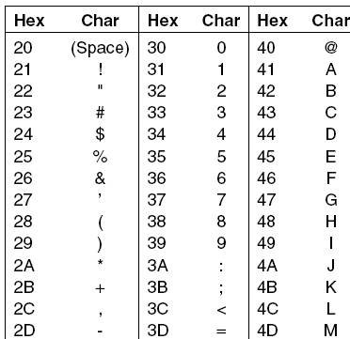
Representing Characters
ASCII:
American Standard Code for Information Interchange
  7-bit code: 128 characters
  Examples
  do not confuse chars with numbers, e.g.
    6: 0011 0110 (char)
    6: 0000 ... 0000 0110 (int)
UNICODE
  16-bits: 65,536 chars (symbols)
  cover foreign languages

