Slide 1
Propositional Equivalences

Slide 2
Tautologies, Contradictions, and Contingencies
A tautology is a proposition that is always true.
  Example: p ∨¬p
A contradiction is a proposition that is always false.
  Example: p ∧¬p
A contingency is a compound proposition that is neither a tautology nor a contradiction
P | ¬p | p ∨¬p | p ∧¬p
T | F | T | F
F | T | T | F

Slide 3
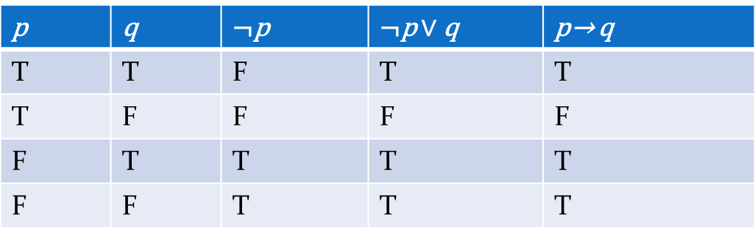
Equivalent Propositions
Two propositions are equivalent if they always have the same truth value.
Formally: Two compound propositions p and q are logically equivalent if p↔q is a tautology.
We write this as p≡q (or p⇔q)
One way to determine equivalence is to use truth tables
Example: show that ¬p ∨q is equivalent to p → q.

Slide 4
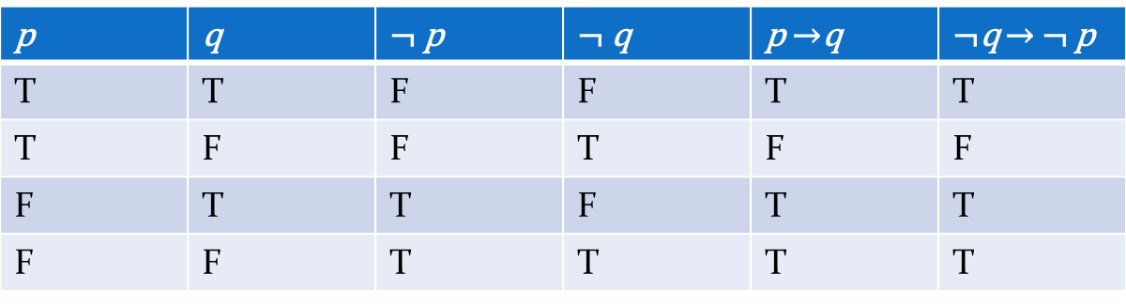
Equivalent Propositions
Example: Show using truth tables that that implication is equivalent to its contrapositive
Solution:

Slide 5
Show Non-Equivalence
Example: Show using truth tables that neither the converse nor inverse of an implication are equivalent to the implication.
Solution:
p | q | ¬ p | ¬ q | p →q | ¬ p →¬ q | q → p
T | T | F | F | T | T | T
T | F | F | T | F | T | T
F | T | T | F | T | F | F
F | F | T | T | T | T | T

Slide 6
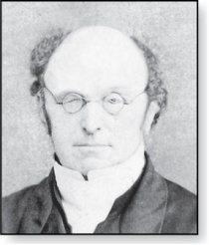
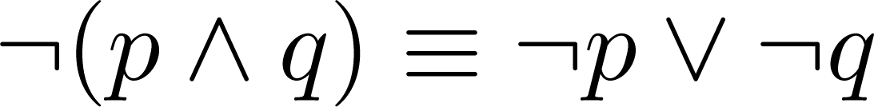
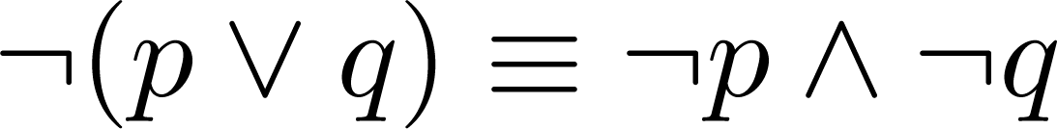
De Morgan’s Laws
Augustus De Morgan
1806-1871
Very useful in constructing proofs
This truth table shows that De Morgan’s Second Law holds
p | q | ¬p | ¬q | (p∨q) | ¬(p∨q) | ¬p∧¬q
T | T | F | F | T | F | F
T | F | F | T | T | F | F
F | T | T | F | T | F | F
F | F | T | T | F | T | T

Slide 7
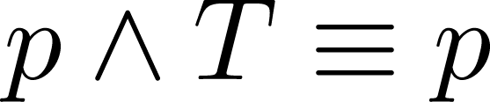
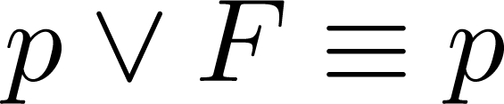
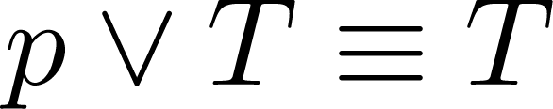
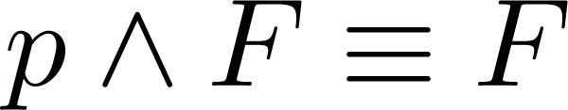
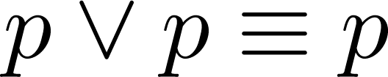
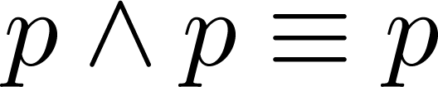
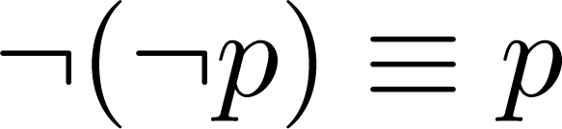
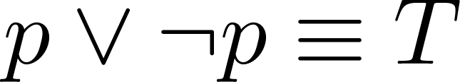
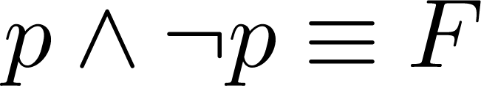
Key Logical Equivalences
Identity Laws: ,
Domination Laws: ,
Idempotent laws: ,
Double Negation Law:
Negation Laws: ,

Slide 8
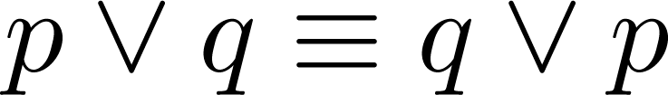
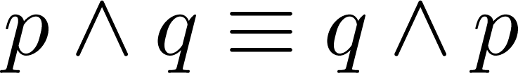
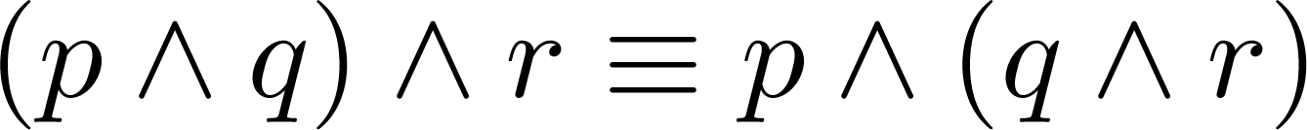
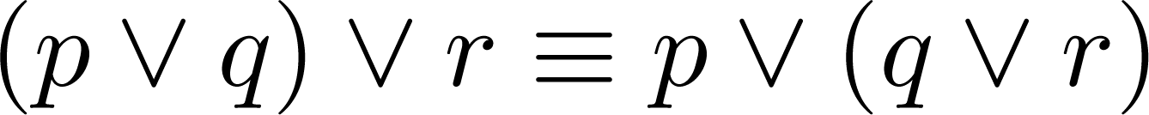
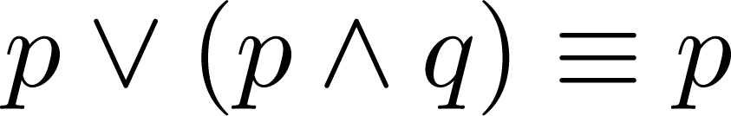
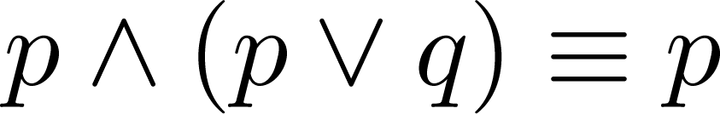
Key Logical Equivalences (cont)
Commutative Laws: ,
Associative Laws:
Distributive Laws:
Absorption Laws:

Slide 9
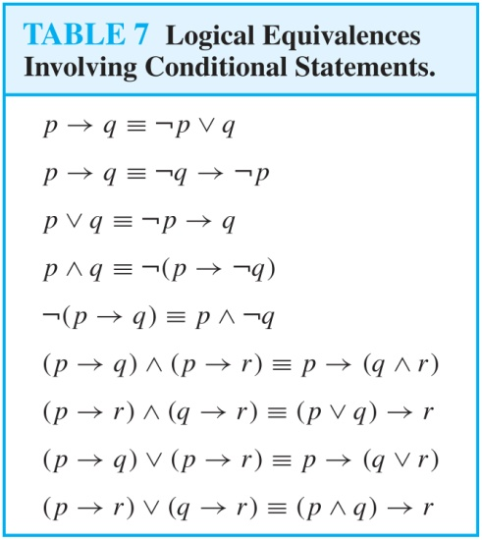
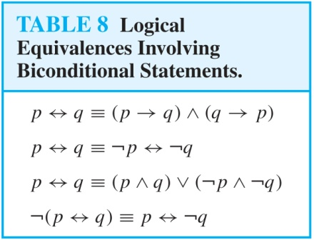
More Logical Equivalences

Slide 10


Equivalence Proofs
Instead of using truth tables, we can show equivalence by developing a series of logically equivalent statements.
To prove that A ≡B we produce a series of equivalences leading from A to B.
Each step follows one of the established equivalences (laws)
Each A_{i} can be an arbitrarily complex compound proposition.

Slide 11
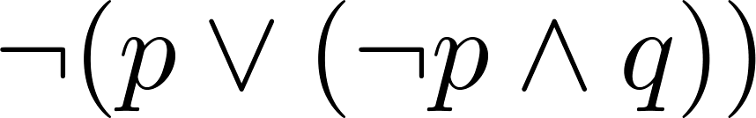
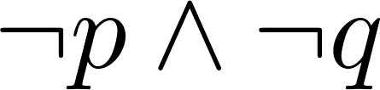
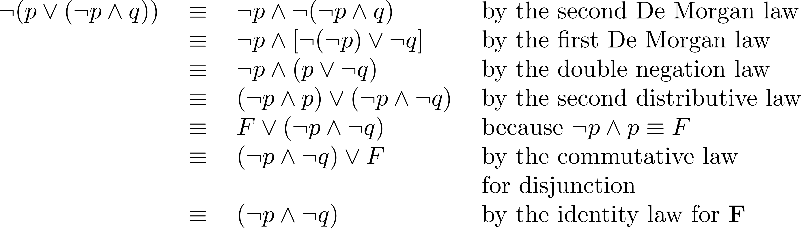
Equivalence Proofs
Example: Show that
is logically equivalent to
Solution:
by the negation law

Slide 12
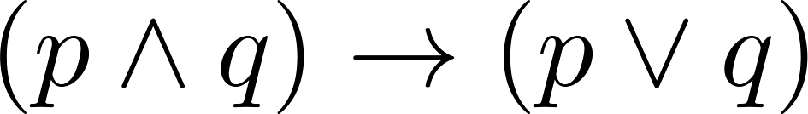
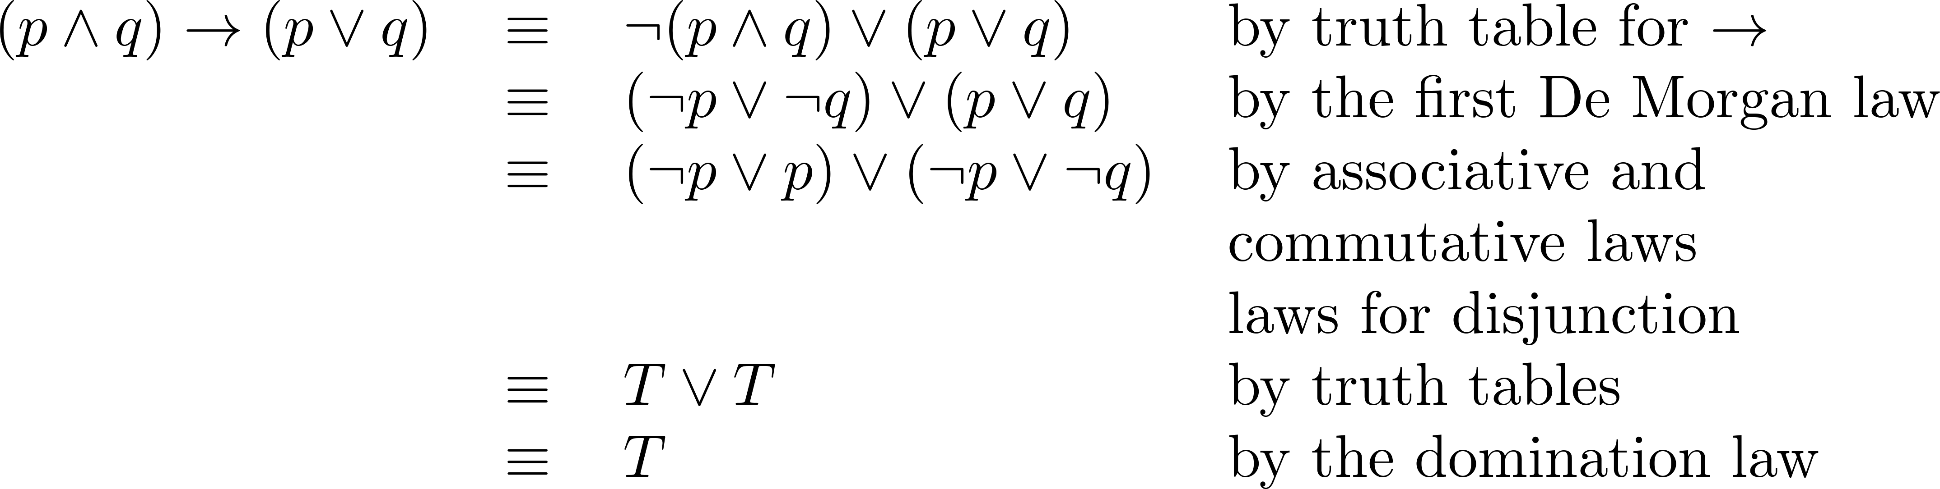
Equivalence Proofs
Example: Show that
is a tautology.
Solution:
by equivalence from Table 7
(¬q ∨ q)
by the negation law

