Slide 1
Set Operations

Slide 2

Union
Definition: The union of sets A and B, denoted by A ∪ B, contains those elements that are in A or B or both:
Example: {1, 2, 3} ∪ {3, 4, 5} = {1, 2, 3, 4, 5}
U
A
B
Venn Diagram for A ∪ B

Slide 3

Intersection
Definition: The intersection of sets A and B, denoted by A ∩ B, contains elements that are in both A and B
If the intersection is empty, then A and B are disjoint.
Examples:
  {1, 2, 3} ∩ {3, 4, 5} = {3}
  {1, 2, 3} ∩ {4, 5, 6} = ∅
Venn Diagram for A ∩B
U
A
B

Slide 4
Difference
Definition: The difference of sets A and B, denoted by A–B, is the set containing the elements of A that are not in B:
A–B = {x | x ∈ A ∧ x ∉ B}
Example: {1, 2, 3} – {3, 4, 5} = {1, 2}
U
A
B
Venn Diagram for A−B

Slide 5
Complement
Definition: The complement of a set A, denoted by Ā is the set U–A; i.e., it contains all elements that are not in A
Ā = {x ∈ U | x ∉ A}
Example: If U are positive integers less than 100 then the complement of {x | x > 70} is {x | x ≤ 70}
U
A
Venn Diagram for Complement
Ā

Slide 6
Examples
U = {0, 1, 2, 3, 4, 5, 6, 7, 8, 9, 10}
A = {1, 2, 3, 4, 5}
B ={4, 5, 6, 7, 8}
A ∪B = {1, 2, 3, 4, 5, 6, 7, 8}
A ∩B = {4, 5}
Ā = {0, 6, 7, 8, 9, 10}
= {0, 1, 2, 3, 9, 10}
A–B = {1, 2, 3}
B–A = {6, 7, 8}

Slide 7


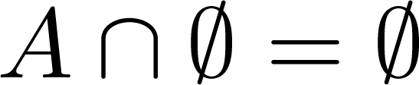



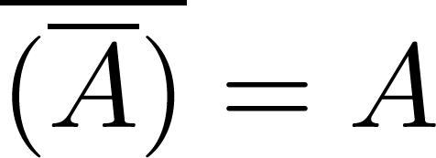
Set Identities
How can we compare sets constructed using the various operators?
Identity laws
Domination laws
Idempotent laws
Complementation law

Slide 8


Set Identities
Commutative laws
Associative laws
Distributive laws

Slide 9





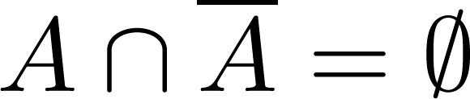
Set Identities
De Morgan’s laws
Absorption laws
Complement laws

Slide 10
Proving Set Identities
Different ways to prove set identities:
  Prove that each set is a subset of the other.
  Use set builder notation and propositional logic.
  Membership Tables:
    To compare two sets S1 and S2, each constructed from some base sets using intersections, unions, differences, and complements:
    Consider an arbitrary element x from U and use 1 or 0 to represent its presence or absence in a given set
    Construct all possible combinations of memberships of x in the base sets
    Use the definitions of set operators to establish the membership of x in S1 and S2
    S1=S2 iff the memberships are identical for all combinations

Slide 11





Membership Table
Example:
Show that the distributive law holds.
Solution:
A | B | C
1 | 1 | 1 | 1 | 1 | 1 | 1 | 1
1 | 1 | 0 | 0 | 1 | 1 | 1 | 1
1 | 0 | 1 | 0 | 1 | 1 | 1 | 1
1 | 0 | 0 | 0 | 1 | 1 | 1 | 1
0 | 1 | 1 | 1 | 1 | 1 | 1 | 1
0 | 1 | 0 | 0 | 0 | 1 | 0 | 0
0 | 0 | 1 | 0 | 0 | 0 | 1 | 0
0 | 0 | 0 | 0 | 0 | 0 | 0 | 0

