Slide 1
Relations and Their Properties

Slide 2
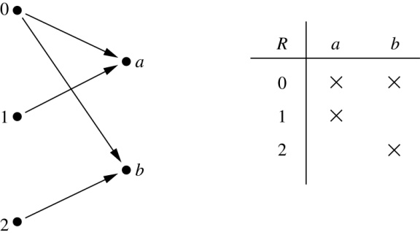
Binary Relations
Definition: A binary relation R from a set A to a set B is a subset R ⊆ A × B.
Example:
  Let A = {0,1,2} and B = {a,b}
  {(0, a), (0, b), (1, a), (2, b)} is a relation from A to B
  We can represent relations graphically or using a table:
Relations are more general than functions. A function is a relation where exactly one element of B is related to each element of A.

Slide 3
Binary Relation on a Set
Definition: A binary relation R on a set A is a subset of A × A
  It is a relation from A to itself
Examples:
  Let A = {a,b,c}. Then R = {(a,a), (a,b), (a,c)} is a relation on A
  Let A = {1, 2, 3, 4}. Then R = {(a,b) | a divides b} is a relation on A consisting of the ordered pairs:
  (1, 1), (1, 2), (1, 3), (1, 4), (2, 2), (2, 4), (3, 3), (4, 4)

Slide 4
Binary Relations on a Set
Examples: Consider these relations on the set Z:
  R₁ = {(a,b) | a ≤ b}, R₄ = {(a,b) | a = b},
  R₂ = {(a,b) | a > b}, R₅ = {(a,b) | a = b + 1},
  R₃ = {(a,b) | a = b or a = −b}, R₆ = {(a,b) | a + b ≤ 3}.
  Which of these relations contain each of the pairs:
  (1, 1), (1, 2), (2, 1), (1, −1), (2, 2)

Slide 5
Reflexive Relations
Definition: R is reflexive iff (a,a) ∊ R for every element a ∊ A
  Formally: ∀a[a ∊ A ⟶ (a,a) ∊ R]
Examples:
  R₁ = {(a,b) | a ≤ b}
  R₃ = {(a,b) | a = b or a =−b}
  R₄ = {(a,b) | a = b}
  The following relations are not reflexive:
  R₂ = {(a,b) | a > b} (e.g. 3 ≯ 3)
  R₅ = {(a,b) | a = b + 1} (e.g. 3 ≠ 3 + 1)
  R₆ = {(a,b) | a + b ≤ 3} (e.g. 4 + 4 ≰ 3)

Slide 6
Symmetric Relations
Definition: R is symmetric iff (b,a) ∊ R whenever (a,b) ∊ R for all a,b ∊ A
  Formally: ∀a∀b [(a,b) ∊ R ⟶ (b,a) ∊ R]
Examples:
  R₃ = {(a,b) | a = b or a =−b}
  R₄ = {(a,b) | a = b}
  R₆ = {(a,b) | a + b ≤ 3}
  The following are not symmetric:
  R₁ = {(a,b) | a ≤ b} (e.g. 3 ≤ 4, but 4 ≰ 3)
  R₂ = {(a,b) | a > b} (e.g. 4 > 3, but 3 ≯ 4)
  R₅ = {(a,b) | a = b + 1} (e.g. 4 = 3 + 1, but 3 ≠ 4 + 1)

Slide 7
Antisymmetric Relations
Definition: R is antisymmetric iff, for all a,b ∊ A, if (a,b) ∊ R and (b,a) ∊ R, then a = b.
  Formally: ∀a∀b [(a,b) ∊ R ∧ (b,a) ∊ R ⟶ a = b]
Examples:
  R₁ = {(a,b) | a ≤ b}
  R₂ = {(a,b) | a > b}
  R₄ = {(a,b) | a = b}
  R₅ = {(a,b) | a = b + 1}
  The following relations are not antisymmetric:
  R₃ = {(a,b) | a = b or a = −b}
  (both (1,−1) and (−1,1) belong to R₃)
  R₆ = {(a,b) | a + b ≤ 3} (both (1,2) and (2,1) belong to R₆)
Note: symmetric and antisymmetric are not opposites!

Slide 8
Transitive Relations
Definition: R is transitive if whenever (a,b) ∊ R and (b,c) ∊ R, then (a,c) ∊ R, for all a,b,c ∊ A.
  Formally: ∀a∀b∀c[(a,b) ∊ R ∧ (b,c) ∊ R ⟶ (a,c) ∊ R ]
Examples:
  R₁ = {(a,b) | a ≤ b}
  R₂ = {(a,b) | a > b}
  R₃ = {(a,b) | a = b or a = −b}
  R₄ = {(a,b) | a = b}
  The following are not transitive:
  R₅ = {(a,b) | a = b + 1}
  (both (3,2) and (4,3) belong to R₅, but not (3,3))
  R₆ = {(a,b) | a + b ≤ 3}
  (both (2,1) and (1,2) belong to R₆, but not (2,2))

Slide 9
Combining Relations
Two relations R₁ and R₂ can be combined using basic set operations, such as R₁∪ R₂, R₁∩ R₂, R₁−R₂, and R₂−R₁
Example: Let A = {1,2,3}, B = {1,2,3,4}
  R₁ = {(1,1),(2,2),(3,3)}, R₂ = {(1,1),(1,2),(1,3),(1,4)}
  Then:
R₁∪ R₂ = {(1,1),(1,2),(1,3),(1,4),(2,2),(3,3)}
R₁∩ R₂ = {(1,1)}
R₁−R₂ = {(2,2),(3,3)}
R₂−R₁ = {(1,2),(1,3),(1,4)}

Slide 10
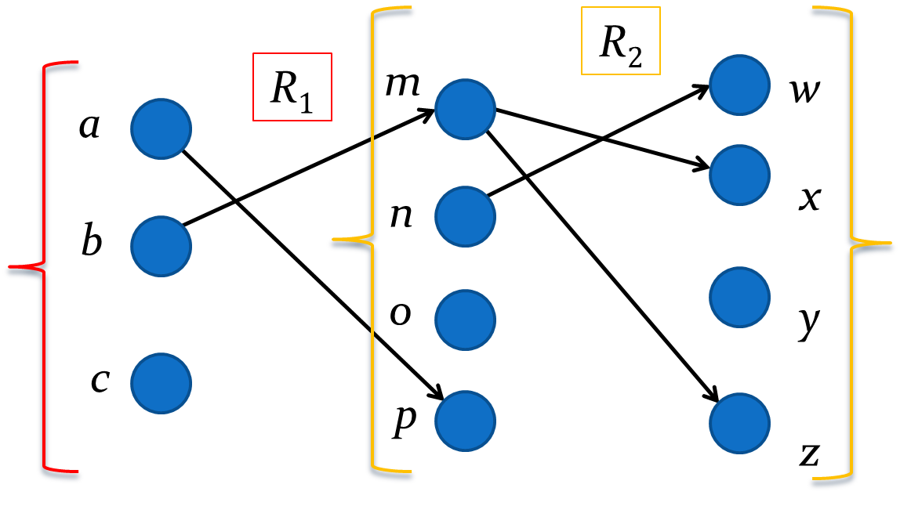

Composition
Definition: Assume that
  R₁ is a relation from a set A to a set B
  R₂ is a relation from B to a set C
The composition of R₂ with R₁ is a relation from A to C such that, if (x,y) ∊ R₁ and (y,z) ∊ R₂, then (x,z) ∊ R₂∘ R₁
Example:
R₂∘ R₁ = {(b,x),(b,z)}

Slide 11
Powers of a Relation
Definition: Let R be a binary relation on A. Then the powers R^{n} of the relation R is defined inductively by:
  Basis Step: R¹ = R
  Inductive Step: R^{n+1} = R^{n} ∘ R
Example: Assume R = {(1, 1), (2, 1), (3, 2), (4, 3)}
  R¹ = R
  R² = R¹ ∘ R = {(1, 1), (2, 1), (3, 1), (4, 2)}
  R³ = R² ∘ R = {(1, 1), (2, 1), (3, 1), (4, 1)}

