Slide 1
Distributed Computing Concepts - Global Time and State in Distributed Systems
Prof. Nalini Venkatasubramanian
Distributed Systems Middleware - Lecture 2

Slide 2
Global Time & Global States of Distributed Systems
Asynchronous distributed systems consist of several processes without common memory which communicate (solely) via messages with unpredictable transmission delays
Global time & global state are hard to realize in distributed systems
Rate of event occurrence is very high
Event execution times are very small
We can only approximate the global view
Simulate synchronous distributed system on a given asynchronous system
Simulate a global time – Clocks (Physical and Logical)
Simulate a global state – Global Snapshots

Slide 3
Simulate Synchronous Distributed Systems
Synchronizers [Awerbuch 85]
Simulate clock pulses in such a way that a message is only generated at a clock pulse and will be received before the next pulse
Drawback
Very high message overhead

Slide 4
The Concept of Time in Distributed Systems
A standard time is a set of instants with a temporal precedence order < satisfying certain conditions [Van Benthem 83]:
Irreflexivity
Transitivity
Linearity
Eternity (∀x∃y: x<y)
Density (∀x,y: x<y → ∃z: x<z<y)
Transitivity and Irreflexivity imply asymmetry
A linearly ordered structure of time is not always adequate for distributed systems
Captures dependence, not independence of distributed activities
Time as a partial order
A partially ordered system of vectors forming a lattice structure is a natural representation of time in a distributed system.

Slide 5
Global time in distributed systems
An accurate notion of global time is difficult to achieve in distributed systems.
Uniform notion of time is necessary for correct operation of many applications (mission critical distributed control, online games/entertainment, financial apps, smart environments etc.)
Clocks in a distributed system drift
Relative to each other
Relative to a real world clock
Determination of this real world clock itself may be an issue
Clock synchronization is needed to simulate global time
Physical Clocks vs. Logical clocks
Physical clocks are logical clocks that must not deviate from the real-time by more than a certain amount.
We often derive causality of events from loosely synchronized clocks

Slide 6
Physical Clock Synchronization

Slide 7
Physical Clocks
How do we measure real time?
17th century - Mechanical clocks based on astronomical measurements
Solar Day - Transit of the sun
Solar Seconds - Solar Day/(3600*24)
Problem (1940) - Rotation of the earth varies (gets slower)
Mean solar second - average over many days
Date | Duration in mean solar time
February 11 | 24 hours
March 26 | 24 hours − 18.1 seconds
May 14 | 24 hours
June 19 | 24 hours + 13.1 seconds
July 26 | 24 hours
September 16 | 24 hours − 21.3 seconds
November 3 | 24 hours
December 22 | 24 hours + 29.9 seconds
Length of apparent solar day (1998) – (cf: wikipedia ⁾

Slide 8
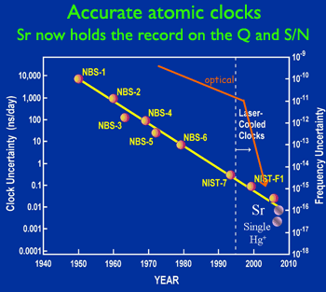
Atomic Clocks
1948 - Counting transitions of a crystal (Cesium 133, quartz) used as atomic clock
crystal oscillates at a well known frequency
2014 – NIST-F2 Atomic clock
Accuracy: ± 1 sec in 300 mil years
NIST-F2 measures particular transitions in Cesium atom (9,192,631,770 vibrations per second), in much colder environment, minus 316F, than NIST-F1
TAI - International Atomic Time
9,192,631,779 transitions = 1 mean solar second in 1948
UTC (Universal Coordinated Time)
From time to time, UTC skips a solar second to stay in phase with the sun (30+ times since 1958)
UTC is broadcast by several sources (satellites…)

Slide 9
How Clocks Work in Computers
Holding register
Quartz crystal
Oscillation at a well-defined frequency
Each crystal oscillation decrements the counter by 1
When counter gets 0, its value reloaded from the holding register
Counter
When counter is 0, an interrupt is generated, which is call a clock tick
CPU
At each clock tick, an interrupt service procedure add 1 to time stored in memory
Memory
From Distributed Systems (cs.nju.edu.cn/distribute-systems/lecture-notes/
9

Slide 10
Accuracy of Computer Clocks
Modern timer chips have a relative error of 1/100,000 - 0.86 seconds a day
To maintain synchronized clocks
Can use UTC source (time server) to obtain current notion of time
Use solutions without UTC.

Slide 11
Cristian’s (Time Server) Algorithm
Uses a time server to synchronize clocks
Time server keeps the reference time (say UTC)
A client asks the time server for time, the server responds with its current time, and the client uses the received value to set its clock
But network round-trip time introduces errors…
Let RTT = response-received-time – request-sent-time (measurable at client),
If we know (a) min = minimum client-server one-way transmission time and (b) that the server timestamped the message at the last possible instant before sending it back
Then, the actual time could be between [T+min,T+RTT— min]

Slide 12
Cristian’s Algorithm
Client sets its clock to halfway between T+min and T+RTT— min i.e., at T+RTT/2
☹ Expected (i.e., average) skew in client clock time = (RTT/2 – min)
Can increase clock value, should never decrease it.
Can adjust speed of clock too (either up or down is ok)
Multiple requests to increase accuracy
For unusually long RTTs, repeat the time request
For non-uniform RTTs
Drop values beyond threshold; Use averages (or weighted average)

Slide 13
Berkeley UNIX algorithm
One Version
One daemon without UTC
Periodically, this daemon polls and asks all the machines for their time
The machines respond.
The daemon computes an average time and then broadcasts this average time.
Another Version
Master/daemon uses Cristian’s algorithm to calculate time from multiple sources, removes outliers, computes average and broadcasts

Slide 14
Decentralized Averaging Algorithm
Each machine has a daemon without UTC
Periodically, at fixed agreed-upon times, each machine broadcasts its local time.
Each of them calculates the average time by averaging all the received local times.

Slide 15
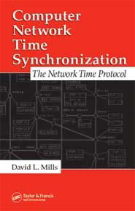
Network Time Protocol (NTP)
Most widely used physical clock synchronization protocol on the Internet (http://www.ntp.org)
Currently used: NTP V3 and V4
10-20 million NTP servers and clients in the Internet
Claimed Accuracy (Varies)
milliseconds on WANs, submilliseconds on LANs, submicroseconds using a precision timesource
Nanosecond NTP in progress

Slide 16
NTP Design
Hierarchical tree of time servers.
The primary server at the root synchronizes with the UTC.
The next level contains secondary servers, which act as a backup to the primary server.
At the lowest level is the synchronization subnet which has the clients.
Variant of Cristian’s algorithm that does not use RTT’s, but multiple 1-way messages

Slide 17
DCE Distributed Time Service
Software service that provides precise, fault-tolerant clock synchronization for systems in local area networks (LANs) and wide area networks (WANs).
determine duration, perform event sequencing and scheduling.
Each machine is either a time server or a clerk
software components on a group of cooperating systems;
client obtains time from DTS entity
DTS entities
DTS server
DTS clerk that obtain time from DTS servers on other hosts

Slide 18
Clock Synchronization in DCE
DCE’s time model is actually in an interval
I.e. time in DCE is actually an interval
Comparing 2 times may yield 3 answers
t1 < t2, t2 < t1, not determined
Periodically a clerk obtains time-intervals from several servers ,e.g. all the time servers on its LAN
Based on their answers, it computes a new time and gradually converges to it.
Compute the intersection where the intervals overlap. Clerks then adjust the system clocks of their client systems to the midpoint of the computed intersection.
When clerks receive a time interval that does not intersect with the majority, the clerks declare the non-intersecting value to be faulty.
Clerks ignore faulty values when computing new times, thereby ensuring that defective server clocks do not affect clients.

Slide 19
Logical Clock Synchronization

Slide 20
Causal Relations
Distributed application results in a set of distributed events
Induces a partial order → causal precedence relation
Knowledge of this causal precedence relation is useful in reasoning about and analyzing the properties of distributed computations
Liveness and fairness in mutual exclusion
Consistency in replicated databases
Distributed debugging, checkpointing

Slide 21
Logical Clocks
Used to determine causality in distributed systems
Time is represented by non-negative integers
Event structures represent distributed computation (in an abstract way)
A process can be viewed as consisting of a sequence of events, where an event is an atomic transition of the local state which happens in no time
Process Actions can be modeled using the 3 types of events
Send Message
Receive Message
Internal (change of state)

Slide 22
Logical Clocks
A logical Clock C is some abstract mechanism which assigns to any event e∈E the value C(e) of some time domain T such that certain conditions are met
C:E→T :: T is a partially ordered set : e<e’→C(e)<C(e’) holds
Consequences of the clock condition [Morgan 85]:
Events occurring at a particular process are totally ordered by their local sequence of occurrence
If an event e occurs before event e’ at some single process, then event e is assigned a logical time earlier than the logical time assigned to event e’
For any message sent from one process to another, the logical time of the send event is always earlier than the logical time of the receive event
Each receive event has a corresponding send event
Future can not influence the past (causality relation)

Slide 23
Event Ordering
Lamport defined the “happens before” (=>) relation
If a and b are events in the same process, and a occurs before b, then a => b.
If a is the event of a message being sent by one process and b is the event of the message being received by another process, then a => b.
If X =>Y and Y=>Z then X => Z.
If a => b then time (a) => time (b)

Slide 24
Event Ordering- the example
Processor Order: e precedes e’ in the same process
Send-Receive: e is a send and e’ is the corresponding receive
Transitivity: exists e’’ s.t. e < e’’ and e’’< e’
Example:
global time
P1
e11
e12
e13
e14
Program order: e13 < e14
Send-Receive: e23 < e12
Transitivity: e21 < e32
e21
e22
e23
P2
e31
e32
P3

Slide 25
Causal Ordering
“Happens Before” also called causal ordering
Possible to draw a causality relation between 2 events if
They happen in the same process
There is a chain of messages between them
“Happens Before” notion is not straightforward in distributed systems
No guarantees of synchronized clocks
Communication latency

Slide 26
Implementation of Logical Clocks
Requires
Data structures local to every process to represent logical time and
a protocol to update the data structures to ensure the consistency condition.
Each process Pi maintains data structures that allow it the following two capabilities:
A local logical clock, denoted by LC_i , that helps process Pi measure its own progress.
A logical global clock, denoted by GCi , that is a representation of process Pi ’s local view of the logical global time. Typically, lci is a part of gci
The protocol ensures that a process’s logical clock, and thus its view of the global time, is managed consistently.
The protocol consists of the following two rules:
R1: This rule governs how the local logical clock is updated by a process when it executes an event.
R2: This rule governs how a process updates its global logical clock to update its view of the global time and global progress.

Slide 27
Types of Logical Clocks
Systems of logical clocks differ in their representation of logical time and also in the protocol to update the logical clocks.
3 kinds of logical clocks
Scalar
Vector
Matrix

Slide 28
Scalar Logical Clocks - Lamport
Proposed by Lamport in 1978 as an attempt to totally order events in a distributed system.
Time domain is the set of non-negative integers.
The logical local clock of a process pi and its local view of the global time are squashed into one integer variable Ci .
Monotonically increasing counter
No relation with real clock
Each process keeps its own logical clock used to timestamp events

Slide 29
Consistency with Scalar Clocks
To guarantee the clock condition, local clocks must obey a simple protocol:
When executing an internal event or a send event at process P_{i} the clock C_{i} ticks
C_{i} += d (d>0)
When P_{i} sends a message m, it piggybacks a logical timestamp t which equals the time of the send event
When executing a receive event at P_{i} where a message with timestamp t is received, the clock is advanced
C_{i} = max(C_{i},t)+d (d>0)
Results in a partial ordering of events.

Slide 31
Total Ordering
Extending partial order to total order
Global timestamps:
(Ta, Pa) where Ta is the local timestamp and Pa is the process id.
(Ta,Pa) < (Tb,Pb) iff
(Ta < Tb) or ( (Ta = Tb) and (Pa < Pb))
Total order is consistent with partial order.
time
Proc_id

Slide 32
Properties of Scalar Clocks
Event counting
If the increment value d is always 1, the scalar time has the following interesting property: if event e has a timestamp h, then h-1 represents the minimum logical duration, counted in units of events, required before producing the event e;
We call it the height of the event e.
In other words, h-1 events have been produced sequentially before the event e regardless of the processes that produced these events.

Slide 33
Properties of Scalar Clocks
No Strong Consistency
The system of scalar clocks is not strongly consistent; that is, for two events ei and ej , C(ei ) < C(ej ) does not imply ei → ej .
Reason: In scalar clocks, logical local clock and logical global clock of a process are squashed into one, resulting in the loss of causal dependency information among events at different processes.

Slide 34
Independence
Two events e, e’ are mutually independent (i.e. e||e’) if ~(e<e’)∧~(e’<e) [none of them happened-before the other]
Two events are independent if they have the same timestamp
Events which are causally independent may get the same or different timestamps
By looking at the timestamps of events it is not possible to assert that some event could not influence some other event
If e < e’, then C(e) < C(e’), but the converse is not true
If C(e)<C(e’) then ~(e’<e) however, it is not possible to decide whether e < e’ or e||e’
C is an order homomorphism which preserves < but it does not preserve negations

Slide 35
Problems with Total Ordering
A linearly ordered structure of time is not always adequate for distributed systems
captures dependence of events
loses independence of events - artificially enforces an ordering for events that need not be ordered – loses information
Mapping partial ordered events onto a linearly ordered set of integers is losing information
Events which may happen simultaneously may get different timestamps as if they happen in some definite order
A partially ordered system of vectors forming a lattice structure is a natural representation of time in a distributed system

Slide 36
Vector Clocks
Independently developed by Fidge, Mattern and Schmuck.
Aim: To construct a mechanism by which each process gets an optimal approximation of global time
Time representation
Set of n-dimensional non-negative integer vectors.
Each process has a clock C_{i} consisting of a vector of length n, where n is the total number of processes vt[1..n], where vt[j ] is the local logical clock of Pj and describes the logical time progress at process Pj .
A process P_{i} ticks by incrementing its own component of its clock
C_{i}[i] += 1
The timestamp C(e) of an event e is the clock value after ticking
Each message gets a piggybacked timestamp consisting of the vector of the local clock
The process gets some knowledge about the other process’ time approximation
C_{i}=sup(C_{i},t):: sup(u,v)=w : w[i]=max(u[i],v[i]), ∀i

Slide 37
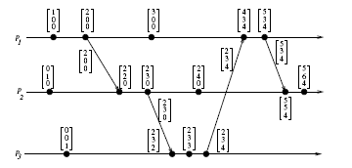
Vector Clocks example
Figure 3.2: Evolution of vector time.
From A. Kshemkalyani and M. Singhal (Distributed Computing)

Slide 38
Vector Times (cont)
Because of the transitive nature of the scheme, a process may receive time updates about clocks in non-neighboring process
Since process P_{i} can advance the i^{th} component of global time, it always has the most accurate knowledge of its local time
At any instant of real time ∀i,j: C_{i}[i]≥ C_{j}[i]

Slide 39
Vector Clocks
Independently developed by Fidge, Mattern and Schmuck
Aim: to get an optimal approximation of global time
Unlike Lamport clock, time is not represented by a single number, instead by a vector of N elements: one for each N processes
Each process maintains its own logical clock as well as the clocks at the other processes
Each process sends out its vector clock when it sends a message
The receiving process updates its vector clock

Slide 40
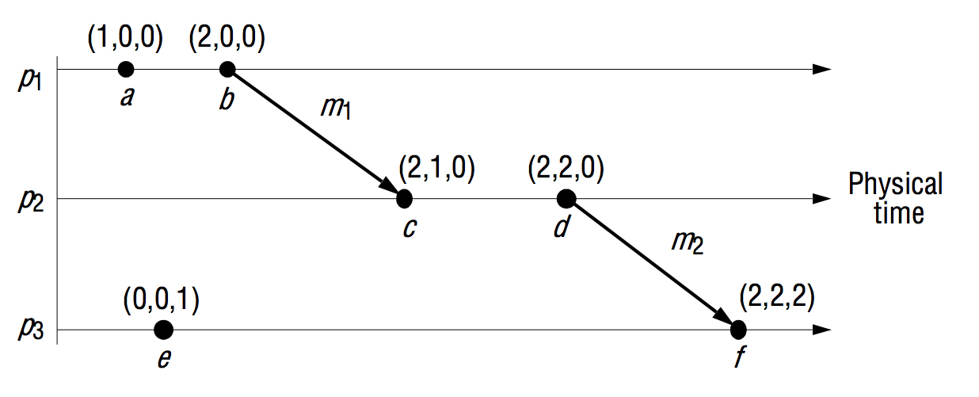
Vector Clocks

Slide 41
Structure of Vector Clocks
For two time vectors u, v
u≤v iff ∀i: u[i] ≤ v[i]
u<v iff u≤v ∧ u ≠ v
u||v iff ~(u<v) ∧ ~(v<u) :: || is not transitive
We can show that e < e’ if and only if V(e) < V(e’)
If part is easy to show
Can you prove the converse? [left as an exercise]
In order to determine if two events e, e’ are causally related or not, just take their timestamps V(e) and V(e’)
if V(e)<V(e’) ∨ V(e’)<V(e), then the events are causally related
Otherwise, they are causally independent

Slide 42
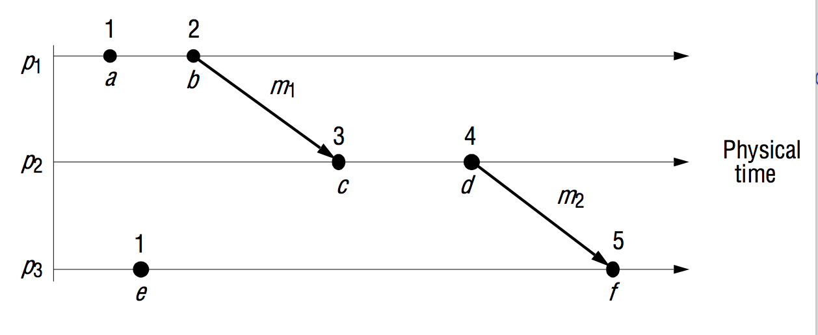
Structure of Vector Clocks

Slide 43
Vector Clocks
Disadvantage of vector timestamps
Storage and message payload ∝ #processes
Techniques exist for storing and transmitting smaller amounts of data, at the expense of the processing required to reconstruct complete vectors (due to Raynal and Singhal 1996)
There is also a notion of matrix clocks, whereby processes keep estimates of other processes’ vector times as well as their own
Used in distributed garbage collection

Slide 44
Matrix Time
Vector time contains information about latest direct dependencies
What does Pi know about Pk
Also contains info about latest direct dependencies of those dependencies
What does Pi know about what Pk knows about Pj
Message and computation overheads are high
Powerful and useful for applications like distributed garbage collection

Slide 45
Time Manager Operations
Logical Clocks
C.adjust(L,T)
adjust the local time displayed by clock C to T (can be gradually, immediate, per clock sync period)
C.read
returns the current value of clock C
Timers
TP.set(T) - reset the timer to timeout in T units
Messages
receive(m,l); broadcast(m); forward(m,l)

Slide 46
Global states

Slide 47
Simulate A Global State
The notions of global time and global state are closely related
A process can (without freezing the whole computation) compute the best possible approximation of a global state [Chandy & Lamport 85]
A global state that could have occurred
No process in the system can decide whether the state did really occur
Guarantee stable properties (i.e. once they become true, they remain true)

Slide 48
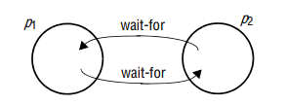
Global States
The state of all processes at a given time
Individual process can record its own (local) state
But, constructing a global state is hard! Why?
Why do we need global states?
Deadlock detection
Termination

Slide 49
Global States: An Analogy
Room 1
Room 2
Room 3
People are moving across three rooms
Q: How do you count the number of total people in the system when you can only count from inside a room?

Slide 50
Event Diagram
Time
P1
e11
e12
e13
P2
e21
e22
e23
e24
e25
P3
e32
e33
e34
e31

Slide 51
Equivalent Event Diagram
Time
P1
e11
e12
e13
P2
e21
e22
e23
e24
e25
P3
e32
e33
e34
e31

Slide 52
Rubber band Event Diagram
Time
P1
e11
e12
P2
e21
e22
P3
e31
P4
e41
e42
cut

Slide 53
Poset Diagram
e34
e13
e33
e12
e25
e32
e24
e23
e22
e11
e21
e31

Slide 54
Poset Diagram
e22
e12
e21
e42
e31
Past
e41
e21

Slide 55
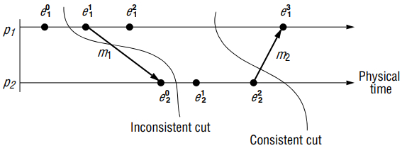
Cuts and Consistent Cuts
A cut (or time slice) is a zigzag line cutting a time diagram into 2 parts (past and future)
E is augmented with a cut event c_{i} for each process P_{i}:E’ =E ∪ {c_{i},…,c_{n}} ∴
A cut C of an event set E is a finite subset C⊆E: e∈C ∧ e’<_{l}e →e’∈C
A cut C₁ is later than C₂ if C₁⊇C₂
A consistent cut C of an event set E is a finite subset C⊆E : e∈C ∧ e’<e →e’ ∈C
i.e. a cut is consistent if every message received was previously sent (but not necessarily vice versa!)
For a consistent cut C:

Slide 56
Consistent Cuts
Instant of local observation
(Cut event)
Time
P1
5
8
3
initial
value
P2
5
2
3
7
4
1
P3
5
4
0
ideal
(vertical)
cut
consistent
cut
inconsistent
cut
not attainable
equivalent to a vertical cut
(rubber band transformation)
can’t be made vertical
(message from the future)

Slide 57
Consistent Cuts
Some Theorems
For a consistent cut consisting of cut events c_{i},…,c_{n}, no pair of cut events is causally related. i.e ∀c_{i},c_{j} ~(c_{i}< c_{j}) ∧ ~(c_{j}< c_{i})
For any time diagram with a consistent cut consisting of cut events c_{i},…,c_{n}, there is an equivalent time diagram where c_{i},…,c_{n} occur simultaneously. i.e. where the cut line forms a straight vertical line
All cut events of a consistent cut can occur simultaneously

Slide 58
Global States of Consistent Cuts
The global state of a distributed system is a collection of the local states of the processes and the channels.
A global state computed along a consistent cut is correct
The global state of a consistent cut comprises the local state of each process at the time the cut event happens and the set of all messages sent but not yet received
The snapshot problem consists of designing an efficient protocol which yields consistent cuts in order to collect the local state information
Messages crossing the cut must be captured
Chandy & Lamport presented an algorithm assuming that message transmission is FIFO

Slide 59
System Model for Global Snapshots
The system consists of a collection of n processes p1, p2, ..., pn that are connected by channels.
There are no globally shared memory and physical global clock and processes communicate by passing messages through communication channels.
C_{ij} denotes the channel from process pi to process pj and its state is denoted by SC_{ij} .
The actions performed by a process are modeled as three types of events:
Internal events, the message send event and the message receive event.
For a message mij that is sent by process pi to process pj , let send(m_{ij} ) and rec(m_{ij} ) denote its send and receive events.

Slide 60
Process States and Messages in transit
At any instant, the state of process pi , denoted by LSi , is a result of the sequence of all the events executed by pi till that instant.
For an event e and a process state LSi , e∈LSi iff e belongs to the sequence of events that have taken process pi to state LSi .
For an event e and a process state LSi , e (not in) LSi iff e does not belong to the sequence of events that have taken process pi to state LSi .
For a channel Cij , the following set of messages can be defined based on the local states of the processes pi and pj
Transit: transit(LSi , LSj ) = {mij |send(mij ) ∈ LSi V
rec(mij ) (not in) LSj }

Slide 61
Chandy-Lamport Distributed Snapshot Algorithm
Assumes FIFO communication in channels
Uses a control message, called a marker to separate messages in the channels
After a process has recorded its snapshot, it sends a marker, along all of its outgoing channels before sending out any more messages.
The marker separates the messages in the channel into those to be included in the snapshot from those not to be recorded in the snapshot.
A process must record its snapshot no later than when it receives a marker on any of its incoming channels.
The algorithm terminates after each process has received a marker on all of its incoming channels.
All the local snapshots get disseminated to all other processes and all the processes can determine the global state.

Slide 62
Chandy-Lamport Distributed Snapshot Algorithm
Record own states
p3
?
p2
?
p1
m
p2
p3
?
m
p3
p2
?
On receiving the marker, say on channel c, the receiving process records its state, set channel c empty, sends out the marker on all outgoing channels and starts recording messages arriving on those channels,

Slide 63
Chandy-Lamport Distributed Snapshot Algorithm
Record own states
p3
p2
p1
m
m
m
p2
p3
m
p3
p2
On receiving the marker, say on channel c, the receiving process records its state, set channel c empty, sends out the marker on all outgoing channels and starts recording messages arriving on those channels, and stops recording whenever receives another marker on the same

Slide 64
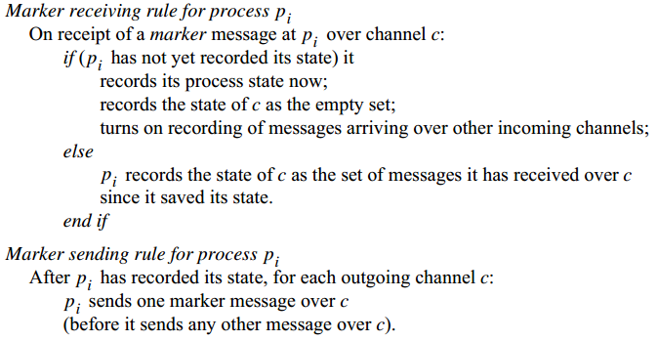
Chandy-Lamport Distributed Snapshot Algorithm

Slide 65
Chandy-Lamport Distributed Snapshot Algorithm
Proof sketch: The cut is consistent.
No recording of a “receive” event without recording its “send” event
Suppose there is one.
But, this cannot happen as channel is FIFO.
p2
p1
m
m
p2
p3

Slide 66
Chandy-Lamport Distributed Snapshot Algorithm
Proof sketch: The protocol terminates.
For each channel, recording stops with the reception of the marker on the channel
What happens if the marker gets lost?
p2
p1
m
m
p2
p3

Slide 67
Chandy-Lamport Distributed Snapshot Algorithm
Marker receiving rule for Process Pi
If (Pi has not yet recorded its state) it
records its process state now
records the state of c as the empty set
turns on recording of messages arriving over other channels
else
Pi records the state of c as the set of messages received over c
since it saved its state
Marker sending rule for Process Pi
After Pi has recorded its state,for each outgoing channel c:
Pi sends one marker message over c
(before it sends any other message over c)

Slide 68
Computing Global States without FIFO Assumption - Lai-Yang Algorithm
Uses a coloring scheme that works as follows
White (before snapshot); Red (after snapshot)
Every process is initially white and turns red while taking a snapshot. The equivalent of the “Marker Sending Rule” (virtual broadcast) is executed when a process turns red.
Every message sent by a white (red) process is colored white (red).
Thus, a white (red) message is a message that was sent before (after) the sender of that message recorded its local snapshot.
Every white process takes its snapshot at its convenience, but no later than the instant it receives a red message.

Slide 69
Computing Global States without FIFO Assumption - Lai-Yang Algorithm (cont.)
Every white process records a history of all white messages sent or received by it along each channel.
When a process turns red, it sends these histories along with its snapshot to the initiator process that collects the global snapshot.
Determining Messages in transit ( i.e. White messages received by red process)
The initiator process evaluates transit(LSi, LSj) to compute the state of a channel Cij as given below:
SCij = {white messages sent by pi on Cij −
white messages received by pj on Cij}
= { send (Mij)|send(mij)∈LSi} − {rec(mij)| rec(mij)∈LSj}.

Slide 70
Computing Global States without FIFO Assumption: Termination
First method
Each process I keeps a counter cntri that indicates the difference between the number of white messages it has sent and received before recording its snapshot, i.e number of messages still in transit.
It reports this value to the initiator along with its snapshot and forwards all white messages, it receives henceforth, to the initiator.
Snapshot collection terminates when the initiator has received Σi cntri number of forwarded white messages.
Second method
Each red message sent by a process piggybacks the value of the number of white messages sent on that channel before the local state recording. Each process keeps a counter for the number of white messages received on each channel.
Termination – Process receives as many white messages on each channel as the value piggybacked on red messages received on that channel.

Slide 71
Computing Global States without FIFO Assumption: Mattern’s Algorithm
Uses Vector Clocks
All process agree on some future virtual time s or a set of virtual time instants s₁,…s_{n} which are mutually concurrent and did not yet occur
A process takes its local snapshot at virtual time s
After time s the local snapshots are collected to construct a global snapshot
P_{i} ticks and then fixes its next time s=C_{i} +(0,…,0,1,0,…,0) to be the common snapshot time
P_{i} broadcasts s
P_{i} blocks waiting for all the acknowledgements
P_{i} ticks again (setting C_{i}=s), takes its snapshot and broadcast a dummy message (i.e. force everybody else to advance their clocks to a value ≥ s)
Each process takes its snapshot and sends it to P_{i} when its local clock becomes ≥ s

Slide 72
Computing Global States without FIFO Assumption (Mattern cont)
Inventing a n+1 virtual process whose clock is managed by P_{i}
P_{i} can use its clock and because the virtual clock C_{n+1} ticks only when P_{i} initiates a new run of snapshot :
The first n components of the vector can be omitted
The first broadcast phase is unnecessary
Counter modulo 2
Termination
Distributed termination detection algorithm [Mattern 87]

Slide 73
Thanks

