Slide 1
Building Bayesian Networks
COMPSCI 276, Fall 2009
Set 3: Rina Dechter
(Reading: Darwiche chapter 5)

Slide 2
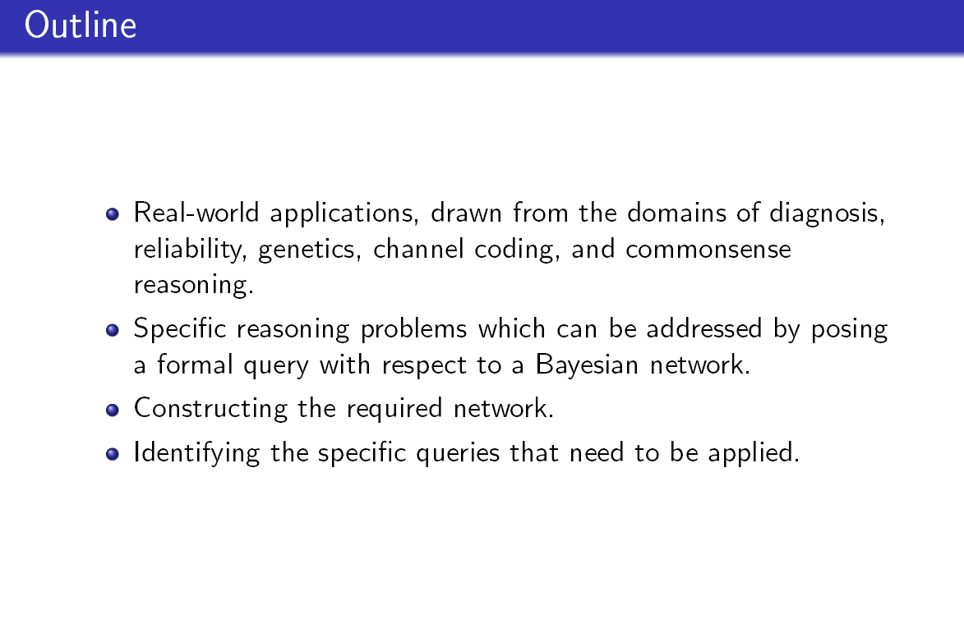

Slide 3
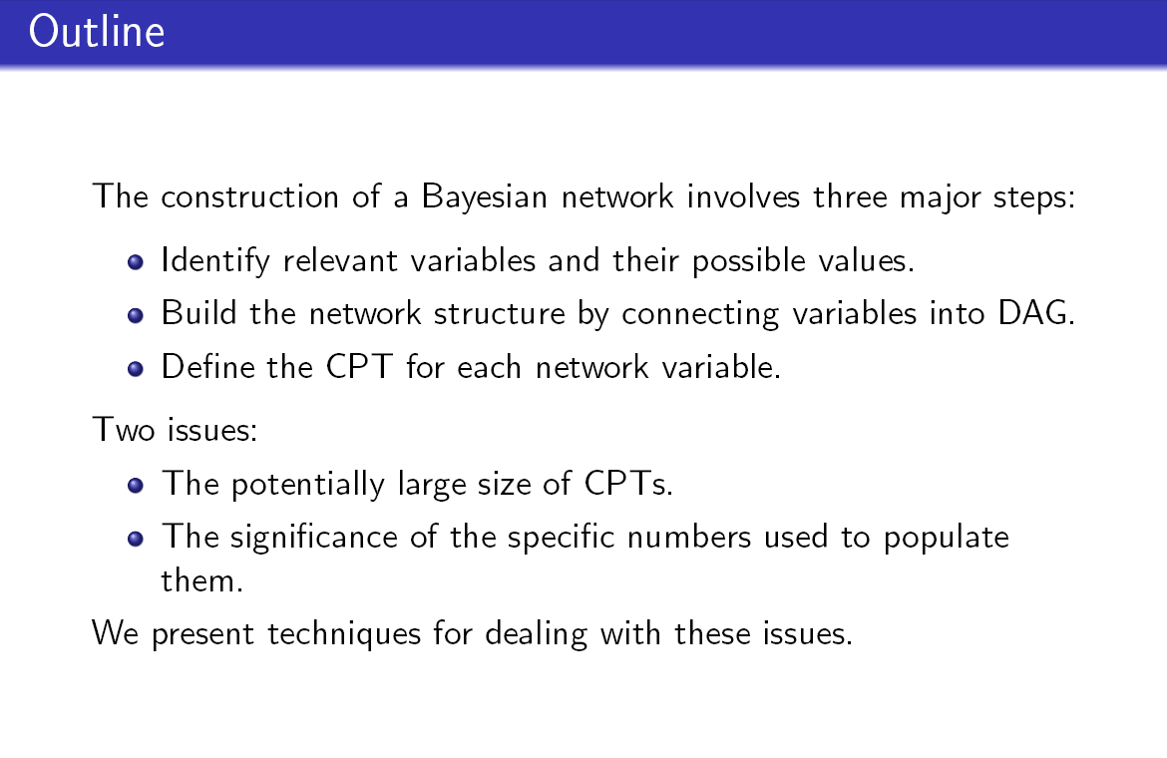
Queries: Different queries may be relevant for different scenarios

Slide 4
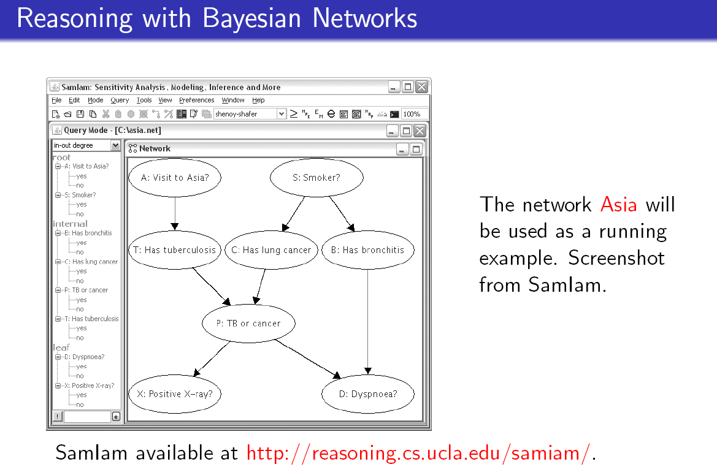
For other tools see class page

Slide 5
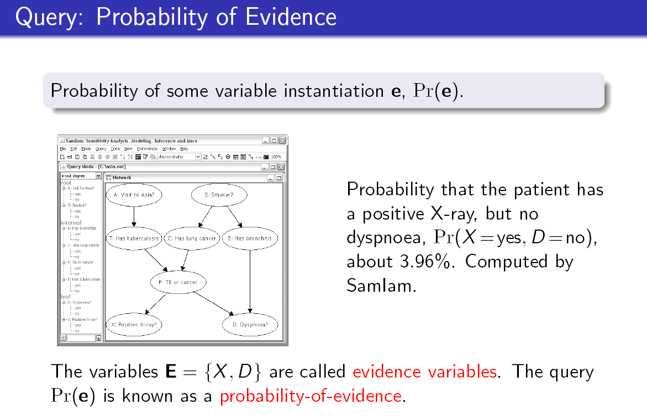
Other type of evidence: We may want to know the probability that the patient has either a
positive X-ray or dyspnoea, X =yes or D=yes.

Slide 6
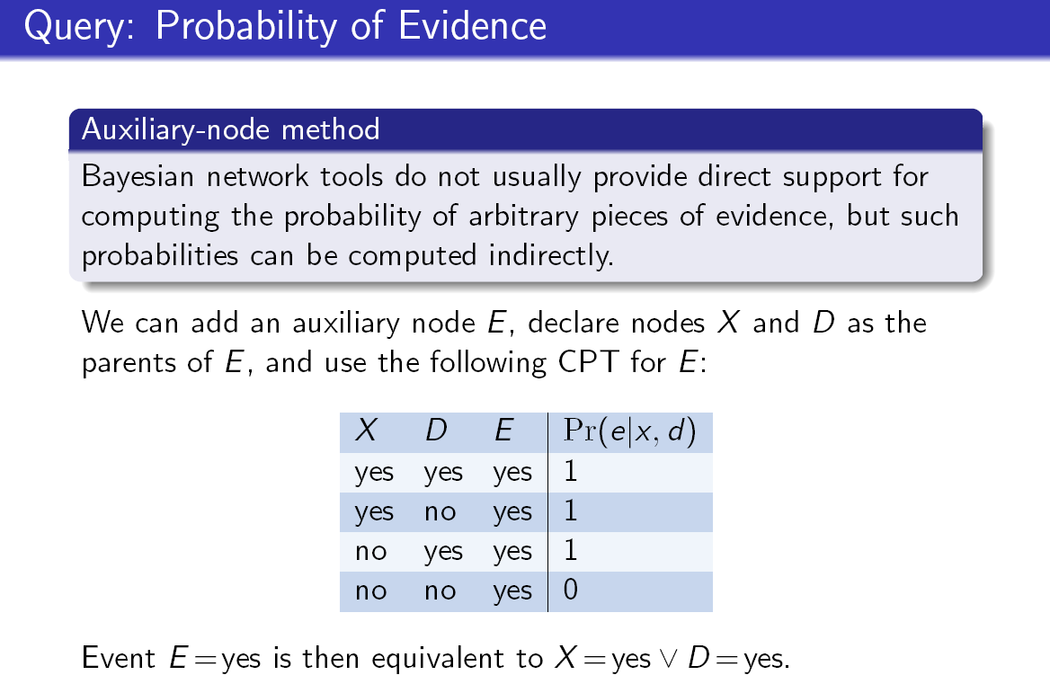

Slide 7
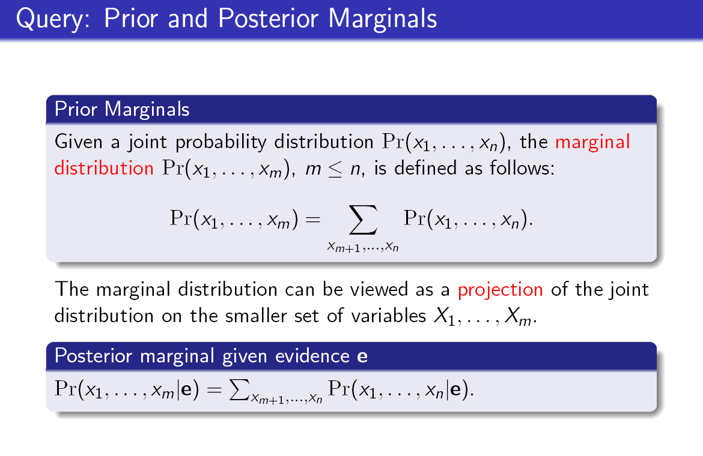

Slide 8
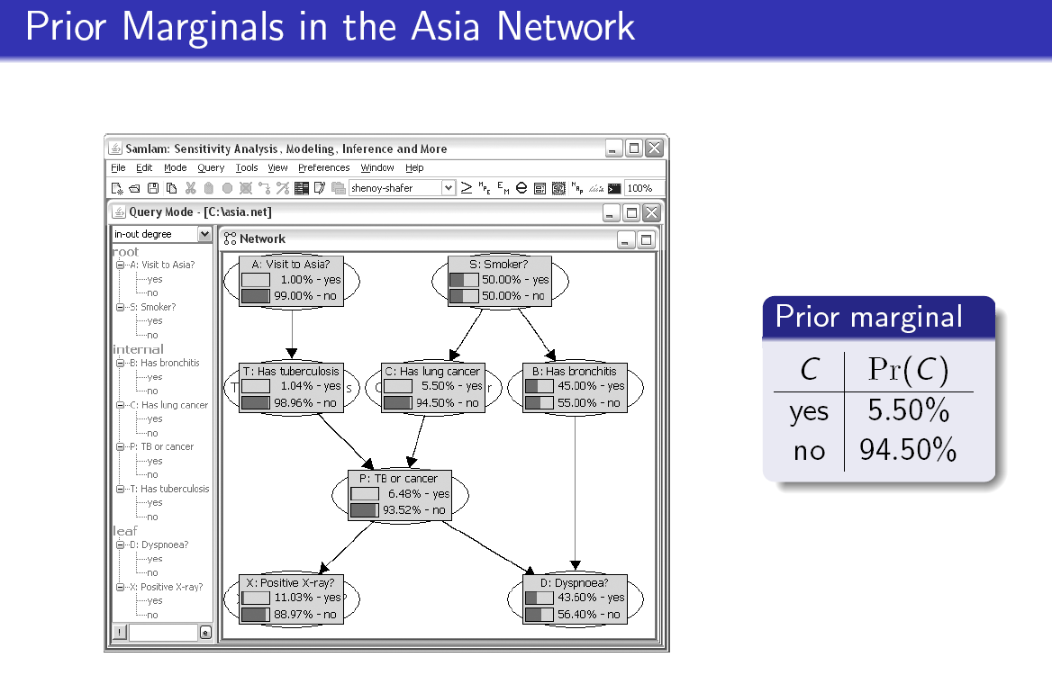
C= lung cancer

Slide 9
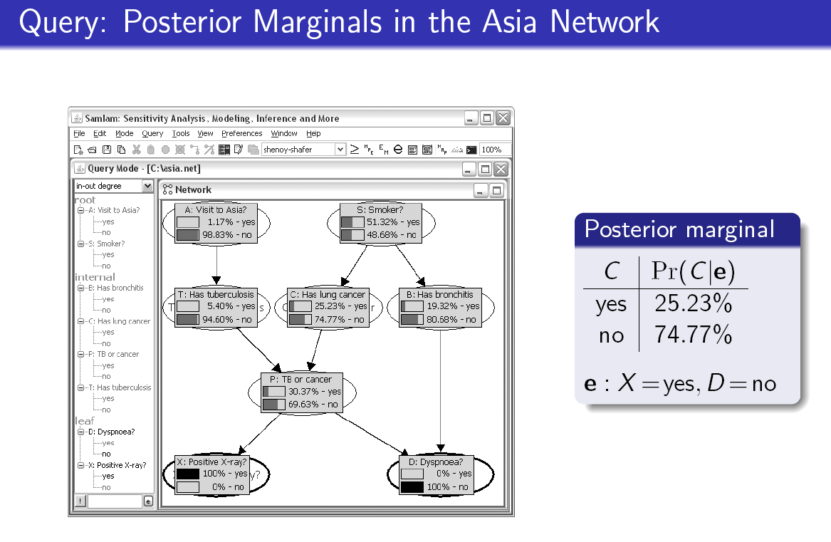

Slide 10
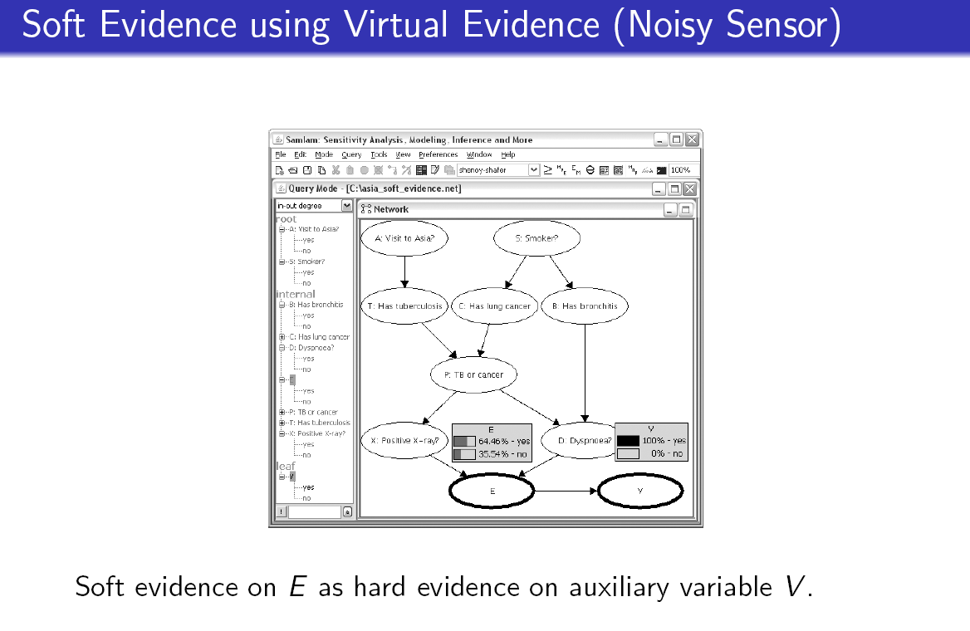
P(V=yes|E=yes)
P(V=yes|E=no)
=2
Define a cpt for V that satisfies this constraint

Slide 11
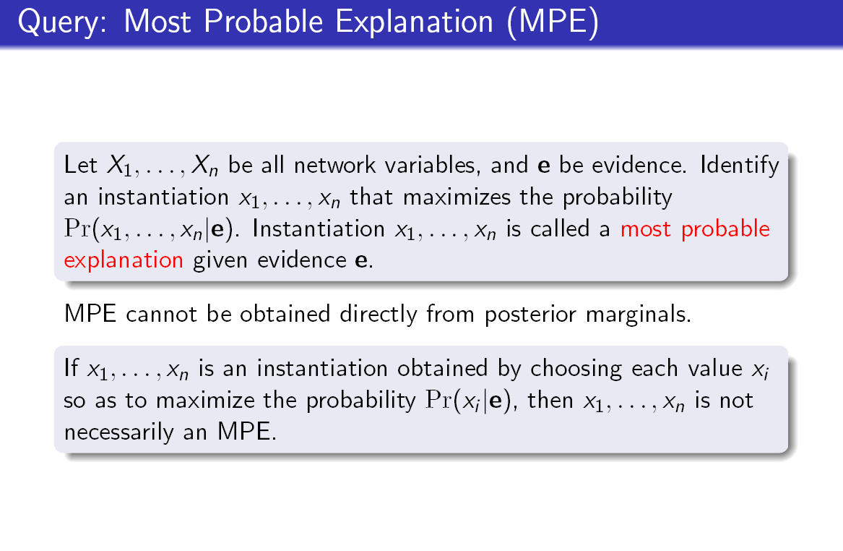

Slide 12
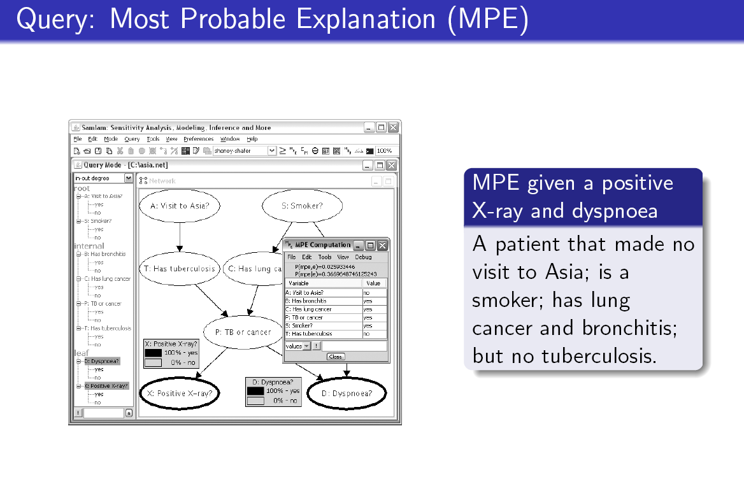

Slide 13
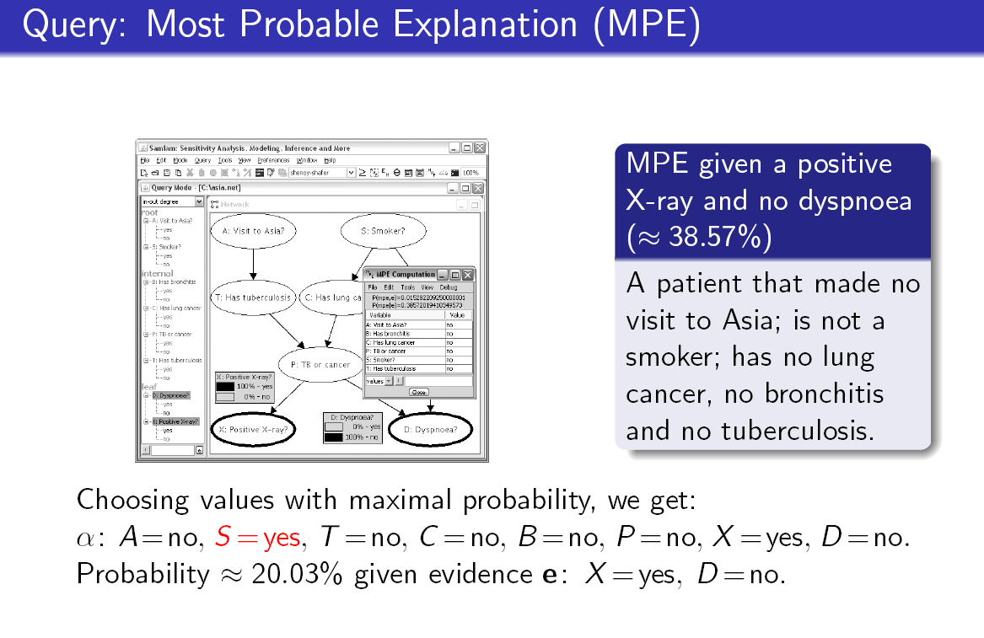

Slide 14
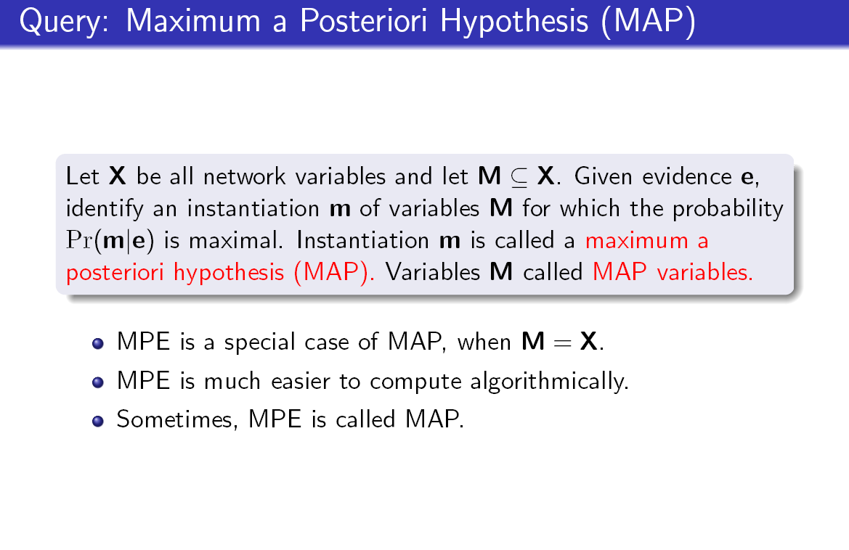

Slide 15
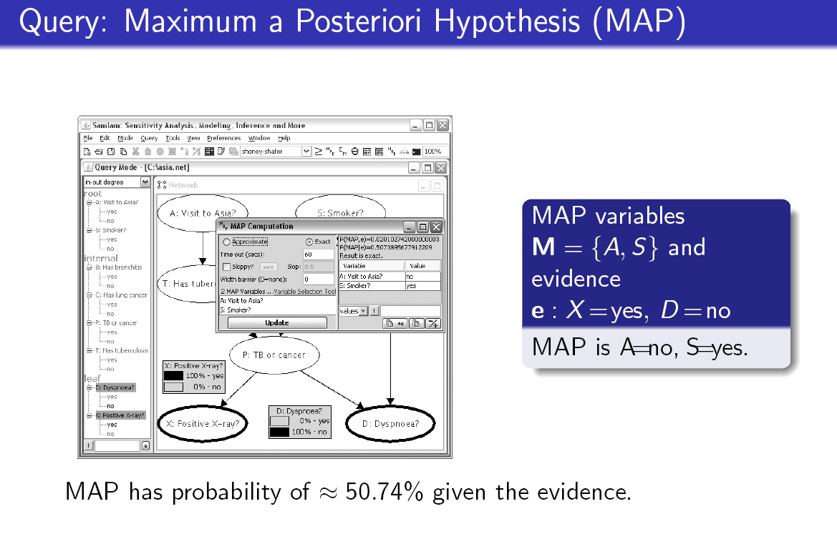

Slide 16
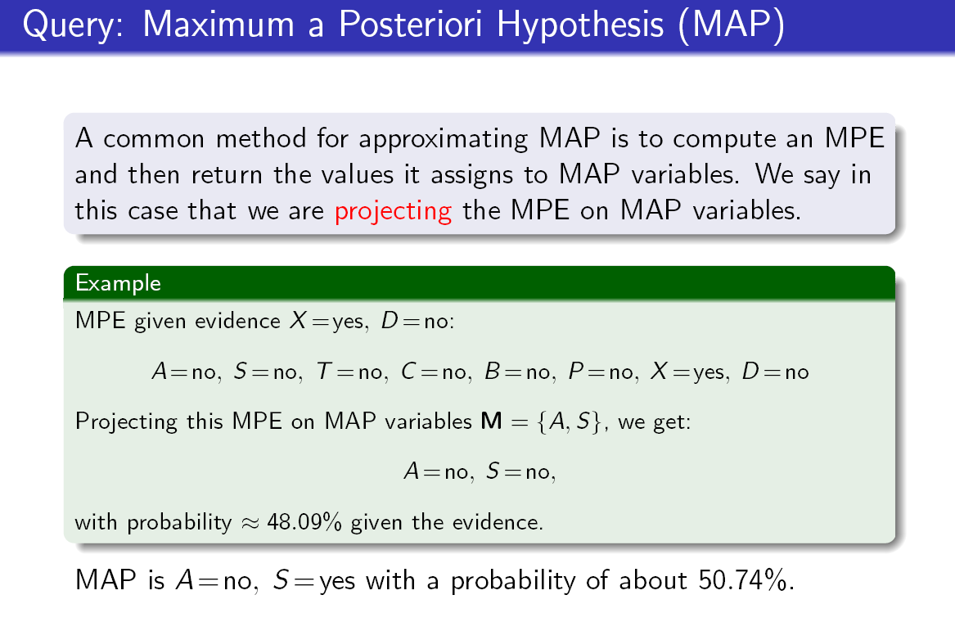
Is it correct?

Slide 18
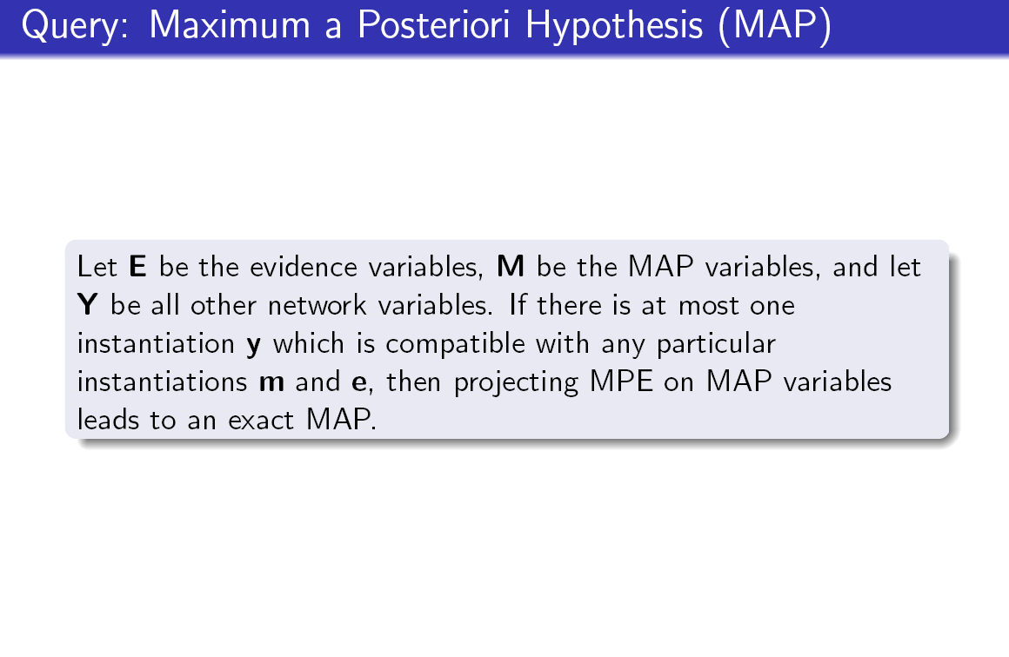

Slide 19
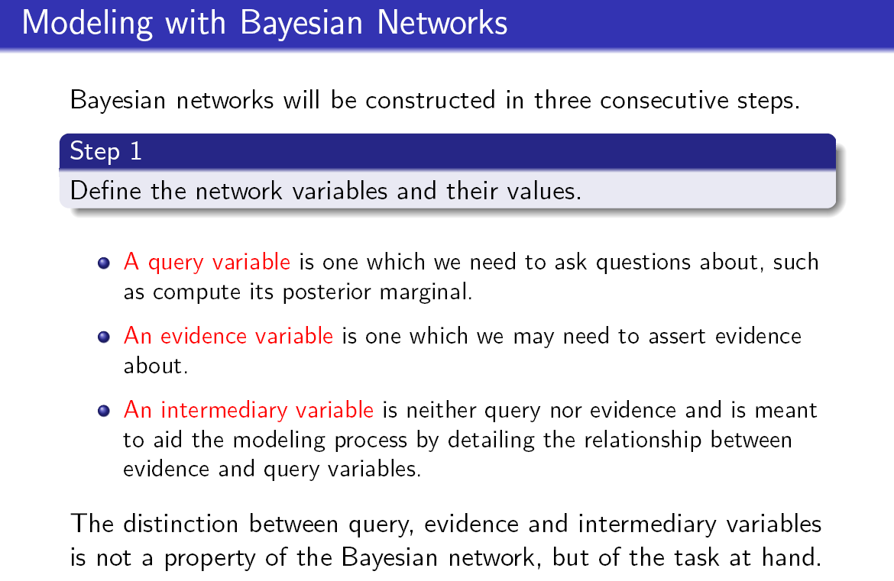

Slide 20
Building email management network
Step 1: define the variables: email characteristics
  Title,
    (values: any sequence of words.)
  sender-id,
    (values: # of id names)
  Recipients, #-of-recipients
    (Values, a sequence of id-names)
  topic,
    (values: a distribution over bag of words, or a set of key words)
  length,
    (values: natural numbers)
  time-sent : (time-of-week, time-of-day),
    (values: days of the week, time (discredized)
  time-read, (values: as above)
  current-time, (value: as above)
  max-reponse-time (value: as above)
Evidence variables
query

Slide 21
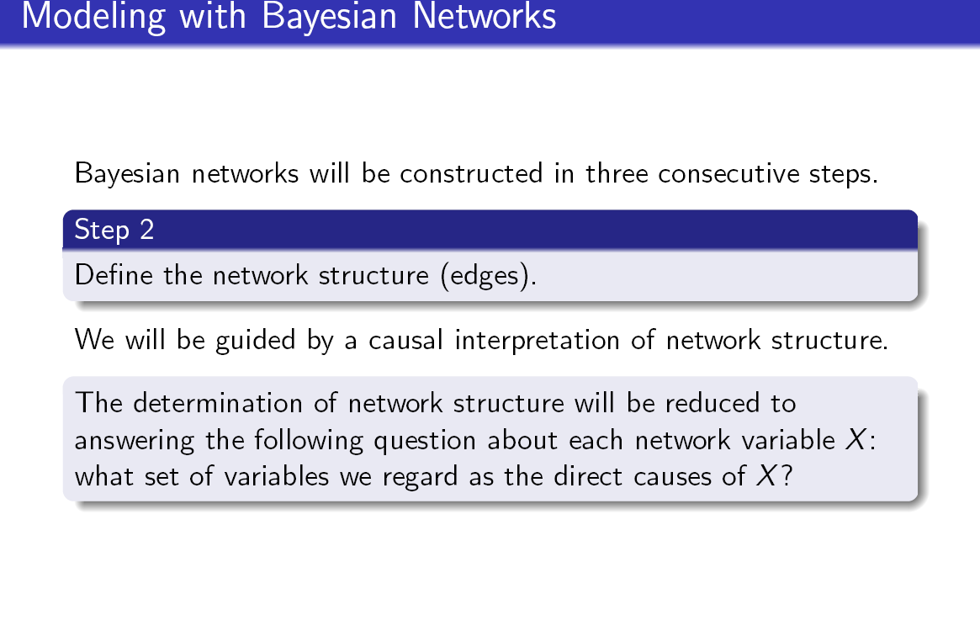

Slide 22
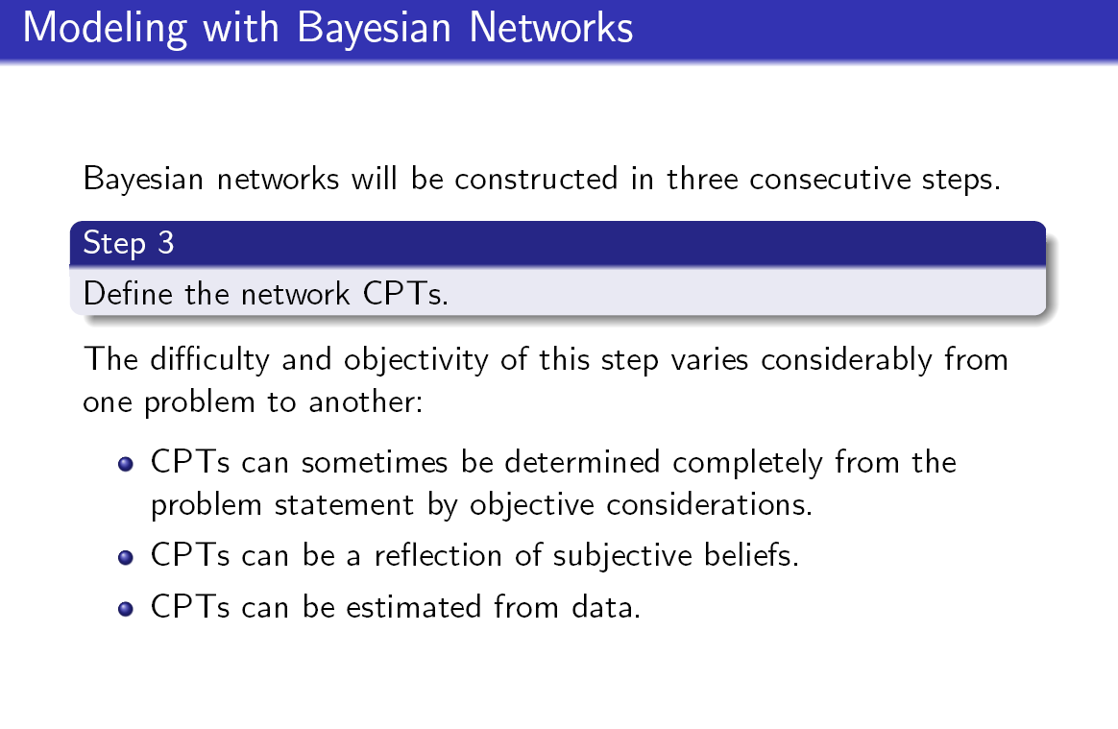

Slide 23
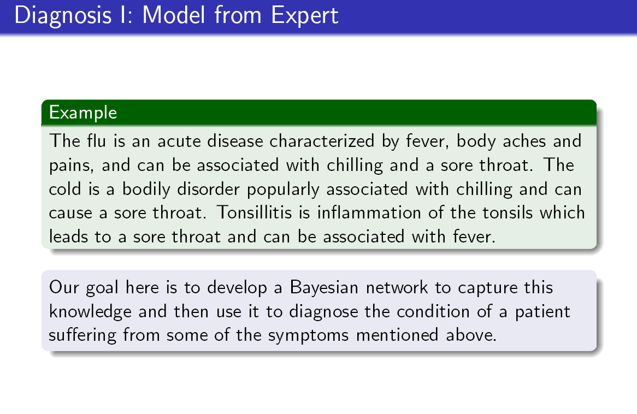
Variables? Arcs? Try it.

Slide 24
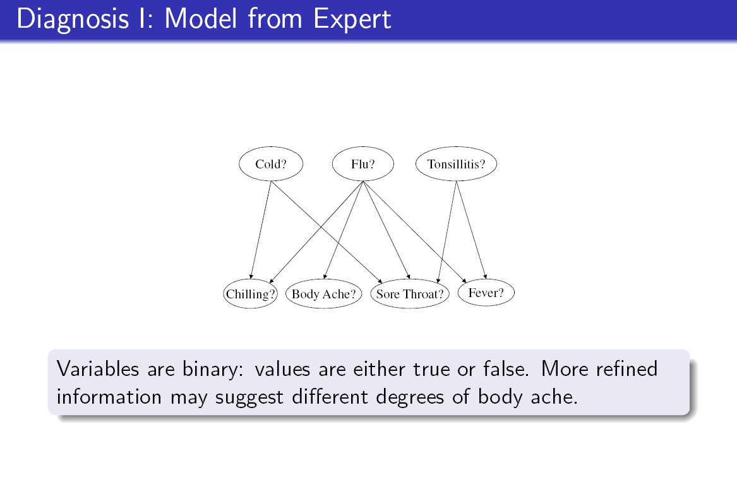
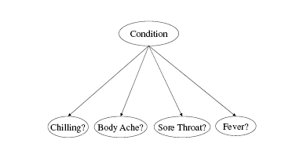
A naive Bayes structure
has the following edges C -> A1, . . . , C -> Am, where C is called the class variable and A1; : : : ;Am are called the attributes.
What about?

Slide 25
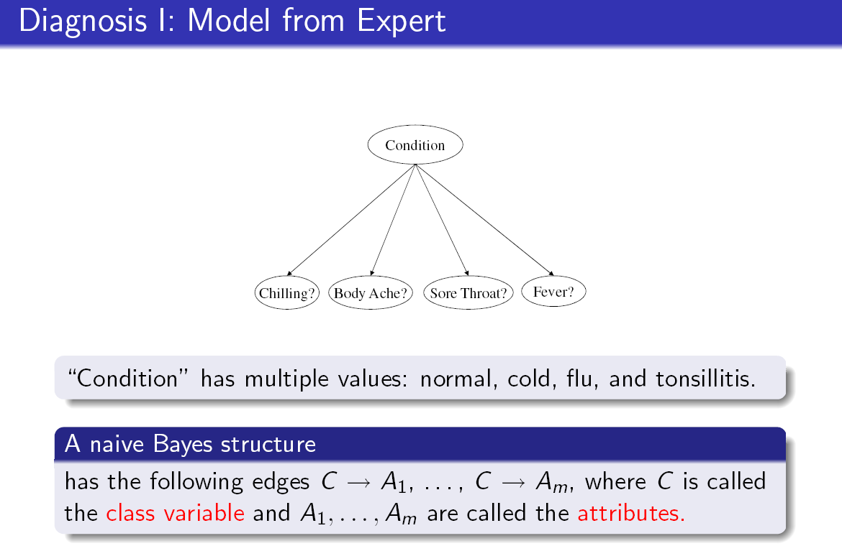

Slide 26
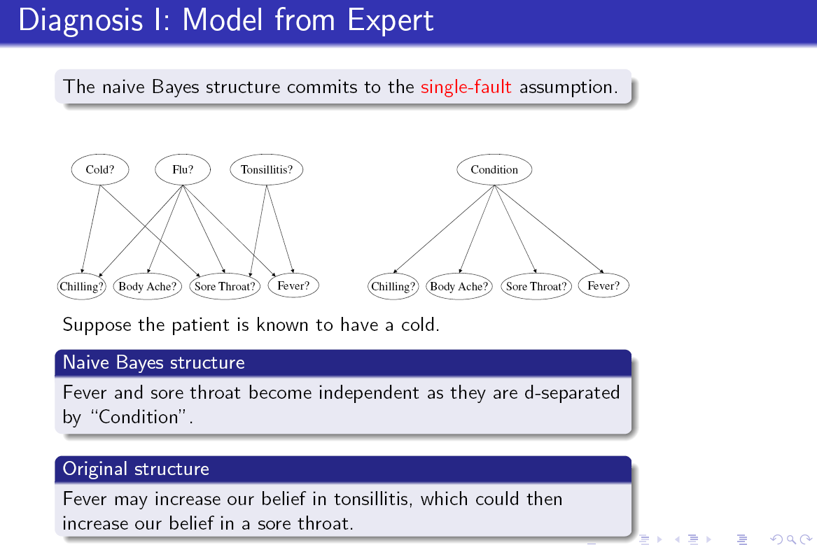

Slide 27
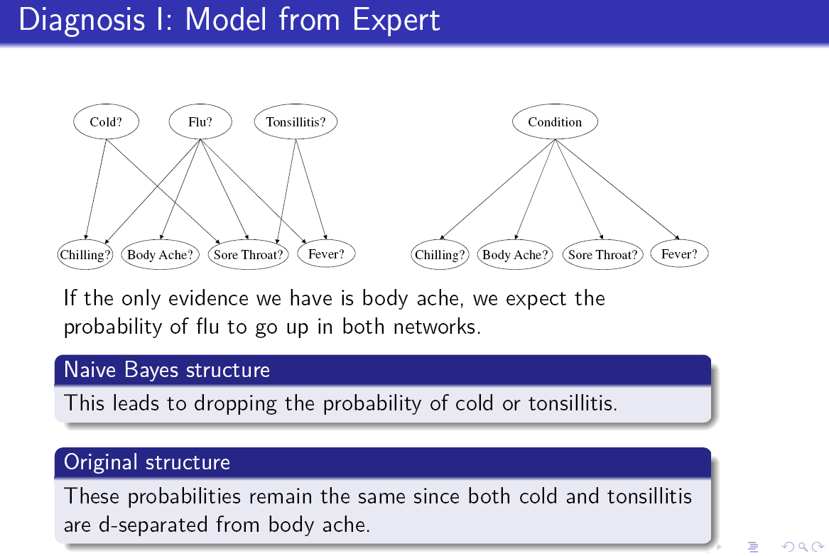

Slide 28
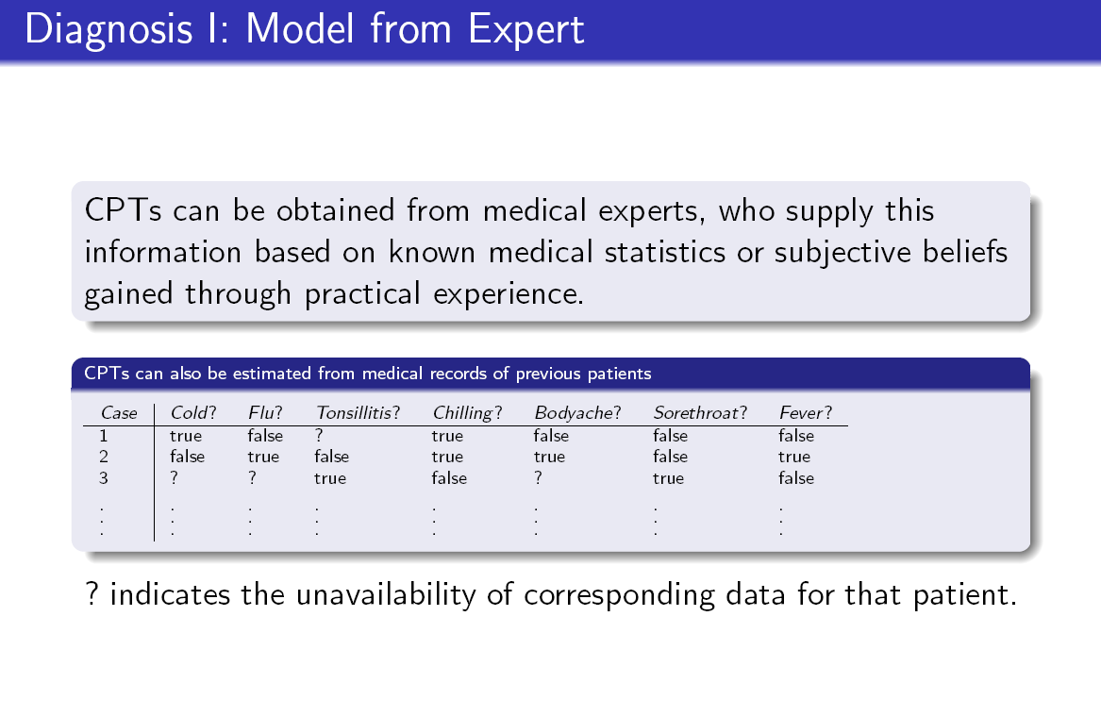
Learn the model from data

Slide 29
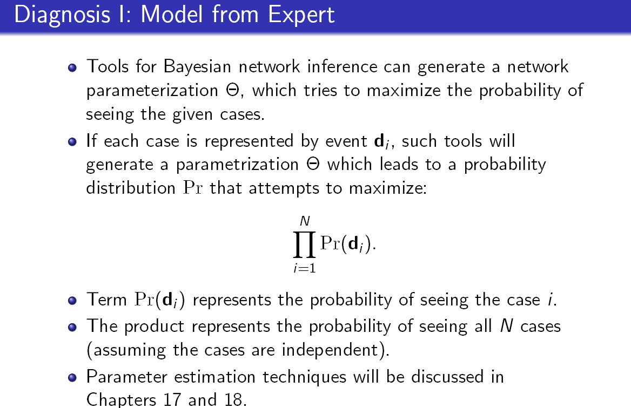
Learning the model

Slide 30
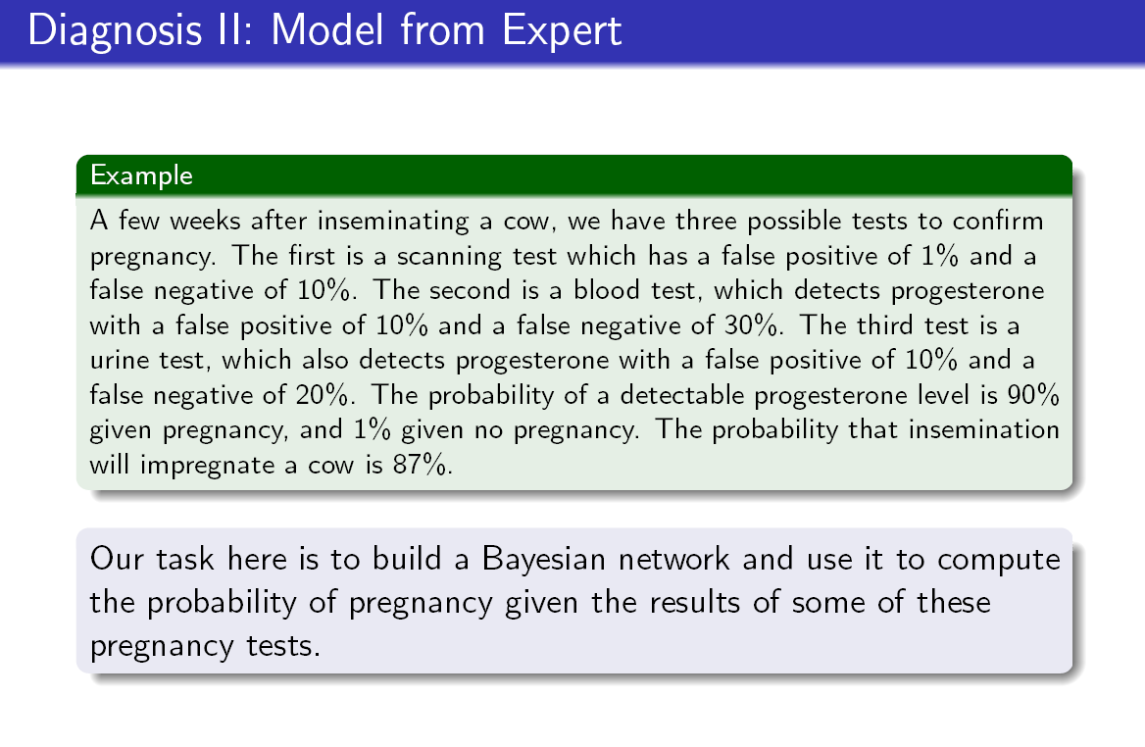
Try it: Variables and values? Structure? CPTs?

Slide 31
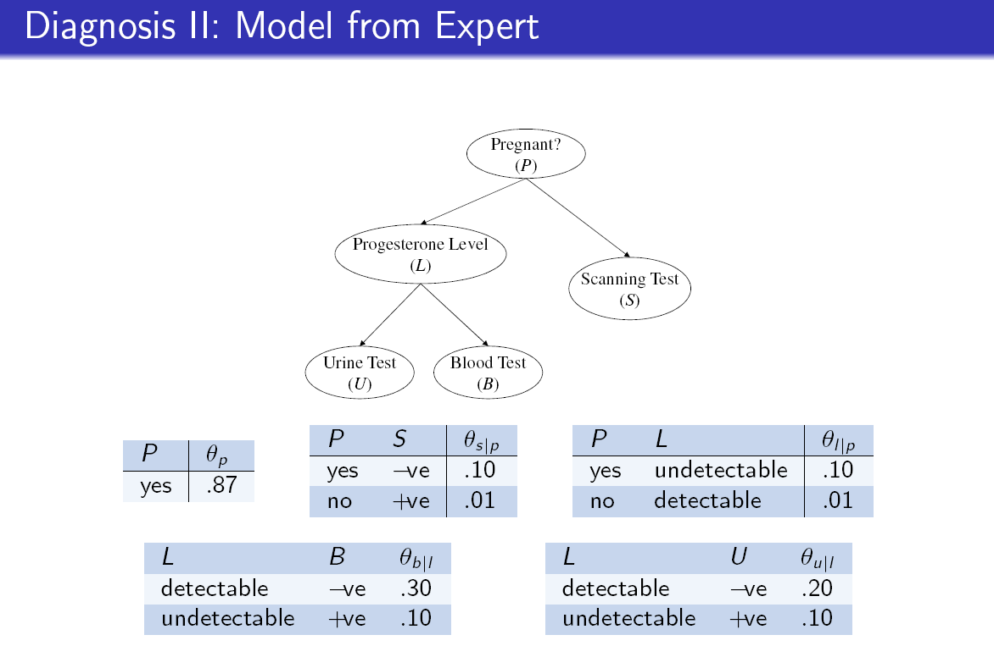

Slide 32
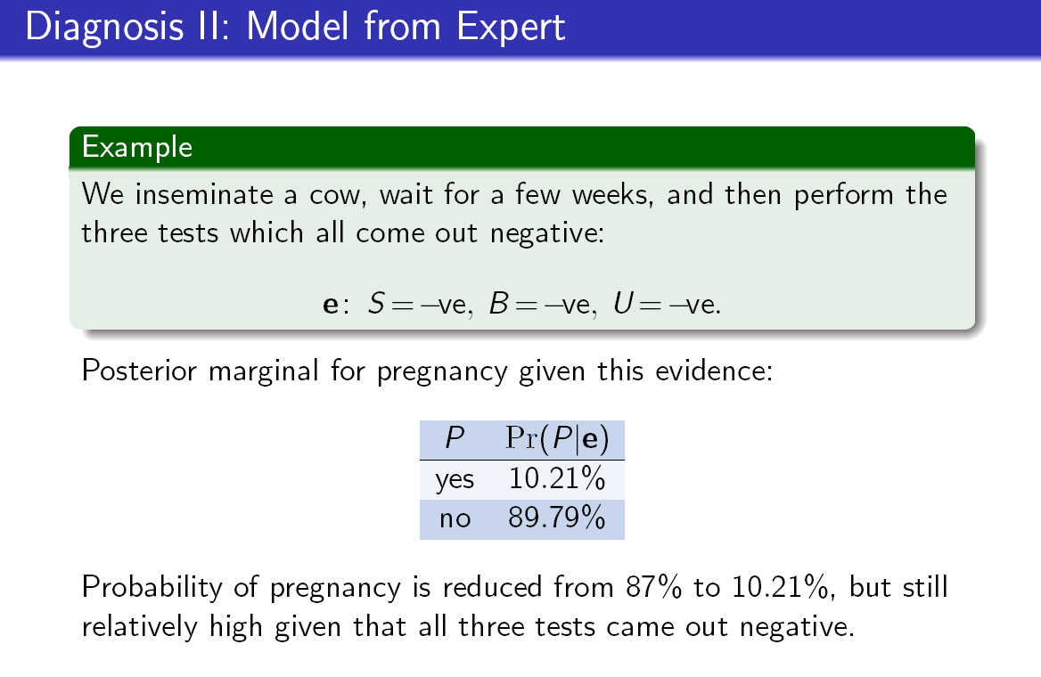

Slide 33
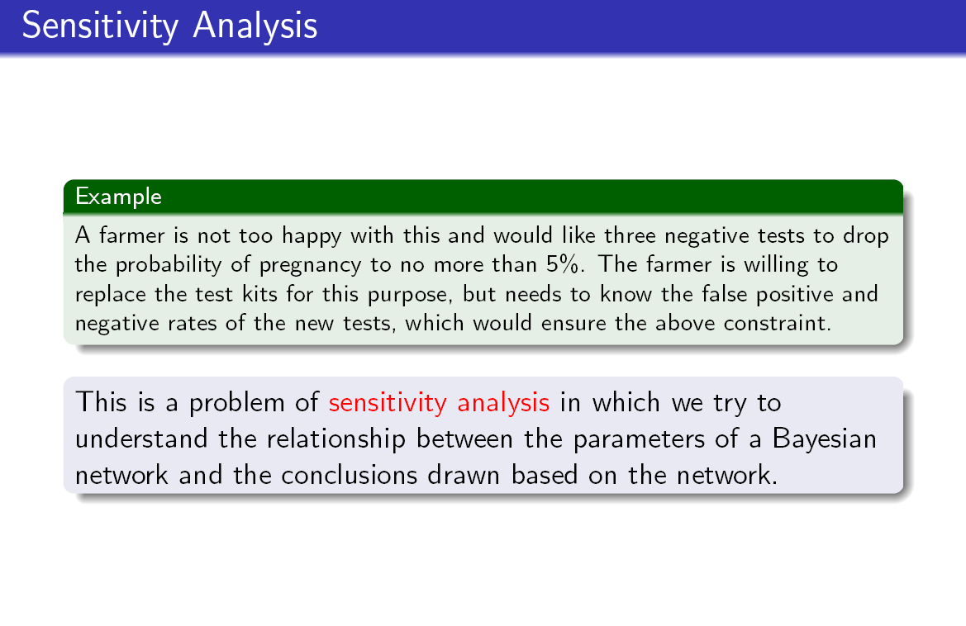

Slide 34
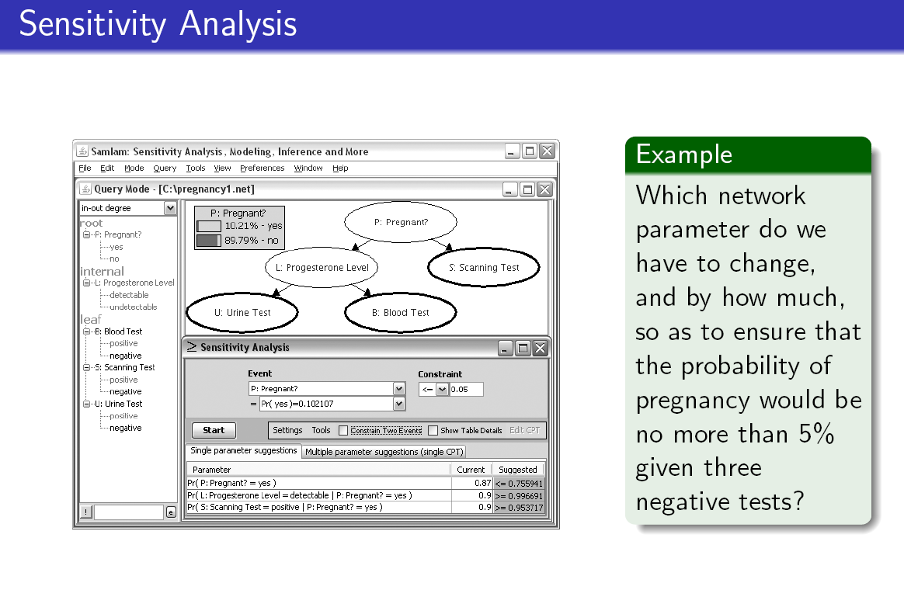

Slide 35
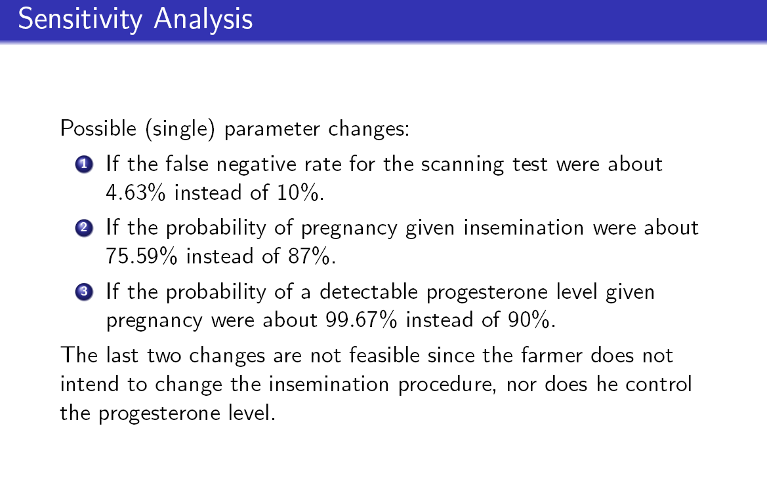

Slide 36
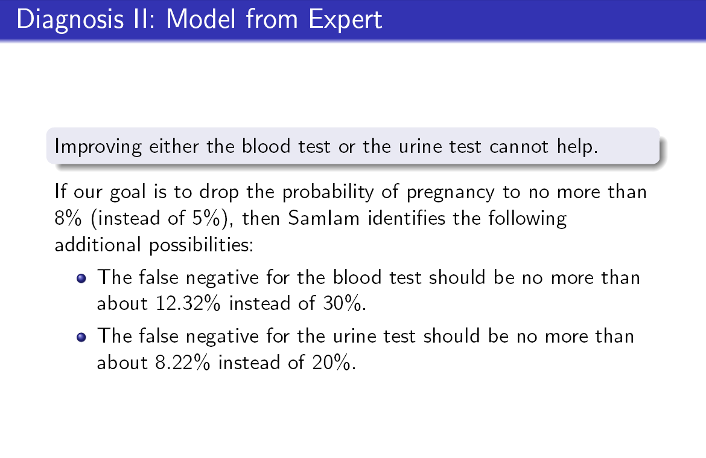

Slide 37
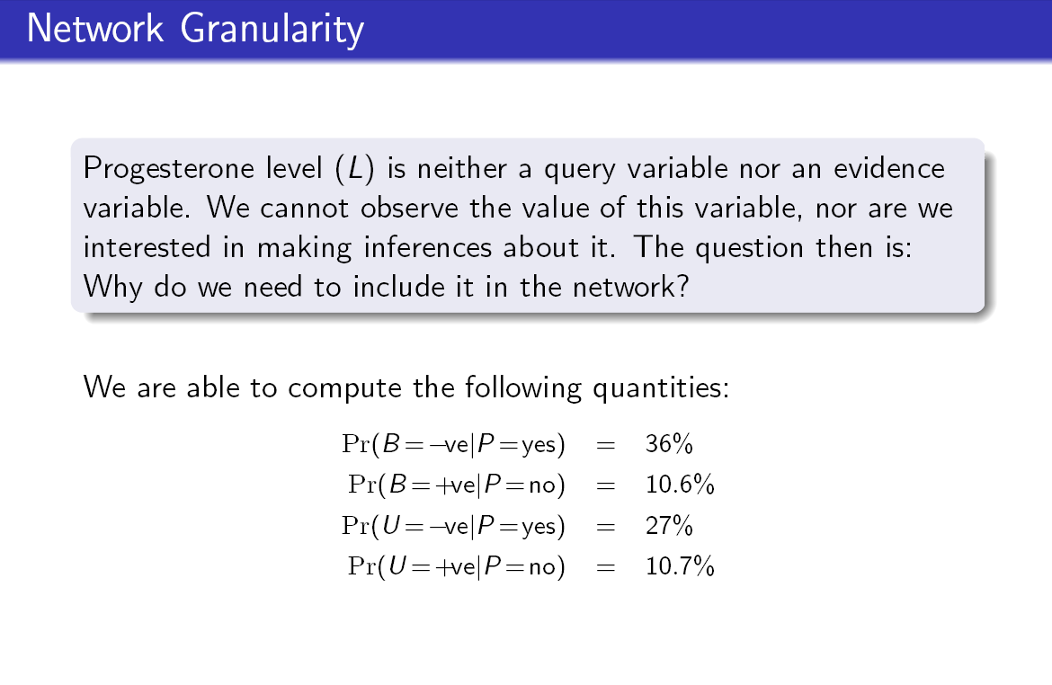
Skip if no time, this and the next 4 slides

Slide 38
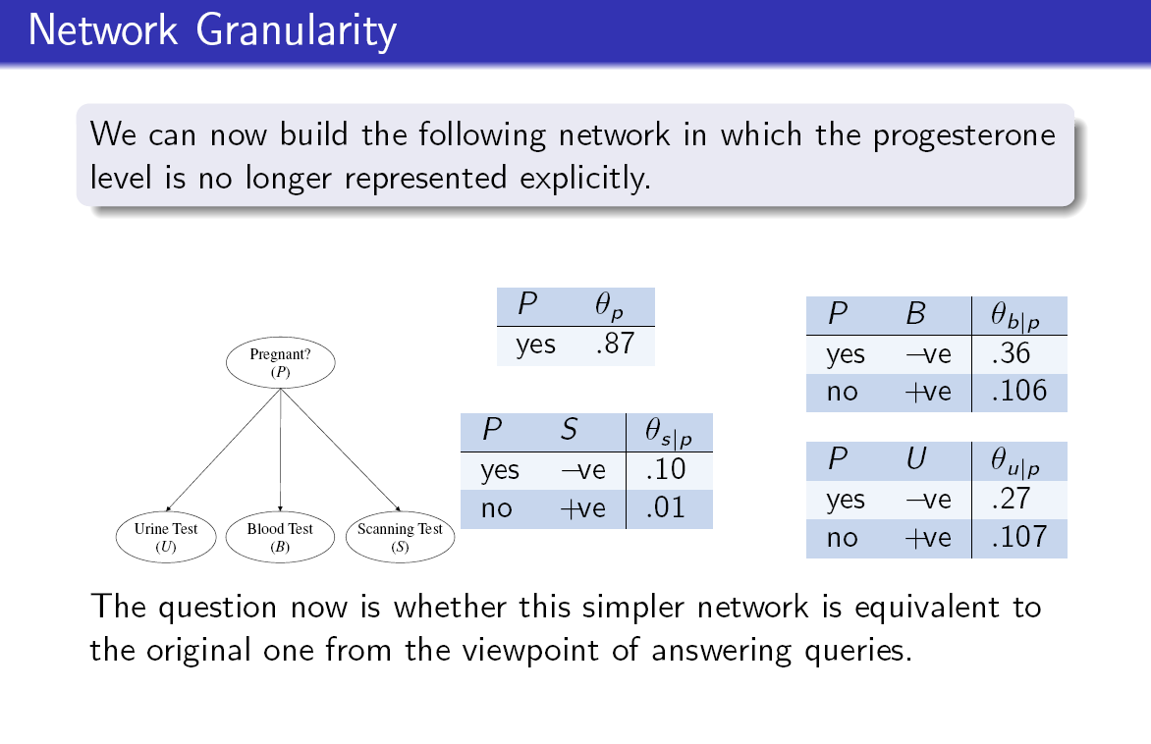

Slide 39
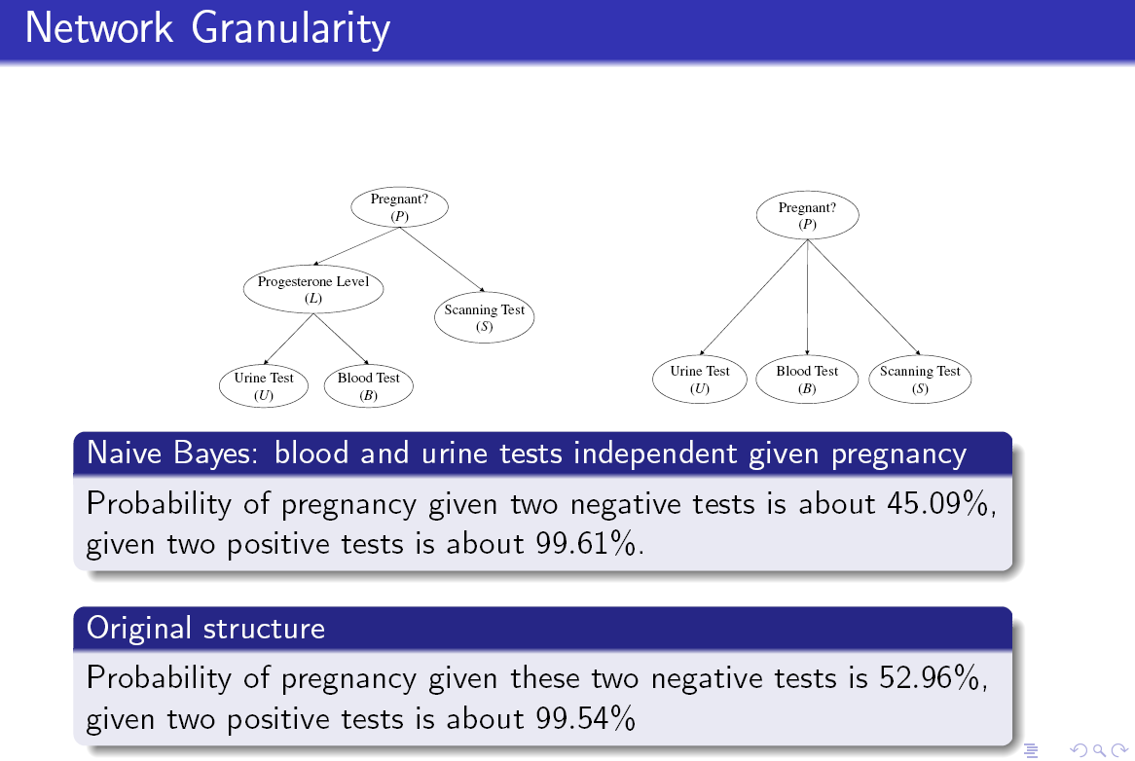

Slide 40
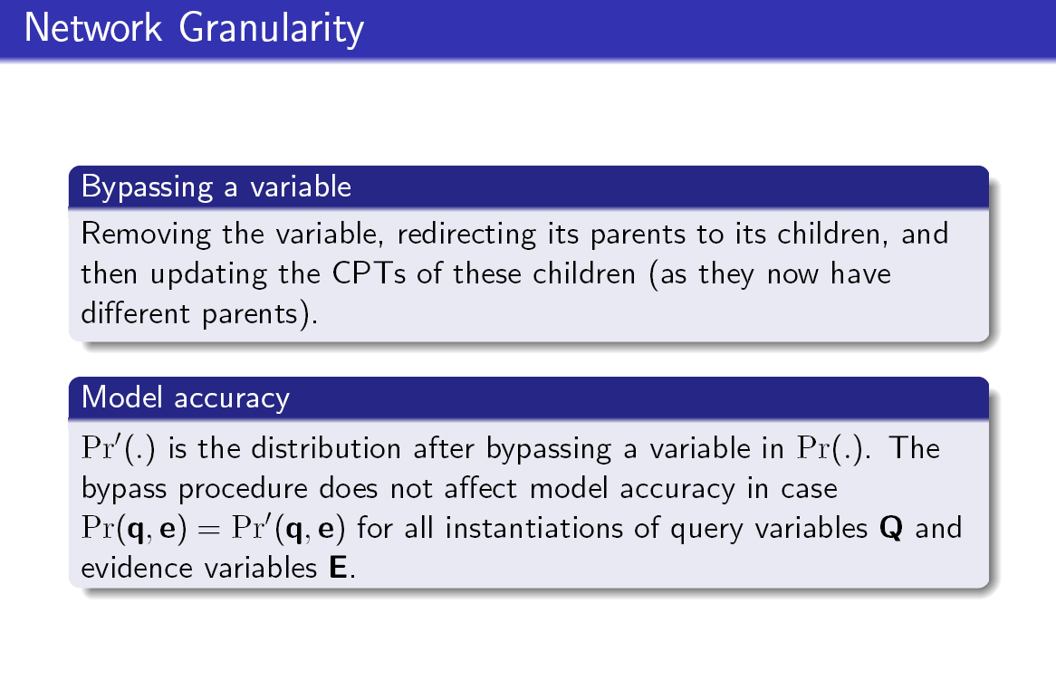

Slide 41
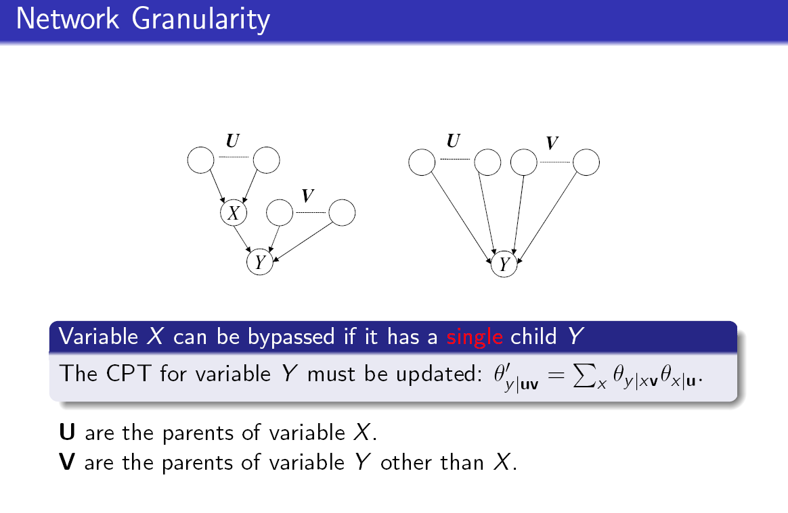

Slide 42
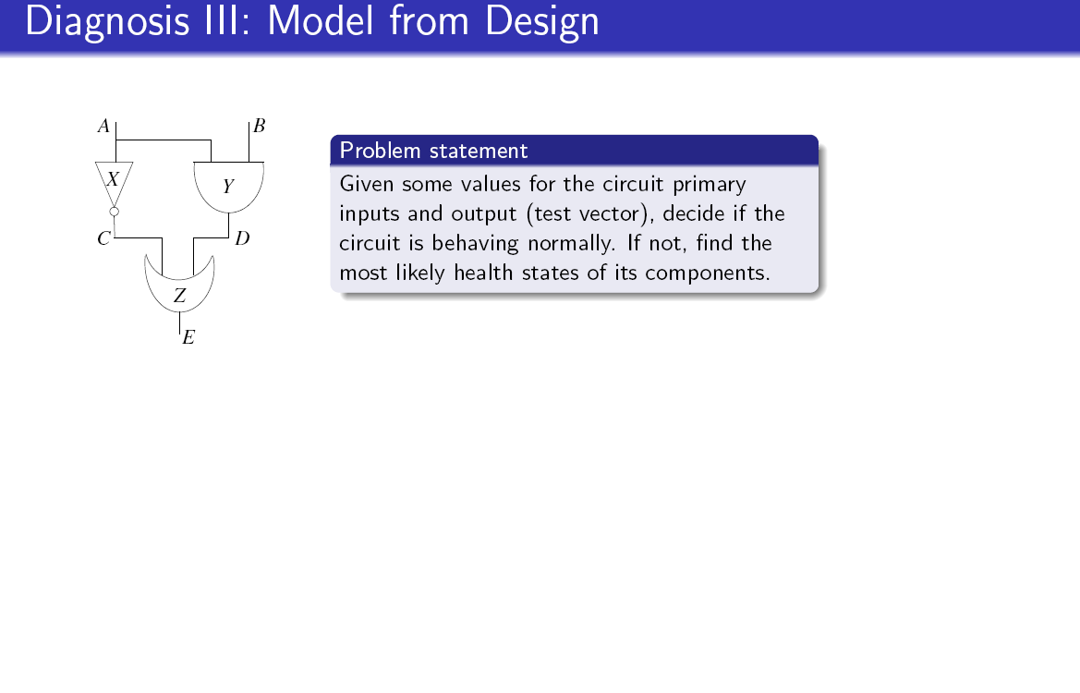
Try it: Variables? Values? Structure?

Slide 43
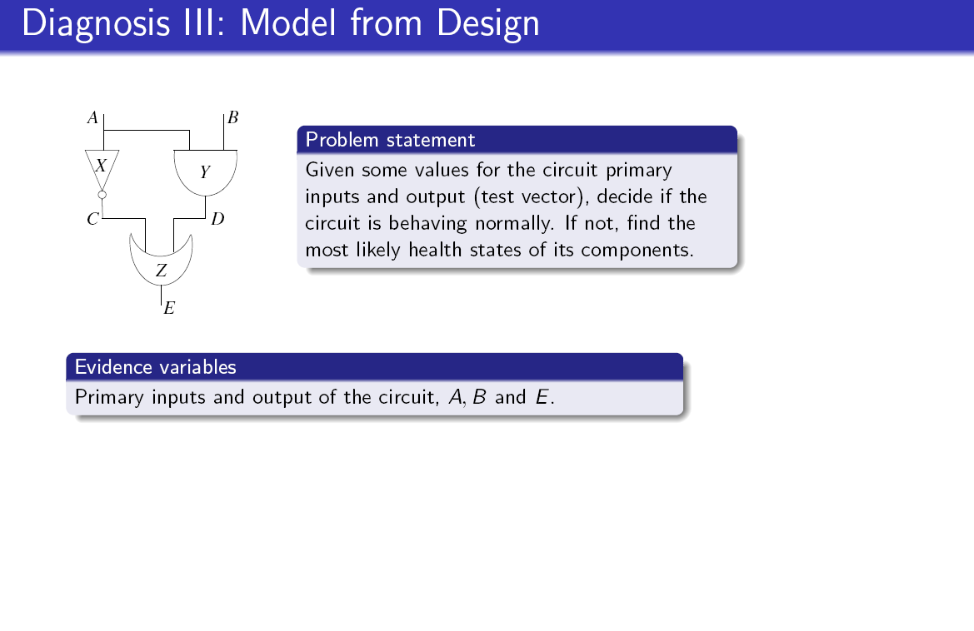

Slide 44
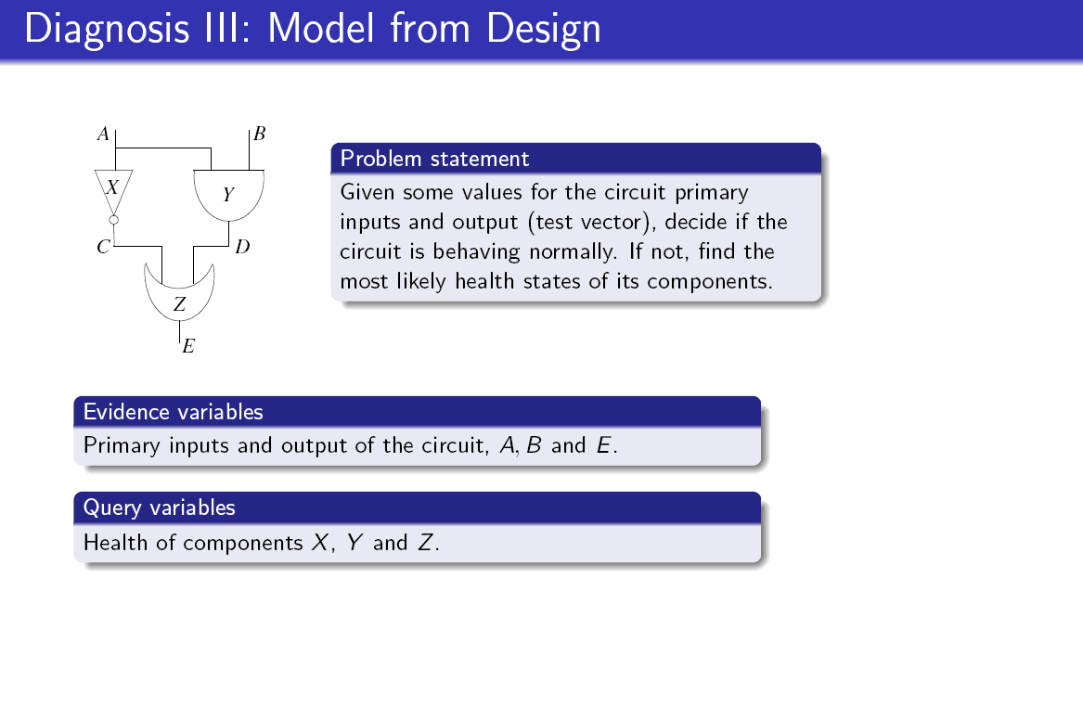

Slide 45
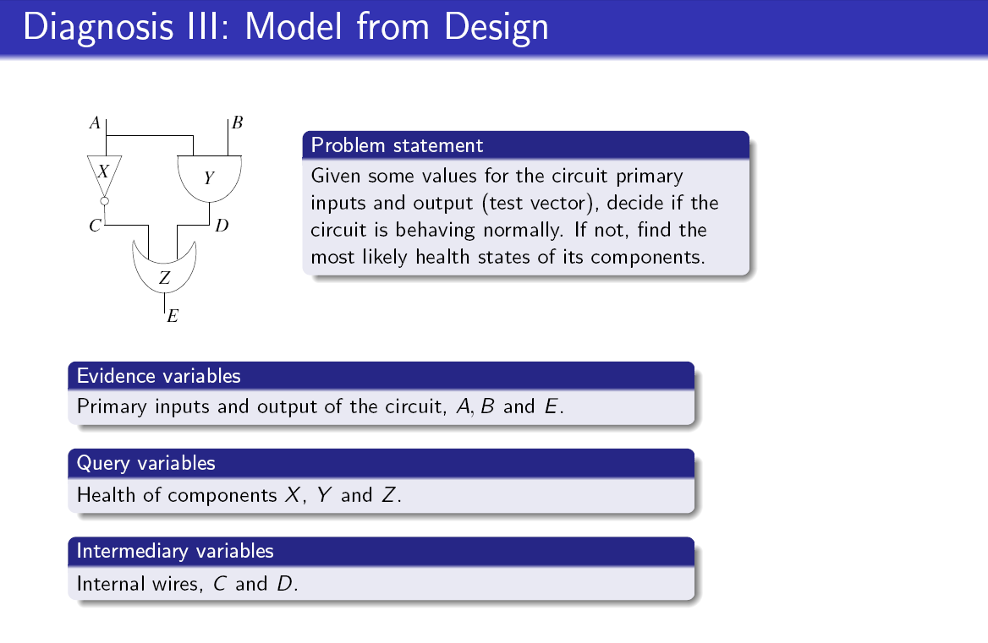
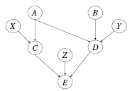

Slide 46
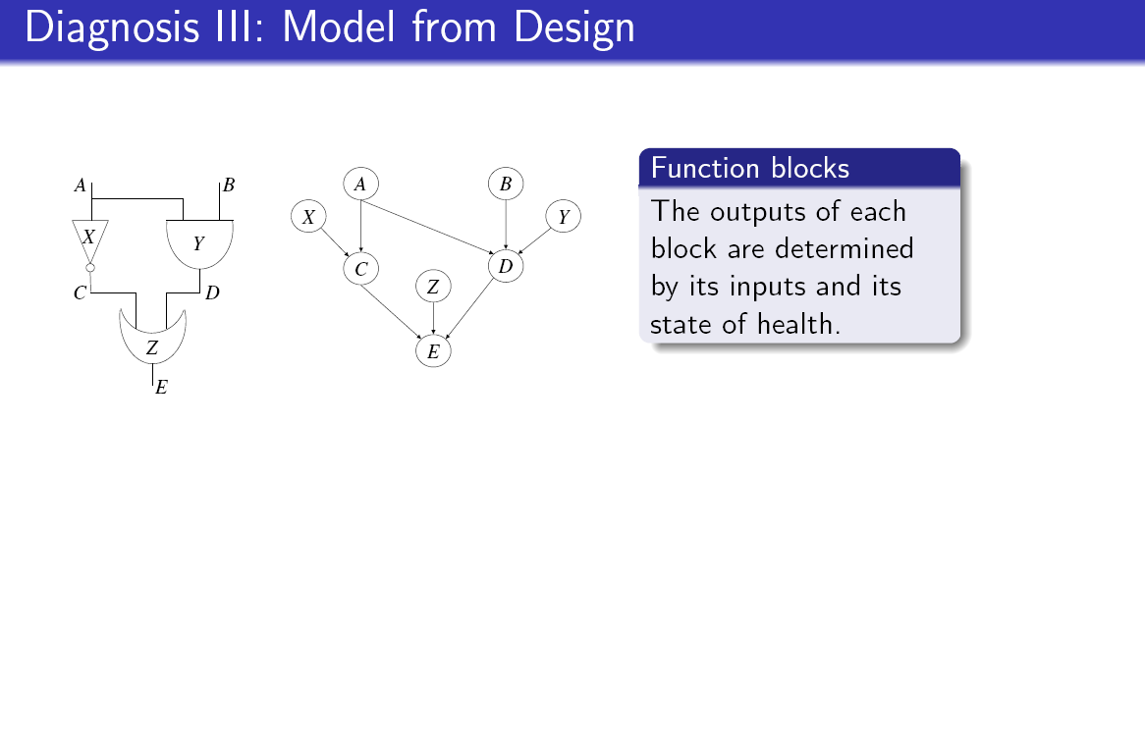

Slide 47
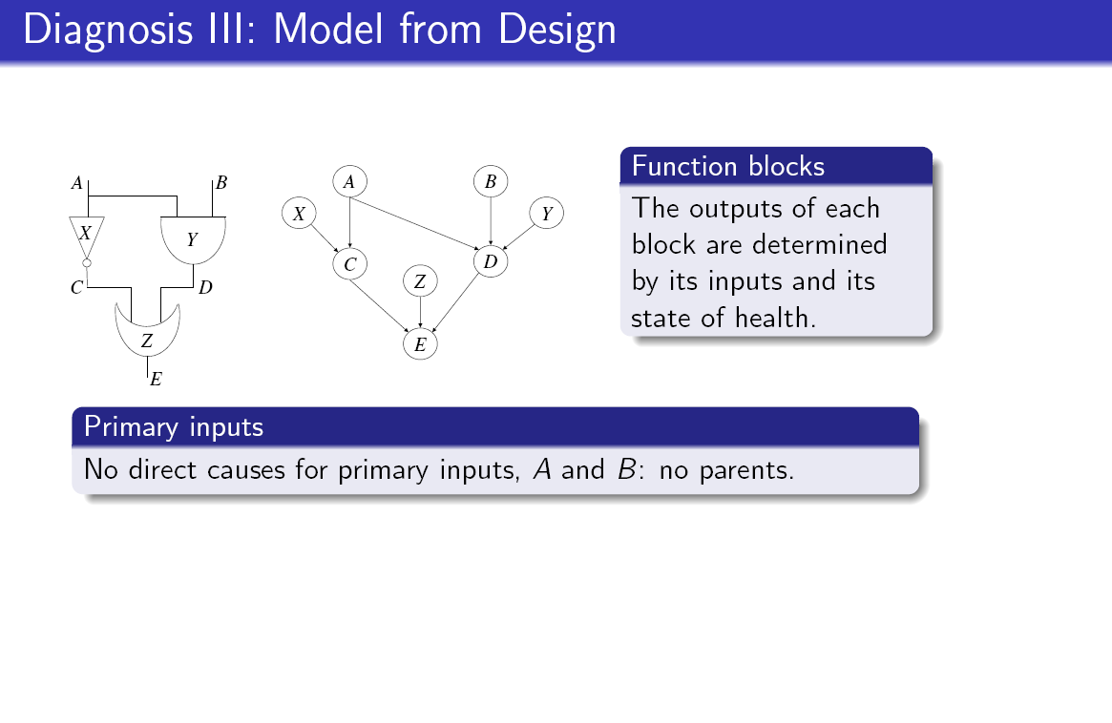

Slide 48
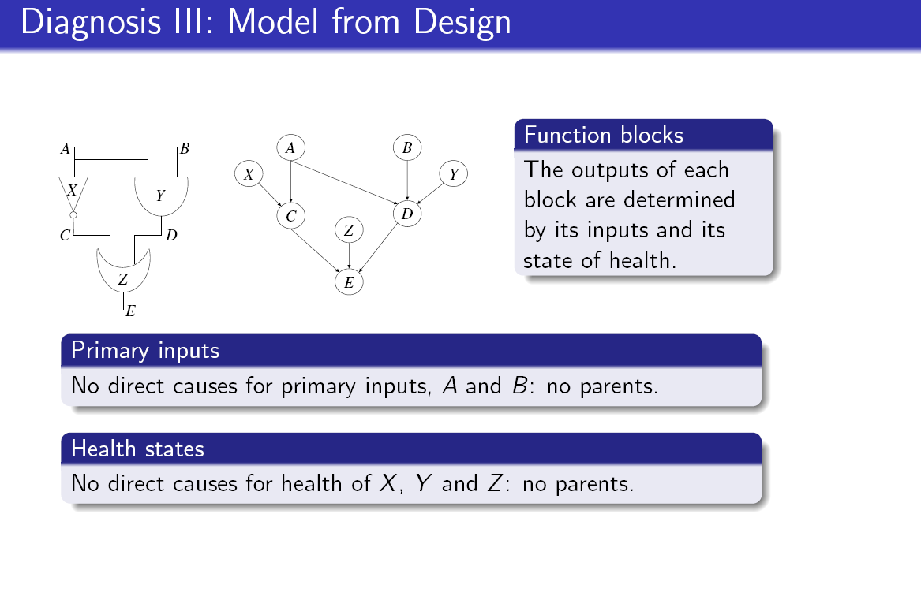

Slide 49
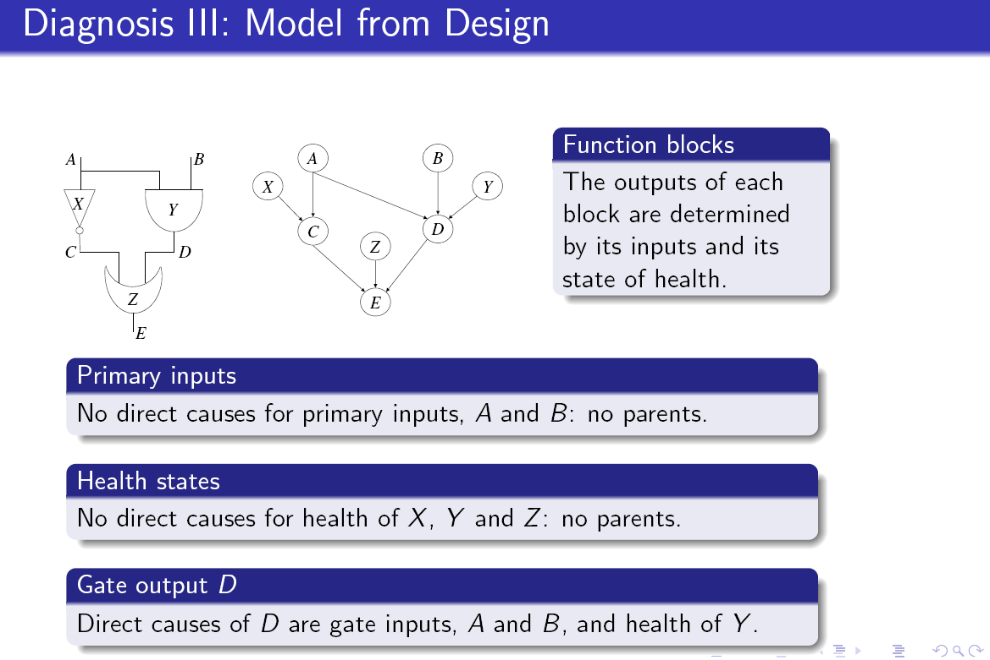

Slide 50
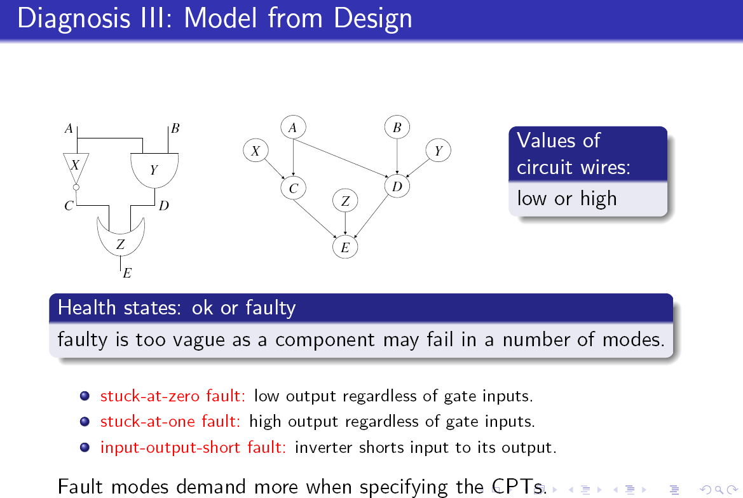

Slide 51
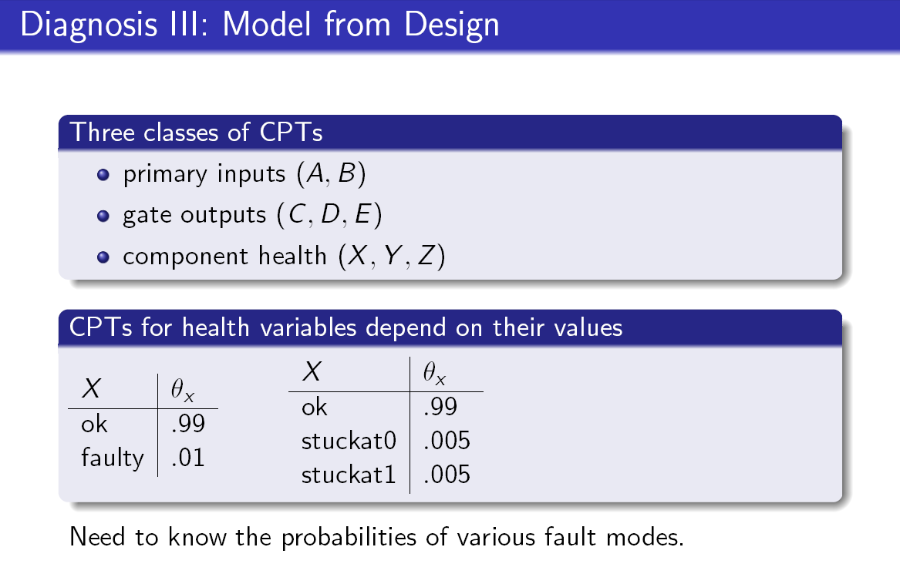

Slide 52


Slide 53


Slide 54


Slide 55


Slide 56


Slide 57


Slide 58


Slide 59


Slide 60


Slide 61


Slide 62

Variables? Values? Structure?

Slide 63


Slide 64


Slide 65


Slide 66


Slide 67


Slide 68

Try it: Variables, values, structure?

Slide 69


Slide 70


Slide 71


Slide 72


Slide 73


Slide 74


Slide 75


Slide 76


Slide 77


Slide 78


Slide 79

What queries should we use here?

Slide 80


Slide 81

WER (word error rate), BER (bit error rate)
MAP (MPE) minimize WER, PM minimize BER…
What do you think?

Slide 82


Slide 83


Slide 84


Slide 85


Slide 86


Slide 87


Slide 88


Slide 89


Slide 90


Slide 91


Slide 92


Slide 93


Slide 94


Slide 95


Slide 96


Slide 97


Slide 98


Slide 99


Slide 100
Building email management network
Step 1: define the variables: email characteristics
  Title,
    (values: any sequence of words.)
  sender-id,
    (values: # of id names)
  Recipients, #-of-recipients
    (Values, a sequence of id-names)
  topic,
    (values: a distribution over bag of words, or a set of key words)
  length,
    (values: natural numbers)
  time-sent : (time-of-week, time-of-day),
    (values: days of the week, time (discredized)
  time-read, (values: as above)
  current-time, (value: as above)
  max-reponse-time (value: as above)
Evidence variables
query

Slide 101
Email network for a message
Topic
Title
Sender-id
recipients
Day-of-Week
Time-of-Day
#-of
MaxWait
Time-now
Real-max-wait
time-left

Slide 102
Topic and title-subnetwork
Topics and titles will have a small number of categories
Words are either present or not
Topic
Title
w1
w2
w3
w1
w100
tw1
tw2
tw3
tw4

Slide 103
Email network for a message
Topic
Topic
Title
Sender-id
recipients
Day-of-Week
Time-of-Day
#-of
MaxWait
Time-now
Real-max-wait
time-left

Slide 104

Slides 130-155 explain the domain.
Read.
Variables, values, structure?

Slide 105


Slide 106


Slide 107


Slide 108


Slide 109


Slide 110


Slide 111


Slide 112


Slide 113


Slide 114


Slide 115


Slide 116


Slide 117


Slide 118


Slide 119


Slide 120


Slide 121


Slide 122


Slide 123


Slide 124


Slide 125


Slide 126


Slide 127


Slide 128


Slide 129


Slide 130


Slide 131


Slide 132


Slide 133


Slide 134


Slide 135


Slide 136


Slide 137


Slide 138


Slide 139


Slide 140


Slide 141


Slide 142


Slide 143


Slide 144


Slide 145


Slide 146


Slide 147


Slide 148


Slide 149


Slide 150


Slide 151


Slide 152
Applications
152
Linkage Analysis
  LOD Scores
Computing Haplotypes
Notes:
What we use to answer the question: what location is important by computing a score on each DNA location.
The score is called as LOD score and if the score is above a threshold, we say that linkage is said to have occurred and that DNA location is the likely cause of the disease.
The score at location gamma is a ratio of two quantities.
152

Slide 153
Two Loci Inheritance
A A
B B
a a
b b
1
2
A a
B b
a a
b b
3
4
A a
b b
A a
B b
5
6
Recombinant
Notes:
There are many applications to bio-informatics of Bayesian networks.
One recent application of graphical models that is quite successful is linkage analysis.
Given a family tree, phenotype of individuals in the tree at the studied trait (affected/unaffected/unknown), and partial, unordered genotype information at some marker loci
Compute the most probable location of the disease gene.
This is done by placing the disease gene on some marker and computing the probability of the data given the assumed location, which is represented by the distance, theta, from a known loci.

Slide 154
Bayesian Network for Recombination
L_{11m}
L_{11f}
L_{12m}
L_{12f}
Locus 1
S_{13m}
X₁₁
X₁₂
S_{13f}
y₁
L_{13m}
L_{13f}
y₂
Deterministic relationships
X₁₃
y₃
Probabilistic relationships
L_{21m}
L_{21f}
L_{22m}
L_{22f}
Locus 2
S_{23m}
X₂₁
X₂₂
S_{23f}
L_{23m}
L_{23f}
X₂₃
P(e|Θ) ?
154
Notes:
154
A Bayesian network for 3 people and two loci is given here. Theta is the parameter controling the distance between the two markers.
The linkage instances are interesting as graphical models because they involve both probabilistic and deterministic relationships,

Slide 155
Linkage analysis:
6 people, 3 markers
L_{11m}
L_{11f}
L_{12m}
L_{12f}
X₁₁
X₁₂
S_{13m}
S_{15m}
L_{13m}
L_{13f}
L_{14m}
L_{14f}
X₁₃
X₁₄
S_{15m}
L_{15m}
L_{15f}
L_{16m}
L_{16f}
S_{15m}
X₁₅
S_{15m}
S_{16m}
X₁₆
L_{21m}
L_{21f}
L_{22m}
L_{22f}
X₂₁
X₂₂
S_{25m}
S_{23m}
L_{23m}
L_{23f}
L_{24m}
L_{24f}
X₂₃
X₂₄
S_{25m}
L_{25m}
L_{25f}
L_{26m}
L_{26f}
S_{25m}
X₂₅
S_{25m}
S_{26m}
X₂₆
L_{31m}
L_{31f}
L_{32m}
L_{32f}
X₃₁
X₃₂
S_{35m}
S_{33m}
L_{33m}
L_{33f}
L_{34m}
L_{34f}
X₃₃
X₃₄
S_{35m}
L_{35m}
L_{35f}
L_{36m}
L_{36f}
S_{35m}
X₃₅
S_{35m}
S_{36m}
X₃₆
Notes:
Here is an example of using Bayesian networks for linkage analysis.
It models the genetic inheritance in a family of 6 individuals relative to some genes of interest.
The task is to find a desease gene on a chromosome
This domain yields very hard probabilistic networks that contain both probabilistic information and deterministic relationship
And it drives many of the methods that we currently develop.
.

Slide 156


Slide 157


Slide 158


Slide 159


Slide 160


Slide 161


Slide 162


Slide 163


Slide 164


Slide 165


Slide 166


Slide 167


Slide 168


Slide 169


Slide 170


Slide 171


Slide 172


Slide 173


Slide 174


Slide 175


