Slide 1
Directional consistency Chapter 4
ICS-179
Spring 2010

Slide 2

Backtrack-free search: or What level of consistency will guarantee global-consistency

Slide 3
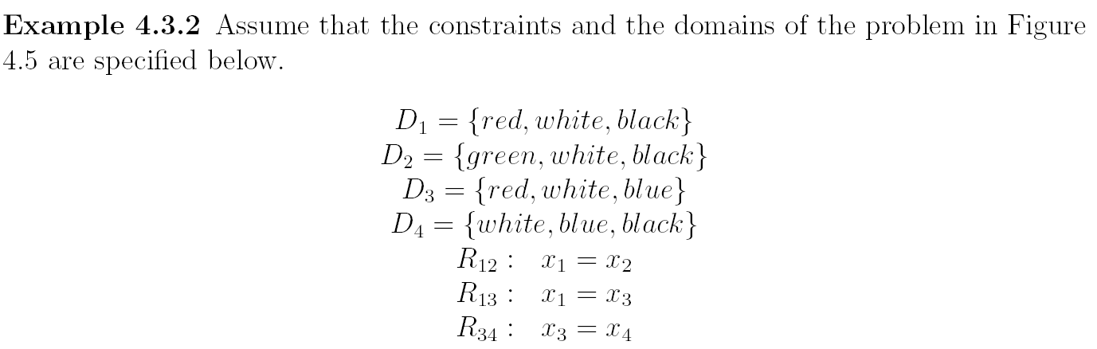
Example of DAC

Slide 4
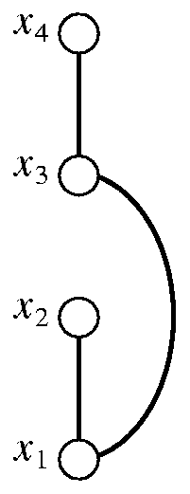
Directional arc-consistency: another restriction on propagation
D4={white,blue,black}
D3={red,white,blue}
D2={green,white,black}
D1={red,white,black}
X1=x2, x1=x3, x3=x4
After DAC:
D1= {white},
D2={green,white,black},
D3={white,blue},
D4={white,blue,black}

Slide 5

Directional arc-consistency: another restriction on propagation
D4={white,blue,black}
D3={red,white,blue}
D2={green,white,black}
D1={red,white,black}
X1=x2, x1=x3,x3=x4

Slide 6
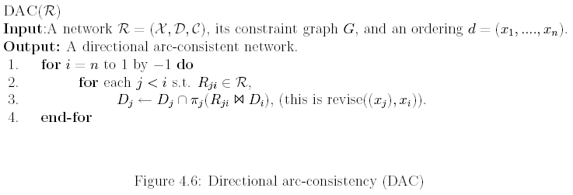
Algorithm for directional arc-consistency (DAC)
Complexity:

Slide 7
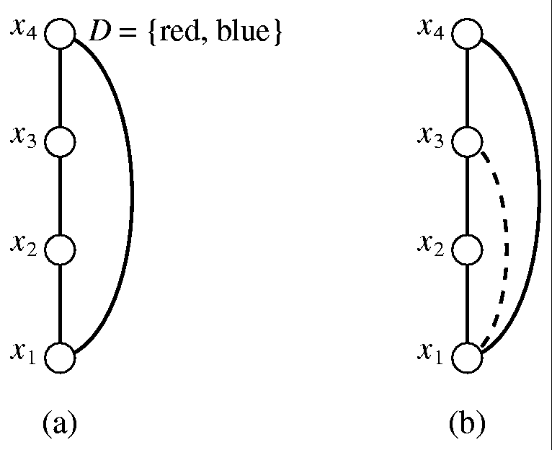
Directional arc-consistency may not be enough → Directional path-consistency

Slide 8
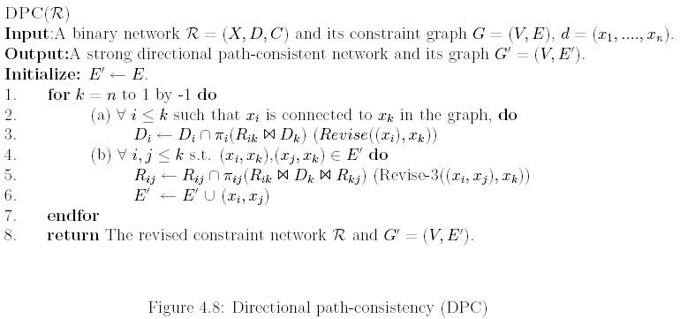

Algorithm directional path consistency (DPC)

Slide 9
Example of DPC
Try it yourself:

Slide 10

Directional i-consistency

Slide 11
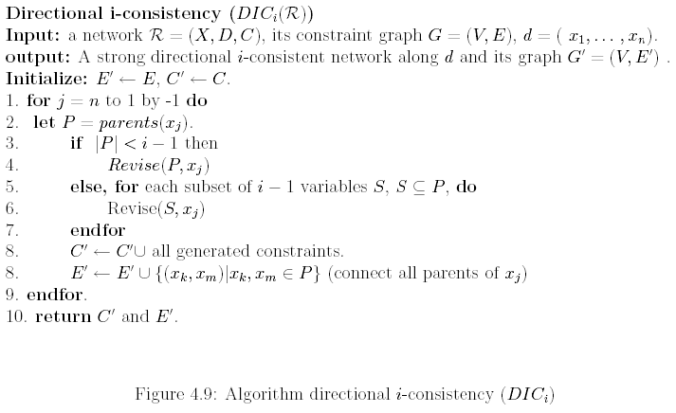
Algorithm directional i-consistency

Slide 12
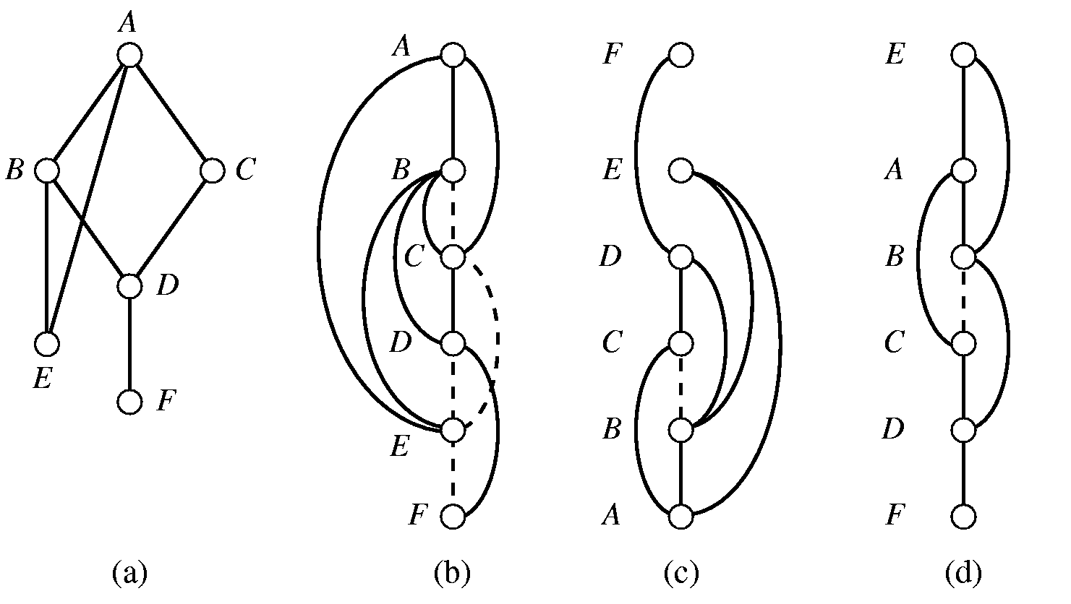
Induced-width captures the changes to the constraint graph:
d1= F,E,D,C,B,A
d2=A,B,C,D,E,F

Slide 13
Induced-width captures the changes to the constraint graph:
d1= F,E,D,C,B,A
d2=A,B,C,D,E,F

Slide 14
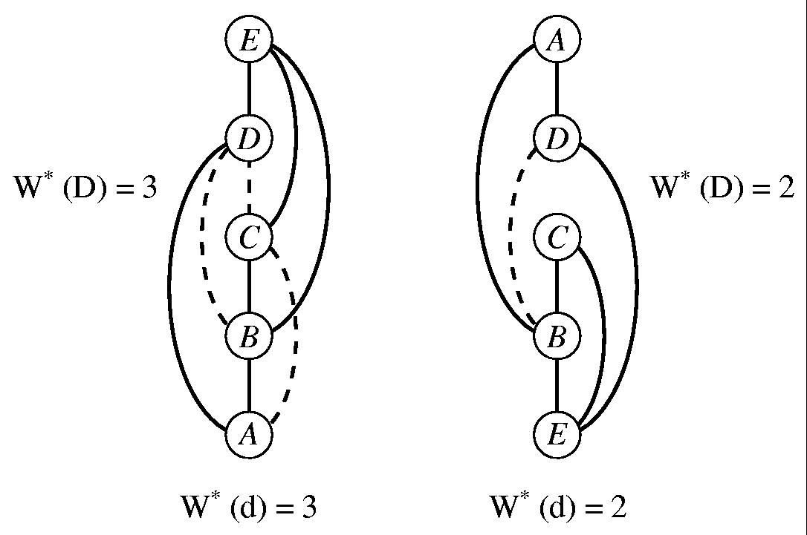
The induced-width DPC recursively connects parents in the ordered graph, yielding:
Width along ordering d, w(d):
max # of previous parents
Induced width w*(d):
The width in the ordered induced graph
Induced-width w*:
Smallest induced-width over all orderings
Finding w*
NP-complete (Arnborg, 1985) but greedy heuristics (min-fill).

Slide 15
The induced-width DPC recursively connects parents in the ordered graph, yielding:
Width along ordering d, w(d):
max # of previous parents
Induced width w*(d):
The width in the ordered induced graph
Induced-width w*:
Smallest induced-width over all orderings
Finding w*
NP-complete (Arnborg, 1985) but greedy heuristics (min-fill).

Slide 16
Induced-width and DPC
The induced graph of (G,d) is denoted (G*,d)
The induced graph (G*,d) contains the graph generated by DPC along d, and the graph generated by directional i-consistency along d

Slide 17

Refined Complexity using induced-width
Consequently we wish to have ordering with minimal induced-width
Induced-width is equal to tree-width to be defined later.
Finding min induced-width ordering is NP-complete

Slide 18
Greedy algorithms for iduced-width
Min-width ordering
Min-induced-width ordering
Max-cardinality ordering
Min-fill ordering
Chordal graphs

Slide 19
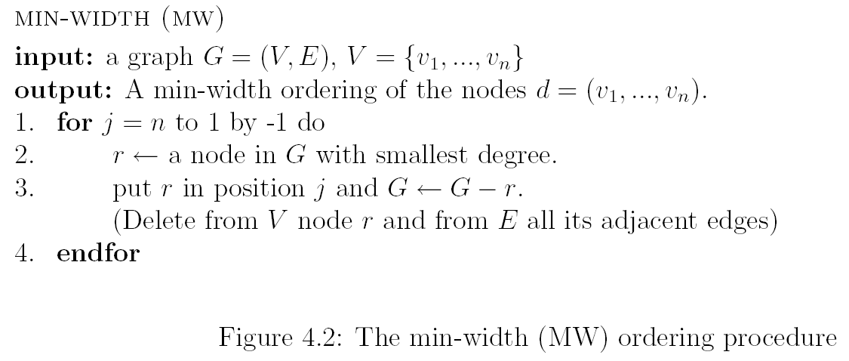
Min-width ordering

Slide 20
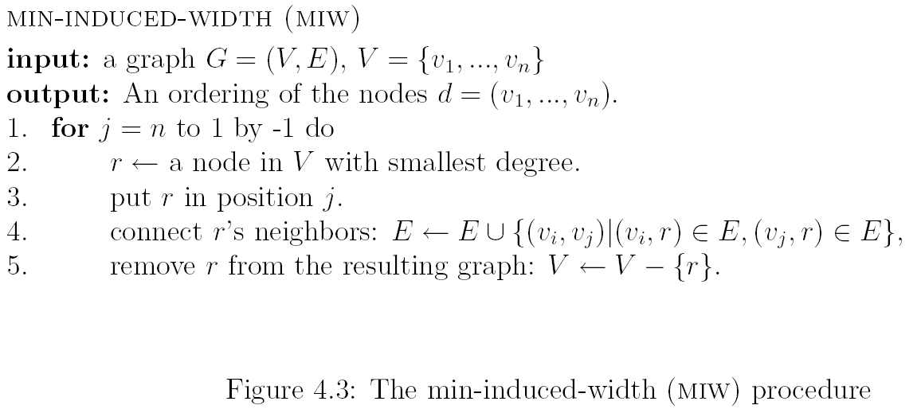
Min-induced-width

Slide 21
Min-fill algorithm
Prefers a node who add the least number of fill-in arcs.
Empirically, fill-in is the best among the greedy algorithms (MW,MIW,MF,MC)

Slide 22
Cordal graphs and Max-cardinality ordering
A graph is cordal if every cycle of length at least 4 has a chord
Finding w* over chordal graph is easy using the max-cardinality ordering
If G* is an induced graph it is chordal
K-trees are special chordal graphs.
Finding the max-clique in chordal graphs is easy (just enumerate all cliques in a max-cardinality ordering

Slide 23
Example
We see again that G in the Figure (a) is not chordal since the parents of A are not connected in the max-cardinality ordering in Figure (d). If we connect B and C, the resulting induced graph is chordal.

Slide 24
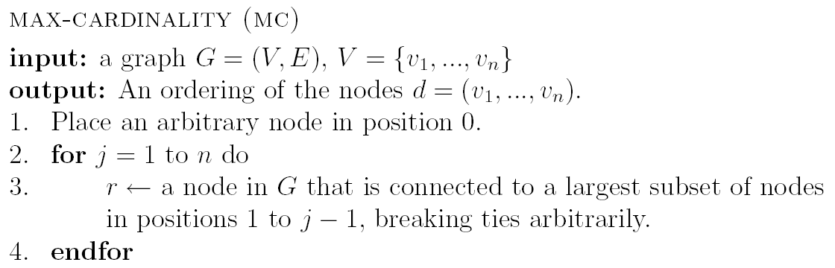
Max-cardinality ordering
Figure 4.5 The max-cardinality (MC) ordering procedure.

Slide 25
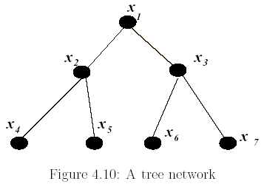
Width vs local consistency: solving trees

Slide 26
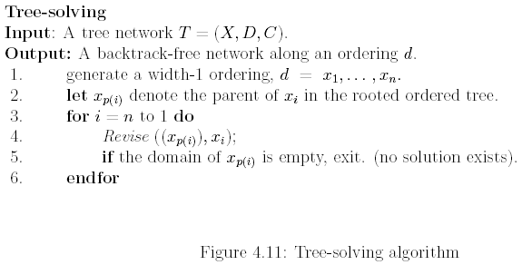
Tree-solving

Slide 27
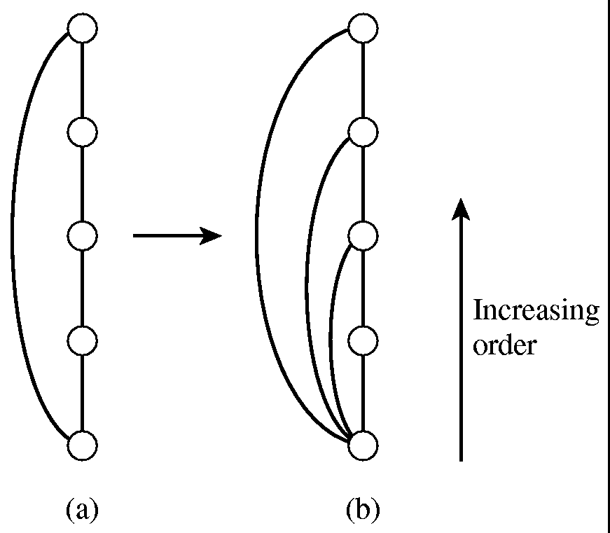

Width-2 and DPC

Slide 28

Width vs directional consistency (Freuder 82)

Slide 29
Width vs i-consistency
DAC and width-1
DPC and width-2
DIC_i and with-(i-1)
→ backtrack-free representation
If a problem has width 2, will DPC make it backtrack-free?
Adaptive-consistency: applies i-consistency when i is adapted to the number of parents

Slide 30
Special case of induced-width 2

Slide 31
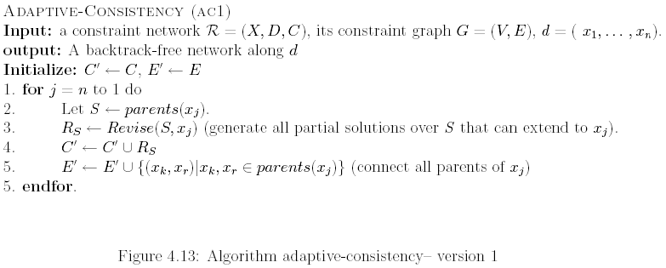
Adaptive-consistency

Slide 32
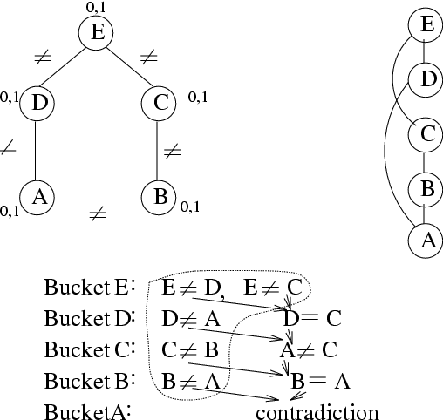
Bucket Elimination Adaptive Consistency (Dechter & Pearl, 1987)
=
≠
=
Bucket E: E ≠ D, E ≠ C
Bucket D: D ≠ A
Bucket C: C ≠ B
Bucket B: B ≠ A
Bucket A:
D = C
A ≠ C
B = A
contradiction

Slide 33
Bucket Elimination Adaptive Consistency (Dechter & Pearl, 1987)
E
D
|| R_{DCB}
|| R_{ACB}
C
|| R_{AB}
B
R_{A}
A
A
|| R_{DB}
D
|| R^{D}_{BE} ,
R^{C}_{BE}
C
|| R_{E}
B
E

Slide 34
The Idea of Elimination
eliminating E
C
D
R_{DBC}
3
value assignment
B

Slide 35
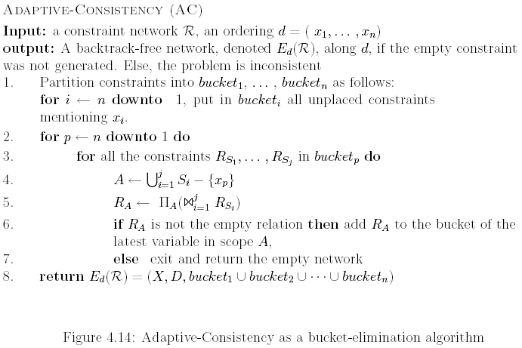
Adaptive-consistency, bucket-elimination

Slide 36
Properties of bucket-elimination (adaptive consistency)
Adaptive consistency generates a constraint network that is backtrack-free (can be solved without dead-ends).
The time and space complexity of adaptive consistency along ordering d is respectively, or O(r k^(w*+1)) when r is the number of constraints.
Therefore, problems having bounded induced width are tractable (solved in polynomial time)
Special cases: trees ( w*=1 ), series-parallel networks (w*=2 ), and in general k-trees ( w*=k ).

Slide 37
Solving Trees (Mackworth and Freuder, 1985)
Adaptive consistency is linear for trees and
equivalent to enforcing directional arc-consistency
(recording only unary constraints)

Slide 38
Summary: directional i-consistency
E
E
E
E
D
C
D
D
D
C
C
C
B
B
B
A
B
Adaptive
d-path
d-arc

Slide 39
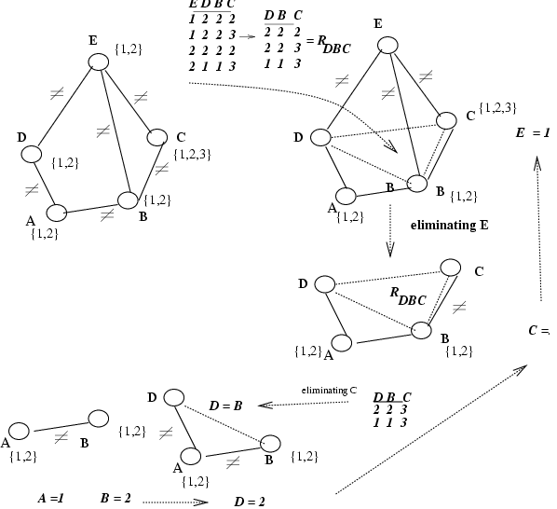
Variable Elimination
Eliminate variables
one by one:
“constraint
propagation”
Solution generation after elimination is backtrack-free

