Slide 1
Efficient computation of sum-products on GPUs
M. Siberstein, A. Schuster, D. Geiger, A. Patley, J. Owens

Slide 2
Introduction
MPF characterized by
  Complex data dependent
  High data reuse
  Low compute-to-memory access ration
Technique to solve MPF
  Memory-bound algorithm with High data reuse (caching ) On GPU

Slide 3
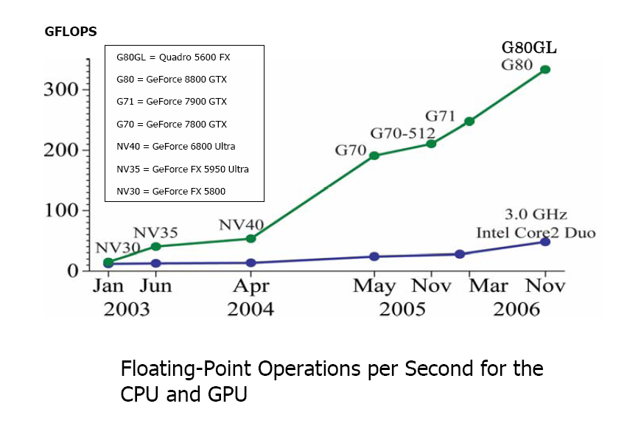
Why GPU ?
High FLOP/s

Slide 4

Why GPU ? (cont.)
specialized for compute-intensive - designed such that more transistors are devoted to data processing rather than data caching and flow control
well-suited for data-parallel computations – the same program is executed on many data elements in parallel (Uniform stream processing)
example of MPF problem:

Slide 5
Disadvantages of using GPU
the lack of cache leads to low performance gains on workloads characterized by high data reuse
GPU’s texture cache is optimized for read-only workloads with 2d spatial locality only

Slide 6
NVIDIA CUDA
NVIDIA CUDA (“Compute Unified Device Architecture"), is a GPGPU technology that allows a programmer to use the C programming language to code algorithms for execution on the GPU
provides special user-managed space called shared memory.

Slide 7
GPU programming & CUDA
CUDA program devided into
  CPU code : input data setup, transfering data to GPU
  GPU code: encapsulated into a kernel
NVIDIA GPUs feature multiple multiprocessors, each with 8 thread processors
One kernel invoked concurrently by many threads on different set of data
Each thread block has its own shared memory

Slide 8

MPF problem
M is the set of variables to be marginalized
F is the set of all functions in MPF
MPF algorithms aim to efficiently compute the expression for any number of functions.
Bucketing
Finding the optimal order of operations that minimize the number of computations under given memory constraints is NP-hard.

Slide 9

Serial MPF Kernel
Focus on designing kernel code for computing single bucket
Asumming buckets are formed by an algorithm under given memory constraints – using intermediate functions is disallowed.

Slide 10
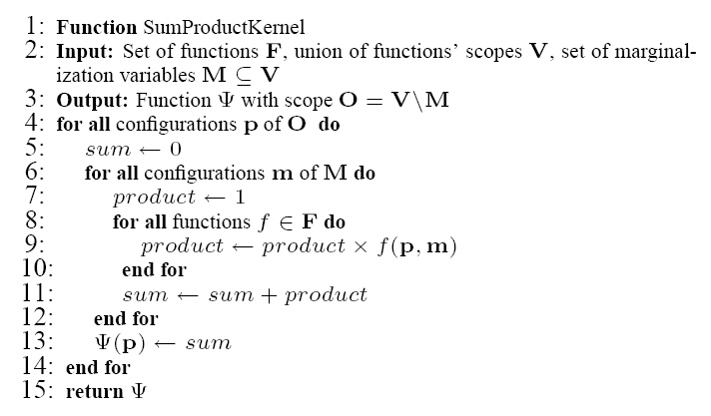
Kernel pseudocode

Slide 11
Input data organization
Input data is organized in multidimentional arrays
E.g .
  F(x,y,z) <-> array of size |X|*|Y|*|Z|
  F(x0,y0,z0) is located at z0+|Z|*y0 + |Z|*|Y|*x0

Slide 12
Input data access
Data traversal should be sequential for both input & output.
Global order on all the variables of each bucket

Slide 13
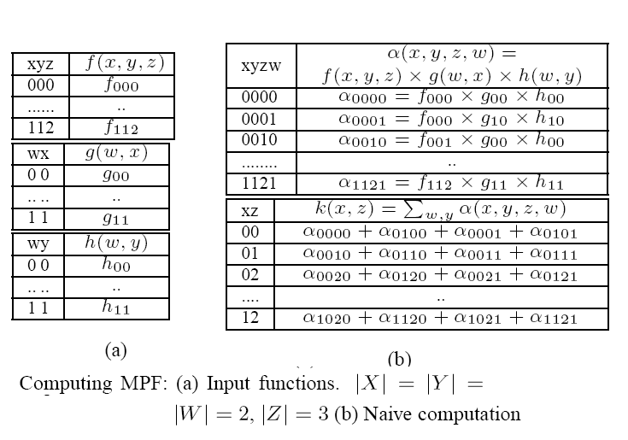
Input data access (cont.)

Slide 14
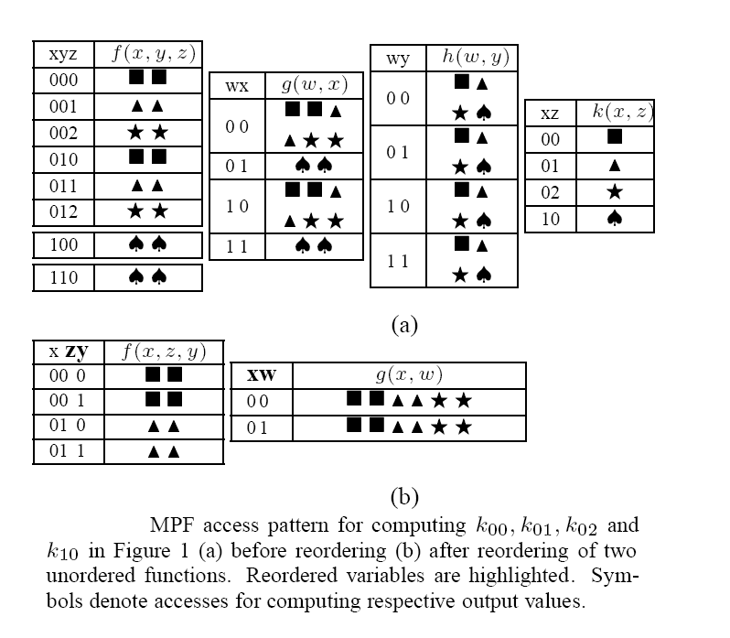
Input data access (cont.)

Slide 15
Input data access (cont.)
Global order of variables over all buckets:
  Sets of marginalization variables of the buckets are ordered in the reverse order of the buckets.
  Within each set, assigning arbitrary order
  All non-marginalization variables are placed to be the highest in the order, and arbitrarily ordered among themselves.

Slide 16
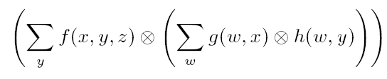


Input data access (cont.)
Global ordering:

Slide 17
Recap…
NVIDIA CUDA
MPF Problem
Serial MPF Kernel
Input data organization (global orderings, sequential access)

Slide 18

Cache Performance Model
Analytically evaluate the algorithm performance using
P = aggregated maximum rate of computations of GPU (FLOP/s)
M= memory band width of tranfers between GPU global memory and ALUs (float/s)
A = Arithmetic intensity.

Slide 19

Cache Performance Model (cont)
Without cache, A is very low
  > Speed = A * M << P
With cache
  ci is the cache miss rate for accessing function i
  m is the number of input functions
  N is the number of configurations of the marginalization variables

Slide 20
User-managed cache
Caching implementation should maintain
  Spatial locality
  Temporal locality
Spatial locality is improved by restructuring the input data
Prefer spatial locality over temporal locality due to high cost of index computation

Slide 21
Cache design
Each value in every input and output array is identified by “bucket address”
Bucket address is a vector (index vector):
  Over all the variables in the bucket
  Variables are ordered according to the global order

Slide 22
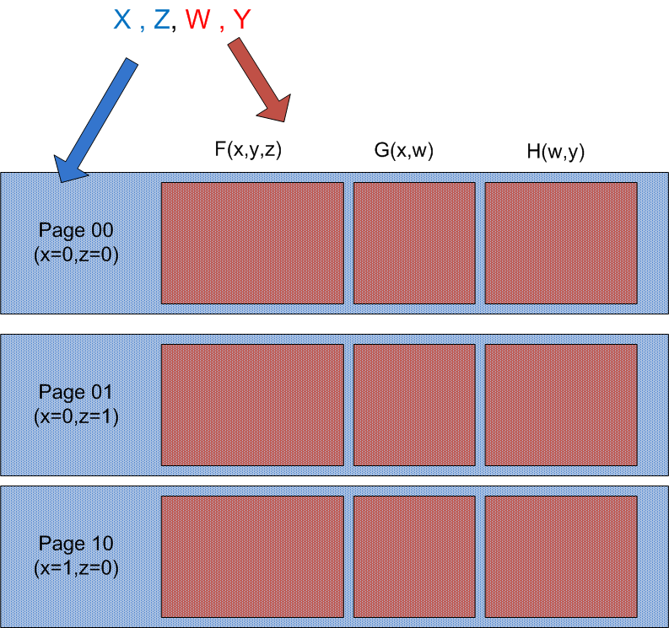
Cache structure
One segment per input function
Cache Tag
Cache Page Tag
Cache page: all data with the same cache page tag

Slide 23
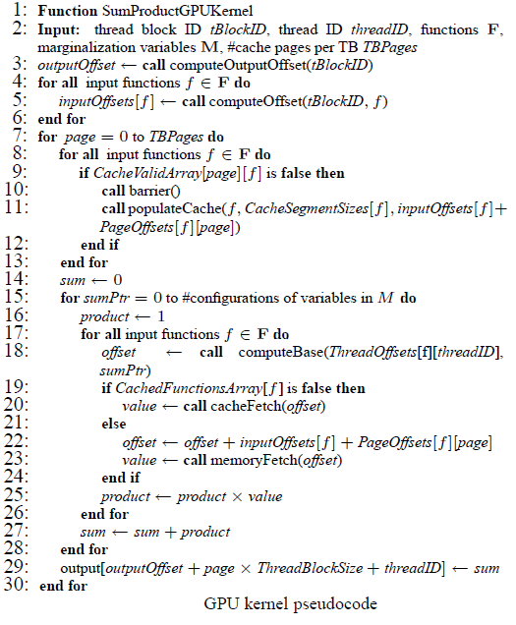
Kernel implementation
3-7 : computation of memory offsets
7-15: cache prefetching
  11: input data is staged into the share mem
  9: freshing function segment to mv to nxt pg
15-29: computation loop
  Is the func cached ?
29 : write back the result

Slide 24
Experiments
GPU version
  NVIDIA’s GeForce GTX800
    128 thread processors
    750 MB of global memory
CPU version
  Intel Core 2 2.4 Ghz
    32KB L1 cache
    4 MB L2 cache

Slide 25
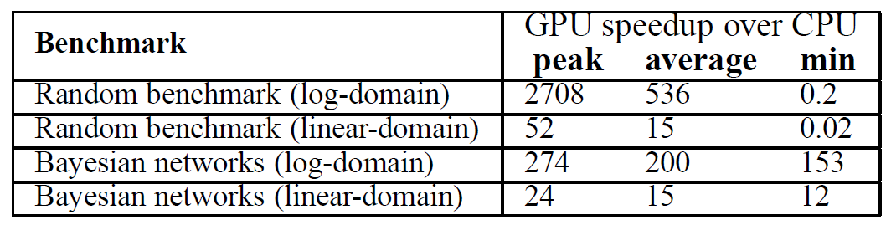
GPU vs. CPU performance

Slide 26
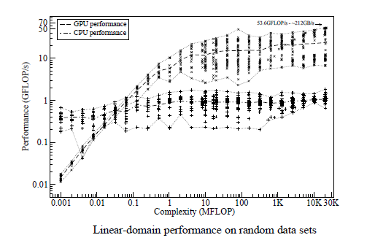
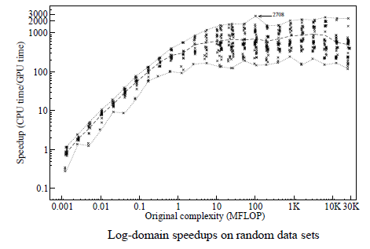
Random datasets
700 buckets
2-4 functions per bucket, 1-10 values per variable,2-32 summation values, 1-18 variables shared between the functions, 5-25 variable per function

Slide 27
Bayesian networks
Bayes Nets were generated using Superlink
Results : average speedup is 15 over 20 networks of different complexity
85% of buckets < 100 KFLOP threshhold, but the overall performance is better due to a few large buckets that consume 98% running time

Slide 28
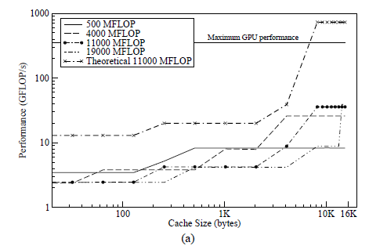
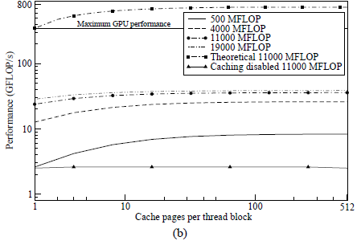
Cache performance
3 functions per bucket

Slide 29
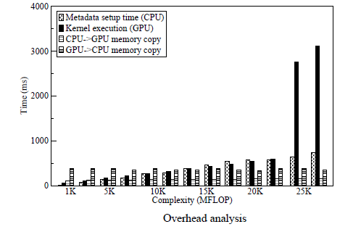
Analysis of the overheads

