Slide 1
Anytime Anyspace AND/OR Search for Bounding the Partition Function
Qi Lou, Rina Dechter, Alexander Ihler
Feb. 8, 2017
Notes:
Hi all, I’m Qi. In this talk, I will be presenting our work “Anytime Anyspace AND/OR Search for Bounding the Partition Function”. This is joint work with Rina Dechter and Alex Ihler.

Slide 2
Guideline
Anytime bounds for the partition function of a graphical model.
  Estimate (bound) the partition function as a heuristic search problem on AND/OR search trees
  Best-first search using pre-compiled variational heuristics and carefully designed priorities.
  Operate with limited-memory settings
Notes:
Here is a general guideline. In this paper, we present a best-first search algorithm to provide anytime upper and lower bounds for the partition function. [click] We convert the problem of estimating (bounding) the partition function to a heuristic search problem on AND/OR search trees. [click] We offer a best-first search algorithm using precompiled variational heuristics and carefully designed priorities. [click] Moreover, this algorithm can also deal with limited-memory settings.

Slide 3
Background
Notes:
background

Slide 4
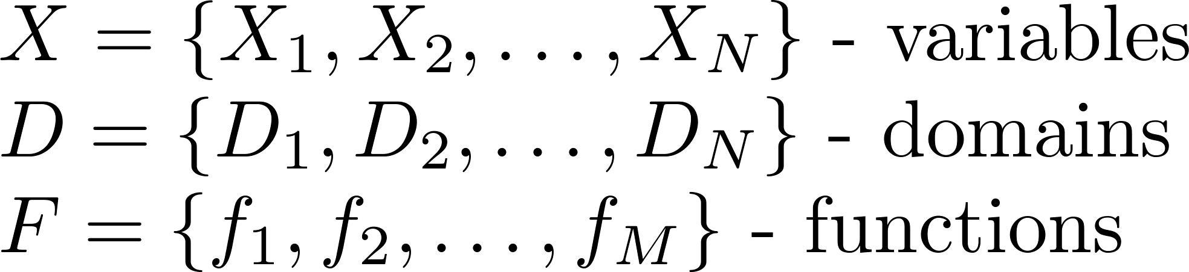
Graphical Models
A graphical model (X, D, F):
Bayesian networks, Markov random fields (MRF), factor graphs, etc.
  Example model (MRF):
A
B
A | B | f(A,B)
0 | 0 | 0.24
0 | 1 | 0.56
1 | 0 | 1.2
1 | 1 | 1.2
B | C | f(B,C)
0 | 0 | 0.12
0 | 1 | 0.36
1 | 0 | 0.3
1 | 1 | 1.7
…
C
Primal Graph
Notes:
As we know, a graphical model is a collection of variables, domains and non-negative functions. Models can be either discrete or continuous. In this work, we focus on discrete models only. There’re many types of graphical models, such as Bayesian networks, Markov random fields, and factor graphs. [click] For example, this is a pairwise model of three variables. On the right is a graph representation of this model. We call it primal graph. There is an edge between two variables if they are in the scope of some function. Usually, we use tables to represent functions.

Slide 5
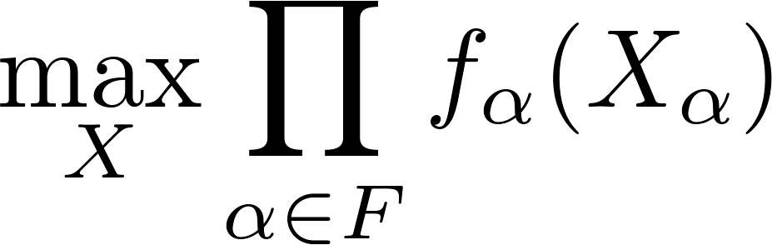
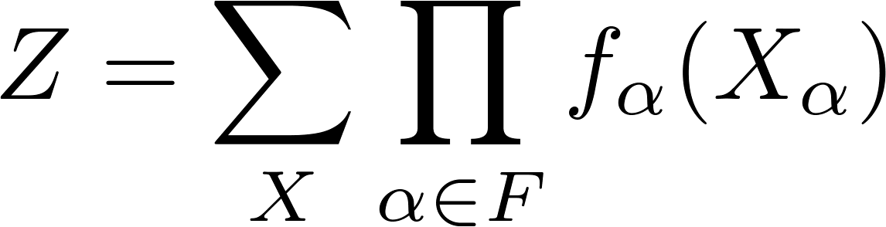
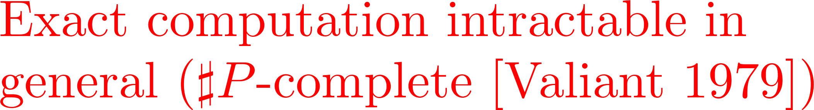
Graphical Models
Typical Queries
  Maximum A Posteriori (MAP) / Most Probable Explanation (MPE)
  The Partition Function
Notes:
There are some typical queries in graphical models. For example, MAP, a.k.a., MPE, aims to find a configuration with the maximum value. Search is well known for this task. Another query is to compute the normalizing constant called the partition function, which is often a key task in evaluating the probability of observed data, model selection, or computing predictive probabilities. [click] However, as we know, exact computation is intractable in general. It is usually a harder task compared to the MAP task.

Slide 6
Bounding the Partition Function Z
Deterministic methods
  Elimination based (e.g., mini-bucket elimination [Dechter and Rish 2001])
  Variational approaches (e.g., tree-reweighted belief propagation [Wainwright et al. 2003])
  Search based (e.g., [Viricel et al. 2016])
Monte Carlo methods
  Importance sampling based (e.g., [Liu et al. 2015, Bidyuk and Dechter 2007])
  Approximate hash-based counting (e.g., [Chakraborty et al. 2016])
Notes:
So, we usually seek for approximations. Among approximation methods, those provide bounds are often favored because we can quantify the approximation errors. Also, the capability to trade computational resources with quality in anytime fashion is important. [click] As we know, approximate elimination methods and closely related variational bounds provide deterministic guarantees on the partition function. However, those bounds are not any-time; their quality often depends on the amount of memory available, and do not improve without additional memory. [click] On the other hand, Monte Carlo methods, such as those based on importance sampling or approximate hash-based counting can smoothly trade time for quality, but provide only probabilistic bounds and can be slow to provide tight bounds. So, we propose an anytime anyspace search algorithm that allows users to trade time and memory with quality.

Slide 7
Algorithm
Notes:
Search is well known for optimization tasks such MAP task. Now I’m gonna show you how it works for the summation task.

Slide 8
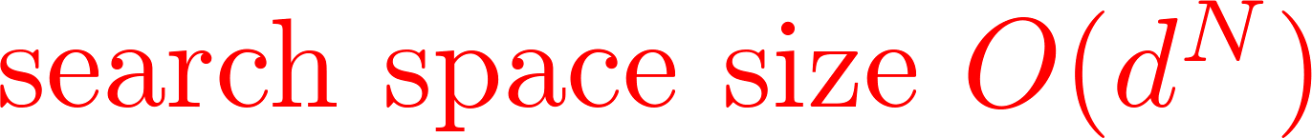
OR Search Tree
F
G
A
B
E
Solution path: corresponds to a complete configuration of all variables
D
C
A
primal graph
0
1
B
B
0
1
1
0
C
C
C
C
0
1
0
1
1
0
1
0
D
D
D
D
D
D
D
D
0
1
0
1
0
1
0
1
0
1
0
1
0
1
0
1
E
E
E
E
E
E
E
E
E
E
E
E
E
E
E
E
0
1
0
1
0
1
0
1
0
1
0
1
0
1
0
1
0
1
0
1
0
1
0
1
0
1
0
1
0
1
0
1
F
F
F
F
F
F
F
F
F
F
F
F
F
F
F
F
F
F
F
F
F
F
F
F
F
F
F
F
F
F
F
F
0
1
0
1
0
1
0
1
0
1
0
1
0
1
0
1
0
1
0
1
0
1
0
1
0
1
0
1
0
1
0
1
0
1
0
1
0
1
0
1
0
1
0
1
0
1
0
1
0
1
0
1
0
1
0
1
0
1
0
1
0
1
0
1
G
G
G
G
G
G
G
G
G
G
G
G
G
G
G
G
G
G
G
G
G
G
G
G
G
G
G
G
G
G
G
G
G
G
G
G
G
G
G
G
G
G
G
G
G
G
G
G
G
G
G
G
G
G
G
G
G
G
G
G
G
G
G
G
0
1
0
1
0
1
0
1
0
1
0
1
0
1
0
1
0
1
0
1
0
1
0
1
0
1
0
1
0
1
0
1
0
1
0
1
0
1
0
1
0
1
0
1
0
1
0
1
0
1
0
1
0
1
0
1
0
1
0
1
0
1
0
1
0
1
0
1
0
1
0
1
0
1
0
1
0
1
0
1
0
1
0
1
0
1
0
1
0
1
0
1
0
1
0
1
0
1
0
1
0
1
0
1
0
1
0
1
0
1
0
1
0
1
0
1
0
1
0
1
0
1
0
1
0
1
0
1
Notes:
To talk about a search algorithm, we have to clarify the search space first. We start from so-called OR search tree here. [click] Let’s take this pairwise model with binary variables for example. This is an OR search tree for this graphical model. [click] Each path from the root to a leaf node corresponds to a complete configuration of all variables called solution path. [click] If we accumulate mass represented by each leaf node, we get the exact value of the partition function. [click] OR search space is a straightforward but not a compact representation.

Slide 9
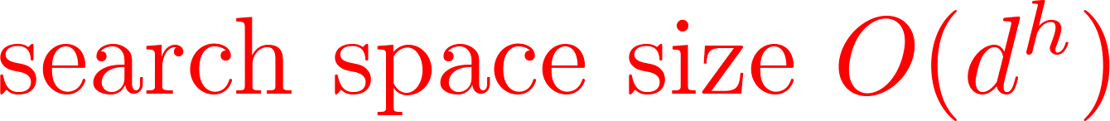
AND/OR Search Tree
[Nillson 1980, Dechter and Mateescu 2007]
A
F
B
G
A
B
E
C
F
Solution tree: corresponds to a complete configuration of all variables
D
C
D
E
G
OR
A
primal graph
pseudo tree
AND
[Freuder and Quinn 1985]
0
1
OR
B
B
AND
0
1
0
1
OR
C
C
C
C
F
F
F
F
AND
0
1
0
1
0
1
0
1
0
1
0
1
0
1
0
1
OR
E
D
E
D
E
D
E
D
E
D
E
D
E
D
E
D
G
G
G
G
G
G
G
G
AND
0
1
0
1
0
1
0
1
0
1
0
1
0
1
0
1
0
1
0
1
0
1
0
1
0
1
0
1
0
1
0
1
1
0
1
1
1
1
1
1
0
0
0
0
0
0
1
0
Notes:
So, we have to introduce a more compact representation called AND/OR search tree. To talk about AND/OR search tree, we first introduce a concept called pseudo tree. [click] A pseudo tree is a directed tree sharing the same set of nodes as the primal graph. Each edge of the primal graph corresponds to a forward arc or a backward arc of the pseudo tree. Pseudo tree captures the problem decomposition. [click] Now guided by a pseudo tree, we can construct an AND/OR search tree, consisting of alternating levels of AND nodes and OR nodes for a graphical model. Each OR node is associated with a variable. children of an OR node are AND nodes corresponding to the possible values of that variable. [click] A solution tree here corresponds to a full configuration of all variables. [click] Now, we can see that AND/OR search space is a more compact representation. So, we will perform our search algorithm on AND/OR trees.

Slide 10
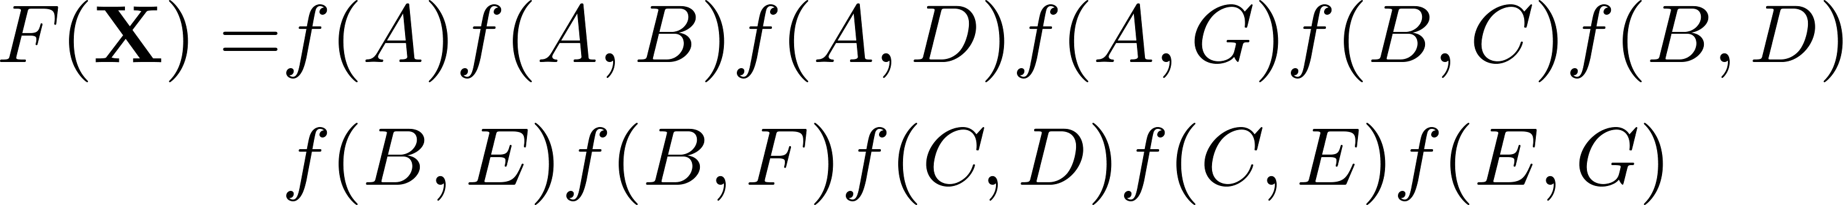

Cost
Cost g(n):
Product of functions fully instantiated by the path from the root to node n.
A
0
1
B
B
0
1
0
1
C
C
C
C
F
F
F
F
0
1
0
1
0
1
0
1
0
1
0
1
0
1
0
1
E
D
E
D
E
D
E
D
E
D
E
D
E
D
E
D
G
G
G
G
G
G
G
G
0
1
0
1
0
1
0
1
0
1
0
1
0
1
0
1
0
1
0
1
0
1
0
1
0
1
0
1
0
1
0
1
0
1
0
1
0
1
0
1
0
1
0
1
0
1
0
1
Notes:
To talk about a heuristics search algorithm, we have to define several terms for our problem first. One is the cost of the path, which is defined as the product of factors fully instantiated by the path from the root to node n. [click] For example, variable A and B are instantiated by the path. [click] So, factors whose scope only involves variable A and B will contribute to the cost.

Slide 11
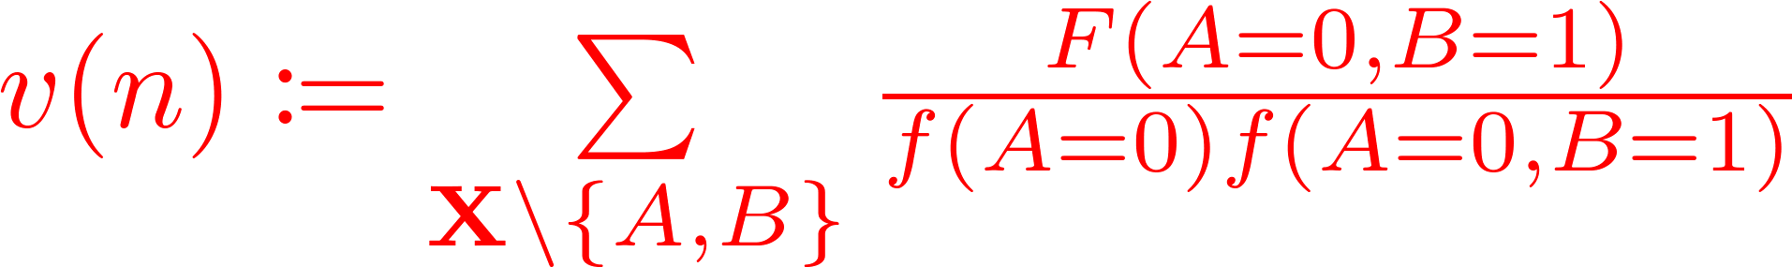
Value and Heuristic
A
Value v(n):
Mass of the subtree rooted at node n
Heuristic h(n): Estimate of v(n)
0
1
B
B
0
1
0
1
C
C
C
C
F
F
F
F
0
1
0
1
0
1
0
1
0
1
0
1
0
1
0
1
E
D
E
D
E
D
E
D
E
D
E
D
E
D
E
D
G
G
G
G
G
G
G
G
0
1
0
1
0
1
0
1
0
1
0
1
0
1
0
1
0
1
0
1
0
1
0
1
0
1
0
1
0
1
0
1
0
1
0
1
0
1
0
1
0
1
0
1
0
1
0
1
Notes:
For a given node n, the value of that node v(n) is defined as the mass of the subtree rooted at this node. [click] For example, for this particular node n, we first identify variables below this node, they are {C,D,E,F,G}. [click] And then we collect all the factors involving those variables. By summing them out, we get the mass of the subtree rooted at this node. [click] Heuristic for a given node is an estimate of v(n). Typically, h(n) is designed to be upper or lower bound of v(n).

Slide 12
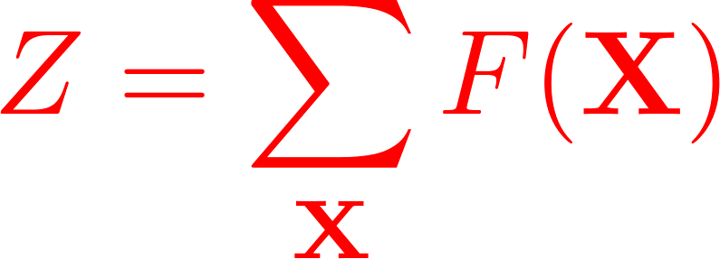
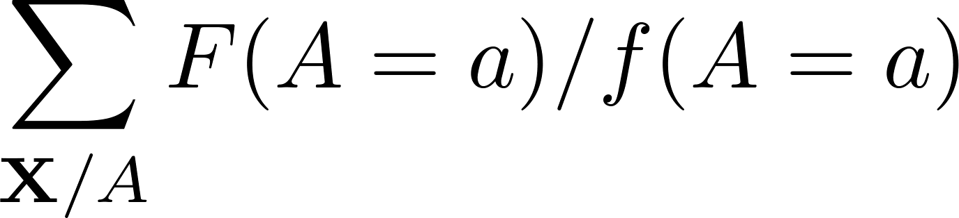


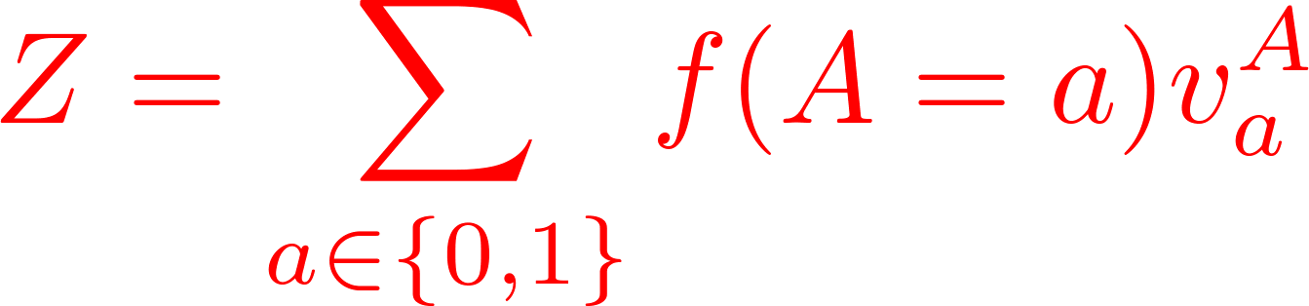
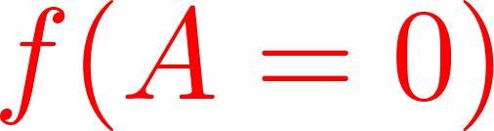
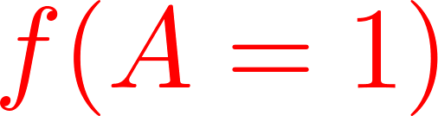
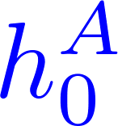
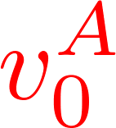
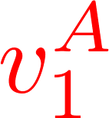
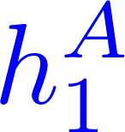
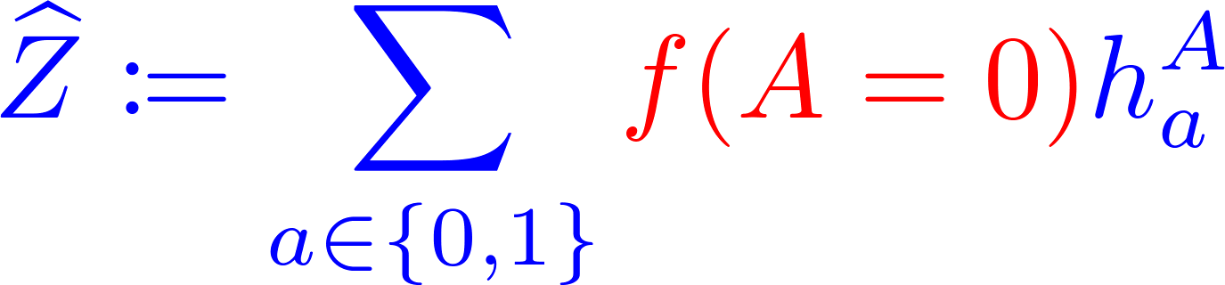
Estimate Z via Search on AND/OR Trees
A
B
C
F
D
E
G
A
pseudo tree
0
1
Notes:
Now, let me walk you through a simple example to show how search works for the summation problem. Let’s say we have a pairwise model over binary variables. [click] We first expand a node according to the given pseudo tree. One factor whose scope is A is instantiated. These “v” stand for the value of these children nodes. [click] It’s easy to see the partition function can be re-written into sum of node values weighted by the instantiated factor. Since we have heuristics at each frontier node. Those heuristics are estimates of those “v” values. We can derive a estimate of the partition function, Z-hat by simply substituting these “v” quantities with heuristics.

Slide 13
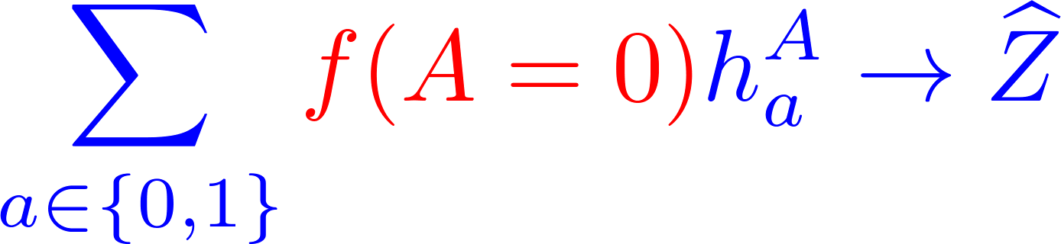
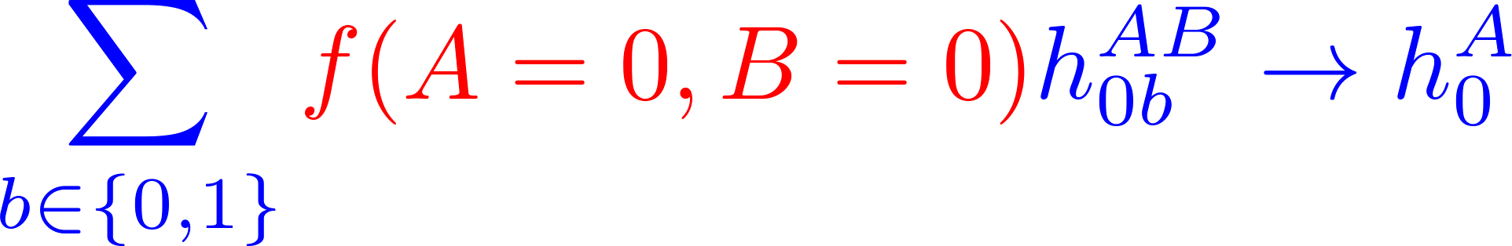
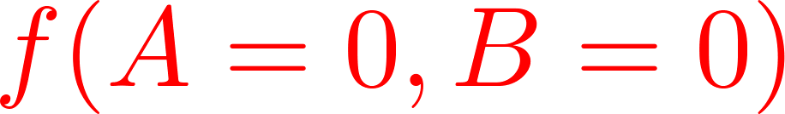
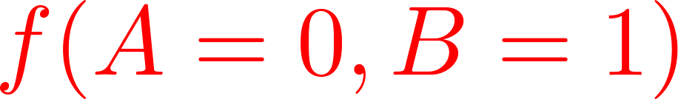
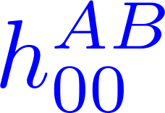
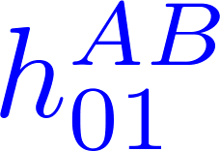
Estimate Z via Search on AND/OR Trees
A
B
C
F
D
E
G
A
pseudo tree
0
1
B
0
1
Notes:
Now, if we pick one frontier node and expand it [click], we have more factors are instantiated. We have pre-compiled heuristics at the newly generated nodes. [click] Now we can update heuristics all the way back until you reach the root [click]. After this backward update, those heuristics on the path usually become more accurate, which leads to a better estimate of the partition function.

Slide 14
Key Issues
How to design high-quality heuristics?
  Quality of the estimate largely depends on the quality of heuristics
Notes:
As we can see, the quality of the estimate largely depends on the quality of heuristics. And, we choose to use wmb heuristics for several reasons

Slide 15
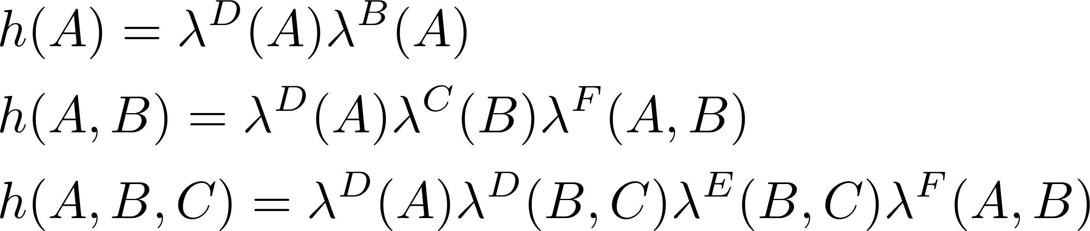
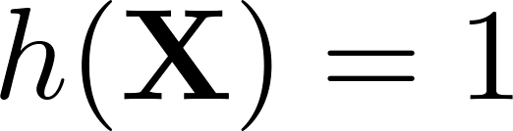

Weighted Mini-Bucket (WMB) Heuristics
[Liu and Ihler 2011]
…
A
f(A)
λ^{B} (A)
B
f(A,B)
WMB heuristics are formed by messages from descendants.
WMB heuristics are upper (or lower) bounds of the node value.
WMB heuristics are monotonic.
  Resolving mini-buckets makes heuristics more (no less) accurate.
λ^{D} (A)
λ^{C} (B)
λ^{F} (A,B)
C
f(B,C)
F
f(B,F)
λ^{D} (B,C)
λ^{E} (B,C)
λ^{G} (A,F)
D
f(A,D)
D
f(B,D) f(C,D)
E
f(B,E) f(C,E)
G
f(A,G) f(F,G)
Notes:
As we know, weighted mini-bucket is an approximate elimination algorithm that generalizes bucket elimination by relaxing the exact computation using holder’s inequality. By setting parameters properly, you can either get upper bound or lower bound. It can be viewed as a message passing procedure on the bucket tree. The size of messages is controlled by a parameter called i-bound. [click] More details can be found in [Liu and Ihler 2011]. [click] What really matters here is that we can extract heuristics from those messages. [click] The heuristics are upper or lower bounds by design. [click] As search goes on, we will resolve more and more relaxations, so the heuristics are getting more and more accurate, which means it’s monotonic.

Slide 16
Key Issues (revisited)
How to design high-quality heuristics?
  Quality of the estimate largely depends on the quality of heuristics
How to design an effective search strategy?
  Our goal: quickly close the bound gap U - L
    U := upper bound of Z
    L := lower bound of Z
  Equivalent: how to set priority for frontier nodes.
Notes:
Remind that our goal is trying to close the bound gap on the partition function as quickly as possible. For a best-first search algorithm, the priority becomes the key part.

Slide 17
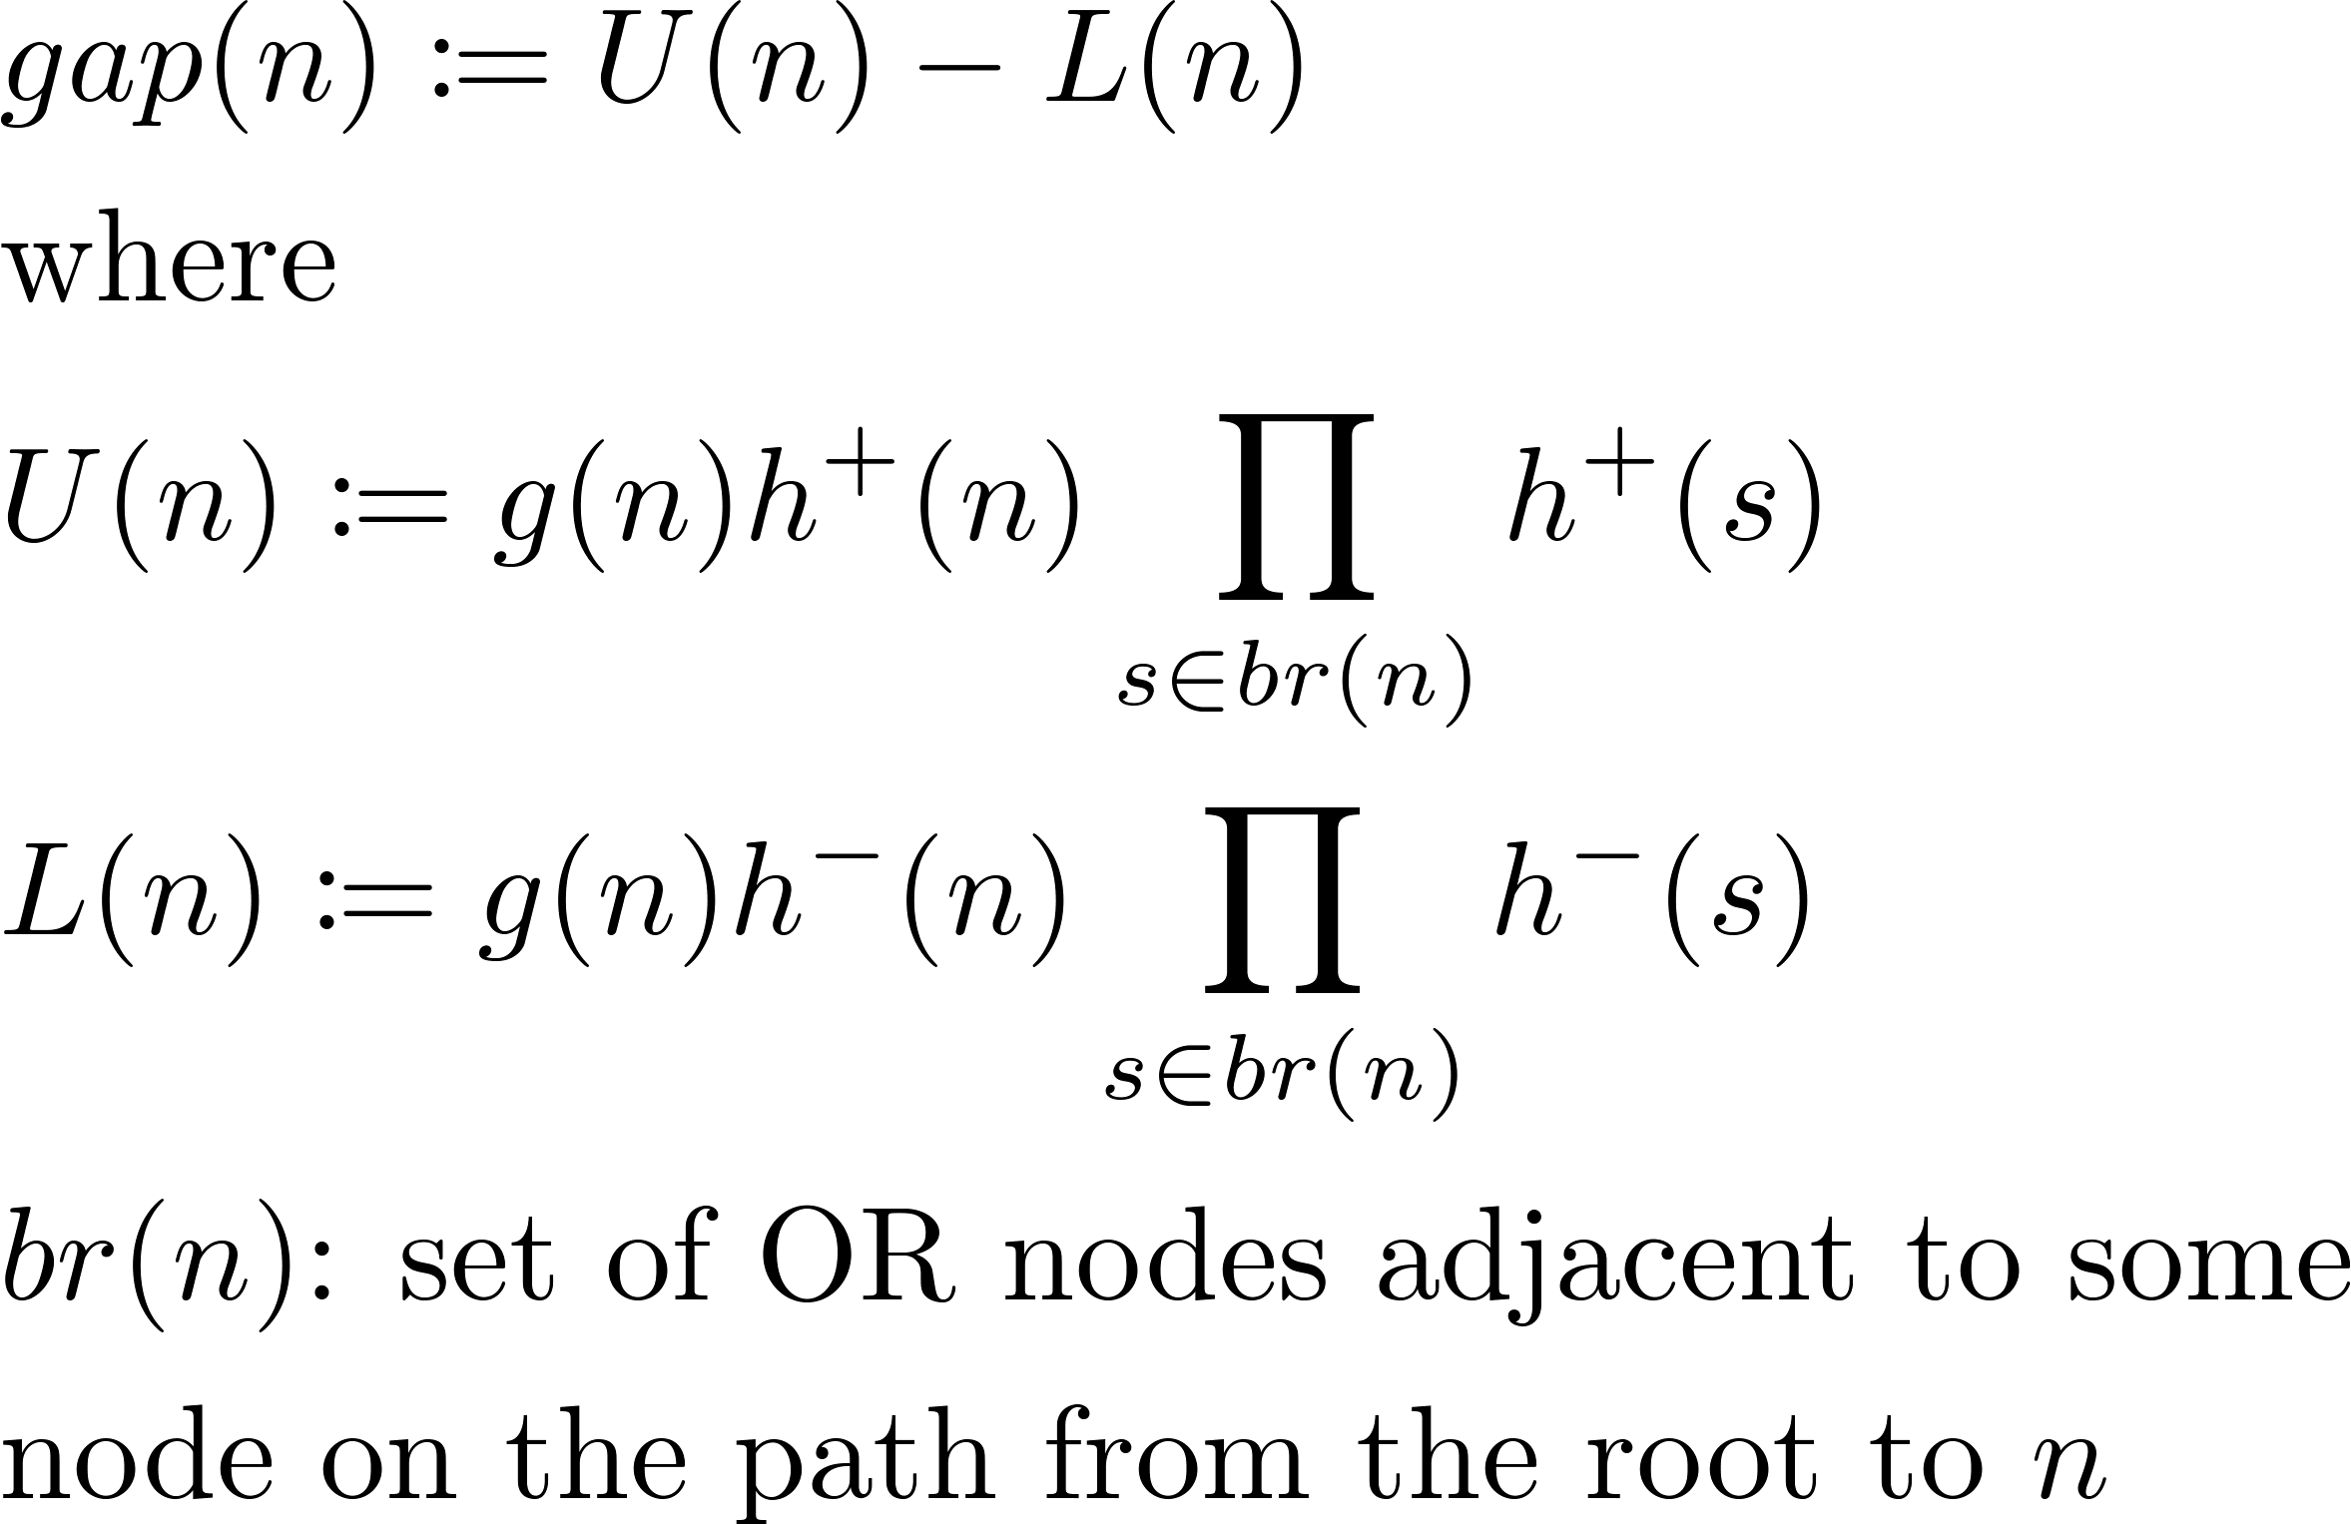
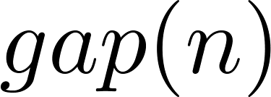
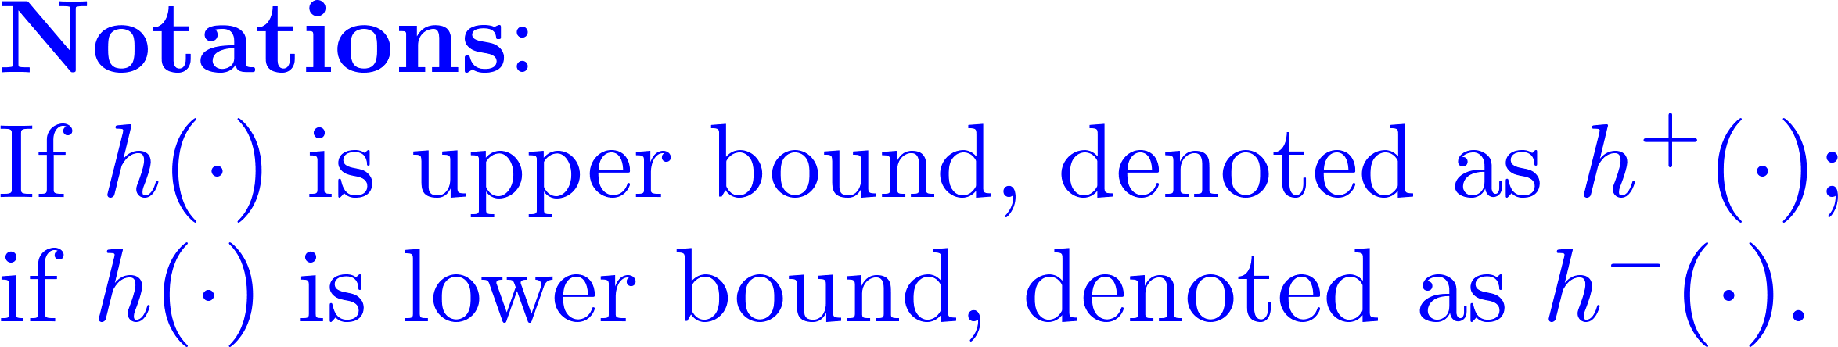
Priority
Intuition: expand the frontier node that potentially reduces the bound gap U - L most
bounds the global bound gap reduction on Z if the subtree beneath n is fully expanded.
A
0
1
B
gap priority
B
0
1
0
1
upper priority
C
F
Strategy: Expand the frontier node
with the largest priority value!
0
1
0
1
Notes:
The intuition here is that we want to expand the frontier node that potentially reduces the bound gap most. [click] To do this, we introduce a quantity called “gap” for each frontier node. It is a difference of two quantities. [click] The 1st one quantifies the contribution of a frontier node to the global upper bound on Z. [click] For example, for this frontier node, its contribution to the upper bound is just the upper bound of the sub-problem it represents. [click] For this frontier node, its contribution to the global upper bound will also be affected by the upper bound of this branch. [click] This is because they are both parts of the same problem. [click] Actually, gap(n) bounds the possible bound reduction on Z we can achieve if we could fully solve the sub-problem represented by this node. Details can be found in the paper. It serves as an optimistic evaluation of the effect of the expansion of this node. [click] We use this quantity as one priority for frontier nodes. We call it gap priority. Usually, the difference is dominant by U(n). So, [click] we use U(n) as another priority called upper priority.

Slide 18
Overcome the Memory Limit
Main strategy (SMA*-like [Russell 1992])
  Keep track of the lowest-priority node as well
  When reach the memory limit, delete the lowest-priority nodes, and keep expanding the top-priority ones
Notes:
As we can see, this best-first search algorithm is memory intensive because we have to keep the entire explored tree in memory. [click] To overcome the memory issue, we adopt a strategy used in SMA*. The main idea is that we keep track of the lowest-priority node; when we reach the memory limit, delete the lowest-priority nodes until it fits the memory. And then we keep expanding the top-priority nodes.

Slide 19
Experiment
Notes:
Now I’m gonna show you some experimental results.

Slide 20
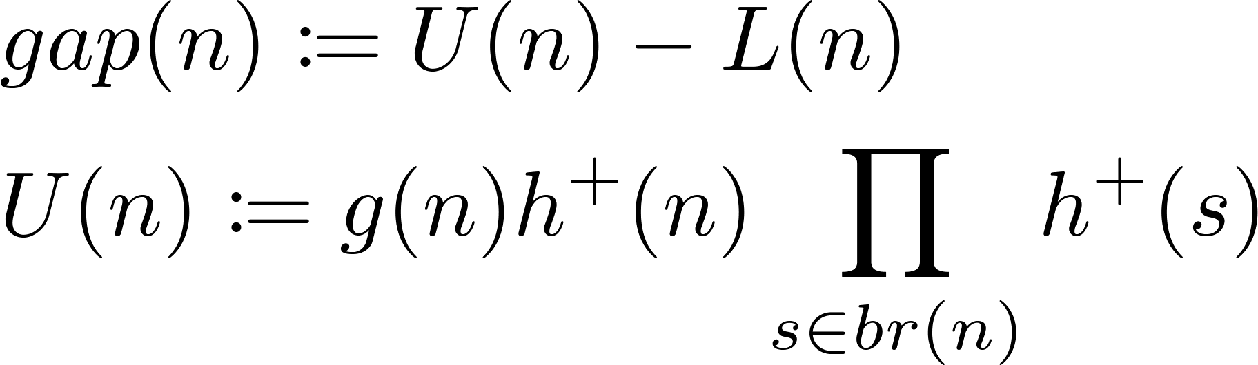
AND/OR Best-first Search (AOBFS)
Variants of our algorithm
  A-G: AND/OR search tree with gap priority
  A-U: AND/OR search tree with upper priority
  O-G: OR search tree with gap priority [Henrion 1991]
Notes:
There’re several variants of our algorithm. A-G means search performs on AND/OR trees with gap priority. A-U is for upper priority . Since we wanna see to what extent the AND/OR structure helps us, we also present a variant runs on OR search trees, denoted as O-G.

Slide 21
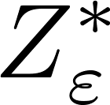
Baselines
[Viricel et al. 2016]
  A recent depth-first branch-and-bound search algorithm that provides deterministic upper and lower bounds on Z.
  For a given ɛ, it returns (non-anytime) bounds on lnZ whose gap is at most ln(1+ɛ).
VEC [Dechter 1999, 2013]
  Variable Elimination with Conditioning, also known as custet-conditioning)
  Apply variable elimination to each assignment of the cutset.
MMAP-DFS [Marinescu et al. 2014] (abbreviated M-D)
  A state-of-the-art method for marginal MAP using AND/OR search
  Solve the internal summation problem exactly using depth-first search aided by WMB heuristics.
Notes:
We compared to some state-of-the-art algorithms. Z-star-eps is a recent depth-first branch-and-bound search algorithm that provides deterministic upper and lower bounds on the partition function. There is a user-specified parameter epsilon that controls the accuracy of the bounds. VEC is an exact method using variable elimination with conditioning. MMAP-DFS is a depth-first search implementation on AND/OR search trees with WMB heuristics.

Slide 22
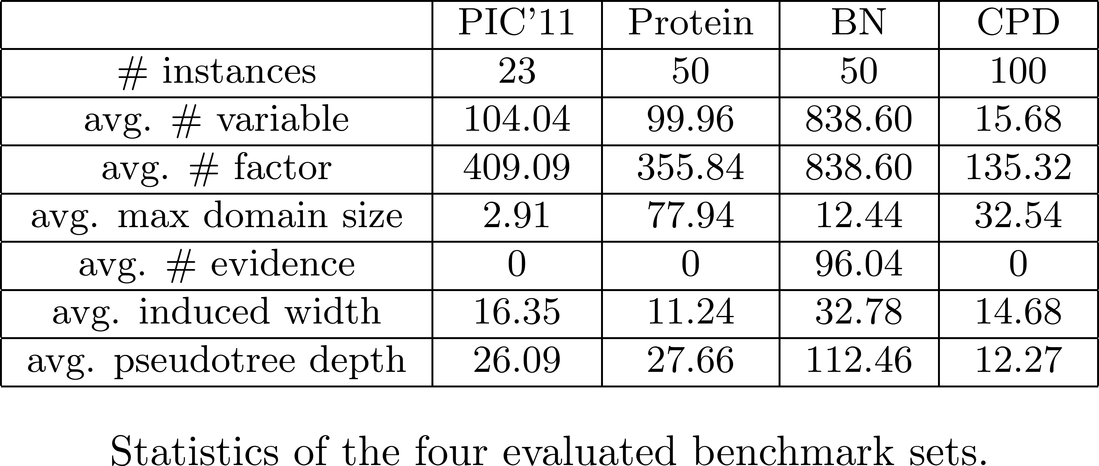
Benchmarks
PIC’11: 23 instances selected by [Viricel et al. 2016] from the 2012 UAI competition
BN: Bayesian networks from the 2006 competition (50 randomly selected instances)
Protein: made from the “small” protein side-chains of [Yanover and Weiss 2002] (50 randomly selected instances)
CPD: computational protein design problems from [Viricel et al. 2016] (100 randomly selected instances)
Notes:
We ran experiment on four datasets. The first three come from the previous UAI competition. The CPD dataset is from one of the baselines. Here are some statistics of the datasets. [click] For example, this column is for the Bayesian nets dataset. Those problems usually have hundreds of variables and factors. The average induced width is above 30. So, those are not trivial problems.

Slide 23
Parameters
Implementation
  all methods are implemented in C++ by the original authors
Runtime:
  1 hour
Memory:
  1GB, 4GB and 16GB
  i-bound determined by memory
Notes:
Every method is implemented by its original author in C++. We set time limit to be I hour. We have three memory settings. For each memory setting, we first find the highest i-bound possible that fits the memory to construct wmb heuristics, and then use the remaining memory for search.

Slide 24
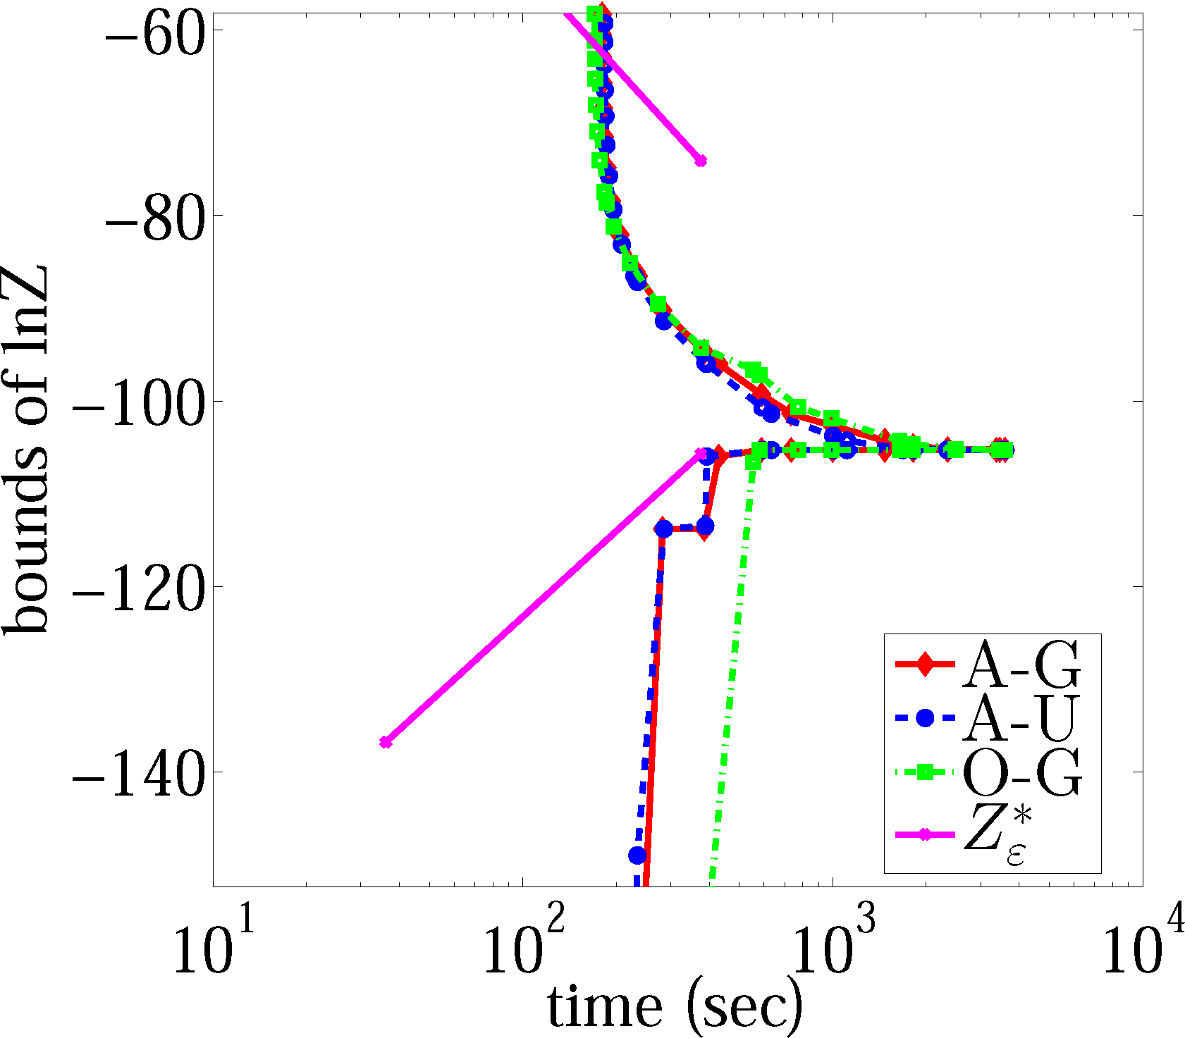
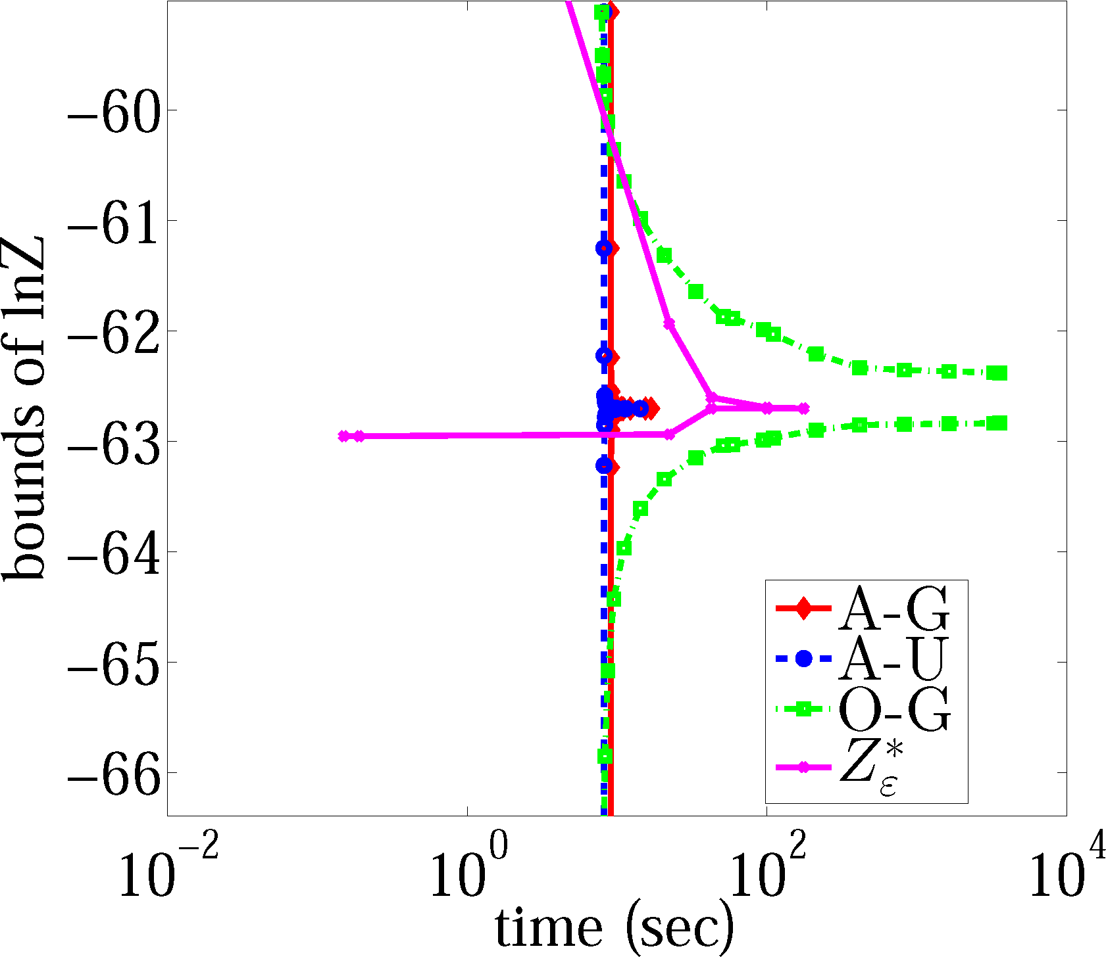
Results
Anytime behavior of AOBFS
(a) PIC’11/queen5_5_4 (b) Protein/1g6x
Notes:
Here are some plots to show the anytime behavior of our algorithm. As expected, the bound gaps decrease with time. Although Z-star-eps is not anytime algorithm, we ran it on different epsilons value to mimic the anytime behavior for comparison.

Slide 25
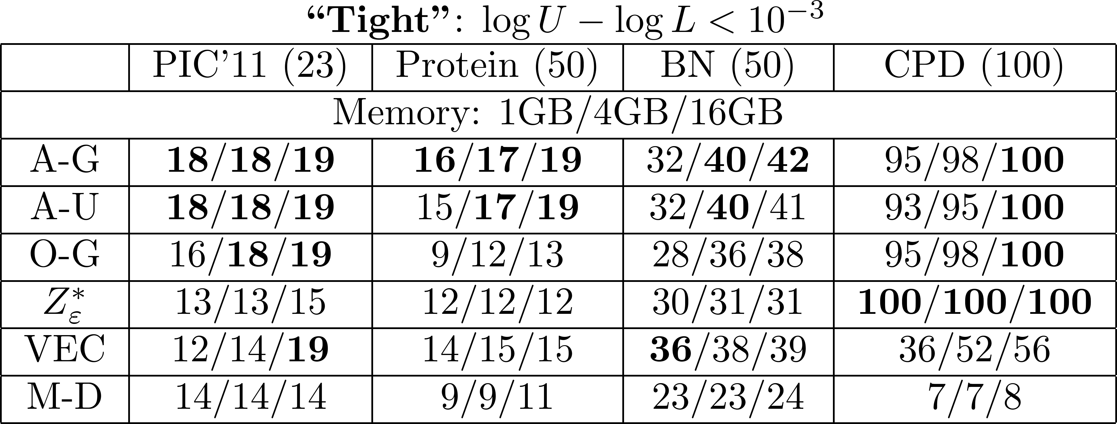
Results
Number of instances solved to “tight” tolerance interval. The best (most solved) for each setting is bolded.
Notes:
The table here shows no. of instances solved to tight tolerance, which means the gap between log upper bound and log lower bound is smaller than 1/1000 for those solved instances. Let’s take one row for example. [click]. This is for our algorithm runs on AND/OR search trees with gap priority. Here’re four columns for four benchmarks. In each column, there’re three entries. Each entry corresponds one memory setting from 1GB to 16GB. winners are bolded. We can observe that A-G wins 9 out of the 12 memory-benchmark settings. A-U is also very competitive in performance. O-G is worse than both of them, which implies AND/OR search spaces does help.

Slide 26
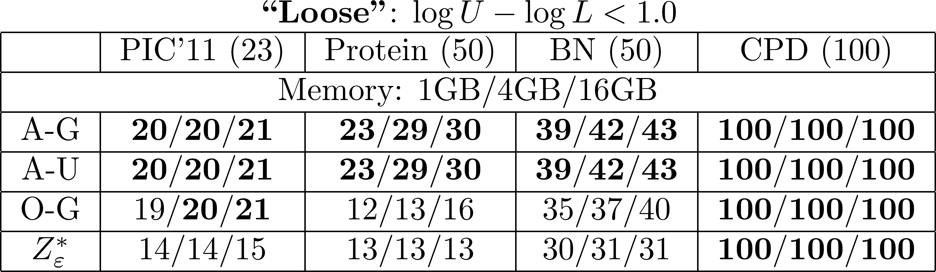
Results
Number of instances solved to “loose” tolerance interval. The best (most solved) for each setting is bolded.
Notes:
Now, if we allow a larger tolerance (that is 1) on the log bound gap. [click] Our methods win over all the settings. We don’t show the results for VEC and M-D coz they’re exact solvers.

Slide 27
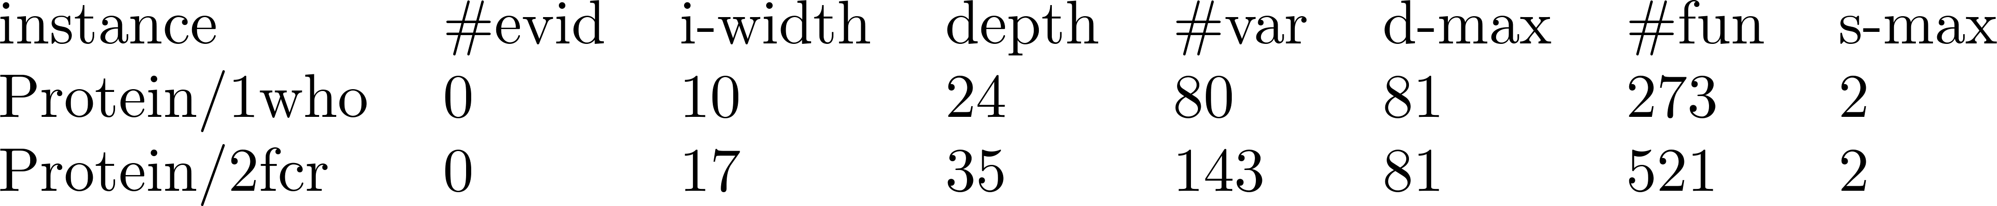
Results
A-G sometimes effectively solve (<1e-3) instances with very high width given relatively few high-weight configurations of the model.
  “1who” is solved in 12 seconds and 1GB memory, while the corresponding junction tree requires about 150GB memory;
  “2fcr” is solved in 21 minutes and 16GB memory, while junction tree would require approximately 3.5PB.
Notes:
As expected, our algorithm works well on problems with very high width given relatively few high-weight configurations of the model. For example, “1who”, an instance from the protein dataset is solved in 12 seconds with 1GB memory, while the corresponding junction tree requires about 150GB memory. This is because our best-first search tends to explore those high-weight configurations first, which results in a good approximation at the very beginning.

Slide 28
Summary
Best-first search algorithm for bounding the partition function
  Bounds in an anytime fashion within limited memory resources.
  Search runs on AND/OR trees that enable exploiting conditional independence
  Priority-driven best-first search scheme based on precompiled variational heuristics
  Outperform state-of-the-art baselines on multiple benchmark & memory setups
Notes:
To summarize, in this work, we develop a best-first search algorithm for bounding the partition function. [click] It provides anytime lower and upper bounds and operates with limited-memory settings. [click] The AND/OR search tree enables exploiting conditional independence during search. [click] It is a priority-driven best-first search scheme based on precompiled heuristics. The specifically designed heuristics and priority guide the search towards critical subtrees of the search tree. [click] In experimental comparisons, our algorithm outperforms existing, state-of-the-art baseline methods on multiple benchmark & memory setups.

Slide 29
Thank You!
Q&A
Notes:
Thanks for your attention.

