Slide 1
Advancing Heuristics for Search over Graphical Models
William Lam
Final Defense
March 16, 2017
Collaborators: Rina Dechter
Kalev Kask
Javier Larrosa
Alexander Ihler
Committee:
Rina Dechter
Alexander Ihler
Sameer Singh
Notes:
Today, I will be talking about my work on advancing heuristics for search over graphical models.

Slide 2
Thesis Contributions
Boost existing heuristics with look-ahead
  Developed a cost-effective scheme
Subproblem ordering for AOBF
  Demonstrated its impact and proposed heuristics
Dynamic heuristics for search
  Superior performance on select problem classes
Exact inference using AOMDDs
  Exploited a compact representation to push feasibility
Notes:
So I’ll begin by talking about the contributions of my thesis.
(Click)
The first chapter focuses on boosting existing heuristics with the classic technique of look-ahead. We developed a cost-effective scheme to achieve fast search
(Click)
The second demonstrates the impact of subproblem ordering in AND/OR Best-First search and proposes heuristics that improve AOBF’s performance
(Click)
Third, we developed dynamic heuristics for search and showed that it allows faster search on certain problem classes.
(Click)
The last chapter diverges from heuristic search. We used AOMDDs, a compact representation for graphical models to push the feasibility of exact inference.
(Click)
This talk will focus on the first two and I will only briefly mention the last two.

Slide 3
Background

Slide 4
Outline
Background
  Graphical Models and Heuristic Search
Cost-Directed Look-ahead in AND/OR Search via Residual Analysis
Subproblem Ordering for AOBF

Slide 5
Graphical Models
A tuple (X, D, F, ⨂):
X = {X₁,…,X_{n}}: variables
D = {D₁,…,D_{n}}: domains of X
F = {f₁,…,f_{m}}: local functions over
scopes S_{j} ⊆ X
A graphical model defines a global function
Query: Optimization (min-sum problem)
F
f_{j}: f(B,E)
G
A
B
E
D
C
Primal Graph
m
F(X) = Σ f_{j}(S_{j})
j=1
Complexity:
Exponential in the treewidth of the graph
m
x*= arg min Σ f_{j}(S_{j})
j=1
Notes:
We work in the framework of (discrete) graphical models, which are defined over a set of local cost functions defined over sets of variables with discrete domains.
The model defines a global function that is the sum of all the local functions.
We can define a primal graph, where each node represents variables and edges connect them if they appear in the same scope of any function.
(Click)
Many queries can be performed over graphical models, but we focus on the min-sum query, which is to find an assignment with the minimal cost.
(Click)
The complexity of this task can be characterized by the treewidth of the primal graph. We won’t go into the specific details, but it is a measure for deciding how close the graph is to a tree.

Slide 6
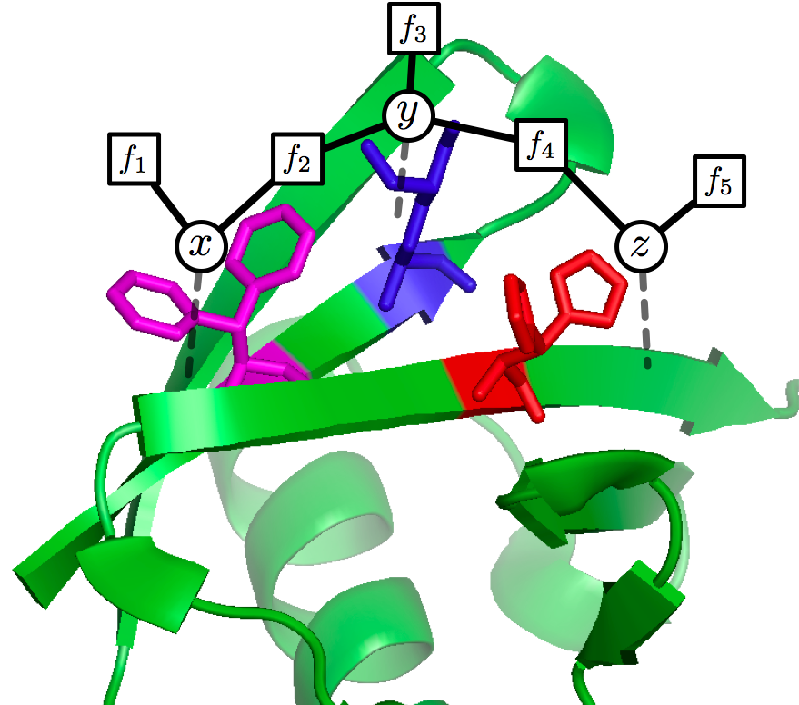
Example Application
Protein Folding
Find the most likely (minimum energy)
configuration of the amino acids in a protein
[Yanover & Weiss 2002]
Notes:
One example of a problem that has been modeled using this framework is the protein folding problem in bioinformatics.
The goal is to minimize the energy between amino acids, which can be mapped as a set of local cost functions in graphical models to globally minimize over.

Slide 7
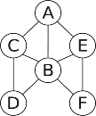
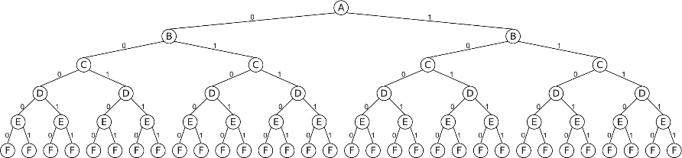
Depth-First Search
Standard depth-first search procedure:
  Instantiate variables one at a time.
    Find the optimal solution path.
  Time complexity: exp(n) .
    Linear space.
Notes:
Now we work into how the min-sum problem can be mapped to a search task.
We can think of enumerating the assignments by instantiating one variable at a time, yielding the search tree here. The goal is to then find the optimal solution path.
(Click) Like this shown here.
(Click)
The time complexity is exponential in the number of variables, but uses only linear space.

Slide 8
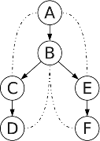
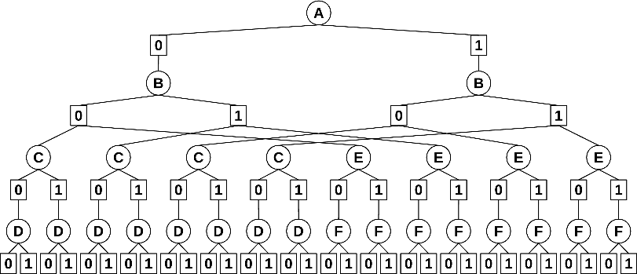
AND/OR Search Tree [Dechter & Mateescu 2006]
Decompose independent subproblems.
  Guided by pseudo tree.
  Exploit conditional independence relations.
  Find the optimal solution tree
Decomposition
Time: O(n·k^{h})
Space: O(n)
Notes:
The search tree used in the previous slide does not exploit conditional independencies in the problem.
For example, after conditioning A and B, the graph splits into two components. This type of information can be captured by a data structure known as a pseudo-tree, which guides the structure of an AND/OR search tree.
(Click)
In this AND/OR search tree, allows us to capture decomposition. Here, this part of the search tree represents that we can decompose the problem into two separate subproblems, each rooted by C and E. The goal is to find an optimal solution tree (Click) Like this highlighted here.
(Click)
The time complexity of depth-first search on this graph is exponential in the height rather than n and we still maintain linear space complexity.

Slide 9
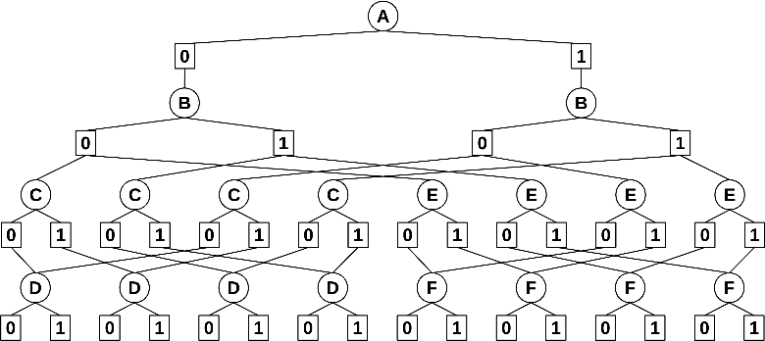
AND/OR Search Graph [Dechter & Mateescu 2006]
Merge unifiable subproblems.
  Based on variables' context.
  Store optimal solution
  in cache table.
[ ]
[A]
[AB]
[AB]
[BC]
[BE]
Time and space: O(n·k^{w*})
Cachetable for F
(independent of A)
Notes:
We can further compact the search tree to a search graph by merging subproblems.
Intuitively, since certain variables are not connected, they only depend on a subset of the ancestors in the search tree.
This information is captured by the context of a variable, which can be derived from the pseudo-tree.
(Click)
For example, since F is not connected to A here, we can merge the copies that came from different assignments to A. This is typically implemented by caching solutions of already explored contexts.
(Click)
The time complexity is further reduced to be exponential in the treewidth, but due to caching, the space is also exponential in the treewidth. In practice, the space usage can be freely adjusted to match the available resources.

Slide 10
AND/OR Branch-and-Bound [Marinescu & Dechter 2009]
Augment to weighted AND/OR spaces.
  Heuristic-based pruning.
    Mini-bucket heuristic bounds
    subproblem solution costs.
    [Kask & Dechter 1999]
[ ]
[A]
[AB]
[AB]
[BC]
[BE]
v=0.56
v=0.7
v=0.9
v=0.8
prune
h=0.7
Notes:
Obviously, depth-first search alone is not good enough to be practical. Thus, we use branch-and-bound, which uses heuristics to prune the search space in the usual way.
In particular, the most popular heuristic used is known as the mini-bucket heuristic, which I talk about next.

Slide 11
Bucket and Mini-Bucket Elimination
F
A
Bucket Elimination (BE) (Dechter 1999)
Solves the min-sum problem by eliminating variables one at a time.
Complexity: exponential in the w* of the underlying primal graph
Mini-Bucket Elimination (MBE) (Dechter and Rish 2001)
We can approximate BE by solving a relaxation created by duplicating variables
to bound the w* by a parameter known as the i-bound.
G
A
B
E
B
D
C
C
F
D
E
G
A
f(A)
A
f(A)
λ^{B} (A)
λ^{B} (A)
B
f(A,B)
B
f(A,B)
λ^{C} (A,B)
λ^{F} (A,B)
λ^{C} (B)
λ^{F} (A,B)
λ^{D} (A)
C
F
C
f(B,C)
F
f(B,F)
f(B,C)
f(B,F)
λ^{D} (A,B,C)
λ^{E} (B,C)
λ^{G} (A,F)
λ^{D} (B,C)
λ^{E} (B,C)
λ^{G} (A,F)
D
D
f(A,D)
f(B,D) f(C,D)
E
f(B,E) f(C,E)
G
f(A,G) f(F,G)
D
f(A,D)
f(B,D) f(C,D)
E
f(B,E) f(C,E)
G
f(A,G) f(F,G)
f(A,D)
D
f(B,D) f(C,D)
λ^{D}(A,B,C) =
min_{D} [f(A,D) +f(B,D) + f(C,D)]
λ^{D}(A) = min_{D} f(A,D)
λ^{D}(B,C) = min_{D} [f(B,D) + f(C,D)]
Notes:
Let’s then talk about the heuristics we use and what we can do.
Bucket elimination is a standard algorithm for solving the min-sum problem exactly by eliminating one variable at at time.
On this example, we place the functions into the buckets as deep as possible (based on their scopes and the bucket’s variable)
We then process the buckets bottom-up. Each bucket processed generates messages that represent the optimal of the functions of that bucket. Messages passed into their parents as we continue the process. At the end, the root contains the optimal cost.
High complexity, so we relax the problem.
MBE does this by duplicating variables, using a parameter known as the i-bound that limits the size of the messages generated.
For example, with an i-bound of 3, we need to partition the D bucket here into two parts, and process them separately as if they were different variables.
These messages, which are all computed before search, are stored in memory and used to form the so-called “static MBE heuristic”.
We typically choose the highest i-bound that memory can allow for this purpose.

Slide 12
Dynamic FGLP Heuristics
Notes:
I’ll now briefly give an overview on my work on dynamic heuristics.

Slide 13
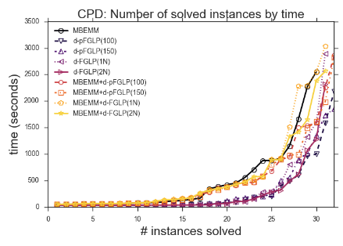
Overview: Dynamic FGLP Heuristics
λ_{A}
A
A’
A
f(A,B)
λ_{A’}
f(A’,C’)
f(A,B)
f(A,C)
B
C’
λ_{B}
λ_{C}
B
C
λ_{B’}
λ_{C’}
f(B,C)
B’
C
f(B’,C)
Original Problem
Relaxed Problem
Dynamic: compute heuristics during search
Use the FGLP algorithm [Ihler et al. 2012] on each node
Similar to “soft arc-consistency” methods in the WCSPs [Larrosa and Schiex 2004]
static
dynamic
Notes:
Dynamic heuristics need to be fast to be cost-effective, since they are computed at every node during search.
So we look into a very loose way of bounding by optimizing each function separately, which is also a process of duplicating variables much like in MBE. If the maximizing assignments between all copies happen to agree, then the bound is tight.
This is often not the case, so an idea known as cost-shifting updates the functions to force the variable copies to be as equal as possible, and can be viewed as a message passing technique.
(Click)
The form of these messages is derived from a well-known linear programming approach and factor graph linear programming is an algorithm that performs these updates.
We adapt the FGLP algorithm as a dynamic heuristic generator, by running it on each node during search
(Click)
This method, derived from the LP literature, is similar to soft arc-consistency methods in the weighted constraint satisfaction literature.
(Click)
An empirical evaluation showed that our scheme was superior to static MBE heuristics where memory restrictions restrict the power of static MBE heurisics. Our methods solve more instances in less time on this particular class of problems.

Slide 14
Extensions to AOMDDs

Slide 15
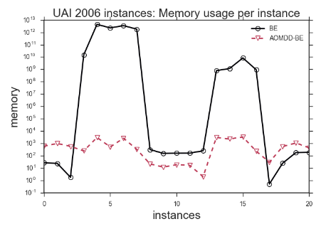
Overview: Extensions to AOMDDs
A | B | C | f(ABC)
0 | 0 | 0 | 0
0 | 0 | 1 | 0
0 | 1 | 0 | 0
0 | 1 | 1 | 1
1 | 0 | 0 | 0
1 | 0 | 1 | 1
1 | 1 | 0 | 0
1 | 1 | 1 | 1
A
A
A
B
B
B
B
C
C
C
C
C
C
0
0
0
1
0
1
0
1
0
1
Decision tree
Reduced Binary Decision Diagram
[Bryant 1986]
AOMDD framework [Mateescu & Dechter 2007]
Provide first implementation and empirical results on existing algorithms
Extended AOMDDs to be used to implement bucket elimination
infeasible
feasible
Notes:
Another chapter I will not delve into is on extensions to AND/OR multivalued decision diagrams (AOMDDs), a framework for the compact representation of functions in graphical models
To give a flavor of decision diagrams, if we have a function, we can represent it as a decision tree. Through some reductions, we can actually represent it compactly as what is known as a decision diagram.
(Click)
AOMDDs are an extension that equip decision diagrams with the ability to decompose subproblems from AND/OR search.
(Click)
Lots of the key algorithms introduce for this framework were not implemented, so we provided implementations and first empirical results on those algorithms.
(Click)
And also extended the framework to allow for these compact representations to be used to implement bucket elimination for summation queries, thus allowing it to solve otherwise infeasible problems.
(Click)
Here’s a plot of the memory usage of each instance on some problems. We see that the memory usage can be magnitudes lower using AOMDDs

Slide 16
Cost-Directed Look-ahead in AND/OR Search via Residual Analysis

Slide 17
Look-ahead in Search
Strengthen a heuristic by backing up heuristics of descendants
residual: res^{d} = h^{d} - h
depth 1
depth 2
h¹=15
res¹=15-10=5
h²=21
res²=17-10=7
h=10
h=10
3+16=19
n
4+11=15
n
3
4
3
4
h¹=19
h¹=17
h=16
n₁
n₂
h=11
h=16
n₁
n₂
h=11
2
1
8
3
h=17
n₃
n₄
h=20
h=15
n₅
n₆
h=14
Notes:
Look-ahead is a classical search technique often found in applications such as games. The idea is when a heuristic is not strong enough, we back up the heuristic values of the descendants.
As a simple example, consider the search tree here from a node n and we want to back the children’s heuristics up. We have the heuristic value on each node and edge costs on each edge.
To back the heuristics up, we add the edge to the heuristic value for each child.
(Click)
Then we take the minimum between the two, which is 15 in this case.
(Click)
So this is our depth-1 look-ahead heuristic.
(Click)
Now let’s consider a slightly larger example using a depth of 2.
(Click)
What we do here is compute the depth 1 look-ahead on each of the children.
So we get 19 here and 17 there.
(Click)
Then we repeat the process here, and 21 is smaller than 22, so that becomes our depth 2 look-ahead heuristic value for n
(Click)
We can characterize this change by what is known as a residual, which just takes the difference between the look-ahead heuristic and original heuristic.

Slide 18
AND/OR Look-ahead
Simple extension to AND/OR Search
Defined relative to AND nodes
  depth 1 goes 2 levels in the AND/OR search space
    Sum over children of AND nodes
    Minimize over children of OR nodes
h¹=12
res¹=12-10=2
h=10
5
n
7
m₁
m₂
2
3
6
5
m₁₀
m₁₁
m₂₀
m₂₁
h=3
h=4
h=5
h=2
Notes:
We quickly illustrate here how look-ahead looks in and AND/OR search space.
We define it relative to AND nodes, so depth 1 actually goes two steps to reach the next level of AND nodes.
Here, we sum over the OR children which are each minimized over.
(Click)
So we do a look-ahead from the OR nodes like before, obtaining 5 and 7 here, we then we add them up and get 12 for the AND node, so this is our depth 1 look-ahead heuristic value. We can then have a residual to measure the change in the same way.

Slide 19
AND/OR Look-ahead
Simple extension to AND/OR Search
Defined relative to AND nodes
  depth 1 goes 2 levels in the AND/OR search space
    Sum over children of AND nodes
    Minimize over children of OR nodes
h¹=10
res¹=10-10=0
h=10
3
n
7
m₁
m₂
2
3
6
5
m₁₀
m₁₁
m₂₀
m₂₁
h=1
h=4
h=5
h=2
Our goal: Cost-effective look-ahead for AND/OR search over graphical models.
Notes:
We quickly illustrate here how look-ahead looks in and AND/OR search space.
We define it relative to AND nodes, so depth 1 actually goes two steps to reach the next level of AND nodes.
Here, we sum over the OR children which are each minimized over.
(Click)
So we do a look-ahead from the OR nodes like before, obtaining 5 and 7 here, we then we add them up and get 12 for the AND node, so this is our depth 1 look-ahead heuristic value. We can then have a residual to measure the change in the same way.

Slide 20
Quantifying MBE’s Errors
Exact Bucket Message
MBE Bucket Message
μ*_{D}(A,B,C) = λ^{D}(A,B,C)
μ_{D}(A,B,C) = λ^{D}(A) + λ^{D}(B,C)
λ^{D}(A,B,C)
λ^{D}(A)
λ^{D}(B,C)
f(A,D)
f(B,D) f(C,D)
D
f(A,D)
D
f(B,D) f(C,D)
λ^{D}(A,B,C) = min_{D} [f(A,D) + f(B,D) + f(C,D)]
λ^{D}(A) = min_{D} f(A,D)
λ^{D}(B,C) = min_{D} [f(B,D) + f(C,D)]
(Local) Bucket Error
Err_{D}(A,B,C) = μ*_{D}(A,B,C) - μ_{D}(A,B,C)
Measures the error induced by the partitioning over a single bucket alone
Notes:
Recall from our MBE example earlier that this particular bucket was partitioned and is therefore a source of error.
Since we use these generated messages as heuristics, we’ll work from these and call their summation the MBE bucket message.
To quantify its error, we then compute the (Click)
exact bucket message, which computes the message as if the bucket were not partitioned.
(Click)
The Bucket Error is defined as the difference between the exact bucket message and the MBE bucket message.
It serves as a measure of just the error produced by the partitioning in this particular bucket.

Slide 21
Bucket Error Evaluation (BEE)
Notes:
Thus, this is our main algorithm which performs this step on each bucket.
(Click)
We start by running MBE to generate the messages.
(Click)
Then for each bucket, we compute the exact and MBE bucket messages.
(Click)
Finally, we take their difference to generate the Bucket Error function

Slide 22
Complexity of BEE
Exponential in the pseudo-width
  Number of variables in a bucket at the time of processing
  i-bound ≤ pseudo-width ≤ treewidth
A
f(A)
A
f(A)
λ^{B} (A)
λ^{B} (A)
B
f(A,B)
B
f(A,B)
λ^{C} (A,B)
λ^{C} (B)
w=3,
psw=3
λ^{D} (A)
w=2, psw=2
C
f(B,C)
C
f(B,C)
λ^{D} (A,B,C)
λ^{E} (B,C)
λ^{D} (B,C)
λ^{E} (B,C)
D
f(A,D)
f(B,D) f(C,D)
E
f(B,E) f(C,E)
D
f(A,D)
D
f(B,D) f(C,D)
E
f(B,E) f(C,E)
w=4,
psw=4
w=3, psw=4
Bucket Elimination
MBE, i-bound=3
Notes:
The complexity of BEE is exponential in the pseudo-width.
It is defined as the number of variables in a bucket at the time of processing
For example, in the MBE figure here, D has a pseudowidth of 4 there are 4 variables in its bucket before partitioning.
In general, the pseudo-width lies between the i-bound and treewidth
We’ll illustrate by comparing the bucket C in each.
In MBE(3), C has 2 variables in its bucket but 3 in BE.
In MBE(3), D has a duplicates, so it has 3 variables in its largest mini-bucket while in BE, D has 4 variables.
Remember for Err_D, we need lambda_D(A,B,C) to compute it.
With pseudowidth, C is still 2, but D is 4. This is because C’s errors are not computed using the 3 variable message even if we are using BEE. So basically, pseudo-width is lower than the treewidth because the *incoming* messages are still the original MBE messages rather than the more accurate, but larger ones.

Slide 23
BEE Example
i-bound=2
A
f(A)
λ^{B} (A)
B
f(A,B)
λ^{C} (B)
λ^{F} (B)
C
f(B,C)
F
f(B,F)
λ^{D} (A)
λ^{D} (B)
λ^{D} (C)
λ^{E} (C)
λ^{G} (F)
λ^{G} (A)
λ^{E} (B)
D
f(A,D)
D
f(B,D)
D
f(C,D)
E
f(C,E)
E
f(B,E)
G
f(F,G)
G
f(A,G)
Err_{D}(A,B,C) =
λ^{D}(A,B,C) - [λ^{D}(A) + λ^{D}(B) + λ^{D}(C)]
Err_{E}(B,C) =
λ^{E}(B,C) - [λ^{E}(B) + λ^{E}(C)]
Err_{G}(A,F) =
λ^{G}(A,F) - [λ^{G}(A) + λ^{G}(F)]
A | B | C | Err_{D}
0 | 0 | 0 | 0
0 | 0 | 1 | 2
0 | 1 | 0 | 1
0 | 1 | 1 | 1
1 | 0 | 0 | 3
1 | 0 | 1 | 2
1 | 1 | 0 | 4
1 | 1 | 1 | 1
B | C | Err_{E}
0 | 0 | 0
0 | 1 | 4
1 | 0 | 2
1 | 1 | 1
A | F | Err_{G}
0 | 0 | 5
0 | 1 | 2
1 | 0 | 3
1 | 1 | 0
Notes:
Now we move on by demonstrating BEE on an example problem here.
(Click)
First, we run MBE, here with an i-bound of 2, generating the following bucket tree and messages.
(Click)
Now we process each bucket. Starting with D, we compute the exact bucket and MBE messages and take their difference. This generates the function, shown as a table here.
The remaining buckets with partitioning are E and G, so we process E
(Click)
Then F
(Click)
The rest are of the error functions are zeros since there is no partitioning.

Slide 24
Average Bucket Error
A
B
A
0
C
F
B
0
D
E
G
0
0
C
F
Err_{D}(A,B,C)
Err_{E}(B,C)
Err_{G}(A,F)
A | B | C | Err_{D}
0 | 0 | 0 | 0
0 | 0 | 1 | 2
0 | 1 | 0 | 1
0 | 1 | 1 | 3
1 | 0 | 0 | 3
1 | 0 | 1 | 5
1 | 1 | 0 | 4
1 | 1 | 1 | 1
B | C | Err_{E}
0 | 0 | 0
0 | 1 | 4
1 | 0 | 2
1 | 1 | 1
A | F | Err_{G}
0 | 0 | 5
0 | 1 | 2
1 | 0 | 3
1 | 1 | 0
D
E
G
2.375
1.75
2.5
Average errors for each variable
2.375
1.75
2.5
Average Bucket Errors
Notes:
We may not be able to actually store the error functions, since their size is exponential in the pseudo-width, which is higher than the i-bound. (Recall that the i-bound is typically chosen to already push memory resources.)
(Click)
Thus, we average over them, and generate average bucket errors. This gives us a simple measure of the error of each bucket.
(Click)
We find it useful to visualize the errors by annotating the pseudo tree like this.

Slide 25
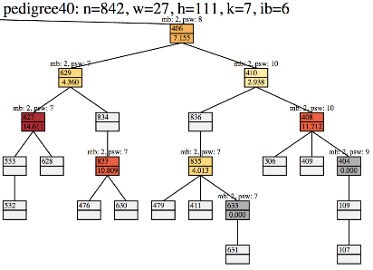
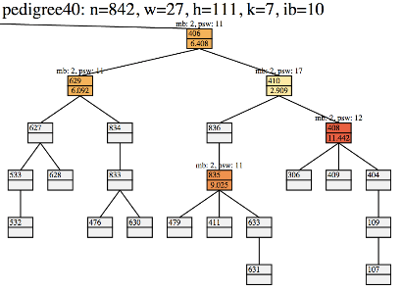
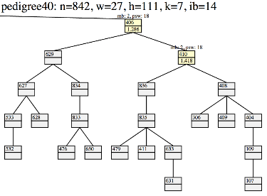
Bucket-Errors: Across i-bounds (pedigree40)
Notes:
Here’s an example on an actual instance, pedigree40.
We show an extracted portion of its pseudo tree. In each node, the top number is a variable index and the bottom is the bucket error. The colors range from a pale yellow to dark red to indicate the magnitude of error. For buckets with zero error, yet had partitioning, they are colored dark gray. Non-partitioned buckets are the rest of the light gray nodes.
For this one with an i-bound of 6, we see errors on some nodes, but not all of them. More importantly, as I pointed out some had partitioning, yet zero error.
(Click)
Increasing the i-bound to 10, thus making MBE more accurate, we can see the changes reflected as fewer nodes have error.
(Click)
Increasing once again to an i-bound of 14 now, barely any nodes have error.
With a way to measure the error of MBE, now we turn our attention back to look-ahead, and in particular, the residual.

Slide 26
Residual and Bucket Error
Residual: measures the impact of look-ahead
res = h¹ - h
Notes:
Now recall the residual is what measures the impact of look-ahead on the heuristic.
In the thesis, assuming AND/OR search, we show that the 1-level residual is equal to the sum of bucket errors of each child. We skip the derivations here, but this means that we now have means of selectively performing look-ahead, given bucket errors.

Slide 27
Look-ahead Subtree
Look-ahead subtree from A
A
A
B
C
F
D
E
G
H
I
Pseudo-tree
Depth 0
Notes:
So now we start to develop our framework for selective look-ahead.
We begin by introducing a representation of the look-ahead computation that we call the look-ahead subtree
Consider a pseudo-tree defining an AND/OR search space.
The look-ahead subtree for a given variable and depth is formed by the subtree rooted by that variable pruned below the depth.
We use the look-ahead subtree as a way to guide the look-ahead computation.
Here’s an example of the look-ahead subtrees from variable A. Increasing the depth, the look-ahead subtree grows.

Slide 28
Look-ahead Subtree
Look-ahead subtree from A
A
A
B
B
C
F
D
E
G
H
I
Pseudo-tree
Depth 1
Notes:
Consider a pseudo-tree defining an AND/OR search space.
The look-ahead subtree for a given variable and depth is formed by the subtree rooted by that variable pruned below the depth.
Here’s an example of the look-ahead subtrees from variable A. Increasing the depth, the look-ahead subtree grows.

Slide 29
Look-ahead Subtree
Look-ahead subtree from A
A
A
B
B
C
F
C
F
D
E
G
H
I
Pseudo-tree
Depth 2
Notes:
Consider a pseudo-tree defining an AND/OR search space.
The look-ahead subtree for a given variable and depth is formed by the subtree rooted by that variable pruned below the depth.
Here’s an example of the look-ahead subtrees from variable A. Increasing the depth, the look-ahead subtree grows.

Slide 30
Look-ahead Subtree
Look-ahead subtree from A
A
A
B
B
C
F
C
F
D
E
G
D
E
G
H
I
Pseudo-tree
Depth 3
Notes:
Consider a pseudo-tree defining an AND/OR search space.
The look-ahead subtree for a given variable and depth is formed by the subtree rooted by that variable pruned below the depth.
Here’s an example of the look-ahead subtrees from variable A. Increasing the depth, the look-ahead subtree grows.

Slide 31
Look-ahead Subtree
Look-ahead subtree from A
A
A
B
B
C
F
C
F
D
E
G
D
E
G
H
I
H
I
Pseudo-tree
Depth 4
Notes:
With this way of representing the look-ahead computation, we can now think of how to avoid look-ahead through pruning nodes from the look-ahead subtrees.
///////
Consider a pseudo-tree defining an AND/OR search space.
The look-ahead subtree for a given variable and depth is formed by the subtree rooted by that variable pruned below the depth.
Here’s an example of the look-ahead subtrees from variable A. Increasing the depth, the look-ahead subtree grows.

Slide 32
Pruned Look-ahead Subtree
Look-ahead subtree from A
ε=5
A
0
A
B
10
B
0.8
C
F
0.2
0.3
D
0.5
E
G
15
8
H
I
1
Pseudo-tree
Depth 1
Look-ahead relevant variable:
A variable whose
bucket error ≥ a threshold ε.
Notes:
Now I will show what we can do with the average bucket errors, which are now labeled on the tree.
(Click)
We will call a variable look-ahead relevant if its bucket error is greater than or equal to some threshold epsilon
(Click)
Here, let’s choose epsilon to be 5. The nodes marked red are the relevant variables.
(Click)
For a depth of 1, we have this look-ahead subtree. Since B has high error, we opt to keep to look-ahead subtree as is in this case.

Slide 33
Pruned Look-ahead Subtree
Look-ahead subtree from A
ε=5
A
0
A
B
10
B
0.8
C
F
0.2
C
F
0.3
D
0.5
E
G
15
8
H
I
1
Pseudo-tree
Depth 2
Look-ahead relevant variable:
A variable whose
bucket error ≥ a threshold ε.
Notes:
Now we start from the look-ahead subtree at a depth of 2.
We prune any node from the tree as long as it has no relevant descendants. In this case, it’s C and F.
(Click)
So we can, for this variable, actually choose to do a less costly depth 1 look-ahead.

Slide 34
Pruned Look-ahead Subtree
Look-ahead subtree from A
ε=5
A
0
A
B
10
B
0.8
C
F
0.2
C
F
0.3
D
0.5
E
G
15
D
E
G
8
H
I
1
Pseudo-tree
Depth 3
Look-ahead relevant variable:
A variable whose
bucket error ≥ a threshold ε.
Notes:
Increasing the depth to 3, we would prune the tree like this:
(Click)

Slide 35
Pruned Look-ahead Subtree
Look-ahead subtree from A
ε=5
A
0
A
B
10
B
0.8
C
F
0.2
C
F
0.3
D
0.5
E
G
15
D
E
G
8
H
I
1
H
I
Pseudo-tree
Depth 4
Look-ahead relevant variable:
A variable whose
bucket error ≥ a threshold ε.
Notes:
And finally at 4, like this:
(Click)
So using this technique, we can often avoid look-ahead where it is not likely to be beneficial.

Slide 36
Generating Minimal Pruned Look-Ahead Subtrees
Run BEE and identify error-relevant variables
For each variable, generate its look-ahead tree.

Slide 37
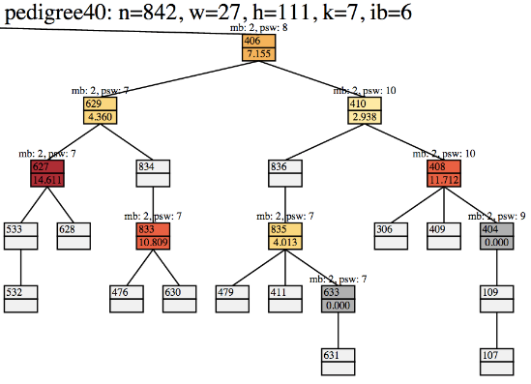
Sample of a part of a pseudotree (pedigree40)
X₄₀₆
X₆₂₉
X₄₁₀
depth = 1,
ε = 0
Notes:
Now we illustrate the same thing on an actual problem

Slide 38
Sample of a part of a pseudotree (pedigree40)
X₄₀₆
X₆₂₉
X₄₁₀
X₆₂₇
X₈₃₄
X₈₃₆
X₄₀₈
X₈₃₃
X₈₃₅
depth = 3,
ε = 0
Notes:
To illustrate the effect on this real problem, consider looking ahead from 406 with a depth of 1, 3, and 5. Assume we take all buckets with Rel Avg Error > 0.

Slide 39
Sample of a part of a pseudotree (pedigree40)
X₄₀₆
X₆₂₉
X₄₁₀
X₆₂₇
X₈₃₄
X₈₃₆
X₄₀₈
X₈₃₃
X₈₃₅
depth = 5,
ε = 0
Notes:
To illustrate the effect on this real problem, consider looking ahead from 406 with a depth of 1, 3, and 5. Assume we take all buckets with Rel Avg Error > 0.

Slide 40
Sample of a part of a pseudotree (pedigree40)
X₄₀₆
X₆₂₉
X₄₁₀
X₆₂₇
X₈₃₄
X₄₀₈
X₈₃₃
depth ≥ 3,
ε = 9.5
Notes:
To illustrate the effect on this real problem, consider looking ahead from 406 with a depth of 1, 3, and 5. Assume we take all buckets with Rel Avg Error > 0.

Slide 41
Look-Ahead Graphical Model
A
f(A)
A
A
λ^{B} (A)
B
f(A,B)
B
prune
B
λ^{C} (B)
λ^{F} (A,B)
C
f(B,C)
F
f(B,F)
C
F
C
λ^{D} (A)
λ^{D} (B,C)
λ^{E} (B,C)
λ^{G} (A,F)
D
f(A,D)
D
f(B,D) f(C,D)
E
f(B,E) f(C,E)
G
f(A,G) f(F,G)
D
E
G
D
Example: Look-ahead (depth 3) from A
A
f(A)
A
B
λ^{B} (A)
B
f(A,B)
Equivalent to improved heuristic for variable A.
D
C
λ^{C} (B)
C
f(B,C)
λ^{D} (A,B,C)
λ^{E} (B,C)
D
f(A,D)
f(B,D) f(C,D)
E
f(B,E) f(C,E)
Notes:
More relevant when we are deeper in the search space.

Slide 42
Experiments
Benchmark Statistics
Notes:
Now we move onto experiments. We performed many experiments across 6 different benchmarks with varying difficulties. The various problem parameters are summarized here.

Slide 43
Goals
Look-ahead for different depths (d={1..6}, ε=0.01)
  Speedup over no look-ahead for solving problems
  Does look-ahead allow AOBB to get better solutions earlier?
Impact of pruned look-ahead subtrees with different thresholds (d={2, 5}, ε={0,0.01,0.5,10})
  How much does it help to prune using bucket error?
Notes:
The main question we have are about the impact of look-ahead depth. We will measure this by considering the speedup obtained over no look-ahead when solving problems exactly.
For harder problems, we consider the anytime context, where we look at the quality of the solutions that are produced over time.
In this first part, we used an epsilon threshold of 0.01, to encourage look-ahead to all variables except the ones smallest errors.
We are also of course interested in the impact of the thresholds used, so we also experimented with various epsilon. The main question here is how much the pruning procedure helps in each case.

Slide 44
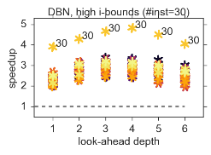
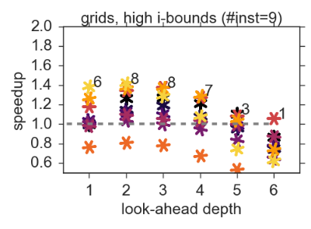
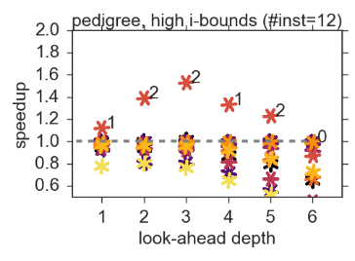
Experiments: Solving Exactly
Notes:
On this figure, we plot the speedups over no look-ahead for each instance in this DBN benchmark for each depth. The number at the top of each column of points indicates the number of instances in the set that had a positive speedup. On this particular benchmark, all of the problem benefited from lookahead with speedups ranging from 2-3, with a single outlier going up to almost 5.
(Click)
Here’s another benchmark, where most of the instances benefited starting from a depth of 1 and improve a bit at 2. However, performance starts deteriorating at 3 and above. So this shows that care must be taken in controlling this parameter.
(Click)
However, on easier benchmarks like this one where the MBE heuristic is strong, it is not as effective.
//Thus, we show that look-ahead boosts the power of the heuristics in the context of exact solving when our memory resources may otherwise limit their power.

Slide 45
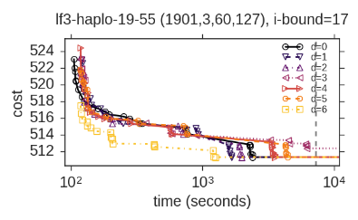
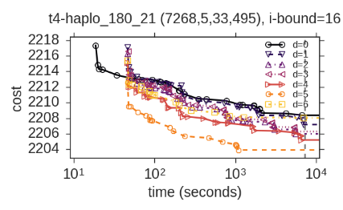
Experiments: Anytime
Notes:
So let’s focus on hard instances that we cannot solve precisely because of this reason.
This here is a plot of the anytime solutions (or upper bounds) on the optimal solution over time for an instance from the largefam3 benchmark.
A line that is lower and to the left is better, so we see here that a depth of 6 produces the best solutions.
(Click)
Here is another instance, which is from the type4 benchmark. We see that a depth of 5 is best here, but the baseline is actually outperformed by all depths for most of the time period.
//So the answer to our question is that look-ahead can indeed improve the quality of anytime solutions, especially when performed at a higher depth.

Slide 46
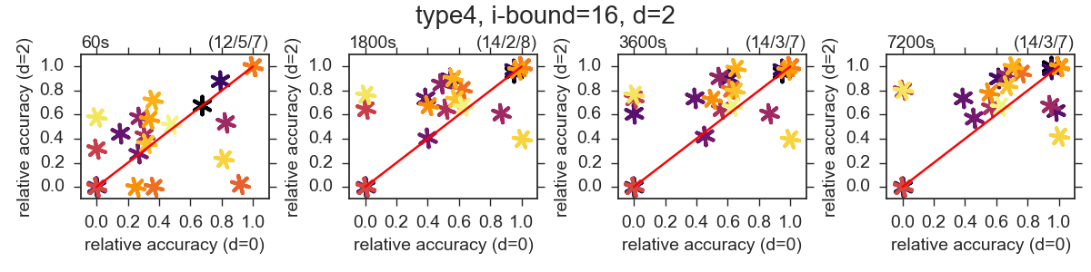
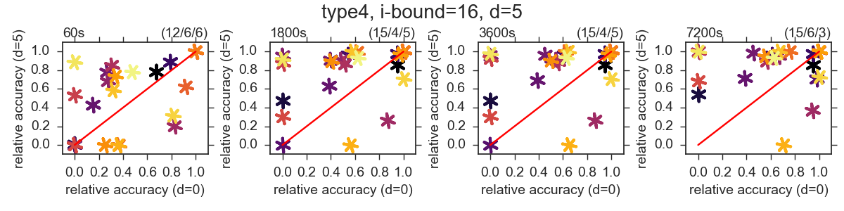
Experiments: Anytime Summary

Slide 47
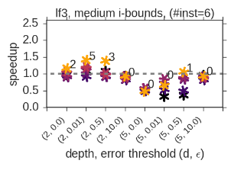
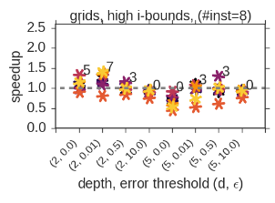
Experiments: Varying the Threshold
Notes:
Now we show the speedup plots for the largefam3 benchmark. Each group of 4 here corresponds to a depth of 2 and 5. Within each group, they correspond to different error thresholds.
Considering a depth of 2 first, 0.0 corresponds to performing no pruning for the look-ahead subtrees. Indeed, we increase the number of instances with positive speedup when we use 0.01 instead.
Further increases negatively impact look-ahead.
A depth of 5 was generally bad for this benchmark, so we can see that increasing the threshold here generally helps.
(Click)
We see similar behavior in this other benchmark too.
//Most of the gain comes from moving from no pruning to pruning zeros and small errors.

Slide 48
Summary
Weaker heuristics benefit more
Depth requires careful control
  Benchmark dependent
    2-3 for exact solving
    4-5 for early improved anytime solutions
Pruning is most important for the smallest errors
Look-ahead trades memory for time
Notes:
Weaker heuristics benefit more. I only showed speedup plots using the highest i-bounds possible. On the easier instances only lower i-bounds were better.
Depth requires careful control: the best was different for each evaluation between exact and anytime.
For exact, high depth usually caused runtime to become much worse. For anytime, better solutions were obtained earlier with higher depths.
For look-ahead subtree pruning, we saw most of the benefit from pruning only the smallest errors, such as the buckets with zero error.
Overall, look-ahead enabled us to strengthen heuristics without spending more memory by using more time in a cost-effective manner, which yielded overall better time performance.
/////////////////////////////////////
Based on these takeaways, we could consider controlling depth during search, as seen with how higher depths seemed to allow for better early solutions, yet worse when running to termination.
It is clear that the threshold using errors is very dependent on the problem, but we usually stuck with 0.01 to encourage look-ahead on most non-zero errors. So a more sophiscated scheme better using this information could improve the look-ahead subtrees. As with depth a dynamic control may also help, as seen where it can sometimes yield better early anytime solutions with eps < 0.01.
Lastly, from our process of casting the look-ahead computation as a BE task, we could instead parameterize look-ahead with width instead.

Slide 49
Subproblem Ordering for AND/OR Best-First Search

Slide 50
Subproblem Ordering
f=10
Partial Solution Tree
2
A
0
1
B
4
0
1
h=1
C
D
h=3
Notes:
In AND/OR Best-First search, search is performed by maintaining a partial solution tree with the best estimate, marked in red lines here.
Here we show a partial solution tree where the current estimate is 10, which is calculated by propagating heuristic values up from descendants. Here we add the edge costs up, and the heuristic values at each of these nodes to get 10. The general idea we constantly maintain the best partial solution tree which will then be extended until a better one is found. So we actually want to increase f as quickly as possible.
When choosing which AND node to expand, we simply choose the best one based on heuristics as usual. However, for choosing OR nodes (which represent the roots of subproblems), the impact of which to expand can have an impact.
(Click)
For example lets say that if we completely explore the nodes under C first,

Slide 51
Subproblem Ordering
f=40
Partial Solution Tree
2
A
0
1
B
4
0
1
h=1
C
D
h=3
Best path cost: 31
Notes:
Then it increases the estimate of the solution tree to 40.
On the other hand…..

Slide 52
Subproblem Ordering
f=50
Partial Solution Tree
2
A
0
1
B
4
0
1
h=1
C
D
h=3
Best path cost: 53
Notes:
If we expand the nodes under D first, the estimate becomes 50. So this would mean we prefer this choice.
Even better yet,

Slide 53
Subproblem Ordering
f=60
Partial Solution Tree
2
A
0
1
Can measure the increase with residuals!
B
4
0
1
Approximate with bucket errors
h=1
C
D
h=3
Best path cost +
heuristic:
25
Best path cost + heuristic:
29
Notes:
We could explore part of each and get an even better estimate.
This is the core problem of subproblem ordering, where we need to find the best balance of exploration between the subproblems.
Re-iterating here: this estimate of a partial solution is calculated by propagating descendant heuristics up. Recall that this is actually what look-ahead does.
For example, performing look-ahead from C would up to the red part would give a look-ahead heuristic value of 25.
Thus the residual quantifies the increase in f from exploring a particular part of the search space below.
The usual heuristic used is just the same heuristic used for calculating the partial solution tree’s value, so this does not actually tell us about the amount of change that will occur in f. It would pick C in that case, but if the heuristic for C was already very accurate, we would not see much change in f.
We have already established the connection between residuals and the bucket errors, so we use the bucket errors as a basis to developing subproblem ordering heuristics.

Slide 54
Best-First Search for AND/OR Graphs [Pearl 1984]
Two steps
  Identify the most promising partial solution tree with an evaluation function f₁
    Estimates solution quality
  Expand nodes with evaluation function f₂
    Priority of subgraphs
Most work only deals with choosing f₁, while f₂ is chosen ad-hoc.
Our goal: An informed f₂ for AOBF
Notes:
This is not a new problem, as Pearl presented a view of the expansions in best-first search on AND/OR graphs.
The first is to identify the most promising partial solution tree as is done with maintaining T* in the previous example. This is decided by the standard heuristics we use for purposes like pruning in branch-and-bound.
The second defines a separate evaluation function (f2) that chooses the tip node.
Indeed, lots of work focuses on finding good evaluation functions first such as in the work I just presented on look-ahead, while the choice for the second is largely ignored and chosen ad-hoc.

Slide 55
Impact of subproblem ordering in AOBF
A
A
B
C
0
1
Optimal cost C*: 5+6 =11
A | B | f₁
0 | 0 | 1
0 | 1 | 2
1 | 0 | 7
1 | 1 | 5
A | C | f₂
0 | 0 | 20
0 | 1 | 25
1 | 0 | 6
1 | 1 | 10
B
C
B
C
0
1
0
1
0
1
0
1
1
2
20
25
7
5
6
10
Assuming a heuristic h = 0 (everywhere), break ties lexicographically.
(The baseline ordering is based on h.)
q=5
q=1
q=11
A
q=0
q=11
q=0
q=1
q=5
q=0
q=21
1
0
B
C
B
C
0
1
0
1
0
1
0
1
1
2
20
25
7
5
6
10
Notes:
So I’ll illustrate AOBF on an example here.
We’ll call the sequence of lower bounds that it produces a “profile”.
We ended up expanding *everything* in the end to find the optimal solution tree.
What we saw on the way from the start was the profile (0,1,5,11)

Slide 56
Impact of subproblem ordering in AOBF
A
A
B
C
0
1
Optimal cost C*: 5+6 =11
A | B | f₁
0 | 0 | 1
0 | 1 | 2
1 | 0 | 7
1 | 1 | 5
A | C | f₂
0 | 0 | 20
0 | 1 | 25
1 | 0 | 6
1 | 1 | 10
B
C
B
C
0
1
0
1
0
1
0
1
1
2
20
25
7
5
6
10
Better subproblem ordering.
q=5
q=11
A
q=0
q=11
q=0
q=0
q=5
q=20
1
0
B
C
B
C
0
1
0
1
0
1
20
25
7
5
6
10
Notes:
Overall idea: If the current best partial solution tree extends to a cost >C*, then we want to discover this as soon as possible.
Intuitively, that means we want to expand the subproblem where our heuristic is the least accurate.
We avoided expanding the left most part.
What we saw on the way from the start was the profile (0,6,11)

Slide 57
Bucket Errors Revisited
A
0
A
0.828125
B
0
Bottom-up propagation
B
1.65625
0
0
C
F
2.0625
C
F
1.25
D
E
G
D
E
G
2.375
1.75
2.5
2.375
1.75
2.5
Average Bucket Errors
Average (Constant) Subtree Errors
Provides an error estimate of subproblems instead.
Notes:
So given a problem with the following errors, we could use this directly to choose between OR nodes, but notice how most of these are zero, so we’re again left with nothing, such as when choosing between C and F.
The problem is the the bucket errors only measure 1-level of look-ahead.
Thus, we employ a process of propagating the error values up from leaves to the root to communicate information about errors to ancestors.
In the process, we also penalize propagated values with some discount factor as a way to capture the distance of errors. In this example, it is ½.
So halving each of these and adding them yield this number here. From G it becomes 1.25 once propagated to F.
And then we continue this process up to the root.
In the thesis, we also propagate entire bucket error functions to provide richer ordering heuristics, but I won’t delve into the details here in this talk.

Slide 58
Experiments
AOBF with 5 subproblem ordering heuristics
  Baseline ordering heuristic (H)
  Constant Subtree Error, absolute/relative errors (C-A, C-R)
  Subtree Error Functions, absolute/relative errors (SB-A, SB-R)
  All are compiled before search
Main question: Significance of the impact of more informed subproblem orderings.
Notes:
We ran experiments on 3 benchmarks.
The baseline is typically uses the heuristic for evaluating the estimate of the partial solution tree.
(Click)
One variant is based on the average subtree errors as described and
(Click)
The other is based on subtree error functions as I mentioned in passing.
Each also have a variant which normalize the scale of the error values to relative errors.
All of them are compiled before search, so there is no overhead during search.

Slide 59
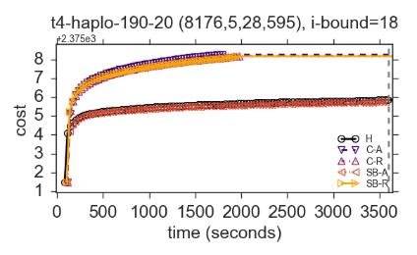
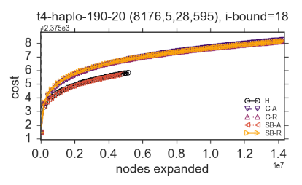
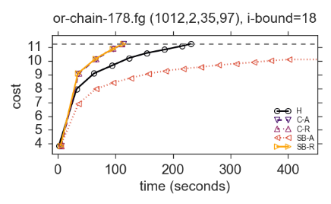
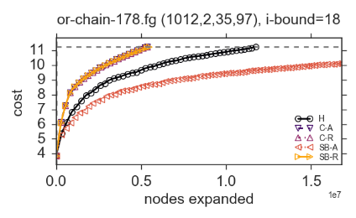
Bound Quality Over Time/Nodes
Notes:
Here we show a plot like the anytime plots earlier, but these are for lower bounds on the optimal solution, so higher and to the left is better.
We see that 3 our new heuristics manage to get better bounds than the baseline.
We also show the bound as a function of the number of nodes expanded.
(Click)
On this other instance, we also see the same 3 methods outperforming the baseline, in fact solving the problem as well in half the time and half the number of nodes.

Slide 60
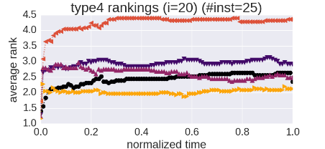
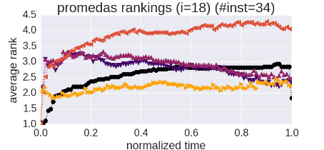
Summary of Bound Quality Over Time
Notes:
To give an account of how the methods rank across all instances we also show their average rankings with each other, plotted by normalizing all the runtimes of each instance.
We see that the one of our methods here outrank the rest (including the baseline) for most of the time.

Slide 61
Summary
Reduced number of nodes in many cases and often cost-effective
Less effective on problems where strong heuristics were possible
Notes:
To summarize, we generally saw that the impact was indeed significant, reducing the number of nodes in many cases while also being cost-effective as there is no overhead during search.
(Click)
Clearly, it is less effective on problems where strong heuristics were possible. In this case subproblem ordering is less likely to have an impact since the residuals would be small.

Slide 62
Publications
Look-ahead
William Lam, Kalev Kask, Javier Larrosa, and Rina Dechter.
Cost-Directed Look-ahead in AND/OR Search via Residual Analysis. (JAIR, under submission)
Rina Dechter, Kalev Kask, William Lam, and Javier Larrosa.
Look-ahead with Mini-Bucket Heuristics for MPE. (AAAI 2016)
William Lam, Kalev Kask, and Rina Dechter
Empowering Mini-Bucket in Anytime Heuristic Search with Look-Ahead: Preliminary Evaluation. (SOCS 2015)
Subproblem Ordering for AOBF
William Lam, Kalev Kask, Rina Dechter, and Javier Larrosa
On the Impact of Subproblem Orderings on Anytime AND/OR Best-First Search for Lower-Bounds. (ECAI 2016)
Dynamic Heuristics
William Lam, Kalev Kask, Rina Dechter, and Alexander Ihler
Beyond Static Mini-Bucket: Towards Integrating with Iterative Cost-Shifting Based Dynamic Heuristics. (SOCS 2014)
AOMDDs
William Lam and Rina Dechter.
Empirical Evaluation of AND/OR Multivalued Decision Diagrams for Inference. (CPDP 2012)

Slide 63
Thanks!

