Slide 1
UAI 2014 Probabilistic Inference Competition
Vibhav Gogate
The University of Texas at Dallas

Slide 2
How it works?
Four Tasks
PR: Partition function estimation (sum-product problem)
MAR: Marginal estimation (Ratio of two sum-product problems)
MAP: Maximum-a-posterior inference (optimization)
MMAP: Marginal MAP (optimization + sum-product problem)
NEW
Three time bounds
20 seconds
20 minutes
1 hour
12 Total Categories

Slide 3
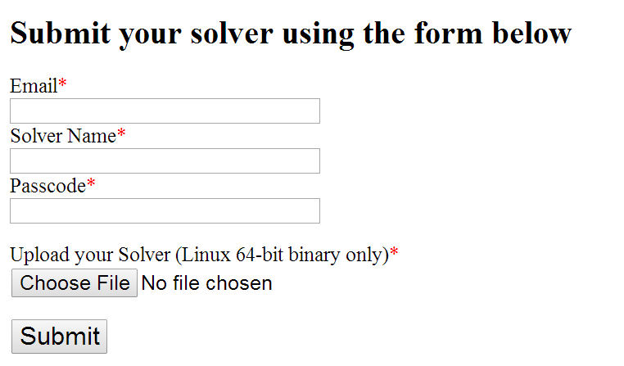
Participation
8 Countries
12 teams
You can submit statically linked Linux 64-bit binaries
Automatically run on Intel i7 machines with 16GB RAM
120 machines (Courtesy of University of Texas at Dallas and the DARPA PPAML program)

Slide 4
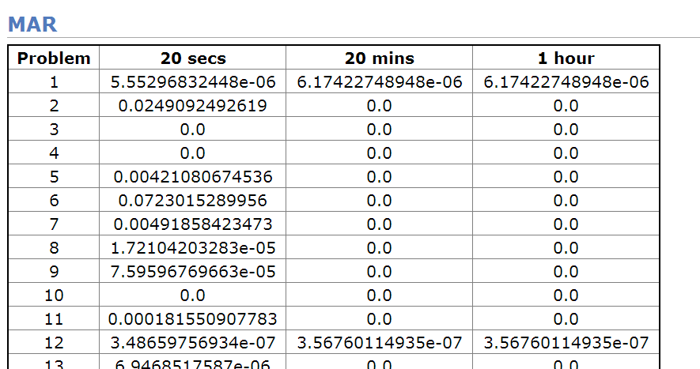
What happens after you submit?
Click here
You see your results

Slide 5
Benchmarks
Approximately 130 problems for each category
Diverse Domains
Grid (Ising models)
Medical Diagnosis
Protein-Protein Interaction
Hard SAT problems
Radio-frequency assignment problems
And so on

Slide 6
Evaluation Metrics used
PR$: |\log\left(Zsolver\right)−log⁡(Zexact)|$
MAR:
Max-absolute error
Hellinger Distance
MAP (and MMAP)
Weight of the assignment output by the solver = $\sum_{i}{log⁡(}φ_{i}(x))$
Relative Gap = abs(best-solver)/abs(best)
MMAP evaluation is harder
MMAP Requires exact inference to compute the weight
Four MMAP problem types
Hard Sum, Hard Optimization
Easy Sum, Hard Optimization
Hard Sum, Easy Optimization (we ran only these types of problems)
Easy Sum, Easy Optimization

Slide 7
Evaluation: Deciding Winners!
Easy if you just have one graphical model and many solvers
The solver with the best score/smallest error wins
Aggregating results and declaring a winner over many problems is hard!
Decision theory.
Borda counts
For each problem
Best solvers get 1 point
Second best solvers get 2 points and so on
Solver with the minimum points wins
Many problems with this scoring
Future research
For MAP Inference, I really don’t know who won!!!

Slide 8
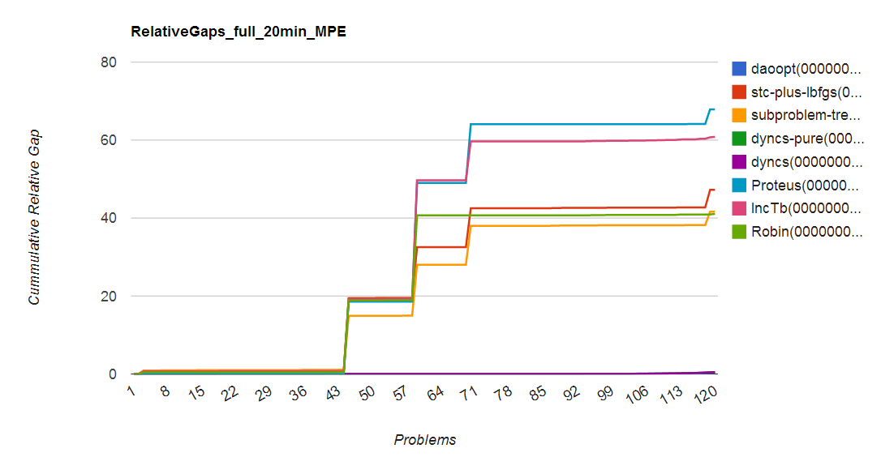
Picking Winners is hard
Dyncs-pure wins, sub-problem tree calibration, close second
Evaluation Criteria: Relative Gap = $\frac{Abs(best−solver)}{Abs(best)}$

Slide 9
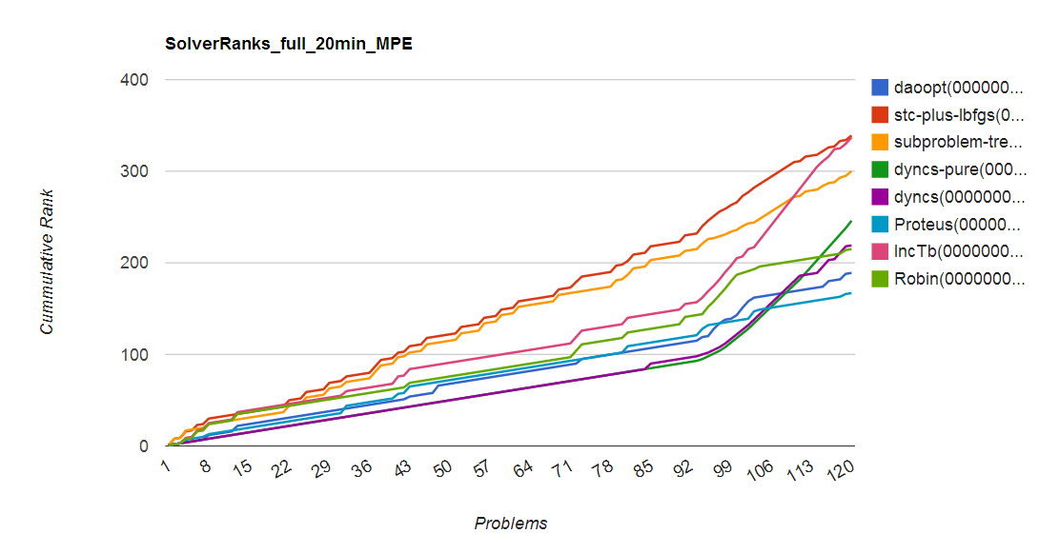
Picking Winners is hard
Proteus wins, daopt is second
Borda count

Slide 10
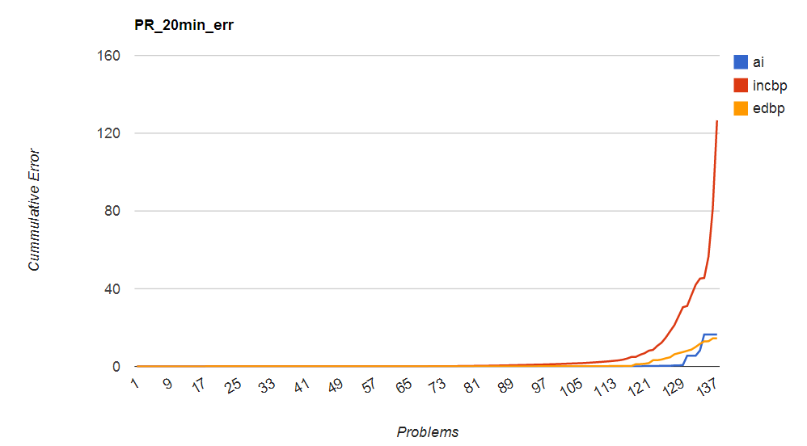
PR Results

Slide 11
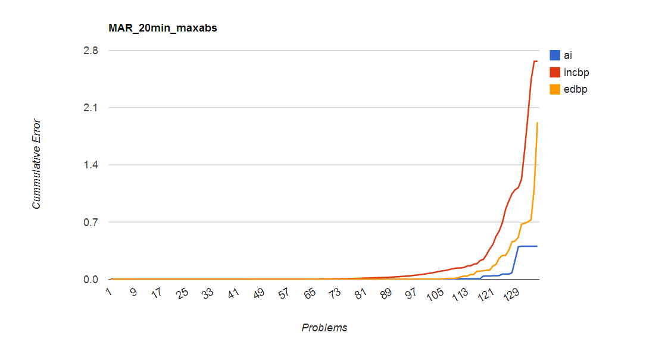
MAR Results

Slide 12
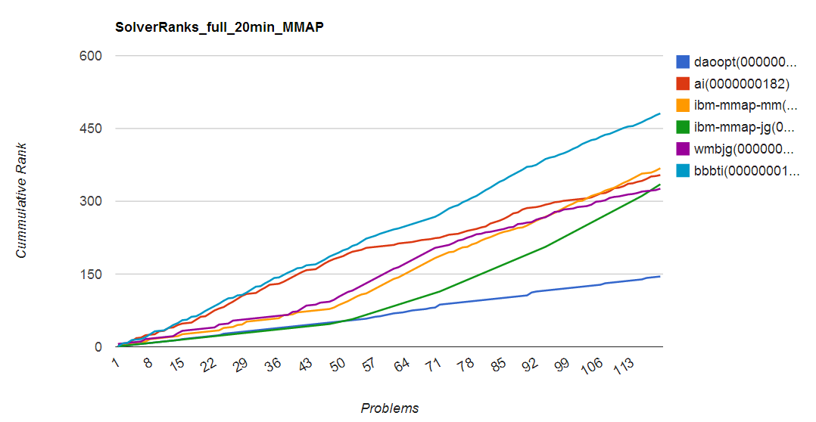
MMAP Results

Slide 13
Winners
 | 20 seconds | 20 minutes | 1 hour
PR
First-prize | Alex Ihler | Arthur Choi | Alex Ihler
Second-prize | Arthur choi | Alex Ihler | Arthur choi
MAR
First-prize | Alex Ihler | Alex Ihler | Alex Ihler
Second-prize | Arthur choi | Arthur choi | Arthur choi
MAP
First-prize | David Allouche | Barry Hurley | Barry Hurley
Second-prize | Barry Hurley | Lars Otten | Lars Otten
Third-prize | David Allouche | David Allouche | David Allouche
MMAP
First-prize | Lars Otten | Lars Otten | Lars Otten
Second-prize | Radu Marinescu | Radu Marinescu | Radu Marinescu

Slide 14
Solver Types
PR and MAR: Generalized Belief propagation based approaches
MAP:
Branch&Bound search
Weighted CSP approaches
Subtree-calibration/LBFGS
MMAP
Branch&Bound search

Slide 15
Post-Competition
We need hard instances for PR and MAR
Recently added a few for PR
OLD/Easier Problems
Hard Problems

Slide 16
Rest of the Session
Winner Certificates
Huayan Wang’s MAP Inference solver
PR and MAR Inference
EDBP
MAP Inference
Radu Marinescu
Barry Hurley
Thank you!!
Amir Globerson, Gal Elidan, Rina Dechter, and Alex Ihler
My students who ran the competition
David Smith, Li Chou, Somdeb Sarkhel, Tahrima Rahman, Srikanth Doss, and Deepak Venugopal.

Slide 17
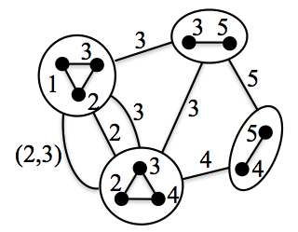
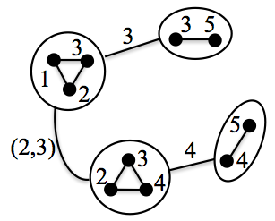
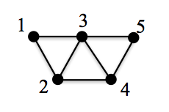
Subproblem tree calibration
Huayan Wang and Daphne Koller
Algorithm
Given MRF (left figure)
Split into subproblems (dual decomposition)
Build a multi-graph with a node for each subproblem (middle figure)
Repeat
Randomly choose a subproblem-tree (right figure)
“Calibrate” the tree by max-product / min-sum message passing
Performed very well; very close to winning
Properties
Each tree calibration is a block coordinate descent step for the dual problem.
The “block” corresponds to all edges in the subproblem-tree.
Subsumes MPLP, TRW-S, and max-sum diffusion as special cases.
Handles larger and more flexible “blocks” than these methods.

Slide 18
Subproblem tree calibration
References
Huayan Wang and Daphne Koller: Subproblem-Tree Calibration: A Unified Approach to Max-Product Message Passing, The 30th International Conference on Machine Learning (ICML 2013)
Huayan Wang and Daphne Koller: A Fast and Exact Energy Minimization Algorithm for Cycle MRFs, The 30th International Conference on Machine Learning (ICML 2013)
Download code at
http://ai.stanford.edu/~huayanw/

