Slide 1
Video Entity Resolution: Applying ER Techniques for Smart Video Surveillance
Liyan Zhang, Ronen Vaisenberg, Sharad Mehrotra, Dmitri V. Kalashnikov
Department of Computer Science
University of California, Irvine
This material is based upon work supported by the NSF grants.

Slide 2
Outline
Person Identification in Smart Video Surveillance
Entity Resolution Problem
RelDC framework for ER
Experiments

Slide 3
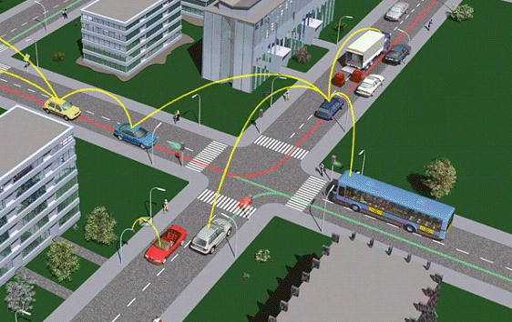
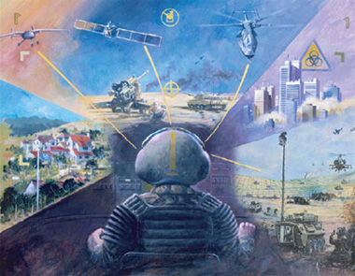
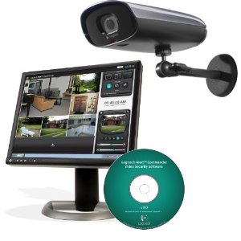
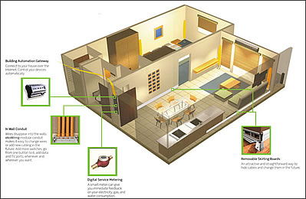
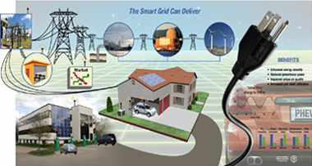
Sensor Driven Applications ..
Numerous physical world domains where sensors are used
  intelligent transportation systems
  reconnaissance
  surveillance
  systems
  smart buildings
  smart grid ...

Slide 4
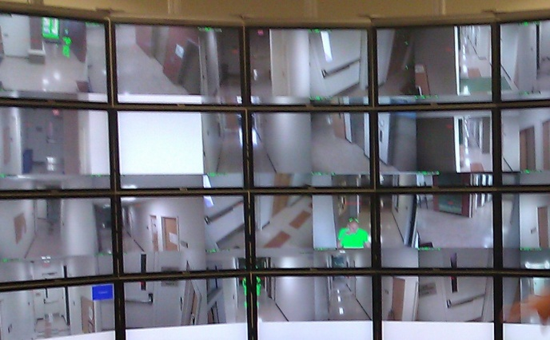
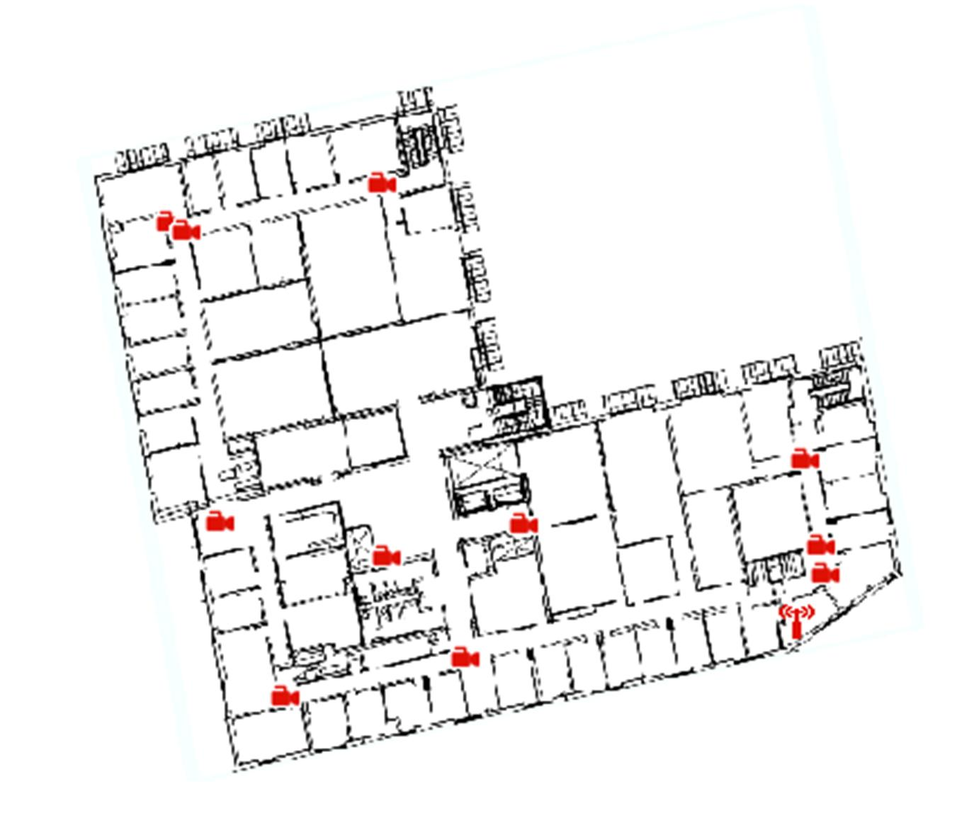




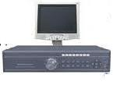
Smart Video Surveillance
We focus on Smart Video Surveillance
  video cameras are installed within
  buildings to monitor human activities
Query/ Analysis
Event
Database
CS Building in UC Irvine
Semantic
Extraction
Surveillance
Video
Database
Video collection

Slide 5
Event Model
Query Examples:
When Sharad left his office on last Friday?
Who is the last visitor to Sharad’s office yesterday?
Query /Analysis
Event model :
when
what
Event
Database
who
Temporal placement
Activity recognition
Face recognition
event
Semantic
Extraction
localization
extraction
Other property
where
Surveillance
Video
Database
Notes:
Draw a couple of applications showing queries over events/analysis.
E.g., detect when the visitor has left sharad’s office, detect when sharad has left his office.

Slide 6
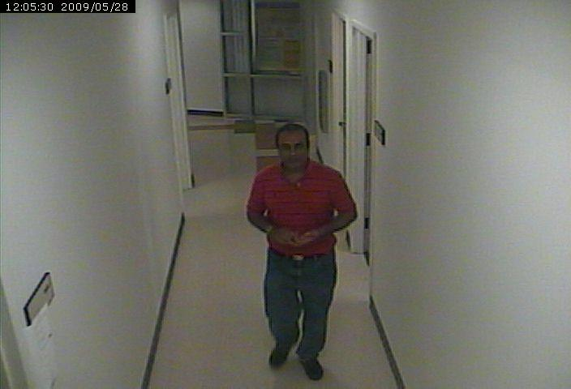
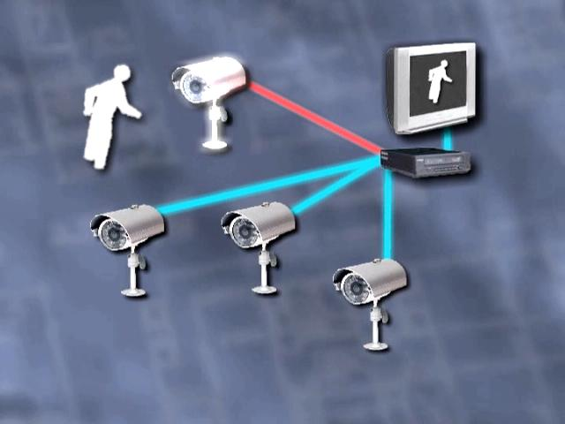
Person Identification Challenge
Bob
？
？
Alice
？
other
Event model :
Person Identification
when
what
who
Temporal placement
Activity recognition
Who ?
Face recognition
event
localization
extraction
Other property
where

Slide 7




Traditional Approach
？
？
？
Traditional
Approach
Face
Detection
Face Recognition
Poor Performance
Detect 70 faces/ 1000 images
2~3 images/ person
Notes:
You need to split this to 3 different slides:
Slide 1: traditional approach to People Identification
face detection → face recognition
Performance: very poor
detection 70 out of 1000 images , recognized only 2-3 images/person

Slide 8
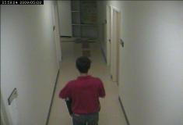
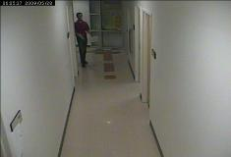
Rationale for Poor Performance
resolution
Sampling
rate
original
performance
original
performance
1 frame/sec
Poor Quality of Data
No faces
Small faces
Low resolution
Low temporal Resolution
1 frame/sec
Drop
to
(original)
Drop
to
70%
53%
1/2 frame/sec
(1/2 original)
Drop
to
Drop
to
30%
35%
1/3 frame/sec
(1/3 original)
Notes:
You need to split this to 3 different slides:
Slide 1: traditional approach to People Identification
face detection → face recognition
Performance: very poor
detection 70 out of 1000 images , recognized only 2-3 images/person

Slide 9


Exploiting Contextual Information
Face Recognition
Failed !!!
activity similar
Time contin-uity
Color similar
Advantages:
-- Additional evidence for People Identification
-- Contextual features may be robust to image quality
-- Color, activity, location, time .. .
Face Recognition
Bob

Slide 10
Contributions
A robust approach to PI in surveillance video by exploiting contextual features.
  Significant improvements over face recognition based technique
  Tolerates degradation in video quality – lower resolution, frame rates, etc.
Key Observation : PI problem in video can be mapped to the entity resolution problem extensively explored in the literature.
  PI problem: subject in video → realworld person
  ER problem: object in database → realworld name
Exploits Relationship based Data Cleaning (RelDC) developed for entity resolution [ACM TODS 2006]
RelDC
Color
Face
Activity
Time & Location
Face detection
Face Recognition
Contextual
Information

Slide 11
RelDC: Entity Relationship Graphs
To solve entity resolution problem, try to construct an entity relationship graph.
⟨P1, ‘Databases . . . ’, ‘John Black’, ‘Don White’⟩
⟨P2, ‘Multimedia . . . ’, ‘Sue Grey’, ‘D. White’⟩
⟨P3, ‘Title3 . . .’, ‘Dave White’⟩
⟨P4, ‘Title5 . . .’, ‘Don White’, ‘Joe Brown’⟩
⟨P5, ‘Title6 . . .’, ‘Joe Brown’, ‘Liz Pink’⟩
⟨P6, ‘Title7 . . . ’, ‘Liz Pink’, ‘D. White’⟩
Entity Resolution
‘Don White’
‘Dave White’
ER Graph:
Node: Entities
Edge: Relationships

Slide 12
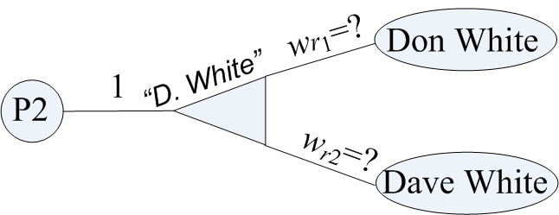
RelDC Framework for Entity Resolution
For each choice node r
  Assigning the value to w_{r1}, w_{r2,}, ... ,w_{rN}
  Value of w_{ri} is degree of belief that y_{ri} is the correct option for r
  Pick the option with the max w_{ri} as its answer for reference r
  Compute w_{r1}, w_{r2,}, ... ,w_{rN} by analyzing connection strength between nodes in the graph
  Connection strength can be based on variety of factors:
    feature-based similarity
    correlations
    Association
    Relationship analysis

Slide 13

Connection between PI and entity resolution
Person Identification
Subject in video
Real-world person name
Shot 1
Bob
Shot 2
Alice
Shot 3
Entity Resolution
Object in database
Real-world
Object name
⟨P1, ‘Databases . . . ’, ‘John Black’, ‘Don White’⟩
⟨P2, ‘Multimedia . . . ’, ‘Sue Grey’, ‘D. White’⟩
⟨P3, ‘Title3 . . .’, ‘Dave White’⟩
⟨P4, ‘Title5 . . .’, ‘Don White’, ‘Joe Brown’⟩
⟨P5, ‘Title6 . . .’, ‘Joe Brown’, ‘Liz Pink’⟩
⟨P6, ‘Title7 . . . ’, ‘Liz Pink’, ‘D. White’⟩
‘Don White’
‘Dave White’

Slide 14
Constructing the ER Graph for PI
Surveillance Videos
Low Level Feature Extraction
Video Segmentation
Foreground Color
Face Recognition
Bounding Box
Event Detection
Shots
Color Histogram
FR Result
Activity
PI relationship graph

Slide 15
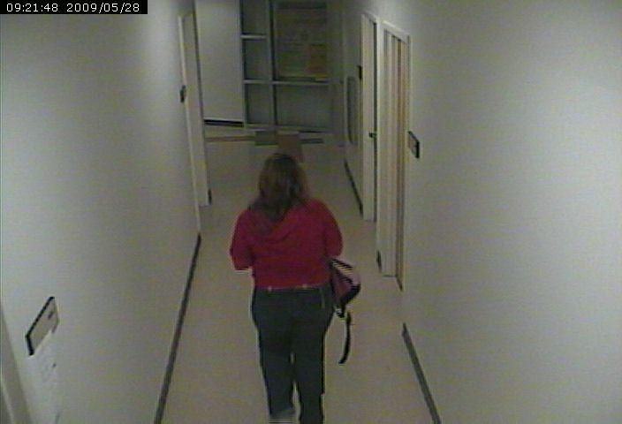
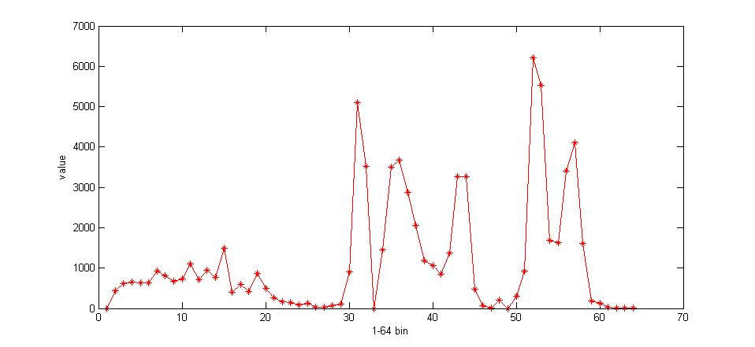
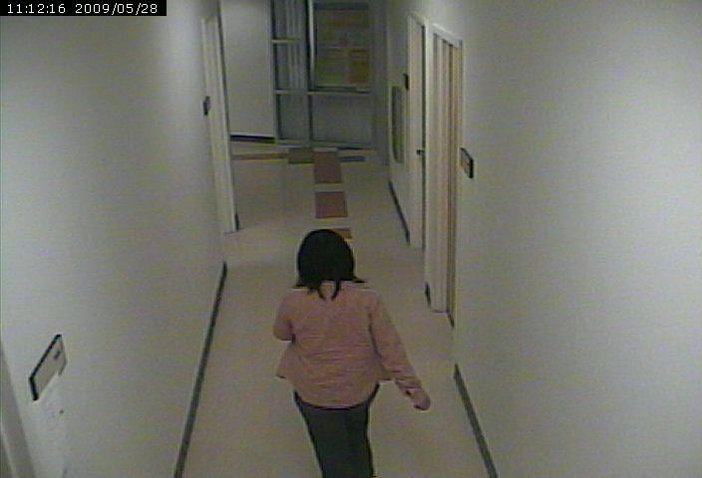
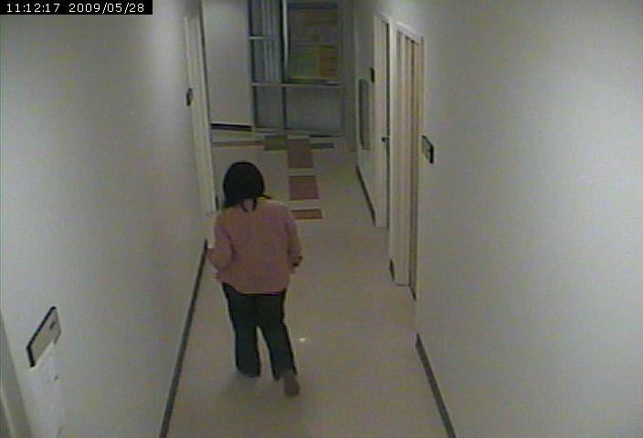
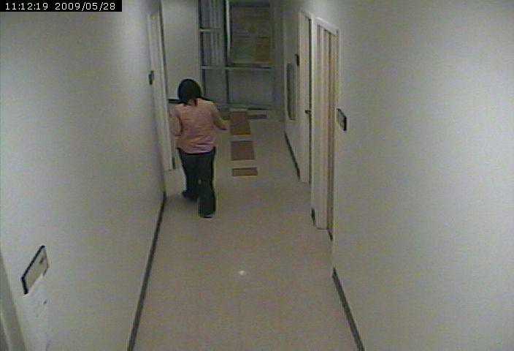
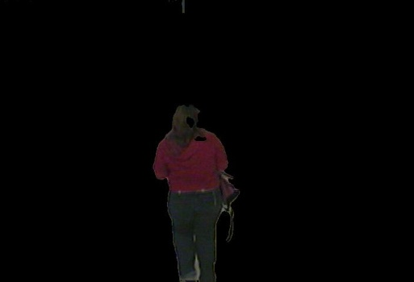
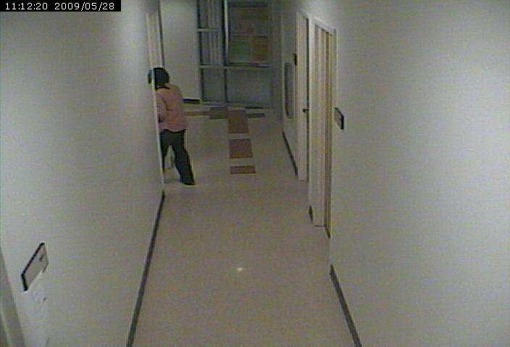
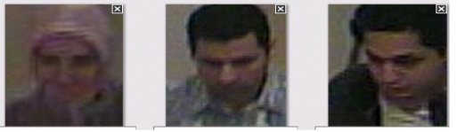
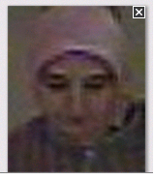
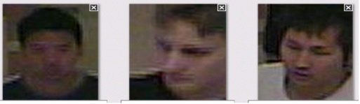
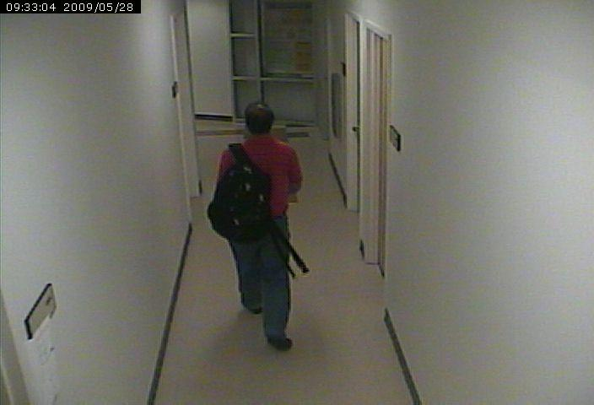
Low Level Feature Extraction
Time Continuity
Videos
Shots
Temporal Segmentation
Color
Continuity
Foreground Color Extraction
64-bin Color histogram
64-bin Color histogram
Face Detection
and Recognition
FR(image, person)=1
Key frame
start
end
Bounding Box and Centroid Extraction
Shot 1

Slide 16
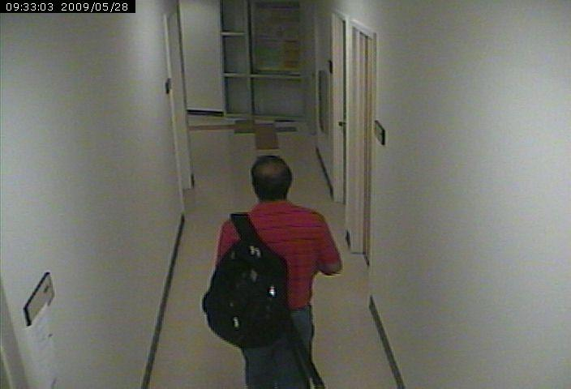
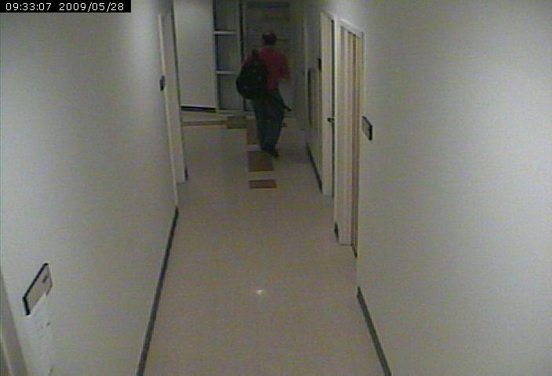
Activity Detection
Walking Direction
Changes of bounding boxes and centroids
Activity Detection
Appear and disappear locations
Observing:
An subject enter/exist Bob’s office frequently
High Probability:
This subject is Bob.
A strong signal in person identification
Downside of Corridor
Walking to
Office in Corner

Slide 17
PI Graph
Time t₁₁
Color Similarity:
Euclidean distance
Shot s1
Time t₁₂
H1
0.2
Subject x₁₂
Subject x11
H₁₂
act1
₂
0.5
0.5
₁
FR result tells:
Subject 2 is “Bob”
0.6
w₂₂
w₁₁
w₁₂
w₂₁
0.4
0.6
Prob. of activity determining entity
Alice
Bob
0.2
0.3
0.7
act3
1
w₃₁
0.5
w₃₂
0.5
₃
Time t3
act2
Subject x2
H₂
0.8
H₃
Subject x3
Shot s3
Shot s2
Time t2
Notes:
Super impose weights w1 w2, on choice node edges.

Slide 18
How to compute weight?
Context Attraction Principle
If the pair <u,v> is more strongly connected than the other pair <u,w>
then the weight between <u,v> should be larger than <u,w>
Delete edges Sim<0.3
Shot s1
0.2
Subject x₁₂
Subject x11
H11
H12
act1
0.5
₁
Who Subject 3 is,
Alice or Bob?
₂
0.5
0.6
0.4
0.6
Bob
0.2
Alice
Bob: 3 paths
Alice: 1 path
So:
W₃₁ <W₃₂
0.3
w₃₂
0.7
w₃₁
₃
act3
0.5
1
0.5
0.8
act2
H2
H3
Subject x3
Subject x2
H₃
Shot s3
Shot s2

Slide 19
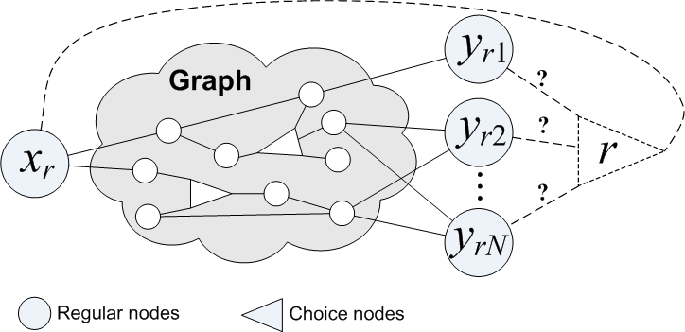
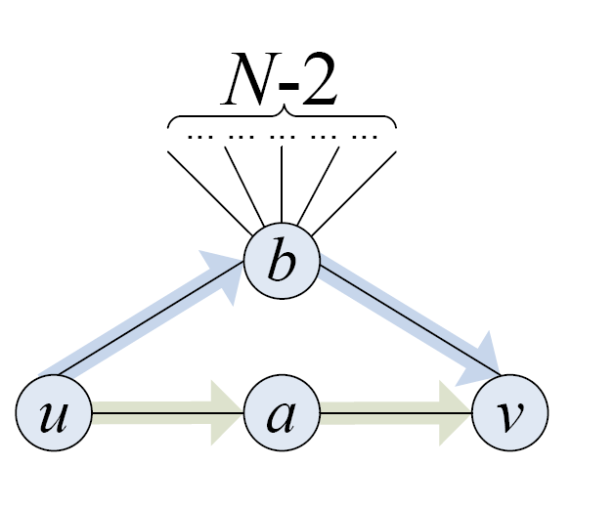
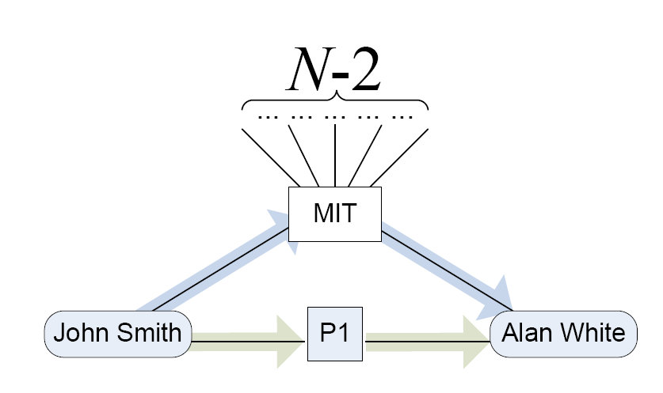
Compute connection strength
Computing Connection Strength
Phase 1: Discover connections
  Find all L-short simple u-v paths
  Bottleneck
  Graph theoretic techniques to optimize
Phase 2: Measure the strength
  In the discovered connections
  Many c(u,v) models are possible
  Random walks in graphs models
Overall generic formula :

Slide 20
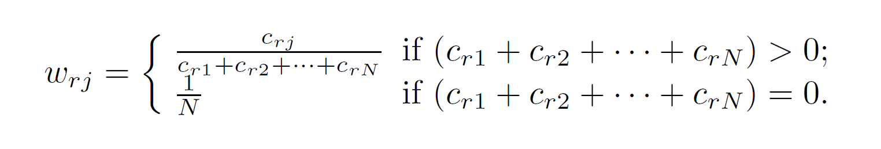
Using connection strength to determine weights
Determine weights
  According to CAP principle
  Proportional to c(x_{r},y_{rj})
Optimization problem
  Slack variables
  Solver
  Iterative solution
  Interpret weights

Slide 21
Dealing with “Others”
Usually, after computing weights, choose the option with max value.
However, in our dataset, for each subject in video
  the weight for “others” is always large
  because there is higher probability that the subject is not the person we are interested in.
Then, how to solve it?
  Learn a classifier based on output of RelDC to other choices.

Slide 22
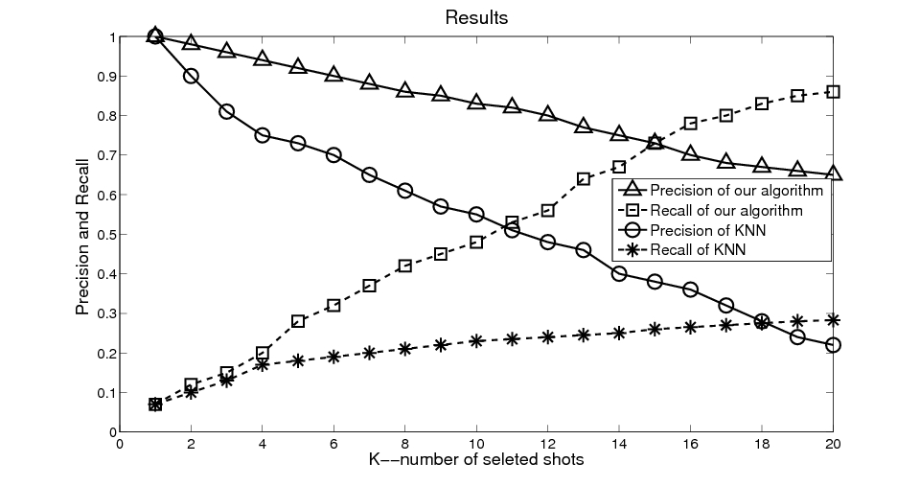
Experiments
Dataset:
  2 weeks surveillance videos from 2 cameras in the CS building of UC Irvine
    Sampling rate: 1 frame/sec
    Frame resolution: 704 *480
    1 week data as training data, 1 week as test data
  About 50 individuals totally
    Manually labeled 4 people
Measurement:
  For each person, select top K subjects
  compute Precision, Recall and F-measure
Comparison with KNN method
  Precision and Recall with K increasing from 1 to20
  F-measure when K=20
    Our approach: 0.76
    KNN:0.24
Our Precision
KNN Precision
Our Recall
KNN Recall
Notes:
Dataset:
We have collected 2 weeks’ surveillance videos from 2 adjacent cameras in the CS Building of UC Irvine.
The sampling rate is 1 frame/second. The resolution of each frame is 704*480. We use the first week’s data as training data, the second week’s data as test data.
There are over 50 people in the surveillance videos. In order to test the performance of the proposed algorithm, we manually labeled 4 people to assign the ground truth labels. From the training data, we get the faces of the chosen 4 people, and train a face recognizer. We also extract activities of people, and compute priors based on activities.
Experimental results:
We have applied RelDC to identify the four people from the testing dataset. After obtaining the weights, for each particular person, we rank the shots based on weights, and select the top-K shots as this person. We notice in the training data, there are almost 10 ~ 20 shots for each person, so we choose K ranging from 1 to 20. We compute the average precision and recall of the 4 people, with K changing from 1 to 20.
We also run KNN (based on color similarity) in the test dataset, and compute precision and recall with K changing from 1 to 20. We also compute F-measure when K=20, our result is 0.76, and KNN is 0.24.
From the result, we find our algorithm is much better than KNN.

Slide 23
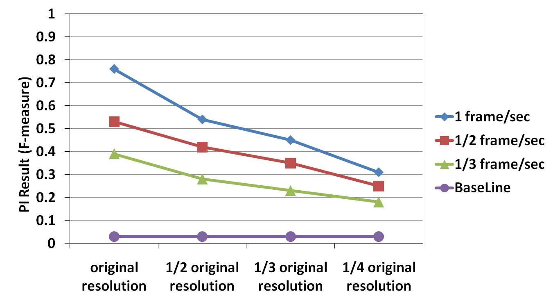
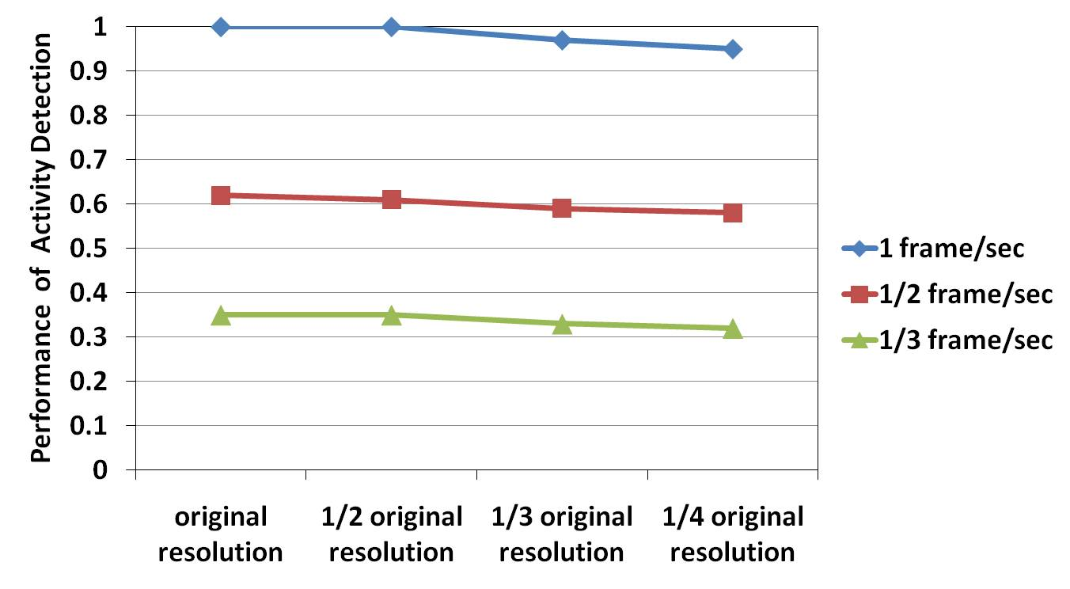
Experiments
To test the robustness of our approach, we degrade the resolution and sampling rate of frames
Performance of activity detection :
  drops when sampling rate reduces from 1 frame/sec to 1/2 and 1/3 frame/sec
  many important frames are lost with the decrease of sampling rate
  decrease of resolution does not affect the performance of activity detection
person identification result
(F-measure when k = 20):
  drops with the reduction of resolution and sampling rate
  However, PI result even with the lowest resolution and sampling rate is much better than the baseline results (Naive Approach)
Notes:
To test the robustness of our approach, we degrade the resolution and sampling rate of frames in our dataset respectively, and run a series of experiments on such dataset.
From the first figure, we can see that the performance of activity detection (suppose the performance with the original resolution and sampling rate is 100%) drops when sampling rate reduces from 1 frame/sec to 1/2 and 1/3 frame/sec, because many important frames are lost with the decrease of sampling rate, however, the decrease of resolution does not affect the performance of activity detection since the contextual information (such as time and location) does not change, and the extraction of bounding box and centriod does not rely on resolution.
The second figure illustrates that person identification result (F-measure when k = 20) drops with the reduction of resolution and sampling rate, due to the lost of activity and color information. However, PI result of our algorithm even with the lowest resolution and sampling rate is much better than the baseline results of Naive Approach (which predicts results just based on the occurrence probability in the training dataset).
Consequently, the result demonstrates the robustness of our approach with low quality video data, because our approach leverages contextual data rather than merely relying on the quality of video data.

Slide 24
Conclusion and Future work
Conclusion
  Task: person identification in the context of Smart Video Surveillance
  Convert an indoor person identification problem into entity resolution problem
  Apply RelDC to solve PI problem
  Experiments demonstrate the effectiveness and robustness of the approach
Future work
  Mine the frequent activity pattern to identify a person
  Construct a multi-sensor model
  Identify person in real time

Slide 25
Thank You

