Slide 1
Quality-aware Data Collection in Energy Harvesting WSN
Nga Dang
Elaheh Bozorgzadeh
Nalini Venkatasubramanian
University of California, Irvine
Notes:
Good afternoon everyone, my name is Nga. Today I’m going to present my research with Professor Elaheh and Professor Nalini. I’m hope this is related and useful to our current effort in CPS project.

Slide 2
Outline
Introduction
  Energy harvesting
  Battery-operated vs. Energy Harvesting systems
Energy Harvesting Wireless Sensor Network
  Data Collection Application
  Quality of data model
  Quality-aware Energy Harvesting Management
Notes:
First I will give a quick introduction about energy harvesting and compare the differences between a traditional battery-operated system and an energy harvesting systems. From there, we will see both opportunities and challenges that energy harvesting systems create. In the second part, we focus on our system model of the wireless sensor network with energy harvesting capability. We describe the data collection application running on a typical sensor network and our model of quality of data. Finally we explain how our proposed framework manages energy harvesting in the system and maximizes quality of data at the same time.

Slide 3
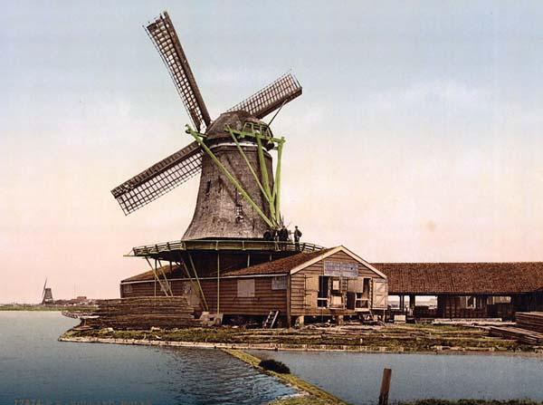
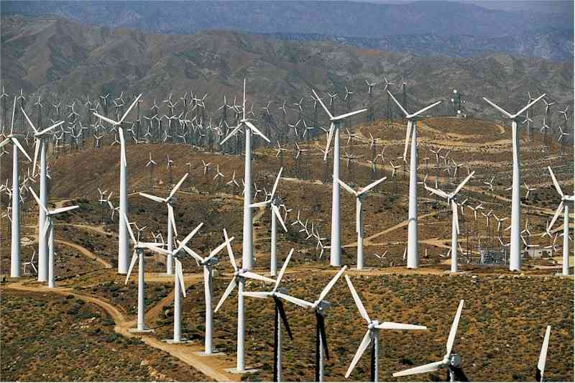
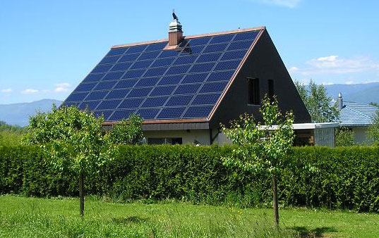

Introduction
Energy harvesting
  Harvesting energy from surrounding environments
  It’s not new!
Notes:
Energy harvesting systems are systems which are able to harvest energy from the surrounding environment. Renewable sources in the environment include wind, solar, kinetic, vibration energy. It’s not a new concept as people have tried to harvest energy since thousand years ago in the original form of windmill. Recently, technology has been developed to harvest energy from multiple sources with higher efficiency and at a larger scale. Interest in energy harvesting is rising quickly due to search for alternative sources of green energy. It has many advantages but also shortcoming which we will present in the next slide, comparing a traditional battery-operated system and an energy harvesting system.

Slide 4
Battery-operated vs. Energy Harvesting Systems
Features | Battery-Operated Systems | Energy Harvesting Systems
Energy Source | Charged battery | Surrounding environment
Maintenance cost | High, require frequent recharge and replacement of battery | Low, self-sustaining
System requirement | Energy efficient, prolong system’s lifetime | Energy-neutral
Quality of service | As low as possible/acceptable | As high as possible
Predictability | High, battery models | Low, fluctuation

Slide 5
Energy Harvesting Prediction
Solar energy is predictable
  “Adaptive Duty Cycling for Energy Harvesting Systems”,Jason Hsu et. al, International Symposium of Low Power Electrical Design’06
  “Solar energy harvesting prediction algorithm”, J. Recas, C. Bergonzini, B. Lee, T. Simunic Rosing, Energy Harvesting Workshop, 2009
  History data, seasonal trend, daily trend, weather forecast
  Predicting energy harvesting every 30 minutes with high accuracy

Slide 6
Outline
Introduction
  Energy harvesting
  Battery-operated vs. Energy Harvesting WSN
Energy Harvesting Wireless Sensor Network
  Data Collection Application
  Quality of services Model
  Quality-aware Energy Harvesting Management

Slide 7
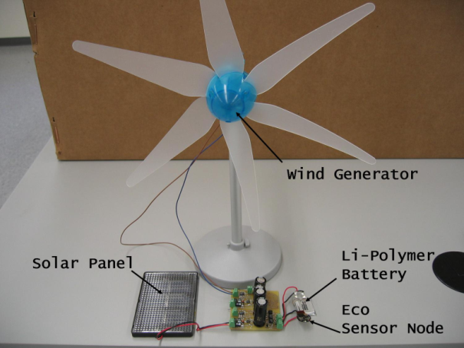
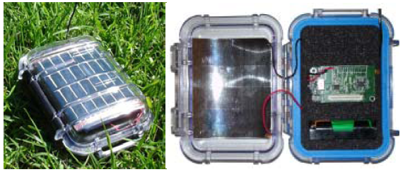
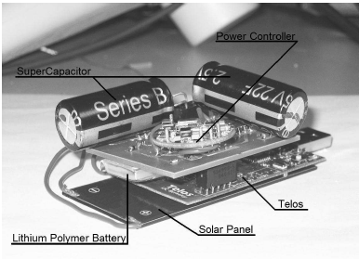
Energy Harvesting
Wireless Sensor Network
Motes capable of harvesting solar and wind
Ambimax/Everlast
Heliomote: powering Mica/Telos
Prometheus: Self-sustaining Telos Mote
Notes:
TODO: Paper references

Slide 8
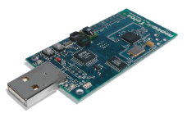
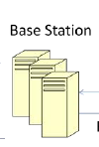
Energy Harvesting
Wireless Sensor Network
Distributed Energy
Harvesting Model
Centralized Energy
Harvesting Model

Slide 9
Energy Harvesting
Wireless Sensor Network
Data Collection
  Each node records sensor value and sends update to base station
  Server receives external queries, asking
  data from sensor nodes
  Communication is costly
  Trade-off between data quality and energy
Queries

Slide 10
Quality of Data Model
Quality of Data Model
  Accuracy of data
  Query responsiveness
  Situation-aware quality requirement
    Timing-based: day vs. night
    Threshold-based: high temperature vs. low temperature, humid vs. dry
    Emergencies: fire, explosion
    Security-based: tracking authority vs. non-authority
Energy Harvesting WSN
  Prediction of energy harvesting
  Use energy in a smart way to achieve best quality of services

Slide 11
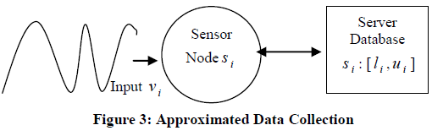
Approximated Data Collection
Exploit error tolerance/margin
  Lots of applications can tolerate a certain degree of error
  Example: temperature of a given region (+/- 2 Celsius)
Approximated Data Collection
  For each sensor data: e is a given margin
  u is value reading on sensor node
  v is cached value on server node
  Requirement: Error margin is within bound
|v – u| < e

Slide 12
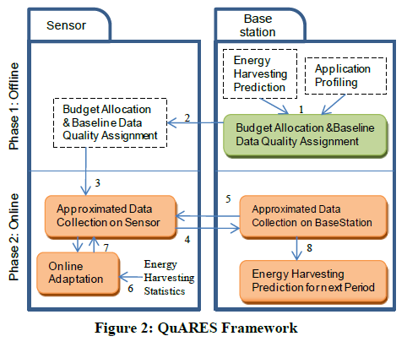
Quality-Aware Energy Management in Energy Harvesting WSN

Slide 13
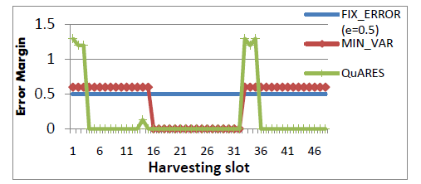
Experimental result
Compare our approach against other approaches
  QuARES: our approach
  MIN_VAR
  FIX_ERROR

