Slide 1
Social Networks
Some content from Ding-Zhu Du, Lada Adamic, and Eytan Adar

Slide 2
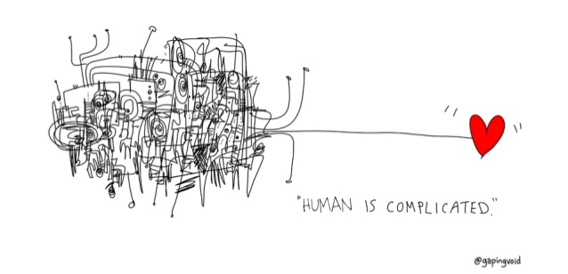
Thesis
There is much to learn from the interaction between computer science and social science, to study social networks from the lens of computer science.

Slide 3
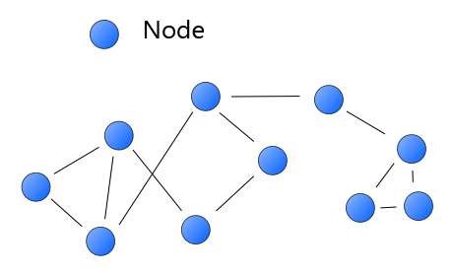
What is a Network?
A network consists of two or more nodes that are linked in pairs.
Notes:
A network contains a set of nodes, or points, connected by links. The nodes can share infor via links.

Slide 4
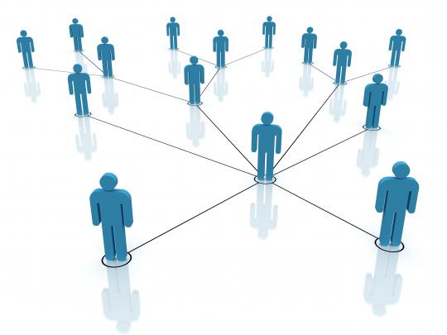
Social Network
Nodes are people (called “actors” or “vertices”)
Links (called “ties” or “edges”) are relationships

Slide 5
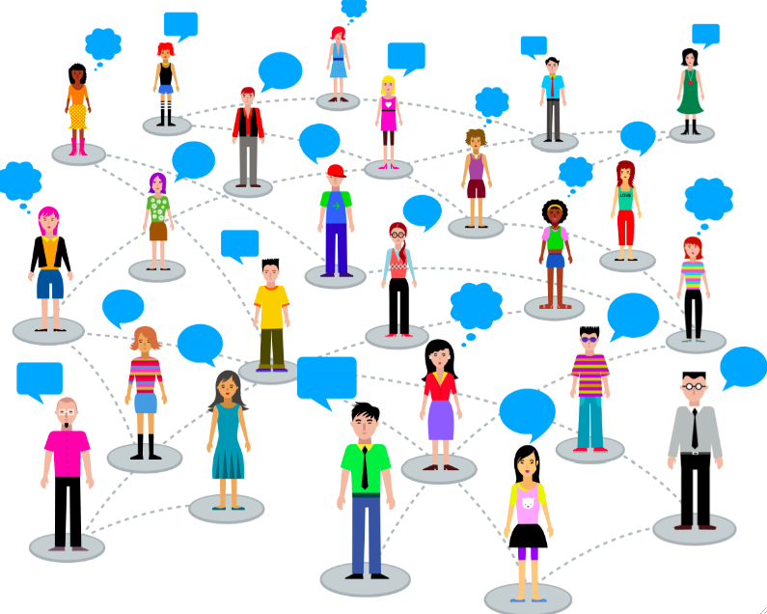
Example 1: Friendship Network
Nodes: all persons in some community
A link exists between two persons if they are friends.

Slide 6
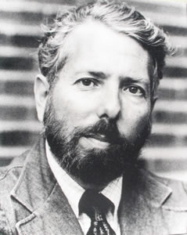
Property of Friendship
Six Degrees of Separation
Milgram (1967)
The experiment:
Random people from Nebraska were to send a letter (via intermediaries) to a stock broker in Boston.
Could only send to someone with whom they know.
Stanley Milgram (1933-1984)
Notes:
In the network of people’s social relation, there is a theory, called Six Degree of Separation, that everyone and everything is six or fewer steps away.
a brilliant psychologist, The goal was to measure the number of steps for the letters to reach the broker.

Slide 7
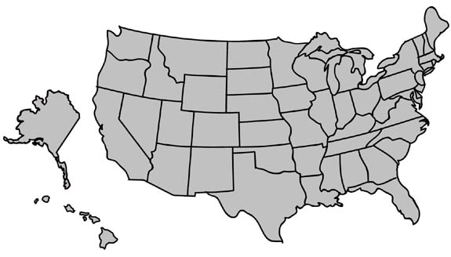
Small world experiment
MA
NE
Milgram’s experiment (1960’s):
Given a target individual and a particular property, pass the message to a person you correspond with who is “closest” to the target.
“Six degrees of separation”

Slide 8

Small World Network
“A small world network is a type of mathematical graph in which most nodes are not neighbors of one another, but most nodes can be reached from every other by a small number of hops or steps.” - Wikipedia

Slide 9
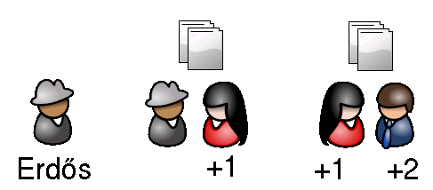
Example 2: Coauthorship Network
Nodes: all publication authors
A link exists between two authors if they are coauthors in a publication.

Slide 10
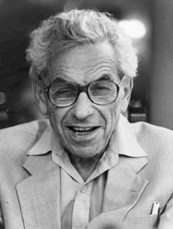
Coauthorship Network is a Small World Network
Distribution in Dec.2010
Erdős number: is the collaboration distance with mathematician Paul Erdős.
Erdös number 0 --- 1 person
Erdös number 1 --- 504 people
Erdös number 2 --- 6593 people
Erdös number 3 --- 33605 people
Erdös number 4 --- 83642 people
Erdös number 5 --- 87760 people
Erdös number 6 --- 40014 people
Erdös number 7 --- 11591 people
Erdös number 8 --- 3146 people
Erdös number 9 --- 819 people
Erdös number 10 --- 244 people
Erdös number 11 --- 68 people
Erdös number 12 --- 23 people
Erdös number 13 --- 5 people
* Two persons are linked if they are coauthors of an article.
What is your Erdős number?

Slide 11
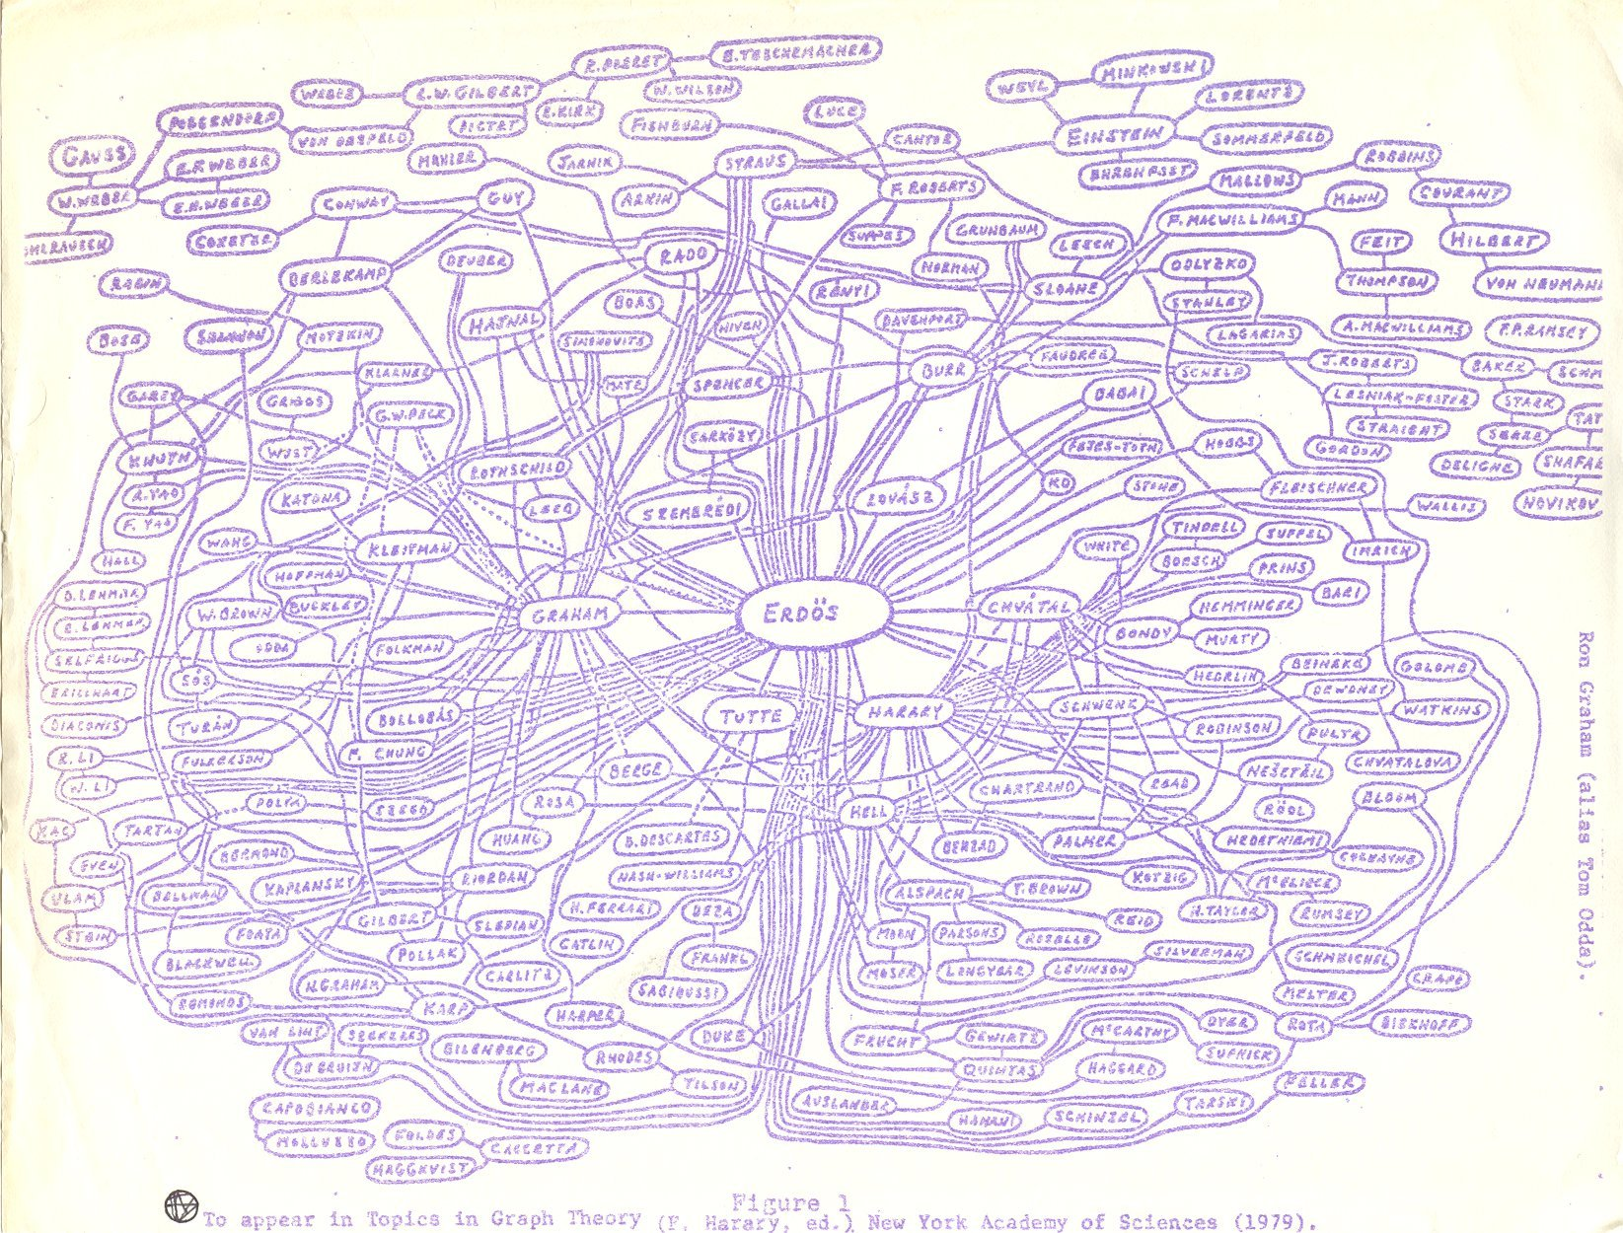

Slide 12
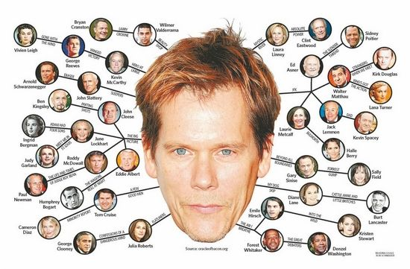
Bacon Numbers

Slide 13
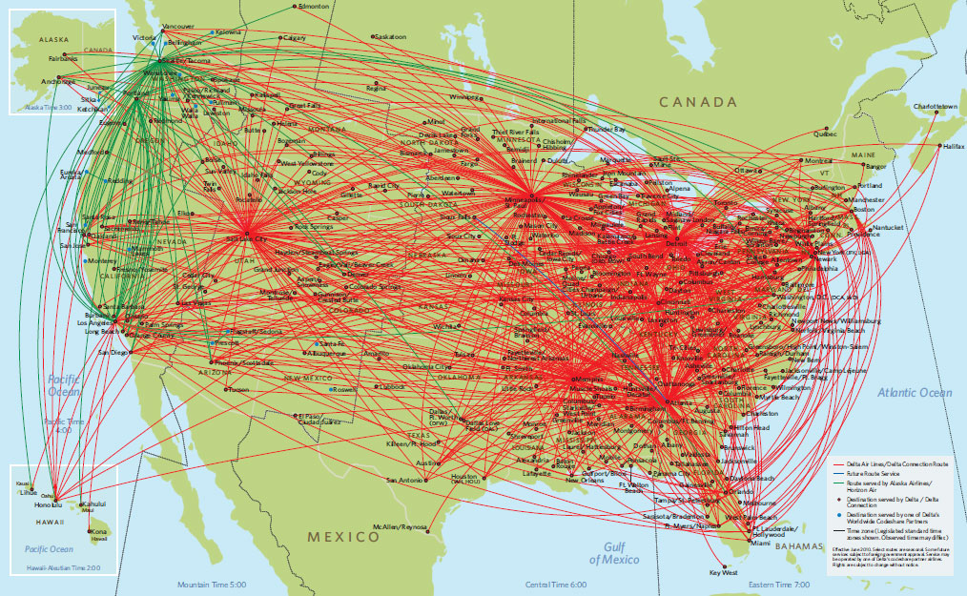
Example 3:
Flight Map Is a Small World Network
Nodes: all cities with an airport.
A link exists between two cities if there exists a direct flight between them.
Notes:
Every two airports can be connected by a few flights even internationally.
Searching cheap airline ticket can be formulated into a shortest path problem in a social network.

Slide 14
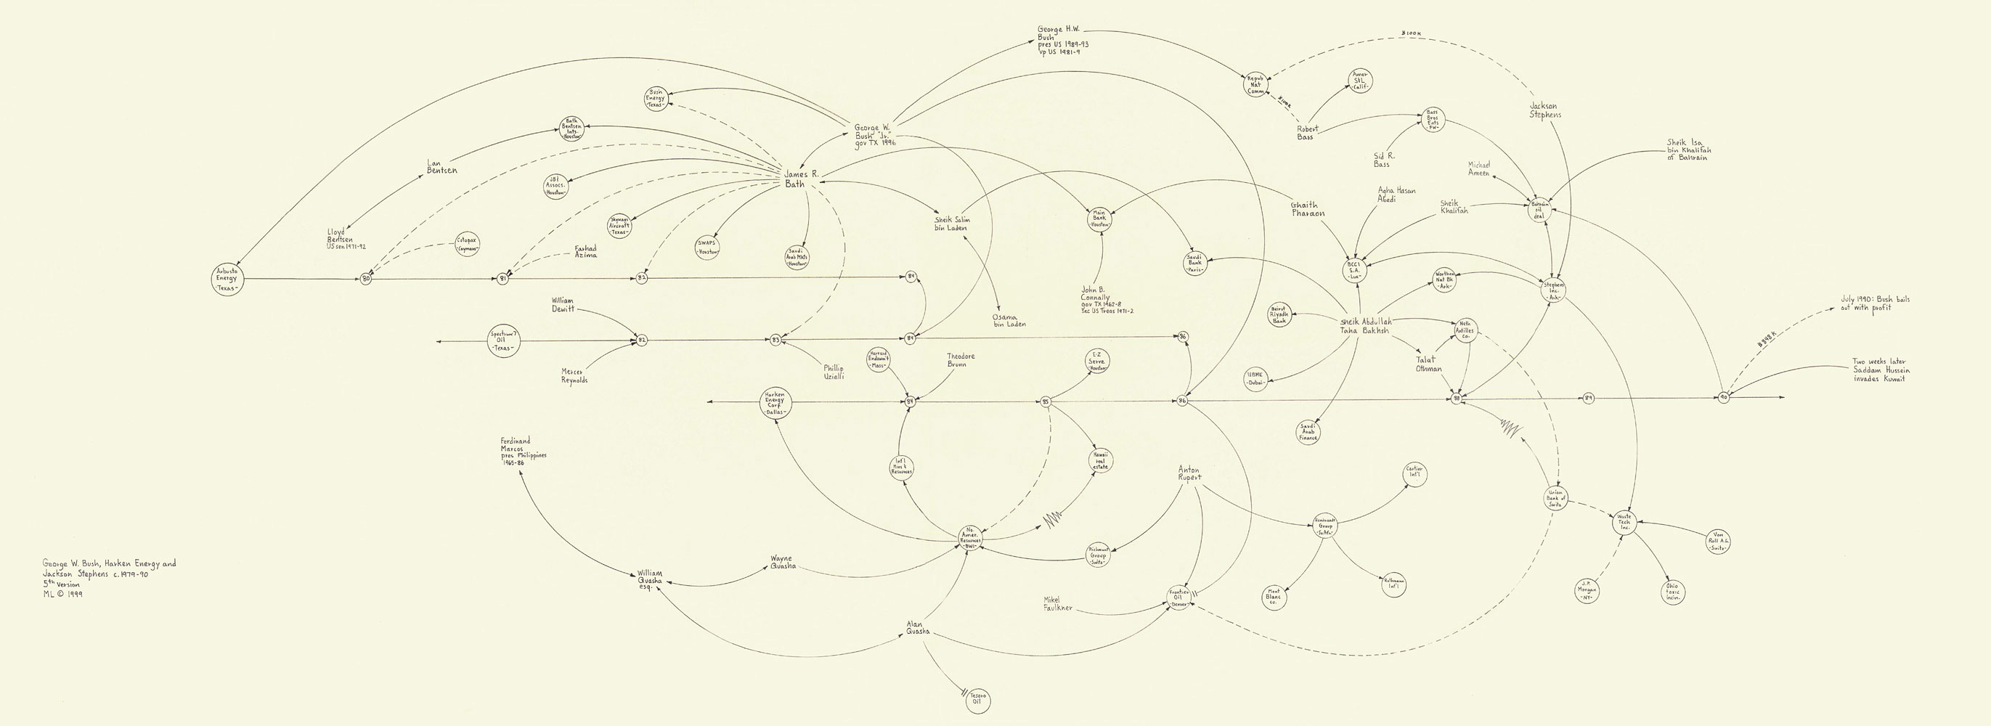
Mark Lombardi Drew Conspiracy Networks

Slide 15
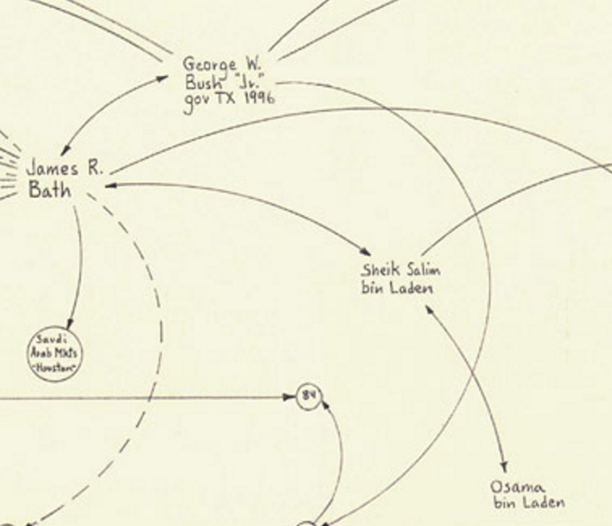
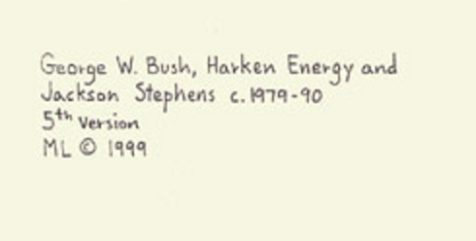
Mark Lombardi Drew Conspiracy Networks

Slide 16
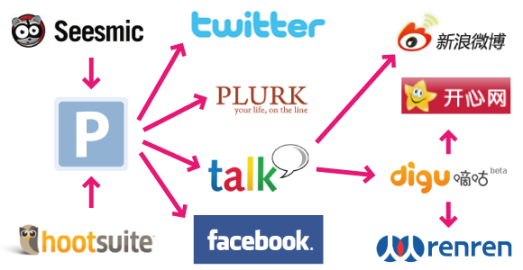
Social Influence
Social influence occurs when one's emotions, opinions, or behaviors are affected by others.
Although social influence is possible in the workplace, universities, communities, it is most popular online.

Slide 17
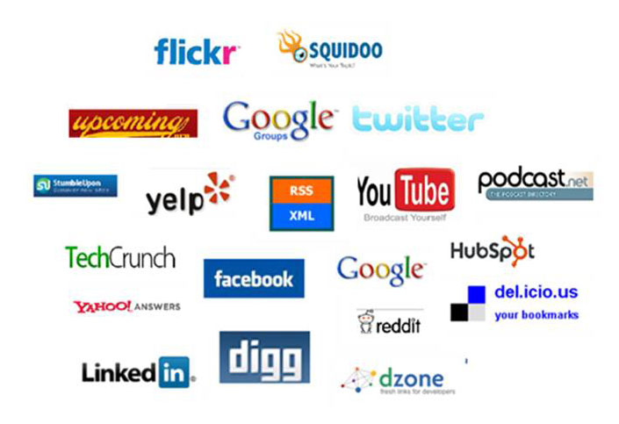
The Internet provides a platform to create and study social networks
Notes:
help in creating Social Networks。

Slide 18
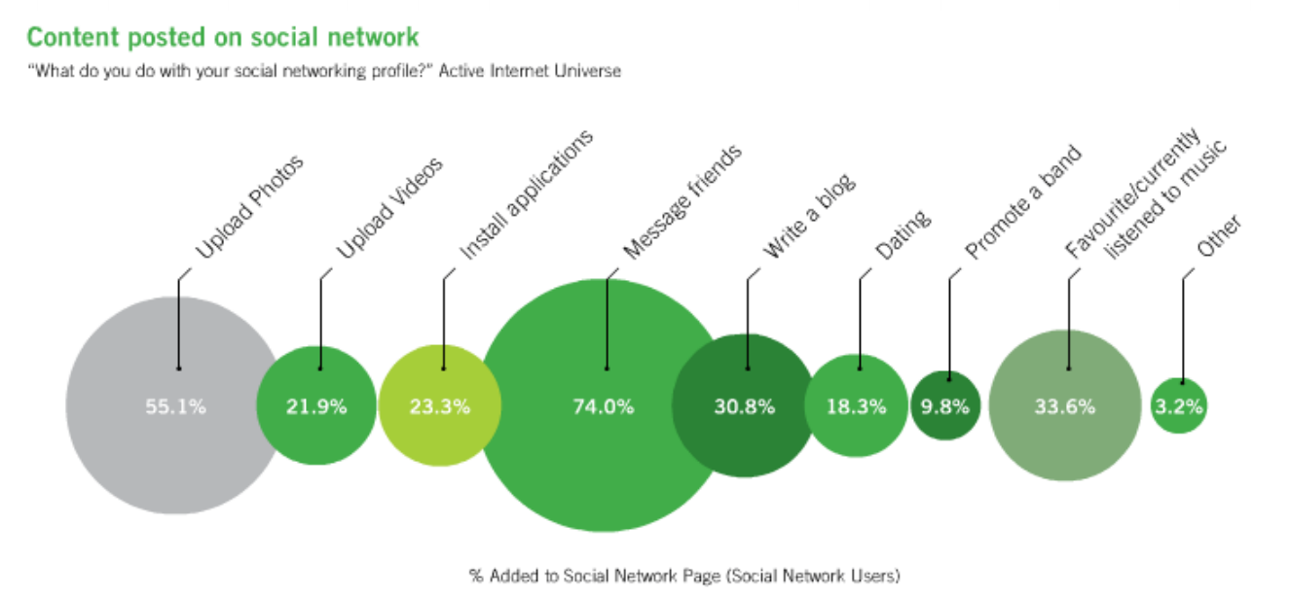
What Are Online Social Networks Used For?
Notes:
Activity of social network users. Content posted on social network: what do you do with your social networking profile? everything can be recorded

Slide 19

Question 1?
Does Six Degrees of Separation imply six degrees of influence?
Notes:
Being connected via six degrees of
separation doesn’t mean that these
connections are socially meaningful.
Influence in social networks has a limited,
finite range.
Actually, influence dissipates as a function of
distance, for some social processes
influence may permeate up to 3 degrees.

Slide 20
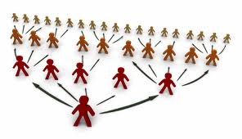
Three
Three Degrees of Influence
The influence of actions ripples through networks 3 hops (to and from your friends’ friends’ friends).
Notes:
Everything we do or say tends to ripple through our network, having an impact on our friends (one degree), our friends’friends (two degrees), and even our friends’ friends’ friends (three degrees). Our influence gradually dissipates and stops after three degrees.
They from various domains, such as gaining weight, happiness, and politics.

Slide 21




I am happy!
Notes:
If I can affect my friends, then affect my friends' friends, and so on.
However, the effect seems to no longer be meaningful after three steps.

Slide 22
Question 2?
How to explain Six Degrees of Separation and Three Degrees of Influence?

Slide 23
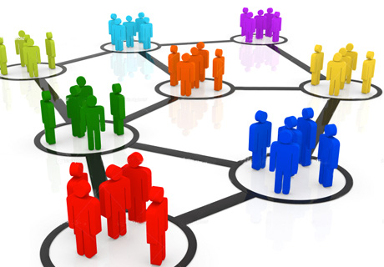






Community
People in a same community share common interests in
- clothes, music, beliefs,
movies, food, etc.
Influence each other strongly.
Notes:
People in a same community share common interests in the same brand of clothes, same kind of music, movies, food, etc.
They influence each other strongly. Therefore, within three steps, the influence is strong.
When companies focus first on meeting the needs of the people they serve, they don’t have to spend big money to attract new customers. And when they stay close to their communities they don’t need market research to tell them what people want.
innovation

Slide 24
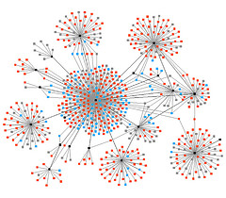
Power Laws
Less nodes with higher degree and more nodes with lower degree.
All peoples are surround leaders.

Slide 25
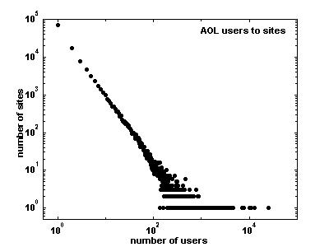
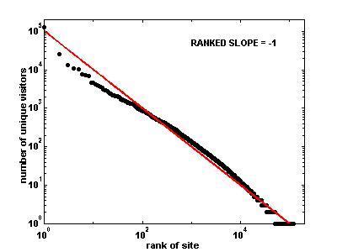
Examples of Power Laws
Distribution of users among web sites
Sites ranked by popularity

Slide 26
Power Laws (Scale-Free Networks)
Power-law
  A scale-free network is a network whose degree distribution follows a power law, at least asymptotically.
  That is, the fraction P(k) of nodes in the network having k connections to other nodes goes for large values of k as
  P(k) ~ x^{-k}
  Typically k is in the range from 2 to 3.
  Many networks have been reported to be scale-free.

Slide 27
Barabási & Albert (BA)
Random Graph Model
Very simple algorithm to implement
  start with an initial set of m₀ fully connected nodes
    e.g. m₀ = 3
  now add new vertices one by one, each one with exactly m edges
  each new edge connects to an existing vertex in proportion to the number of edges that vertex already has → preferential attachment

Slide 28
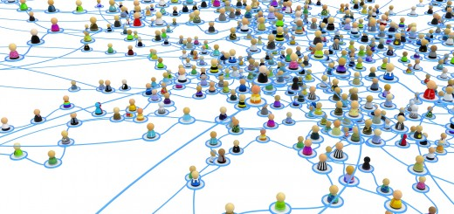
Common Tasks
Measuring “importance”
Diffusion modeling
Clustering
Structure analysis
Privacy

Slide 29
Centrality Measures
Degree centrality
  Edges per node (the more, the more important the node)
Closeness centrality
  How close the node is to every other node
Betweenness centrality
  How many shortest paths go through the edge node (communication metaphor)

Slide 30
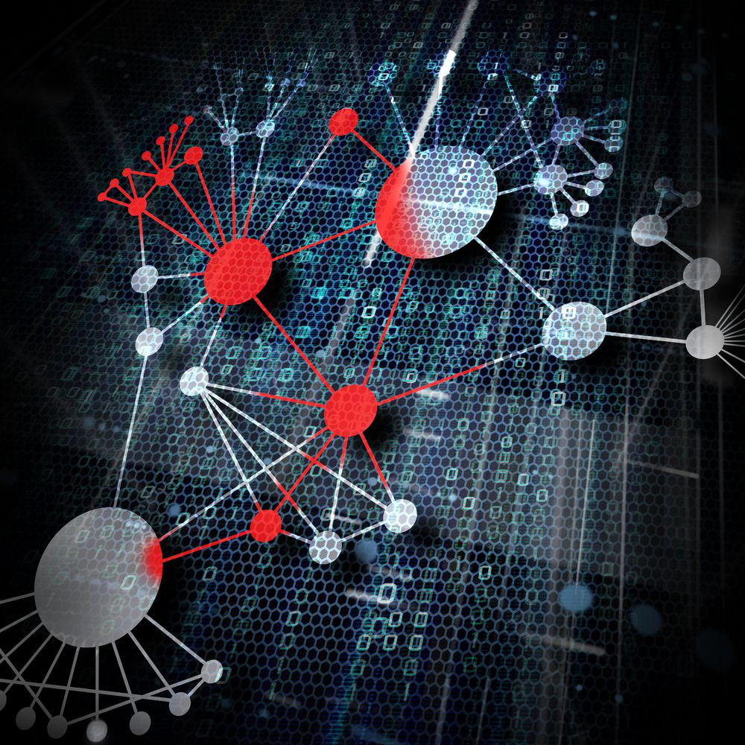
Virus/Disease Spread
Diffusion through networks:
  Biological viruses in friendship networks
  STDs in sexual networks
  Needle sharing in drug user networks
  Computer viruses in computer networks

Slide 31
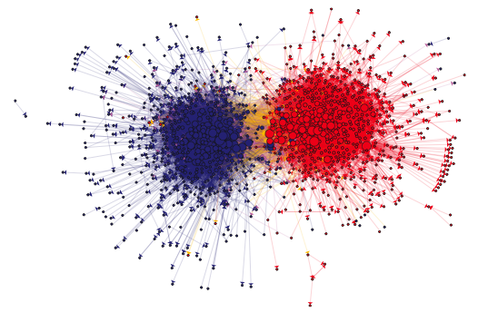
Clustering

Slide 33
Looking for Connection Patterns

Slide 34
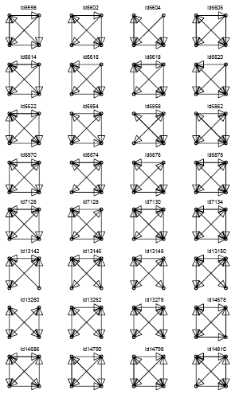
Looking for Connection Patterns

Slide 35
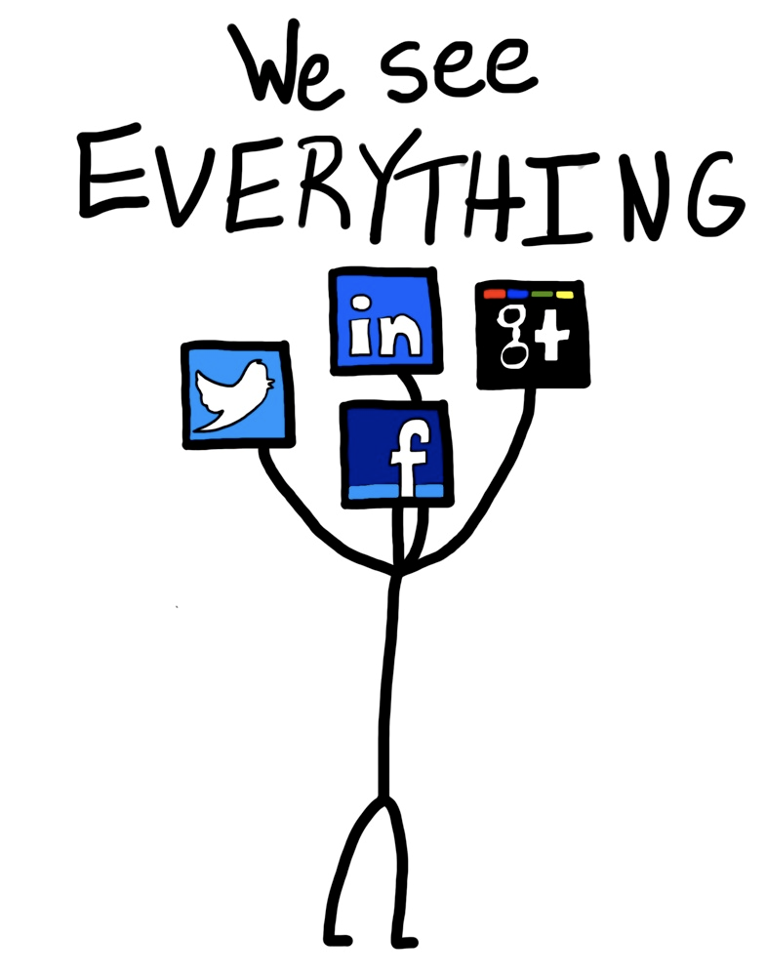
(Lack of) Privacy
Privacy in social networks is hard.
You can be identified by your friends.
Your data is being collected and stored everywhere you go.

