Slide 1
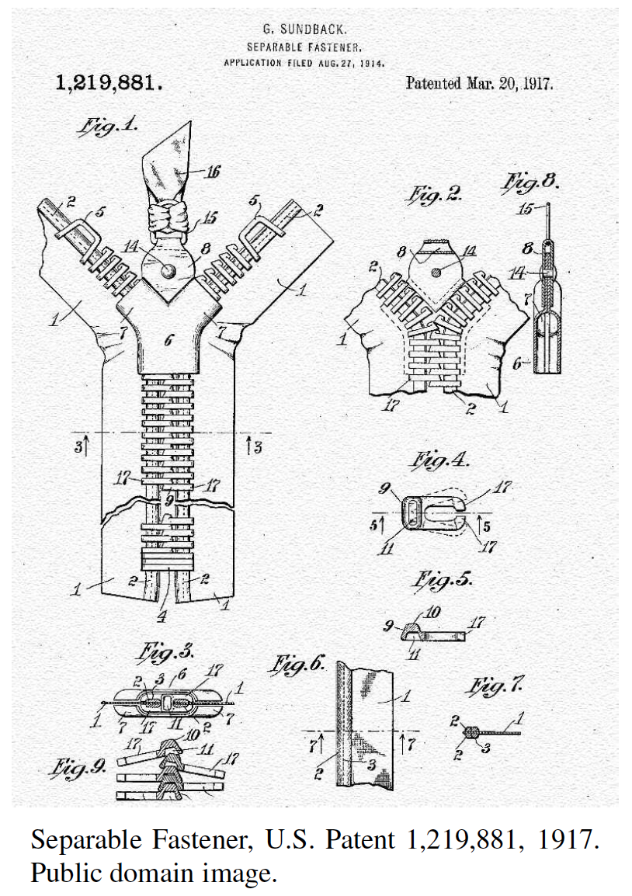
Merge Sort
Presentation for use with the textbook, Algorithm Design and Applications, by M. T. Goodrich and R. Tamassia, Wiley, 2015

Slide 2
Application: Internet Search Engines
Sorting has a lot of applications, including uses in Internet search engines.
Sorting arises in the steps needed to build a data structure, known as the inverted file or inverted index, that allows a search engine to quickly return a list of the documents that contain a given keyword.
Word | Document Number & word location
banana | 1:3, 2:45
butterfly | 2:15, 3:12
camel | 4:40
dog | 1:60, 1:70, 2:22, 3:20, 4:11
horse | 4:21
pig | 2:55
pizza | 1:56, 3:33
Documents

Slide 3
Application: How Sorting Builds an Internet Search Engine
To build an inverted file we need to identify, for each keyword, k, the documents containing k.
Bringing all such documents together can be done simply by sorting the set of keyword-document pairs by keywords.
This places all the (k, d) pairs with the same keyword, k, right next to one another.
From this sorted list, it is then a simple computation to scan the list and build a lookup table of documents for each keyword that appears in this sorted list.
Word | Document Number & word location
banana | 1:3, 2:45
butterfly | 2:15, 3:12
camel | 4:40
dog | 1:60, 1:70, 2:22, 3:20, 4:11
horse | 4:21
pig | 2:55
pizza | 1:56, 3:33
Documents

Slide 4
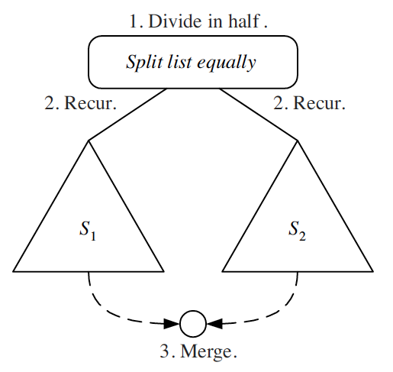
Divide-and-Conquer
Divide-and conquer is a general algorithm design paradigm:
Divide: divide the input data S in two disjoint subsets S₁ and S₂
Recur: solve the subproblems associated with S₁ and S₂
Conquer: combine the solutions for S₁ and S₂ into a solution for S
The base case for the recursion are subproblems of size 0 or 1

Slide 5
Merge-Sort
Merge-sort is a sorting algorithm based on the divide-and-conquer paradigm
Like heap-sort
It has O(n log n) running time
Unlike heap-sort
It does not use an auxiliary priority queue
It accesses data in a sequential manner (suitable to sort data on a disk)

Slide 6
The Merge-Sort Algorithm
Merge-sort on an input sequence S with n elements consists of three steps:
Divide: partition S into two sequences S₁ and S₂ of about n/2 elements each
Recur: recursively sort S₁ and S₂
Conquer: merge S₁ and S₂ into a unique sorted sequence
Algorithm mergeSort(S)
Input sequence S with n elements
Output sequence S sorted
according to C
if S.size() > 1
(S₁, S₂) ← partition(S, n/2)
mergeSort(S₁)
mergeSort(S₂)
S ← merge(S₁, S₂)

Slide 7
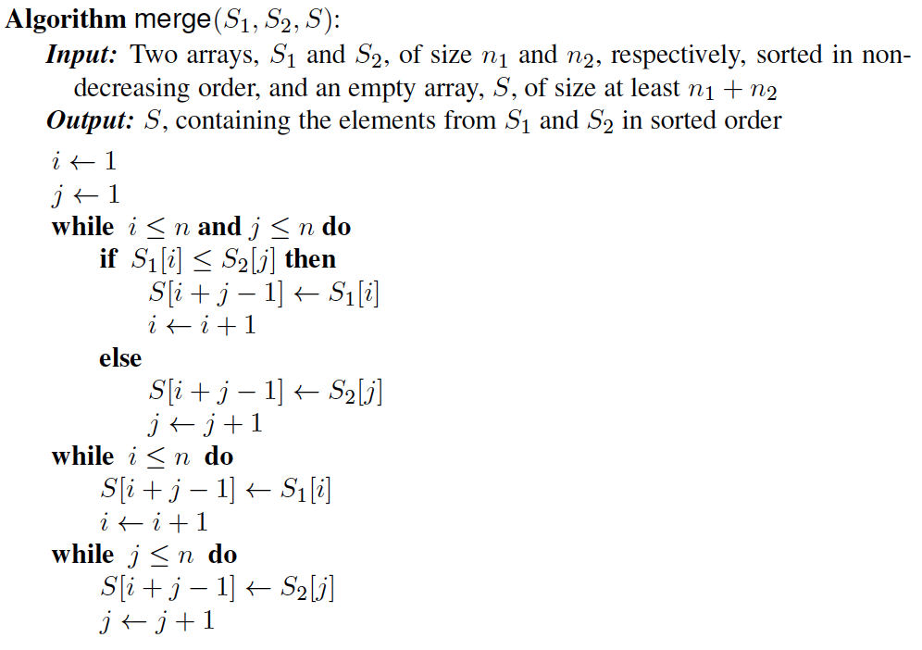
Merging Two Sorted Sequences
The conquer step of merge-sort consists of merging two sorted sequences A and B into a sorted sequence S containing the union of the elements of A and B
Merging two sorted sequences, each with n/2 elements and implemented by means of a doubly linked list, takes O(n) time

Slide 8
Merge-Sort Tree
An execution of merge-sort is depicted by a binary tree
each node represents a recursive call of merge-sort and stores
unsorted sequence before the execution and its partition
sorted sequence at the end of the execution
the root is the initial call
the leaves are calls on subsequences of size 0 or 1
7 2 ⏐ 9 4 → 2 4 7 9
7 ⏐ 2 → 2 7
9 ⏐ 4 → 4 9
7 → 7
2 → 2
9 → 9
4 → 4

Slide 9
Execution Example
Partition
7 2 9 4 ⏐ 3 8 6 1 → 1 2 3 4 6 7 8 9
7 2 9 4 → 2 4 7 9
3 8 6 1 → 1 3 8 6
7 2 → 2 7
9 4 → 4 9
3 8 → 3 8
6 1 → 1 6
7 → 7
2 → 2
9 → 9
4 → 4
3 → 3
8 → 8
6 → 6
1 → 1

Slide 10
Execution Example (cont.)
Recursive call, partition
7 2 9 4 ⏐ 3 8 6 1 → 1 2 3 4 6 7 8 9
7 2 ⏐ 9 4 → 2 4 7 9
3 8 6 1 → 1 3 8 6
7 2 → 2 7
9 4 → 4 9
3 8 → 3 8
6 1 → 1 6
7 → 7
2 → 2
9 → 9
4 → 4
3 → 3
8 → 8
6 → 6
1 → 1

Slide 11
Execution Example (cont.)
Recursive call, partition
7 2 9 4 ⏐ 3 8 6 1 → 1 2 3 4 6 7 8 9
7 2 ⏐ 9 4 → 2 4 7 9
3 8 6 1 → 1 3 8 6
7 ⏐ 2 → 2 7
9 4 → 4 9
3 8 → 3 8
6 1 → 1 6
7 → 7
2 → 2
9 → 9
4 → 4
3 → 3
8 → 8
6 → 6
1 → 1

Slide 12
Execution Example (cont.)
Recursive call, base case
7 2 9 4 ⏐ 3 8 6 1 → 1 2 3 4 6 7 8 9
7 2 ⏐ 9 4 → 2 4 7 9
3 8 6 1 → 1 3 8 6
7 ⏐ 2 → 2 7
9 4 → 4 9
3 8 → 3 8
6 1 → 1 6
7 → 7
2 → 2
9 → 9
4 → 4
3 → 3
8 → 8
6 → 6
1 → 1

Slide 13
Execution Example (cont.)
Recursive call, base case
7 2 9 4 ⏐ 3 8 6 1 → 1 2 3 4 6 7 8 9
7 2 ⏐ 9 4 → 2 4 7 9
3 8 6 1 → 1 3 8 6
7 ⏐ 2 → 2 7
9 4 → 4 9
3 8 → 3 8
6 1 → 1 6
7 → 7
2 → 2
9 → 9
4 → 4
3 → 3
8 → 8
6 → 6
1 → 1

Slide 14
Execution Example (cont.)
Merge
7 2 9 4 ⏐ 3 8 6 1 → 1 2 3 4 6 7 8 9
7 2 ⏐ 9 4 → 2 4 7 9
3 8 6 1 → 1 3 8 6
7 ⏐ 2 → 2 7
9 4 → 4 9
3 8 → 3 8
6 1 → 1 6
7 → 7
2 → 2
9 → 9
4 → 4
3 → 3
8 → 8
6 → 6
1 → 1

Slide 15
Execution Example (cont.)
Recursive call, …, base case, merge
7 2 9 4 ⏐ 3 8 6 1 → 1 2 3 4 6 7 8 9
7 2 ⏐ 9 4 → 2 4 7 9
3 8 6 1 → 1 3 8 6
7 ⏐ 2 → 2 7
9 4 → 4 9
3 8 → 3 8
6 1 → 1 6
7 → 7
2 → 2
9 → 9
4 → 4
3 → 3
8 → 8
6 → 6
1 → 1

Slide 16
Execution Example (cont.)
Merge
7 2 9 4 ⏐ 3 8 6 1 → 1 2 3 4 6 7 8 9
7 2 ⏐ 9 4 → 2 4 7 9
3 8 6 1 → 1 3 8 6
7 ⏐ 2 → 2 7
9 4 → 4 9
3 8 → 3 8
6 1 → 1 6
7 → 7
2 → 2
9 → 9
4 → 4
3 → 3
8 → 8
6 → 6
1 → 1

Slide 17
Execution Example (cont.)
Recursive call, …, merge, merge
7 2 9 4 ⏐ 3 8 6 1 → 1 2 3 4 6 7 8 9
7 2 ⏐ 9 4 → 2 4 7 9
3 8 6 1 → 1 3 6 8
7 ⏐ 2 → 2 7
9 4 → 4 9
3 8 → 3 8
6 1 → 1 6
7 → 7
2 → 2
9 → 9
4 → 4
3 → 3
8 → 8
6 → 6
1 → 1

Slide 18
Execution Example (cont.)
Merge
7 2 9 4 ⏐ 3 8 6 1 → 1 2 3 4 6 7 8 9
7 2 ⏐ 9 4 → 2 4 7 9
3 8 6 1 → 1 3 6 8
7 ⏐ 2 → 2 7
9 4 → 4 9
3 8 → 3 8
6 1 → 1 6
7 → 7
2 → 2
9 → 9
4 → 4
3 → 3
8 → 8
6 → 6
1 → 1

Slide 19
Analysis of Merge-Sort
The height h of the merge-sort tree is O(log n)
at each recursive call we divide in half the sequence,
The overall amount or work done at the nodes of depth i is O(n)
we partition and merge 2^{i} sequences of size n/2^{i}
we make 2^{i+1} recursive calls
Thus, the total running time of merge-sort is O(n log n)
depth | #seqs | size
0 | 1 | n
1 | 2 | n/2
i | 2^{i} | n/2^{i}
… | … | …

Slide 20
Summary of Sorting Algorithms
Algorithm | Time | Notes
selection-sort | O(n²) | slow in-place for small data sets (< 1K)
insertion-sort | O(n²) | slow in-place for small data sets (< 1K)
heap-sort | O(n log n) | fast in-place for large data sets (1K — 1M)
merge-sort | O(n log n) | fast sequential data access for huge data sets (> 1M)

