Slide 1
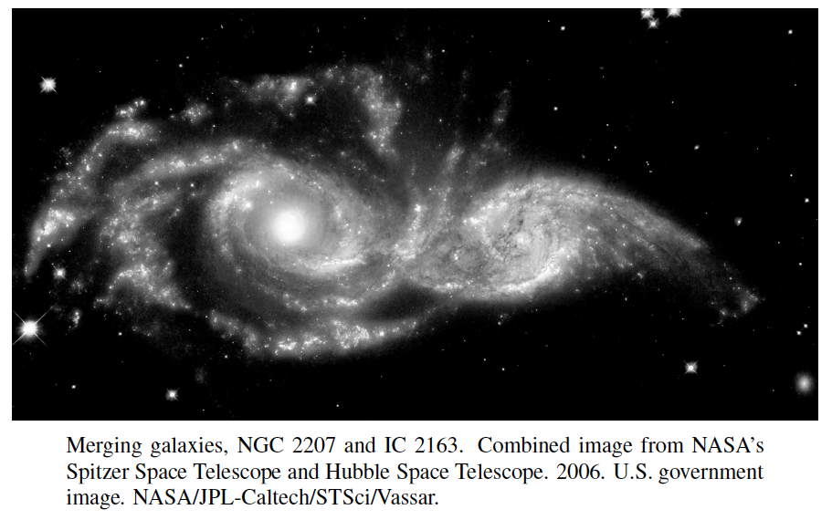
Union-Find Structures
Presentation for use with the textbook, Algorithm Design and Applications, by M. T. Goodrich and R. Tamassia, Wiley, 2015

Slide 2
Application: Connected Components in a Social Network
Social networking research studies how relationships between various people can influence behavior.
Given a set, S, of n people, we can define a social network for S by creating a set, E, of edges or ties between pairs of people that have a certain kind of relationship. For example, in a friendship network, like Facebook, ties would be defined by pairs of friends.
A connected component in a friendship network is a subset, T, of people from S that satisfies the following:
Every person in T is related through friendship, that is, for any x and y in T, either x and y are friends or there is a chain of friendship, such as through a friend of a friend of a friend, that connects x and y.
No one in T is friends with anyone outside of T.

Slide 3
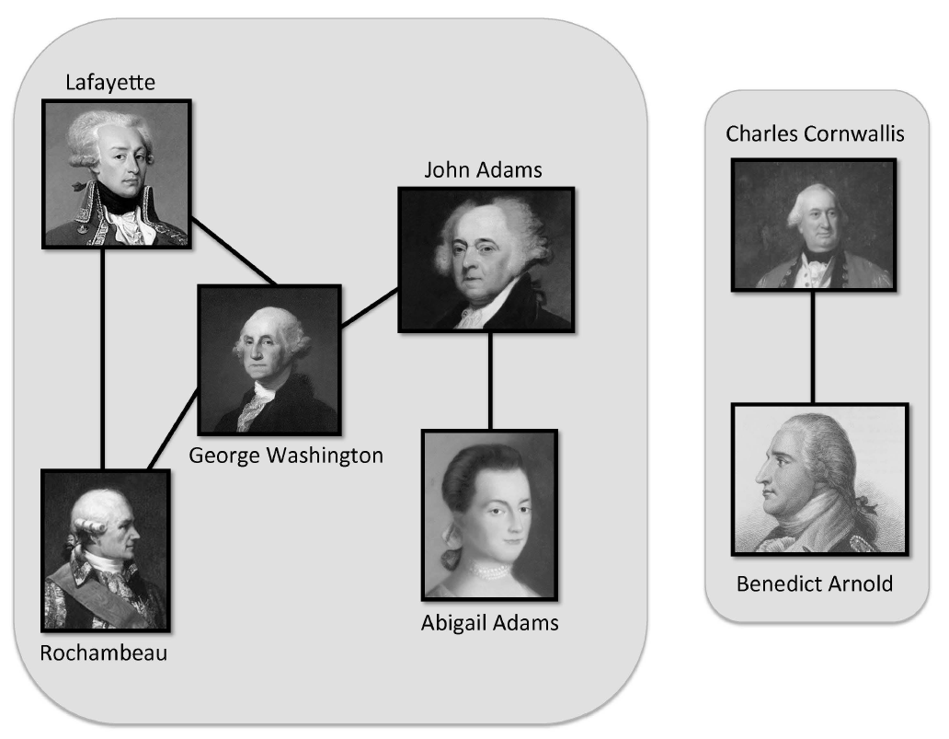
Example
2 Connected components in a friendship network of some of the key figures in the American Revolutionary War.
All images are in the public domain.

Slide 4
Union-Find Operations
A partition or union-find structure is a data structure supporting a collection of disjoint sets subject to the following operations:
makeSet(e): Create a singleton set containing the element e and return the position storing e in this set
union(A,B): Return the set A U B, naming the result “A” or “B”
find(e): Return the set containing the element e

Slide 5
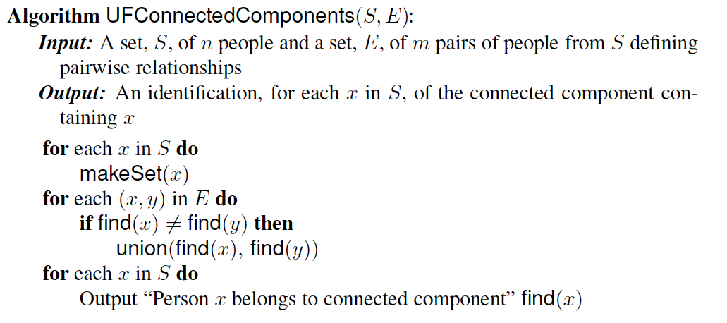
Connected Components Algorithm
The output from this algorithm is an identification, for each person x in S, of the connected component to which x belongs.
The running time of this algorithm is O(t(n,n+m)), where t(j,k) is the time for k union-find operations starting from j singleton sets.

Slide 6
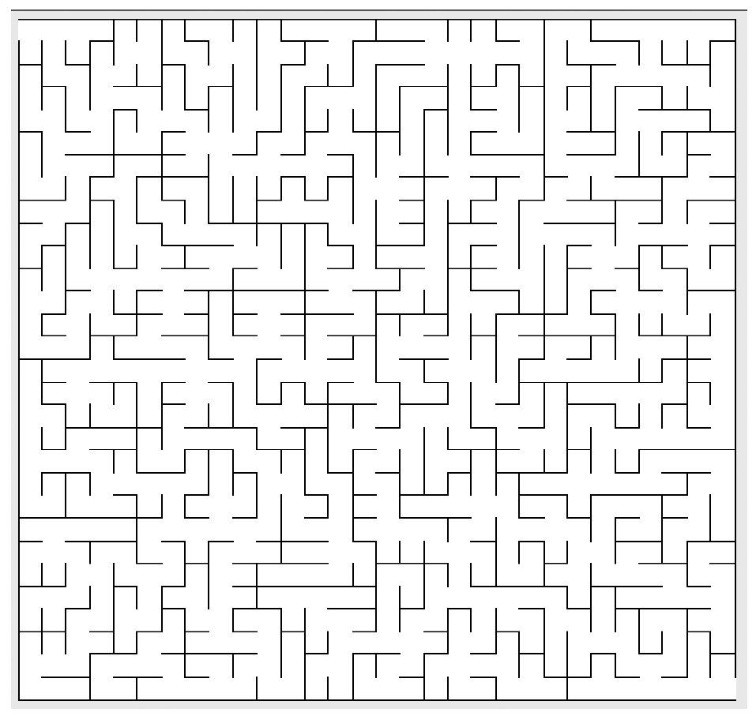
Another Application: Maze Construction and Percolation
Problem: Construct a good maze.

Slide 7
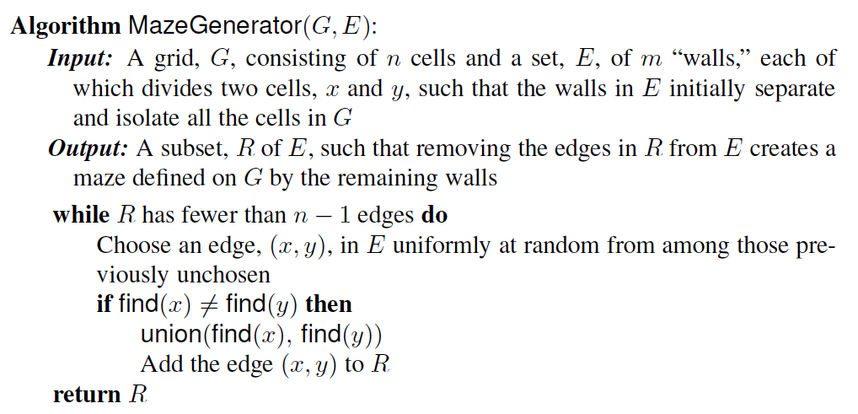
A Maze Generator
This is actually is related to the science of percolation theory, which is the study of how liquids permeate porous materials.
For instance, a porous material might be modeled as a three-dimensional n x n x n grid of cells. The barriers separating adjacent pairs of cells might then be removed virtually with some probability p and remain with probability 1 − p. Simulating such a system is another application of union-find structures.

Slide 8
List-based Implementation
Each set is stored in a sequence represented with a linked-list
Each node should store an object containing the element and a reference to the set name

Slide 9
Analysis of List-based Representation
When doing a union, always move elements from the smaller set to the larger set
Each time an element is moved it goes to a set of size at least double its old set
Thus, an element can be moved at most O(log n) times
Total time needed to do n unions and m finds is O(n log n + m).

Slide 10
Tree-based Implementation
Each element is stored in a node, which contains a pointer to a set name
A node v whose set pointer points back to v is also a set name
Each set is a tree, rooted at a node with a self-referencing set pointer
For example: The sets “1”, “2”, and “5”:
1
2
5
4
7
3
6
8
10
9
11
12

Slide 11
Union-Find Operations
5
To do a union, simply make the root of one tree point to the root of the other
To do a find, follow set-name pointers from the starting node until reaching a node whose set-name pointer refers back to itself
2
8
10
3
6
11
9
12
5
2
8
10
3
6
11
9
12

Slide 12
Union-Find Heuristic 1
Union by size:
When performing a union, make the root of smaller tree point to the root of the larger
Implies O(n log n) time for performing n union-find operations:
Each time we follow a pointer, we are going to a subtree of size at least double the size of the previous subtree
Thus, we will follow at most O(log n) pointers for any find.
5
2
8
10
3
6
11
9
12

Slide 13
Union-Find Heuristic 2
Path compression:
After performing a find, compress all the pointers on the path just traversed so that they all point to the root
Implies a fast “almost linear” time for n union-find operations.
5
5
8
10
8
10
11
11
2
12
2
12
3
6
3
6
9
9

Slide 14
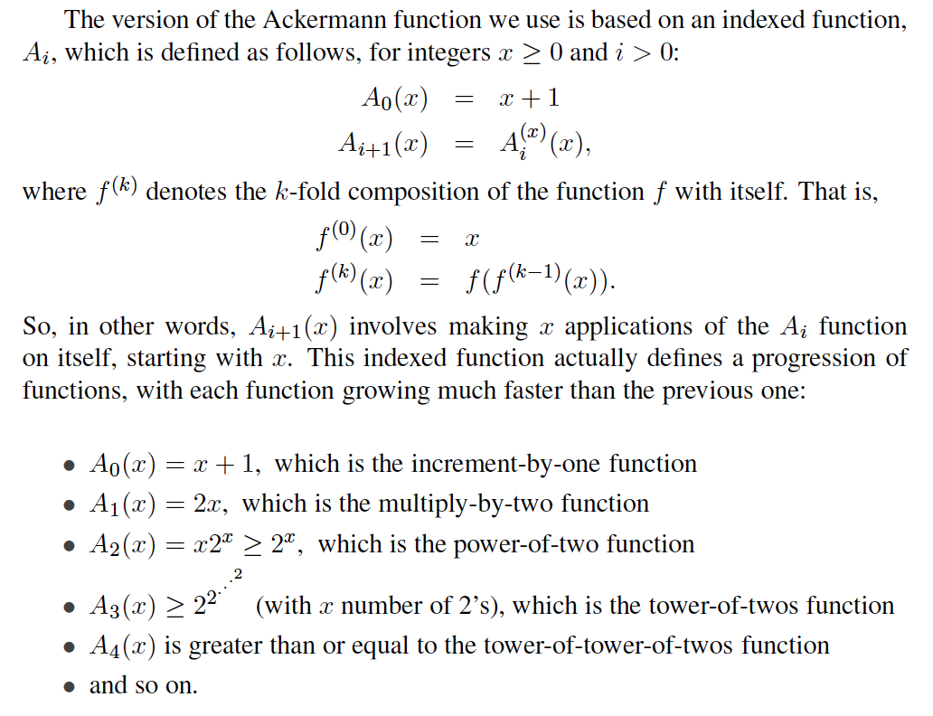
Ackermann Function

Slide 15
Ackermann Function
We then define the Ackermann function as
A(x) = A_{x}(2),
which is an incredibly fast-growing function.
To get some perspective, note that A(3) = 2048 and A(4) is greater than or equal to a tower of 2048 twos, which is much larger than the number of subatomic particles in the universe.
Likewise, its inverse, which is pronounced “alpha of n”,
α(n) = min{x: A(x) ≥ n},
is an incredibly slow-growing function. Even though α(n) is indeed growing as n goes to infinity, for all practical purposes, α(n) ≤ 4.

Slide 16
Fast Amortized Time Analysis
For each node v in the union tree that is a root
define n(v) to be the size of the subtree rooted at v (including v)
identified a set with the root of its associated tree.
We update the size field of v each time a set is unioned into v. Thus, if v is not a root, then n(v) is the largest the subtree rooted at v can be, which occurs just before we union v into some other node whose size is at least as large as v ’s.
For any node v, then, define the rank of v, which we denote as r(v), as r(v) = [log n(v)] + 2:
Thus, n(v) ≥ 2^{r(v)-2}.
Also, since there are at most n nodes in the tree of v, r(v) < [log n]+2, for each node v.

Slide 17
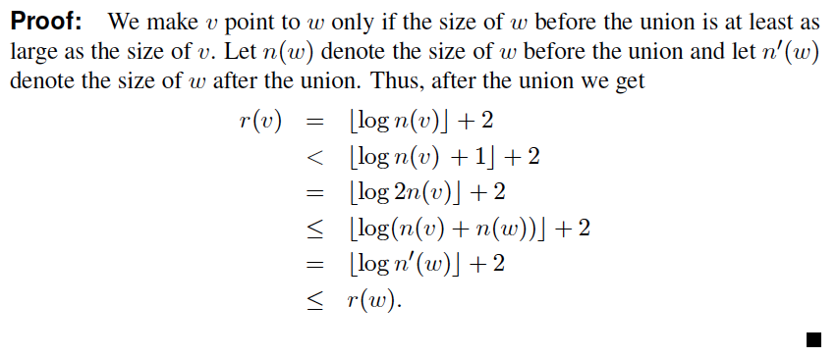
Amortized Time Analysis (2)
For each node v with parent w:
r (v ) < r (w )
Thus, ranks are strictly increasing as we follow parent pointers.

Slide 18
Amortized Time Analysis (3)
Claim: There are at most n/ 2^{s-2} nodes of rank s.
Proof:
Since r(v) < r(w), for any node v with parent w, ranks are monotonically increasing as we follow parent pointers up any tree.
Thus, if r(v) = r(w) for two nodes v and w, then the nodes counted in n(v) must be separate and distinct from the nodes counted in n(w).
If a node v is of rank s, then n(v) ≥ 2^{s-2}.
Therefore, since there are at most n nodes total, there can be at most n/2^{s-2} that are of rank s.

Slide 19
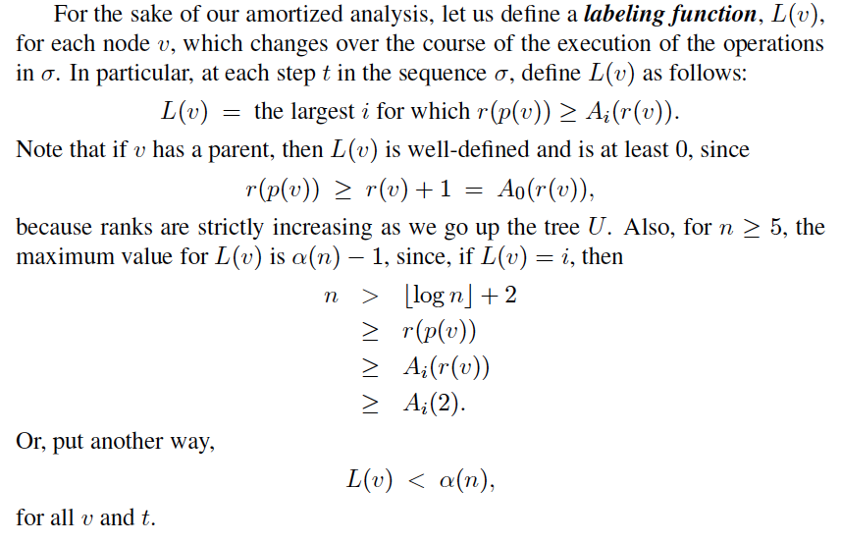
Amortized Time Analysis (4)

Slide 20
Amortized Time Analysis (5)
Let v be a node along a path, P, in the union tree. Charge 1 cyber-dollar for following the parent pointer for v during a find:
If v has an ancestor w in P such that L(v) = L(w), at this point in time, then we charge 1 cyber-dollar to v itself.
If v has no such ancestor, then we charge 1 cyber-dollar to this find.
Since there are most α(n) rank groups, this rule guarantees that any find operation is charged at most α(n) cyber-dollars.

Slide 21
Amortized Time Analysis (6)
After we charge a node v then v will get a new parent, which is a node higher up in v ’s tree.
The rank of v ’s new parent will be greater than the rank of v ’s old parent w.
Any node v can be charged at most r(v) cyber-dollars before v goes to a higher label group.
Since L(v) can increase at most α(n)-1 times, this means that each vertex is charged at most r(n)α(n) cyber-dollars.

Slide 22
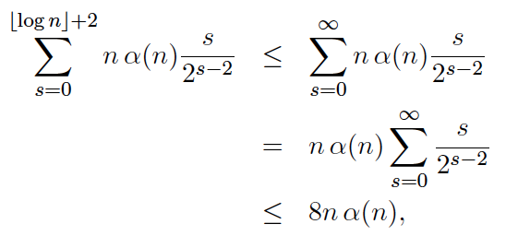
Amortized Time Analysis (7)
Combining this fact with the bound on the number of nodes of each rank, this means there are at most
cyber-dollars charged to all the vertices of rank s.
Summer over all possible ranks, the total number of cyber-dollars charged to all nodes is at most
so the total time for m union-find operations, starting
with n singleton sets is O((n+m)α(n)).

