Slide 1
Bin Packing
CS 165
Michael T. Goodrich
Some slides adapted from slides from
Professor C. L. Liu, Tsing Hua University
Professor Teofilo F. Gonzalez, UCSB

Slide 2
Bin Packing Example
The bins;
(capacity 1)
1
……
.5 .7 .5 .2 .4 .2 .5 .1 .6
.5
.5
.2
.4
.2
.5
.1
.7
.6
Items to be packed

Slide 3
Bin Packing Problem Definition
Given n items with sizes s₁, s₂, ..., s_{n} such that 0 ≤ s_{i} ≤ 1 for 1 ≤ i ≤ n, pack them into the fewest number of unit capacity bins.
Problem is NP-hard (NP-Complete for the decision version).
There is no known polynomial time algorithm for its solution, and it is conjectured that none exists.

Slide 4
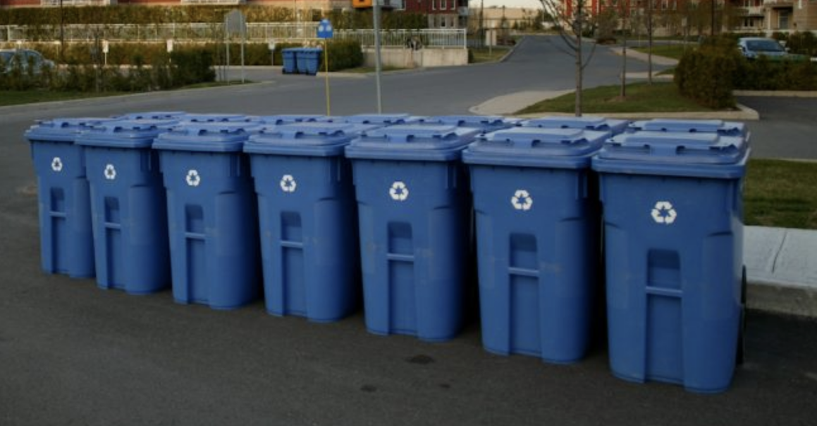
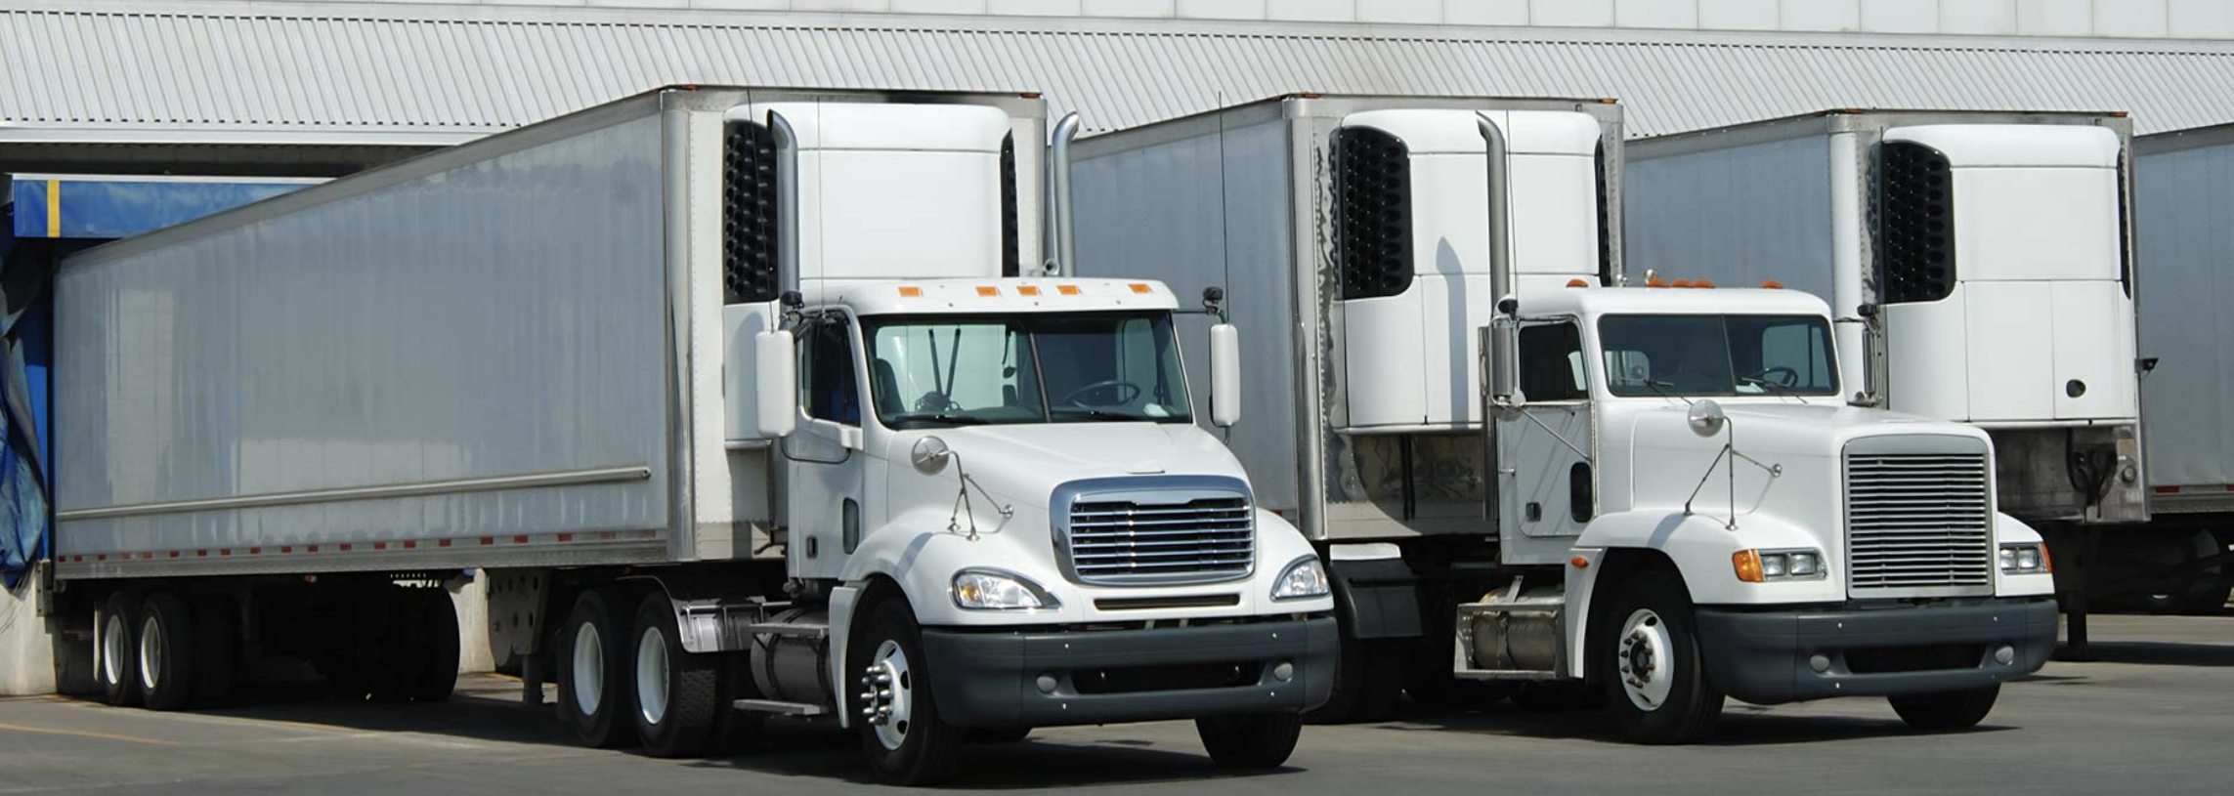
Example Applications
Filling recycle bins
Loading trucks

Slide 5
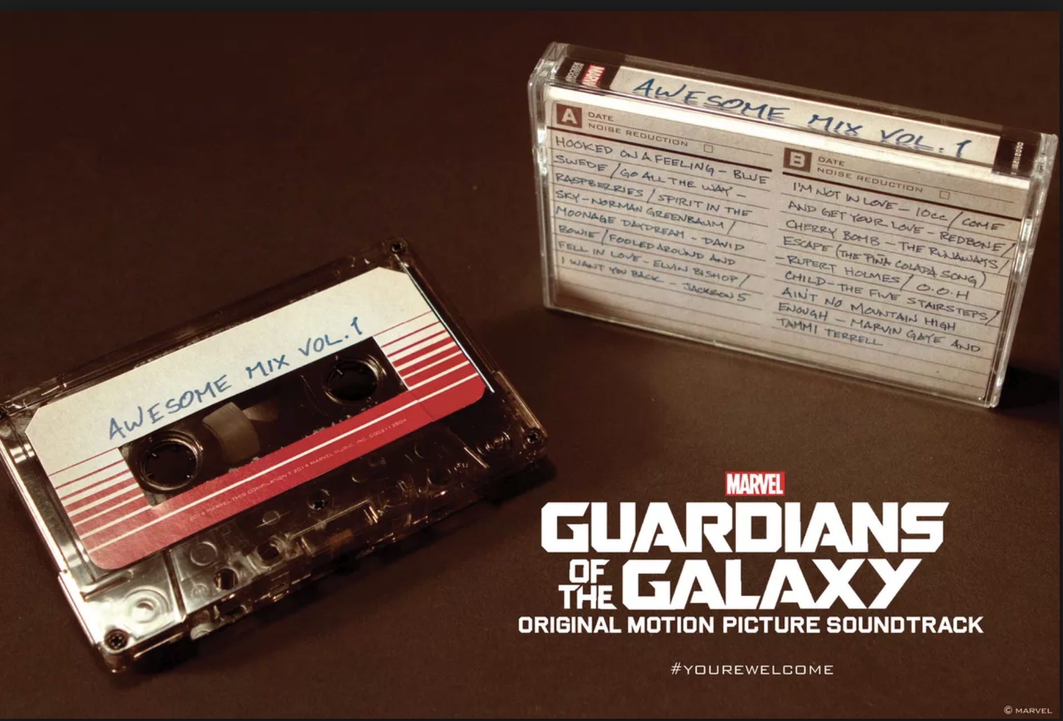
Historical Application
Mix tapes

Slide 6
Bin Packing Optimal Solution
Bin Packing Problem
1
……
.5 .7 .5 .2 .4 .2 .5 .1 .6
Optimal Packing
.2
.1
.5
.5
M_{Opt} = 4
.6
.5
.7
.4
.2

Slide 7
Bin-Packing Heuristics
Because the Bin-Packing problem is NP-hard, it is very unlikely that we can solve it 100% of the time with 100% optimality in polynomial time.
Fortunately, there are a number of interesting heuristics we can apply to hopefully come close to optimality.

Slide 8
Next-Fit (NF) Algorithm
Check to see if the current item fits in the current bin. If so, then place it there, otherwise start a new bin.

Slide 9
Next Fit (NF) Packing Algorithm Example
Bin Packing Problem
.5 .7 .5 .2 .4 .2 .5 .1 .6
.2
.1
.5
.5
M_{Opt} = 4
.6
.5
.7
.4
.2
Next Fit Packing Algorithm
.2
.2
.1
.5
.7
.5
.4
.5
.6
M = 6

Slide 10
Approximation Ratios
Approximation Algorithm:
Not an optimal solution, but with some performance ratio guarantee for a given problem instance, I
(e.g., no worst than twice the optimal)
Approx. Ratio = Alg(I)/Opt(I)

Slide 11
Next Fit (NF) Approximation Ratio
Theorem: Let M be the number of bins required to pack a list I of items optimally. Next Fit will use at most 2M bins.
Proof:
Let s(B_{i}) be the sum of sizes of the items assigned to bin B_{i} in the Next Fit solution.
For any two adjacent bins (B_{j} and B_{j+1}), we know that s(B_{j}) + s(B_{j+1}) > 1.

Slide 12
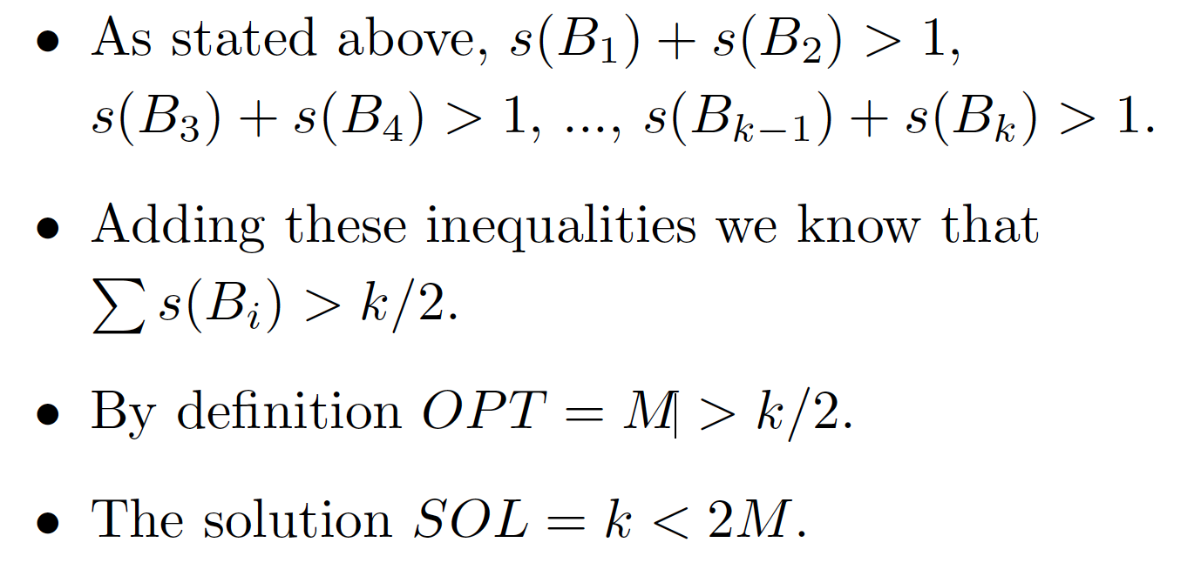
Next Fit (NF) Approximation Ratio
Let k be the number of bins used by Next Fit for list I. We prove the case when k is even (odd case is similar).

Slide 13
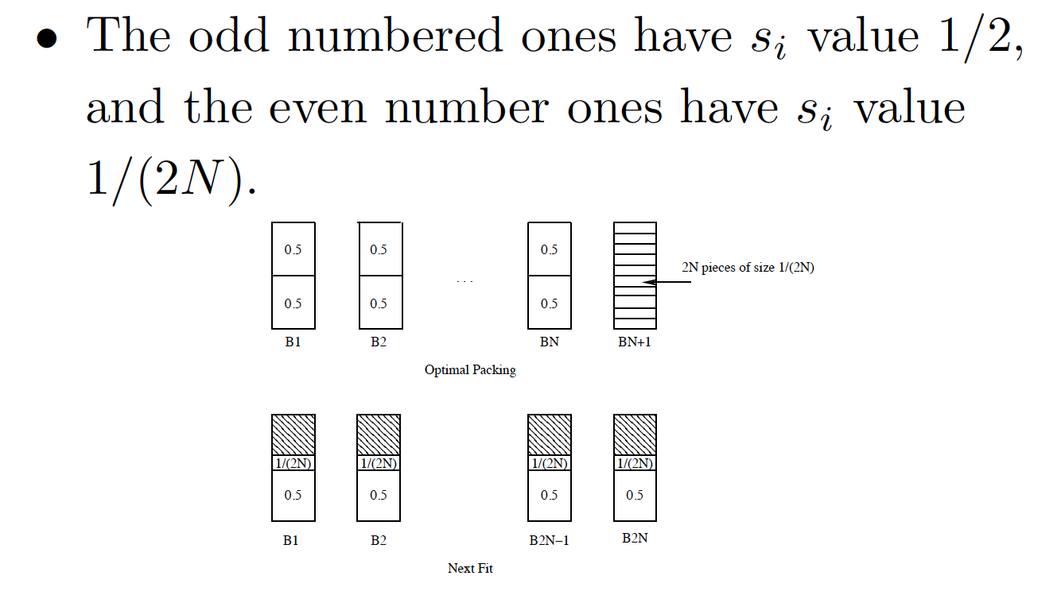
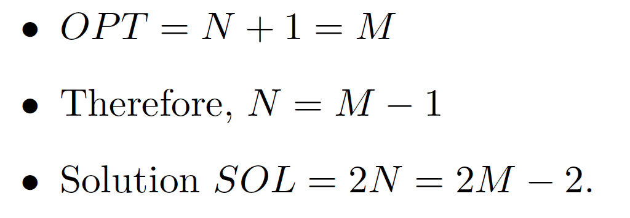
Next Fit (NF) Lower Bound
There exist sequences such that Next Fit uses 2M −2 bins, where M is the number of bins in an optimal solution.
Proof:

Slide 14
First Fit (FF) Algorithm
Scan the bins in order and place the new item in the first bin that is large enough to hold it. A new bin is created only when an item does not fit in the previous bins.

Slide 15
First Fit (FF) Packing Algorithm Example
.5 .7 .5 .2 .4 .2 .5 .1 .6
Next Fit Packing Algorithm
.2
.2
.1
.5
.7
.5
.4
.5
.6
First Fit Packing Algorithm
.1
.5
.2
.7
.2
.5
.4
.5
.6
M = 5

Slide 16
Running Time for First Fit
Easily implemented in O(n²) time
Can be implemented in O(n log n) time:
Idea: Use a balanced search tree with height O(log n).
Each node has three values:
index of bin
remaining capacity of bin
best (largest) in all the bins represented by the subtree rooted at the node.
The ordering of the tree is by bin index.

Slide 17
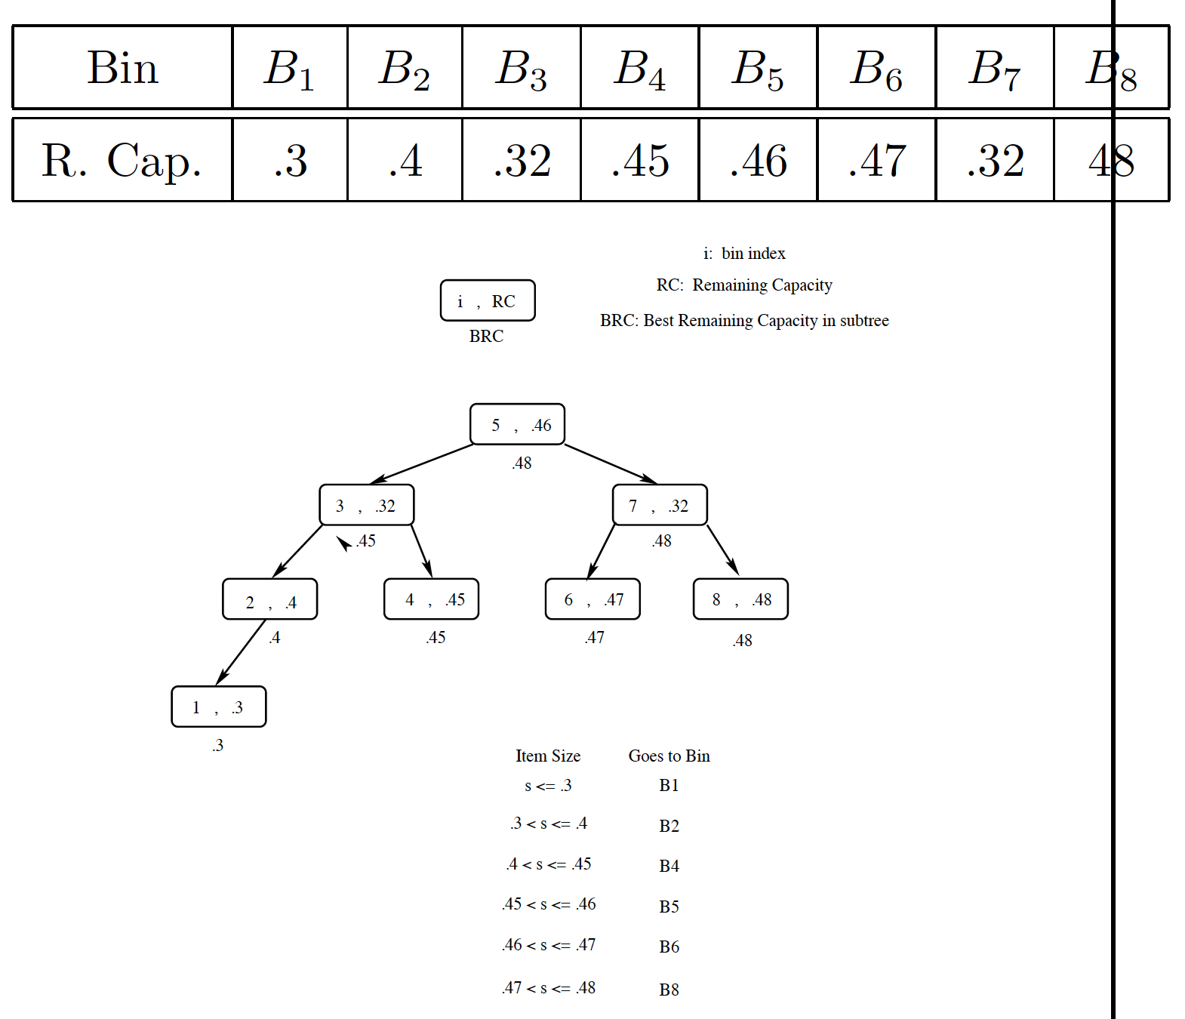
Faster First-Fit (FF) Algorithm
8 bins:

Slide 18
Zip-Zip Trees
For Project 2, students are required to implement the faster First-Fit Algorithm using the zip-zip tree data structure, which received the Best Paper Award at WADS 2023.
Michael Goodrich Ofek Gila Robert Tarjan

Slide 19
First-Fit (FF) Approx. Ratio
Let M be the optimal number of bins required to pack a list I of items. Then First Fit never uses more than ⌈1.7M⌉.
Proof:
[omitted]

Slide 20
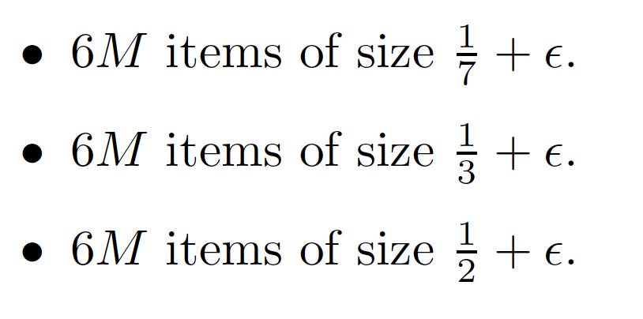
First-Fit (FF) Approx. Ratio
There exist sequences such that First Fit uses 1.6666…(M) bins.
Proof:

Slide 21
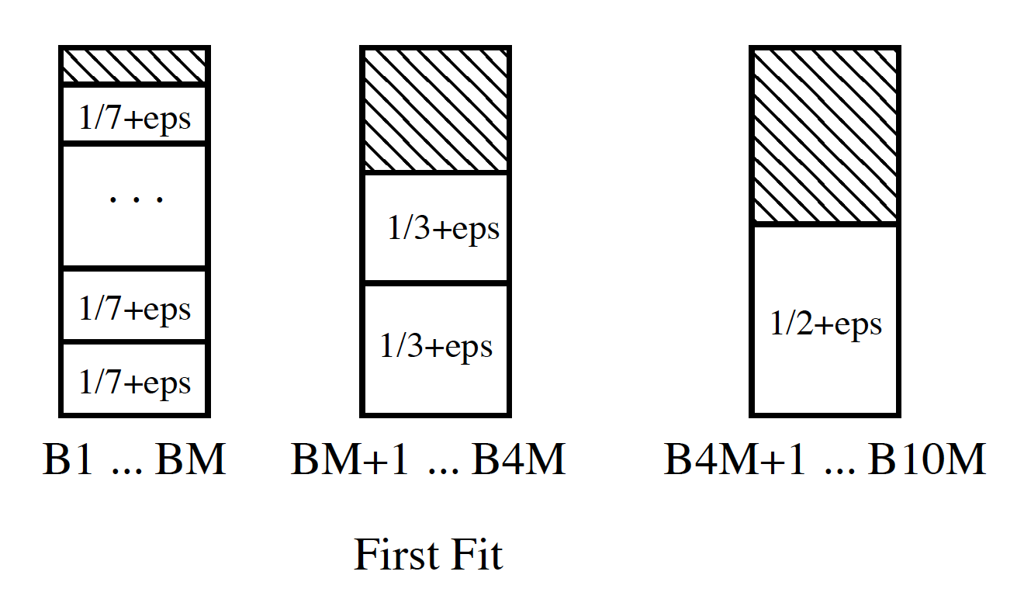
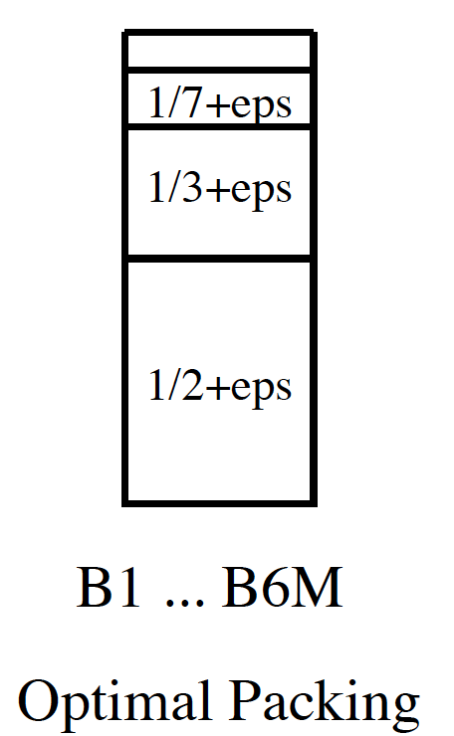
First-Fit (FF) Lower Bound
First Fit uses 10M bins, but optimal uses 6M

Slide 22
Best Fit Algorithm (BF)
New item is placed in a bin where it fits the tightest. If it does not fit in any bin, then start a new bin.
Can be implemented in O(n log n) time, by using a balanced binary tree storing bins ordered by remaining capacity as search key.
Repeatedly delete the chosen node and re-insert with new remaining capacity.

Slide 23
Zip-Zip Trees
For Project 2, students are required to implement the Best-Fit Algorithm using the zip-zip tree data structure.

Slide 24
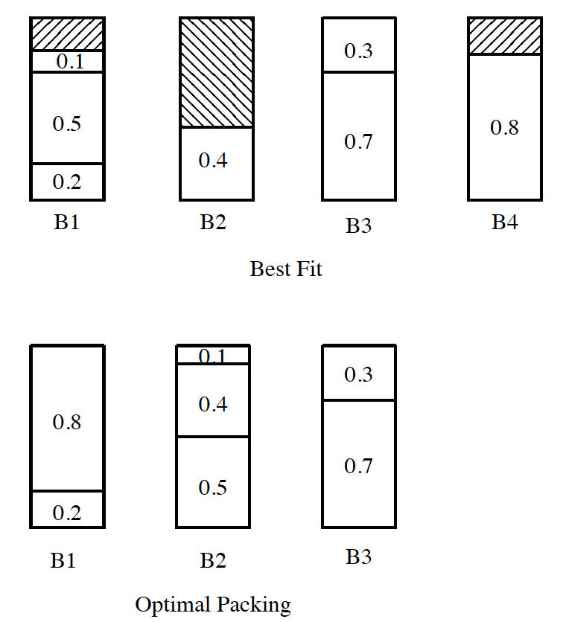
Example for Best Fit (BF)
I = (0.2, 0.5, 0.4, 0.7, 0.1, 0.3, 0.8)

Slide 25
Other Heuristics
First Fit Decreasing (FFD): First order the items by size, from largest to smallest, then run the First Fit Algorithm.
Best Fit Decreasing (BFD): First order the items by size, from largest to smallest, then run the Best Fit Algorithm.

Slide 26
Experiments
It is difficult to experimentally compute approximation ratios.
It requires that we know the optimal solution to an NP-hard problem!
But we can do experiments for a related parameter:
Define the waste, W(A), for a bin-packing algorithm A to be the number of bins that it uses minus the total size of all n items.

Slide 27
Experiments
We are interested in estimating the waste, W(A), as a function of n and as n grows towards infinity, for random items uniformly distributed in the interval (0, x), for x < 1 defined in the assignment and for the following algorithms:
A = Next Fit (NF)
A = First Fit (FF)
A = Best Fit (BF)
A = First Fit Decreasing (FFD)
A = Best Fit Decreasing (BFD)

