Slide 1
Network Algorithms
Michael Goodrich
Some slides adapted from:
Networked Life (NETS) 112, Univ. of Penn., 2018, Prof. Michael Kearns
Determining the Diameter of Small World Networks, Frank W. Takes & Walter A. Kosters, Leiden University, The Netherlands
Structure and models of real-world graphs and networks, Jure Leskovec, Carnegie Mellon University
Complex (Biological) Networks, by Elhanan Borenstein, Roded Sharan, and Tomer Shlomi

Slide 2
Computational
Representation of Networks
A
B
C
D
Adjacency List
List or hash table of edges:
(ordered) pairs of nodes
{ (A,C) , (C,B) , (D,B) , (D,C) }
Adjacency Matrix
 | A | B | C | D
A | 0 | 0 | 1 | 0
B | 0 | 0 | 0 | 0
C | 0 | 1 | 0 | 0
D | 0 | 1 | 1 | 0
Name:D
ngr:
Name:C
ngr:
Name:A
ngr:
p1
p2
p1
Name:B
ngr:
p1
Which is the most useful representation?
Should you use them in combination?

Slide 3
Network Structures
Network structures characterize how networks “look”:
  Large or small diameter?
  Number of edges: sparse or dense?
  Degree distributions: heavy/long tail with a power law?
  Clustering coefficient: high or low?
These are empirical phenomena
How do you compute them?
Image from https://matrix.berkeley.edu/research/social-networks-history

Slide 4
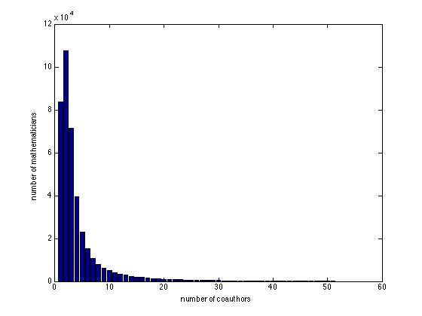
Degree Distribution
x axis: number of neighbors (degree)
y axis: number of vertices with that degree
A long tail
(also known as a “heavy tail”)

Slide 5
Degree Distribution Algorithm
Compute the degree, deg(v), of each vertex, v.
  If G is represented as an adjacency list, count the number of elements in v’s list.
Create a histogram count array, H, of size n, and initialize each H[i] = 0.
For each vertex, v, increment H[deg(v)].
Plot the values of H from 0 to n-1 on a regular and log-log scale
If the values on the log-log plot form a straight line, determine its slope to find the exponent of the power law degree distribution

Slide 6
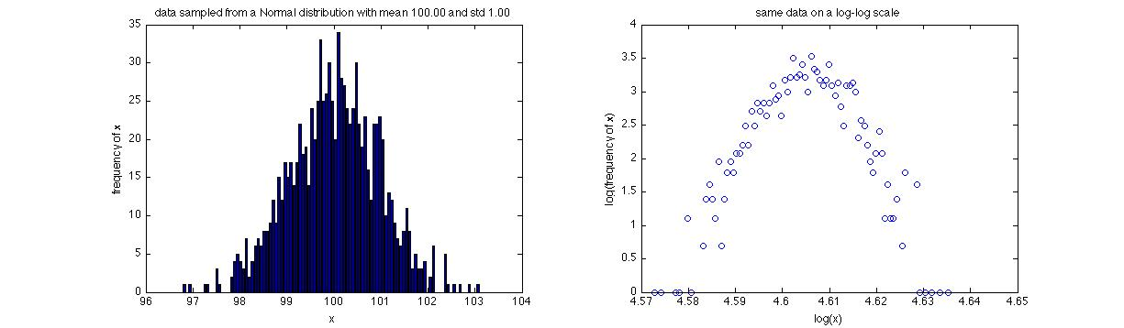
Example 1
Degree distribution without a long/heavy tail .
Does not exhibit a power law.
frequency(x)
log(frequency(x))
x
log(x)

Slide 7
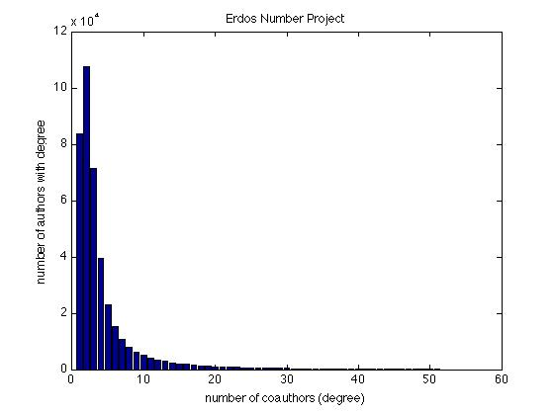
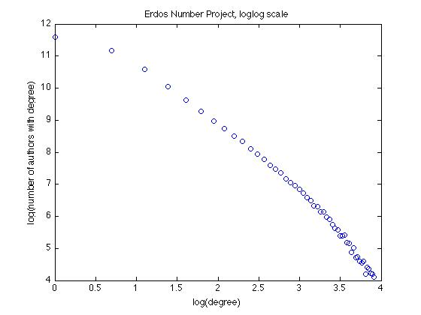
Example 2
Degree distribution with a long/heavy tail .
Does exhibit a power law, with exponent -2.5.
Slope = -2.5

Slide 8
Distance
The distance between two vertices is the length of the shortest path connecting them.
  This assumes the network has only a single connected component
  If two vertices are in different components, their distance is infinite
Image from https://www.sci.unich.it/~francesc/teaching/network/geodesic.html

Slide 9
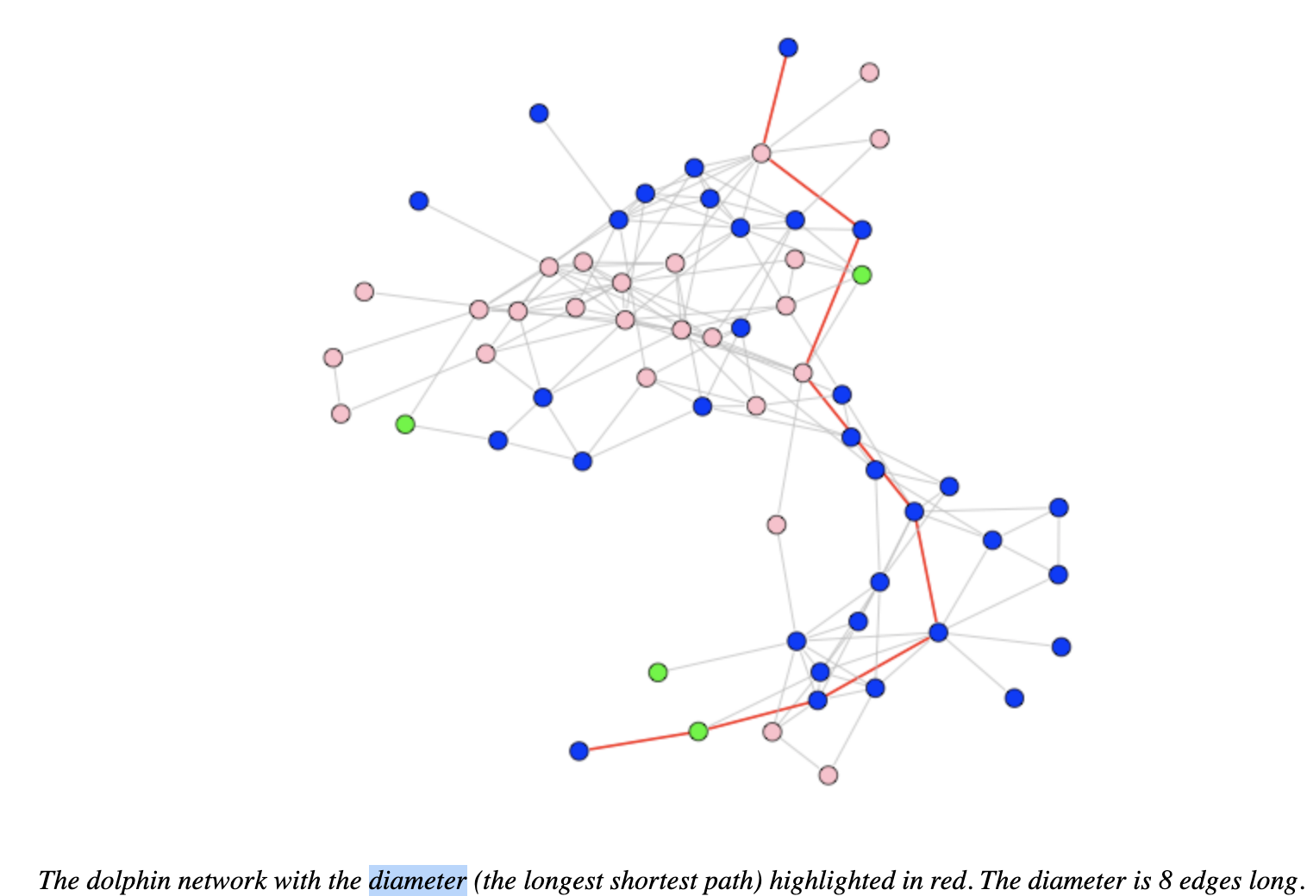
Diameter
The diameter of a network is the maximum distance between a pair of vertices in the network
  It measures how near or far typical individuals are from each other
From https://users.dimi.uniud.it/~massimo.franceschet/bottlenose/bottlenose.html

Slide 10
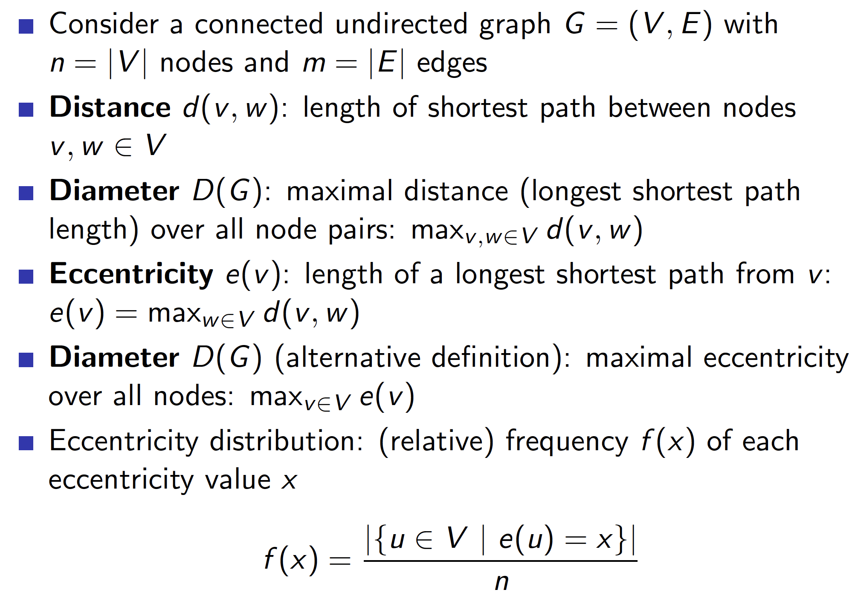
Definitions

Slide 11
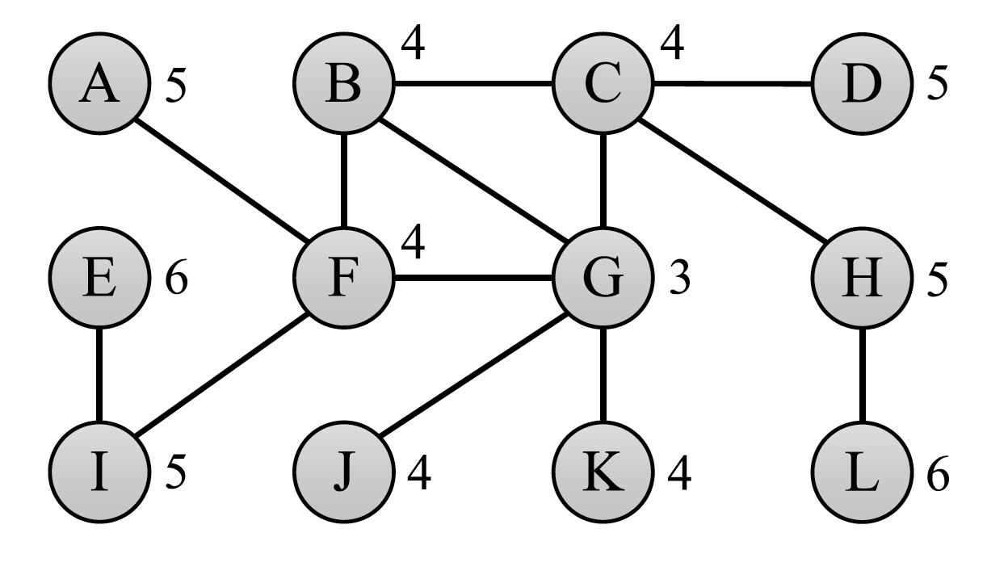
Example
A graph with diameter 6
Numbers next to nodes denote eccentricity values

Slide 12
Naïve Algorithm
Diameter is equal to the largest value returned by an All Pairs Shortest Path (APSP) algorithm
Brute-force: for each vertex v, execute a Breadth First Search (BFS) from v in O(m) time to find v’s eccentricity. Return the largest value found.
Time complexity O(nm)
Problematic if n = 8 million and m = 1 billion.
  If one BFS takes 6 seconds on a 3.4GHz machine, this brute-force algorithm takes 1.5 years to compute the diameter . . .

Slide 13
Heuristic Idea 1
If we can find one of the nodes in a diameter pair, we can compute the diameter with one more BFS.
Perform a BFS from a random sample of nodes, recording nodes with maximum found distance, d.
Perform a BFS from all the far nodes (if small) or a random sample of this set (if large).

Slide 14
Heuristic Idea 2
Let r be a random vertex and set D_{max} = 0.
Perform a BFS from r.
Select the farthest node, w, in this BFS.
If the distance from r to w is larger than D_{max}, set D_{max} to this distance, let r = w, and repeat the above two steps.

Slide 15
Plot Results as a Function of n
If the networks exhibit the small world phenomenon, then diameters are small.
So plot diameters as a function of n on a lin-log scale:
The log n function
looks like a straight line
LinLogScale.png: davidfg derivative work: Autopilot [CC BY-SA 3.0 (http://creativecommons.org/licenses/by-sa/3.0/)]

Slide 16
Clustering Coefficient
“friend of a friend is a friend”
If a connects to b, and b to c, then with high probability a connects to c.
Clustering coefficient C:
C = 3*number of triangles / number of 2-edge paths
v₁
v₄
C = 3*(1)/(1+1+6+0+0) = 3/8 = 0.375
v₃
v₅
v₂

Slide 17
Clustering Coefficient (2)
Clustering coefficient might have a power law:
It is speculated that in real networks:
C=O(1) as n→∞
Synonyms network
World Wide Web

Slide 18
Clustering Coefficient Algorithm
Clustering coefficient C:
C = 3*number of triangles / number of 2-edge paths
Computing the denominator is easy:
  For each vertex v, let deg(v) denote its degree.
  The number of paths of length 2 with v in the middle is deg(v) choose 2 = deg(v)(deg(v)-1)/2.
  So, to get the denominator for C, sum up deg(v)(deg(v)-1)/2 for all vertices, v, in G.
Number of 2-edge paths with
v in the middle is 4(3)/2 = 6.
v

Slide 19
Counting Triangles
To get the numerator for C, we need to count the number of triangles in the graph, G.
Naïve algorithm:
  For every triple, u, v, w in G, see if they form a triangle. If so, add 1 to a running count.
  Running time is O(n⁴) if G is represented with an adjacency list.
w
u
This is bad.
v

Slide 20
Counting Triangles:
Slight Improvement
Put every edge, (v,w), into a hash table, T, so we can do a lookup to see if an edge exists in O(1) expected time, i.e., with a get((v,w)).
Slightly better naïve algorithm:
  For every triple, u, v, w in G, see if they form a triangle. If so, add 1 to a running count.
  Running time is O(n³) expected if edges in G are stored in a hash table.
w
u
This is still bad.
v

Slide 21
Graph Degeneracy
The degeneracy of a graph is the smallest value of d for which every subgraph has a vertex of degree at most d.
If a graph has degeneracy d, then there exists an ordering of the vertices of G in which each vertex has at most d neighbors that are earlier in the ordering.
An ordering for a
graph with degeneracy 2:
Public domain image by David Eppstein

Slide 22
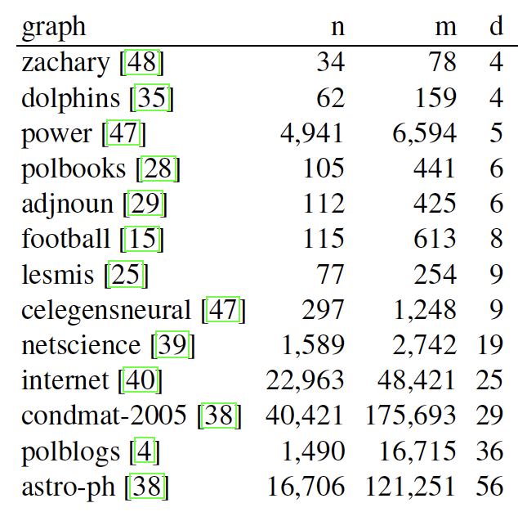
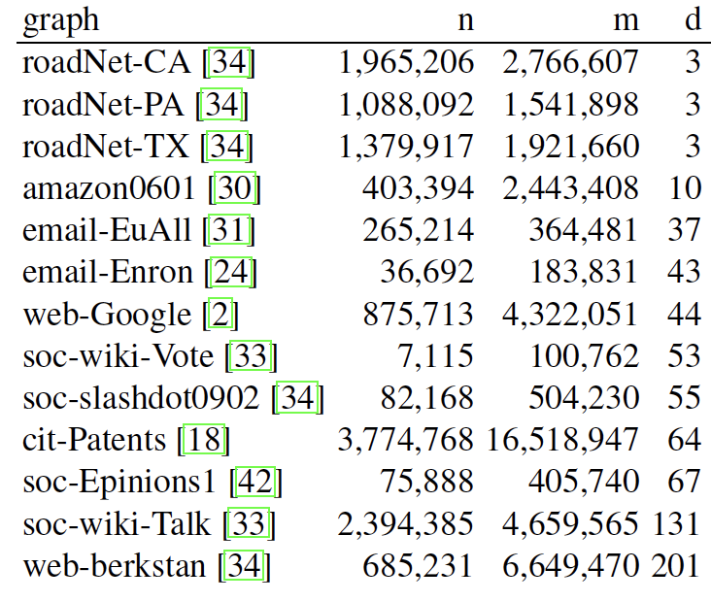
Real-World Graphs
Real-world graphs tend to have small degeneracy, d.
Data from “Listing All Maximal Cliques in Large Sparse Real-World Graphs,” by David Eppstein and Darren Strash

Slide 23
Degeneracy Ordering Algorithm
Degeneracy can be computed by a simple greedy algorithm:
  Repeatedly find and remove the vertex of smallest degree, adding it to the end of the list.
  The degeneracy is then the highest degree, d, of any vertex at the moment it is removed.
  The ordering is a d-degeneracy ordering.
2-degeneracy
ordering
Public domain image by David Eppstein

Slide 24
Linear-time Implementation
Initialize an output list, L, to be empty.
Compute a number, d_{v}, for each vertex v in G, which is the number of neighbors of v that are not already in L. Initially, d_{v} is just the degrees of v.
Initialize an array D such that D[i] contains a list of the vertices v that are not already in L for which d_{v} = i.
Let N_{v} be a list of the neighbors of v that come before v in L. Initially, N_{v} is empty for every vertex v.
Initialize k to 0.
Repeat n times:
  Let i be the smallest index such that D[i] is nonempty.
  Set k to max(k, i).
  Select a vertex v from D[i]. Add v to the beginning of L and remove it from D[i]. Mark v as being in L (e.g., using a hash table, H_{L}).
  For each neighbor w of v not already in L (you can check this using H_{L}):
    Subtract one from d_{w}
    Move w to the cell of D corresponding to the new value of d_{w} , i.e., D[d_{w}]
    Add w to N_{v}

Slide 25
Triangle Counting Algorithm
Compute a d-degeneracy ordering of the vertices, e.g., using the algorithm of the previous slide.
Process the vertices according to this ordering, L:
  For each vertex, v:
    For each pair of vertices, u and w, adjacent to v and earlier in the ordering, i.e., u and v are in the list N_{v} from the degeneracy algorithm:
      If (u,w) is an edge in the graph, then add one to the triangle count.
Running time is O(d ²n) = O(dm) expected, assuming edges are stored in a hash table.

