Slide 1
Network Structure
Michael Goodrich
Some slides adapted from:
Networked Life (NETS) 112, Univ. of Penn., 2018, Prof. Michael Kearns
Kentaro Toyama - Microsoft Research India

Slide 2
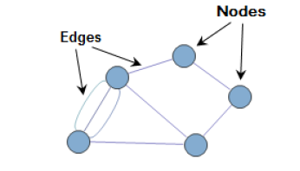
Terminology
Graph: a network, G=(V,E), consists of two sets, V, of vertices and, E, edges.
Vertices: these are the entities in graph (also called nodes or actors). For example, if we consider Facebook friends as a graph, then every friend is a vertex.
Edges: These are pairwise relationships between vertices. For example, if we consider Facebook friends as a graph then every friendship is an edge. Edges are sometimes also called “ties.”

Slide 3
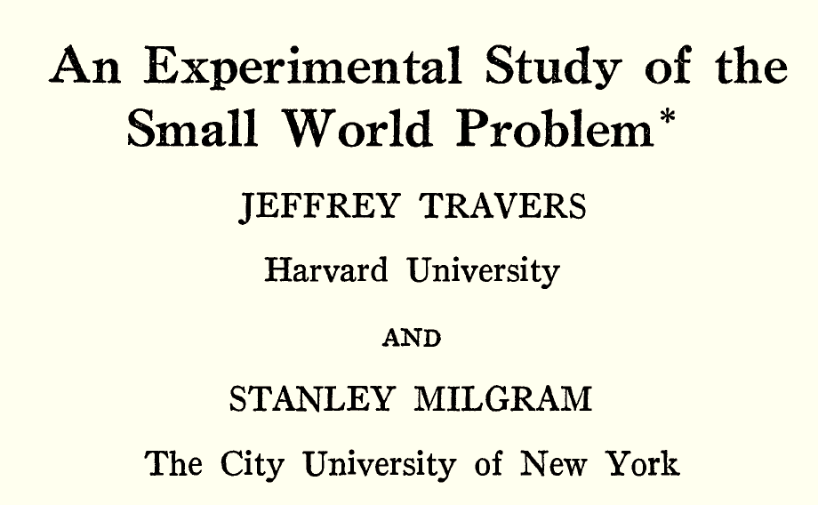
The Degrees-of-Separation Experiment
An experiment by Travers and Milgram published in 1969 to determine how many acquaintance “hops” exist between people in America.

Slide 4
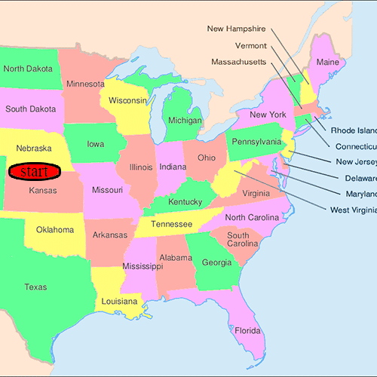
The Degrees-of-Separation Experiment
Random people in Nebraska were asked to send a letter to a stockbroker in Boston, MA.
Participants could only mail the letter to personal acquaintances, sending it directly only if they knew the stockbroker and otherwise sending it to a friend they thought might be able to reach the target.
GIF image by Ageev Andrew [CC BY-SA 3.0 (https://creativecommons.org/licenses/by-sa/3.0)]

Slide 5
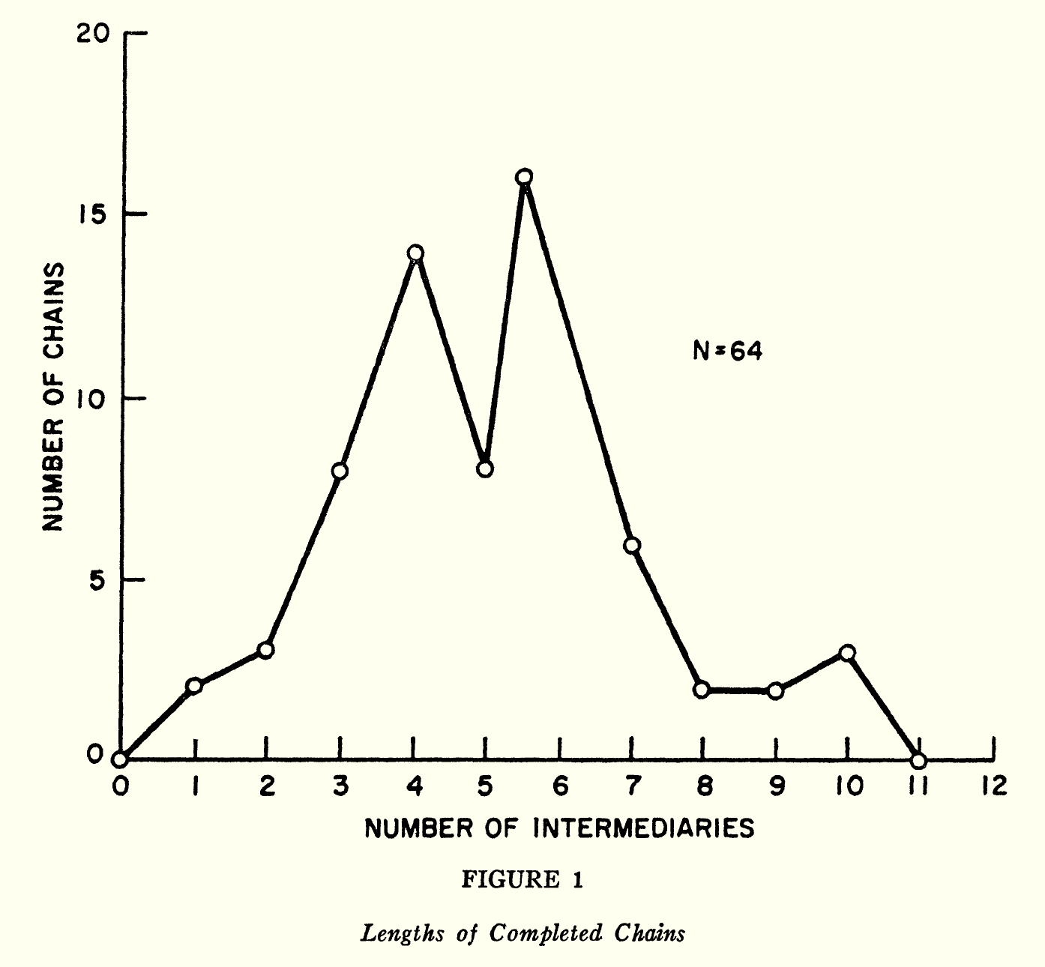
The Degrees-of-Separation Experiment
64 out of the 296 starting letters succeeded to be delivered to the stockbroker in Boston.
The average number of hops for successful letters was between 5 and 6.

Slide 6
The Degrees-of-Separation Experiment
This result gave rise to the expression that everyone in America has at most six degrees of separation.
Image by Daniel&#039; (User:Dannie-walker) [CC BY-SA 3.0 (https://creativecommons.org/licenses/by-sa/3.0)]

Slide 7
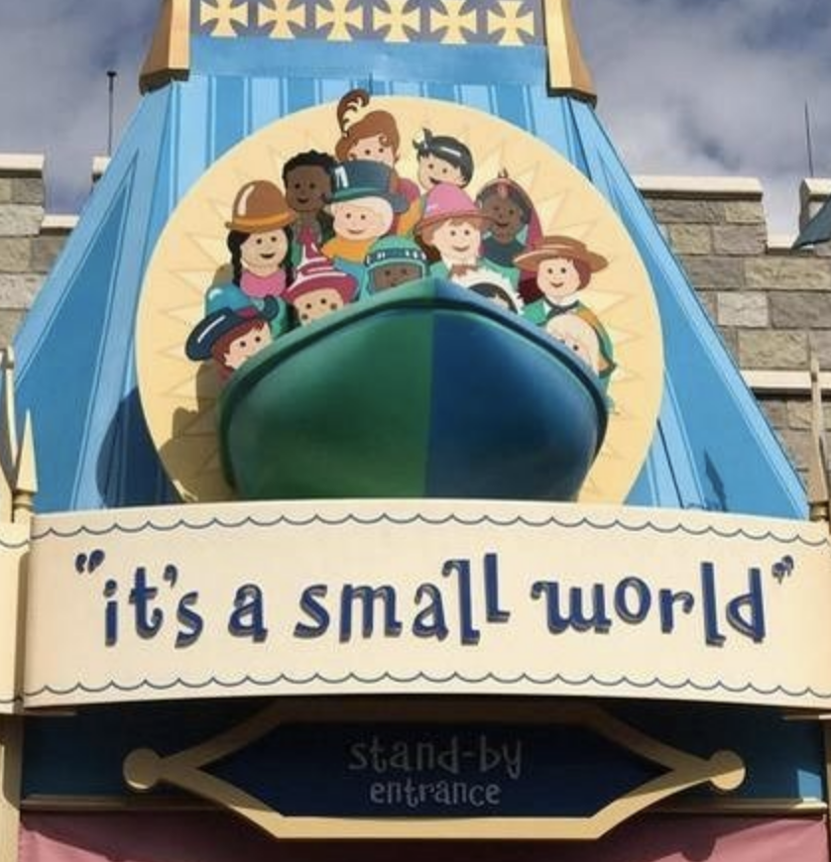
Small Worlds
This experiment led to many other, similar experiments and to a popular ride at Disneyland.*
*Actually, the Disneyland ride, “It’s a Small World,” opened in 1966, three years
before the Travers-Milgram experiment was published.

Slide 8
Example Networks (Social and Otherwise)

Slide 9
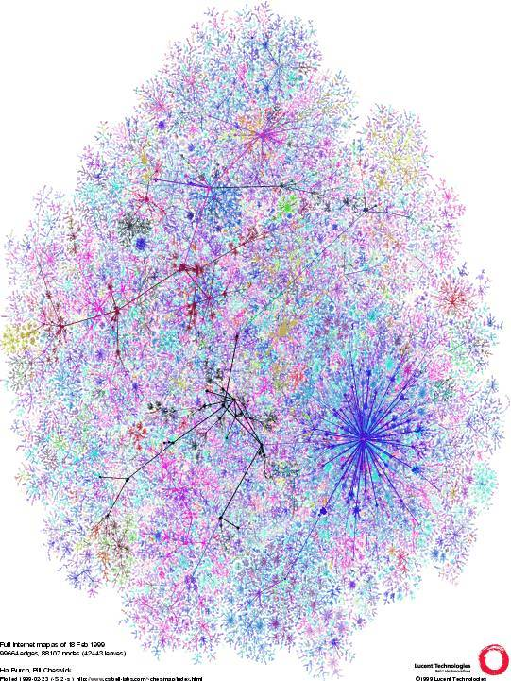
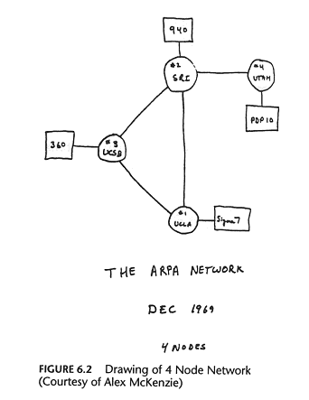
The Internet, Router Level
“Vertices” are physical machines
“Edges” are physical wires
Interaction is electronic
A purely technological network?

Slide 10
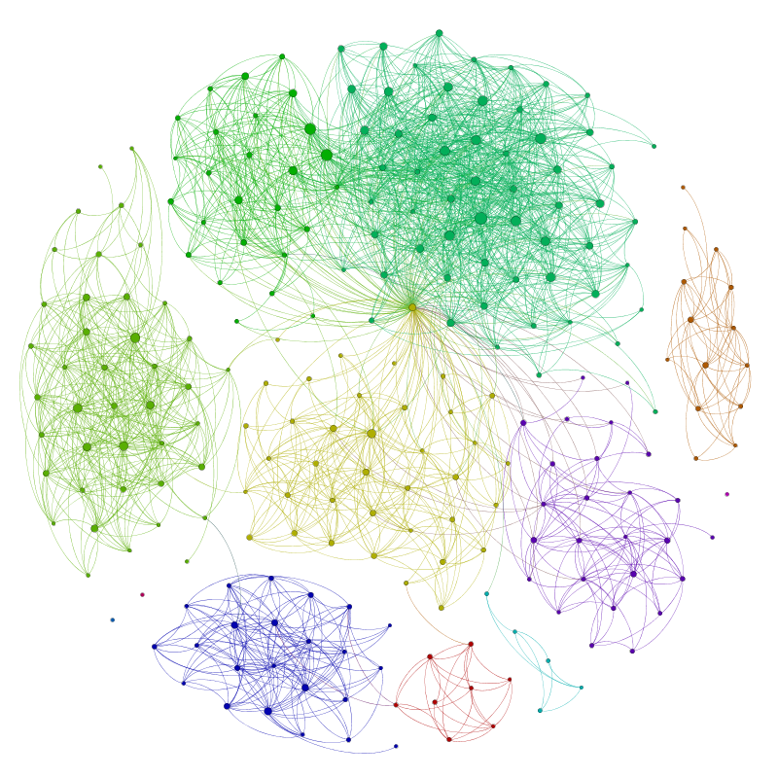
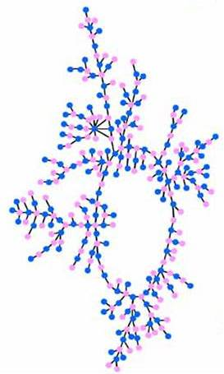
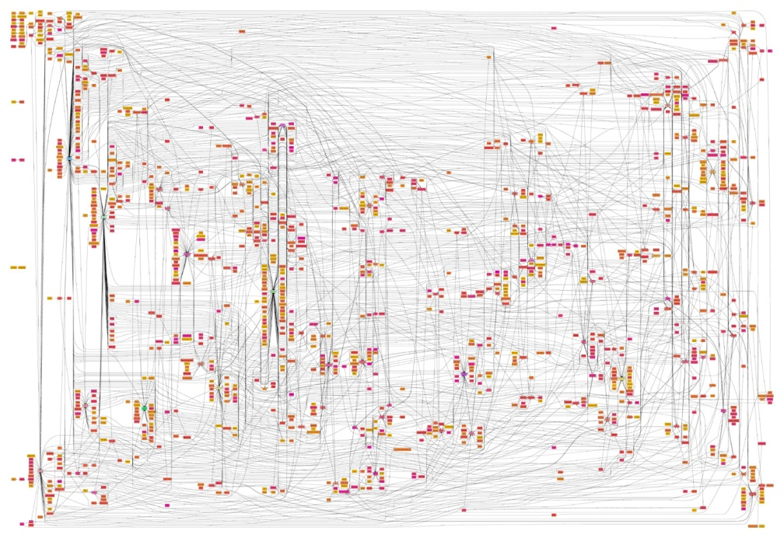
Social Networks
Vertices are people or animals
Edges are social relationships
Interactions: relationships, professional, virtual…
How and why does structure form?

Slide 11
A Small Social Network
From the TV show, “Breaking Bad”:

Slide 12
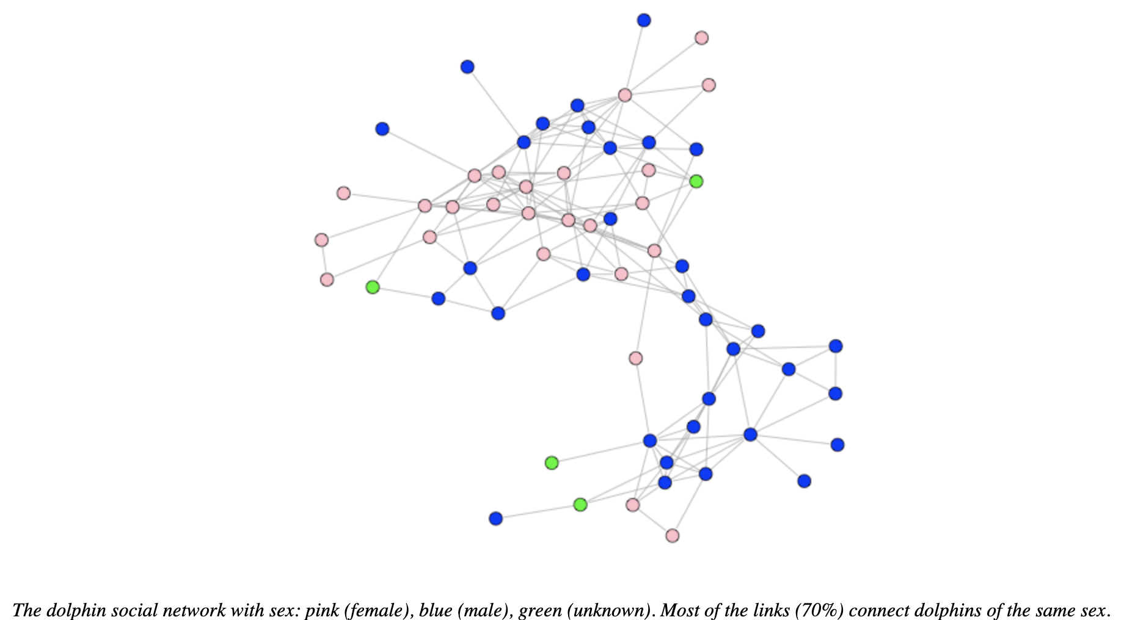
Another Small Social Network
Bottlenose dolphins
Vertices are dolphins
Edges are observed companionships
From https://users.dimi.uniud.it/~massimo.franceschet/bottlenose/bottlenose.html

Slide 13
Protein-Protein Interaction Networks
Vertices are proteins in a cell.
Edges represent the physical contacts between proteins in the cell.
Image by Madhavicmu - Own work, CC BY-SA 4.0, https://commons.wikimedia.org/w/index.php?curid=48447204

Slide 14
Who’s Doing All This?
Computer Scientists
Understand and design complex, distributed networks
View “competitive” decentralized systems as economies
Social Scientists, Behavioral Psychologists, Economists
Understand human behavior in “simple” settings
Revised views of economic rationality in humans
Theories and measurement of social networks
Biologists
Protein-protein interaction networks, gene regulatory networks,…
Physicists and Mathematicians
Interest and methods in complex systems
Theories of macroscopic behavior (phase transitions)
Communities are interacting and collaborating

Slide 15
Structural Properties of Networks

Slide 16
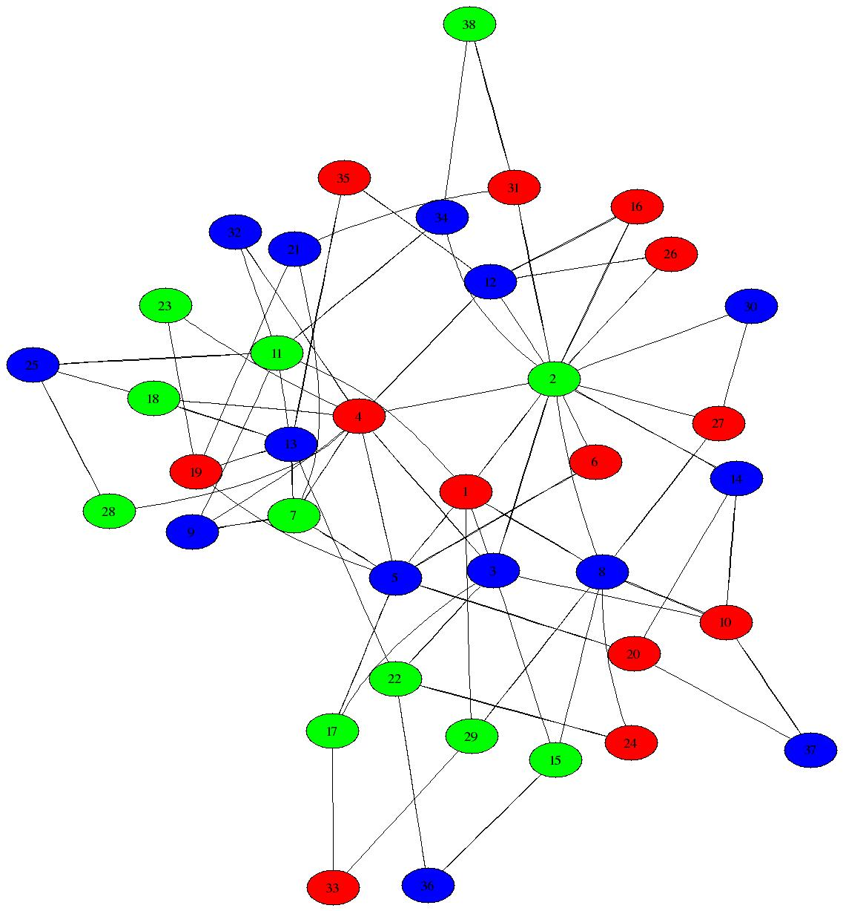
Networks: Basic Definitions
A network (or graph) is:
a collection of individuals or entities, each called a vertex or node
a list of pairs of vertices that are neighbors, representing edges or links
Examples:
vertices are mathematicians, edges represent coauthorship relationships
vertices are Facebook users, edges represent Facebook friendships
vertices are news articles, edges represent word overlap
Networks can represent any binary relationship over individuals
Often helpful to visualize networks with a diagram, but the network is the list of vertices and edges, not the visualization
same network has many different visualizations

Slide 17
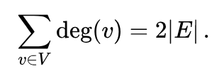
Networks: Basic Definitions
We will use the following notations:
n to denote the number of vertices, |V|, in a network
m to denote the number of edges, |E|, in a network
Number of possible edges:
In an undirected network, m is at most n(n-1)/2.
The degree of a vertex is its number of neighbors
Sum of all degrees is 2m:
Weisstein, Eric W. "Vertex Degree." From MathWorld--A Wolfram Web Resource. http://mathworld.wolfram.com/VertexDegree.html

Slide 18
Networks: Basic Definitions
The distance between two vertices is the length of the shortest path connecting them.
This assumes the network has only a single connected component
If two vertices are in different components, their distance is infinite
Image from https://www.sci.unich.it/~francesc/teaching/network/geodesic.html

Slide 19
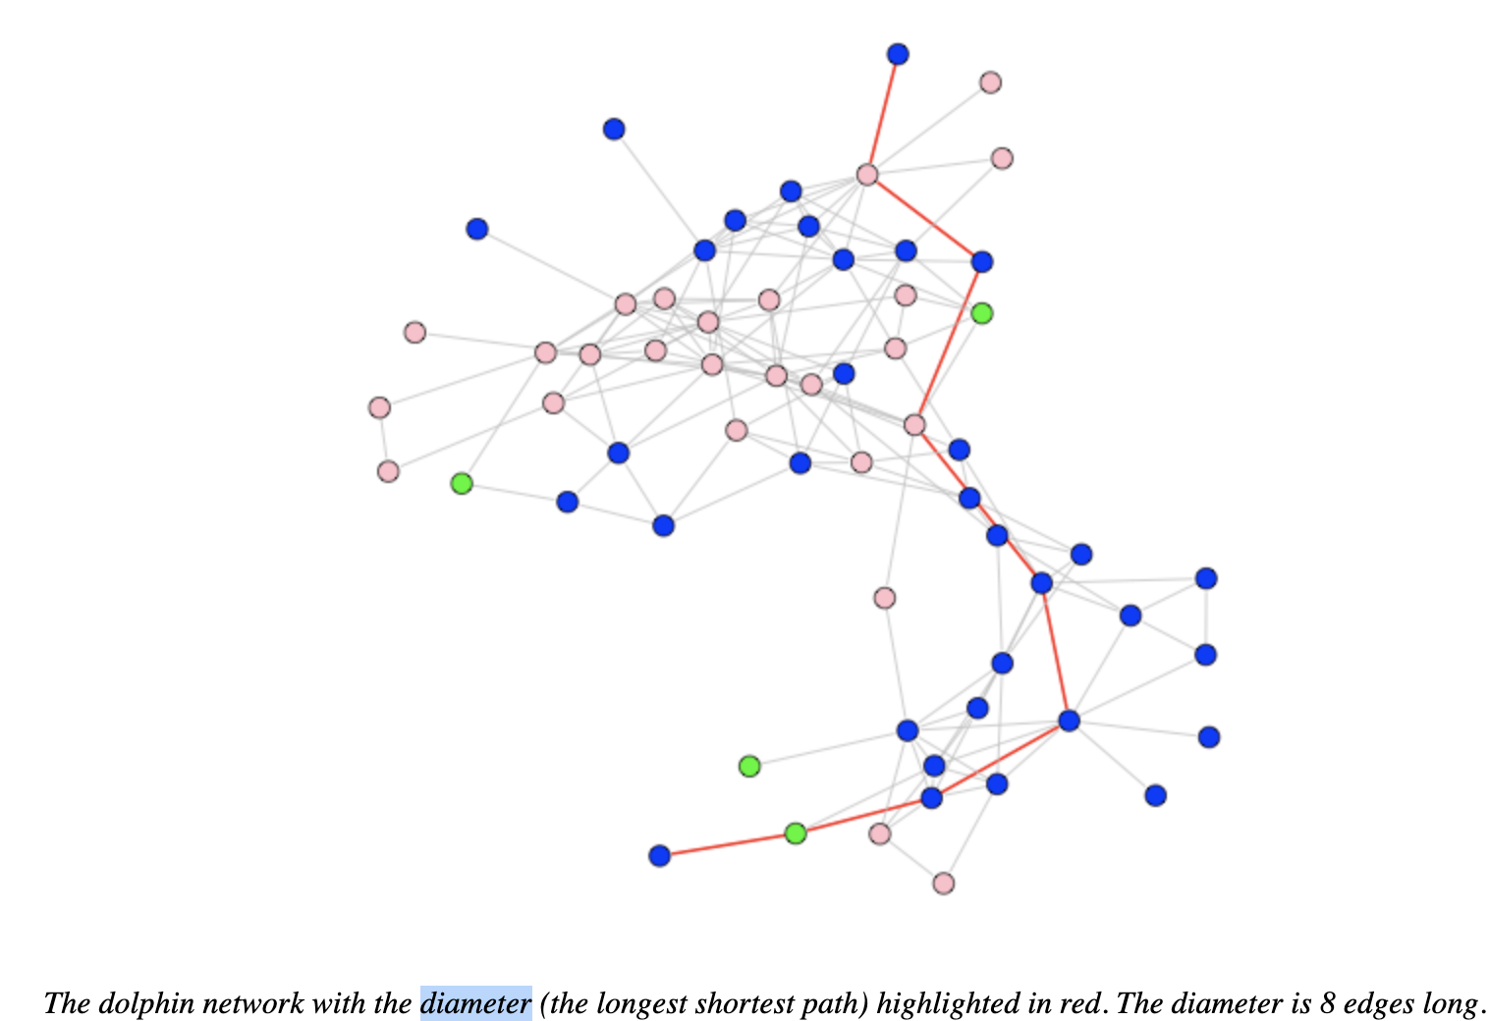
Networks: Basic Definitions
The diameter of a network is the maximum distance between a pair of vertices in the network
It measures how near or far typical individuals are from each other
From https://users.dimi.uniud.it/~massimo.franceschet/bottlenose/bottlenose.html

Slide 20
Networks: Basic Definitions
So far, we have been discussing undirected networks
Connection relationship is symmetric:
if vertex u is connected to vertex v, then v is also connected to u
Facebook friendship is symmetric/reciprocal
Sometimes we’ll want to discuss directed networks
I can follow you on Twitter without you following me
web page A may link to page B, but not vice-versa
In such cases, directionality matters and edges are annotated by arrows
Image from https://med.bioinf.mpi-inf.mpg.de/netanalyzer/help/2.7/index.html

Slide 21
Illustrating the Concepts
Example: scientific collaboration
vertices: math and computer science researchers
links: between coauthors on a published paper
Erdős numbers: distance to Paul Erdős
Erdős was definitely a hub or connector;
he had 507 coauthors
MG’s Erdős number is 3, and there are 11 different 3-hop paths:
Erdős->Avis->Snoeyink->Goodrich
Erdős->Pach->Bronnimann->Goodrich
Erdős->Pollack->Agarwal->Goodrich
Erdős->Alon->Vishkin->Goodrich
Erdős->Aronov->Kosaraju->Goodrich
Erdős->Wagstaff->Atallah->Goodrich
Erdős->Silverman->Mount->Goodrich
Erdős->Fraenkel->Scheinerman->Goodrich
Erdős->Odlyzko->Guibas->Goodrich
Erdős->Yao->Eppstein->Goodrich
Erdős->Fishburn->Tanenbaum->Goodrich
(Prof. Eppstein’s Erdős number is 2)

Slide 22
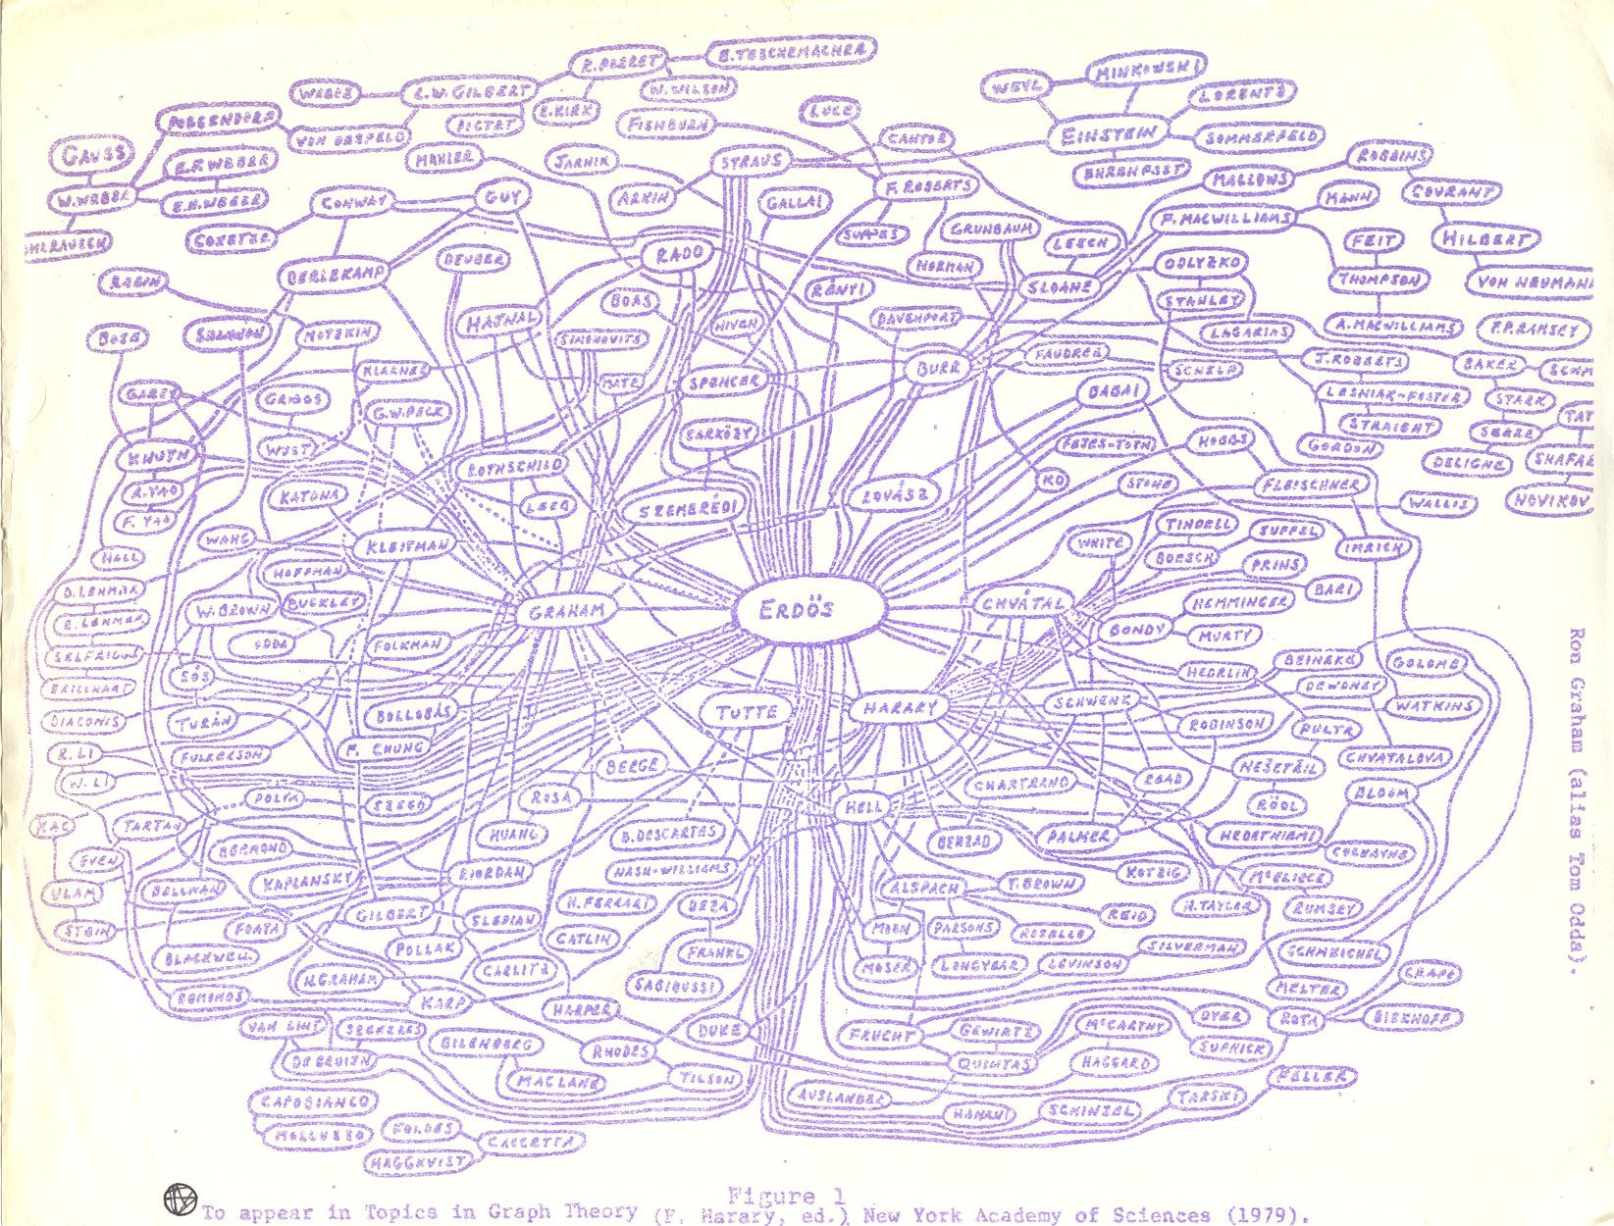

Slide 23
Erdös number 0 --- 1 person
Erdös number 1 --- 504 people
Erdös number 2 --- 6593 people
Erdös number 3 --- 33605 people
Erdös number 4 --- 83642 people
Erdös number 5 --- 87760 people
Erdös number 6 --- 40014 people
Erdös number 7 --- 11591 people
Erdös number 8 --- 3146 people
Erdös number 9 --- 819 people
Erdös number 10 --- 244 people
Erdös number 11 --- 68 people
Erdös number 12 --- 23 people
Erdös number 13 --- 5 people
The median Erdös number is 5; the mean is 4.65,
and the standard deviation is 1.21.

Slide 24
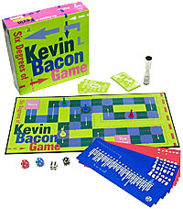
The Kevin Bacon Game
Invented by Albright College students in 1994:
Craig Fass, Brian Turtle, Mike Ginelly
Goal: Connect any actor to Kevin Bacon, by linking actors who have acted in the same movie.
Oracle of Bacon website uses Internet Movie Database (IMDB.com) to find shortest link between any two actors:
http://oracleofbacon.org/
Boxed version of the
Kevin Bacon Game

Slide 25
The Kevin Bacon Game
An Example
Kevin Bacon
Mystic River (2003)
Tim Robbins
Code 46 (2003)
Om Puri
Yuva (2004)
Rani Mukherjee
Black (2005)
Amitabh Bachchan
Notes:
(Actually, Amitabh is closer to Kevin, but the minimal path of 4 uses two actors who always play minor parts in movies, so I used this path, which involves better known actors.)

Slide 26
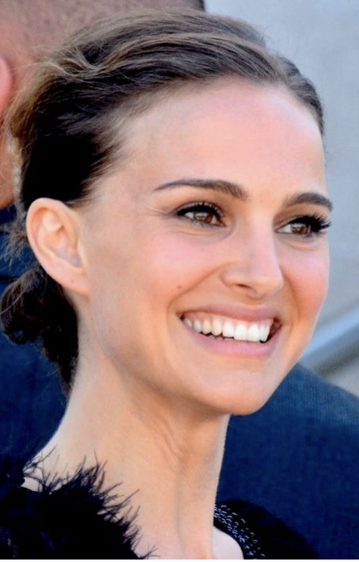
Erdős-Bacon Numbers
The sum of a person’s Erdős number and their Bacon number.
Colin Firth’s is 6=5+1
Natalie Portman’s is 7=5+2

Slide 27
Network Structure
Emphasize purely structural properties
size, diameter, connectivity, degree distribution, etc.
may examine statistics across many networks
will also use the term topology to refer to structure
Structure can reveal:
community
“important” vertices, centrality, etc.
robustness and vulnerabilities
can also impose constraints on dynamics
Less emphasis on what actually occurs on network
web pages are linked… but people surf the web
buyers and sellers exchange goods and cash
friends are connected… but have specific interactions

Slide 28
Network Structure: 1. Power Law Degree Distributions

Slide 29
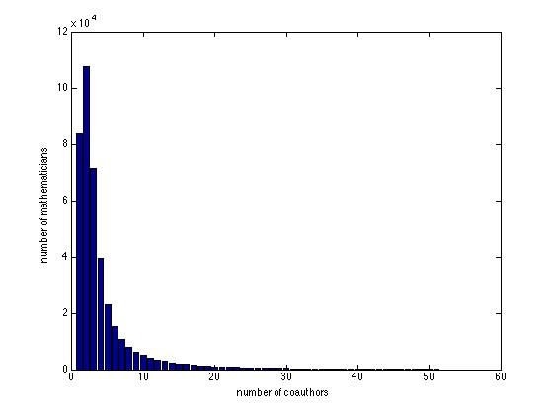
Math Collaboration Degree Distribution
x axis: number of neighbors/coauthors (degree)
y axis: number of mathematicians with that degree
A long tail
(also known as a heavy tail)

Slide 30
What Do We Mean By Not “Heavy-Tailed”?
Mathematical model of a typical “bell-shaped” distribution:
the Normal or Gaussian distribution over some quantity x
Good for modeling many real-world quantities… but not degree distributions
if mean/average is then probability of value x is:
main point: exponentially fast decay as x moves away from
if we take the logarithm:
Claim: if we plot log(x) vs log(probability(x)), will get strong curvature
Let’s look at some (artificial) sample data…
(Poisson better than Normal for degrees, but same story holds)

Slide 31
frequency(x)
log(frequency(x))
x
log(x)

Slide 32
What Do We Mean By “Heavy-Tailed”?
One mathematical model of a typical “heavy-tailed” distribution:
the Power Law distribution with exponent
main point: inverse polynomial decay as x increases
if we take the logarithm:
Claim: if we plot log(x) vs log(probability(x)), will get a straight line!
Let’s look at (artificial) some sample data…

Slide 33
frequency(x)
log(frequency(x))
x
log(x)

Slide 34
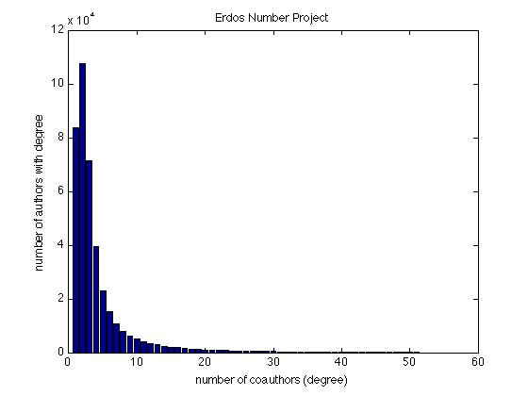
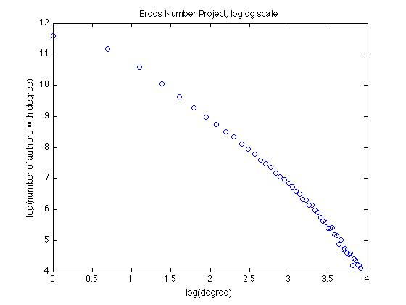
Erdos Number Project Revisited

Slide 35
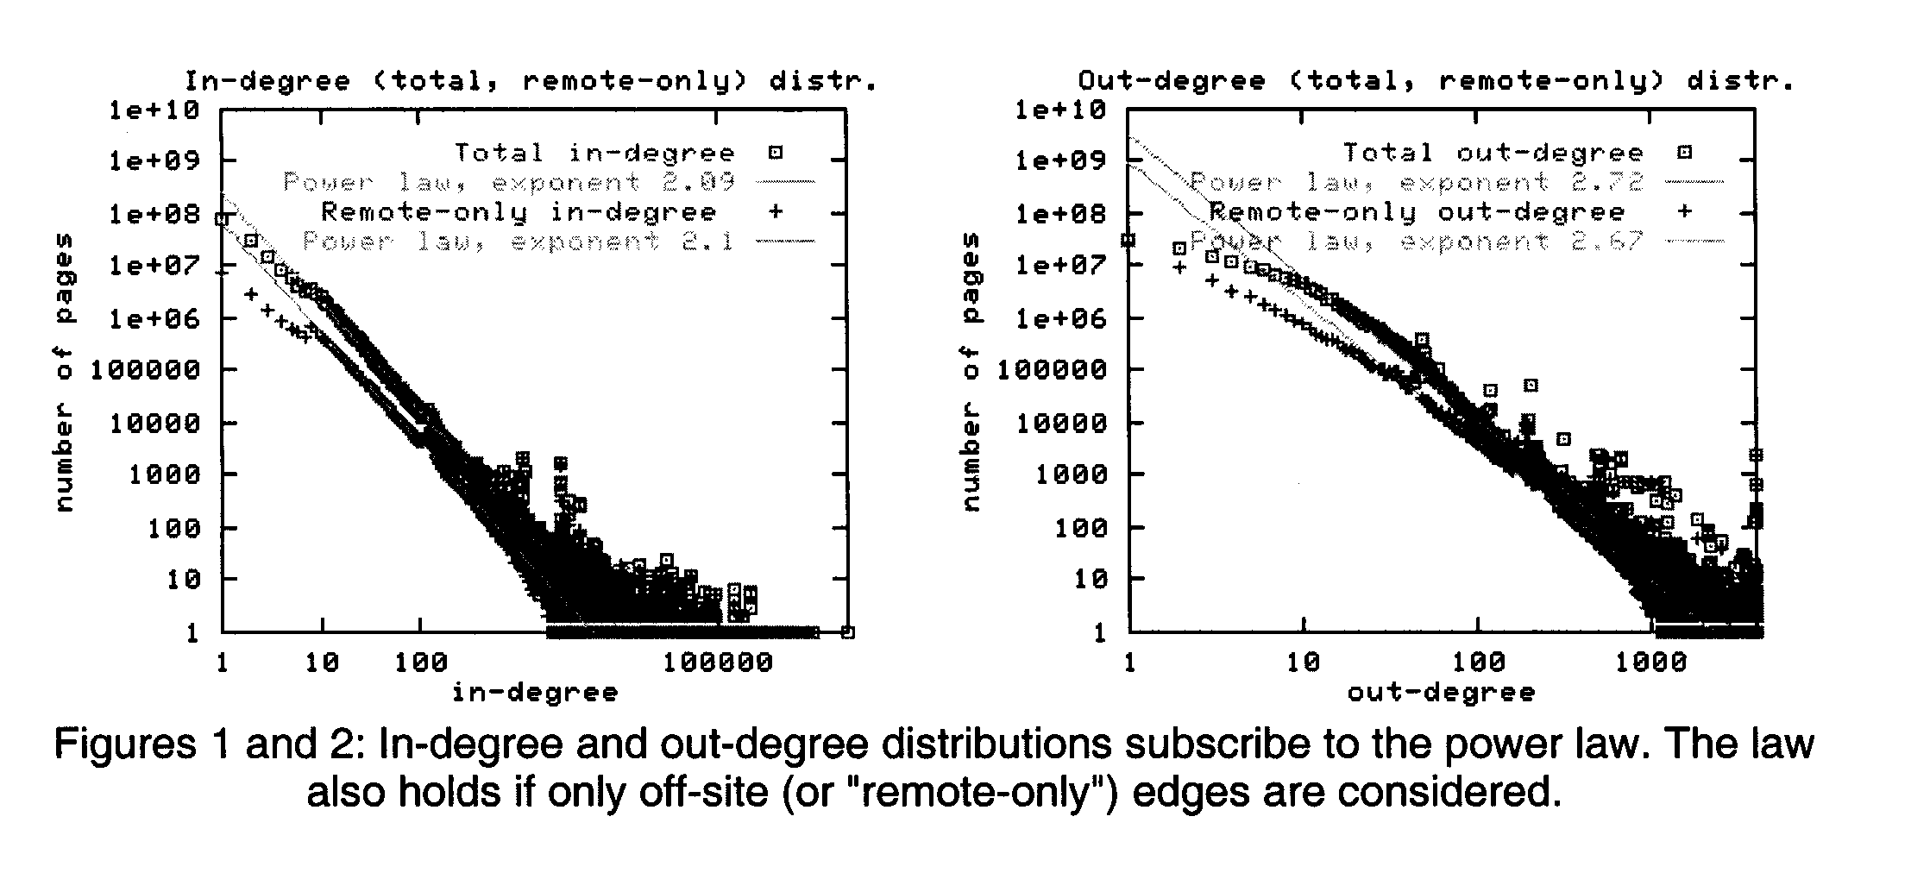
Degree Distribution of the Web Graph [Broder et al.]

Slide 36
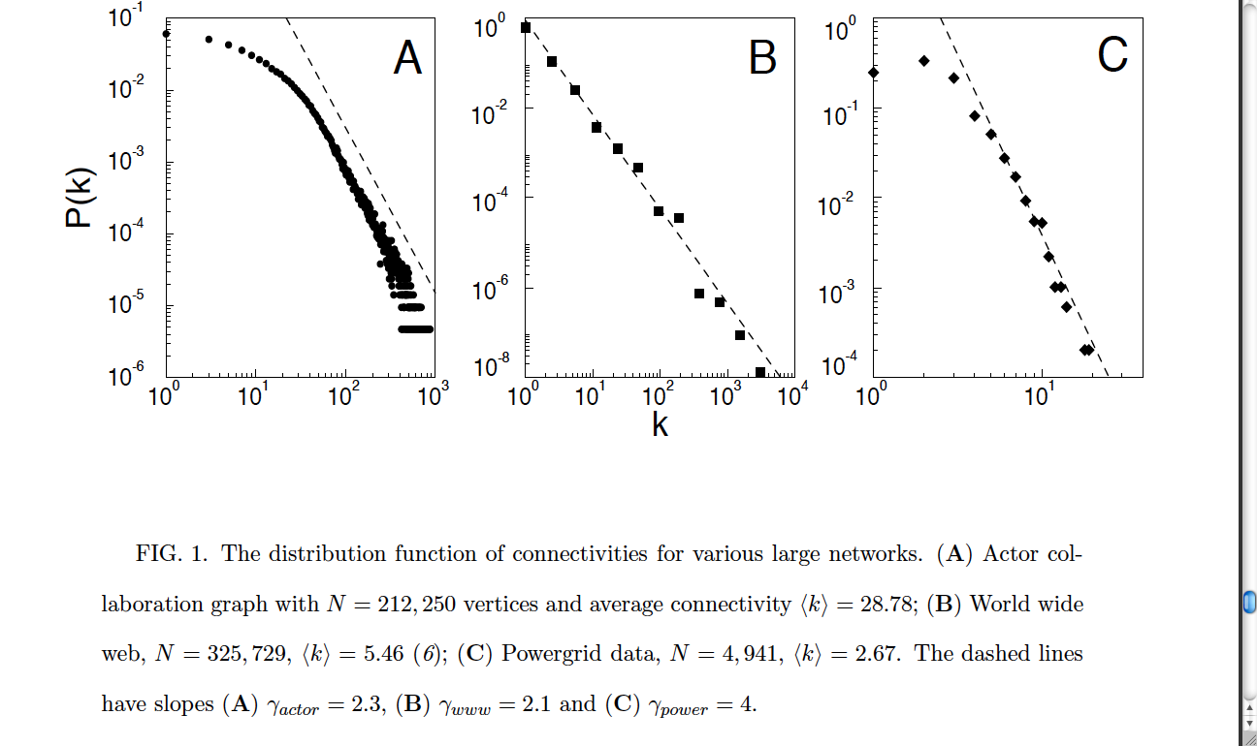
Actor Collaborations; Web; Power Grid [Barabasi and Albert]

Slide 37
Power Laws
A distribution has a power law if
P(k) = ck^{-α}, for constants, c and α
So log P(k) = log c + -α log k
Substituting b = log c, y = log P(k), and x = log k,
y = -α x + b
Look at the frequency of English words:
“the” is the most common, followed by “of”, “to”, etc.
claim: frequency of the n-th most common ~ 1/n (power law, a ~ 1)
General theme:
rank events by their frequency of occurrence
resulting distribution often is a power law!
Other examples:
North America city sizes
personal income
file sizes
let’s look at log-log plots of these

Slide 38
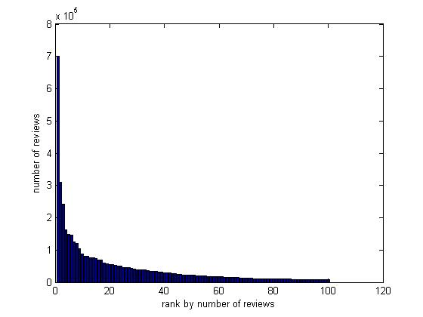
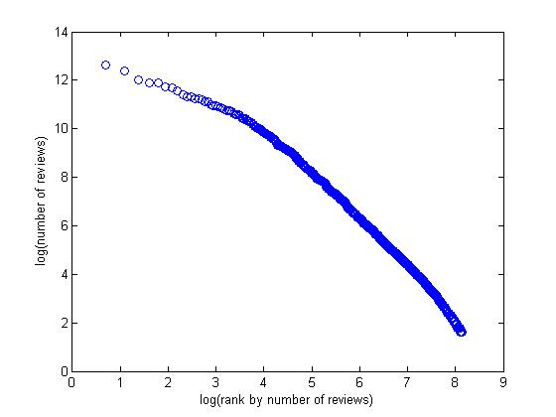
iPhone App Popularity

Slide 39
Power Laws
Power law distribution is a good mathematical model for heavy tails; Normal/bell-shaped is not
Statistical signature of power law and heavy tails: linear on a log-log scale
Many social and other networks exhibit this signature

Slide 40
Network Structure: 2. Small Diameter

Slide 41
What Do We Mean By “Small Diameter”?
First let’s recall the definition of diameter:
assumes network has a single connected component (or examine “giant” component)
for every pair of vertices u and v, compute shortest-path distance d(u,v)
equivalent: pick a random pair of vertices (u,v); what do we expect d(u,v) to be?
What’s the smallest/largest diameter(G) could be?
smallest: 1 (complete network, all N(N-1)/2 edges present); independent of N
largest: linear in N (chain or line network)
“Small” diameter:
no precise definition, but certainly << N
Travers and Milgram: ~5; any fixed network has fixed diameter
may want to allow diameter to grow slowly with N (?)
e.g. log(N)

Slide 42
Empirical Support for Small Diameter
Travers and Milgram, 1969:
diameter ~ 5-6, N ~ 200M
Columbia Small Worlds, 2003:
diameter ~4-7, N ~ web population?
Lescovec and Horvitz, 2008:
Microsoft Messenger network
Diameter ~6.5, N ~ 180M
Backstrom et al., 2012:
Facebook social graph
diameter ~5, N ~ 721M

Slide 43
Network Structure: 3. Clustering of Connectivity

Slide 44
The Clustering Coefficient of a Network
Intuition: a measure of how “bunched up” edges are
The clustering coefficient of vertex u:
let k = degree of u = number of neighbors of u
k(k-1)/2 = max possible # of edges between neighbors of u
c(u) = (actual # of edges between neighbors of u)/[k(k-1)/2]
fraction of pairs of friends that are also friends
0 <= c(u) <= 1; measure of cliquishness of u’s neighborhood
Clustering coefficient of a graph G:
CC(G) = average of c(u) over all vertices u in G
u
k = 4
k(k-1)/2 = 6
c(u) = 4/6 = 0.666…

Slide 45
What Do We Mean By “High” Clustering?
CC(G) measures how likely vertices with a common neighbor are to be neighbors themselves
Should be compared to how likely random pairs of vertices are to be neighbors
Let p be the edge density of network/graph G:
Here E = total number of edges in G
If we picked a pair of vertices at random in G, probability they are connected is exactly p
So we will say clustering is high if CC(G) >> p

Slide 46
Clustering Coefficient Example 1
1/(2 x 1/2) = 1
2/(3 x 2/2) = 2/3
3/(4 x 3/2) = 1/2
2/(3 x 2/2) = 2/3
1/(2 x 1/2) = 1
C.C. = (1 + ½ + 1 + 2/3 + 2/3)/5 = 0.7666…
p = 7/(5 x 4/2) = 0.7
Not highly clustered

Slide 47
Clustering Coefficient Example 2
Network: simple cycle + edges to vertices 2 hops away on cycle
By symmetry, all vertices have the same clustering coefficient
Clustering coefficient of a vertex v:
Degree of v is 4, so the number of possible edges between pairs of neighbors of v is 4 x 3/2 = 6
How many pairs of v’s neighbors actually are connected? 3 --- the two clockwise neighbors, the two counterclockwise, and the immediate cycle neighbors
So the c.c. of v is 3/6 = ½
Compare to overall edge density:
Total number of edges = 2N
Edge density p = 2N/(N(N-1)/2) ~ 4/N
As N becomes large, ½ >> 4/N
So this cyclical network is highly clustered

Slide 48
Clustering Coefficient Example 3
Divide N vertices into sqrt(N) groups of size sqrt(N) (here N = 25)
Add all connections within each group (cliques), connect “leaders” in a cycle
N – sqrt(N) non-leaders have C.C. = 1, so network C.C. → 1 as N becomes large
Edge density is p ~ 1/sqrt(N)

