Slide 1
Network Models
Michael Goodrich
Some slides adapted from:
Networked Life (NETS) 112, Univ. of Penn., 2018, Prof. Michael Kearns
Efficient generation of large random networks, by Batagelj and Brandes.

Slide 2
Database of Real-World Graphs
SNAP: Stanford Network Analysis Project’s Large Network Dataset Collection
http://snap.stanford.edu/data/index.html
Many real-world networks:
  Social networks : online social networks, edges represent interactions between people
  Communication networks : email communication networks with edges representing communication
  Citation networks : nodes represent papers, edges represent citations
  Collaboration networks : nodes represent scientists, edges represent collaborations (co-authoring a paper)
  Web graphs : nodes represent webpages and edges are hyperlinks
  Amazon networks : nodes represent products and edges link commonly co-purchased products
  Internet networks : nodes represent computers and edges communication
  … many more

Slide 3
Network Models
Recent studies of complex systems such as the Internet, biological networks, or social networks, have significantly increased the interest in modeling networks.
Network models are desired that match real-world graph structures and properties, including:
  Degree distributions
  Small-world property
  Clustering coefficients
Image from https://matrix.berkeley.edu/research/social-networks-history

Slide 4
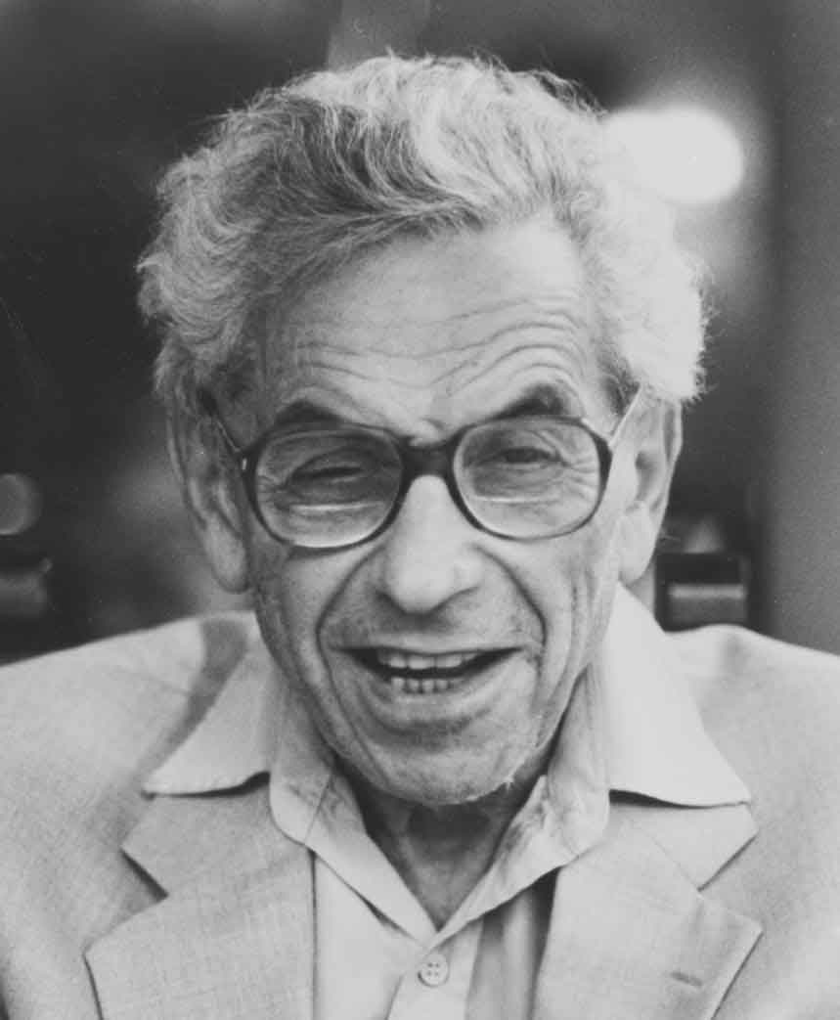
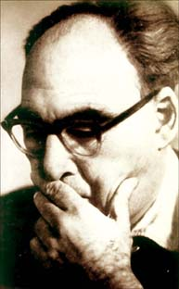
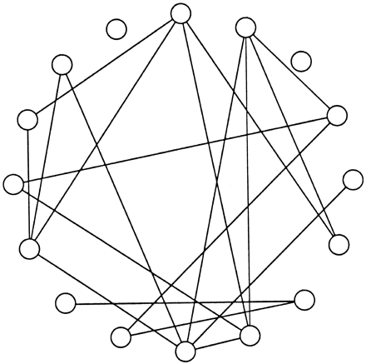
Network Models
I. The Erdös-Rényi (Random Graph) Model

Slide 5
Random Graphs (Erdös/Rényi)
G(n,p):
  n nodes
  Every pair of nodes is connected independently with probability p
  Average degree: d = (n-1)p ~ np

Slide 6
Erdös-Rényi G(n,p) Generation
Begin with n isolated vertices, no edges
Consider (unordered) vertex pairs, {v,w}, according to some ordering.
For each such pair, {v,w}:
  Randomly generate a bit, b, that is 1 with probability p.
  If b = 1, then add the edge (v,w) to the graph
This algorithm runs in O(n²) time, however.

Slide 7
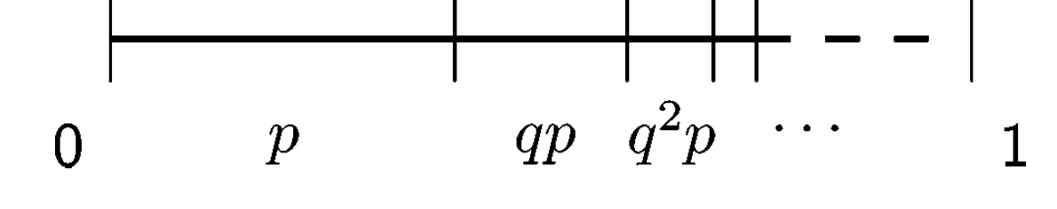
Faster Erdös-Rényi G(n,p) Generation
The above algorithm for generating G(n,p) is slow if p is small, because most of the bits are 0.
Probability of having k-1 0’s then a 1 is q^{k-1}p, where q = 1-p.
Waiting times are geometrically distributed.
Divide the interval [0,1) according to the waiting times:

Slide 8
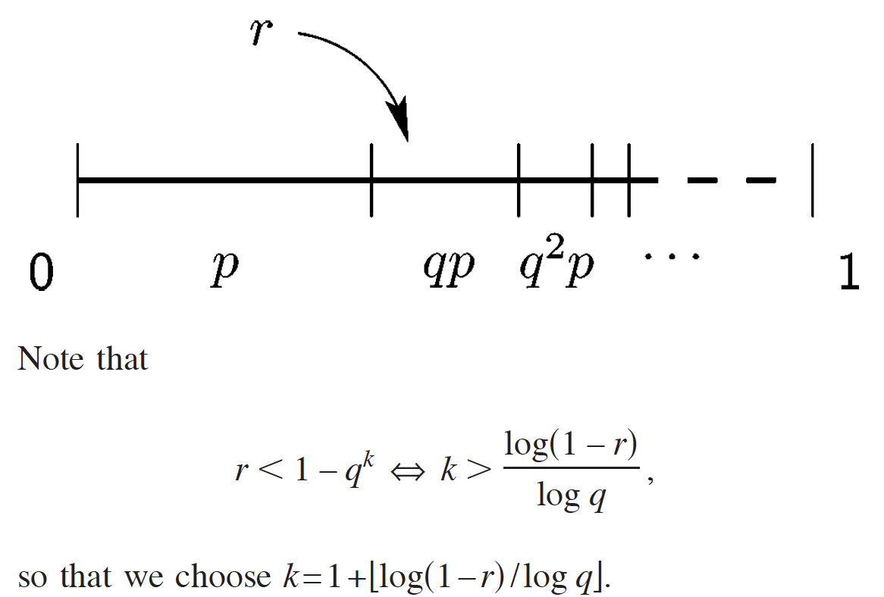
Faster Erdös-Rényi G(n,p) Generation
Pick r uniformly at random in the interval [0,1)
Divide the interval [0,1) according to the waiting times.
The subinterval in which r falls will sample a waiting time:

Slide 9
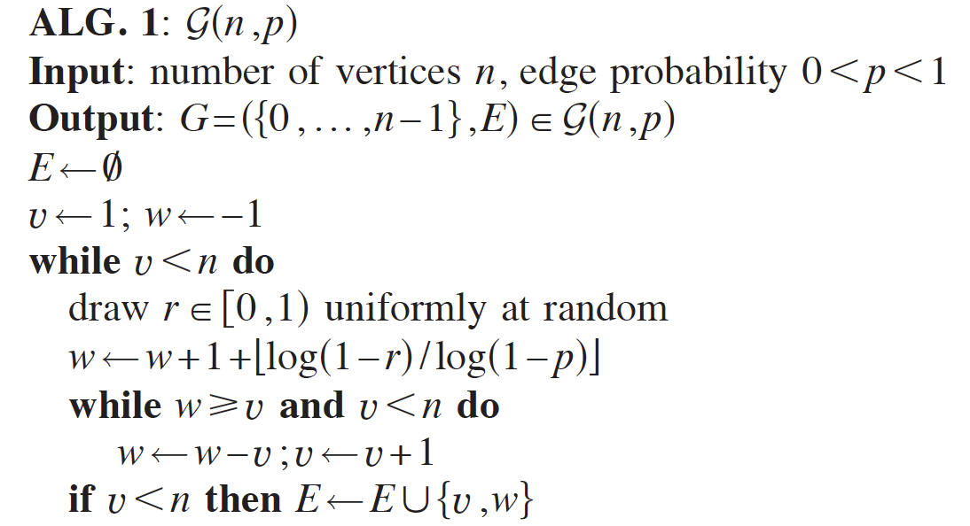
Faster Erdös-Rényi G(n,p) Generation
The above algorithm for generating G(n,p) is slow if p is small, because most of the bits are 0.
Probability of having k-1 0’s then a 1 is (1-p)^{k-1}p
Faster O(n+m)-time algorithm skips over runs of 0’s:

Slide 10
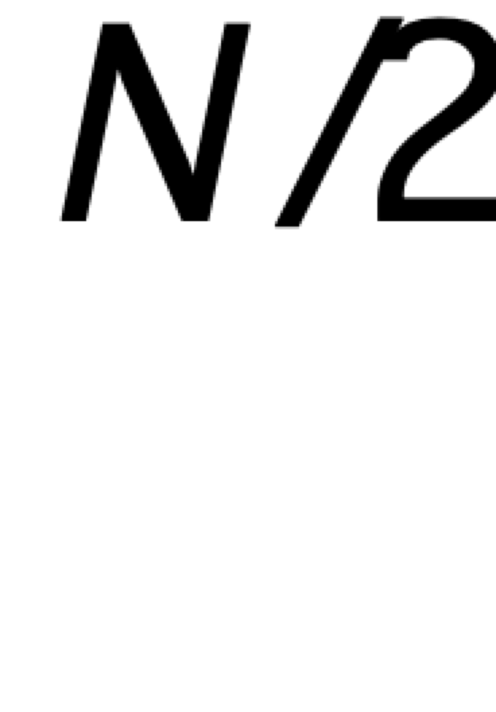
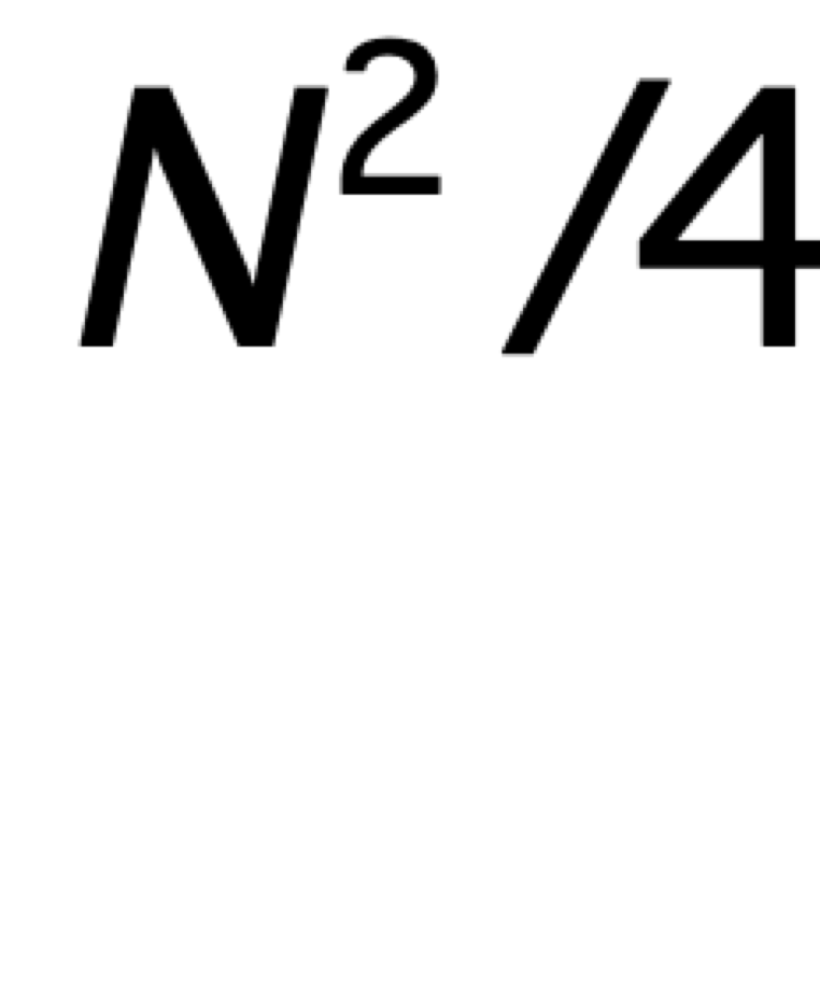
There Can’t Be Two Large Components?
densely connected
densely connected
missing edges

Slide 11
Threshold Phenomena in Erdös-Renyi
Theorem: In Erdös-Renyi, as n becomes large:
  If p < 1/n, probability of a giant component (e.g. 50% of vertices) goes to 0
  If p > 1/n, probability of a giant component goes to 1, and all other components will have size at most log(n)
Note: at edge density p, expected/average degree is p(N-1) ~ pn
So at p ~ 1/n, average degree is ~ 1: incredibly sparse
So model “explains” giant components in real networks
General “tipping point” at edge density q (may depend on n):
  If p < q, probability of property goes to 0 as n becomes large
  If p > q, probability of property goes to 1 as n becomes large
For example, could examine property “diameter 6 or less”

Slide 12
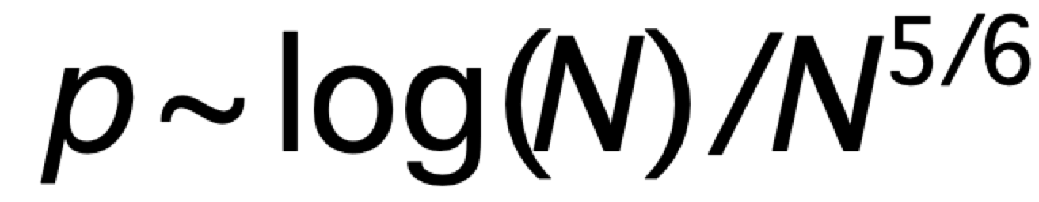
Threshold Phenomena in Erdös-Renyi
Theorem: In Erdös-Renyi, as N becomes large:
  The diameter is O(log (N) / log (Np).
  Threshold at
  for diameter 6.
  Note: degrees growing (slightly) with N
  If N = 300M (U.S. population) then average degree pN ~ 500
  If N = 7BN (world population) then average degree pN ~ 1000
  Not unreasonable figures…
At p not too far from 1/N, get strong connectivity
Very efficient use of edges

Slide 13
What Doesn’t the Model Explain?
Erdös-Renyi explains giant component and small diameter
But:
  degree distribution not heavy-tailed; exponential decay from mean (Poisson)
  clustering coefficient is *exactly* p
To model these real-world phenomena, we’ll need richer models with greater realism…

Slide 14
Rich-Get-Richer Processes
Processes in which the more someone has of something, the more likely they are to get more of it
Examples:
  the more friends you have, the easier it is to make more
  the more business a firm has, the easier it is to win more
  the more people there are at a nightclub, the more who want to go
Such processes will amplify inequality
One simple and general model: if you have amount x of something, the probability you get more is proportional to x
  so if you have twice as much as me, you’re twice as likely to get more
Generally leads to heavy-tailed distributions (power laws)

Slide 15
Preferential Attachment
Start with two vertices connected by an edge
At each step, add one new vertex v with one edge back to previous vertices
Probability a previously added vertex u receives the new edge from v is proportional to the (current) degree of u
  more precisely, probability u gets the edge is
  (current degree of u)/(sum of all current degrees)
Vertices with high degree are likely to get even more links!
  just like Instagram, Twitter, …
Generates a power law distribution of degrees
Variation: each new vertex initially gets d edges

Slide 16
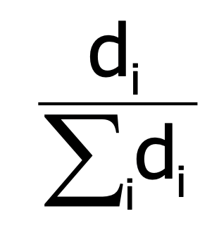
Barabasi-Albert (BA) model
The BA model for preferential attachment
  input: some initial subgraph G₀, and d the number of edges per new node
  the process:
    nodes arrive one at the time
    each node connects to d other nodes selecting them with probability proportional to their degree
    if [d₁,…,d_{t}] is the degree sequence at time t, the node t+1 links to node i with probability equal to
Guarantees a degeneracy of d. Why?
Brute-force algorithm runs in O(n²) time. (Bad.)

Slide 17
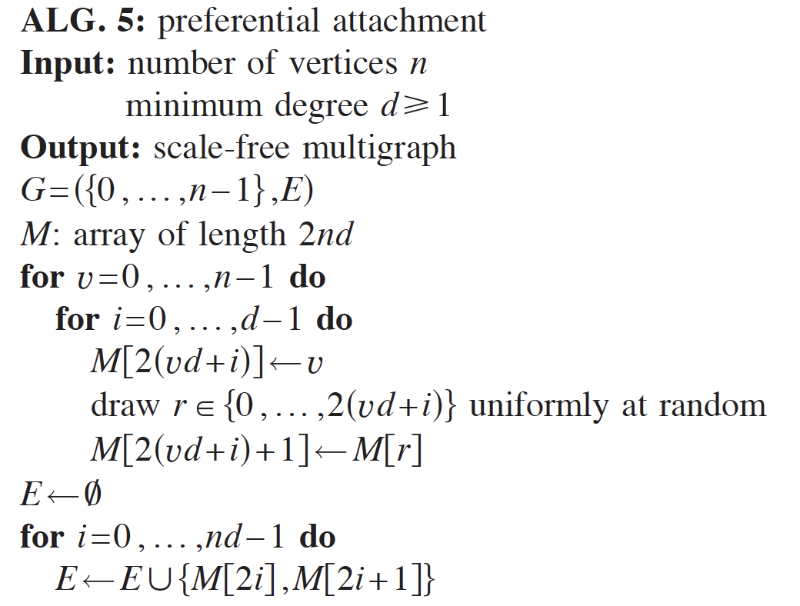
Faster Barabasi-Albert (BA) Algorithm
Let d be the parameter for the BA algorithm
// M is an array of edges chosen so far.
// Each vertex v appears d_{v} times in M.

Slide 18
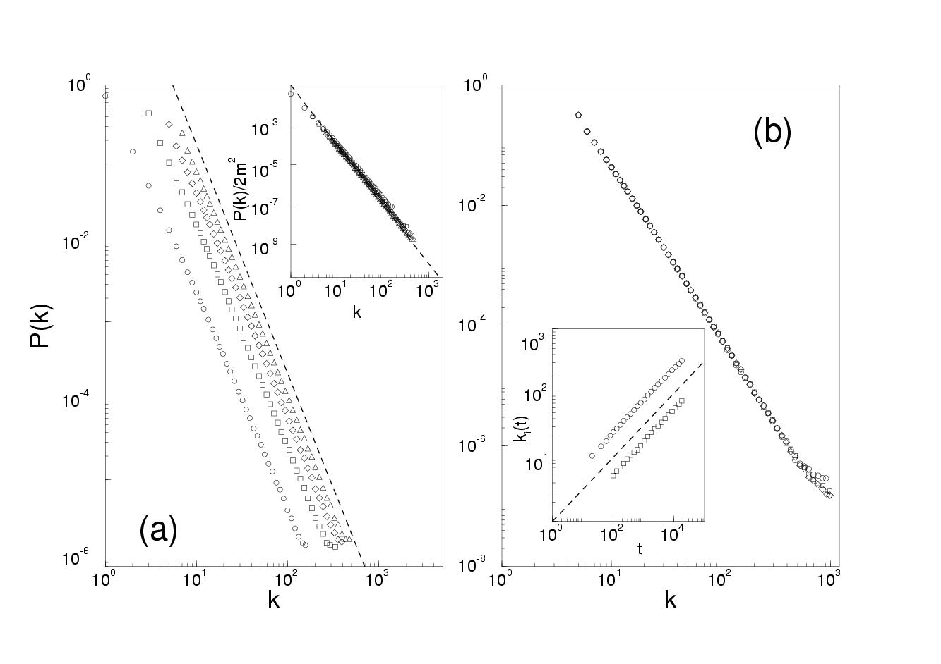
Barabasi-Albert (BA) algorithm
Faster algorithm runs in O(nd) = O(n+m) time.
The BA model should result in power-law degree distribution with exponent c = -3
c = -3. different d’s. P(k) changes. c does not

