Slide 1
Principles for Experimental Algorithmics
Michael T. Goodrich
Dept. of Computer Science
based, in part, on the following papers:
Towards a Discipline of Experimental Algorithmics, by Bernard M.E. Moret
A Theoretician’s Guide to the Experimental Analysis of Algorithms, by David S. Johnson

Slide 2
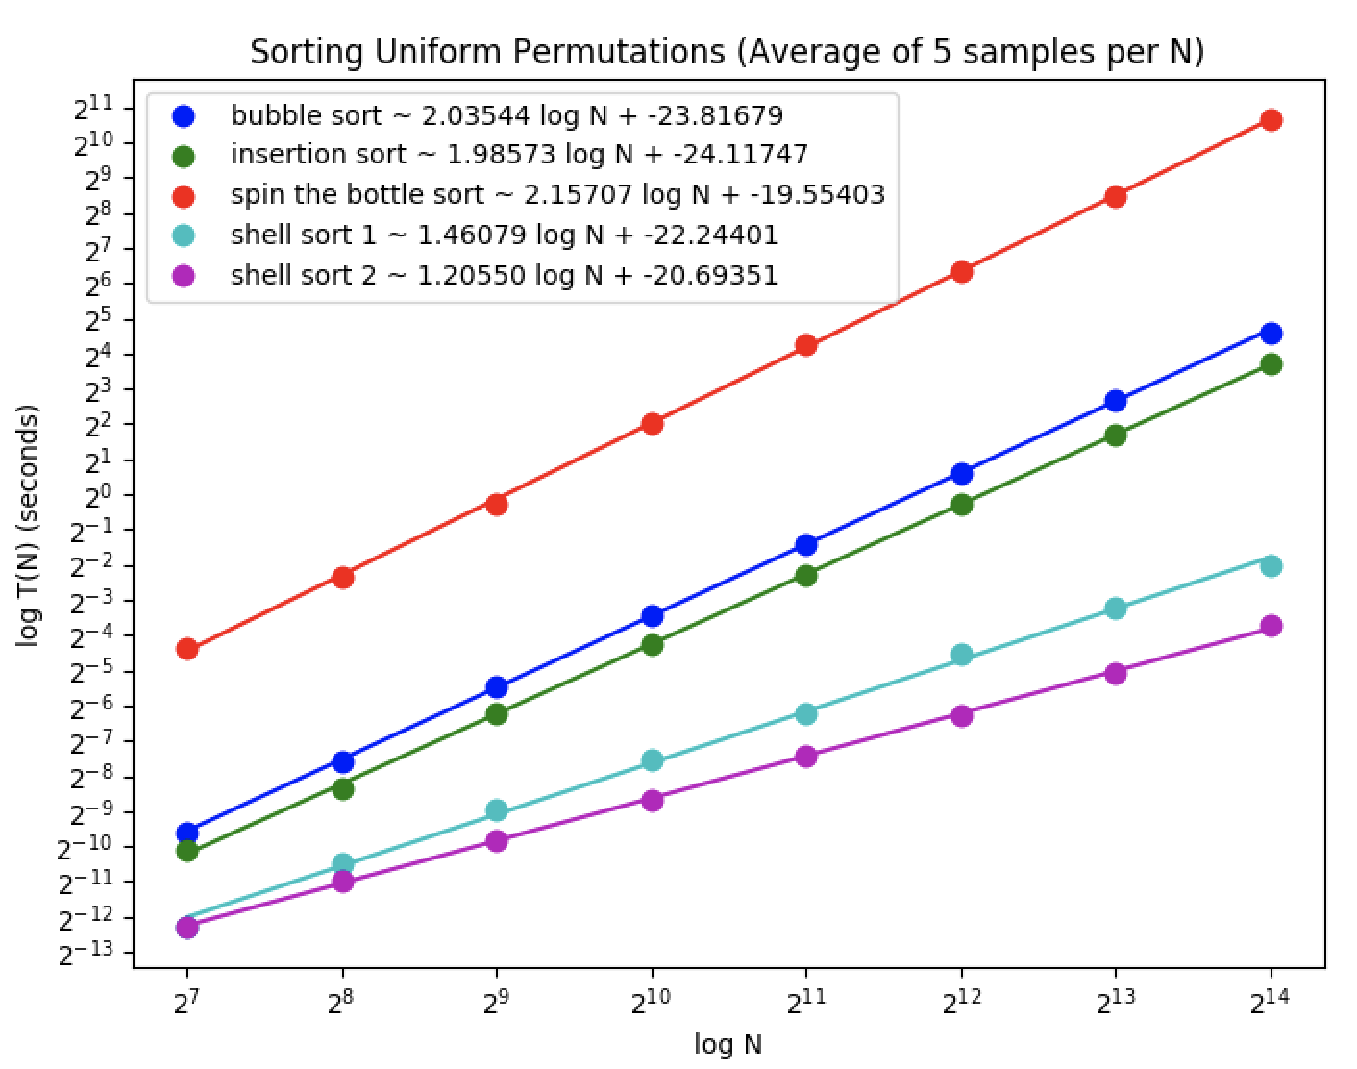
Experimental Algorithmics
Experimental Algorithmics studies algorithms and data structures by joining experimental studies with the traditional theoretical analyses.
Scientists do experiments because they have no choice
In experimental algorithmics we combine theoretical analysis with experimentation.

Slide 3
Experimental Algorithmics
Experimentation with algorithms and data structures can prove to be indispensable for the following tasks:
The assessment of heuristics for hard problems
The characterization of asymptotic behavior of complex algorithms
The comparison of competing designs for tractable problems
The formulation of new combinatorial conjectures
The evaluation of optimization criteria
The transfer of research results from paper to production code

Slide 4
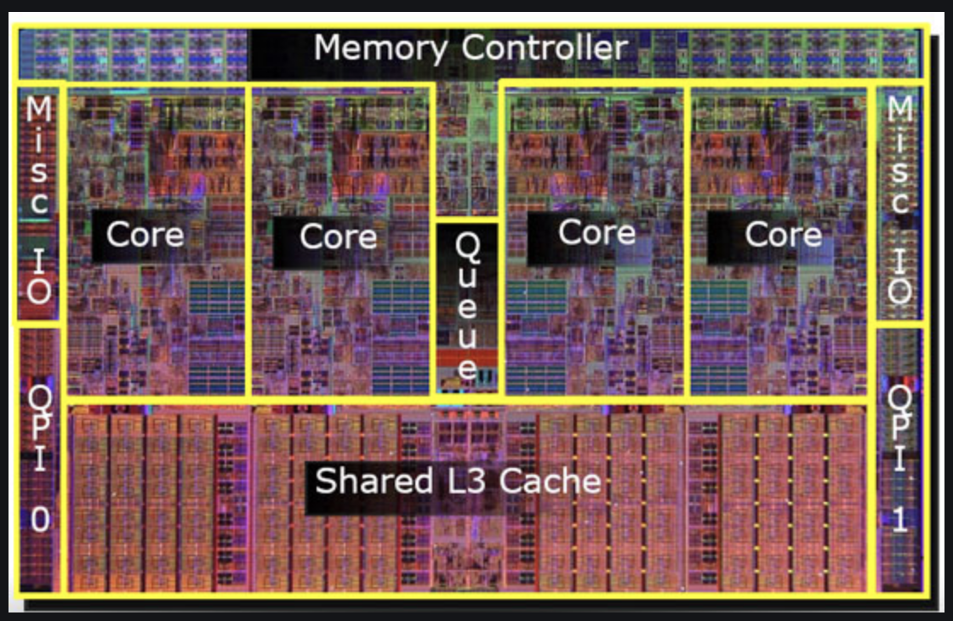
Perform Worthwhile Experiments
Ask questions worth asking
New problems
New algorithms
New types of input distributions
New types of computer hardware

Slide 5
Measuring Actual Performance
Random instances should be motivated from real-world data
Also use real-world data when possible
http://dimacs.rutgers.edu/programs/challenge/
http://snap.stanford.edu/

Slide 6
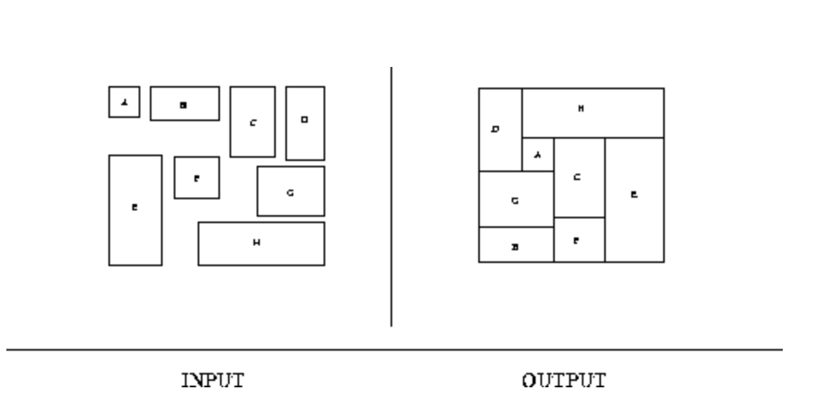
Testing the Quality of Solutions
Find a parameter that can be effectively tested experimentally
Waste in bin packing
Closeness to a known lower bound

Slide 7
Experimental Setup
Have clear objectives
Gather data to answer the questions posed
Choose hardware appropriately
Code solutions consistently to allow for good conclusions
Generate useful problem instances
Analyze your data

Slide 8
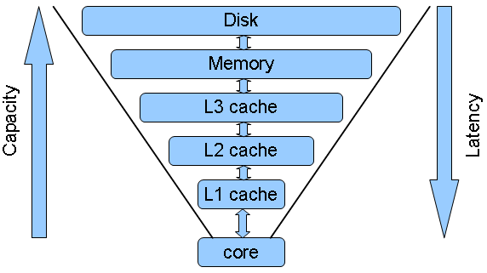
Understand Your Hardware: The Memory Hierarchy
The trade-off of size and speed
1 TB
10 ms
4 GB
100 ns
5 ns
0.5 ns

Slide 9
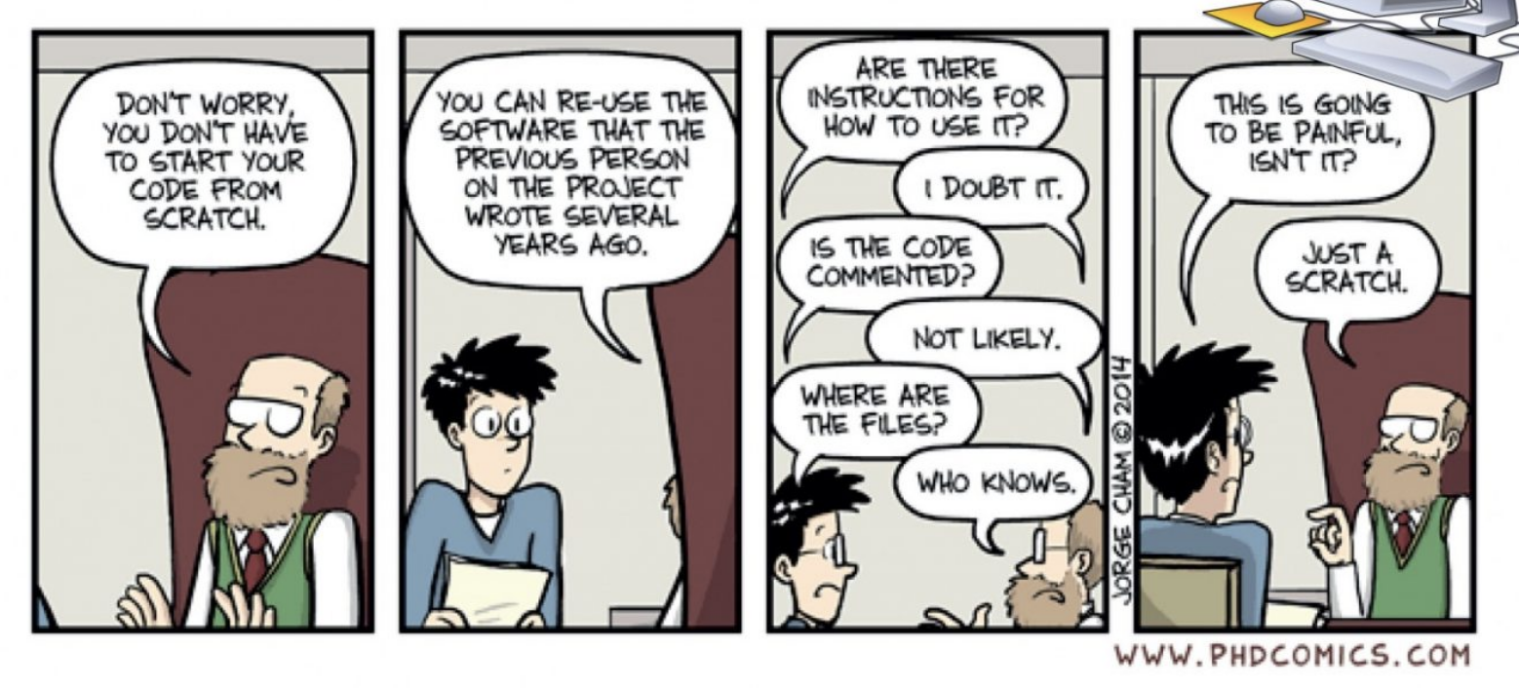
Ensure Reproducibility
Unless it is truly confidential, post your code for others to use.
For random data, post how you generated it
For real-world data, post how to get it

Slide 10
Ensure Comparability
Perform all experiments on the same hardware
Report the type of hardware used
Code all algorithms with the same level of code optimizations and tuning

Slide 11
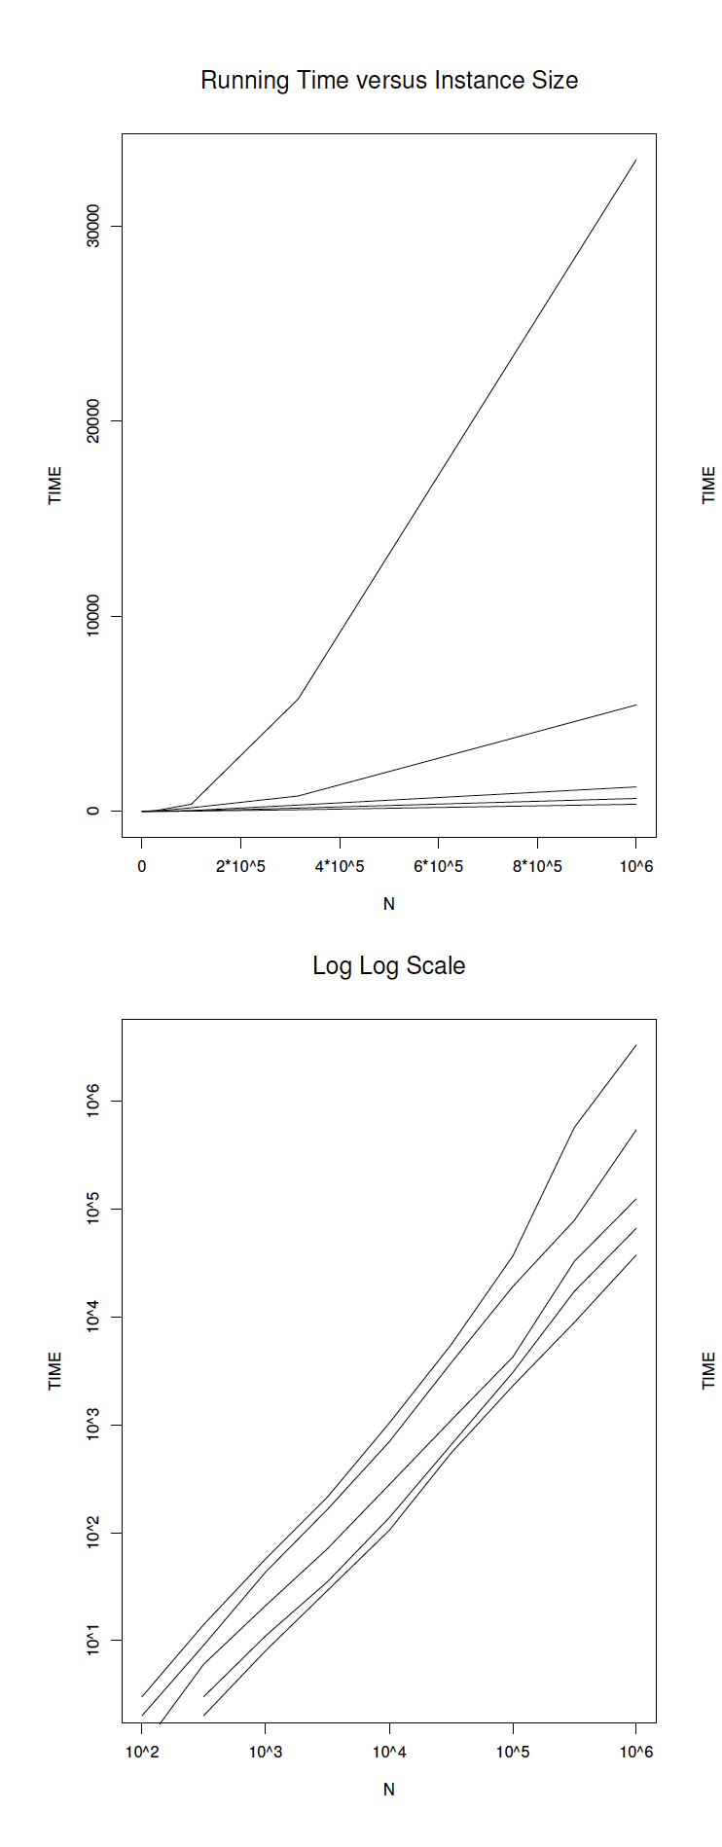
Present your Data in Meaningful Ways
Use tables only for small data sets

