Slide 1
Some slides from CS 15-853:Algorithms in the Real World, Carnegie Mellon University
Generating Random and Pseudorandom Numbers
Michael Goodrich
CS 165

Slide 2
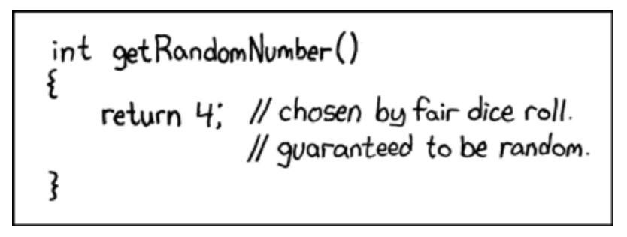
Random Numbers in the Real World
https://fitforrandomness.files.wordpress.com/2010/11/dilbert-does-randomness.jpg
https://xkcd.com/221/

Slide 3
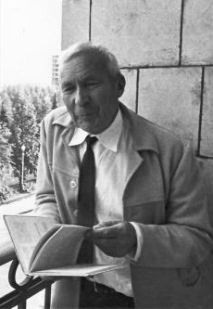
Random number sequence definitions
Randomness of a sequence is the Kolmogorov complexity of the sequence (size of smallest Turing machine that generates the sequence) – infinite sequence should require infinite size Turing machine.
This definition is useful for proving computational complexity results, but it is not as useful for algorithm experiments.
Andrey Kolmogorov

Slide 4
Random number sequence definitions
Each element is chosen independently from a probability distribution [Donald Knuth].
This definition is more usable for algorithm experiments.
A typical distribution is the uniform distribution, where every number in a range of numbers is equally likely.
Donald Knuth

Slide 5
Environmental Sources of Randomness
Radioactive decay http://www.fourmilab.ch/hotbits/
Radio frequency noise http://www.random.org
Noise generated by a resistor or diode.
Canada http://www.tundra.com/ (find the data encryption section, then look under RBG1210. My device is an NM810 which is 2?8? RBG1210s on a PC card)
Colorado http://www.comscire.com/
Holland http://valley.interact.nl/av/com/orion/home.html
Sweden http://www.protego.se
Inter-keyboard timings (watch out for buffering)
Inter-interrupt timings (for some interrupts)

Slide 6
Combining Sources of Randomness
Suppose r₁, r₂, …, r_{k} are random numbers from different sources. E.g.,
r₁ = from JPEG file
r₂ = sample of hip-hop music on radio
r₃ = clock on computer
b = r₁ ⊕ r₂ ⊕ … ⊕ r_{k}
If any one of r₁, r₂, …, r_{k} is truly random, then so is b.

Slide 7
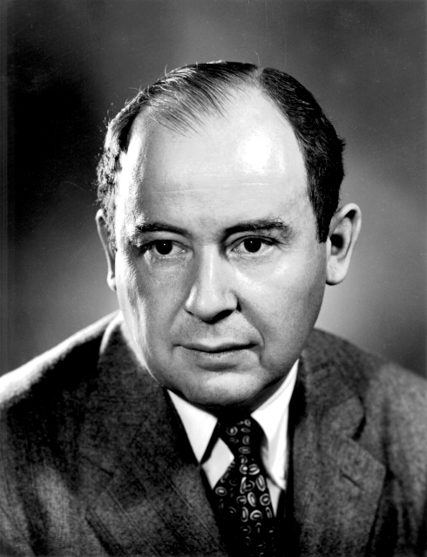
Skew Correction
Von Neumann’s algorithm – converts biased random bits to unbiased random bits:
Collect two random bits.
Discard if they are identical.
Otherwise, use first bit.
Efficiency?
John von Neumann

Slide 8
Chi Square Test
Experiment with k outcomes, performed n times.
p₁, …, p_{k} denote probability of each outcome
Y₁, …, Y_{k} denote number of times each outcome occured
Large X² indicates deviance from random chance

Slide 9
Analysis of random.org numbers
John Walker’s Ent program
Entropy = 7.999805 bits per character.
Optimum compression would reduce the size of this 1048576 character file by 0 percent.
Chi square distribution for 1048576 samples is 283.61, and randomly would exceed this value 25.00 percent of the times.
Arithmetic mean value of data bytes is 127.46 (127.5 = random).
Monte Carlo value for PI is 3.138961792 (error 0.08 percent).
Serial correlation coefficient is 0.000417 (totally uncorrelated = 0.0

Slide 10
Analysis of JPEG file
Entropy = 7.980627 bits per character.
Optimum compression would reduce the size of this 51768 character file by 0 percent.
Chi square distribution for 51768 samples is 1542.26, and randomly would exceed this value 0.01 percent of the times.
Arithmetic mean value of data bytes is 125.93 (127.5 = random).
Monte Carlo value for Pi is 3.169834647 (error 0.90 percent).
Serial correlation coefficient is 0.004249 (totally uncorrelated = 0.0).

Slide 11
Pseudorandom Number Generators
A pseudorandom number generator (PRNG) is an algorithm for generating a sequence of numbers whose properties approximate the properties of sequences of random numbers.
The PRNG-generated sequence is not truly random, because it is completely determined by an initial value, called the PRNG's seed (which may include truly random values).
Although sequences that are closer to truly random can be generated using hardware random number generators, pseudorandom number generators are important in practice for their speed and reproducibility.

Slide 12
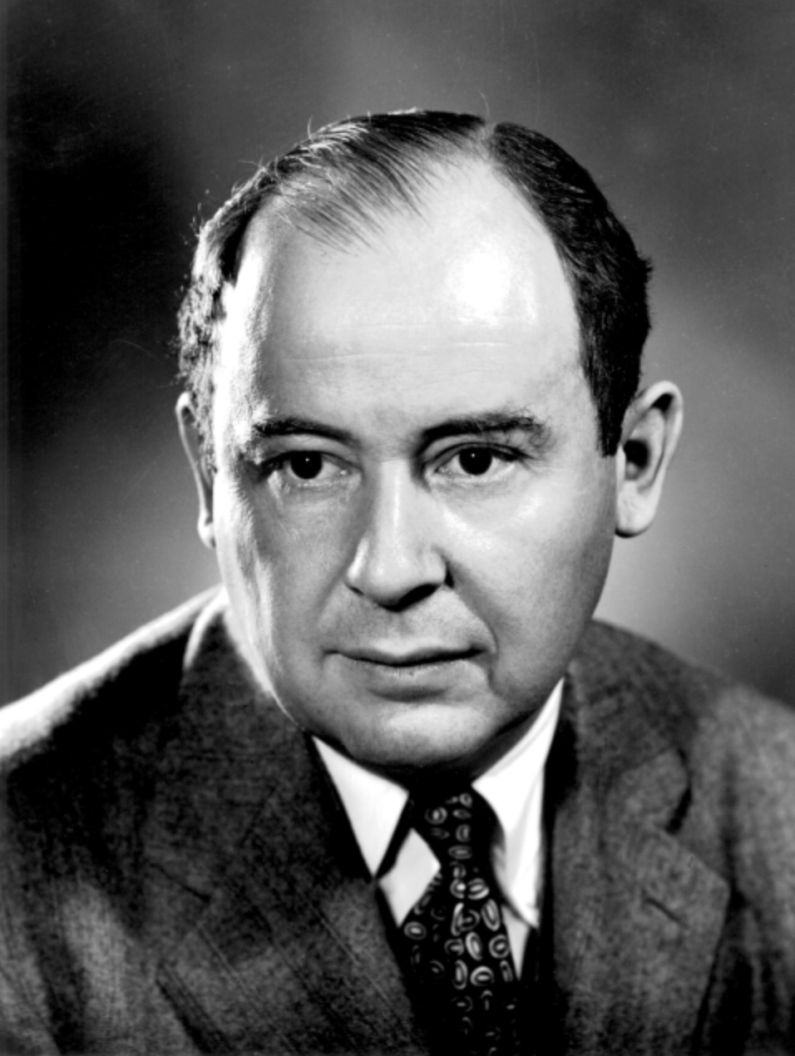
Pseudorandom Number Generators
PRNGs are central in applications such as simulations (e.g. for the Monte Carlo method), electronic games (e.g. for procedural generation), and cryptography.
Cryptographic applications require the output not to be predictable from earlier outputs.
“Anyone who considers arithmetical methods of producing random digits is, of course, in a state of sin.”
- John Von Neumann, 1951

Slide 13
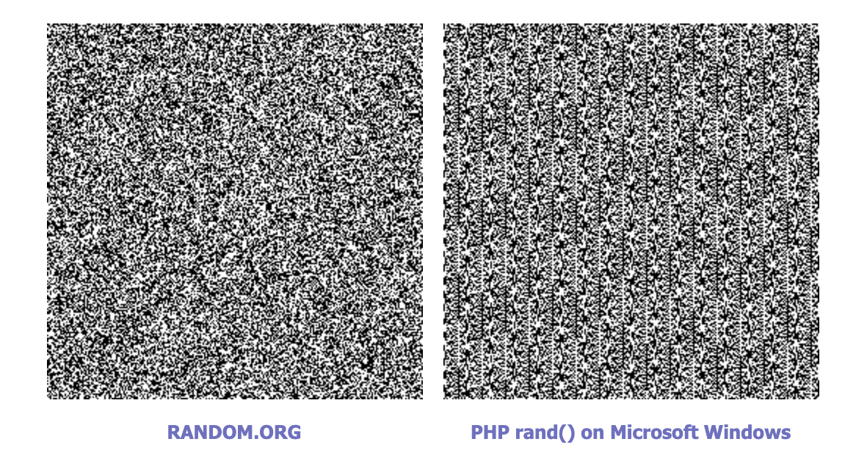
Simple Visual Test
Create a visualization of the consecutive tuples of numbers it produces.
Humans are really good at spotting patterns.

Slide 14
Linear Congruential Generator (LCG)
x₀ = given, x _{n+1} = P₁ x_{n} + P₂ (mod N) n = 0,1,2,... (*)
x ₀ =79, N = 100, P ₁ = 263, and P ₂ = 71
x₁ = 79*263 + 71 (mod 100) = 20848 (mod 100) = 48,
x₂ = 48*263 + 71 (mod 100) = 12695 (mod 100) = 95,
x₃ = 95*263 + 71 (mod 100) = 25056 (mod 100) = 56,
x₄ = 56*263 + 71 (mod 100) = 14799 (mod 100) = 99,
Sequence: 79, 48, 95, 56, 99, 8, 75, 96, 68, 36, 39, 28, 35, 76, 59, 88, 15, 16, 79, 48, 95
Park and Miller:
P₁ = 16807, P₂ = 0, N= 2³¹-1 = 2147483647, x₀ = 1.
ANSI C rand():
P₁ = 1103515245, P₂ = 12345, N = 2³¹, x₀ = 12345

Slide 15
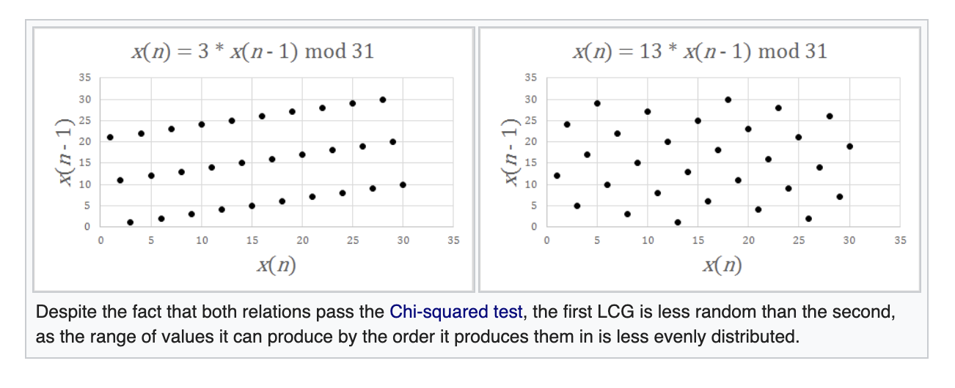
Example Comparison

Slide 16
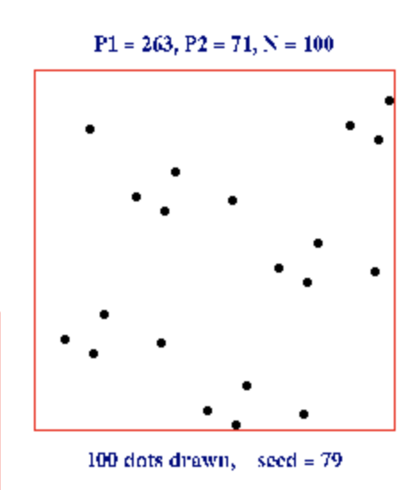
Plot (x_{i}, x_{i+1})

Slide 17
Plot (x_{i}, x_{i+1})
Park and Miller

Slide 18
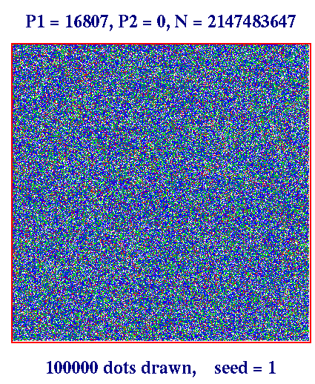
(x_{i}, x_{i+1}), (x_{i},x_{i+2}), (x_{i}, x_{i+2})
http://www.math.utah.edu/~alfeld/Random/Random.html

Slide 19
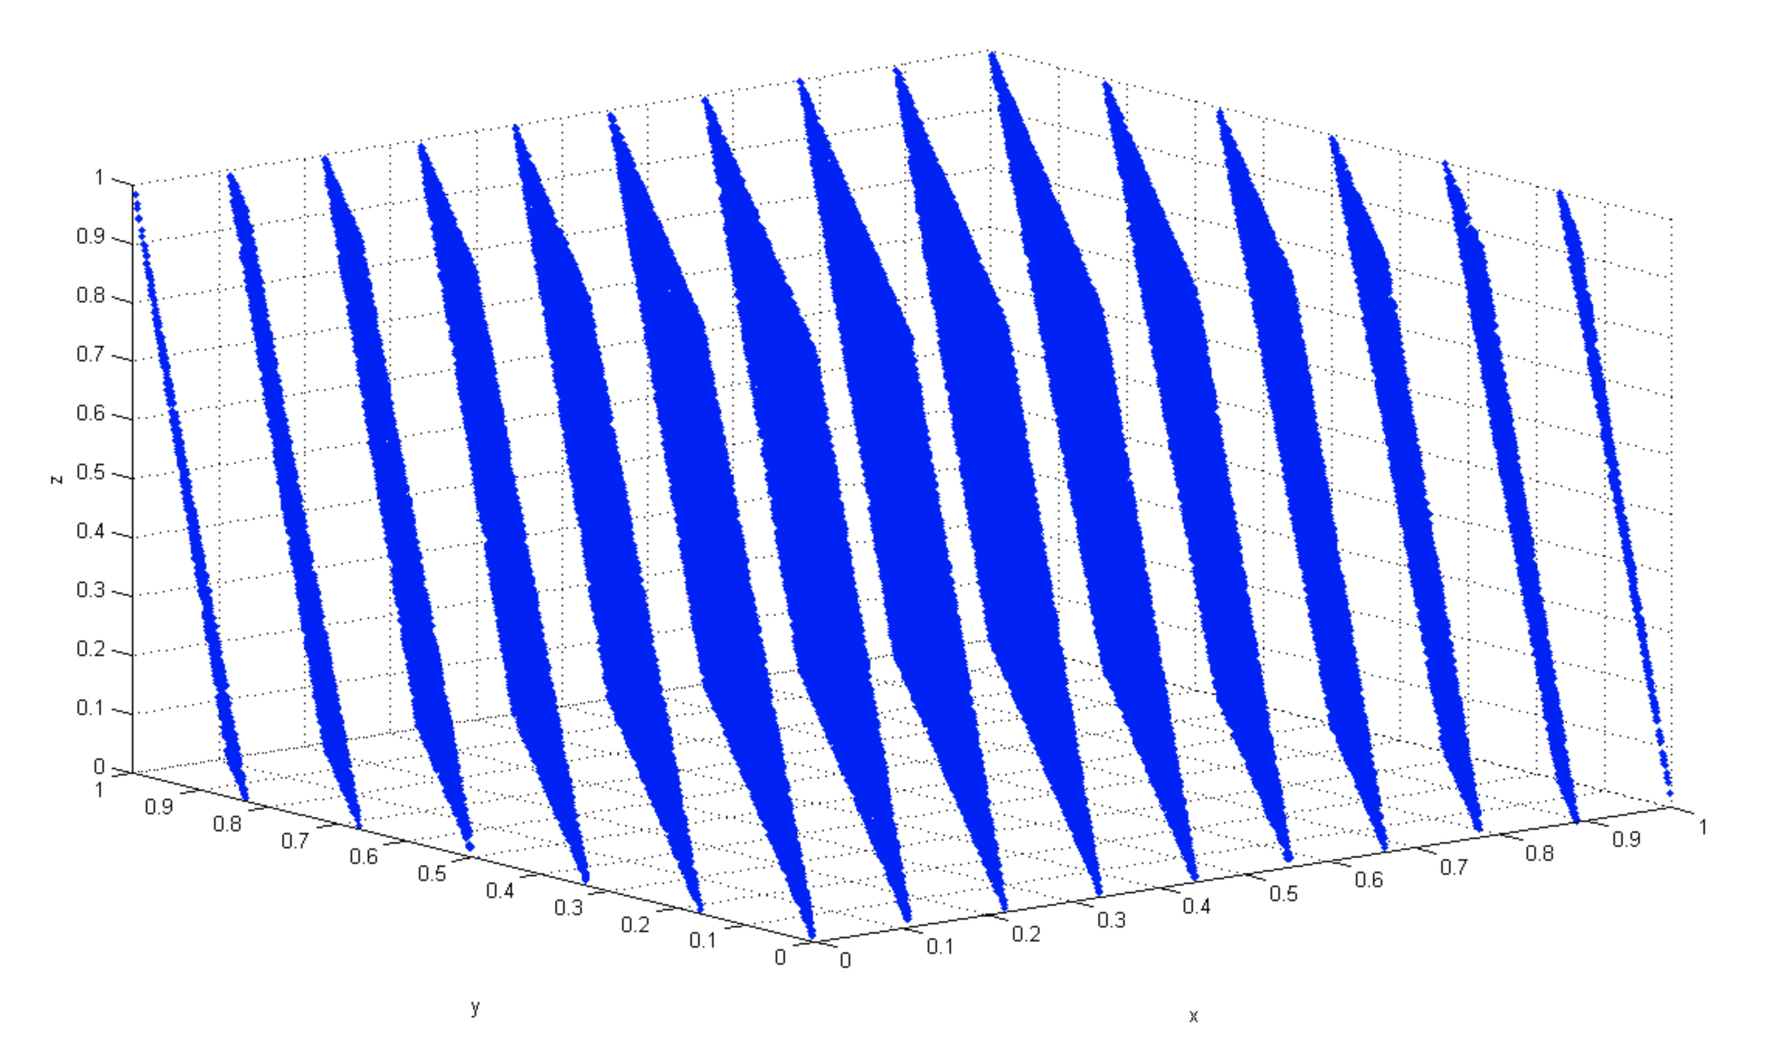
Visual Test in 3D
Three-dimensional plot of 100,000 values generated with IBM RANDU routine. Each point represents 3 consecutive pseudorandom values.
It is clearly seen that the points fall in 15 two-dimensional planes.

Slide 20
Matsumoto’s Marsenne Twister
Considered one of the best linear congruential generators.
http://www.math.sci.hiroshima-u.ac.jp/~m-mat/MT/emt.html

Slide 21
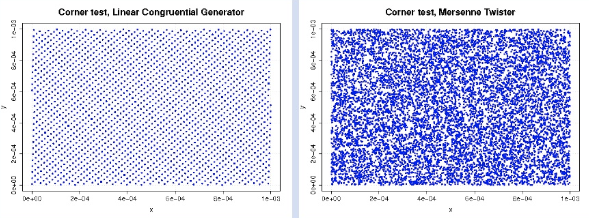
Example Visual Test

Slide 22
Cryptographically Strong Pseudorandom Number Generator
Next-bit test: Given a sequence of bits x₁, x₂, …, x_{k}, there is no polynomial time algorithm to generate x_{k+1}.
Yao [1982]: A sequence that passes the next-bit test passes all other polynomial-time statistical tests for randomness.

Slide 23
Hash/Encryption Chains
Last bit of x_{i+1}
Hash or Encryption Function
key
x_{i+1}
x_{i}
(need a random seed x₀ or key value)

Slide 24
Some Cryptographic Hash Functions
SHA-1 Hash function https://en.wikipedia.org/wiki/SHA-1
MD5 Hash function https://en.wikipedia.org/wiki/MD5
These functions are good pseudo-random number generators and when seeded with a random number generator, they provide good sequences for use in algorithm experiments.

Slide 25
BBS “secure” random bits
BBS (Blum, Blum and Shub, 1984)
Based on difficulty of factoring, or finding square roots modulo n = pq.
Fixed
p and q are primes such that p = q = 3 (mod 4)
n = pq (is called a Blum integer)
For a particular bit seq.
Seed: random x relatively prime to n.
Initial state: x₀ = x²
i^{th} state: x_{i} = (x_{i-1})²
i^{th} bit: lsb of x_{i}
Note that:
Therefore knowing p and q allows us to find x₀ from x_{i}

Slide 26
Random Numbers in Python
https://docs.python.org/3/library/random.html
[Review this website]

