Slide 1
Insertion Sort and Shell Sort
CS 260P: Fundamentals of Algorithms
With Applications
Michael T. Goodrich
Some slides are from J. Miller, CSE 373, U. Washington

Slide 2
Insertion sort
insertion sort: orders a list of values by repetitively inserting a particular value into a sorted subset of the list
more specifically:
consider the first item to be a sorted sublist of length 1
insert the second item into the sorted sublist, shifting the first item if needed
insert the third item into the sorted sublist, shifting the other items as needed
repeat until all values have been inserted into their proper positions

Slide 3
Insertion sort
Simple sorting algorithm.
n-1 passes over the array
At the end of pass i, the elements that occupied A[0]…A[i] originally are still in those spots and in sorted order.
2 | 15 | 8 | 1 | 17 | 10 | 12 | 5
0 | 1 | 2 | 3 | 4 | 5 | 6 | 7
after
pass 2
2 | 8 | 15 | 1 | 17 | 10 | 12 | 5
0 | 1 | 2 | 3 | 4 | 5 | 6 | 7
after
pass 3
1 | 2 | 8 | 15 | 17 | 10 | 12 | 5
0 | 1 | 2 | 3 | 4 | 5 | 6 | 7

Slide 4
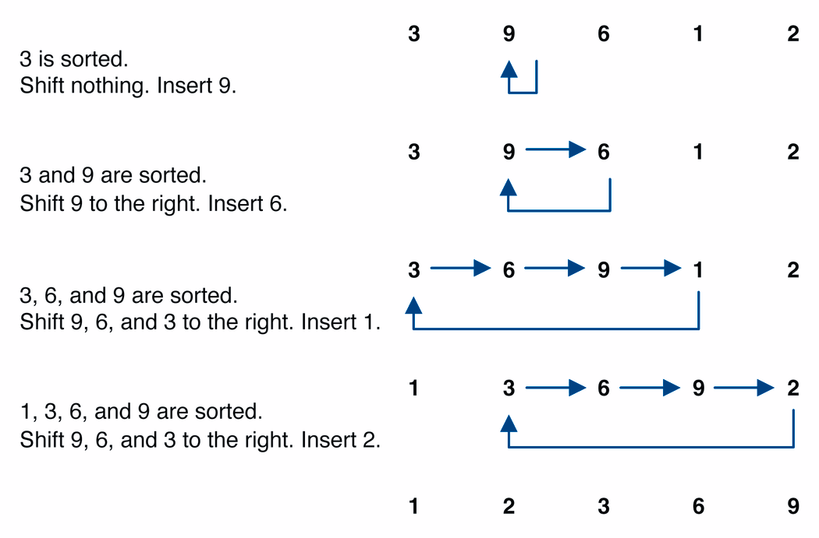
Insertion sort example

Slide 5
Insertion sort code
public static void insertionSort(int[] a) {
for (int i = 1; i < a.length; i++) {
int temp = a[i];
// slide elements down to make room for a[i]
int j = i;
while (j > 0 && a[j - 1] > temp) {
a[j] = a[j - 1];
j--;
}
a[j] = temp;
}
}

Slide 6
Analysis of Insertion Sort
In the worst case, we spend O(n) in each iteration (to slide element to its place). So worst-case running time is O(n²).
Each time we slide an element, we swap two elements that were out of order.
If K is the number of out-of-order pairs, then running time actually is O(n+K).

Slide 7
Shell sort description
shell sort: orders a list of values by comparing elements that are separated by a gap of >1 indexes
a generalization of insertion sort
invented by computer scientist Donald Shell in 1959
based on some observations about insertion sort:
insertion sort runs fast if the input is almost sorted
insertion sort's weakness is that it swaps each element just one step at a time, taking many swaps to get the element into its correct position

Slide 8
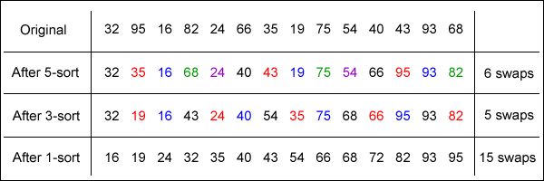
Shell sort example
Idea: Sort all elements that are 5 indexes apart, then sort all elements that are 3 indexes apart, ...

Slide 9
Shell sort code
public static void shellSort(int[] a) {
for (int gap = a.length / 2; gap > 0; gap /= 2) {
for (int i = gap; i < a.length; i++) {
// slide element i back by gap indexes
// until it's "in order"
int temp = a[i];
int j = i;
while (j >= gap && temp < a[j - gap]) {
a[j] = a[j – gap];
j -= gap;
}
a[j] = temp;
}
}
}

Slide 10
Analysis of Shell sort
The worst-case running time depends on the gap sequence.
N/2^{k}: O(n²) time
2^{k}-1: O(n^{3/2}) time
2^{j}3^{k}: O(n log² n) time
Other gap sequences might be even better…

Slide 11
Experimental Analysis
Has never been done for all possible gap sequences.
Even known gap sequences might have different real-world performance.
That is where Project 1 comes in…

