Slide 1
CS 262P Text Processing and Pattern Matching
Michael T. Goodrich
University of California, Irvine
Introduction

Slide 2
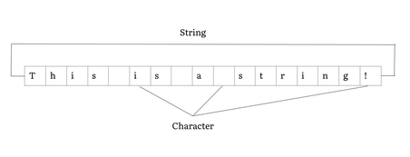
Text Processing and Pattern Matching
Text processing and pattern deals with efficient methods for processing and searching text strings
A text string is a sequence of characters from an alphabet, Σ.
Image from https://en.wikipedia.org/wiki/String_(computer_science)

Slide 3
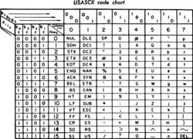
Example Alphabets
ASCII – a 7-bit code for characters used since the 1960s
Unicode – an 8, 16, or 32 bit character encoding that includes non-Western characters
{A,C,G,T} – used in DNA analysis
Image from https://en.wikipedia.org/wiki/ASCII

Slide 4
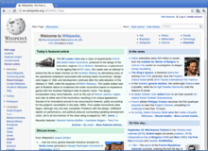
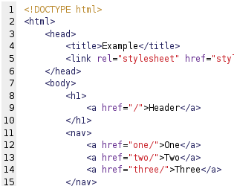
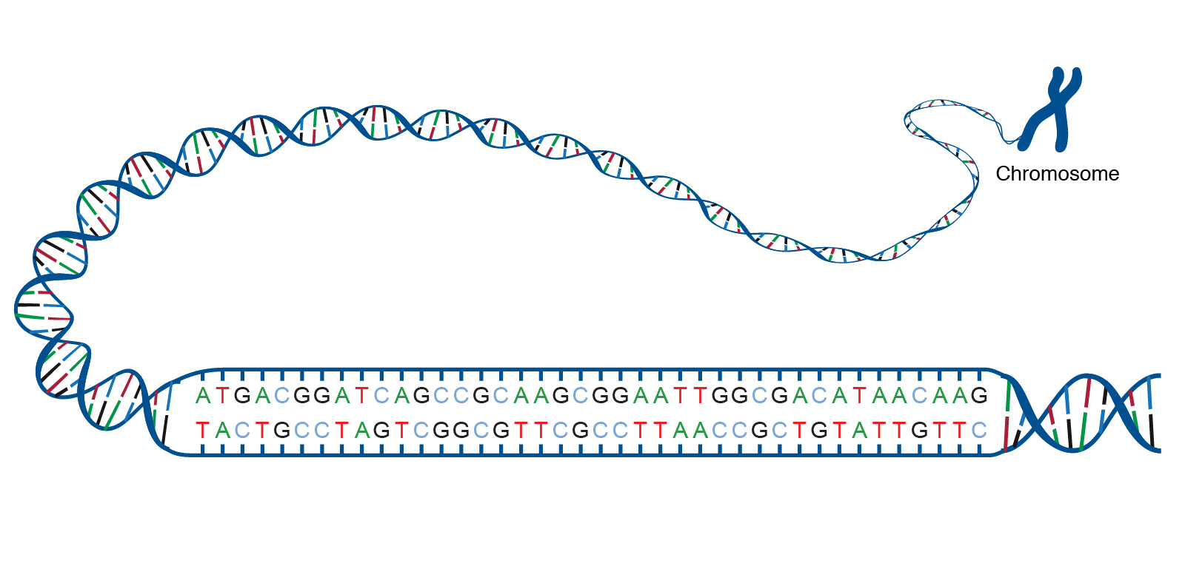
Example Strings
Documents
Web pages
DNA sequences
Source code
Social media
Images from https://en.wikipedia.org/wiki/Syntax_highlighting, https://www.genome.gov/genetics-glossary/acgt, https://en.wikipedia.org/wiki/Web_page

Slide 5
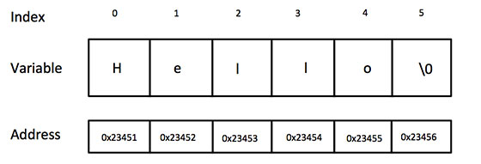
C-style Strings
A string in C is an array of bytes (interpreted as ASCII characters) that ends in a null byte (0).
It does not explicitly store its length and can sometimes be exploited in buffer overflow attacks.

Slide 6
Simple C Example
#include <stdio.h>
#include <string.h>
int main() {
char *str, substr[6];
str = "hello";
printf("The whole string: %s\n", str);
printf("The e: %c\n", str[1]);
printf("Skipping h: %s\n", &str[1]);
strncpy(substr, &str[2], 2);
substr[2] = '\0';
printf("Substring: %s\n", substr);
return 0;
}
Output:
The whole string: hello
The e: e
Skipping h: ello
Substring: ll

Slide 7
C++-Style Strings
C++ can use std::string objects, which may have different implementations.
See https://www.cplusplus.com/reference/string/string/
length() – return length of the string
assign() – assign content to part of a string
at() – return the character at a location in a string (starting at 0)
insert() – insert content into a string
append() – append content at the end of a string
copy() – copy a sequence of characters from a string
find() – find content in a string
substr() – generate a substring
compare() – compare two strings
The + operator performs concatenation.

Slide 8
Simple C++ Example
#include <iostream>
#include <string>
using namespace std;
int main()
{
string a = "dogs", b = "cats", str = "horses";
cout << "Initial str: " << str << endl;
cout << "Starting at 3: " << &str[3] << endl;
str = a + " and " + b;
cout << "New string: " << str << endl;
cout << "Char at 5: " << str.at(5) << endl;
cout << "cat is at: " << str.find("cat") << endl;
cout << "Substring at 5 w/ length 3 is:";
cout << str.substr(5,3) << endl;
str.insert(8," pigs and");
cout << "Final str: " << str << endl;
return 0;
}
Output:
Initial str: horses
Starting at 3: ses
New string: dogs and cats
Char at 5: a
cat is at: 9
Substring at 5 w/ length 3 is:and
Final str: dogs and pigs and cats

Slide 9
Strings in Java
Java has a built-in String class, which is implemented as an array of 16-bit Unicode characters.
https://docs.oracle.com/javase/7/docs/api/java/lang/String.html
length() – return length of the string
charAt() – return the character at a location in a string (starting at 0)
concat() – concatenate a string at the end of the string
indexOf() – find content in a string
substring() – return a substring
matches() – tests if string matches a regular expression
The + operator performs concatenation.

Slide 10
Simple Java Example
public class Main {
public static void main(String[] args) {
String a = "dogs", b = "cats", str = "horses";
System.out.println("Initial str: " + str);
System.out.println("Starting at 3: " + str.substring(3));
str = a + " and " + b;
System.out.println("New string: " + str);
System.out.println("Char at 5: " + str.charAt(5));
System.out.println("cat is at: " + str.indexOf("cat"));
System.out.println("Substring from 5 to 7 is:" + str.substring(5,7));
}
}
Output:
Initial str: horses
Starting at 3: ses
New string: dogs and cats
Char at 5: a
cat is at: 9
Substring from 5 to 7 is:an

Slide 11
Strings in Python
Strings in Python are arrays of Unicode characters.
The + operator performs concatenation.
Strings can be indexed from the front (using nonnegative numbers) or back (using negative numbers).
The “in” operator tests if a string is in another string.
Substrings can be indexed using the “:” operator.
len(s) – returns length of string s.
t.find(s) – finds the substring s in the string t
See also:
https://en.wikipedia.org/wiki/Comparison_of_programming_languages_(string_functions)

Slide 12
Simple Python Example
str = "program" + "mers"
print("str = ", str)
print("str[0] = ", str[0])
print("str[-1] = ", str[-1])
print("str[1:5] = ", str[1:5])
print("str[5:-2] = ", str[5:-2])
print("Contains rog = ", "rog" in str)
print("gram is at = ", str.find("gram"))
Output:
str = programmers
str[0] = p
str[-1] = s
str[1:5] = rogr
str[5:-2] = amme
Contains rog = True
gram is at = 3

Slide 13
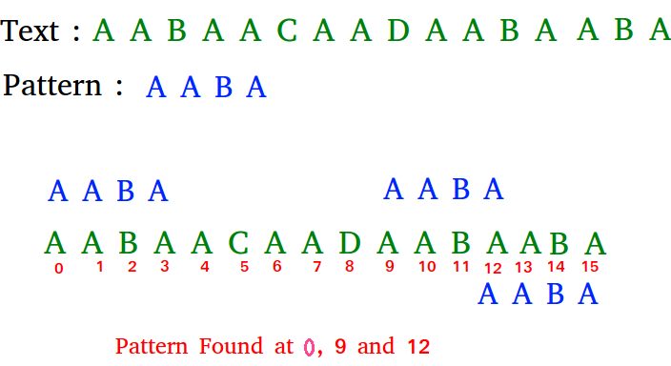
Exact Matching
Exact matching involves finding exact matches of a pattern string in a text string.
Image from https://www.geeksforgeeks.org/algorithms-gq/pattern-searching/

Slide 14
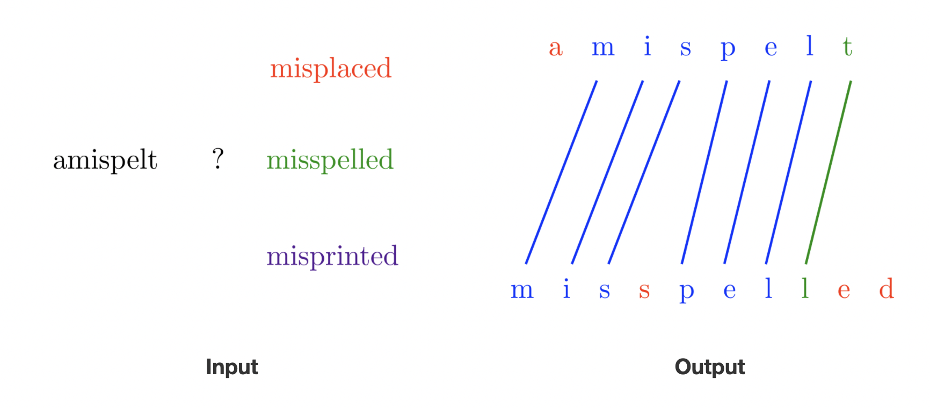
Approximate Matching
Find good matches between strings where some characters might not have matches
Image from https://algorist.com/problems/Approximate_String_Matching.html

Slide 15
Regular Expression Matching
Matching text to an algebraic description of a pattern.
Image from https://www.computerhope.com/jargon/r/regex.htm

Slide 16
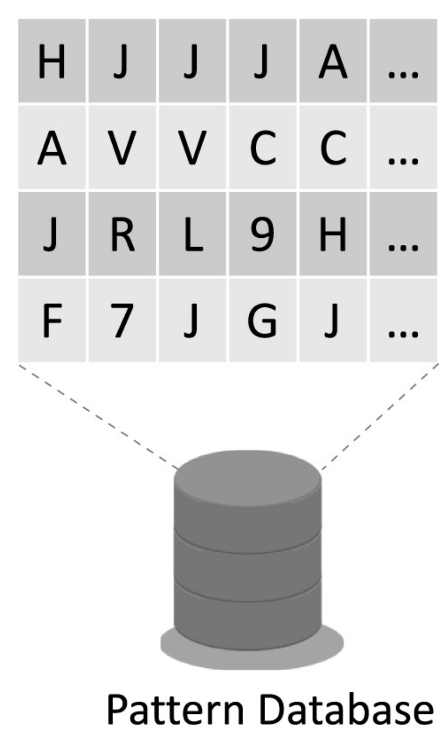
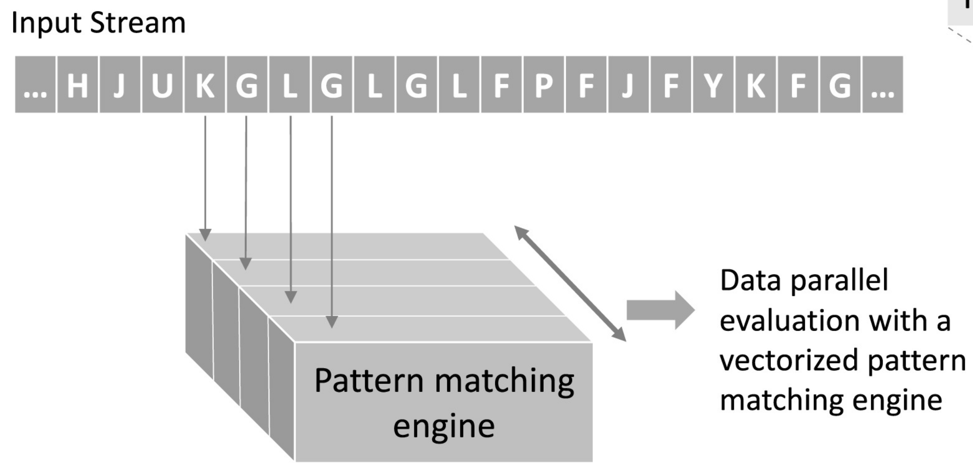
Multiple Pattern Matching
Given multiple pattern strings or test strings, answer queries over the set of strings.
Longest prefix match.
Dictionary matching a set of patterns.
Longest common substring.
Most frequent substring.
Longest palindrome in a string.
Image from
https://www.sciencedirect.com/
science/article/pii/S0743731519301984#fig1

Slide 17
Application: Search Engines
Search engines process online documents and support searching them.
Image from https://www.searchenginejournal.com/alternative-search-engines/271409/

Slide 18
Application: Document Merging
Merging documents from different authors
Image from https://www.brightcarbon.com/blog/merge-two-versions-document/

Slide 19
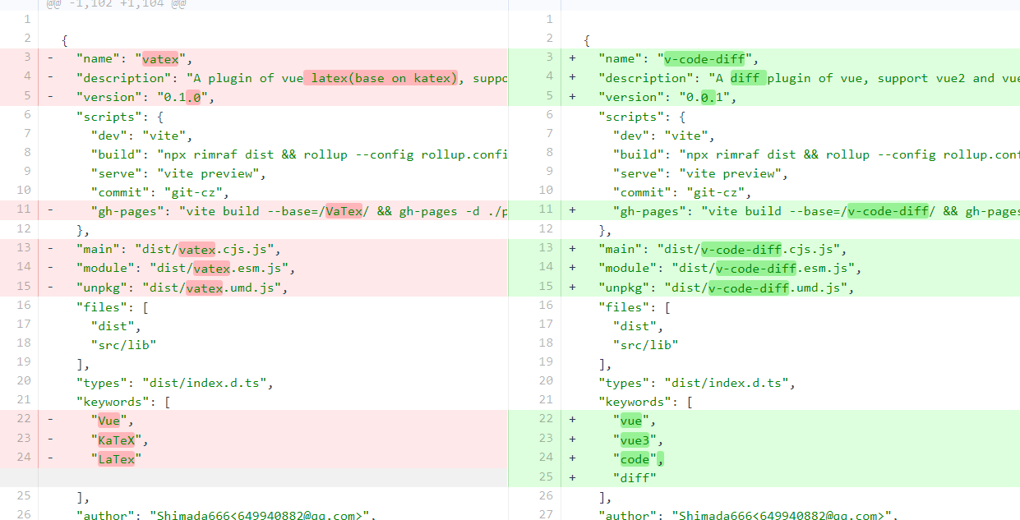
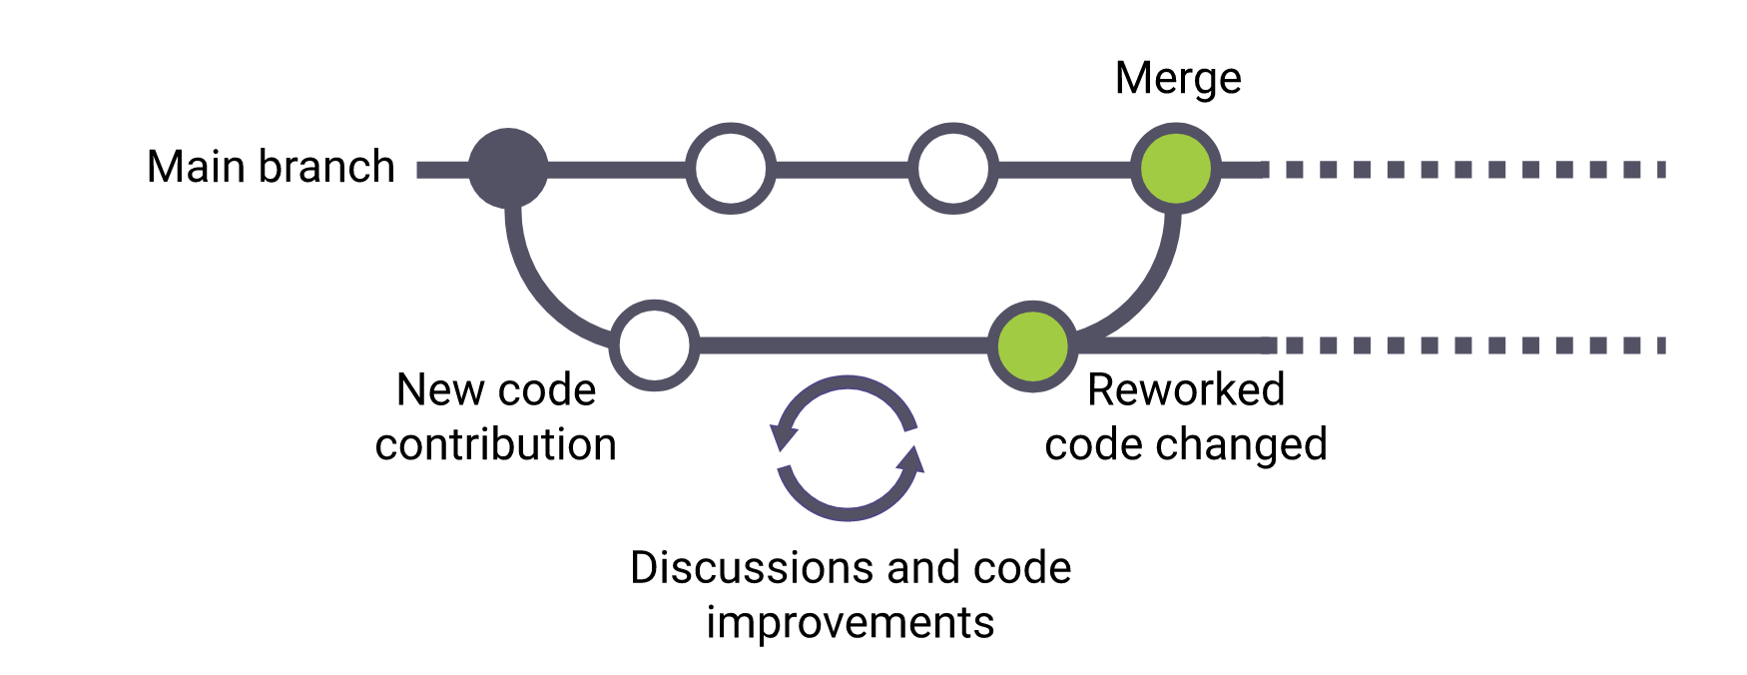
Application: Source-code Differencing
Determining changes between source code files.
Used by code repositories, like git.
Image from https://www.vuescript.com/code-diff-plugin/, https://www.synopsys.com/glossary/what-is-code-review.html

Slide 20
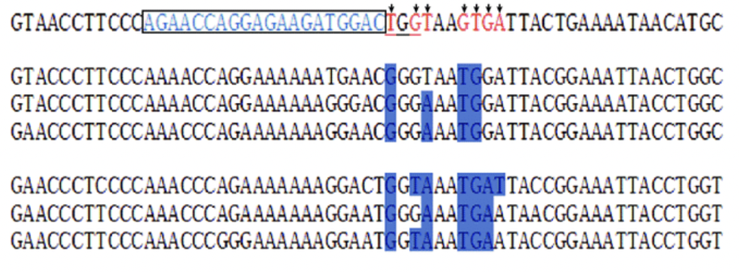
Application: DNA Analysis
Determining differences between DNA strings
Image from https://www.researchgate.net/figure/DNA-sequence-alignment-of-wild-type-and-mutant-mutation-site-A-sequence-alignment-of_fig2_337666946

Slide 21
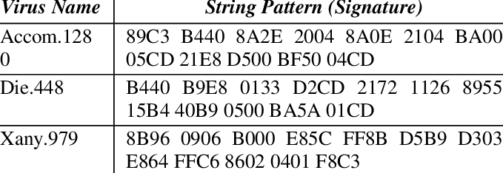
Application: Computer Security
Spam filters and firewalls
Detecting computer virus signatures
Image from https://www.researchgate.net/figure/Examples-of-viruses-string-signature_tbl1_235641042

Slide 22
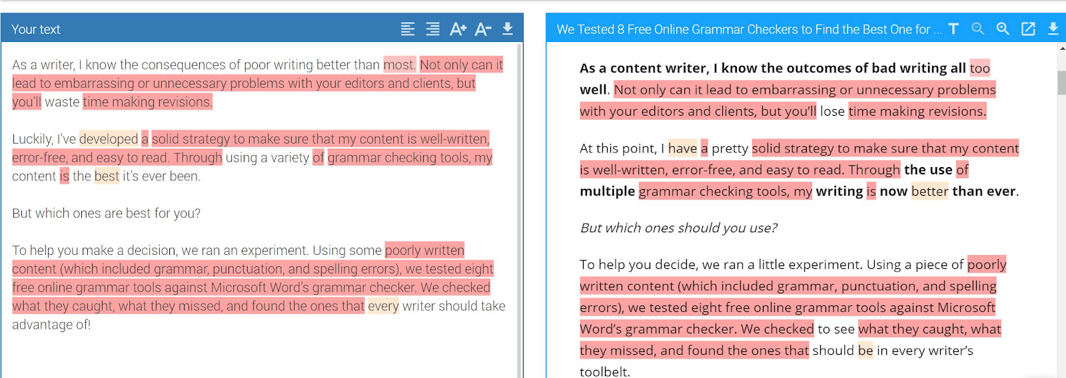
Application: Plagiarism Checkers
Detecting similarities between documents
Image from https://www.websiteplanet.com/blog/best-plagiarism-checking-tools/

Slide 23
Application: Spelling Correction
Autocorrection
Image from https://cafemom.com/news/155278-10_hilarious_awkward_mom_autocorrect

Slide 24
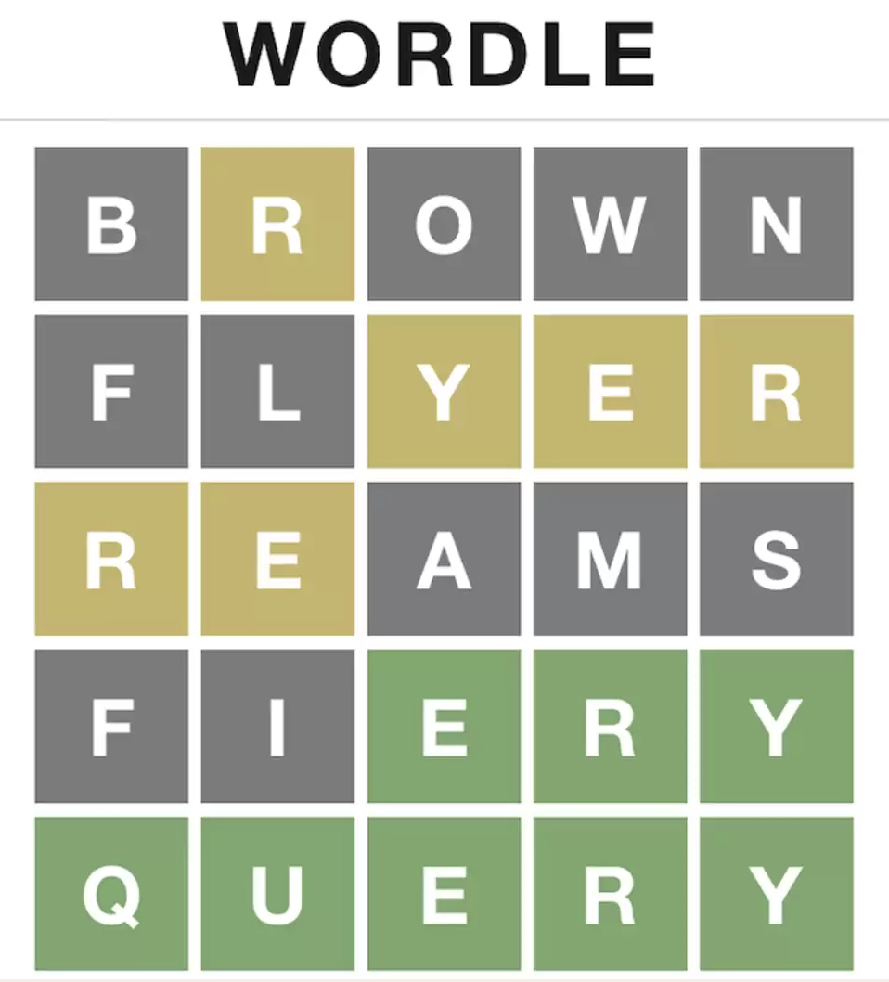
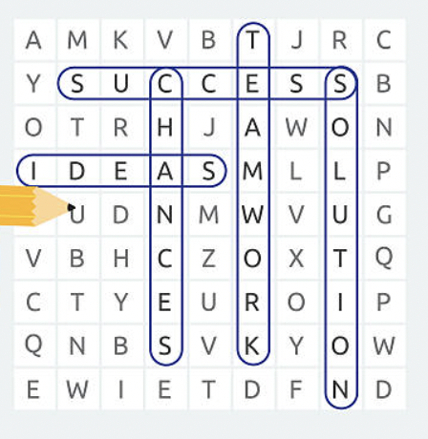
Application: Computer Games
Text-based computer games
Images from https://www.istockphoto.com/photos/word-game, https://www.thrillist.com/news/nation/what-is-wordle-how-to-play

Slide 25
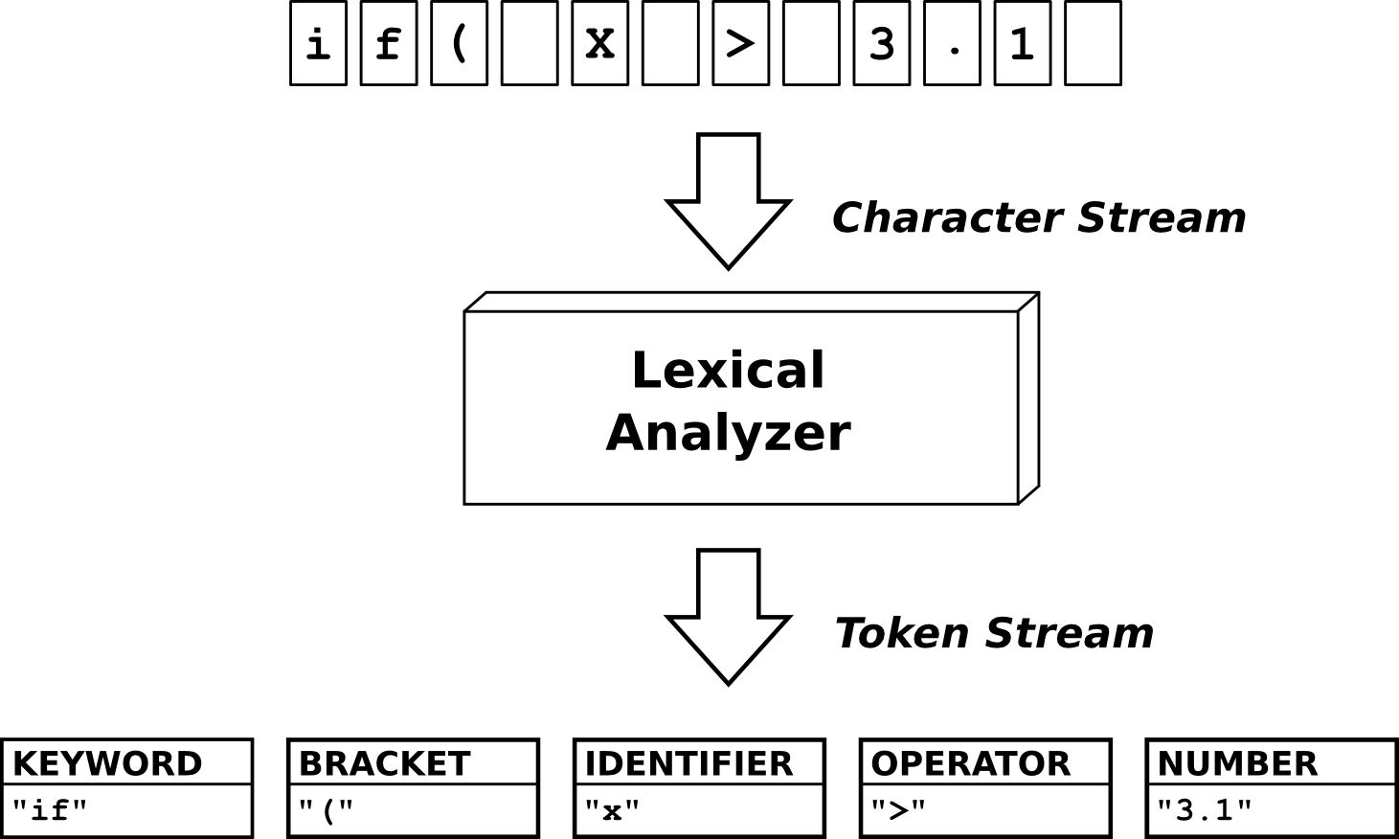
Application: Compilers
Breaking source code into language tokens
Image from http://quex.sourceforge.net/

Slide 26
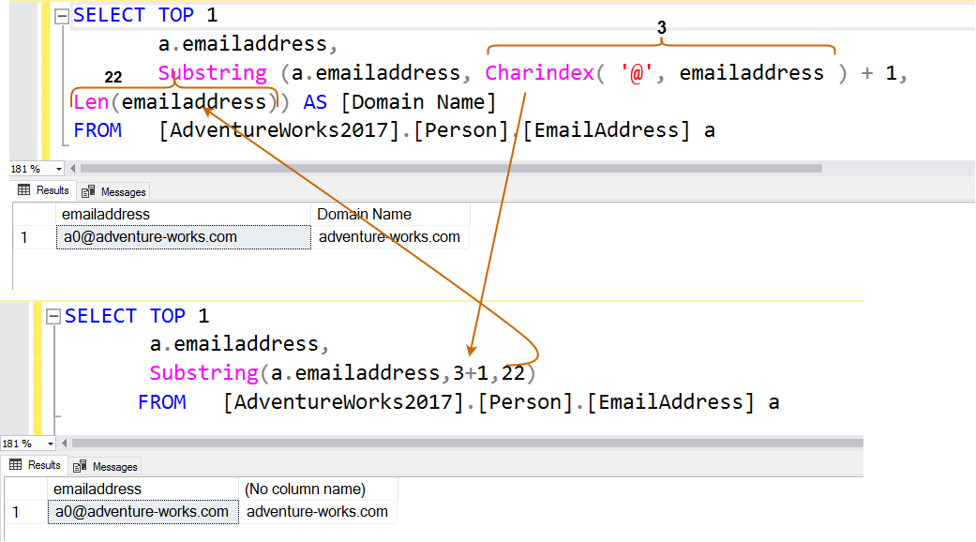
Application: Database Queries
Queries that involve text strings.
Image from https://www.sqlshack.com/substring-patindex-and-charindex-string-functions-in-sql-queries/

Slide 27
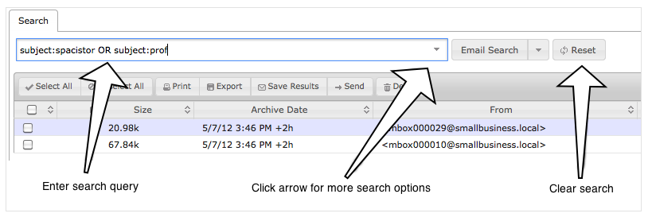
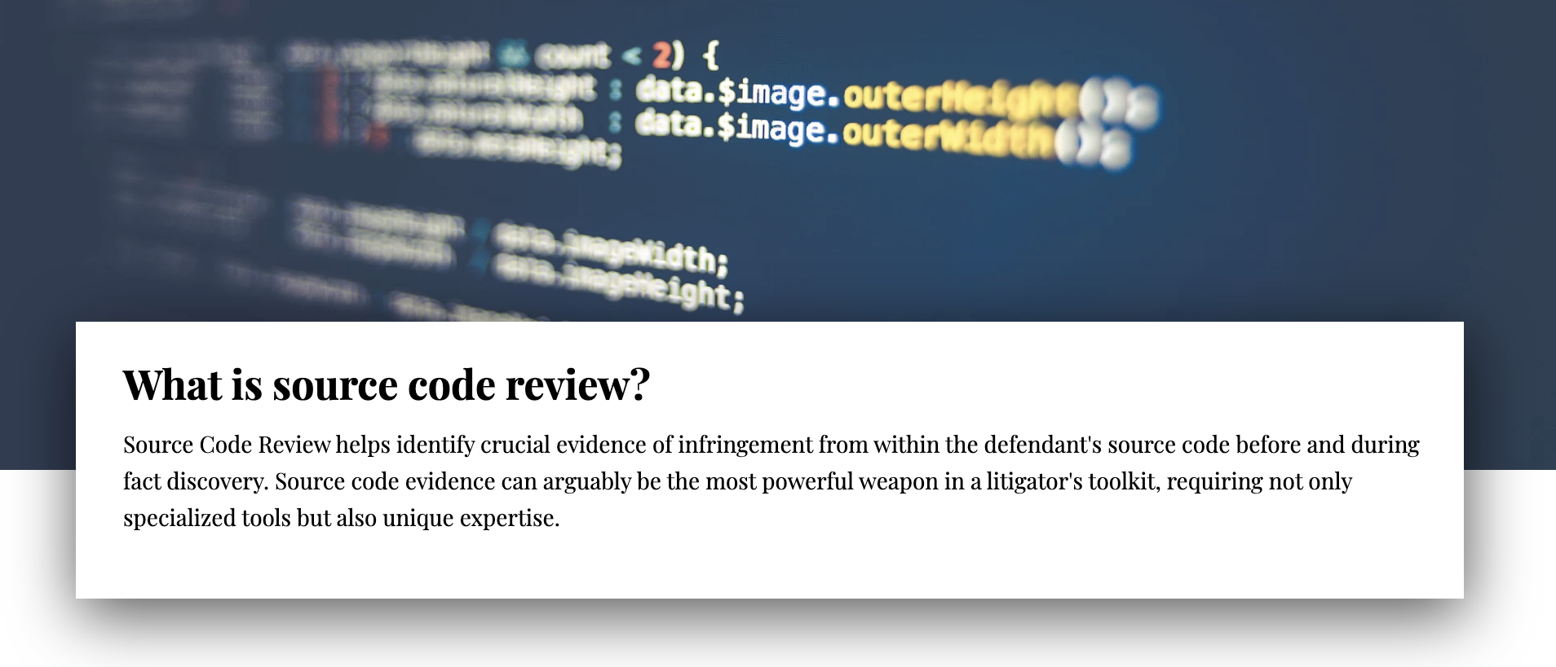
Application: Lawsuits and Criminal Cases
Email and document keyword and pattern searching for civil and criminal cases
Source-code review in patent cases
Images from https://www.copperpodip.com/source-code-review, http://help.mailarchiva.com/enteprise-query-syntax

Slide 28
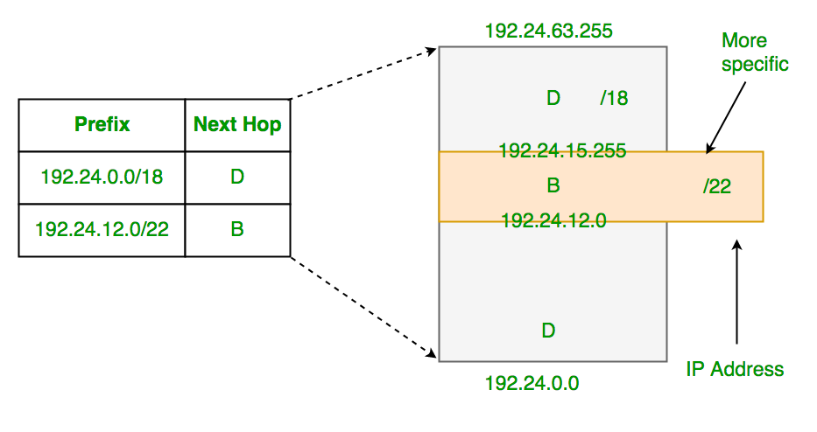
Application: Internet Routing
A central computation in IP routing involves computing the longest matching prefix of a set of network address patterns.
Image from https://www.geeksforgeeks.org/longest-prefix-matching-in-routers/

Slide 29
Other Applications
A survey of Stanford grads 5 years out asked which of their courses they used most in their jobs.
The course (CS154) covering topics overlapping topics in CS262P stood remarkably high.
3 times the score for the Stanford A.I. course.
Data from http://infolab.stanford.edu/~ullman/ialc/spr10/slides/intro.pdf, image from https://online.stanford.edu/bing-programs

