Slide 1
Regular Expressions and Command-line Text Searching
Michael T. Goodrich
University of California, Irvine

Slide 2
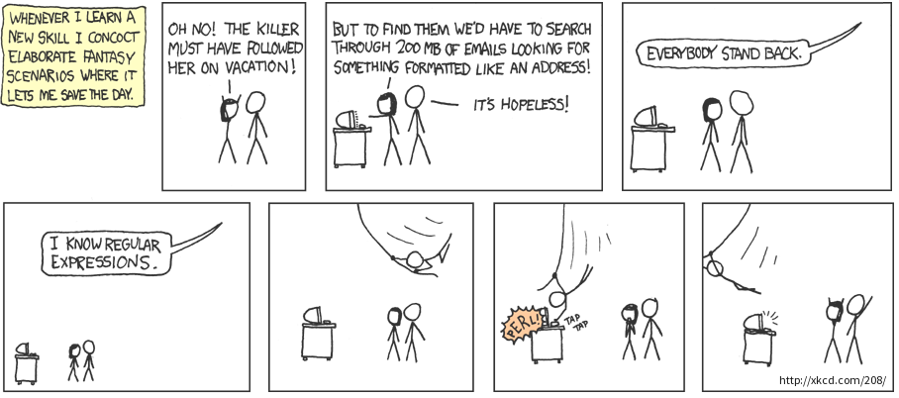
Regular Expressions
Regular expressions are an algebraic way of describing text patterns.
Regular expressions support powerful searches.

Slide 3
Basic Definition of Regular Expressions
A regular expression (RE) defines a language, that is, a set of character strings
A single character matches just that character.
RE a matches the string “a”
Concatenation: concatenating two RE’s x and y as xy matches any string αβ, where x matches α and y matches β.
RE ab matches the string “ab”
Or: joining two RE’s x and y with the symbol | as x|y matches any string that matches x or y.
RE ab|cd matches the string “ab” or the string “cd”
Order: first Concatenation then Or

Slide 4
Basic Definition of Regular Expressions
Parentheses: joining an RE with parentheses matches the RE inside the parentheses and allows for grouping in the usual way.
RE a(a|bc) matches the strings “aa” and “abc”.
Closure: given RE x, the RE x* matches 0 or more repetitions of strings that match the RE x.
RE “ab*” matches strings “a”, “ab”, “abb”, “abbb”, …
RE “a(a|b)*” matches any string of a’s and b’s that begins with an a.

Slide 5
Some More Examples
(aa)* matches any string consisting of an even number of a’s.
(a|b)* matches all strings of a’s and b’s (including the null string).
(a|b)*aaa(a|b)* matches any string of a’s and b’s containing three a’s in a row.
(g|G)oodrich matches my last name with the first letter capitalized or not.
(g|G)(o|O)(o|O)(d|D)(r|R)(i|I)(c|C)(h|H) matches my last name ignoring case

Slide 6
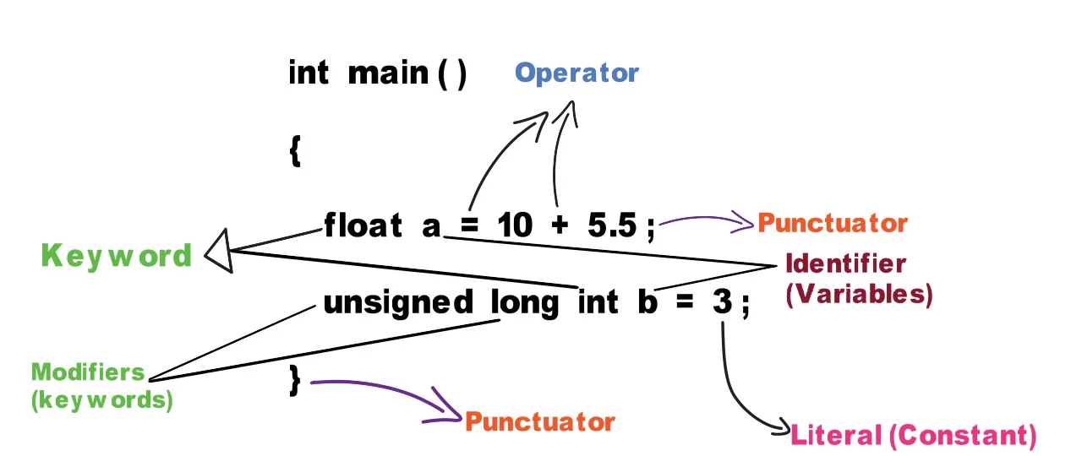
RE’s are Surprisingly Powerful
The tokens of every programming language are defined as regular expressions.
Image from https://www.journaldev.com/26353/tokens-in-c

Slide 7
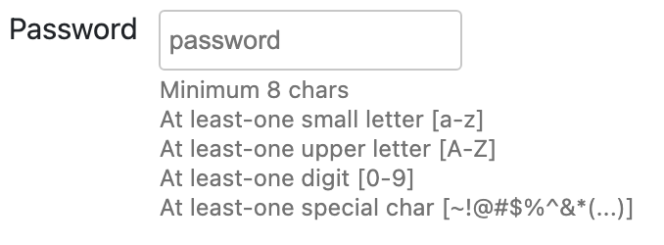
Extended Regular Expressions
Extended regular expressions provide additional syntax for defining regular expressions.
Every extended regular expression has an equivalent basic regular expression that defines the same language.
Extended regular expressions just give us a shorter way of defining regular expressions, for the sake of convenience.
Image from https://www.html-code-generator.com/javascript/regular-expression-validation

Slide 8
Extended Regular Expressions (egrep)
A bracket expression is a list of characters enclosed by [ and ].
It matches any single character in that list
If the first character of the list is the caret ^ then it matches any character not in the list.
For example, the regular expression [0123456789] matches any single digit and [^0123456789] matches any single character that is not a digit.
Within a bracket expression, a range consists of two characters separated by a hyphen. It matches any single character between the two characters, inclusive, using the character set. For example, in the default C locale, [a-d] is equivalent to [abcd].

Slide 9
Character Classes
[:alnum:] matches alphanumeric characters. In the C locale, this is the same as ‘[0-9A-Za-z]’.
[:alpha:] matches alphabet characters. In the C locale, this is the same as ‘[A-Za-z]’.
[:blank:] matches blank characters space and tab.
[:cntrl:] matches control characters.
[:digit:] matches digits: 0 1 2 3 4 5 6 7 8 9.
[:graph:] matches graphical characters: ‘[:alnum:]’ and ‘[:punct:]’.

Slide 10
Character Classes (continued)
[:lower:] matches lower-case letters.
[:print:] matches printable characters: ‘[:alnum:]’, ‘[:punct:]’, and space.
[:punct:] matches punctuation characters; in the C locale, this is ! " # $ % & ' ( ) * + , - . / : ; < = > ? @ [ \ ] ^ _ ` { | } ~.
[:space:] matches space characters: in the ‘C’ locale, this is tab, newline, vertical tab, form feed, carriage return, and space.
[:upper:] matches upper-case letters.
[:xdigit:] matches hexadecimal digits: 0 1 2 3 4 5 6 7 8 9 A B C D E F a b c d e f.

Slide 11
Other Matching Symbols
The dot . symbol matches any character.
The caret ^ and the dollar sign $ are meta-characters that respectively match the empty string at the beginning and end of a line.
The symbols \< and \> respectively match the empty string at the beginning or end of a word.
The symbol \w is a synonym for [_[:alnum:]] and \W is a synonym for [^_[:alnum:]].
To match a special symbol as itself, you sometimes have to precede it with backslash \, e.g., \$ matches a dollar sign. \n matches a newline (if used with –z option in grep).

Slide 12
Repetition
An RE may be followed by a repetition operator:
? The preceding item is optional and matched at most once.
* The preceding item will be matched zero or more times.
+ The preceding item will be matched one or more times.
{n} The preceding item is matched exactly n times.
{n,} The preceding item is matched n or more times.
{,m} The preceding item is matched at most m times.
{n,m} The preceding item is matched at least n times, but not more than m times.

Slide 13
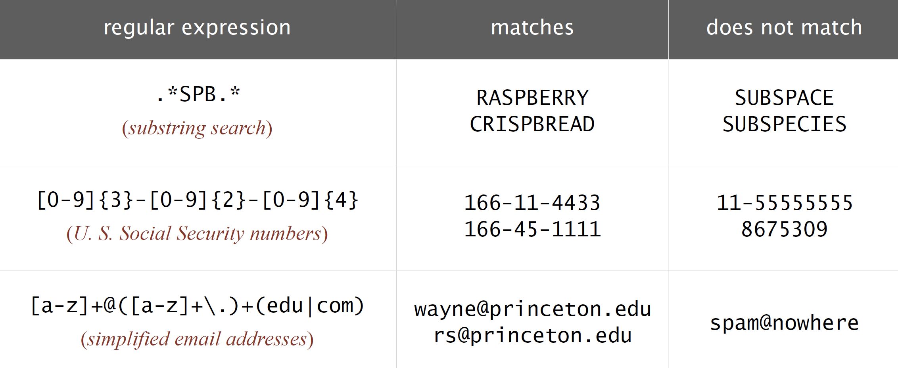
Some Examples
Image from https://algs4.cs.princeton.edu/54regexp/

Slide 14
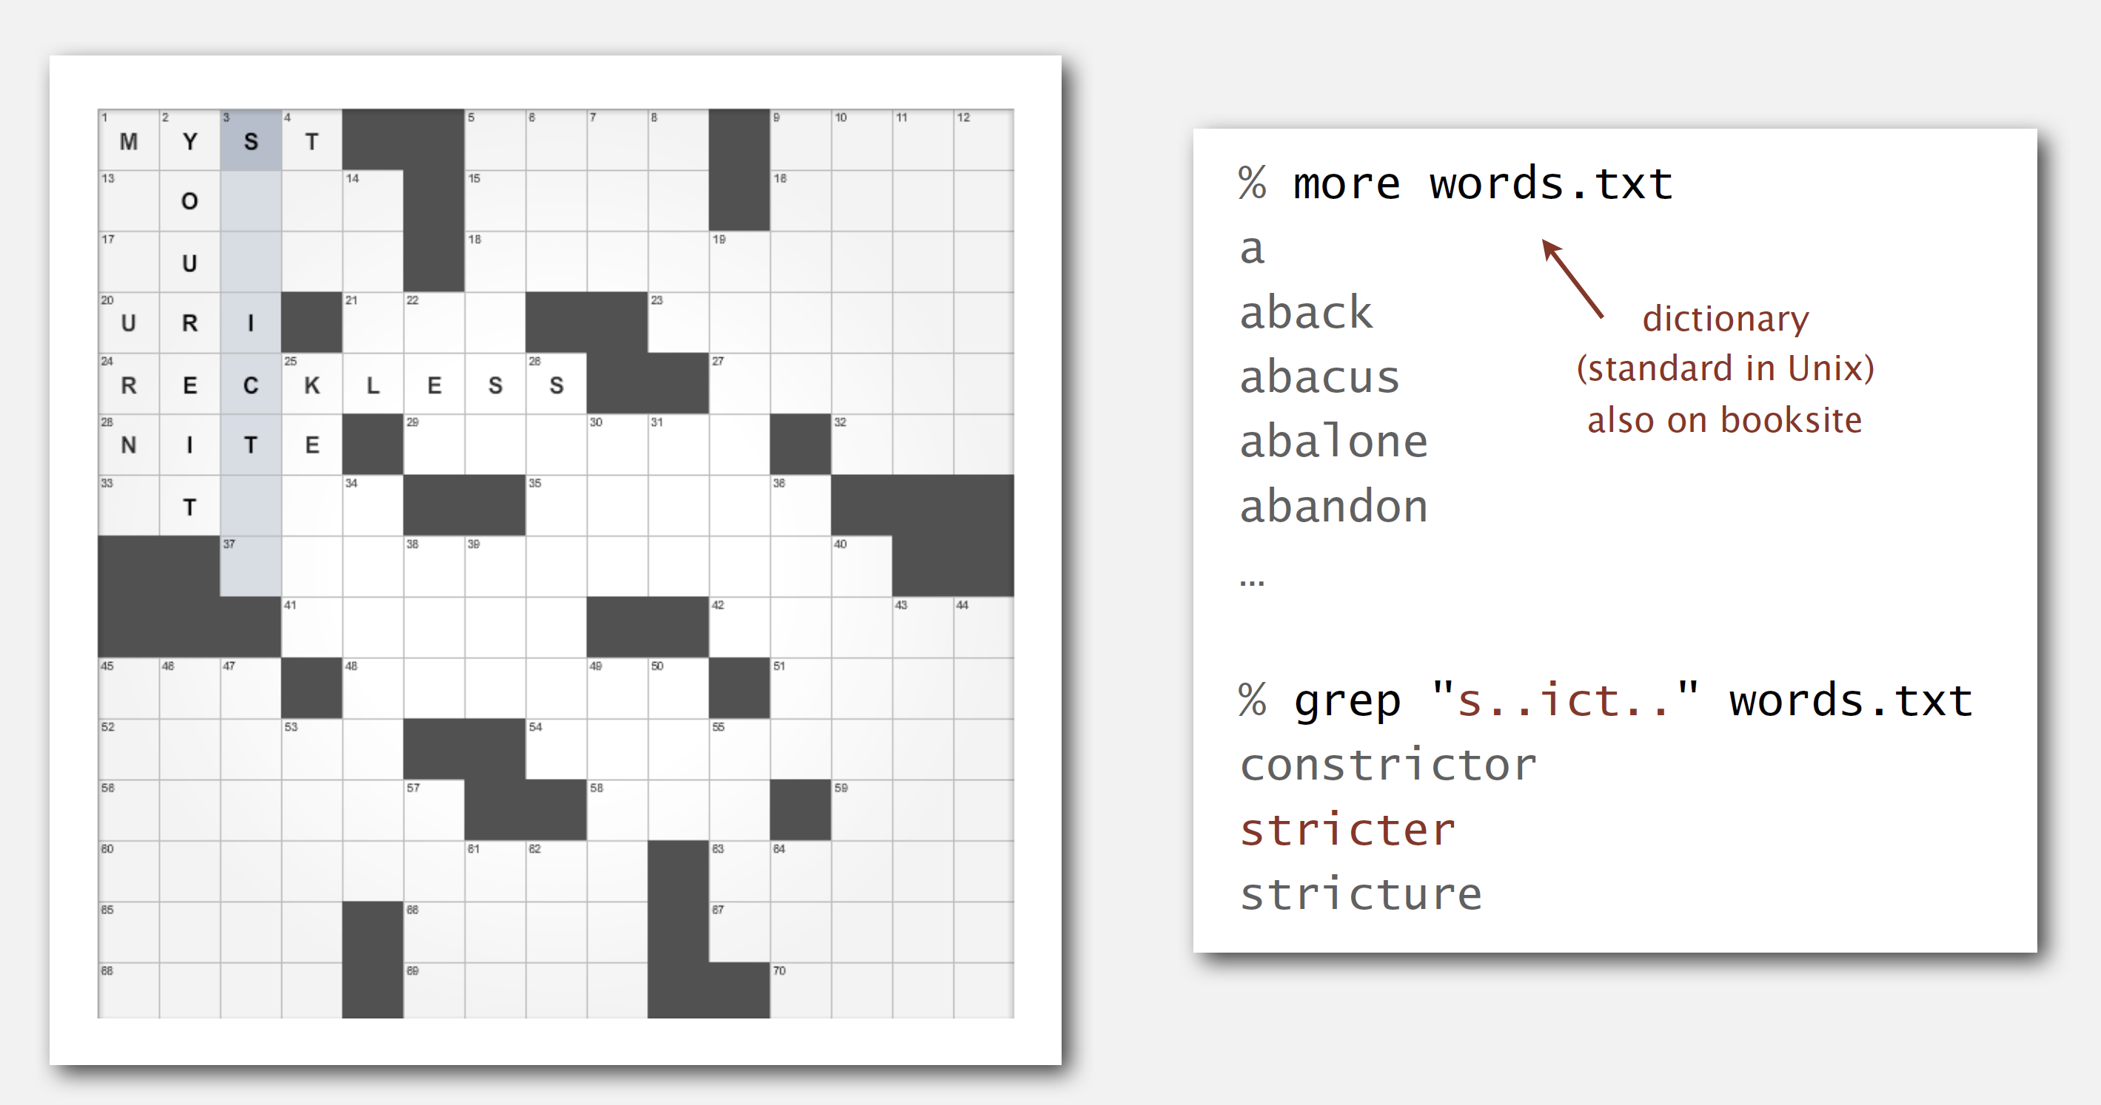
Another Example
Unix/Linux/MacOS has a list of words in /usr/share/dict or /usr/local/dict. It is useful for doing regular expression word searches.
Image from http://algs4.cs.princeton.edu

Slide 15
Difference Between grep and egrep
The command grep requires all the meta characters to be escaped with a backslash \ to have their special meaning.
In egrep, +, ?, |, (, and ), treated as meta characters, whereas in grep, they are treated as a pattern instead of meta characters.
By including backslash \ followed by meta character lets grep treat it as meta characters like \?, \+, \{, \|, \(, and \).
grep -E is the same as egrep

Slide 16
Extended Example: Wordle
Every day, a five-letter word is chosen which players aim to guess within six tries. After every guess, each letter is marked as either green, yellow or gray: green indicates that letter is correct and in the correct position, yellow means it is in the answer but not in the right position, while gray indicates it is not in the answer at all

Slide 17
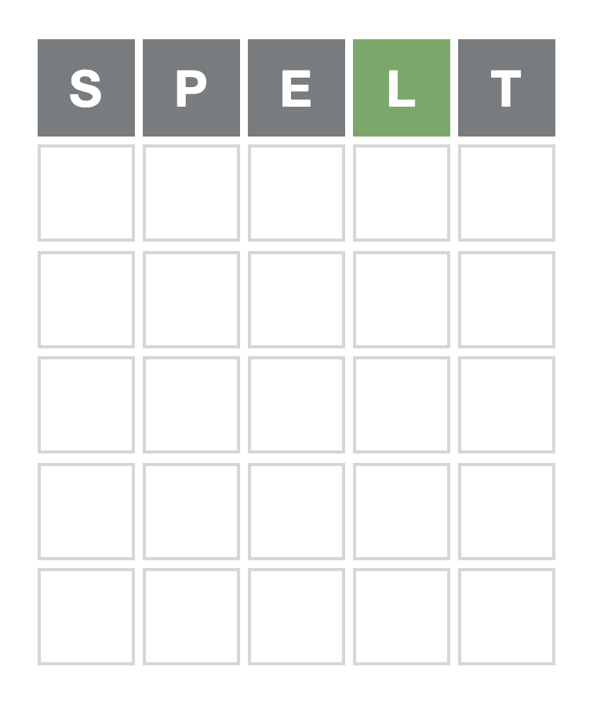
Game 285
% egrep "^[^spet]{3}l[^spet]$" words | wc
211 211 1266

Slide 18
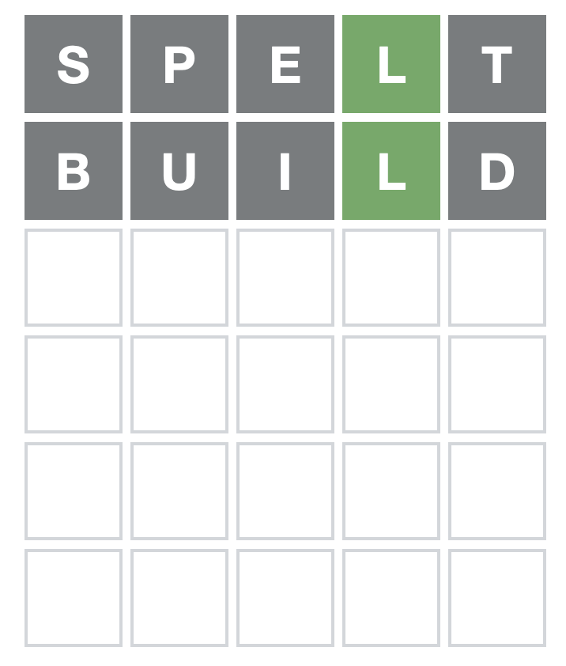
Game 285
akala
Alala
alala
amala
amylo
Calla
callo
Carlo
chalk
Chola
chola
Cholo
coaly
Colla
colly
cooly
coyly
Dafla
fally
foaly
folly
fonly
Galla
galla
gally
Goala
golly
holla
hollo
Holly
holly
hooly
jagla
jolly
joola
jowly
knoll
koala
laxly
lolly
lowly
manly
Marla
marly
Molly
molly
myall
nonly
oolly
ovolo
oxfly
Paola
Polly
rally
Rollo
Sally
wally
wanly
warly
whalm
whaly
wryly
yalla
yarly
% egrep "^[^spetbuid]{3}l[^spetbuid]$" words | wc
64 64 384

Slide 19
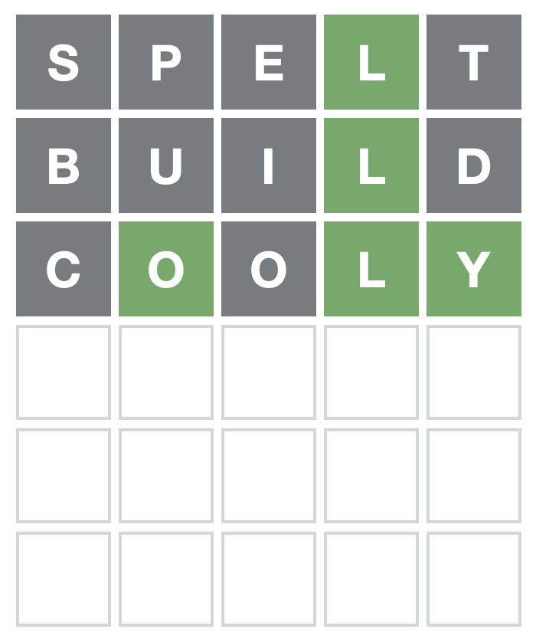
Game 285
foaly
folly
fonly
golly
Holly
holly
jolly
jowly
lolly
lowly
Molly
molly
nonly
Polly
% egrep "^[^spetbuidco]o[^[spetbuidco]ly$" words | wc
14 14 84

Slide 20
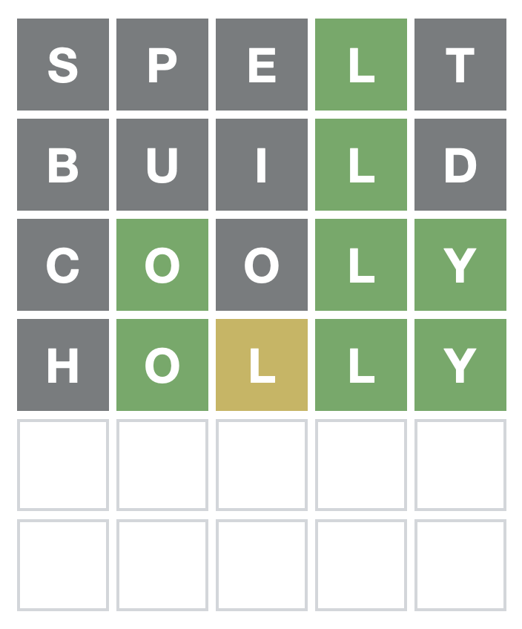
Game 285
% egrep "^lo[^spetbuidcohl]ly$" words
lowly

Slide 21
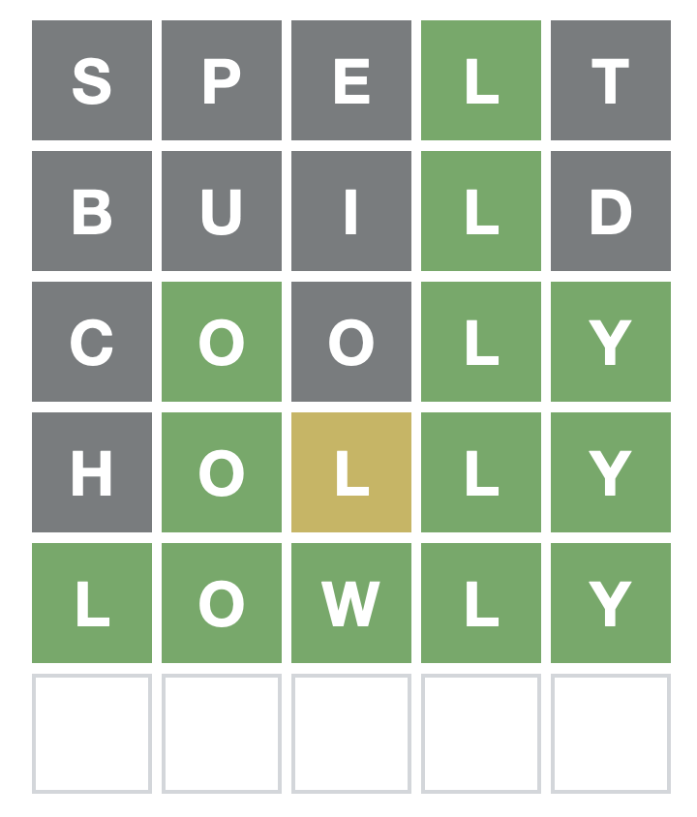
Game 285

Slide 22
Difference Between grep and fgrep
fgrep only does exact matching (same as grep -F):
% fgrep shaken /usr/share/dict/words
shaken
shakenly
unshaken
unshakenly
unshakenness

Slide 23
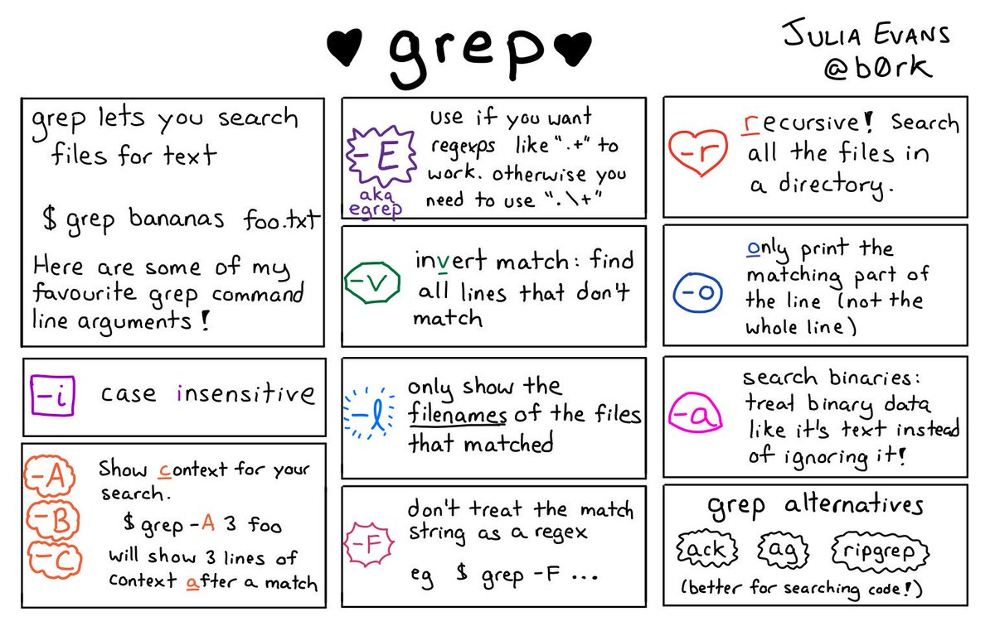
Useful grep Options
Image from https://drt.sh/command-of-the-day/grep/

Slide 24
Useful Linux/Unix/Cygwin Commands
wc
cat
diff
find
xargs
grep
sort
uniq
shasum
sed
strings
join
cut
comm
split
paste
tr

Slide 25
wc
Word count – prints number of lines, words, and bytes in a file (or from standard input).
Useful options:
-c The number of bytes in each input file is written to the standard output.
-l The number of lines in each input file is written to the standard
output.
-m The number of characters in each input file is written to the
standard output.
-w The number of words in each input file is written to the standard output.
Example:
% wc /usr/share/dict/words
235886 235886 2493109 /usr/share/dict/words
Implies average number of letters
in an English word is over 9
(wc counts newline characters)

Slide 26
cat
Concatenate files and print to standard output.
Example:
% fgrep dogs /usr/share/dict/words > dog-words.txt
% fgrep cats /usr/share/dict/words > cat-words.txt
% cat dog-words.txt cat-words.txt
dogs
dogship
dogshore
dogskin
dogsleep
dogstone
catskin
catstep
catstick
catstitch
catstitcher
catstone
catsup

Slide 27
diff
Compare the differences between files.
Options:
-i Ignore case differences in file contents.
-q Output only whether files differ.
-y Output in two columns.
-w Ignore all white space.
Example:
% diff dogs.txt cats.txt
3c3
< dogs are great
---
> cats are fine

Slide 28
find
The find utility recursively descends the directory tree for each path listed, evaluating an expression.
Options (too many to list – see “man find”)
Example:
% find . -name "*txt"
./cats.txt
./dir2/Time fish.txt
./dir2/Horse fire.txt
./dir2/Dog breath.txt
./dir2/Pig breath.txt
./dogs.txt
./files2.txt
./dir1/Time fish.txt
./dir1/Horse fire.txt
./dir1/Dog breath.txt
./dir1/Pig breath.txt
./files1.txt

Slide 29
xargs [utility [arguments]]
xargs takes any arguments specified on the command line and gives them to utility upon each invocation. Example:
% find . -type f -print0 | xargs -0 wc
3 9 44 ./cats.txt
0 10 6148 ./.DS_Store
1 2 9 ./dir2/Time fish.txt
1 2 9 ./dir2/Horse fire.txt
2 3 15 ./dir2/Dog breath.txt
2 3 14 ./dir2/Pig breath.txt
3 9 45 ./dogs.txt
4 12 263 ./files2.txt
1 2 9 ./dir1/Time fish.txt
1 2 9 ./dir1/Horse fire.txt
1 1 6 ./dir1/Dog breath.txt
1 1 5 ./dir1/Pig breath.txt
4 14 257 ./files1.txt
24 70 6833 total

Slide 30
sort
sort sorts lines in a file by a specified column (1st by default)
% cat cats.txt
Linux Tutorials
Vim Editor
Sed Scripting
Awk Scripting
Bash Shell Scripting
Nagios Monitoring
OpenSSH
IPTables Firewall
Apache Web Server
MySQL Database
Perl Programming
Google Tutorials
Ubuntu Tutorials
PostgreSQL DB
Hello World Examples
C Programming
% sort cats.txt
Apache Web Server
Awk Scripting
Bash Shell Scripting
C Programming
Google Tutorials
Hello World Examples
IPTables Firewall
Linux Tutorials
MySQL Database
Nagios Monitoring
OpenSSH
Perl Programming
PostgreSQL DB
Sed Scripting
Ubuntu Tutorials
Vim Editor

Slide 31
uniq
The uniq utility reads a specified input_file comparing adjacent lines, and writes a copy of each unique input line to the output_file.
-d Only output lines that are repeated in the input.
-u Only output lines that are not repeated in the input.
% cat example.txt
cats
cats
dogs
pigs
rats
% uniq -d example.txt
cats
% uniq example.txt
cats
dogs
pigs
rats
% uniq -u example.txt
dogs
pigs
rats

Slide 32
sed
The sed utility reads the specified files, or the standard input if no files are specified, modifying the input as specified by a list of commands. The input is then written to the standard output.
Example:
% sed "s/a/o/" example.txt
cots
cots
dogs
pigs
rots

Slide 33
shasum
Print or check SHA checksums
Example:
% find . -type f -print0 | xargs -0 shasum
d62bc08671a4fc867fbb31e9d70cd0adc59e3cb9 ./dir2/Time fish.txt
55999560dc4321dc4650d2db7cc8a2c3eca1d7e4 ./dir2/Horse fire.txt
64d8b7e11ec7a7d7104de99d78b0c7054e93200a ./dir2/Dog breath.txt
775a42427b9062ea53595d25412eca93c48716f3 ./dir2/Pig breath.txt
d62bc08671a4fc867fbb31e9d70cd0adc59e3cb9 ./dir1/Time fish.txt
55999560dc4321dc4650d2db7cc8a2c3eca1d7e4 ./dir1/Horse fire.txt
b32f0990e2d7c9103a877f90677b88ab3dd03098 ./dir1/Dog breath.txt
cbcee2e6d3319eef25eff9325f8ece5674c1f154 ./dir1/Pig breath.txt

Slide 34
join
The join utility performs an “equality join” on the specified files and writes the result to the standard output.
The “join field” is the field in each file by which the files are compared.
The first field in each line is used by default.
There is one line in the output for each pair of lines in file1 and file2 which have identical join fields.
Each output line consists of the join field, the remaining fields from file1 and then the remaining fields from file2.

Slide 35
Extended Example - Deduplication
% find ./dir1 -type f -print0 | xargs -0 shasum | sed "s/ /:/" | sort > files1.txt
% cat files1.txt
55999560dc4321dc4650d2db7cc8a2c3eca1d7e4:./dir1/Horse fire.txt
b32f0990e2d7c9103a877f90677b88ab3dd03098:./dir1/Dog breath.txt
cbcee2e6d3319eef25eff9325f8ece5674c1f154:./dir1/Pig breath.txt
d62bc08671a4fc867fbb31e9d70cd0adc59e3cb9:./dir1/Time fish.txt
% find ./dir2 -type f -print0 | xargs -0 shasum | sed "s/ /:/" | sort > files2.txt
% cat files2.txt
55999560dc4321dc4650d2db7cc8a2c3eca1d7e4:./dir2/Horse fire.txt
64d8b7e11ec7a7d7104de99d78b0c7054e93200a:./dir2/Dog breath.txt
775a42427b9062ea53595d25412eca93c48716f3:./dir2/Pig breath.txt
d62bc08671a4fc867fbb31e9d70cd0adc59e3cb9:./dir2/Time fish.txt
% join -t : -o 1.2 files1.txt files2.txt > duplicates.txt
% cat duplicates.txt
./dir1/Horse fire.txt
./dir1/Time fish.txt

