Slide 1
Regular Expression Matching Algorithms
Michael T. Goodrich
University of California, Irvine

Slide 2
RE’s: Review
Regular expressions are an algebraic way to describe languages.
They describe exactly the regular languages.
If E is a regular expression, then L(E) is the language it defines.
An individual character is an RE, and we define RE’s inductively using concatenation, or (union), and * closure.
Parentheses may be used wherever needed to influence the grouping of operators.
Order of precedence is * (highest), then concatenation, then | (lowest).

Slide 3
Examples: RE’s
L((0|1)*101(0|1)*) = all strings of 0’s and 1’s having 101 as a substring.
L((0|1)*1(0|1)*0(0|1)*1(0|1)*) = all strings of 0’s and 1’s having 101 as a subsequence.
L(1*(1*01*01*01*)*1*) =all strings of 0’s and 1’s having a number of 0’s that is a multiple of 3.

Slide 4
Converting a RE to an ε-NFA
Proof was published in 1968 by Ken Thompson.
…*
1983: Ken Thompson received the Turing Award (along with Dennis Ritchie).
*He also invented Unix (w/ Dennis Ritchie) and the B language (which was a precursor to C, which was invented by Ritchie)
Image from https://en.wikipedia.org/wiki/Ken_Thompson

Slide 5
Converting a RE to an ε-NFA
Proof is an induction on the number of operators (or, concatenation, * closure) in the RE.
We always construct an automaton of a special form:
No arcs from outside,
no arcs leaving
Start state:
Only state
with external
predecessors
“Final” state:
Only state
with external
successors

Slide 6
RE to ε-NFA: Basis
Symbol a:
ε:
∅:
a
ε

Slide 7
RE to ε-NFA: Induction 1 – Or
For E₁
ε
ε
For E₂
ε
ε
For E₁ | E₂

Slide 8
RE to ε-NFA: Induction 2 – Concatenation
For E₁
For E₂
ε
For E₁E₂

Slide 9
RE to ε-NFA: Induction 3 – Closure
ε
For E
ε
ε
ε
For E*

Slide 10
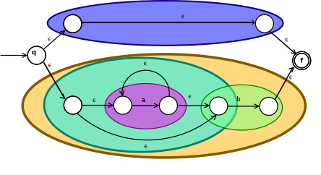
Example
For the RE (ε|(a*b)):
Image from https://en.wikipedia.org/wiki/Thompson%27s_construction

Slide 11
Analysis
Note that each combination in the above construction adds only a constant number of nodes and edges in each step.
So, if we start with an RE with m symbols, we will construct an equivalent ε-NFA of size O(m).
Thus, we can determine whether a regular expression of size m matches a string of size n by converting the RE to an equivalent ε-NFA, converting that to an equivalent DFA, and using DFA simulation to test for a match in O(2^{m} + n) time.
Alternatively, we can use ε-NFA simulation to test for a regular-expression match in O(mn) time.

