Slide 1
Longest Common Subsequences
Michael T. Goodrich
University of California, Irvine

Slide 2
Application: DNA Sequence Alignment
DNA sequences can be viewed as strings of A, C, G, and T characters, which represent nucleotides.
Finding the similarities between two DNA sequences is an important computation performed in bioinformatics.
  For instance, when comparing the DNA of different organisms, such alignments can highlight the locations where those organisms have identical DNA patterns.

Slide 3
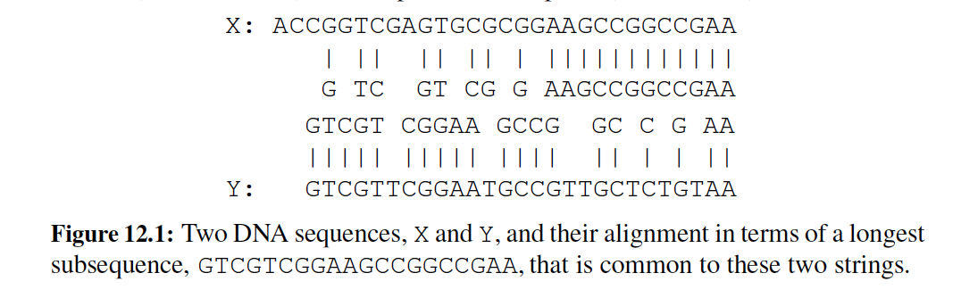
Application: DNA Sequence Alignment
Finding the best alignment between two DNA strings involves minimizing the number of changes to convert one string to the other.
A brute-force search would take exponential time, but we can do much better using dynamic programming.

Slide 4
Dynamic Programming
Applies to a problem that at first seems to require a lot of time (possibly exponential), provided we have:
  Simple subproblems: the subproblems can be defined in terms of a few variables, such as j, k, l, m, and so on.
  Subproblem optimality: the global optimum value can be defined in terms of optimal subproblems
  Subproblem overlap: the subproblems are not independent, but instead they overlap (hence, should be constructed bottom-up).

Slide 5
Subsequences
A subsequence of a character string x₀x₁x₂…x_{n-1} is a string of the form x_{i1}x_{i2}…x_{ik}, where ij < ij+1.
Not the same as substring!
Example String: ABCDEFGHIJK
  Subsequence: ACEGJIK
  Subsequence: DFGHK
  Not subsequence: DAGH

Slide 6
The Longest Common Subsequence (LCS) Problem
Given two strings X and Y, the longest common subsequence (LCS) problem is to find a longest subsequence common to both X and Y
Has applications to DNA similarity testing (alphabet is {A,C,G,T})
Example: ABCDEFG and XZACKDFWGH have ACDFG as a longest common subsequence

Slide 7
A Poor Approach to the LCS Problem
A Brute-force solution:
  Enumerate all subsequences of X
  Test which ones are also subsequences of Y
  Pick the longest one.
Analysis:
  If X is of length n, then it has 2^{n} subsequences
  This is an exponential-time algorithm!

Slide 8
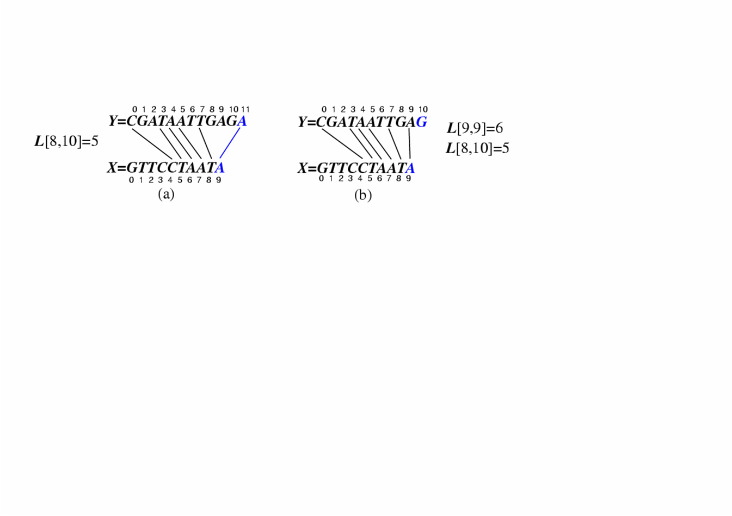
A Dynamic-Programming Approach to the LCS Problem
Define L[i,j] to be the length of the longest common subsequence of X[0..i] and Y[0..j].
Allow for -1 as an index, so L[-1,k] = 0 and L[k,-1]=0, to indicate that the null part of X or Y has no match with the other.
Then we can define L[i,j] in the general case as follows:
  If xi=yj, then L[i,j] = L[i-1,j-1] + 1 (we can add this match)
  If xi≠yj, then L[i,j] = max{L[i-1,j], L[i,j-1]} (we have no match here)
Case 1:
Case 2:

Slide 9
An LCS Algorithm
Algorithm LCS(X,Y ):
Input: Strings X and Y with n and m elements, respectively
Output: For i = 0,…,n-1, j = 0,...,m-1, the length L[i, j] of a longest string that is a subsequence of both the string X[0..i] = x₀x₁x₂…x_{i} and the string Y [0.. j] = y₀y₁y₂…y_{j}
for i =1 to n-1 do
L[i,-1] = 0
for j =0 to m-1 do
L[-1,j] = 0
for i =0 to n-1 do
for j =0 to m-1 do
if x_{i} = y_{j} then
L[i, j] = L[i-1, j-1] + 1
else
L[i, j] = max{L[i-1, j] , L[i, j-1]}
return array L

Slide 10
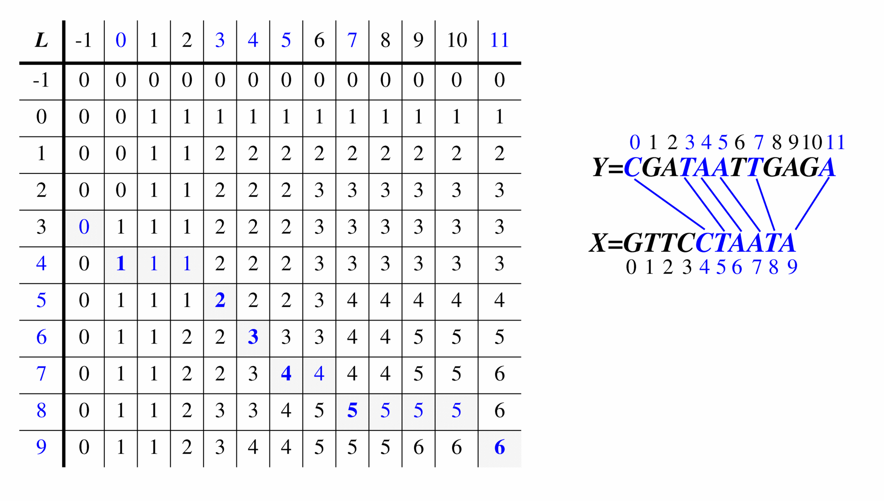
Visualizing the LCS Algorithm

Slide 11
Analysis of LCS Algorithm
We have two nested loops
  The outer one iterates n times
  The inner one iterates m times
  Thus, the total running time is O(nm)
  For example, if n = 1 million and m = 1 million, and we can do ops in 1 ns, then we need approx. 17 minutes.
Answer is contained in L[n,m] (and the subsequence can be recovered from the L table).
This takes O(nm) space, however!
  For example, if n = 1 million and m = 1 million, then we need over 1 TB of memory for the L table!

Slide 12

Hirschberg’s Algorithm
Hirschberg’s algorithm is a way of computing the LCS in linear space.
Dan Hirschberg is a faculty member in the Department of Computer Science at University of California, Irvine.
He teaches Algorithms and Data Compression in the MCS program.

Slide 13
Idea #1
When we are computing the L table, we only need to store the previous row and the current row.
If we just want to know the last row of the LCS (e.g., to compute the length of the LCS), this is enough to achieve linear space.

Slide 14
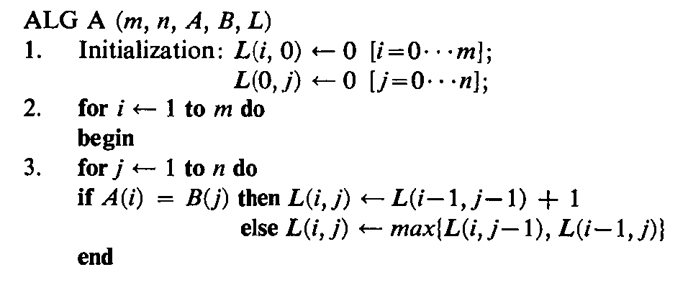
Review of the LCS Algorithm
To match Hirschberg’s notation, let A be string of length m and B be string of length n (both indexed starting from 1).

Slide 15
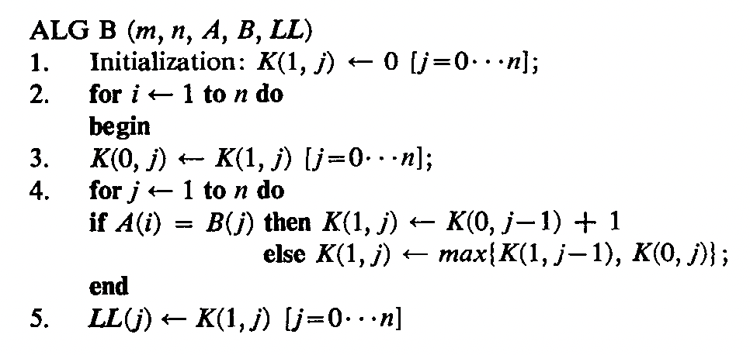
Applying Idea #1
Use a 2 x n matrix, K, instead of L.
Let A be string of length m and B be string of length n (indexed starting from 1). The following algorithm gives the last line, LL, of the L table:

Slide 16
Idea #2: Divide and Conquer Algorithm
Where does the LCS path cross the middle column of the L table?
For i=m/2, find the place, k, where the LCS path crosses the middle column using Algorithm B. Then recursively find the LCS for A[1,i] and B[1,k] and the LCS for A[i+1,m] and B[k+1,n].

Slide 17
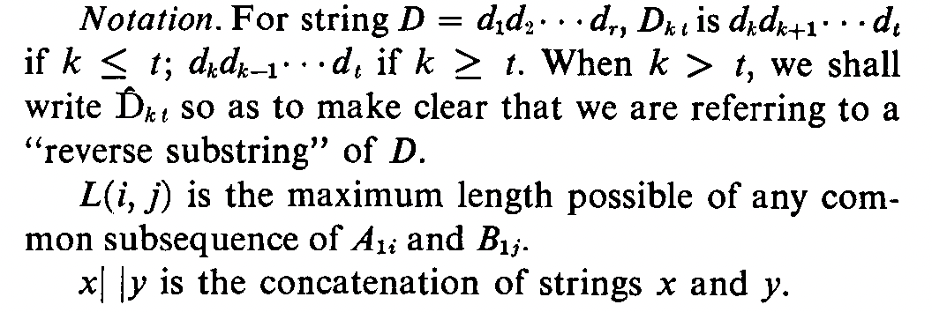
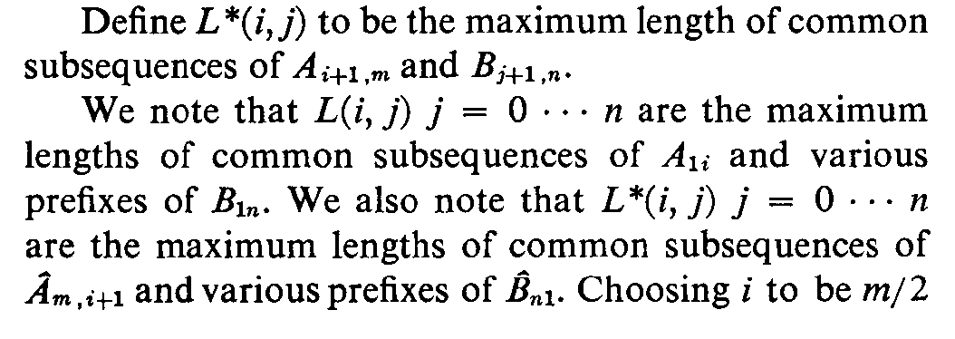
Notation

Slide 18
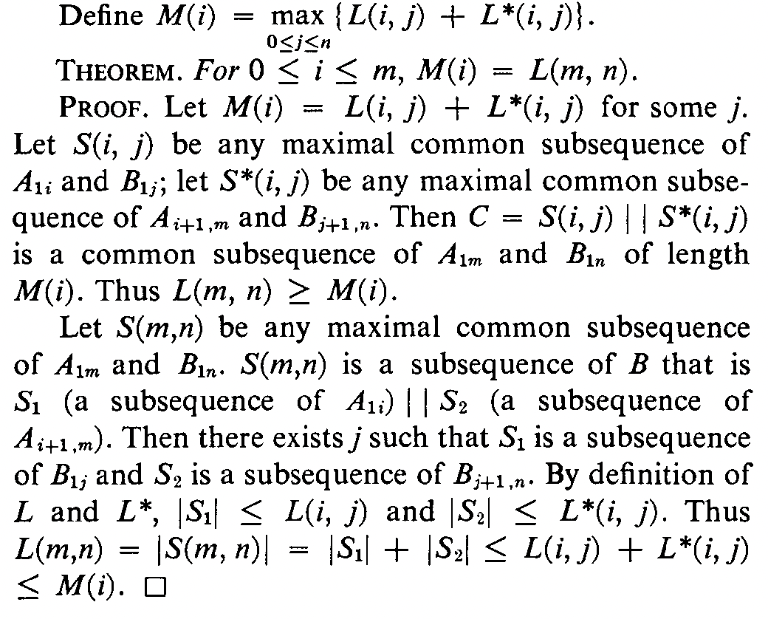

Slide 19
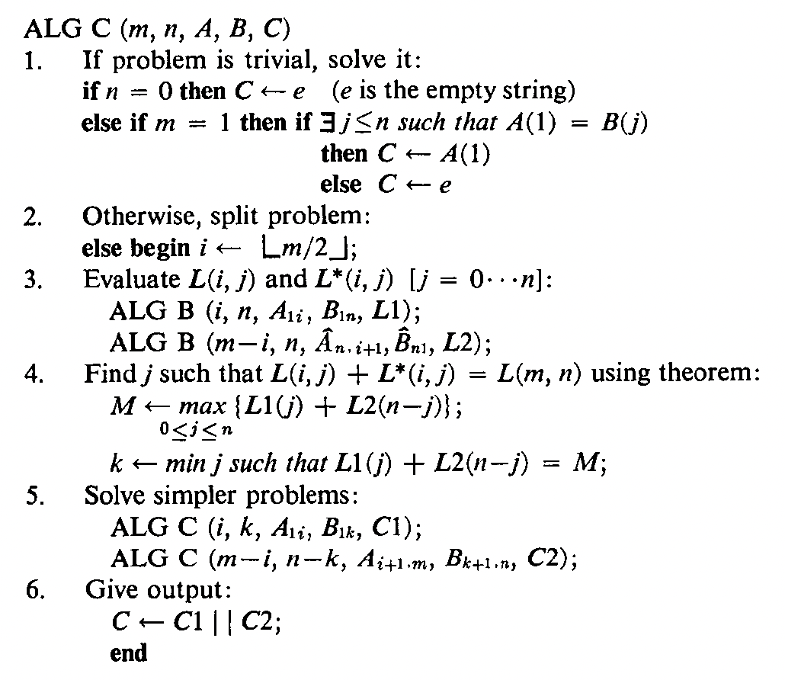

Slide 20
Algorithm Analysis
Space is O(n + m).
Time: T(m,n) = T(m/2, j) + T(m/2, n-j) + cnm

Slide 21
Prove by induction that
T(m,n) <= 2cmn
In class…

