Slide 1
Search Engines
Michael T. Goodrich
University of California, Irvine
Some slides adapted from slides by Md. Abdus Salam, Chris Manning, Pandu Nayak, and Prabhakar Raghavan

Slide 2
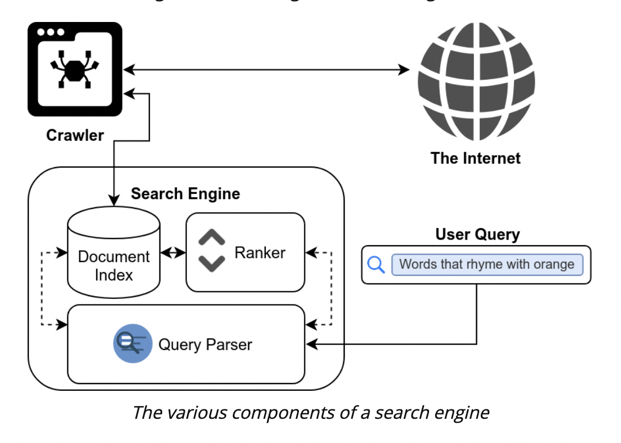
Components of a Search Engine
Image from https://www.cs.toronto.edu/~muuo/blog/build-yourself-a-mini-search-engine/

Slide 3
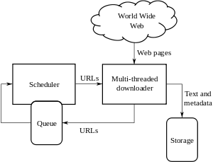
Web Crawlers
Image from https://en.wikipedia.org/wiki/Web_crawler

Slide 4
Basic crawler operation
Sec. 20.2
Begin with known “seed” URLs
Fetch and parse them
  Extract URLs they point to
  Place the extracted URLs on a queue
Fetch each URL on the queue and repeat

Slide 5
Crawling picture
Sec. 20.2
URLs crawled
and parsed
Unseen Web
Seed
pages
URLs frontier
Web

Slide 6
Simple picture – complications
Sec. 20.1.1
Web crawling isn’t feasible with one machine
  All of the above steps distributed
Malicious pages
  Spam pages
  Spider traps – incl dynamically generated
Even non-malicious pages pose challenges
  Latency/bandwidth to remote servers vary
  Webmasters’ stipulations
    How “deep” should you crawl a site’s URL hierarchy?
  Site mirrors and duplicate pages
Politeness – don’t hit a server too often

Slide 7
What any crawler must do
Sec. 20.1.1
Be Polite: Respect implicit and explicit politeness considerations
  Only crawl allowed pages
  Respect robots.txt (more on this shortly)
Be Robust: Be immune to spider traps and other malicious behavior from web servers

Slide 8
What any crawler should do
Sec. 20.1.1
Be capable of distributed operation: designed to run on multiple distributed machines
Be scalable: designed to increase the crawl rate by adding more machines
Performance/efficiency: permit full use of available processing and network resources

Slide 9
What any crawler should do
Sec. 20.1.1
Fetch pages of “higher quality” first
Continuous operation: Continue fetching fresh copies of a previously fetched page
Extensible: Adapt to new data formats, protocols

Slide 10
Updated crawling picture
Sec. 20.1.1
URLs crawled
and parsed
Unseen Web
Seed
Pages
URL frontier
Crawling thread

Slide 11
URL frontier
Sec. 20.2
Can include multiple pages from the same host
Must avoid trying to fetch them all at the same time
Must try to keep all crawling threads busy

Slide 12
Explicit and implicit politeness
Sec. 20.2
Explicit politeness: specifications from webmasters on what portions of site can be crawled
  robots.txt
Implicit politeness: even with no specification, avoid hitting any site too often

Slide 13
Robots.txt
Sec. 20.2.1
Protocol for giving spiders (“robots”) limited access to a website, originally from 1994
  www.robotstxt.org/wc/norobots.html
Website announces its request on what can(not) be crawled
  For a server, create a file /robots.txt
  This file specifies access restrictions

Slide 14
Robots.txt example
Sec. 20.2.1
No robot should visit any URL starting with
"/yoursite/temp/", except the robot called “searchengine":
User-agent: *
Disallow: /yoursite/temp/
User-agent: searchengine
Disallow:

Slide 15
Processing steps in crawling
Sec. 20.2.1
Pick a URL from the frontier
Fetch the document at the URL
Parse the URL
  Extract links from it to other docs (URLs)
Check if URL has content already seen
  If not, add to indexes
For each extracted URL
  Ensure it passes certain URL filter tests
  Check if it is already in the frontier (duplicate URL elimination)
Which one?
E.g., only crawl .edu, obey robots.txt, etc.

Slide 16
Basic crawl architecture
Sec. 20.2.1
WWW
DNS
Doc
FP’s
robots
filters
URL
set
Parse
Fetch
Content
seen?
URL
filter
Dup
URL
elim
URL Frontier

Slide 17
DNS (Domain Name Server)
Sec. 20.2.2
A lookup service on the internet
  Given a URL, retrieve its IP address
  Service provided by a distributed set of servers – thus, lookup latencies can be high (even seconds)
Common OS implementations of DNS lookup are blocking: only one outstanding request at a time
Solutions
  DNS caching
  Batch DNS resolver – collects requests and sends them out together

Slide 18
Parsing: URL normalization
Sec. 20.2.1
When a fetched document is parsed, some of the extracted links are relative URLs
E.g., http://en.wikipedia.org/wiki/Main_Page has a relative link to /wiki/Wikipedia:General_disclaimer which is the same as the absolute URL http://en.wikipedia.org/wiki/Wikipedia:General_disclaimer
During parsing, must normalize (expand) such relative URLs

Slide 19
Content seen?
Sec. 20.2.1
Duplication is widespread on the web
If the page just fetched is already in the index, do not further process it
This is verified using document fingerprints or shingles

Slide 20
Distributing the crawler
Sec. 20.2.1
Run multiple crawl threads, under different processes – potentially at different nodes
  Geographically distributed nodes
Partition hosts being crawled into nodes
  Hash used for partition
How do these nodes communicate and share URLs?

Slide 21
Communication between nodes
Sec. 20.2.1
Output of the URL filter at each node is sent to the Dup URL Eliminator of the appropriate node
WWW
DNS
To
other
nodes
URL
set
Parse
Doc
FP’s
robots
filters
Fetch
Content
seen?
URL
filter
Host
splitter
Dup
URL
elim
From
other
nodes
URL Frontier

Slide 22
URL frontier: two main considerations
Sec. 20.2.3
Politeness: do not hit a web server too frequently
Freshness: crawl some pages more often than others
  E.g., pages (such as News sites) whose content changes often
These goals may conflict each other.
(E.g., simple priority queue fails – many links out of a page go to its own site, creating a burst of accesses to that site.)

Slide 23
Duplicate documents
Sec. 19.6
The web is full of duplicated content
Strict duplicate detection = exact match
  Not as common
But many, many cases of near duplicates
  E.g., Last modified date the only difference between two copies of a page

Slide 24
Duplicate/Near-Duplicate Detection
Sec. 19.6
Duplication: Exact match can be detected with fingerprints
Near-Duplication: Approximate match
  Overview
    Compute syntactic similarity with an edit-distance measure
    Use similarity threshold to detect near-duplicates, e.g., Similarity > 80% => Documents are “near duplicates”

Slide 25
Jaccard Similarity
Sec. 19.6
Features:
  Segments of a document (natural or artificial breakpoints)
  Shingles (Word N-Grams)
  a rose is a rose is a rose → 4-grams are:
  a_rose_is_a
  rose_is_a_rose
  is_a_rose_is
Similarity Measure between two docs (= sets of shingles)
  Jaccard cooefficient:
    (Size_of_Intersection / Size_of_Union)

Slide 26
Shingles + Set Intersection
Sec. 19.6
Computing exact set intersection of shingles between all pairs of documents is expensive
Approximate using a cleverly chosen subset of shingles from each (a sketch)
Estimate (size_of_intersection / size_of_union) based on a short sketch
Doc A
Shingle set A
Sketch A
Jaccard
Doc B
Shingle set B
Sketch B

Slide 27
Min-Hash Sketch of a document
Sec. 19.6
Create a “sketch vector” (of size ~200) for each document
  Documents that share ≥ t (say 80%) corresponding vector elements are deemed near duplicates
  For doc D, sketch_{D}[ i ] is as follows:
    Let f map all shingles in the universe to 1..2^{m} (e.g., f = fingerprinting)
    Let π_{i} be a random permutation on 1..2^{m}
    Pick MIN {π_{i}(f(s))} over all shingles s in D

Slide 28
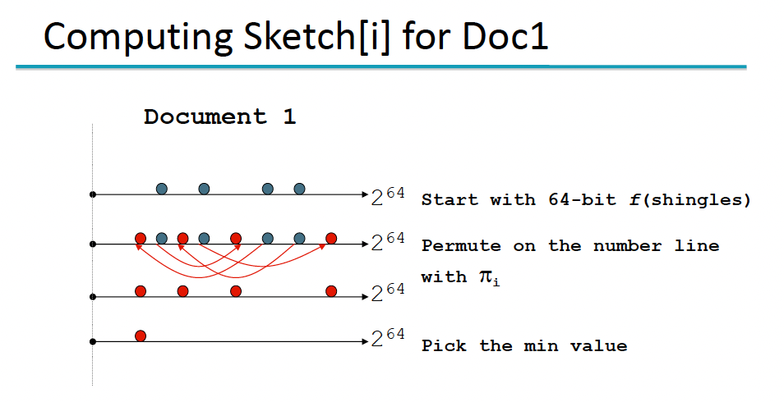

Slide 29
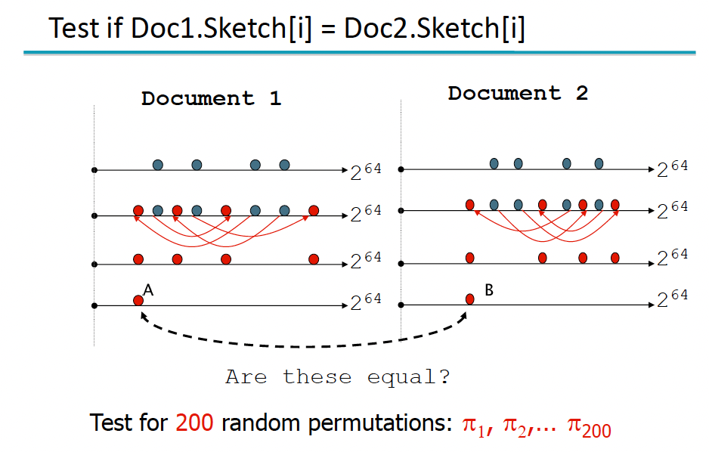

Slide 30
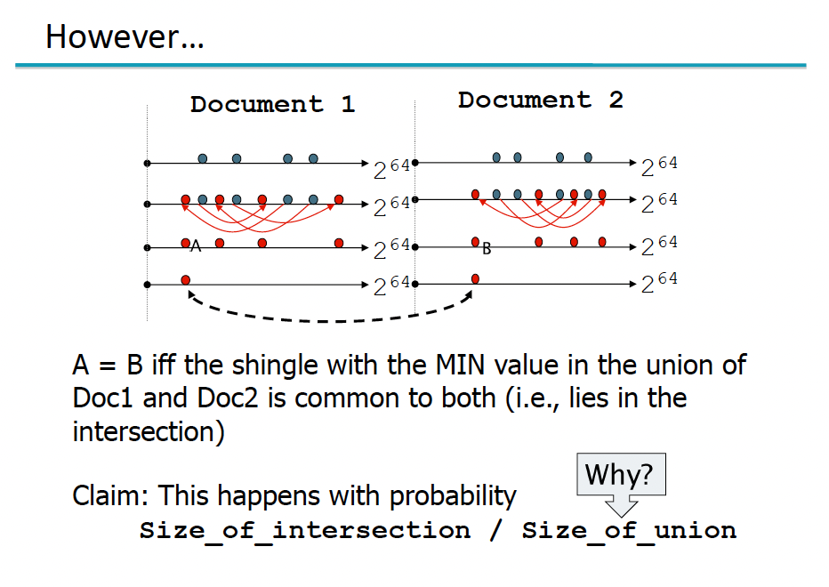

Slide 31
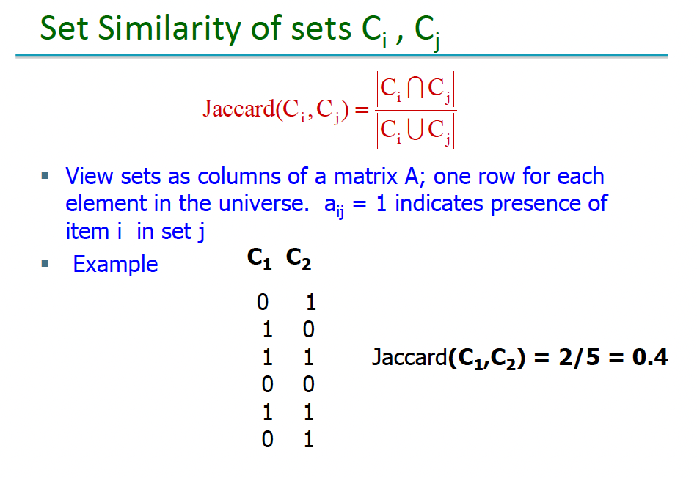

Slide 32
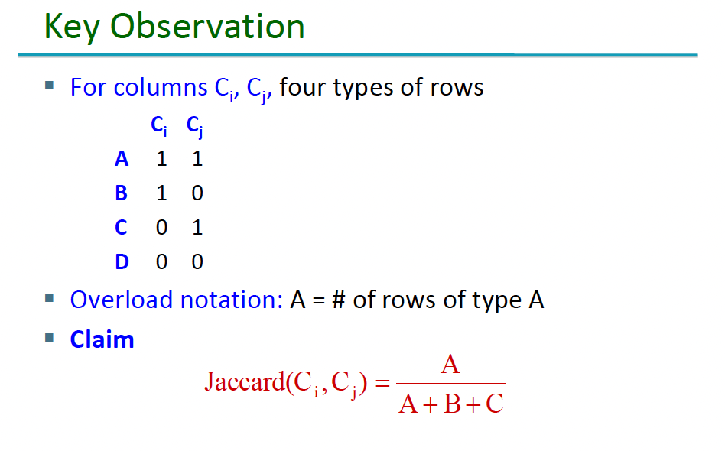

Slide 33
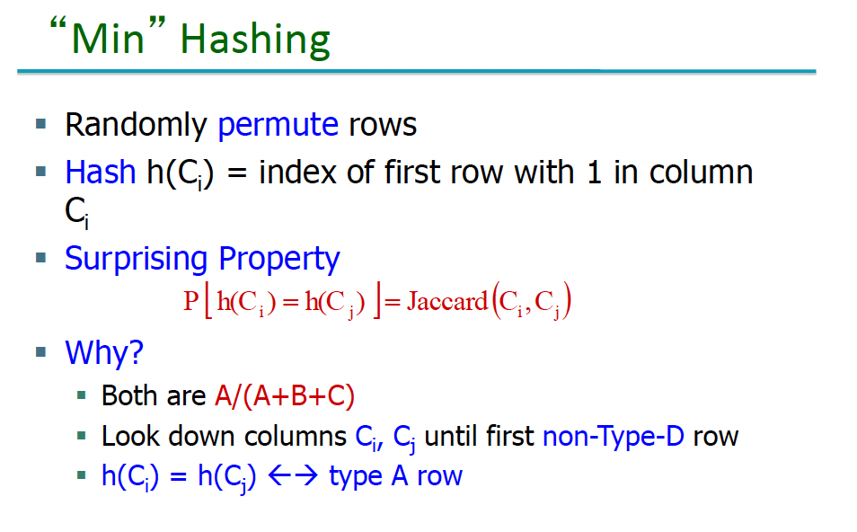

Slide 34
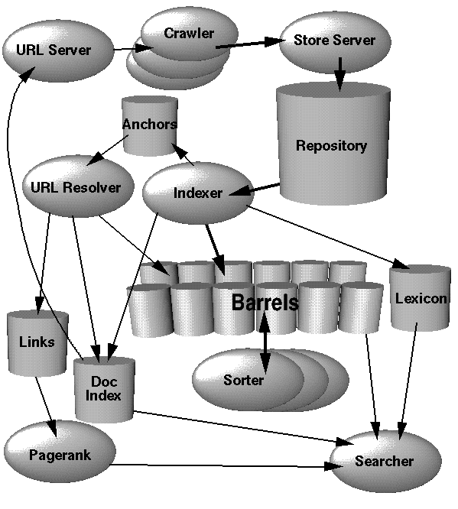
Google’s Original Architecture

Slide 35
Major Data Structures
BigFiles
      virtual files spanning multiple file systems and are addressable by 64 bit integers.
Repository
      contains the full HTML of every web page.
Document Index
      keeps information about each document.
Lexicon
      two parts – a list of the words and a hash table of pointers.
Hit Lists
      a list of occurrences of a particular word in a particular document including position, font, and capitalization information.
Forward Index
      stored in a number of barrels
Inverted Index
      consists of the same barrels as the forward index, except that they have been processed by the sorter.

Slide 36
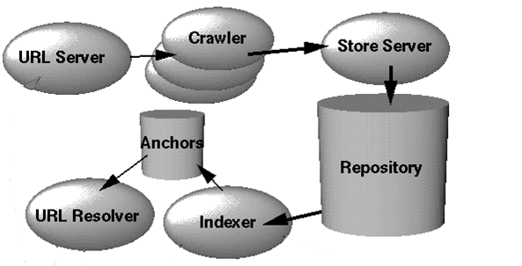
Google’s Original Architecture
Multiple crawlers run in parallel. Each crawler keeps its own DNS lookup cache and ~300 open connections open at once.
Keeps track of URLs that have and need to be crawled
Compresses and stores web pages
Stores each link and text surrounding link.
Converts relative URLs into absolute URLs.
Uncompresses and parses documents. Stores link information in anchors file.
Contains full html of every web page. Each document is prefixed by docID, length, and URL.

Slide 37
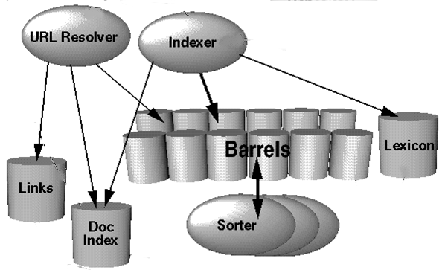
Google’s Original Architecture
Maps absolute URLs into docIDs stored in Doc Index. Stores anchor text in “barrels”. Generates database of links (pairs of docIds).
Parses & distributes hit lists into “barrels.”
Partially sorted forward indexes sorted by docID. Each barrel stores hitlists for a given range of wordIDs.
In-memory hash table that maps words to wordIds. Contains pointer to doclist in barrel which wordId falls into.
Creates inverted index whereby document list containing docID and hitlists can be retrieved given wordID.
  DocID keyed index where each entry includes info such as pointer to doc in repository, checksum, statistics, status, etc. Also contains URL info if doc has been crawled. If not just contains URL.

Slide 38
Crawling the Web
Google has a fast distributed crawling system.
A single URLserver serves lists of URLs to a number of crawlers.
Both the URLserver and the crawlers are implemented in parallel.
      Each crawler keeps roughly 300 connections open at once. At peak speeds, the system can crawl over 100 web pages per second using four crawlers. This amounts to roughly 600K per second of data.
Each crawler maintains its own DNS cache so it does not need to do a DNS lookup before crawling each document.

Slide 39
Indexing the Web
Parsing
  Any parser which is designed to run on the entire Web must handle a huge array of possible errors.
Indexing Documents into Barrels
  After each document is parsed, it is encoded into a number of barrels. Every word is converted into a wordID by using an in-memory hash table -- the lexicon.
  Once the words are converted into wordID's, their occurrences in the current document are translated into hit lists and are written into the forward barrels.
Sorting
  the sorter takes each of the forward barrels and sorts it by wordID to produce an inverted barrel for title and anchor hits and a full text inverted barrel.

Slide 40
Anchor Text
<A href="http://www.yahoo.com/">Yahoo!</A>
Besides the text of a hyperlink (anchor text) is
associated with the page that the link is on,
it is also associated with the page the link
points to.
  anchors often provide more accurate descriptions of web pages than the pages themselves.
  anchors may exist for documents which cannot be indexed by a text-based search engine, such as images, programs, and databases.

Slide 41
Google Query Evaluation
Parse the query.
Convert words into wordIDs.
Seek to the start of the doclist in the short barrel for every word.
Scan through the doclists until there is a document that matches all the search terms.
Compute the rank of that document for the query.
If we are in the short barrels and at the end of any doclist, seek to the start of the doclist in the full barrel for every word and go to step 4.
If we are not at the end of any doclist go to step 4.
Sort the documents that have matched by rank and return the top k.

Slide 42
Single Word Query Ranking
Hitlist is retrieved for single word
Each hit can be one of several types: title, anchor, URL, large font, small font, etc.
Each hit type is assigned its own weight
Type-weights make up vector of weights
Number of hits of each type is counted to form count-weight vector
Dot product of type-weight and count-weight vectors is used to compute IR score
IR score is combined with PageRank to compute final rank

Slide 43
Multi-word Query Ranking
Similar to single-word ranking except now must analyze proximity of words in a document and perform Boolean operations
Hits occurring closer together are weighted higher than those farther apart
Each proximity relation is classified into 1 of 10 bins ranging from a “phrase match” to “not even close”
Each type and proximity pair has a type-prox weight
Counts converted into count-weights
Take dot product of count-weights and type-prox weights to computer for IR score

Slide 44
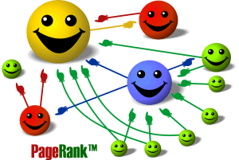
Ranking
  PageRank is a link analysis algorithm which assigns a numerical weighting to each Web page, with the purpose of "measuring" relative importance.
      Based on the hyperlinks map
      An excellent way to prioritize the results of web keyword searches

Slide 45


Simplified PageRank algorithm
Assume four web pages: A, B,C and D. Let each page would begin with an estimated PageRank of 0.25.
L(A) is defined as the number of links going out of page A. The PageRank of a page A is given as follows:
C
A
D
B
C
A
D
B

Slide 46

PageRank algorithm including damping factor
  Assume page A has pages B, C, D ..., which point to it. The parameter d is a damping factor which can be set between 0 and 1. Usually set d to 0.85. The PageRank of a page A is given as follows:

Slide 47
Intuitive Justification
A "random surfer" who is given a web page at random and keeps clicking on links, never hitting "back“, but eventually gets bored and starts on another random page.
  The probability that the random surfer visits a page is its PageRank.
  The d damping factor is the probability at each page the "random surfer" will get bored and request another random page.
A page can have a high PageRank
  If there are many pages that point to it
  Or if there are some pages that point to it, and have a high PageRank.

