Slide 1
Vector Space Model
Michael T. Goodrich
University of California, Irvine
Some slides adapted from notes by Ben Horowitz and Guy Blelloch,
and slides from Pandu Nayak and Prabhakar Raghavan (Senior Vice President at Google responsible for
Google Search, Assistant, Geo, Ads, Commerce, and Payments products).

Slide 2
Ranked retrieval
Thus far, our queries have all been Boolean.
Documents either match or don’t.
Good for expert users with precise understanding of their needs and the collection.
Also good for applications: Applications can easily consume 1000s of results.
Not good for the majority of users.
Most users incapable of writing Boolean queries (or they are, but they think it’s too much work).
Most users don’t want to wade through 1000s of results.
This is particularly true of web search.

Slide 3
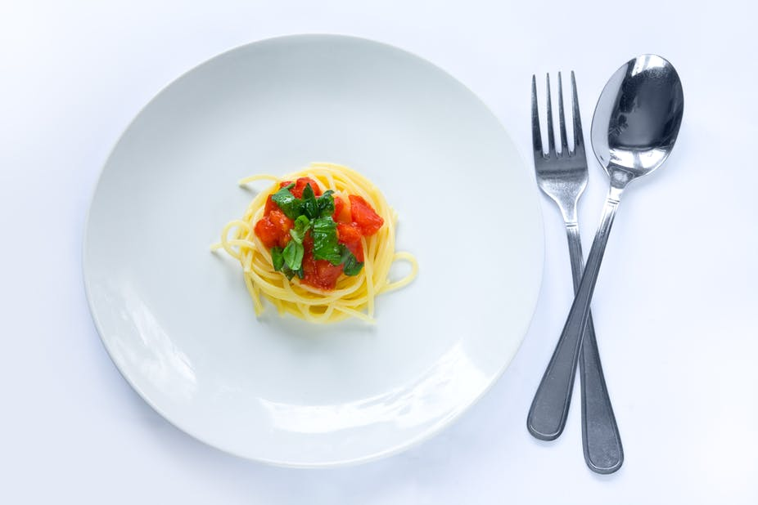
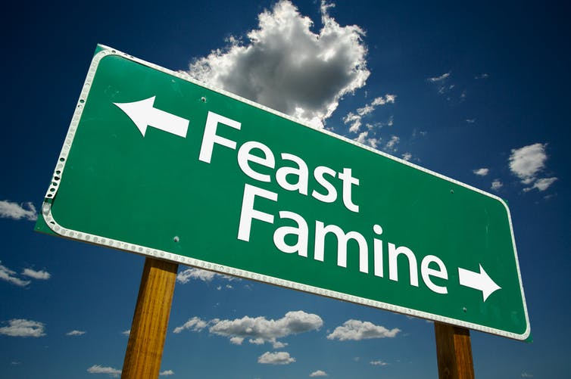
Problem with Boolean search: feast or famine
Images from https://healthyfitnessmeals.com/one-pot-chicken-spaghetti/
and https://theconversation.com/feast-then-famine-how-fasting-might-make-our-cells-more-resilient-to-stress-38808
Boolean queries often result in either too few (=0) or too many (1000s) results.
Query 1: “standard user dlink 650”: 200,000 hits
Query 2: “standard user dlink 650 cash”: 0 hits
It takes a lot of skill to come up with a query that produces a manageable number of hits.
AND gives too few; OR gives too many
Notes:
Cf. our discussion of how Westlaw Boolean queries didn’t actually outperform free text querying

Slide 4
Ranked retrieval models
Rather than a set of documents satisfying a query expression, in ranked retrieval, the system returns an ordering over the (top) documents in the collection for a query
Free text queries: Rather than a query language of operators and expressions, the user’s query is just one or more words in a human language
In principle, there are two separate choices here, but in practice, ranked retrieval has normally been associated with free text queries and vice versa

Slide 5
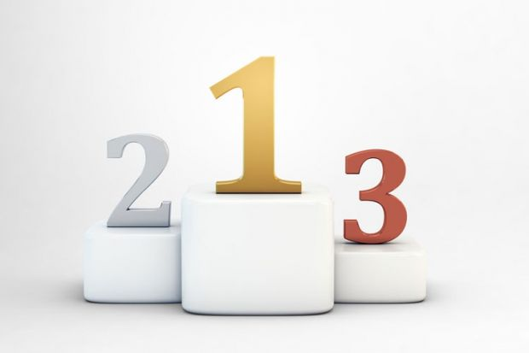
Feast or famine: not a problem in ranked retrieval
When a system produces a ranked result set, large result sets are not an issue
Indeed, the size of the result set is not an issue
We just show the top k ( ≈ 10) results
We don’t overwhelm the user
Premise: the ranking algorithm works
Image from https://www.timeshighereducation.com/features/top-20-ways-to-improve-your-world-university-ranking/410392.article

Slide 6
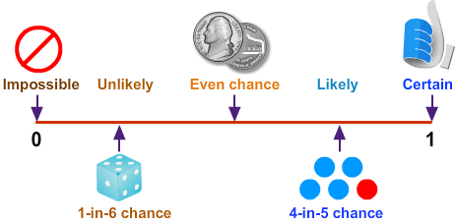
Scoring as the basis of ranked retrieval
We wish to return in order the documents most likely to be useful to the searcher
How can we rank-order the documents in the collection with respect to a query?
Assign a score – say in [0, 1] – to each document
This score measures how well document and query “match”.
Image from https://www.turtlediary.com/lesson/probability.html

Slide 7
Query-document matching scores
We need a way of assigning a score to a query/document pair
Let’s start with a one-term query
If the query term does not occur in the document: score should be 0
The more frequent the query term in the document, the higher the score (should be)
We will look at a number of alternatives for this.

Slide 8
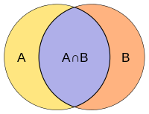
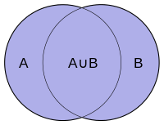
Take 1: Jaccard similarity
Recall: A commonly used measure of overlap of two sets A and B:
jaccard(A,B) = |A ∩ B| / |A ∪ B|
jaccard(A,A) = 1
jaccard(A,B) = 0 if A ∩ B = 0
A and B don’t have to be the same size.
Always assigns a number between 0 and 1.
Images from https://en.wikipedia.org/wiki/Jaccard_index

Slide 9
Issues with Jaccard for scoring
It doesn’t consider term frequency (how many times a term occurs in a document)
Rare terms in a collection are more informative than frequent terms. Jaccard doesn’t consider this information
We need a more sophisticated way of incorporating term frequency…
Image from https://www.r-bloggers.com/2020/05/learning-tfidf-with-political-theorists/

Slide 10
Recall: Binary term-document incidence matrix
Each document is represented by a binary vector ∈ {0,1}^{|V|}

Slide 11
Term-document count matrices
Consider the number of occurrences of a term in a document:
Each document is a count vector in ℕ^{v}: a column below

Slide 12
Bag of words model
Vector representation doesn’t consider the ordering of words in a document
John is quicker than Mary and Mary is quicker than John have the same vectors
This is called the bag of words model.
In a sense, this is a step back: The positional index was able to distinguish these two documents.
We will look at “recovering” positional information later in this course.
For now: bag of words model

Slide 13
Term frequency, tf
The term frequency tf_{t,d} of term t in document d is defined as the number of times that t occurs in d.
We want to use tf when computing query-document match scores. But how?
Raw term frequency is not what we want:
A document with 10 occurrences of the term is more relevant than a document with 1 occurrence of the term.
But not 10 times more relevant.
Relevance does not increase proportionally with term frequency.

Slide 14
Log-frequency weighting of tf
The log frequency weight of term t in d is
log₁₀ (1 + tf_{t,d})
tf: 0 → 0, 9 → 1, 99 → 2, 999 → 3, 9999 → 4, …
Score for a document-query pair: sum over terms t in both q and d:
Score
The score is 0 if none of the query terms is present in the document.

Slide 15
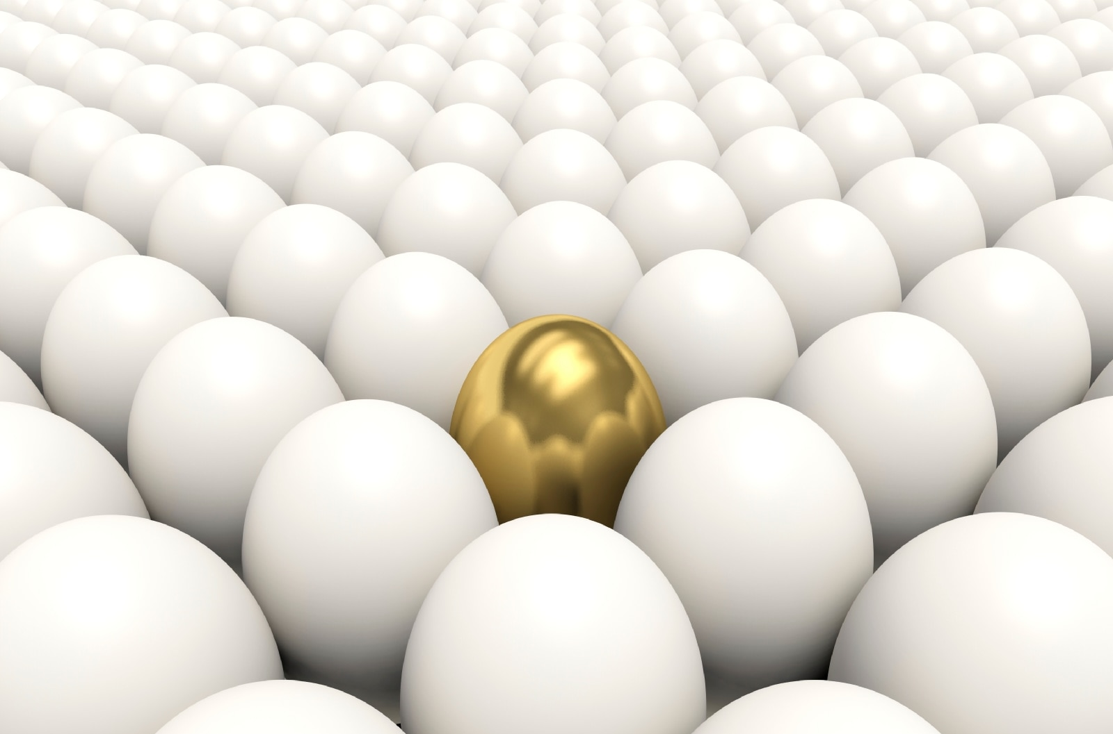
Document frequency
Rare terms are more informative than frequent terms
Recall stop words
Consider a term in the query that is rare in the collection (e.g., porridge)
A document containing this term is very likely to be relevant to the query porridge
We want a high weight for rare terms like porridge.
Image from https://www.thermofisher.com/blog/metals/a-snapshot-of-the-worlds-rarest-metals/

Slide 16
Document frequency
Frequent terms are less informative than rare terms
Consider a query term that is frequent in the collection (e.g., high, increase, line)
A document containing such a term is more likely to be relevant than a document that doesn’t
But it’s not a sure indicator of relevance.
For frequent terms, we want high positive weights for words like high, increase, and line
But lower weights than for rare terms.
We use document frequency (df) to capture this.

Slide 17
idf weight
N = the number of documents
df_{t} is the document frequency of t: the number of the N documents that contain t
df_{t} is an inverse measure of the informativeness of t
df_{t} ≤ N
We define the idf (inverse document frequency) of t by
We use log (N/df_{t}) instead of N/df_{t} to “dampen” the effect of idf.
It turns out the base of the log is immaterial.

Slide 18
idf example, suppose N = 1 million
term | df_{t} | idf_{t}
calpurnia | 1 | 6
animal | 100 | 4
sunday | 1,000 | 3
fly | 10,000 | 2
under | 100,000 | 1
the | 1,000,000 | 0
There is one idf value for each term t in a collection.
Notes:
6 4 3 2 1 0

Slide 19
Effect of idf on ranking
Does idf have an effect on ranking for one-term queries, like
iPhone
idf has no effect on ranking one term queries
idf affects the ranking of documents for queries with at least two terms
For the query capricious person, idf weighting makes occurrences of capricious count for much more in the final document ranking than occurrences of person.

Slide 20
Term freqency vs. Document frequency
The collection frequency of a term t is the number of occurrences of t in the collection, counting multiple occurrences.
Example: N = 20,000
Which word is a better search term (and should get a higher weight)? (Hint: insurance is twice as rare.)
Word | Term frequency in doc. | Document frequency of term | log (1 + tf) | log (N / df)
insurance | 108 | 3997 | 2.04 | 0.70
try | 104 | 8760 | 2.02 | 0.36
Notes:
Why do you get these numbers?
Suggests df is better.

Slide 21
tf-idf weighting
The tf-idf weight of a term is the product of its tf weight and its idf weight.
Best known weighting scheme in information retrieval
Note: the “-” in tf-idf is a hyphen, not a minus sign!
Alternative names: tf.idf, tf x idf
Increases with the number of occurrences within a document
Increases with the rarity of the term in the collection

Slide 22
Score for a document given a query
There are many variants
How “tf” is computed (with/without logs)
How idf is computed
Whether the terms in the query are also weighted
But the score is always a sum of tf.idf values

Slide 23
Binary → count → weight matrix
Each document is now represented by a real-valued vector of tf-idf weights ∈ R^{|V|}

Slide 24
Documents as vectors
So we have a |V|-dimensional vector space
Terms are axes of the space
Documents are points or vectors in this space
Very high-dimensional: tens of millions of dimensions when you apply this to a web search engine
These are very sparse vectors - most entries are zero.

Slide 25
Queries as vectors
Key idea 1: Do the same for queries: represent them as vectors in the space
Key idea 2: Rank documents according to their proximity to the query in this space
proximity = similarity of vectors
proximity ≈ inverse of distance
Recall: We do this because we want to get away from the you’re-either-in-or-out Boolean model.
Instead: rank more relevant documents higher than less relevant documents

Slide 26
Formalizing vector space proximity
First cut: distance between two points
( = distance between the end points of the two vectors)
Euclidean distance?
Euclidean distance is a bad idea . . .
. . . because Euclidean distance is large for vectors of different lengths.

Slide 27
Why distance is a bad idea
The Euclidean distance between q
and d₂ is large even though the
distribution of terms in the query q and the distribution of
terms in the document d₂ are
very similar.

Slide 28
Use angle instead of distance
Thought experiment: take a document d and append it to itself. Call this document d′.
“Semantically” d and d′ have the same content
The Euclidean distance between the two documents can be quite large
The angle between the two documents is 0, corresponding to maximal similarity.
Key idea: Rank documents according to angle with query.

Slide 29
From angles to cosines
The following two notions are equivalent.
Rank documents in decreasing order of the angle between query and document
Rank documents in increasing order of cosine(query,document)
Cosine is a monotonically decreasing function for the interval [0º, 180º]

Slide 30
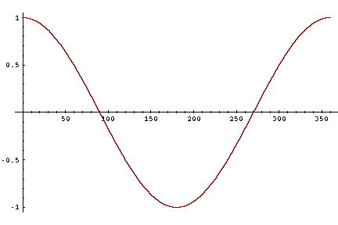
From angles to cosines
But how – and why – should we be computing cosines?

Slide 31
Length normalization
A vector can be (length-) normalized by dividing each of its components by its length – for this we use the L₂ norm:
Dividing a vector by its L₂ norm makes it a unit (length) vector (on surface of unit hypersphere)
Effect on the two documents d and d′ (d appended to itself) from earlier slide: they have identical vectors after length-normalization.
Long and short documents now have comparable weights

Slide 32
cosine(query,document)
Dot product
Unit vectors
q_{i} is the tf-idf weight of term i in the query
d_{i} is the tf-idf weight of term i in the document
cos(q,d) is the cosine similarity of q and d … or,
equivalently, the cosine of the angle between q and d.
Notes:
See Law of Cosines (Cosine Rule) wikipedia page

Slide 33
Cosine for length-normalized vectors
For length-normalized vectors, cosine similarity is simply the dot product (or scalar product):
for q, d length-normalized.

Slide 34
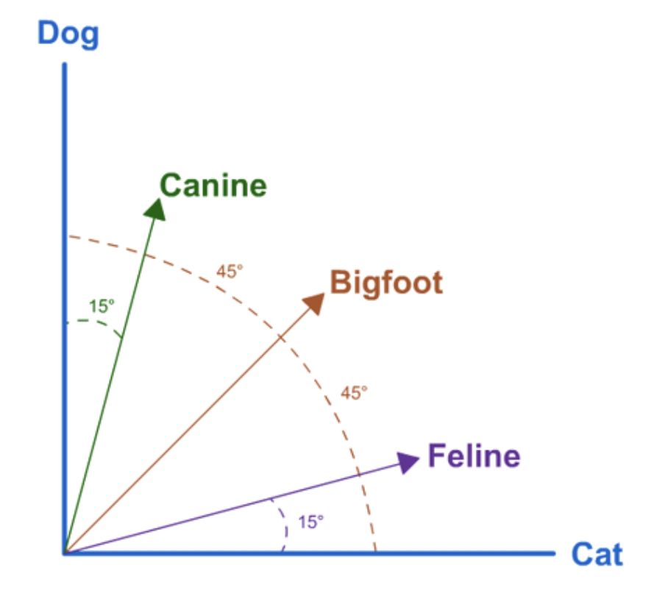
Cosine similarity illustrated
Image from https://shannonlong2014.wordpress.com/2014/06/01/ir-models-vector-space-model/

Slide 35
Cosine similarity amongst 3 documents
How similar are
the novels
SaS: Sense and
Sensibility
PaP: Pride and
Prejudice, and
WH: Wuthering
Heights?
term | SaS | PaP | WH
affection | 115 | 58 | 20
jealous | 10 | 7 | 11
gossip | 2 | 0 | 6
wuthering | 0 | 0 | 38
Term frequencies (counts)
Note: To simplify this example, we don’t do idf weighting.

Slide 36
3 documents example contd.
Log frequency weighting
After length normalization
term | SaS | PaP | WH
affection | 3.06 | 2.76 | 2.30
jealous | 2.00 | 1.85 | 2.04
gossip | 1.30 | 0 | 1.78
wuthering | 0 | 0 | 2.58
term | SaS | PaP | WH
affection | 0.789 | 0.832 | 0.524
jealous | 0.515 | 0.555 | 0.465
gossip | 0.335 | 0 | 0.405
wuthering | 0 | 0 | 0.588
cos(SaS,PaP) ≈
0.789 × 0.832 + 0.515 × 0.555 + 0.335 × 0.0 + 0.0 × 0.0
≈ 0.94
cos(SaS,WH) ≈ 0.79
cos(PaP,WH) ≈ 0.69
Why do we have cos(SaS,PaP) > cos(SaS,WH)?

Slide 37
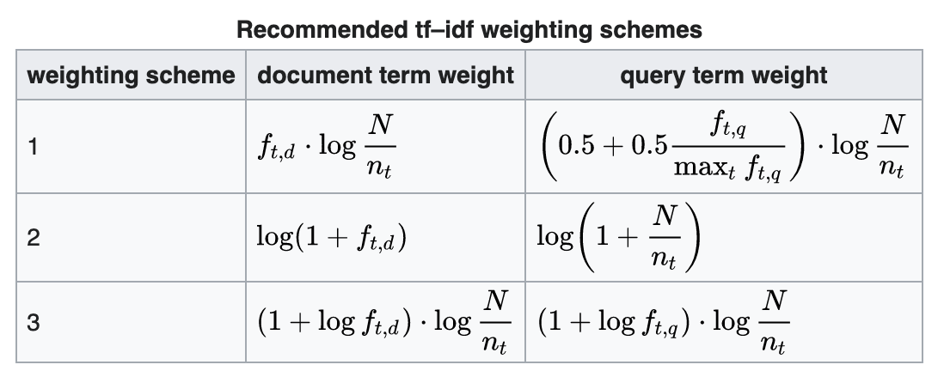
tf-idf weighting has variants
Why is the base of the log in idf immaterial?
From https://en.wikipedia.org/wiki/Tf%E2%80%93idf
Notes:
n default is just term frequency
ltc is best known form of weighting

Slide 38
Summary – vector space ranking
Represent the query as a weighted tf-idf vector
Represent each document as a weighted tf-idf vector
Compute the cosine similarity score for the query vector and each document vector
Rank documents with respect to the query by score
Return the top K (e.g., K = 10) to the user

