Slide 1
Constructing Phylogenetic Trees
Michael T. Goodrich
University of California, Irvine
Some slides adapted from slides by Tandy Warnow, Ramtin Afshar, and Martha Osegueda

Slide 2
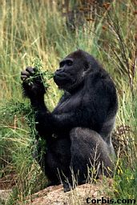
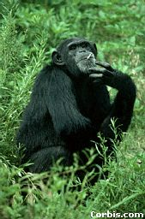
Phylogeny
From the Tree of the Life Website, University of Arizona
Orangutan
Gorilla
Chimpanzee
Human
Notes:
A phylogeny is a tree representation for the evolutionary history relating the species we are interested in.
This is an example of a 13-species phylogeny.
At each leaf of the tree is a species – we also call it a taxon in phylogenetics (plural form is taxa). They are all distinct.
Each internal node corresponds to a speciation event in the past.
When reconstructing the phylogeny we compare the characteristics of the taxa, such as their appearance, physiological features, or the composition of the genetic material.

Slide 3
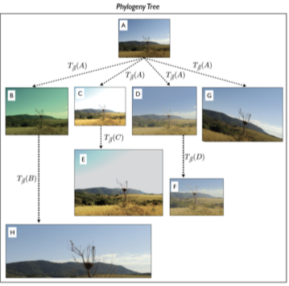
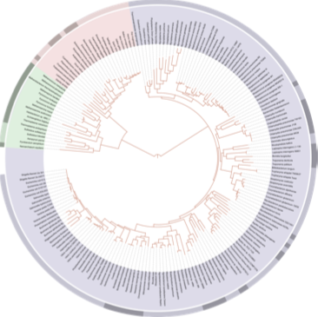
Phylogenetic trees
A data structure to store evolutionary relationships:
Biological:
Species
Bacteria
Virus
Digital:
Computer virus
Text file
Document
Image
Video
a)
b)
a) A biological tree of life; public domain image by Ivica Letunic, b) A digital Phylogenetic tree from Dias et al.

Slide 4
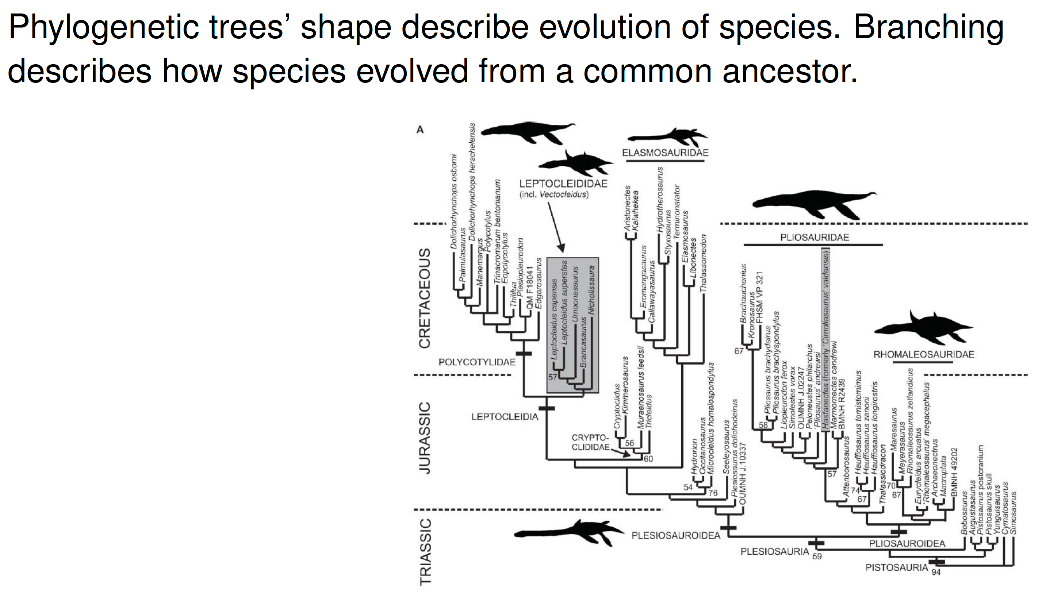
Another Biological Example
(should have been named
“Cretaceous Park”)

Slide 5
Data
Biomolecular sequences: DNA, RNA, amino acid, in a multiple alignment
Molecular markers
Morphology
Gene order and content
These are “character data”: each character is a function mapping the set to distinct states (equivalence classes), with evolution modelled as a process that changes the state of a character

Slide 6
DNA Sequence Evolution
AAGACTT
-3 mil yrs
AAGACTT
-2 mil yrs
AAGGCCT
AAGGCCT
AAGGCCT
AAGGCCT
TGGACTT
TGGACTT
TGGACTT
TGGACTT
-1 mil yrs
AGGGCAT
AGGGCAT
AGGGCAT
TAGCCCT
TAGCCCT
TAGCCCT
AGCACTT
AGCACTT
AGCACTT
AGGGCAT
TAGCCCA
TAGACTT
AGCACAA
AGCGCTT
today
AGGGCAT
TAGCCCA
TAGACTT
AGCACAA
AGCGCTT

Slide 7
Evolution informs Biology
Big genome sequencing projects just produce data -- so what?
Evolutionary history relates all organisms and genes, and helps us understand and predict
interactions between genes (genetic networks)
drug design
predicting functions of genes
influenza vaccine development
origins and spread of disease
origins and migrations of humans

Slide 8
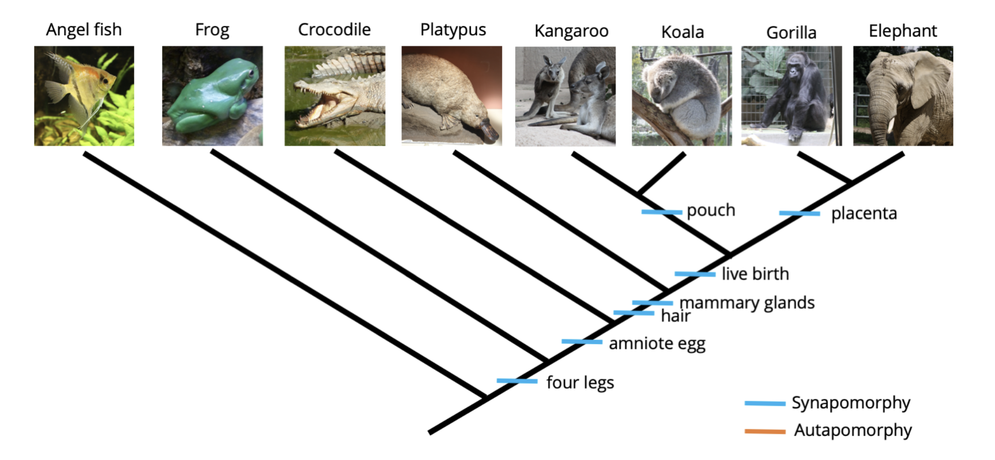
Evolution informs Biology
Phylogeny correlates with biological properties
Image by Jonathan R. Hendricks is licensed under a Creative Commons Attribution-ShareAlike 4.0 International License.

Slide 9
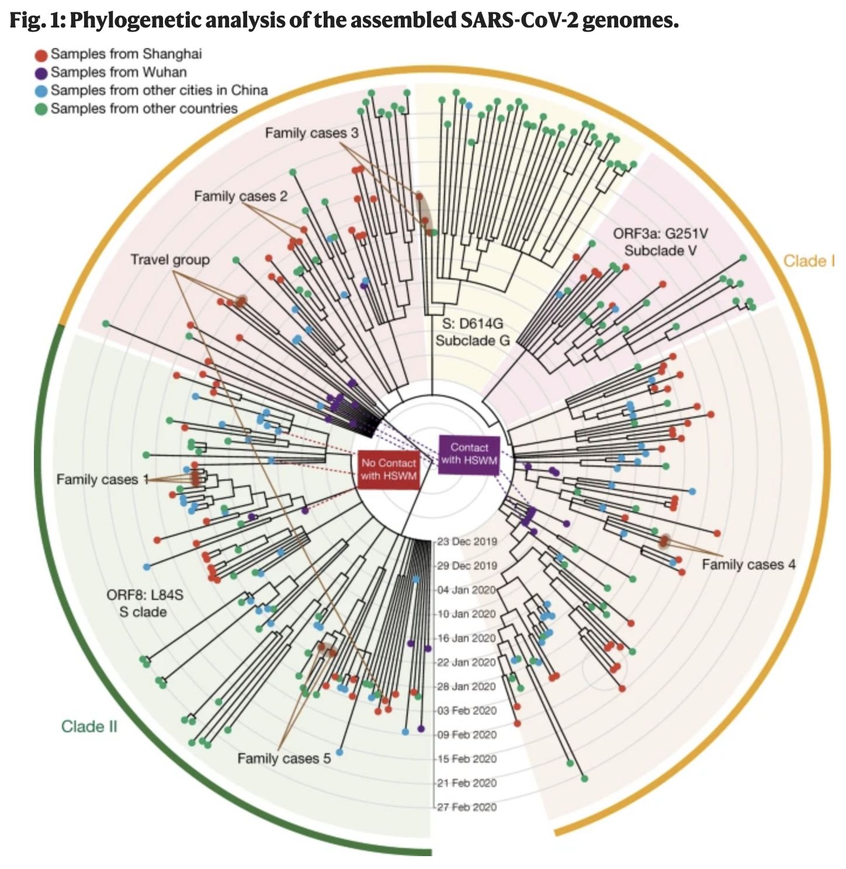
COVID-19
Phylogenetic analysis can help determine the origins and spread of a disease.
Image from https://www.nature.com/articles/s41586-020-2355-0

Slide 10
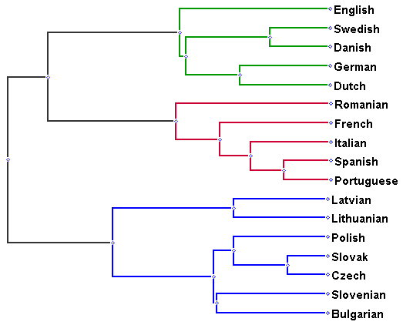
Phylogenies of Languages
Languages evolve over time, just as biological species do (geographic and other separations induce changes that over time make different dialects incomprehensible -- new languages appear)
The result can be modelled as a rooted tree
Image from https://aryamccarthy.github.io/rabinovich2017found/

Slide 11
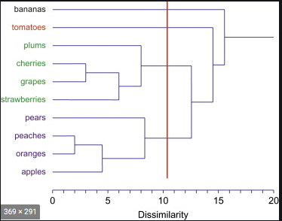
Hierarchical Clustering
A hierarchical clustering example by Tullis and Albert.

Slide 12
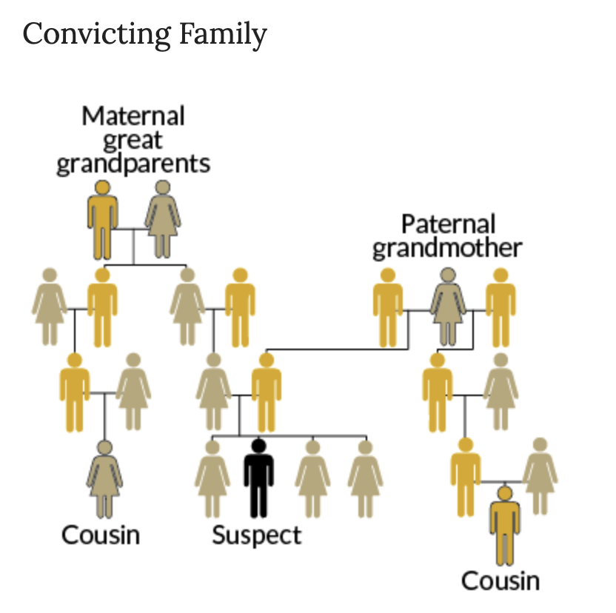
Related to Ancestry DNA Analysis
Submitting your DNA could get a relative arrested…
Edit distance of DNA used as evidence.
Image from https://ctlsites.uga.edu/biol2013h-2019/family-tree-forensics-fighting-crime-with-dna/

Slide 13
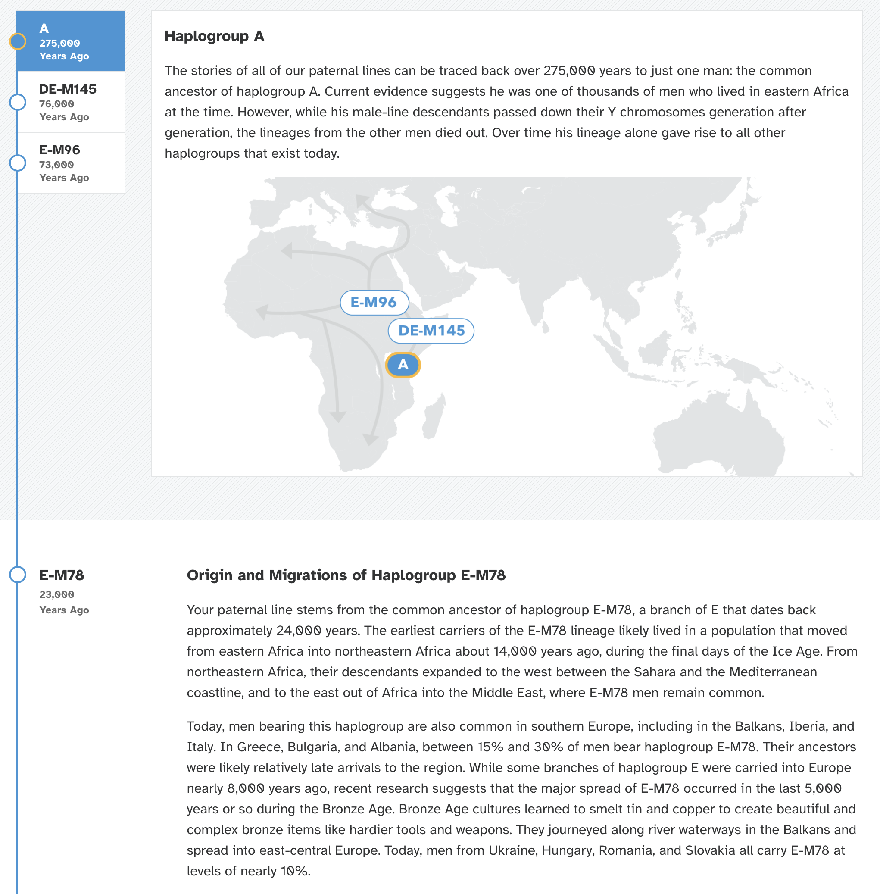
DNA Analysis
DNA analysis can reveal interesting histories.
Y-chromosome lineage of
an American male with
male ancestors from England shows
he probably actually is a descendant
of an ancient Roman soldier.

Slide 14
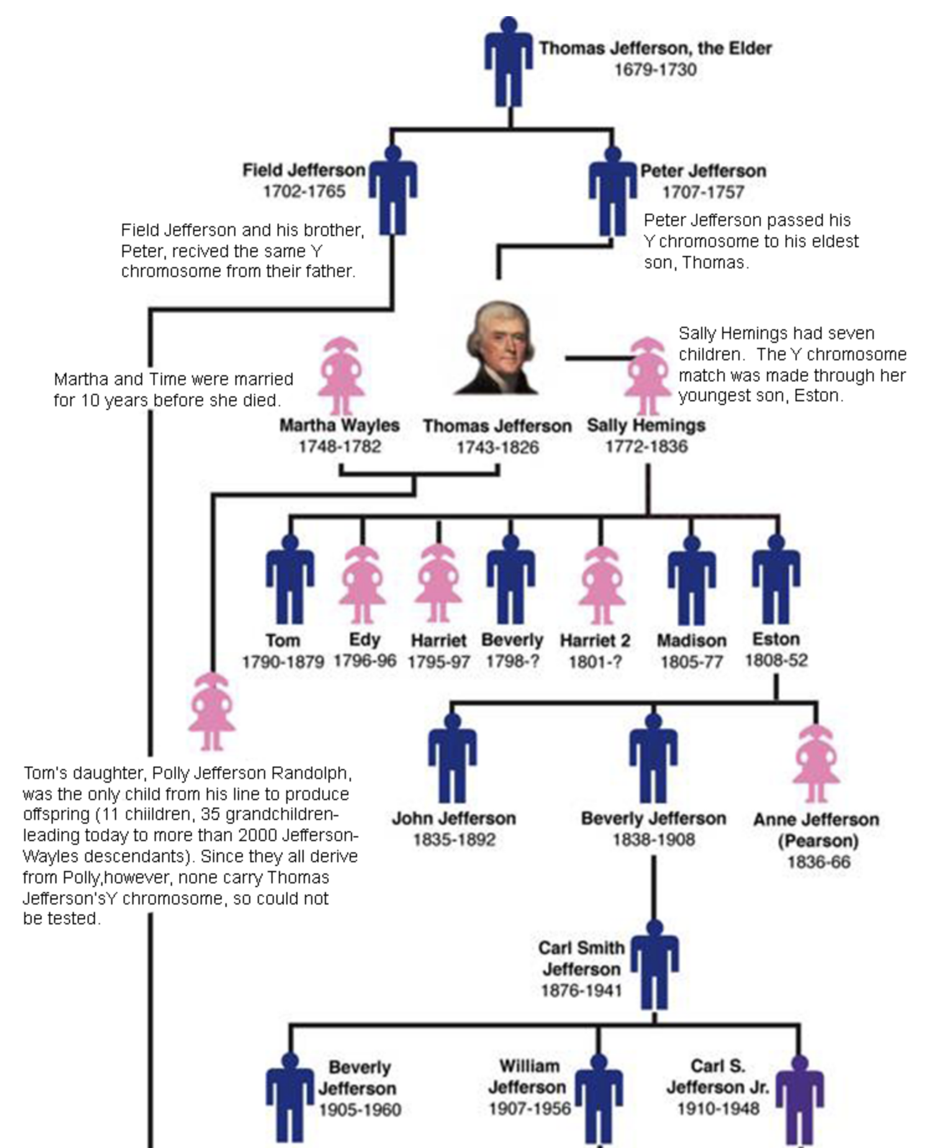
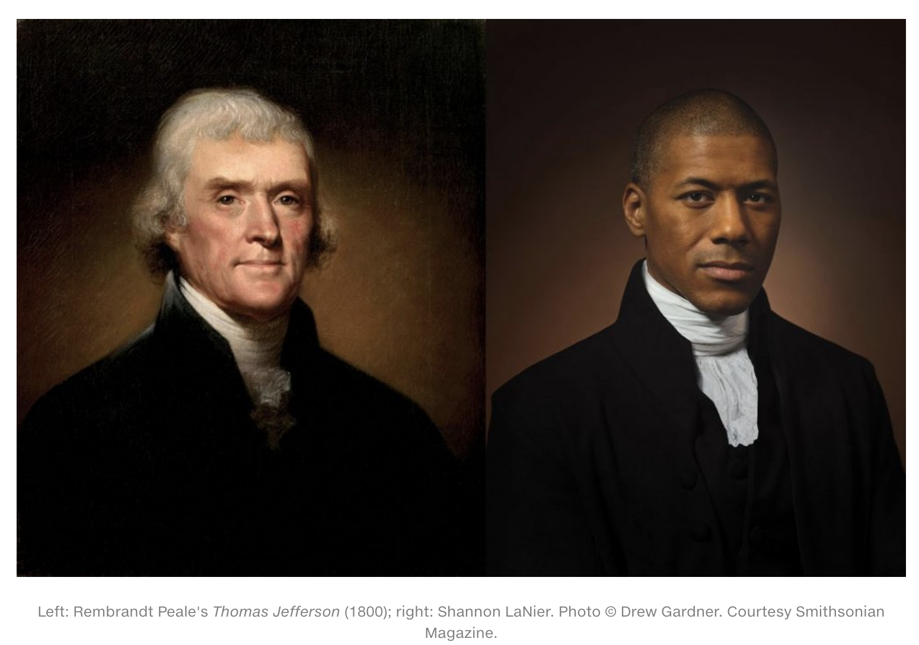
Ancestry DNA Analysis
DNA could uncover secret relatives.
Image from https://www.csueastbay.edu/museum/pre-exhibit/dna/history-jefferson.html/

Slide 15
Problem
Given a set of nodes or leaves of a binary tree:
The goal is to discover the edges of the tree using queries.
The queries involve nodes or leaves of the tree.
Each query reveals certain type of information.
We study the reconstruction of the trees based on:
Query complexity
Round complexity
Querying leaves or internal nodes
Querying leaves

Slide 16
Problem for Relative-Distance Queries
Given a set of leaves of a rooted binary tree:
We learn the tree using three node relative-distance queries in parallel.
Relative-distance query:
Given $3$ leaves $a, b,$and $c$:
It finds the pair with the lowest common ancestor
Comparisons are based on edit distance
a
b
c
Image from https://www.biorxiv.org/content/10.1101/2020.03.30.017384v1.full

Slide 20
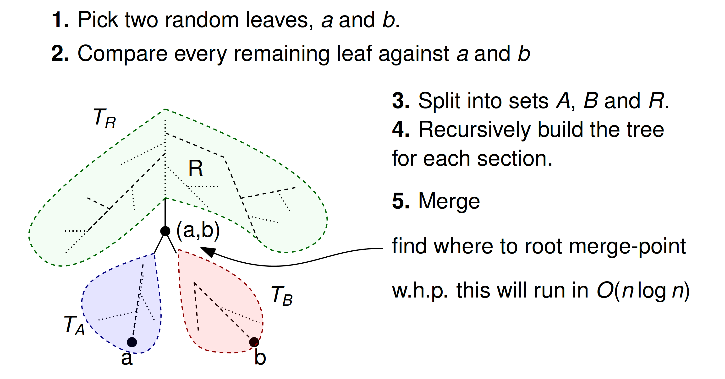

Slide 21
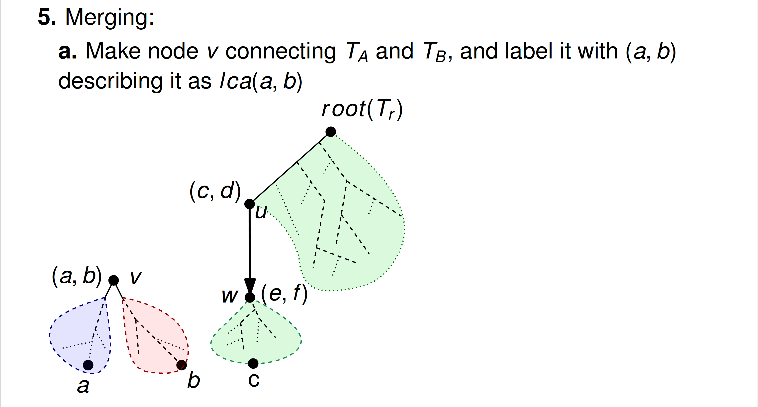

Slide 22
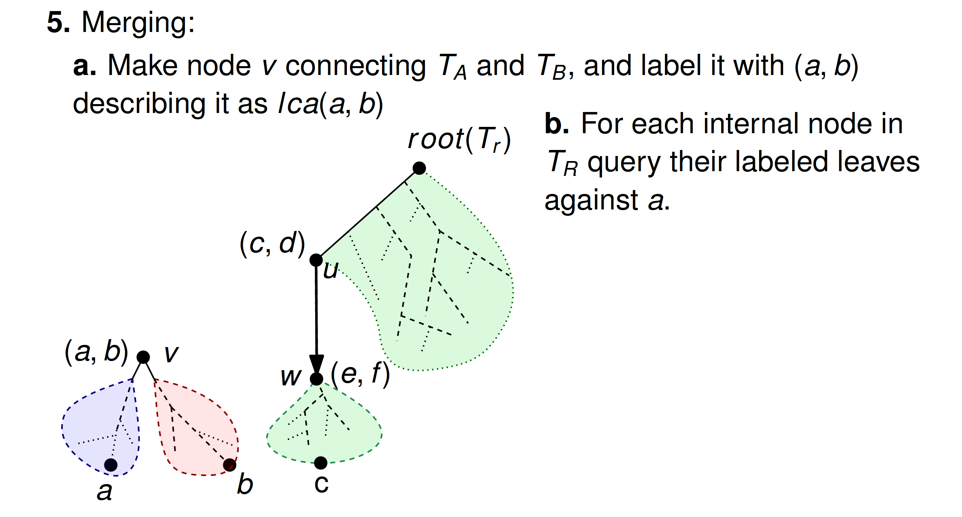

Slide 23
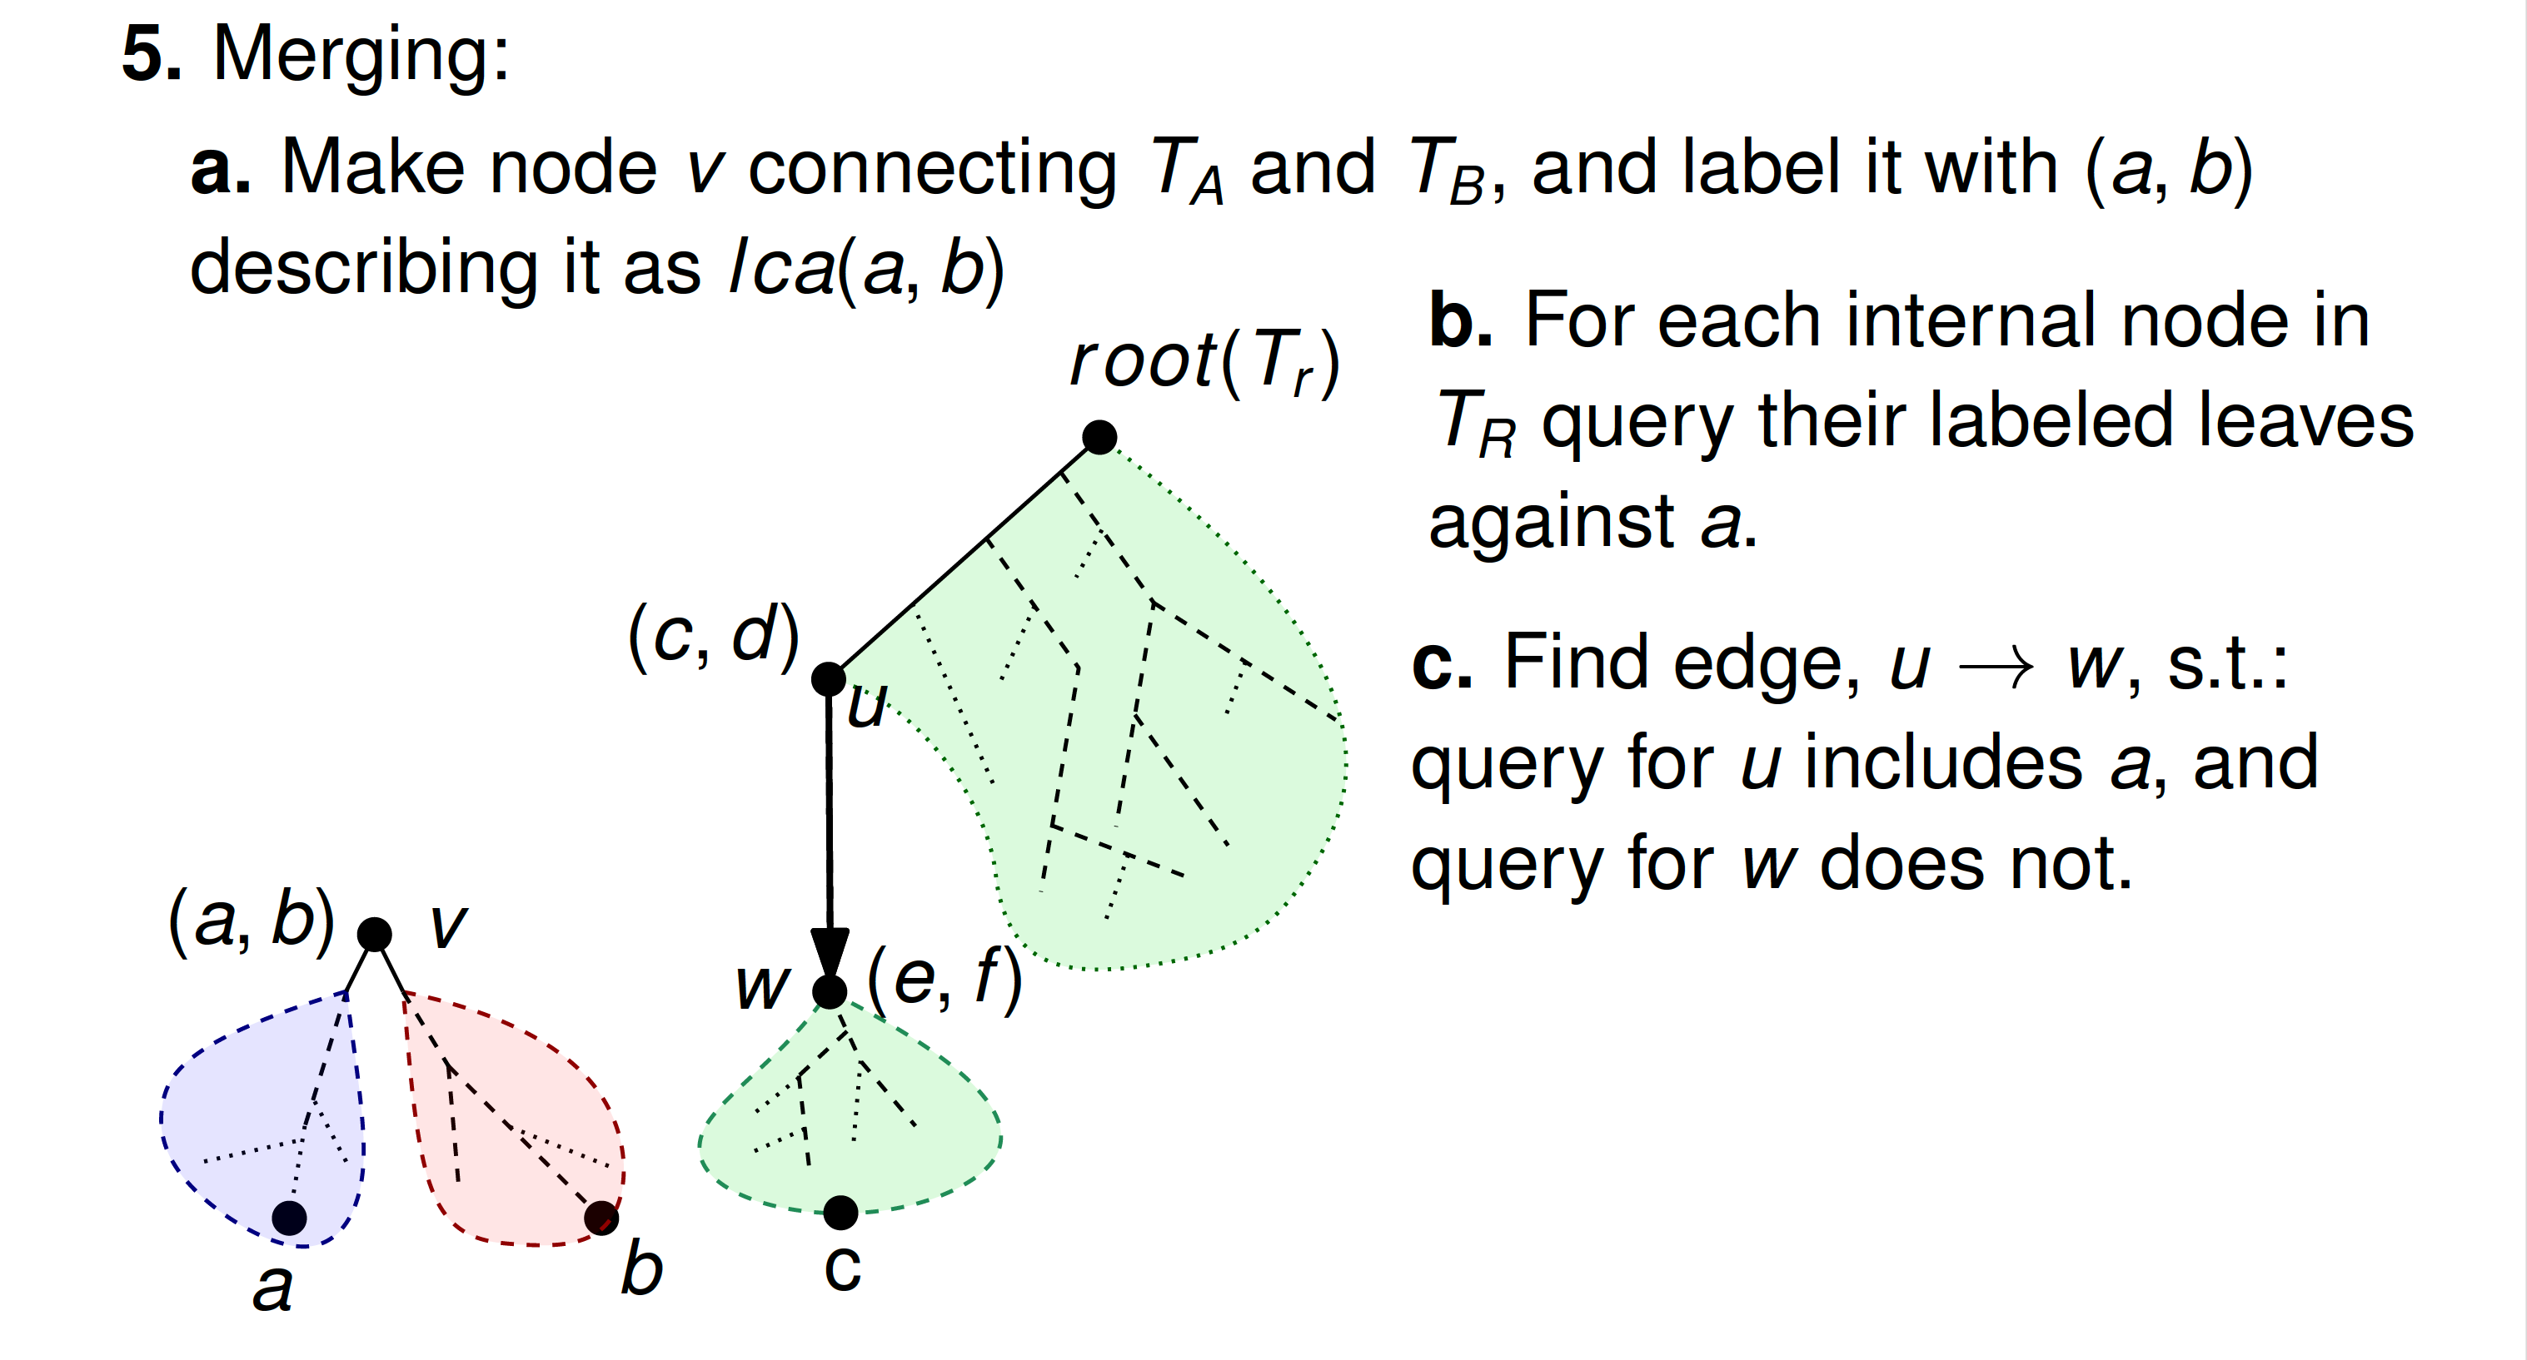

Slide 24
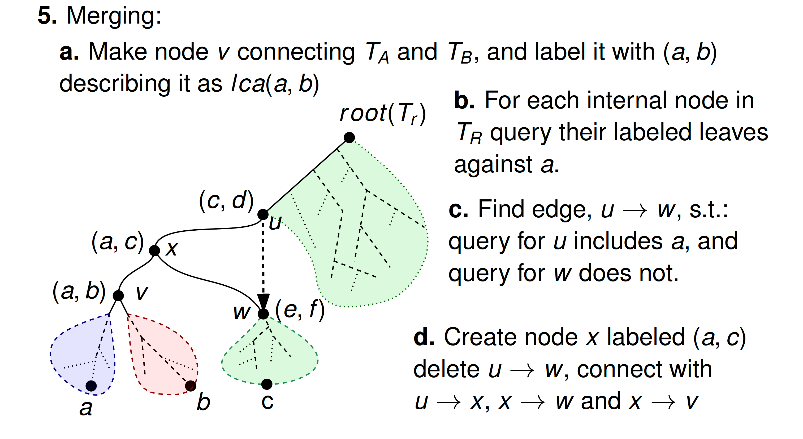

Slide 25
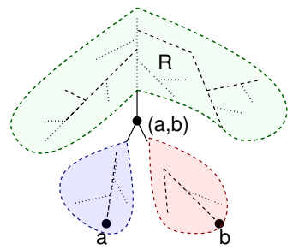
Performance of Reconstruction Algorithm using Relative-Distance Queries
$O(n)$ queries in $O(1)$ rounds
Pick two random leaves, $a$ and$b$.
Perform queries $closer(a,b,c)$ for each leaf $c.$
3. Split into sets $A, B,$ and $R$.
4. Recursively build the tree for each section.
5. Merge
Theorem 1: We can reconstruct a rooted binary tree using $O(n\log{n)}$relative-distance queries and $O(\log{n})$ rounds with high probablity.
$$T_{R}$$
$O(n)$ queries in $O(1)$ rounds
$$T_{A}$$
Find where to root the merge-point
$$T_{B}$$

Slide 26
Real World Issues
The above algorithm assumes there is a perfect tree, which is unknown, and all relative-distance queries are consistent with it.
This is not always the case in practice.
Real-world genetics doesn’t always produce a tree.
There are many types of distances, and real-world data is rarely consistent for all O(n²) pairs.
NP-hard optimization problems abound in phylogeny reconstruction.
Many real problems can nevertheless be approximated using heuristics based on things like relative-distance queries.

