Slide 1
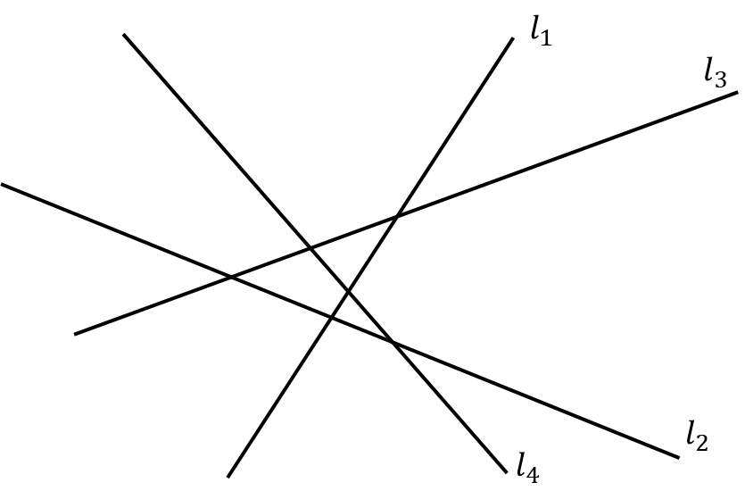
Computational Geometry
Line Arrangements
Michael Goodrich
with slides from Carola Wenk

Slide 2
Arrangement of Lines
Lines. Not line segments.
Let $L=\left\{l_{1},…, l_{n}\right\}$ be a set of $n$ lines in $ℝ^{2}$. Then $𝒜\left(L\right)$ is called the arrangement of $L$. It is defined as the planar subdivision induced by all lines in $L$.
Vertices, edges, faces.
$$l_{1}$$
$$l_{3}$$
$$l_{2}$$
$$l_{4}$$
$𝒜\left(L\right)$ is simple if no three lines meet in one point, and no two lines are parallel.

Slide 3
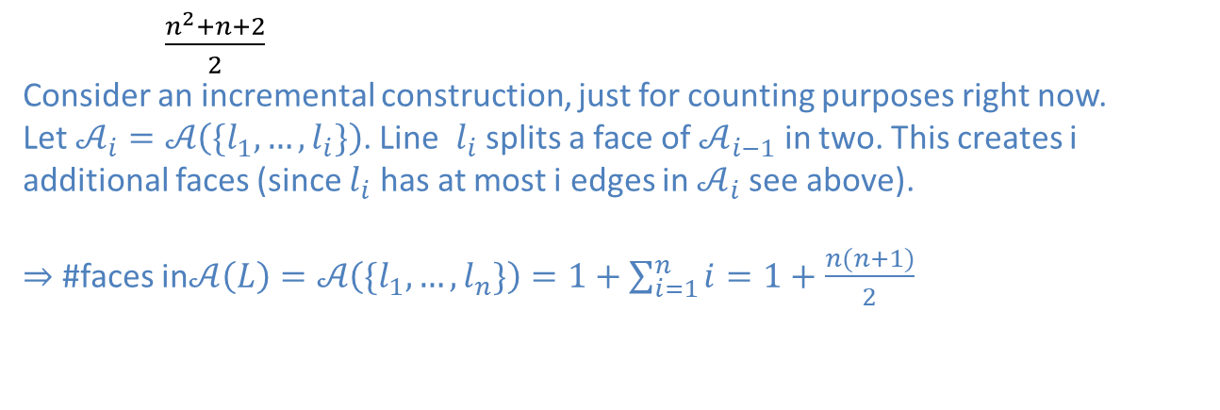
Arrangement Complexity
Because it’s a planar subdivision.
The complexity of $𝒜\left(L\right)$ is its #vertices + #edges + #faces.
$$L=\left\{l_{1},…, l_{n}\right\}$$
$\left({n \atop 2}\right)= \frac{n(n−1)}{2}$
We have $n$ lines, and in the worst case every pair intersects (vertex).
#vertices $≤$
#edges $≤$
#faces $≤$
$n^{2}$
On one line we can have at most $n−1$ vertices, so at most $n$ edges total.
$\frac{n^{2}+n+2}{2}$
Consider an incremental construction, just for counting purposes right now. Let $𝒜_{i}=𝒜\left(\{l_{1},…, l_{i}\}\right)$. Line $l_{i}$ splits a face of $𝒜_{i−1}$ in two. This creates i additional faces (since $l_{i}$ has at most i edges in $𝒜_{i}$ see above). $⇒$ #faces in$𝒜\left(L\right)=𝒜\left(\{l_{1},…, l_{n}\}\right)=1+\sum_{i=1}^{n}{i}=1+$ $\frac{n(n+1)}{2}$

Slide 4
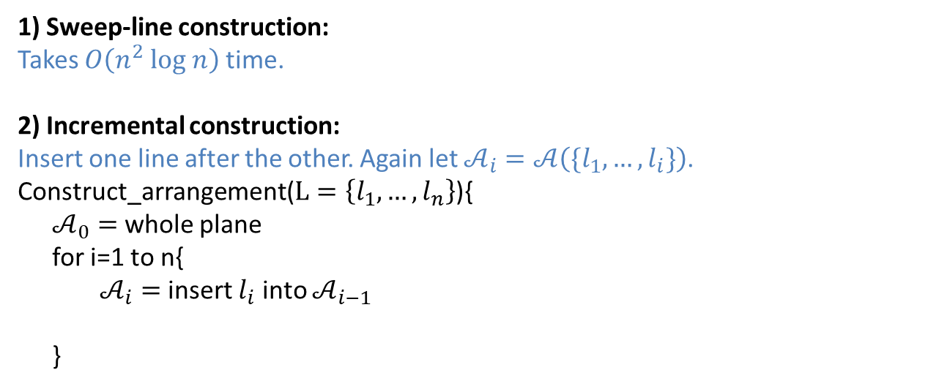
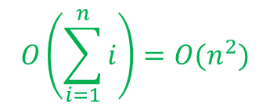
Arrangement Construction
Input: A set of $n$ lines $L=\left\{l_{1},…, l_{n}\right\}$ in $ℝ^{2}$
Output: The arrangement $𝒜_{n}=𝒜\left(\{l_{1},…, l_{n}\}\right)$ stored in a DCEL
1) Sweep-line construction:
Takes $O\left(n^{2} log n\right)$ time.
2) Incremental construction:
Insert one line after the other. Again let $𝒜_{i}=𝒜\left(\{l_{1},…, l_{i}\}\right)$.
Construct_arrangement($L=\left\{l_{1},…, l_{n}\right\}$){
$𝒜_{0}=$ whole plane
for i=1 to n{
$𝒜_{i}=$insert $l_{i}$ into $𝒜_{i−1}$
}
$$l_{5}$$
$$O(i)$$
by threading $l_{i}$ through $𝒜_{i−1}$ face by face and splitting edges and faces accordingly (using the DCEL!).
Using “zone theorem”
$$O\left(\sum_{i=1}^{n}{i}\right)=O(n^{2})$$
Runtime:

Slide 5
Zone Theorem
Zone Theorem: Let $𝒜$ be an arrangement of $n$ lines and let $l$ be another line. The zone of $l$in $𝒜$ is the planar subdivision consisting of all faces, edges, and vertices intersected by $l$. The complexity of the zone of $l$in $𝒜$ is $O(n)$ .
$$l$$
How can the zone have complexity $O(n)$ if $𝒜$ has complexity $O(n^{2})$?

Slide 6
Zone Theorem Proof
Assume $l$is horizontal. Also assume $𝒜$ is simple and as no horizontal edges
$$l$$
$$f$$
right-bounding edges
left-bounding edges
Goal: Prove that # left-bounding edges in the zone is $≤3n$, using induction.
Base: $n=1$
$$l$$
Step: $n−1 →n$ Let $L$ be a set of $n$lines and $𝒜(L)$ its arrangement.
$$l_{1}$$
$l_{1}=$ line that has the rightmost intersection with $l$
$$l_{2}$$
$$v$$
$v=$ vertex on $l_{1}$ above $l$, closest to $l$
$$l$$
$w=$ vertex on $l_{1}$ below $l$, closest to $l$
$$w$$
$$l_{3}$$

Slide 7
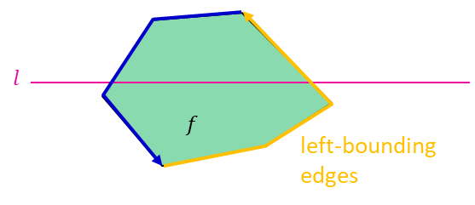
Zone Theorem Proof
Goal: Prove that # left-bounding edges in the zone is $≤3n$, using induction.
Step: $n−1 →n$ Let $L$ be a set of lines and $𝒜(L)$ its arrangement.
$$l_{1}$$
$$R$$
$l_{1}=$ line that has the rightmost intersection with $l$
$$l_{2}$$
$v=$ vertex on $l_{1}$ above $l$, closest to $l$
$$v$$
$w=$ vertex on $l_{1}$ below $l$, closest to $l$
$$l$$
$$w$$
$$l_{3}$$
Think about $𝒜(L\backslash \{l_{1}\}).$
⇒ # left-bounding edges in $𝒜(L\backslash \{l_{1}\})$ is $≤3(n−1)$ by inductive hypothesis.
Now insert $l_{1}$ into $𝒜(L\backslash \{l_{1}\})$:
$\overline{vw}$ is a new edge, and two edges were split into two.
3 new edges
No more new edges: Region $R$ is not in $zone(l)$ but is the only part of $l_{1}$ above $v$ that could contribute with left-bounding edges.
In total, the zone has $3(n−1)+3$ edges
For $l$ in $𝒜(L\backslash \{l_{1}\})$

